Slide 1
Advanced Health Economics
Risk Adjustment and Quality Competition
March 1, 2023
HAD 6750 • Alex Hoagland, Ph.D.
Notes:
To add: https://repositorium.uminho.pt/bitstream/1822/79916/1/WP-07.2022.pdf

Slide 2
Last time: Competition in Health Markets
How do physicians/hospitals/insurers compete for patients?
Structural modeling + its benefits
What evidence is there of profit-maximizing behavior for MDs?
Example: Your Health Act 2023:
“as of right” rules: healthcare workers licensed in Canada can work in Ontario without college registration
integrate community surgical and diagnostic centres into the health system to reduce surgical wait times
How might we model these?
Notes:
Proposed Feb 21

Slide 3
Last time: Competition in Health Markets
How do physicians/hospitals/insurers compete for patients?
Structural modeling + its benefits
What evidence is there of profit-maximizing behavior for MDs?
Can risk measurement reduce information asymmetries + improve payment?
How does competition affect quality of care provided?
What policies can incentivize high-quality care?
This time: Risk Adjustment & Quality Competition

Slide 4

Intro to Risk Adjustment
Anytime there is unpriced cost heterogeneity, then agents will try to increase profits by avoiding the unprofitable.
Examples:
High and low-cost enrollees with same premium $⇒$ plans avoid high cost patients
High and low-cost patients with same DRG $⇒$ hospitals avoid sicker patients
Notes:
Goal of risk adjustment it to avoid making high cost patients unprofitable without paying per item costs

Slide 5
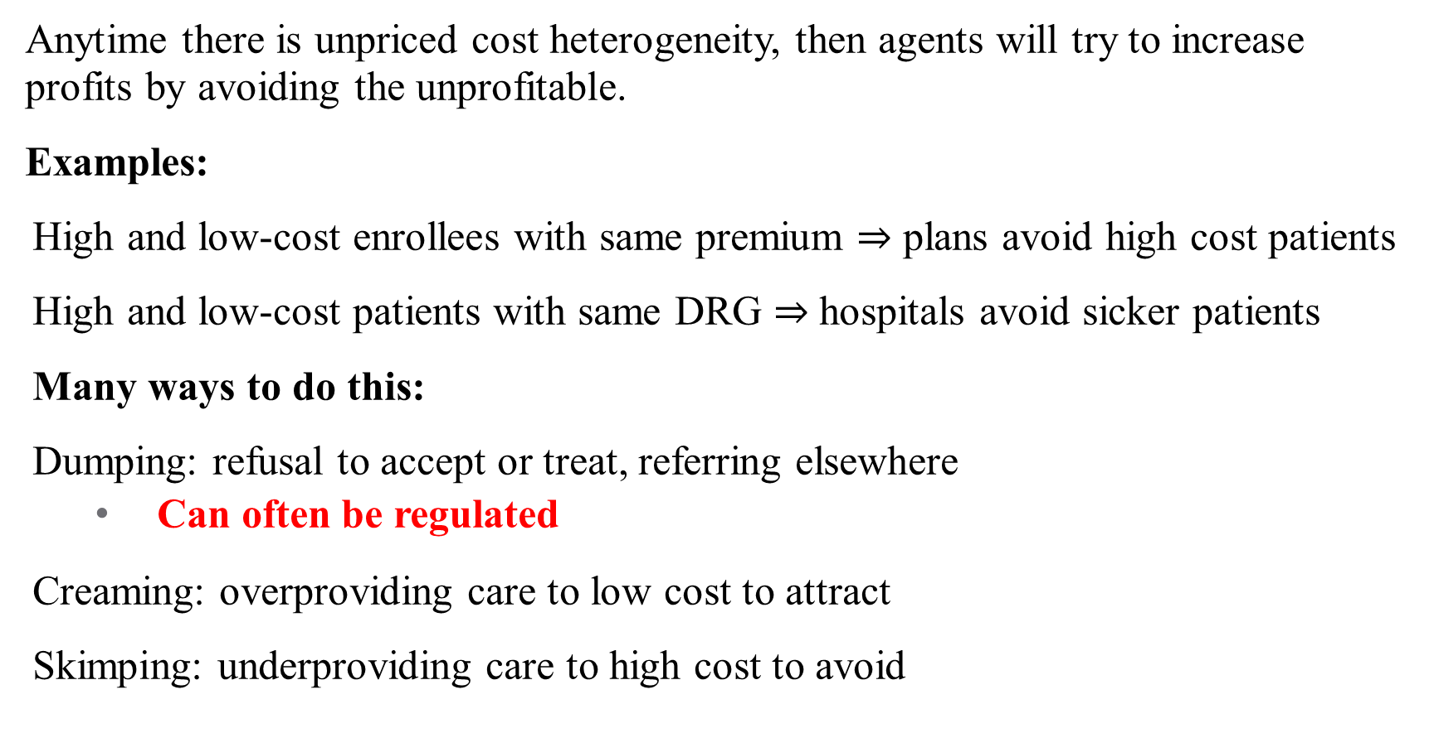
Intro to Risk Adjustment
Anytime there is unpriced cost heterogeneity, then agents will try to increase profits by avoiding the unprofitable.
Examples:
High and low-cost enrollees with same premium $⇒$ plans avoid high cost patients
High and low-cost patients with same DRG $⇒$ hospitals avoid sicker patients
Many ways to do this:
Dumping: refusal to accept or treat, referring elsewhere
Can often be regulated
Creaming: overproviding care to low cost to attract
Skimping: underproviding care to high cost to avoid
Service level selection:
Hard to regulate
Notes:
Goal of risk adjustment it to avoid making high cost patients unprofitable without paying per item costs

Slide 6
Intro to Risk Adjustment
Insurers and physicians want to attract lowest-cost patients
Can lead to problems with dumping or cream skimming
What tools do we have?
Physician fees – bigger payments for higher-intensity services
Heterogeneous payments based on patient risk
This is the idea of risk adjustment
Patients are assigned risk scores based on diagnoses, claims
Risk scores are then used to adjust insurer/physician payments
Notes:
What problem are we trying to solve? Adverse selection! See Ellis and Layton for a good review / intro to some of these topics

Slide 7
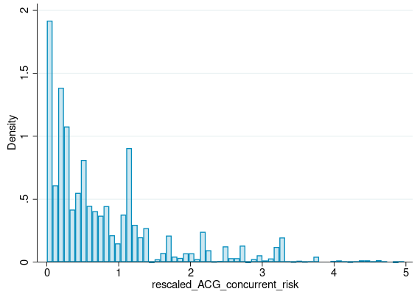
Risk Score Intuition
Risk scores capture expected cost heterogeneity in:
Demographics
Diagnoses
Medical histories
Social determinants of health
How is patient risk predicted?
Linear regression
Nonlinear regression (?)
Machine learning!
Notes:
Contributions to risk score

Slide 8
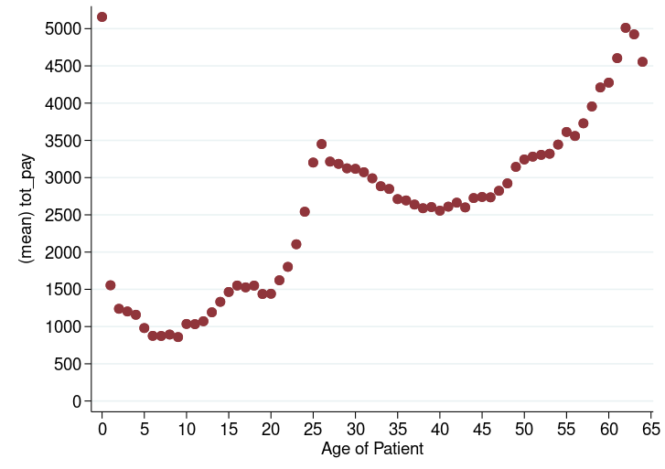
Risk Adjustment Intuition
Unadjusted annual spending across age:
Notes:
Here, just showing differences across age (others exist!)

Slide 9
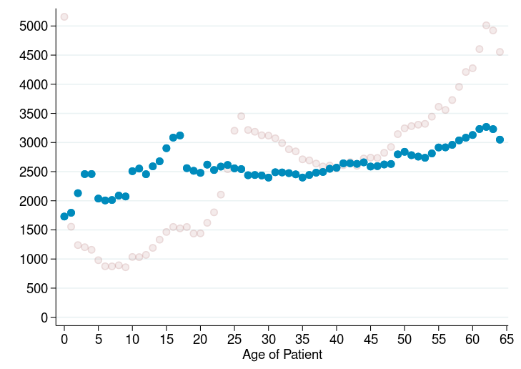
Risk Adjustment Intuition
After normalizing by the risk score:
Notes:
Here, just showing differences across age (others exist!) Is risk adjustment perfect? No! Is it good enough? Idk.

Slide 10
US Medicare Prospective Risk Adjustment Example 74 year old female with Type 1 diabetes, renal problems, and depression
0.303 | Female, age 74
0.373 0.771 | Diabetes Type 1 Diabetes with Renal Manifestations
0.376 | Nephritis (inflammation of the kidneys)
0.000 | Urinary Obstruction and Retention
0.120 | Depression
1.943 | Sum of the above relative risk components = relative risk score (RRS)
Notes:
Contributions to risk score: Average of all patients is $5 314, Predicted cost of this person is $10 325

Slide 11
How is risk adjustment used?
Higher plan revenue for sicker patients
Bundled payment to Providers
Hospital DRGs
Accountable Care Organizations (ACOs)
Patient Centered Medical Home (primary clinics)
Risk-adjusted premiums
Higher for sicker people?
Higher for wealthier families?
Higher for larger families?
Higher for older workers?

Slide 12
Risk Adjustment in Canada
Risk adjustment is used to:
Compare outcomes across organizations (e.g., surgical quality)
Pay providers (especially capitated payments to GPs)
CIHI risk adjustment models tend to underperform relative to other models (e.g., US Marketplace, WHO risk adjustment)
GPs are typically paid only on age-sex, but CIHI models don’t even include demographics in risk adjustment!
What would this mean for provider payment?
Notes:
See: https://www.ncbi.nlm.nih.gov/pmc/articles/PMC6798736/pdf/mlr-57-875.pdf for more.

Slide 13
Glazer & McGuire (2000)
“Optimal Risk Adjustment in Markets with Adverse Selection:
An Application to Managed Care”
American Economic Review
Notes:
Short paper, hopefully a pretty easy read?

Slide 14
Optimal Risk Adjustment (Optimality of what?)
Conventional risk adjustment can still lead to inefficiencies
Gaming, upcoding
Others?
So what optimal risk adjustment is depends on the specific economic objective
Start with a theory-based objective function
Conceptualize risk adjustment as a price-adjustment tool to maximize (1)
Hence, optimal is ex-post, not ex-ante!
Notes:
Does not mean improvements on the algorithm are not possibl.e Add Sen meme

Slide 15
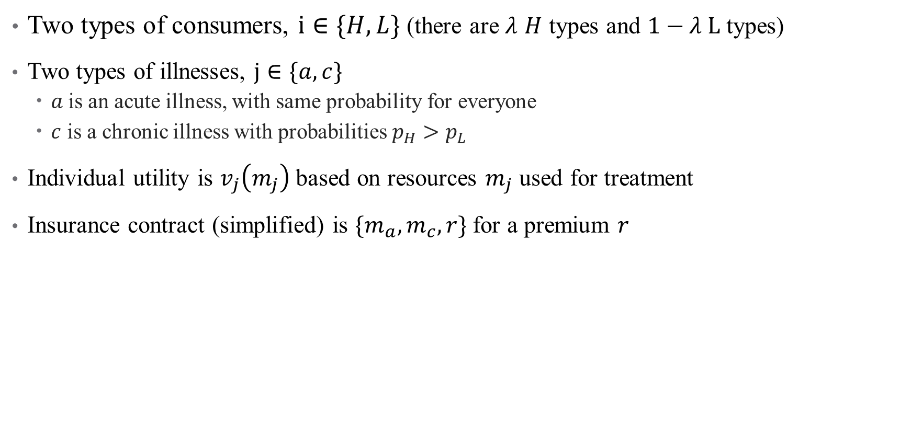
A Simple Model of Risk Adjustment
Two types of consumers, $i∈\{H, L\}$ (there are $λ$ $H$ types and $1−λ L$ types)
Two types of illnesses, $j∈\{a, c\}$
$a$is an acute illness, with same probability for everyone
$c$ is a chronic illness with probabilities $p_{H}>p_{L}$
Individual utility is $v_{j}\left(m_{j}\right)$ based on resources $m_{j}$ used for treatment
Insurance contract (simplified) is $\{m_{a},m_{c},r\}$for a premium $r$
Notes:
Simple model of risk adjustment

Slide 16
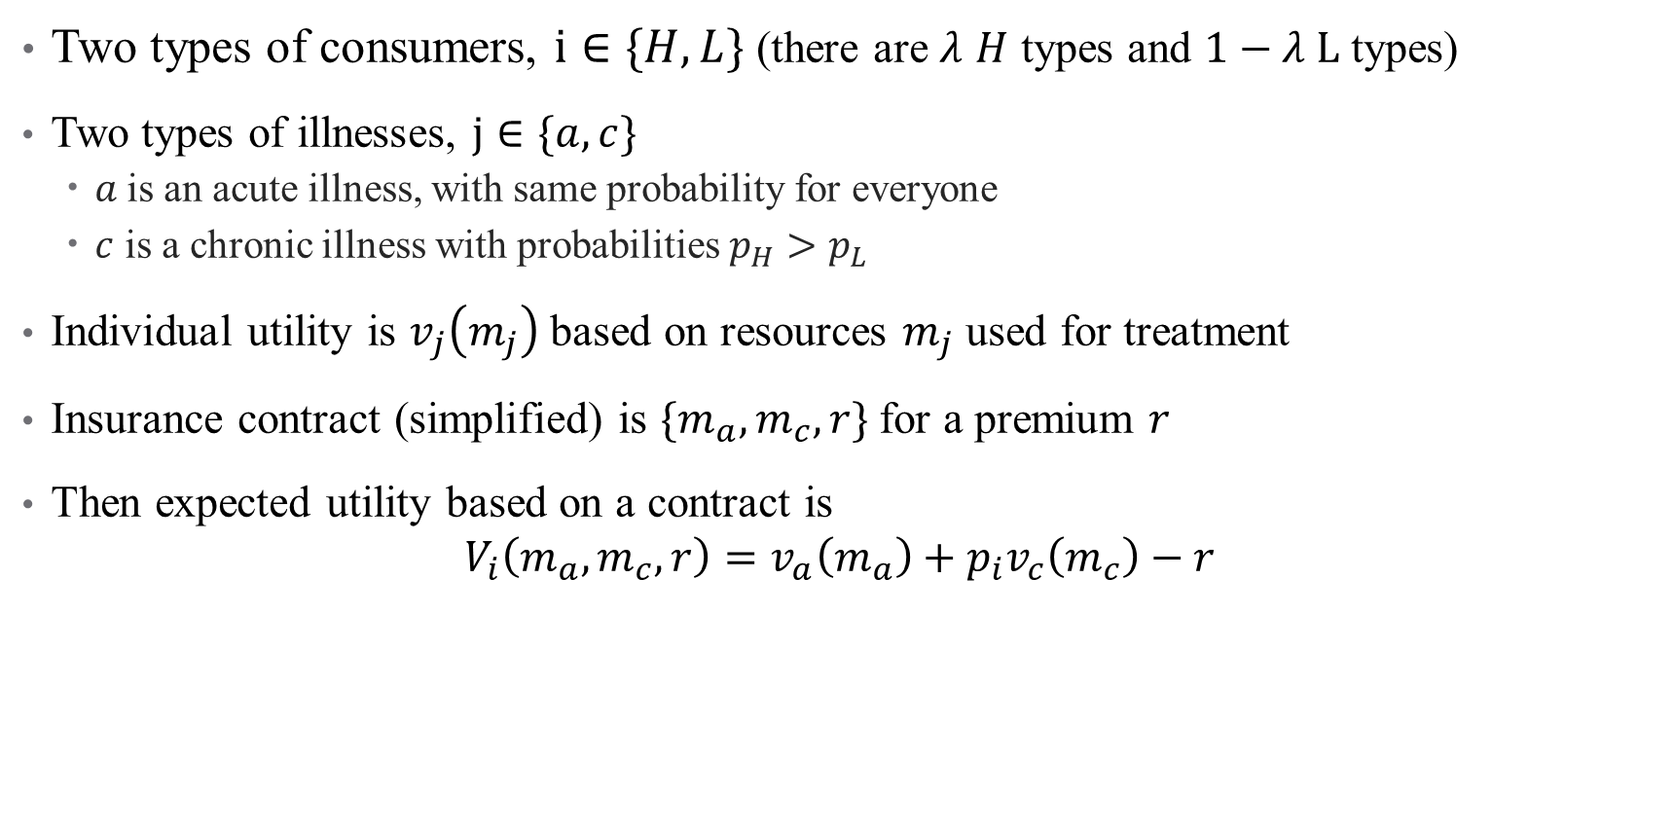
A Simple Model of Risk Adjustment
Two types of consumers, $i∈\{H, L\}$ (there are $λ$ $H$ types and $1−λ L$ types)
Two types of illnesses, $j∈\{a, c\}$
$a$is an acute illness, with same probability for everyone
$c$ is a chronic illness with probabilities $p_{H}>p_{L}$
Individual utility is $v_{j}\left(m_{j}\right)$ based on resources $m_{j}$ used for treatment
Insurance contract (simplified) is $\{m_{a},m_{c},r\}$for a premium $r$
Then expected utility based on a contract is
$$V_{i}\left(m_{a},m_{c},r\right)=v_{a}\left(m_{a}\right)+p_{i}v_{c}\left(m_{c}\right)−r$$
Notes:
Simple model of risk adjustment – what aren’t we dealing with here? Copayments, income effects, risk aversion

Slide 17
A Simple Model of Risk Adjustment
What is the socially optimal contract? What would a social planner care about?
Efficiency – are we providing the necessary care at the lowest cost?
Equity – are the burden of health costs distributed equally across healthy/sick?
What else might we think about?
Notes:
Notes here (this is a good place to talk about extensions)

Slide 18

A Simple Model of Risk Adjustment
What is the socially optimal contract? What would a social planner care about?
Efficiency – are we providing the necessary care at the lowest cost?
Marginal benefits should be equal to marginal costs
$$v_{a}^{′}\left(m_{a}^{∗}\right)=v_{c}^{′}\left(m_{c}^{∗}\right)=1$$
Note that these are the same for both types – why?
Notes:
Because these are ex-post – sure you have different probabilities of getting sick, but once you’re sick, you should get the same level of care regardless of how your underlying risk is (is this true?)

Slide 19
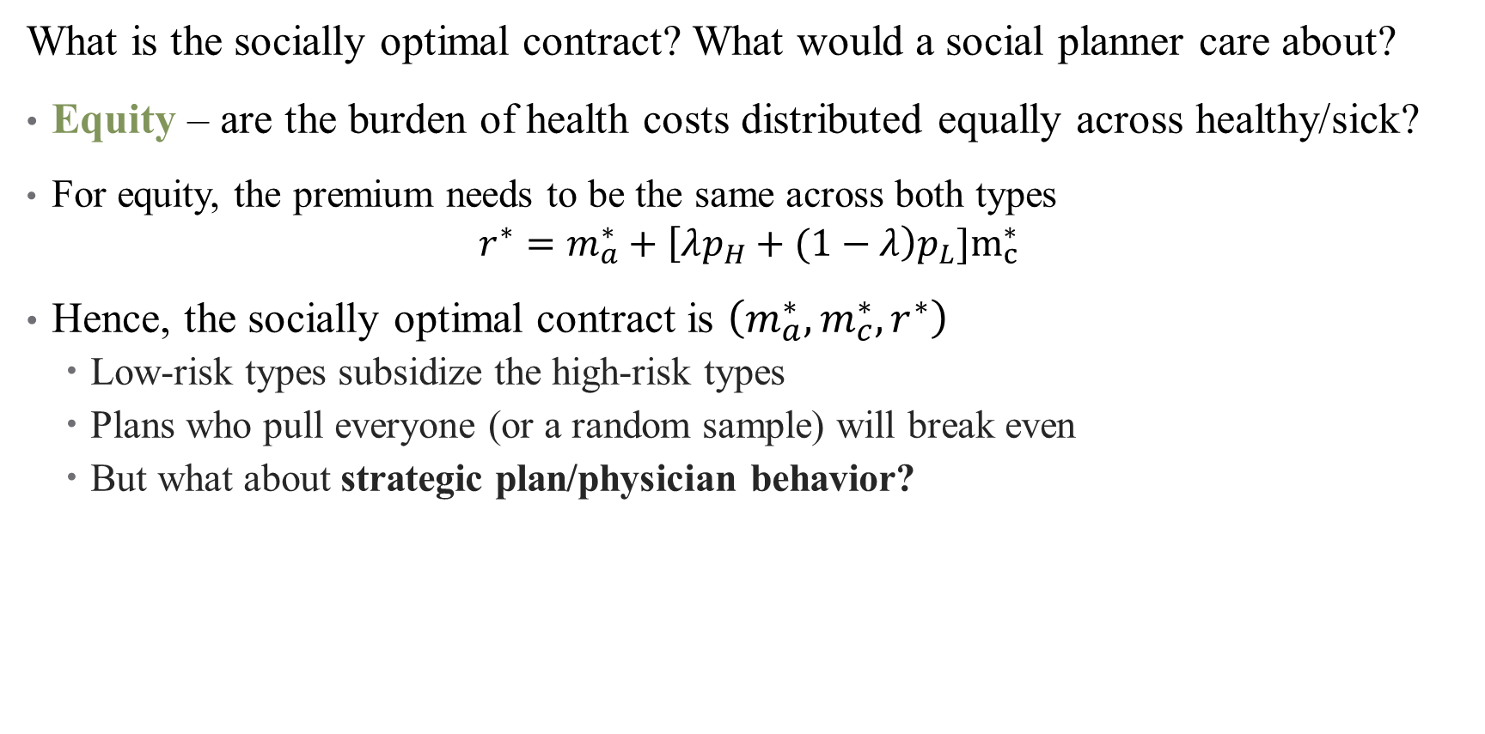
A Simple Model of Risk Adjustment
What is the socially optimal contract? What would a social planner care about?
Equity – are the burden of health costs distributed equally across healthy/sick?
For equity, the premium needs to be the same across both types
$$r^{∗}=m_{a}^{∗}+\left[λp_{H}+(1−λ\right)p_{L}]m_{c}^{∗}$$
Hence, the socially optimal contract is $\left(m_{a}^{∗},m_{c}^{∗}, r^{∗}\right)$
Low-risk types subsidize the high-risk types
Plans who pull everyone (or a random sample) will break even
But what about strategic plan/physician behavior?
Notes:
Note that this is averaged across the whole population

Slide 20
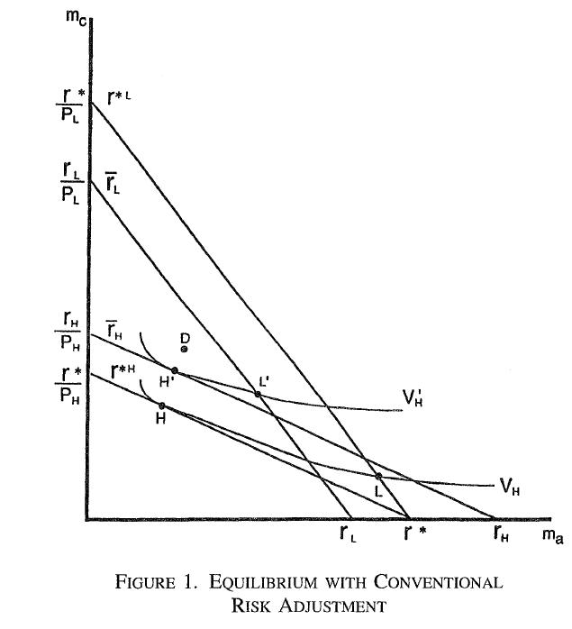
A Simple Model of Risk Adjustment
If plans or providers can be selective in who they take on, what would they pick?
Obviously, get the premium from low-risk types and deny coverage to high-risk!
Hence the competitive equilibrium falls apart (think Rothschild/Sitglitz)
Even a pooling equilibrium doesn’t achieve first-best optimum
Notes:
Equilibrium falling apart depends a little bit on the size of lambda – the larger the fraction of high types, the more a pooling equilibrium can exist. Providers would over-provide services for acute illnesses (which are more likely to attract healthy consumers) than chronic conditions (which attract sicker customers). What does this look like in practice (hospitals providing less mental health care / psych units, social services).

Slide 21
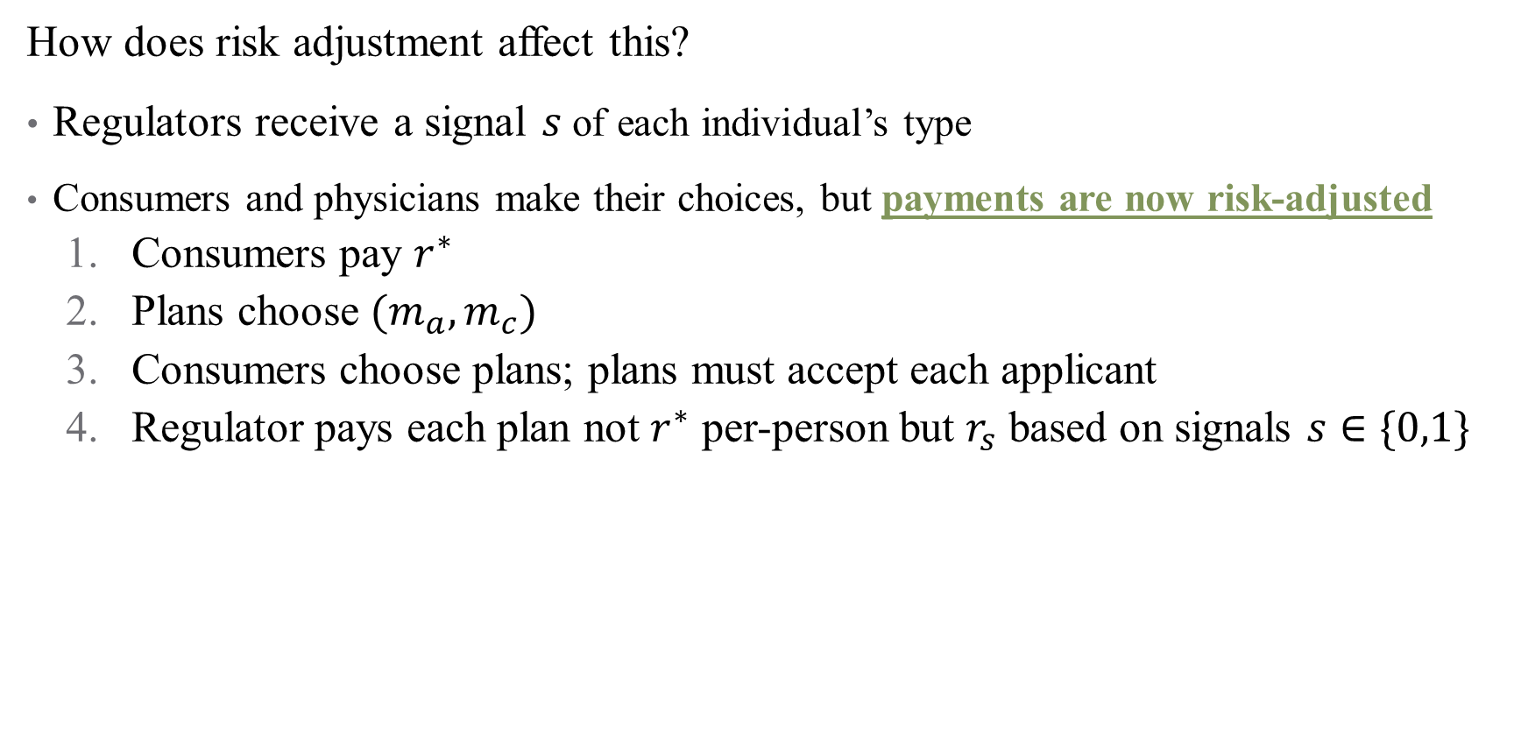
A Simple Model of Risk Adjustment
How does risk adjustment affect this?
Regulators receive a signal $s$ of each individual’s type
Consumers and physicians make their choices, but payments are now risk-adjusted
Consumers pay $r^{∗}$
Plans choose $(m_{a},m_{c})$
Consumers choose plans; plans must accept each applicant
Regulator pays each plan not $r^{∗}$ per-person but $r_{s}$ based on signals $s∈\{0,1\}$
Notes:
Assume that s is informative, so that high types are more likely to get high-risk signals. Need not be perfect though (e.g., demographics, diagnoses with chronic conditions)

Slide 22
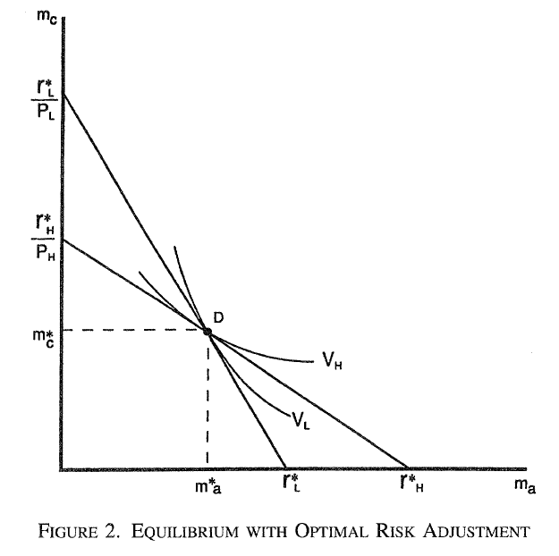
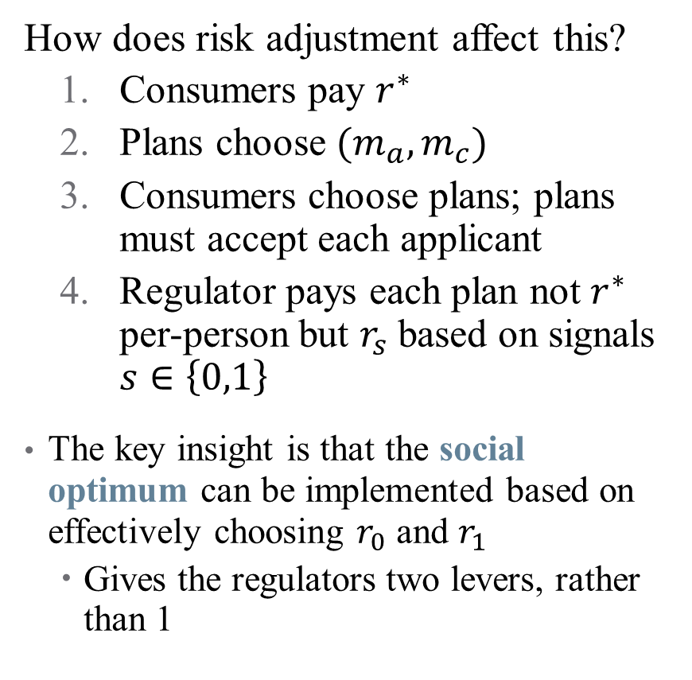
A Simple Model of Risk Adjustment
How does risk adjustment affect this?
Consumers pay $r^{∗}$
Plans choose $(m_{a},m_{c})$
Consumers choose plans; plans must accept each applicant
Regulator pays each plan not $r^{∗}$ per-person but $r_{s}$ based on signals $s∈\left\{0,1\right\}$
The key insight is that the social optimum can be implemented based on effectively choosing $r_{0}$ and $r_{1}$
Gives the regulators two levers, rather than 1
Notes:
So the regulator is over-paying on those more likely to be high cost than those likely to be low cost (taking on some of the patient risk, moving away from physicians). This undoes incentive to overtreat low-risk patients.

Slide 23
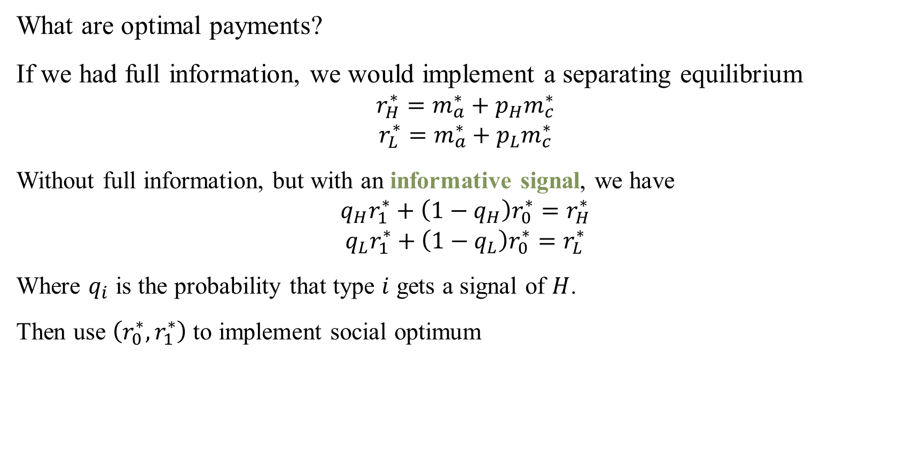
A Simple Model of Risk Adjustment
What are optimal payments?
If we had full information, we would implement a separating equilibrium
$$r_{H}^{∗}=m_{a}^{∗}+p_{H}m_{c}^{∗}$$
$$r_{L}^{∗}=m_{a}^{∗}+p_{L}m_{c}^{∗}$$
Without full information, but with an informative signal, we have
$$q_{H}r_{1}^{∗}+\left(1−q_{H}\right)r_{0}^{∗}=r_{H}^{∗}$$
$$q_{L}r_{1}^{∗}+\left(1−q_{L}\right)r_{0}^{∗}=r_{L}^{∗}$$
Where $q_{i}$ is the probability that type $i$ gets a signal of $H$.
Then use $\left(r_{0}^{∗},r_{1}^{∗}\right)$to implement social optimum
Notes:
What’s the intuition? Choose two premiums such that the expected average of those premiums gives the expected cost of each group. Take all the information out of the risk signal as possible. Looking at the proof here is very informative (might make a good problem set question).

Slide 24
Discussion
The key takeaway is that changing payment based on expected risk can get a pooling equilibrium (close to) the social optimum
Glazer and McGuire (2006) show that this can be improved by including risk signals of patients as well as quality signals of physicians/plans (e.g., report cards)
Neoclassical result: Improving information improves welfare
Mini referee report?
Notes:
Note that the neoclassical result doesn’t always hold in practice, we’ll talk about that more in next few lectures.

Slide 25
Eggleston, Ellis, and Lu (2012)
“Risk Adjustment and Prevention”
Canadian Journal of Economics

Slide 26
What complications should we consider?
Dynamics of risk adjustment – what about utilizing health care now to prevent higher costs later (e.g., preventive care)?
Risk adjustment may over-incentivize Band-Aids over preventive care
If patient risk can be influenced, risk adjustment may discourage population risk reduction
What types of policies can take this into account?
Notes:
Especially in a preventive sense.

Slide 27

Modeling preventive care use with adverse selection
Let’s build on the model above with dynamics. In period 0:
Two types of consumers, $i∈\{H, L\}$ (there are $1−λ H$types and $λ L$ types)
Expected costs $c_{L}<c_{H}$ (includes all of the propensity for acute/chronic illnesses)
Consider a large insurer (government) with average risk of $λ$
Notes:
Simplest version of dynamics – two periods. Have to switch the notation a little bit, but want to be consistent with the eggleston paper.

Slide 28
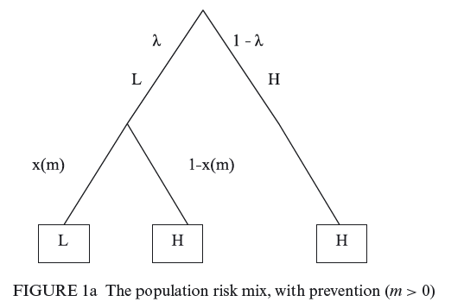

Modeling preventive care use with adverse selection
Let’s build on the model above with dynamics. In period 0:
Two types of consumers, $i∈\{H, L\}$ (there are $1−λ H$types and $λ L$ types)
Expected costs $c_{L}<c_{H}$ (includes all of the propensity for acute/chronic illnesses)
Key development: patient risk can change over time
Notes:
Investment in preventive care changes risk types – high risk are always high risk, but low risk need preventive care to catch things early (is this a reasonable model?) Define m to be preventive spending and x(m) the probability that a low-risk type remains low-risk based on m (so x’(m)> 0, and x’’(m) < 0)).

Slide 29

How do risk types evolve?
Suppose a local market’s (e.g., province’s) risk $λ_{0}(e,m)$ can be influenced by:
Selection efforts $e$
Locating in a healthier community, selectively advertising, but also…
Stinting on oncologists and employing numerous pediatricians, to avoid expensive cancer patients and attract young families who are better risks.
Notes:
Why can’t we simply pay providers m so that they do the appropriate amount? M is non-contractible – may be over-used (A1c’s, imaging – these might be good for some patients but can’t determine when provider is just over-using treatments)

Slide 30
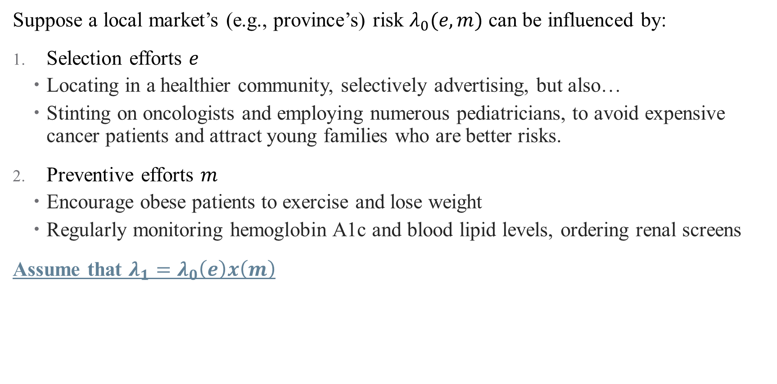
How do risk types evolve?
Suppose a local market’s (e.g., province’s) risk $λ_{0}(e,m)$ can be influenced by:
Selection efforts $e$
Locating in a healthier community, selectively advertising, but also…
Stinting on oncologists and employing numerous pediatricians, to avoid expensive cancer patients and attract young families who are better risks.
Preventive efforts $m$
Encourage obese patients to exercise and lose weight
Regularly monitoring hemoglobin A1c and blood lipid levels, ordering renal screens
Assume that $λ_{1}=λ_{0}\left(e\right)x\left(m\right)$
Notes:
Why can’t we simply pay providers m so that they do the appropriate amount? M is non-contractible – may be over-used (A1c’s, imaging – these might be good for some patients but can’t determine when provider is just over-using treatments)

Slide 31

What is optimal level of prevention?
Consider social planner’s perspective:
Social benefits in period 1 (conditional on actions in period 0) are given by:
$$B\left(m\right)=λ_{0}\left(e\right)x\left(m\right)\{\left[B_{L}−c_{L}\right]−[B_{H}−c_{H}]\}$$
Social planner thus maximizes:
$$W=B\left(m\right)−m−e$$

Slide 32
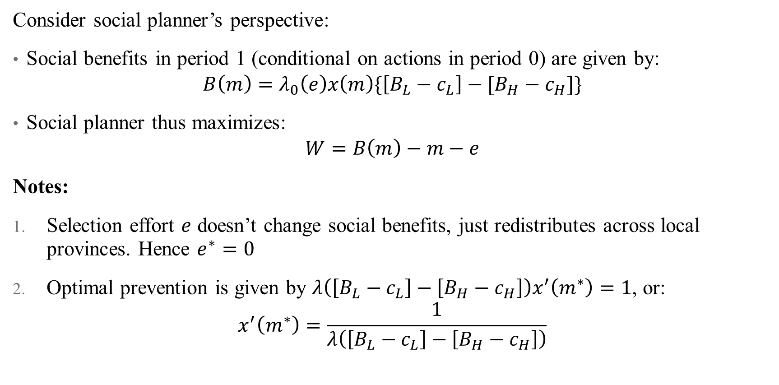
What is optimal level of prevention?
Consider social planner’s perspective:
Social benefits in period 1 (conditional on actions in period 0) are given by:
$$B\left(m\right)=λ_{0}\left(e\right)x\left(m\right)\{\left[B_{L}−c_{L}\right]−[B_{H}−c_{H}]\}$$
Social planner thus maximizes:
$$W=B\left(m\right)−m−e$$
Notes:
Selection effort $e$ doesn’t change social benefits, just redistributes across local provinces. Hence $e^{∗}=0$
Optimal prevention is given by $λ\left(\left[B_{L}−c_{L}\right]−\left[B_{H}−c_{H}\right]\right)x^{′}\left(m^{∗}\right)=1$, or:
$$x^{′}\left(m^{∗}\right)=\frac{1}{λ\left(\left[B_{L}−c_{L}\right]−\left[B_{H}−c_{H}\right]\right)}$$
Notes:
The marginal benefit of prevention includes better health (i.e., more quality-adjusted life years per low risk, BL − BH) as well as saving resources on future treatment costs (cH − cL) for each low risk.

Slide 33

What is actual level of prevention?
Now consider provider’s perspective:
Expected net revenue $V(e,m)$ as a function of $π_{L}, π_{H}$
$$V\left(e,m\right)=λ_{0}\left(e\right)π_{L}+\left(1−λ_{0}\left(e\right)\right)π_{H}−e−m+λ_{1}\left(e,m\right)π_{L}+\left(1−λ_{1}\left(e,m\right)\right)π_{H}$$
Chooses $e,m$ to maximize $V(e,m)$
How does risk adjustment affect this (section 2.5):
Notes:
Revenue in periods 1 and 2 in blue and green (ignoring the patient mobility tau factor presented in paper)

Slide 34
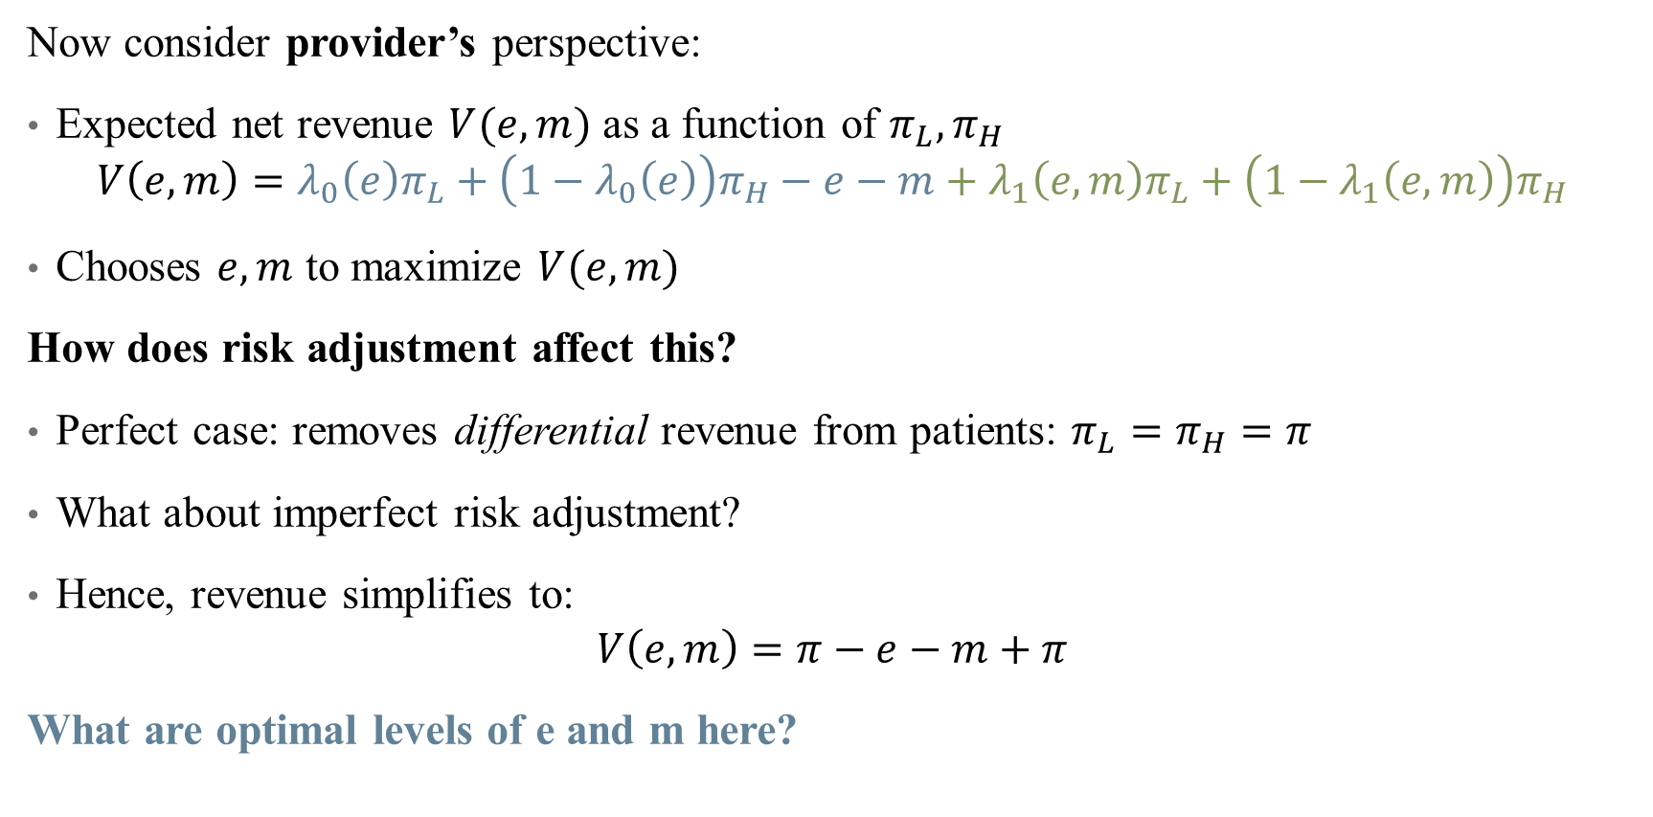
What is actual level of prevention?
Now consider provider’s perspective:
Expected net revenue $V(e,m)$ as a function of $π_{L}, π_{H}$
$$V\left(e,m\right)=λ_{0}\left(e\right)π_{L}+\left(1−λ_{0}\left(e\right)\right)π_{H}−e−m+λ_{1}\left(e,m\right)π_{L}+\left(1−λ_{1}\left(e,m\right)\right)π_{H}$$
Chooses $e,m$ to maximize $V(e,m)$
How does risk adjustment affect this?
Perfect case: removes differential revenue from patients: $π_{L}=π_{H}=π$
What about imperfect risk adjustment?
Hence, revenue simplifies to:
$$V\left(e,m\right)=π−e−m+π$$
What are optimal levels of e and m here?
Notes:
We can discuss model of imperfect RA if there is time. Should be obvious that e and m are both 0 – that’s good for selection effort, but terrible for prevention!

Slide 35
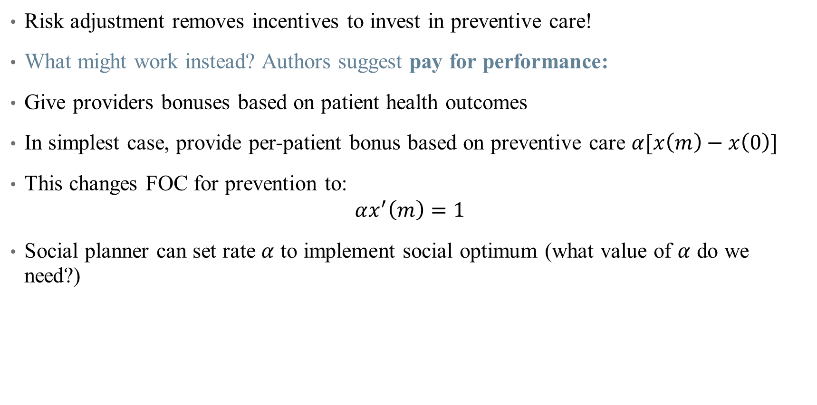
Takeaways and Extensions
Risk adjustment removes incentives to invest in preventive care!
What might work instead? Authors suggest pay for performance:
Give providers bonuses based on patient health outcomes
In simplest case, provide per-patient bonus based on preventive care $α[x\left(m\right)−x\left(0\right)]$
This changes FOC for prevention to:
$$αx^{′}\left(m\right)=1$$
Social planner can set rate $α$ to implement social optimum (what value of $α$ do we need?)
Notes:
Are there other options here? Is the model misleading in any way? What do you think? Risk averse altruism and dynamic health evolution? Idk.
To get social optimum, need alpha = lambda([B_L-c_L]-[B_h-c_h])

Slide 36
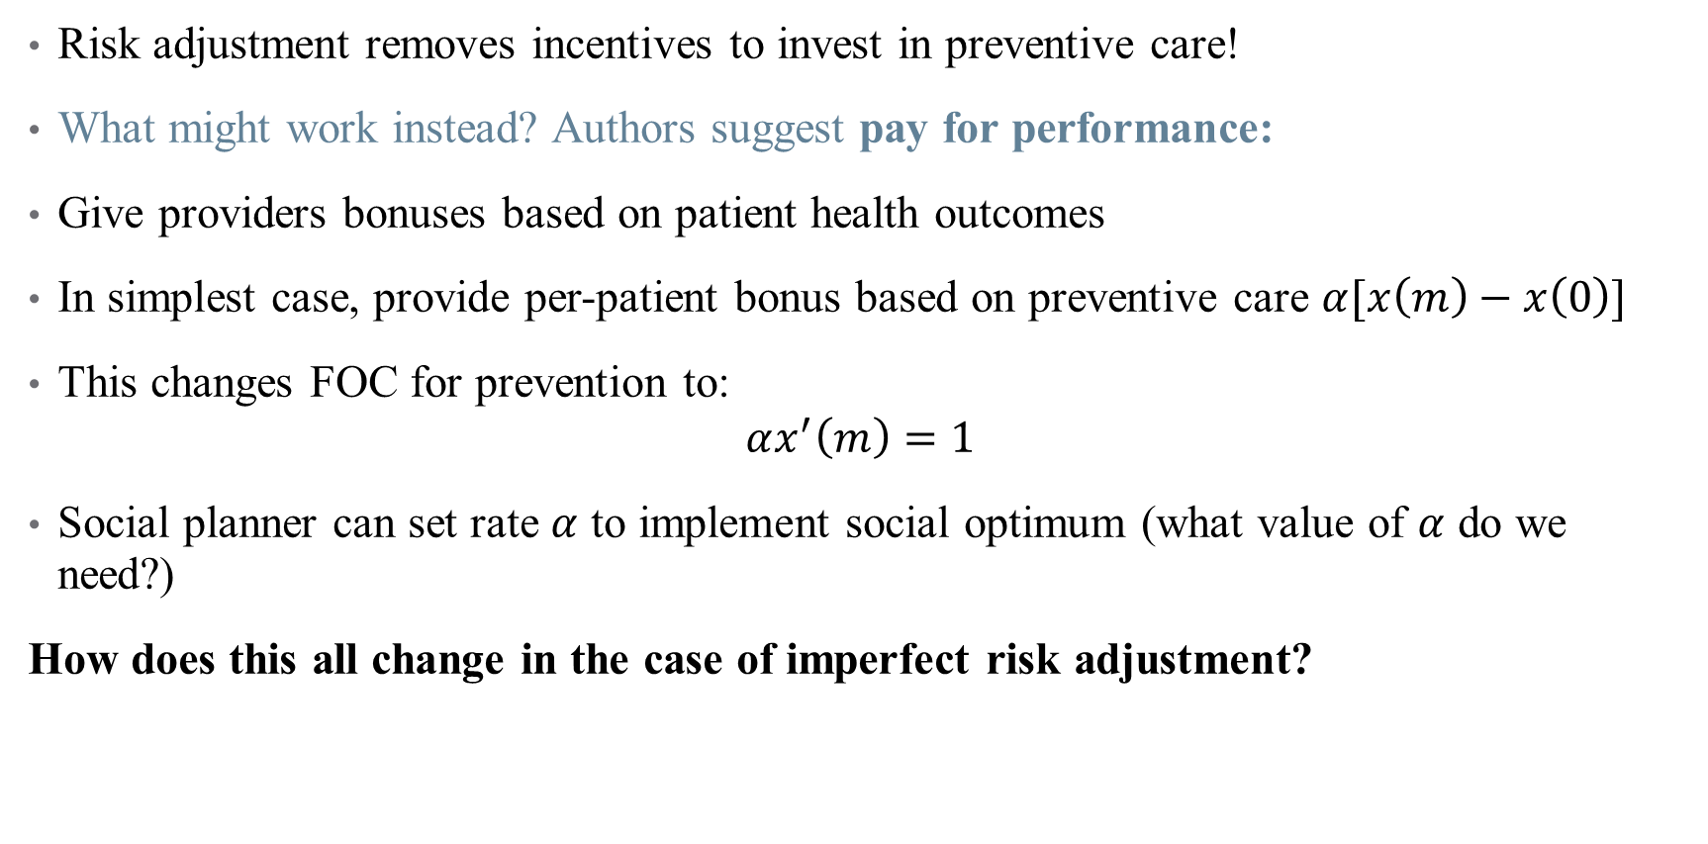
Takeaways and Extensions
Risk adjustment removes incentives to invest in preventive care!
What might work instead? Authors suggest pay for performance:
Give providers bonuses based on patient health outcomes
In simplest case, provide per-patient bonus based on preventive care $α[x\left(m\right)−x\left(0\right)]$
This changes FOC for prevention to:
$$αx^{′}\left(m\right)=1$$
Social planner can set rate $α$ to implement social optimum (what value of $α$ do we need?)
How does this all change in the case of imperfect risk adjustment?
Notes:
If constrained by imperfect risk adjustment (we always are), then we can model the extent to which risk adjustment decreases pi_H-pi_L (based on scaling parameter beta in [0,1]). Math gets more complicated but results are qualitatively similar. Go over results of Proposition 1 if there’s time.

Slide 37
Brekke, Gravelle, Siciliani, & Straume (2014)
“Patient Choice, Mobility and Competition Among Health Care Providers”
Health Care Provision and Patient Mobility
Notes:
Use to cover general quality models (e.g., Ma and Burgess 1993?) and then move to frontier here. Do if there’s time.

