Slide 1
Advanced Health Economics
Lecture 2: Moral Hazard in Health Care
January 16, 2023
HAD 6750 • Alex Hoagland, Ph.D.

Slide 2
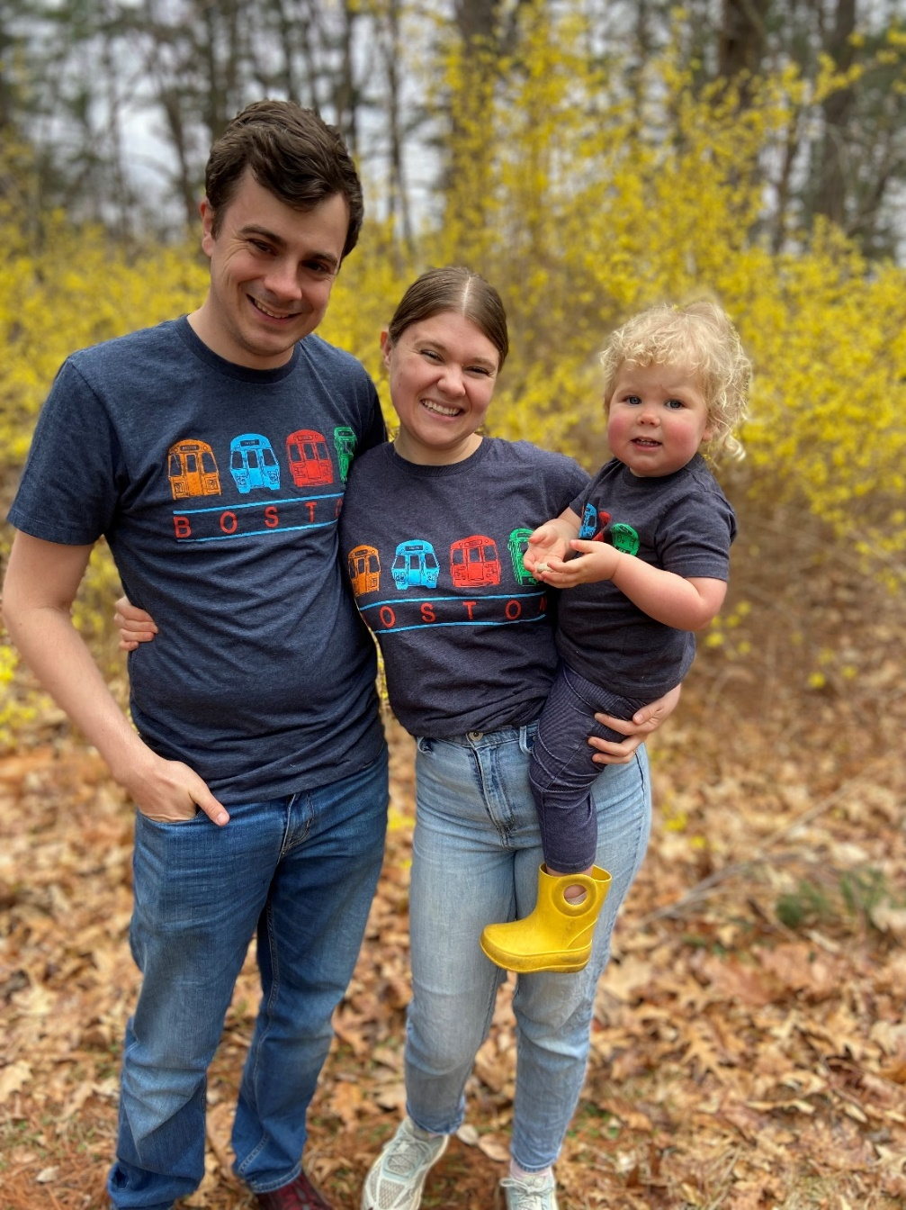
Introductions
Notes:
Some of my “get to know you” answers:

Slide 3
Introductions
From: USA (Texas $→$ Utah $→$ Boston)
Health Systems Experience: US, Ontario
Health Systems Experience 2:
Chronic disease, innovation
Education: Economics PhD (Health/IO)
Main Goals of the Course:
Practical over theoretical
Emphasize applications/evaluations
Notes:
We’ll spend about 5 weeks on regression and conditioning/matching (back-door approaches), and 7 weeks on quasi-experimental/front-door approaches (IV, DID, etc.)

Slide 4
Introductions: Backgrounds
I now work in the Ontario system as a plastic surgery resident
I have worked as a research assistant within the health services/policy field
I am currently a nurse and have 10 years' worth of experience in clinical research.
I have been working for the last four years as a Director in a specialized mental health hospital.
Notes:
Some of your answers to the survey (if you haven’t taken it, please do! For my own info at least). We have both Master’s and PhD students with all kinds of interests (here are just a few – can remain anonymous if desired)

Slide 5
Introductions: Goals from Course
I hope to go on to work as a policy analyst for provincial/territorial ministries of health.
To know more about research and apply it to make impact
Hoping to get hard skills that can be to evaluate and improve the health system (specifically the mental health system)
Ideally focus on redistributing resources to upstream preventative care, while maintaining quality curative care.
I am hoping to further advance and inform health care funding models for mental health
Notes:
Lots of different professional and academic goals!

Slide 6
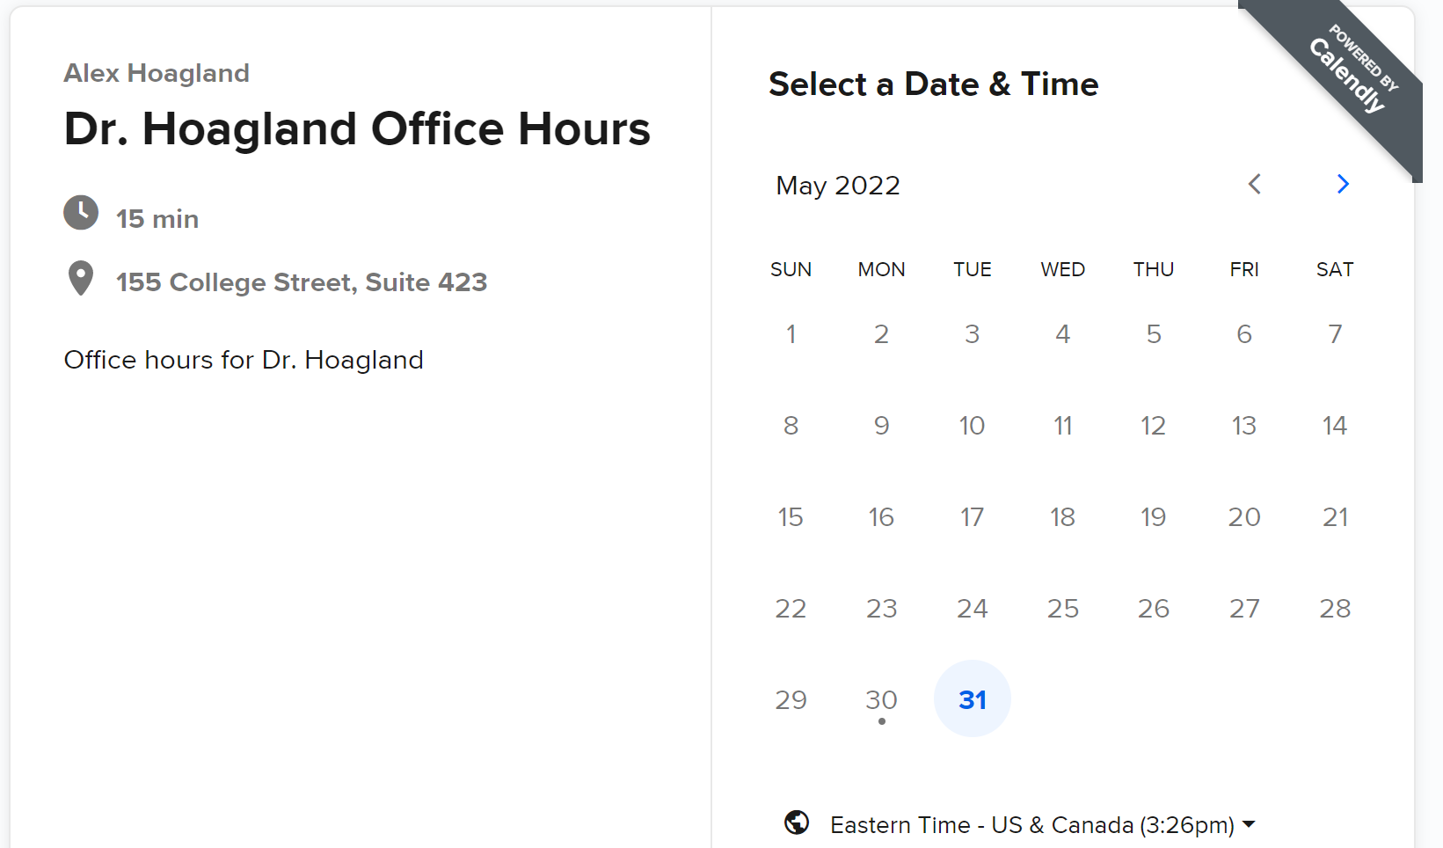
Introduction & Syllabus
Booking office hours: calendly.com/Hoagland-office-hours/had5744-2022f
In-person: Fridays from 9 to 11
Zoom: Tuesdays and Wednesdays, 10-10:30
Notes:
Click on link to go through software here. Will probably always send you a Zoom link.

Slide 7
Introduction & Syllabus
Booking office hours: calendly.com/Hoagland-office-hours/had5744-2022f
In-person: Wednesdays, 9:30-10:30; Fridays from 9 to 10
Zoom: Tuesdays and Wednesdays, 9:30-10:30
Notes:
note: the seminar is going on Fridays from 10 to 12, so I am considering moving this to be: TTh 9:30 – 10:30, Fridays from 9-10. If you have concerns email me! I’ll update this this week.

Slide 8
Introduction & Syllabus
Evaluation Criteria
Assignments: 3 assignments, each worth 20% of the final grade.
Please submit by email before class on the due date
Include both your code and your output
Please include “Econometrics_AssignmentX_LastName” in subject line
Notes:
Instructions are on each assignment for submission. There is a 10 (percentage point) penalty for each late day. Can work together, but each must submit their own copy (and copy/paste for code isn’t a great way to learn)

Slide 9
Introduction & Syllabus
Evaluation Criteria
Assignments: 3 assignments, each worth 20% of the final grade.
Major Paper: worth 40% of the final grade.
Major paper: Investigation of a research question of your own choosing
Pair up in groups of two or three to produce a paper.
Outline of major paper due October 21st :
Should be presented in the form of a journal manuscript (econ or policy)
Final paper is due December 8
Notes:
Outline is due 10/21. Meet with me to talk about topics before then (very advisable) and to strategize a little bit.

Slide 10

Introduction & Syllabus
Software.
We will use R:
You are welcome to use other software (textbooks cover STATA/Python)
R is free! Download R here and an interface RStudio here
Training sessions: September 16 (R) and September 23 (STATA)
Notes:
Lots of online resources – I’m going to try to cover things in real time, as that has been the most helpful way I’ve learned R. Group work is encouraged, Github discussions, office hours, etc.

Slide 11
Introduction & Syllabus
Software.
We will use R:
You are welcome to use other software (textbooks cover STATA/Python)
R is free! Download R here and an interface RStudio here
Training sessions: September 16 (R) and September 23 (STATA)
Github repo
Contains all relevant course materials
Sample papers
Discussion boards
Notes:
Group work is encouraged, Github discussions, office hours, etc. Talk about sample papers and reading materials (useful as you prep your final paper; treat this course as an intro to a lot of methods but you should take a deep dive into methods you care more about.)

Slide 12

Using R
We will use the tidyverse
Notes:
Tidyverse: set of packages to make R code more readable. We’ll spend some time at the end of class today with a simple R exercise and more next lecture.

Slide 13
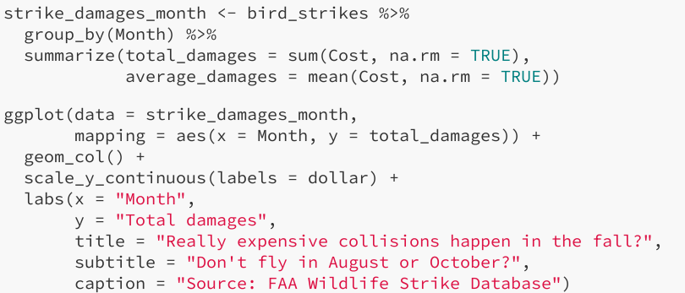
Using R
We will use the tidyverse
Makes R code read more like English!
Notes:
Tidyverse: set of packages to make R code more readable.

Slide 14
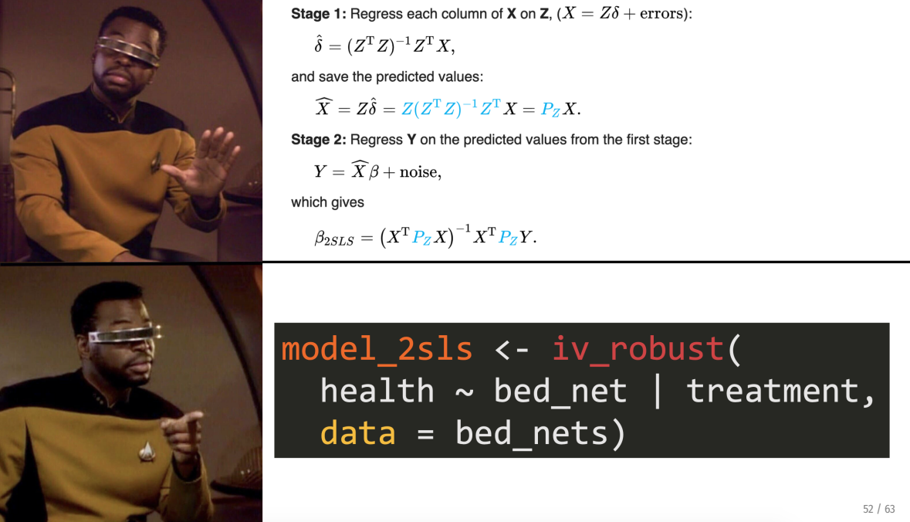
Using R
We will use the tidyverse
Makes R code read more like English!
We will emphasize practical applications (e.g., coding) over theory
Notes:
Note: there will still be some theory, but less

Slide 15
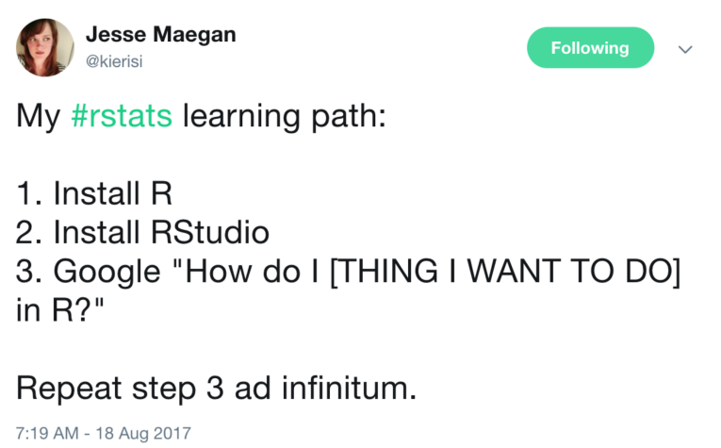
Using R: A Trial of Patience/Faith/Etc.
Mini-modules: https://jacobjameson.github.io/Intro%20R.html
Notes:
It can be a pain to learn R – but the best way to learn really is trial by error. Note that there’s some literature/ideas out there that it’s good to suck at something (it’s the first step to being good at something), but I don’t want you to feel like you are sucking! Come to me with questions, but don’t be stressed if you are feeling frustrated. These are tools that will serve you well, invest in them.

Slide 16

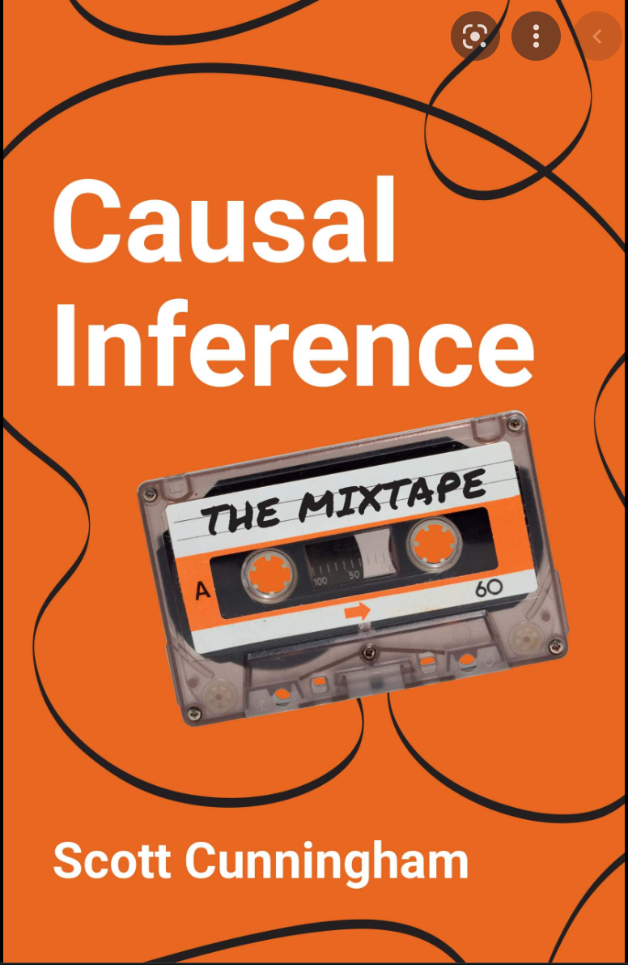
Introduction & Syllabus
Notes:
Cheap, great resource, online version available. Highly recommend for all applied quant researchers.

Slide 17
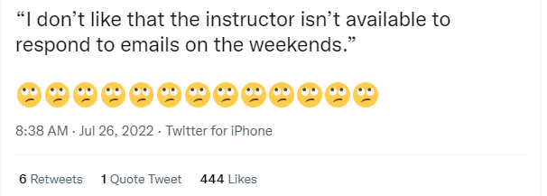
One Pet Peeve:
Introduction & Syllabus
Notes:
I’m supposed to read my negative Rate my professor reviews (to get a positive selection bias? Hungarian prof at BYU who did this), but I don’t have any reviews yet. There are no real-time emergencies in a university class setting – send me an email, and please be respectful of my time. Likewise, I will be respectful of yours.
Also cld calling – I want not to know who’s right or wrong, but also how you are receiving the course. I want us all (meincluded) to be comfortabl being wrong. So if I cold call, just try to tell me what you think (or if you’re stuck, what you’re stuck on). We’ll all get used to be wrong together.

Slide 18
Economic Modeling

Slide 19
What is economics?

Slide 20
Why model?

Slide 21
What should we get from this class?

Slide 22
Some basic reviews
Lagrangians
Optima and equilibria
Risk aversion
Ex-ante/ex-post
Integrals and derivatives
Others?

Slide 23
Grossman (1972)
In Determinants of Health (pp. 6-41). Columbia University Press.

Slide 24
Does health happen to you, or do you choose it?
What are the dynamic results of “health” decisions?
Diet, exercise
Preventive screenings
Etc.
The Grossman model thinks of health behaviors as investments into health

Slide 25
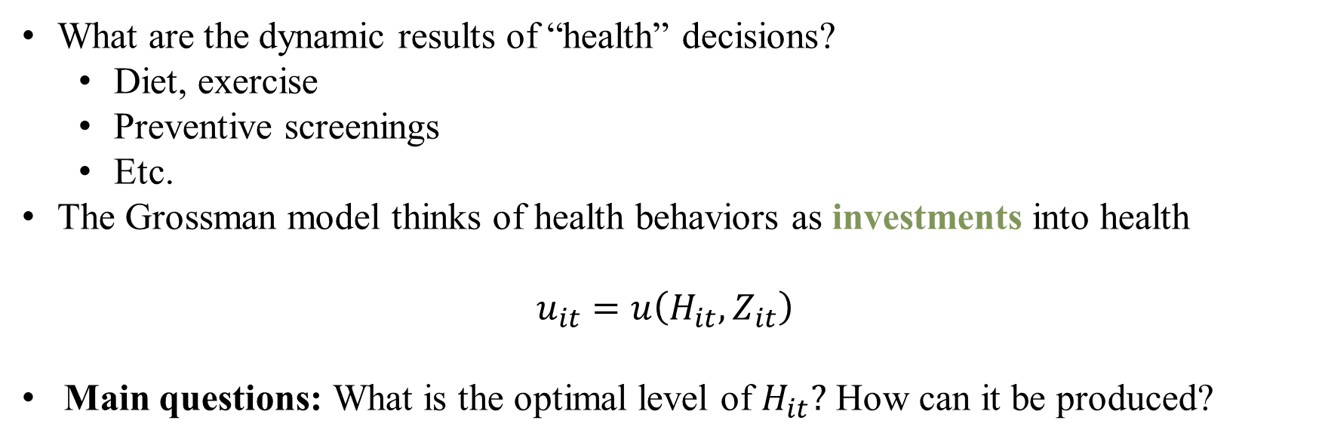
Does health happen to you, or do you choose it?
What are the dynamic results of “health” decisions?
Diet, exercise
Preventive screenings
Etc.
The Grossman model thinks of health behaviors as investments into health
$$u_{it}=u\left(H_{it},Z_{it}\right)$$
Main questions: What is the optimal level of $H_{it}?$ How can it be produced?
Notes:
Little u is our index. H_i is health status and Z_i is consumption of everything else (food, opera, etc.). For now we are starting with one period

Slide 26

Does health happen to you, or do you choose it?
What are the dynamic results of “health” decisions?
Diet, exercise
Preventive screenings
Etc.
The Grossman model thinks of health behaviors as investments into health
$$u_{it}=u\left(H_{it},Z_{it}\right)$$
Main questions: What is the optimal level of $H_{it}?$ How can it be produced?
Note: where is health care in this model?
Notes:
Health care (vaccines etc) only appear as they influence H. So you could write H as a function of all health services. Note that health is a stock (you invest in it, it grows or reduces each period) while z is a flow (you consume so much opera in each period, and opera today doesn’t rollover to opera tomorrow)

Slide 27
Investing in Health
What does the unconstrained problem look like? What are the choice variables? What is the optimum?
Notes:
Health care (vaccines etc) only appear as they influence H. So you could write H as a function of all health services.

Slide 28
Investing in Health
What does the unconstrained problem look like? What are the choice variables? What is the optimum?
What kinds of constraints might exist?
Notes:
Health care (vaccines etc) only appear as they influence H. So you could write H as a function of all health services.

Slide 29

Investing in Health
What does the unconstrained problem look like? What are the choice variables? What is the optimum?
What kinds of constraints might exist?
$$Θ=T^{W}+T^{ℓ}+T^{H}+T^{S},$$
$T^{W}:$time working
$T^{ℓ}:$time in leisure
$T^{H}:$time in health production (e.g., what is this?)
$T^{S}:$time sick
What does the constrained problem look like now?
Notes:
Also what other kinds of constraints could exist? Note that there is still no relationship between health production and these obscure time components. How do we link them?

Slide 30
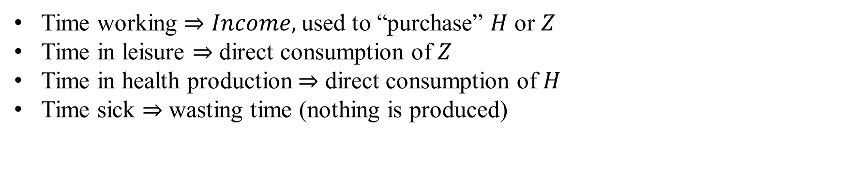
Linking Health Production and Time
Time working $⇒Income,$used to “purchase” $H$ or $Z$
Time in leisure $⇒$ direct consumption of $Z$
Time in health production $⇒$ direct consumption of $H$
Time sick $⇒$ wasting time (nothing is produced)
Notes:
Time sick is this model’s “outside option” – the base that all other model characteristics are related to (kind of like omitted category in dummy variables)

Slide 31

Linking Health Production and Time
Time working $⇒Income,$used to “purchase” $H$ or $Z$
Time in leisure $⇒$ direct consumption of $Z$
Time in health production $⇒$ direct consumption of $H$
Time sick $⇒$ wasting time (health influences this!)
Hence, we can convert time constraints to budget constraints:
$$Y_{t}=wT^{W}$$
$$p_{h}h_{it}+p_{z}z_{it}≤Y_{t}+y(H_{it})$$
Notes:
Here, lower case variables indicate inputs into big variables H and Z. Since health influences time sick, you can allow H to influence total income (by reducing sick time)

Slide 32

Linking Health Production and Time
Time working $⇒Income,$used to “purchase” $H$ or $Z$
Time in leisure $⇒$ direct consumption of $Z$
Time in health production $⇒$ direct consumption of $H$
Time sick $⇒$ wasting time (health influences this!)
Hence, we can convert time constraints to budget constraints:
$$Y_{t}=wT^{W}$$
$$p_{h}h_{it}+p_{z}z_{it}≤Y_{t}+y(H_{it})$$
We can also write a law of motion for how health evolves over time:
$$\frac{∂H}{∂t}=G\left(h_{it}\right)−δH$$
Notes:
The change in H in each period is the investment in each period minus depreciation (at rate \delta)

Slide 33
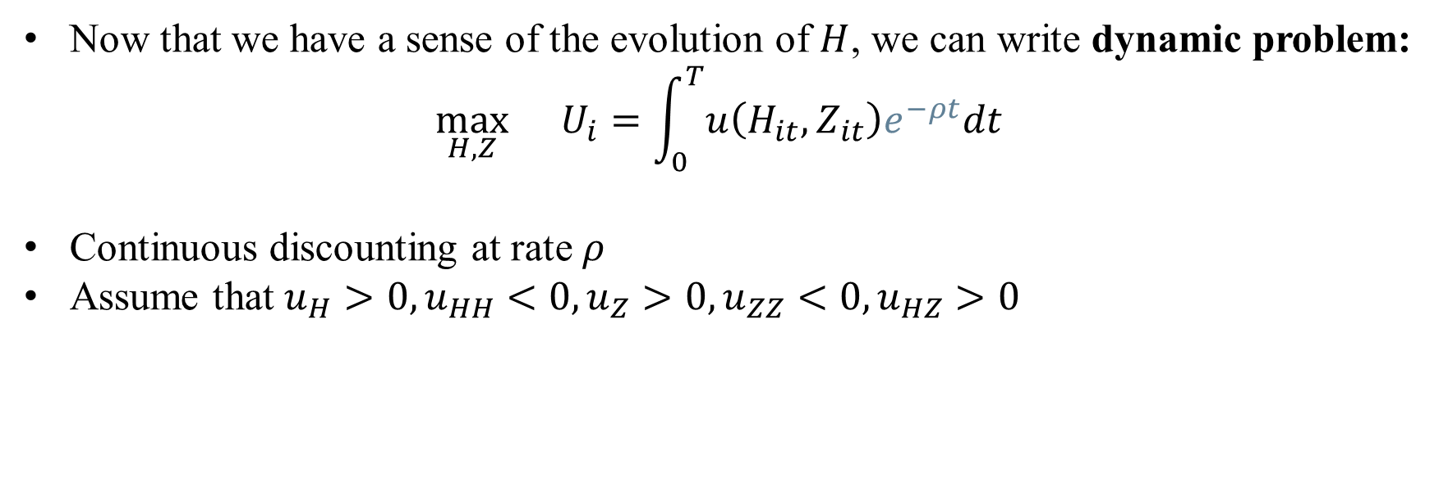
Formal Statement of the Problem
Now that we have a sense of the evolution of $H$, we can write dynamic problem:
$$\max_{H,Z}{}U_{i}=\int_{0}^{T}{u\left(H_{it},Z_{it}\right)e^{−ρt}dt }$$
Continuous discounting at rate $ρ$
Assume that $u_{H}>0, u_{HH}<0, u_{Z}>0,u_{ZZ}<0,u_{HZ}>0$
Notes:
Assume individuals live for T periods. Little u is our index. What do each of these assumptions on u mean?

Slide 34

Formal Statement of the Problem
Now that we have a sense of the evolution of $H$, we can write dynamic problem:
$$\max_{H,Z}{}U_{i}=\int_{0}^{T}{u\left(H_{it},Z_{it}\right)e^{−ρt}dt }$$
Continuous discounting at rate $ρ$
Assume that $u_{H}>0, u_{HH}<0, u_{Z}>0,u_{ZZ}<0,u_{HZ}>0$
Subject to:
$$\frac{∂H}{∂t}=G\left(h_{it}\right)−δH \left(1\right)Law of motion$$
$$p_{z}z_{it}+p_{h}h_{it}=wT^{w}+y(H_{it}) \left(2\right)Budget constraint \left(per−period\right)$$
Notes:
Note that we assume no savings, so budget constraint is met ni each period. Can endogenize the

Slide 35
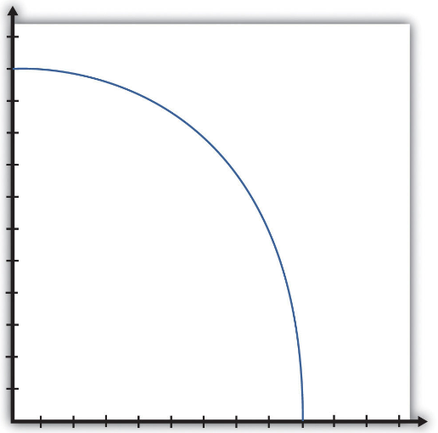
Visualizing the Problem
How do our assumptions change the production possibilities frontier?
Consumption
Health state
Notes:
Note that this isn’t the way it works given complementarities between H and Z – low H means low income, and hence low consumption of Z

Slide 36
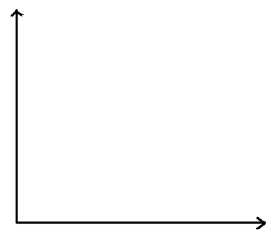
Visualizing the Problem
How do our assumptions change the production possibilities frontier?
Consumption
Health state
Notes:
Instead, this is the PPF – low H means low consumption. So what part of this shape will be used (where is the free lunch region) ?

Slide 37
Visualizing the Problem
What does an equilibrium look like?
Consumption
Health state
Notes:
Instead, this is the PPF – low H means low consumption. So what part of this shape will be used (where is the free lunch region) ?

Slide 38
Visualizing the Problem
What does an equilibrium look like?
Consumption
Health state
Notes:
Instead, this is the PPF – low H means low consumption. So what part of this shape will be used (where is the free lunch region) ?

Slide 39
Finding the Equilibrium
What is the Lagrangian?
Notes:
Note that we assume no savings, so budget constraint is met ni each period. Can endogenize the

Slide 40
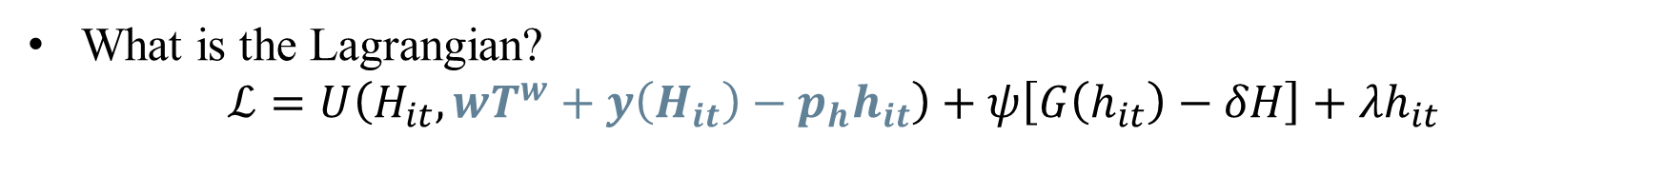
Finding the Equilibrium
What is the Lagrangian?
$$ℒ=U\left(H_{it}, wT^{w}+y\left(H_{it}\right)−p_{h}h_{it}\right)+ψ\left[G\left(h_{it}\right)−δH\right]+λh_{it}$$
Notes:
Now we solved the budget constraint for Z and plugged it in. lambda incorporates the constraint that health investment must be nonnegative. How many choice variables are there now?

Slide 41
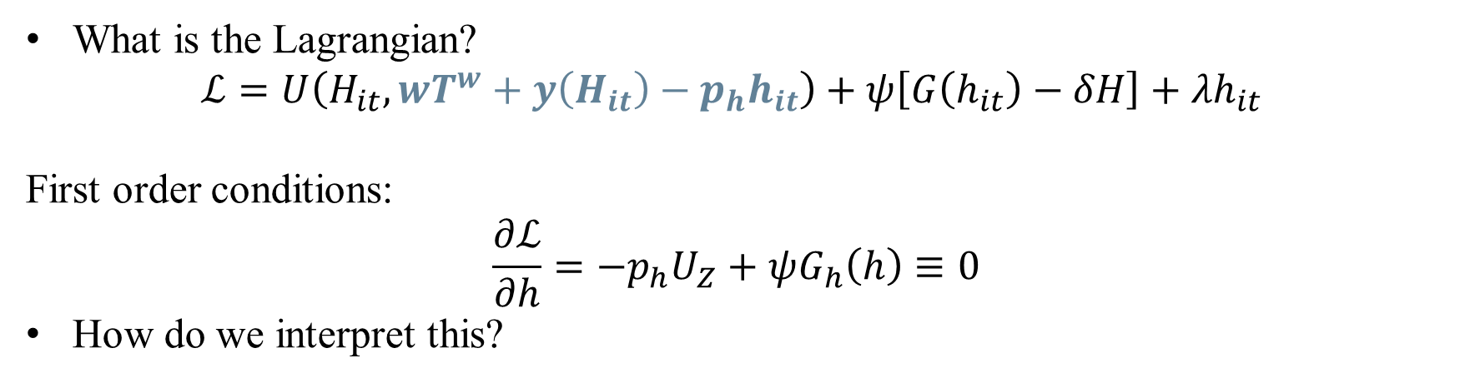
Finding the Equilibrium
What is the Lagrangian?
$$ℒ=U\left(H_{it}, wT^{w}+y\left(H_{it}\right)−p_{h}h_{it}\right)+ψ\left[G\left(h_{it}\right)−δH\right]+λh_{it}$$
First order conditions:
$$\frac{∂ℒ}{∂h}=−p_{h}U_{Z}+ψG_{h}\left(h\right)≡0$$
How do we interpret this?
Notes:
Marginal benefit = marginal cost! G() is the marginal benefit and U_z is the cost of not consuming z

Slide 42

Main Model Takeaways
So why do we care?
Shows that health production can be modeled as a stock/investment
Helps to model long term decision-making for health
How has this model been used empirically?
To theoretically justify SES Health Gradient
Model health optimally deteriorating with age
What limitations exist?
Requires certainty – known function $G\left(⋅\right)$
No savings
Others?

Slide 43
Jacobson (2000)
“The family as producer of health—an extended Grossman model.” Journal of Health Economics.
Notes:
Paper options for presenting:
Einav et al. (2013) : “Selection on moral hazard in health insurance” Heterogeneity in moral hazard (structural/applied)
De Meza and Webb (2017): False Diagnosis: Pitfalls of Testing for Asymmetric Information ni Insurance Markets (?)
Fang and Wu (2018): Multidimensional private information, market structure, and insurance markets (and look at citing papers)?

Slide 44

Spin on a Classic: who produces health?
Main update on question: what if families produce health together?

Slide 45
Spin on a Classic: who produces health?
Main update on question: what if families produce health together?
Family members’ investments spill over to others’ health
What questions does this allow us to answer?
Notes:
Why is this model extension useful? Should we do it just for its own sake? No! But we can consider something new: how families value health within households (who gets to go to the doctor when budgets are tight)

Slide 46
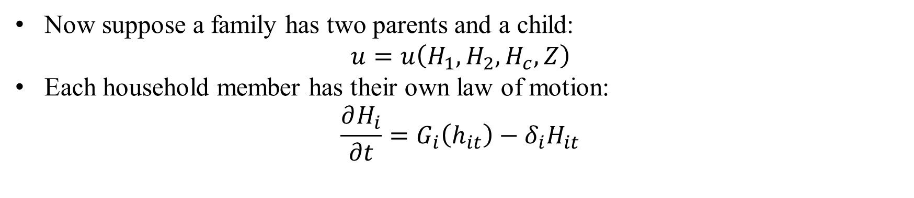
Updated Problem
Now suppose a family has two parents and a child:
$$u=u\left(H_{1},H_{2},H_{c},Z\right)$$
Each household member has their own law of motion:
$$\frac{∂H_{i}}{∂t}=G_{i}\left(h_{it}\right)−δ_{i}H_{it}$$
Notes:
We can bundle Z at the household level – why does this simplification make sense?

Slide 47

Updated Problem
Now suppose a family has two parents and a child:
$$u=u\left(H_{1},H_{2},H_{c},Z\right)$$
Each household member has their own law of motion:
$$\frac{∂H_{i}}{∂t}=G_{i}\left(h_{it}\right)−δ_{i}H_{it}$$
Suppose, though that the child’s production function depends on parental investment:
$$G_{c}=G_{c}\left(h_{c}, h_{1},h_{2};E_{1},E_{2}\right)$$
Time constraints also evolve for each family member to take care of one’s own sick time and child’s sick time, when needed (how would you write these?)
Notes:
Here, E variables indicate relative productivitiy of household members in producing health (in old model, we could just normalize this to 1, but want to model potential comparative advantages in health production)

Slide 48
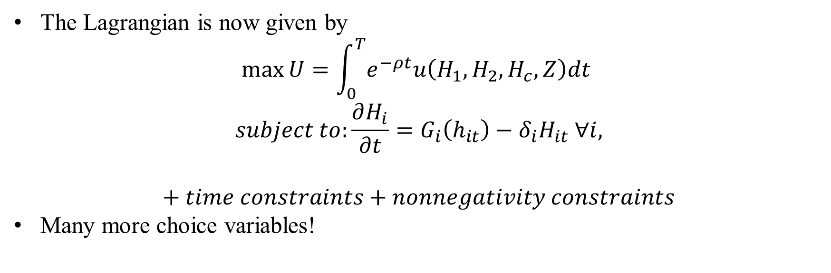
Updated Problem
The Lagrangian is now given by
$$\max{U}=\int_{0}^{T}{e^{−ρt}u\left(H_{1},H_{2},H_{c},Z\right)dt }$$
$$subject to:\frac{∂H_{i}}{∂t}=G_{i}\left(h_{it}\right)−δ_{i}H_{it} ∀i,$$
$$+ time constraints+nonnegativity constraints$$
Many more choice variables!
Notes:
Here, E variables indicate relative productivitiy of household members in producing health (in old model, we could just normalize this to 1, but want to model potential comparative advantages in health production)

Slide 49
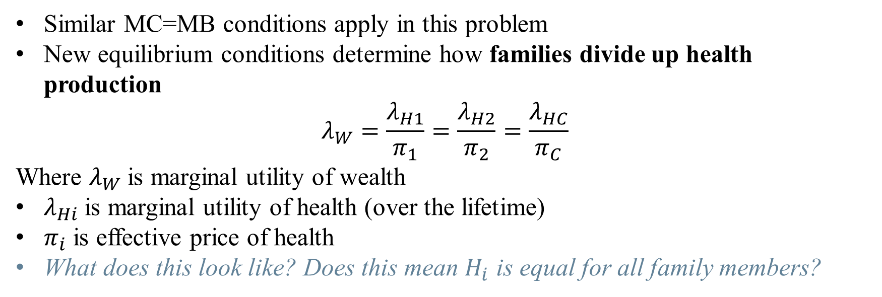
Key Insight
Similar MC=MB conditions apply in this problem
New equilibrium conditions determine how families divide up health production
$$λ_{W}=\frac{λ_{H1}}{π_{1}}=\frac{λ_{H2}}{π_{2}}=\frac{λ_{HC}}{π_{C}}$$
Where $λ_{W}$ is marginal utility of wealth
$λ_{Hi}$ is marginal utility of health (over the lifetime)
$π_{i}$ is effective price of health
What does this look like? Does this mean $H_{i}$ is equal for all family members?
Notes:
Hence, family invests in health until the rate of marginal utilities of (lifetime) health to effective price of health for all family members is equal and equal to the marginal utility of wealth – this is how goods are divided up in micro theory of demand. Health stock need not be equal for family members depending on productivity!

Slide 50

Key Insight
Similar MC=MB conditions apply in this problem
New equilibrium conditions determine how families divide up health production
$$λ_{W}=\frac{λ_{H1}}{π_{1}}=\frac{λ_{H2}}{π_{2}}=\frac{λ_{HC}}{π_{C}} \left(1\right)$$
Where $λ_{W}$ is marginal utility of wealth
$λ_{Hi}$ is marginal utility of health (over the lifetime)
$π_{i}$ is effective price of health
What does this look like? Does this mean $H_{i}$ is equal for all family members?
Note that you can rearrange (1) to get $λ_{W}π_{c}=λ_{Hc}$
Families whose wealth constraint is binding ($λ_{W}>0)$ value marginal change in child’s health more than unconstrained (wealthy) families.
Further, children with unhealthy parents tend to be less healthy
Does this make sense? Is it empirically validated.
Notes:
More $ has to be spent to bring up parents’ health to meet equation (1) , so less resources for child. But not true that households that are poorer seek out greater health interventions (why not?)

Slide 51
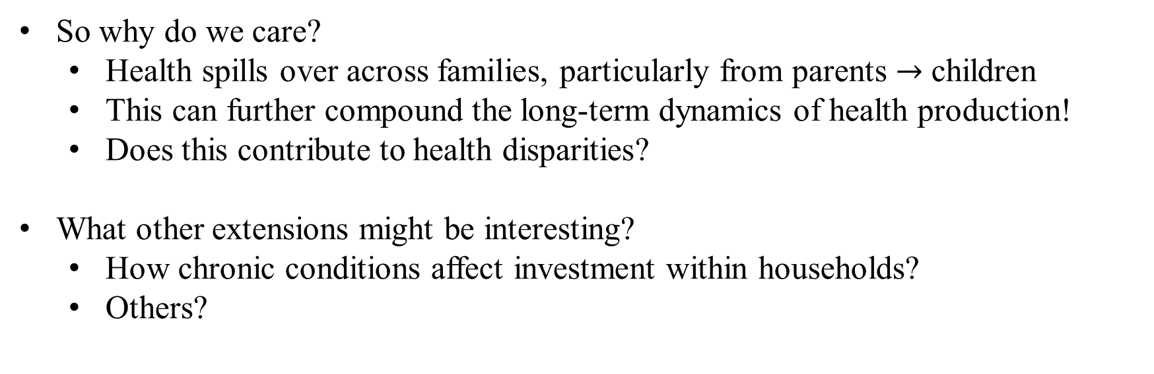
Main Model Takeaways
So why do we care?
Health spills over across families, particularly from parents $→$ children
This can further compound the long-term dynamics of health production!
Does this contribute to health disparities?
What other extensions might be interesting?
How chronic conditions affect investment within households?
Others?
Notes:
We’ll get to talking about disparities.

Slide 52
Discussions on Grossman
Zweifel, P. (2012). “The Grossman model after 40 years”. The European Journal of Health Economics
Kaestner, R. (2013). “The Grossman model after 40 years: a reply to Peter Zweifel”. The European Journal of Health Economics
Notes:
Paper options for presenting:
Einav et al. (2013) : “Selection on moral hazard in health insurance” Heterogeneity in moral hazard (structural/applied)
De Meza and Webb (2017): False Diagnosis: Pitfalls of Testing for Asymmetric Information ni Insurance Markets (?)
Fang and Wu (2018): Multidimensional private information, market structure, and insurance markets (and look at citing papers)?

Slide 53
Critique: Zweifel (2012)
The Grossman model has failed to be policy relevant
Assumes a long, fixed planning horizon – do people really plan 50 years out?
Assumes that return of investment is constant across health states
Notes:
Is this a critique we care about (multiple answers here)? Note the style of the critique – addresses core assumptions of the model. Can we weaken these assumptions? What would be the benefit of doing so? Note that critique 2 is broken out into multiple parts in the paper.

Slide 54
Critique: Zweifel (2012)
The Grossman model has failed to be policy relevant
Assumes a long, fixed planning horizon – do people really plan 50 years out?
Assumes that return of investment is constant across health states
“However, the acronym MGM already suggests that the model amounts
to something like the Hollywood dream factory Metro-Goldwyn-Mayer:
much elegance, very inspiring, but of limited relevance to the real world.”
“It is amazing that neither the reviewers nor the editors of
Health Economics recognized this. Or was there collusion
between the journal and the author, serving their shared
interest in keeping the MGM bandwagon rolling?
Notes:
He’s clearly got a bone to pick here – he had a kind of longstanding animosity here.

Slide 55

Critique: Zweifel (2012)
The Grossman model has failed to be policy relevant
Assumes a long, fixed planning horizon – do people really plan 50 years out?
Assumes that return of investment is constant across health states
Fundamental critique: Grossman predicts complementarities between $h$ and $H$
But in empirical work, sicker people (lower health status) are, found to visit the doctor more frequently!
Thankfully, he proposes an alternative model, based on stochastic state dependence
Your health investment return is random
Your health therefore is random…
But it depends a lot on where you were yesterday

Slide 56
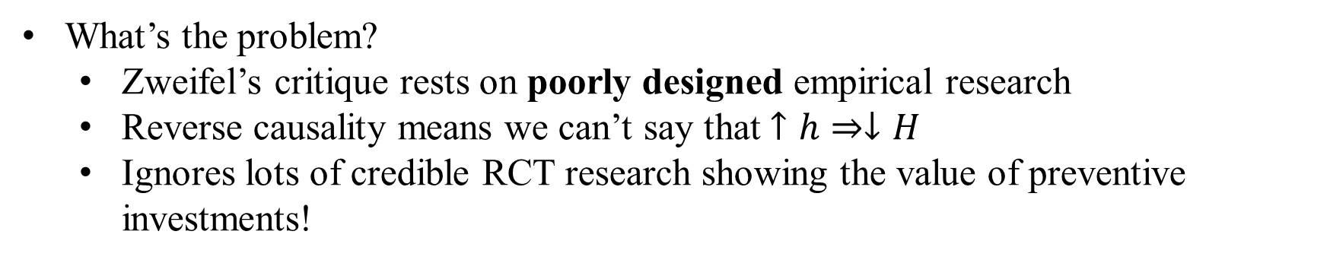
Response: Kaestner (2013), Laporte (2014)
What’s the problem?
Zweifel’s critique rests on poorly designed empirical research
Reverse causality means we can’t say that $↑h⇒↓H$
Ignores lots of credible RCT research showing the value of preventive investments!
“Zweifel suggests, disconcertingly, that there is a conspiracy within the health economics community to shield the Grossman model from meaningful criticism (‘‘Or was there collusion between the journal and the author, serving
their shared interest in keeping the MGM bandwagon rolling?’’). This barely disguised (as a question) accusation is unjustified and disingenuous.”
“Is the Grossman model perfect? No, but it provides a logically consistent framework to: (1) explain observed differences in health, investments in health including medical care, and consumption; and (2) evaluate public and private policies to affect these outcomes. It is as relevant today as it was 40 years ago.”
Notes:
Sure you go to the dentist if you have cavities but this doesn’t mean brushing your teeth is bad

Slide 57

Response: Kaestner (2013), Laporte (2014)
What’s the problem?
Zweifel’s critique rests on poorly designed empirical research
Reverse causality means we can’t say that $↑h⇒↓H$
Ignores lots of credible RCT research showing the value of preventive investments!
Laporte (2014) walks through a credible way to test this claim:
Zweifel is treating $H$ effectively as non-durable in his critique
That’s the opposite of what Grossman assumed!
You can show directly that higher levels of $H$ may reduce $h$ tomorrow, but this is because of the lower returns from increasing an already high level of health
Notes:
e.g., if you regress H on h, you treat H as a flow not a stock. If you have time, you can show this: go to page 6 of Audrey’s paper and walk through the math on the whiteboard

Slide 58
Summary
Health can be modeled as a choice
Health evolves over time in response to investments
Small decisions add up to large changes in health
Accounting for spillovers within households may explain disparities in investments
Is the empirical evidence consistent with these predictions? Meh.
Is the model trash? Also meh.
Next time: moral hazard in health care
How does messing with the price of care affect demand for services?

