Slide 1
Advanced Health Economics
Lecture 3: Adverse Selection
January 25, 2023
HAD 6750 • Alex Hoagland, Ph.D.

Slide 2
Last time: Moral Hazard
Moral hazard in health care
Do people exert effort to preserve health?
Do people “consume more health care” when they are insured?
How can elastic demand be curbed?

Slide 3
Last time: Moral Hazard
Moral hazard in health care
Do people exert effort to preserve health?
Do people “consume more health care” when they are insured?
How can elastic demand be curbed?
What happens when people have private information about type?
How does this affect health choices?
This time: Adverse Selection

Slide 4
What is Adverse Selection?
Another form of asymmetric information
Moral hazard was a form of “hidden action”
Adverse selection is a form of “hidden type”
Notes:
Do we remember what AI is?

Slide 5
What is Adverse Selection?
Another form of asymmetric information
Moral hazard was a form of “hidden action”
Adverse selection is a form of “hidden type”
Think about the market for health insurance
Who would have the greatest demand for protection?
Who do insurers/regulators/government want to be insured the most?
Notes:
Note: answers differ for each of these!

Slide 6
What is Adverse Selection?
Another form of asymmetric information
Moral hazard was a form of “hidden action”
Adverse selection is a form of “hidden type”
Think about the market for health insurance
Who would have the greatest demand for protection?
Who do insurers/regulators/government want to be insured the most?
Adverse Selection threatens markets
If I can keep my risk hidden, can I get better outcomes?
Can people find out my risk?
Equilibria are distorted (pooling versus screening equilibria)
Notes:
Note: answers differ for each of these! One minute video: https://www.youtube.com/watch?app=desktop&v=tyzf3T2LASs&autoplay=1&ab_channel=OneMinuteEconomics

Slide 7
Akerlof’s Market for Lemons
We are looking to buy a used car
Assumption 1: Heterogeneity in car quality
Car valuation v is distributed uniformly on interval [$1,000, $9,000]
Assumption 2: Car sellers know valuation
Assumption 3: Car quality is unknown to buyer
Notes:
Classic paper – nobel prize winning, < 15 pages.

Slide 8

Akerlof’s Market for Lemons
We are looking to buy a used car
Assumption 1: Heterogeneity in car quality
Car valuation v is distributed uniformly on interval [$1,000, $9,000]
Assumption 2: Car sellers know valuation
Assumption 3: Car quality is unknown to buyer
Information asymmetry
Notes:
One minute video: https://www.youtube.com/watch?app=desktop&v=tyzf3T2LASs&autoplay=1&ab_channel=OneMinuteEconomics

Slide 9
Akerlof’s Market for Lemons
We are looking to buy a used car
Assumption 1: Heterogeneity in car quality
Car valuation v is distributed uniformly on interval [$1,000, $9,000]
Assumption 2: Car sellers know valuation
Assumption 3: Car quality is unknown to buyer
Information asymmetry
What will be the equilibrium price / quantity of cars sold in this market?
Notes:
One minute video: https://www.youtube.com/watch?app=desktop&v=tyzf3T2LASs&autoplay=1&ab_channel=OneMinuteEconomics

Slide 10
Akerlof’s Model: Solution
What is the expected value to a buyer from buying a car?

Slide 11
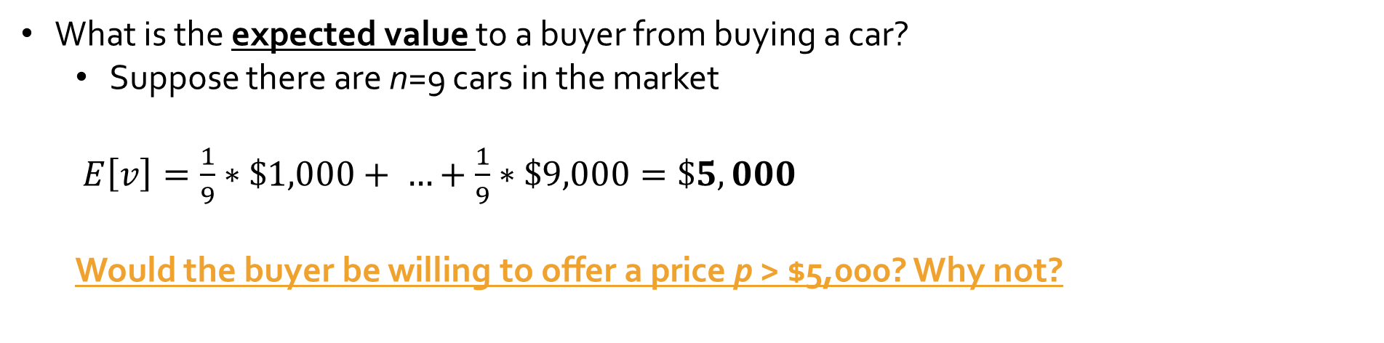
Akerlof’s Model: Solution
What is the expected value to a buyer from buying a car?
Suppose there are n=9 cars in the market
$E\left[v\right]=\frac{1}{9}∗\$1,000+ …+\frac{1}{9}∗\$9,000=\$5,000$
Would the buyer be willing to offer a price p > $5,000? Why not?

Slide 12
Akerlof’s Model: Solution
What is the expected value to a buyer from buying a car?
Suppose there are n=9 cars in the market
$E\left[v\right]=\frac{1}{9}∗\$1,000+ …+\frac{1}{9}∗\$9,000=\$5,000$
Would the buyer be willing to offer a price p > $5,000? Why not?
But remember that the sellers know their car’s value!
Which sellers would accept a price p = $5,000?

Slide 13
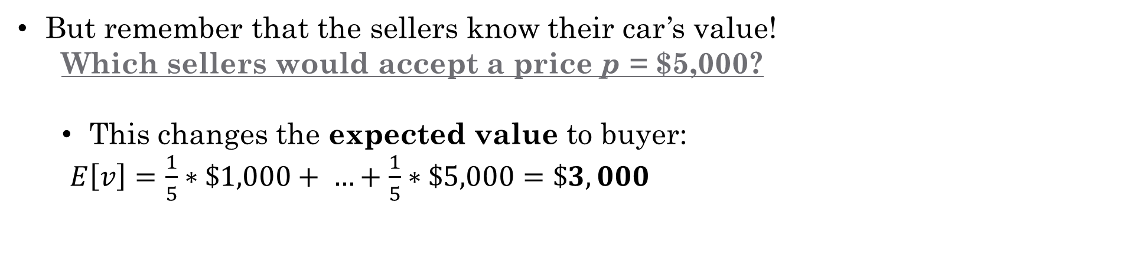
Akerlof’s Model: Solution
What is the expected value to a buyer from buying a car?
Suppose there are n=9 cars in the market
$E\left[v\right]=\frac{1}{9}∗\$1,000+ …+\frac{1}{9}∗\$9,000=\$5,000$
Would the buyer be willing to offer a price p > $5,000? Why not?
But remember that the sellers know their car’s value!
Which sellers would accept a price p = $5,000?
This changes the expected value to buyer:
$E\left[v\right]=\frac{1}{5}∗\$1,000+ …+\frac{1}{5}∗\$5,000=\$3,000$

Slide 14
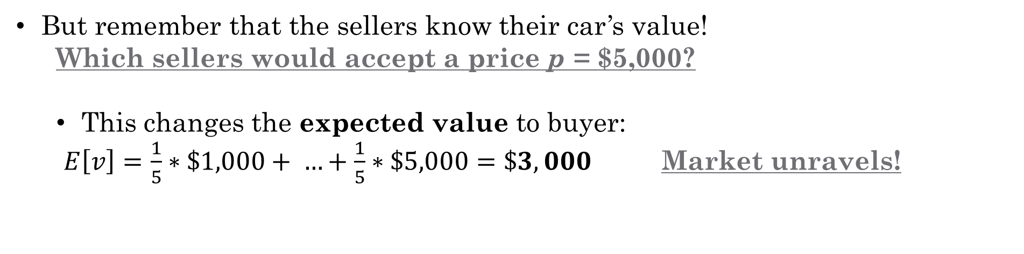
Akerlof’s Model: Solution
What is the expected value to a buyer from buying a car?
Suppose there are n=9 cars in the market
$E\left[v\right]=\frac{1}{9}∗\$1,000+ …+\frac{1}{9}∗\$9,000=\$5,000$
Would the buyer be willing to offer a price p > $5,000? Why not?
But remember that the sellers know their car’s value!
Which sellers would accept a price p = $5,000?
This changes the expected value to buyer:
$E\left[v\right]=\frac{1}{5}∗\$1,000+ …+\frac{1}{5}∗\$5,000=\$3,000$ Market unravels!

Slide 15
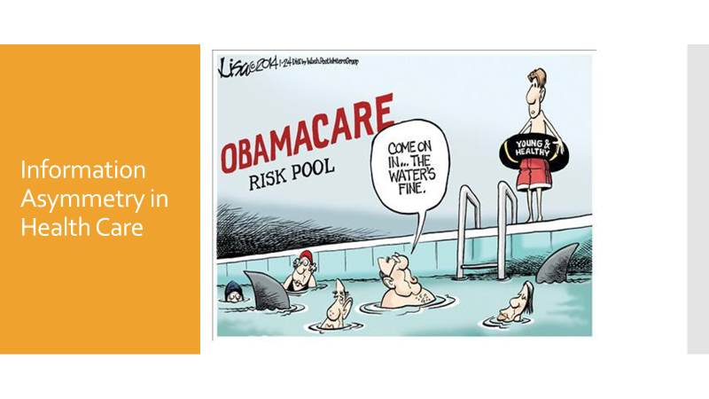
Adverse Selection in Health Care

Slide 16
Adverse Selection in Health Care
Notes:
Anything to add here?

Slide 17
Rothschild & Stiglitz (1976)
“Equilibrium in competitive insurance markets: an essay on the economics of imperfect information” Quarterly Journal of Economics

Slide 18
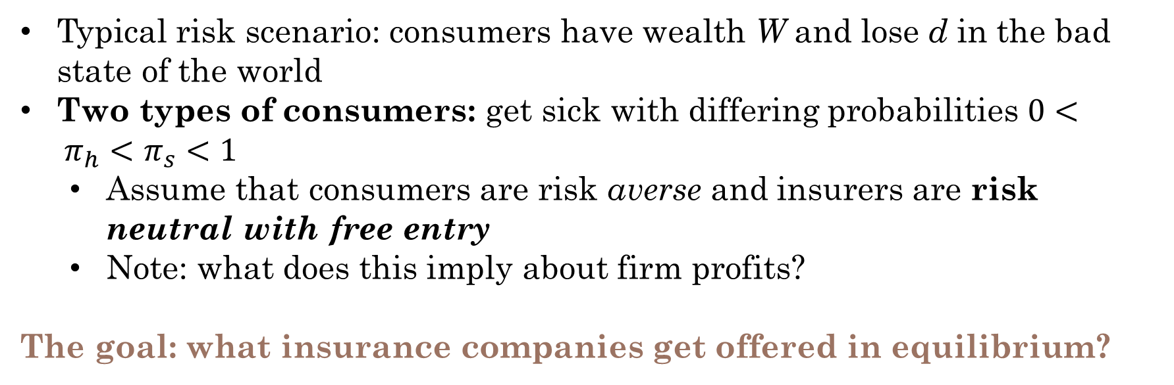
Information Asymmetry in Insurance
Typical risk scenario: consumers have wealth W and lose d in the bad state of the world
Two types of consumers: get sick with differing probabilities $0< π_{h}<π_{s}<1$
Assume that consumers are risk averse and insurers are risk neutral with free entry
Note: what does this imply about firm profits?
The goal: what insurance companies get offered in equilibrium?
Notes:
Quick digression: what are our equilibrium conditions? (1) No contract makes less than 0 in E(pi), and (2) No contract has positive profit in E(pi)

Slide 19
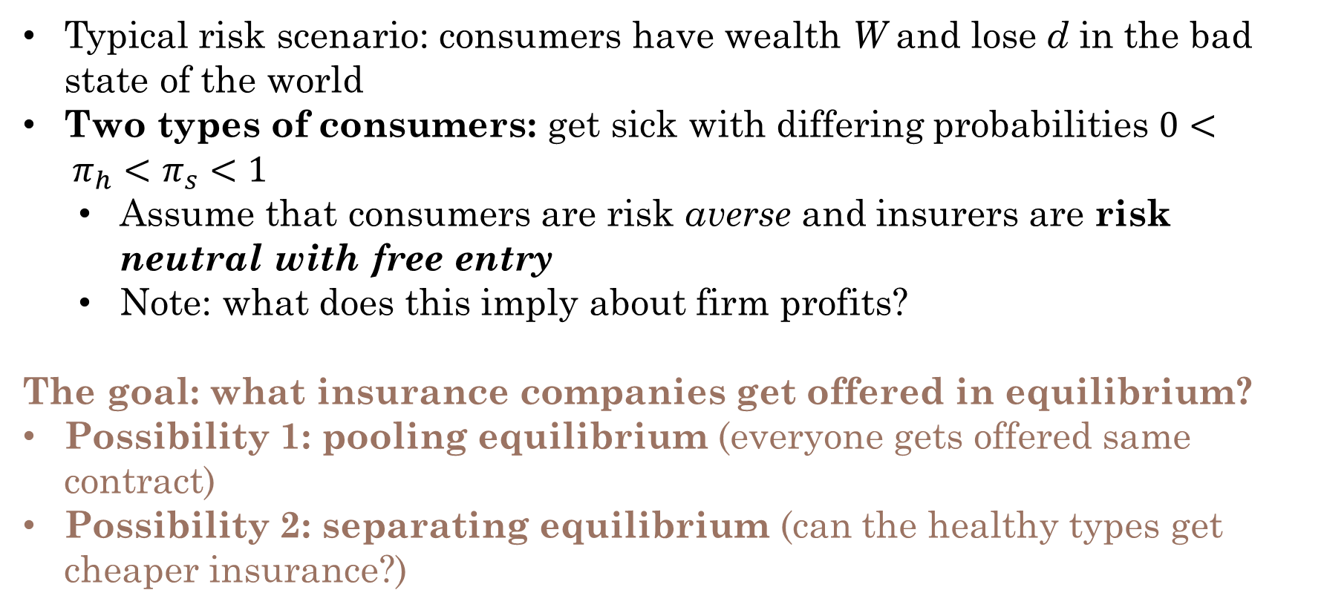
Information Asymmetry in Insurance
Typical risk scenario: consumers have wealth W and lose d in the bad state of the world
Two types of consumers: get sick with differing probabilities $0< π_{h}<π_{s}<1$
Assume that consumers are risk averse and insurers are risk neutral with free entry
Note: what does this imply about firm profits?
The goal: what insurance companies get offered in equilibrium?
Possibility 1: pooling equilibrium (everyone gets offered same contract)
Possibility 2: separating equilibrium (can the healthy types get cheaper insurance?)

Slide 20
Case 1: What would happen with full information?
What contracts would be offered if information could not be hidden?
Notes:
Under full information, consumers get charged a premium equal to their expected loss, which is type specific. Separating equilibrium (show this on board)

Slide 21
Case 2: Separating Equilibrium?
What contracts would be offered if information could not be hidden?
Now, what happens when information is hidden? Can we preserve the separating equilibrium?
Notes:
Show that the screening equilibrium works, but needs to be adjusted apart (pictures, then math?)

Slide 22
Case 2: Pooling Equilibrium?
What contracts would be offered if information could not be hidden?
Now, what happens when information is hidden? Can we preserve the separating equilibrium?
What is the next best option?
Notes:
Show graphical illustration for pooling equilibrium. Discuss takeaways for each type (low type is fine, high type is worse off)

Slide 23
Rothschild and Stiglitz (1976): Takeaways
The presence of hidden risk information makes markets unstable
Consider extending this model:
Continuum of consumers
Barriers to entry for insurers
Multidimensional risk
Each of these may make the insurance market more unstable!
So what can we do in practice?
Notes:
Briefly talk about the ACA.

Slide 24
Einav & Finkelstein (2011)
“Selection in Insurance Markets: Theory and Empirics in Pictures”
Journal of Economic Perspectives.

Slide 25
Geruso et al. (2019)
“The Two Margin Problem in Insurance Markets”
The Review of Economics and Statistics (RESTAT)

Slide 26
Presentations

Slide 27
The Affordable Care Act
Notes:
If there’s time

Slide 28
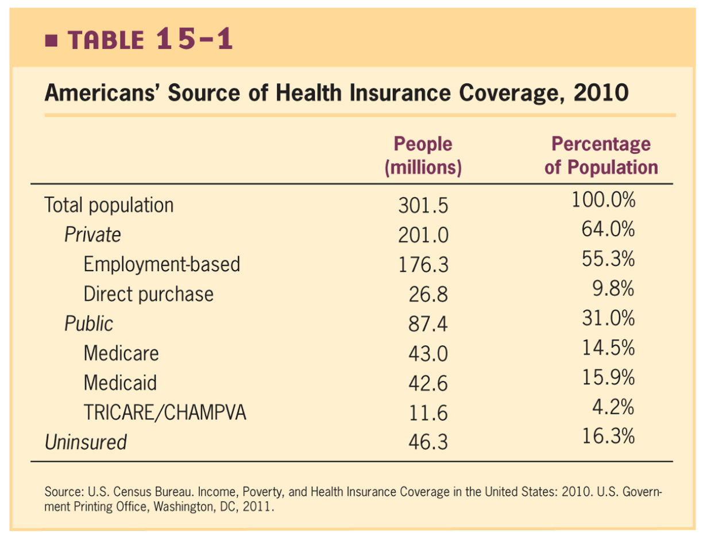
Adverse Selection in Health Insurance pre-ACA
Biggest problem: high variance in expected costs
Why would most insurance be from private insurers?
Why would we care about these?

Slide 29
Adverse Selection in Health Insurance pre-ACA
Biggest problem: high variance in expected costs
Why would most insurance be from private insurers?
Risk pooling
Failure in non-group markets
Why would we care about these?
Externalities
Paternalism
Job lock

Slide 30
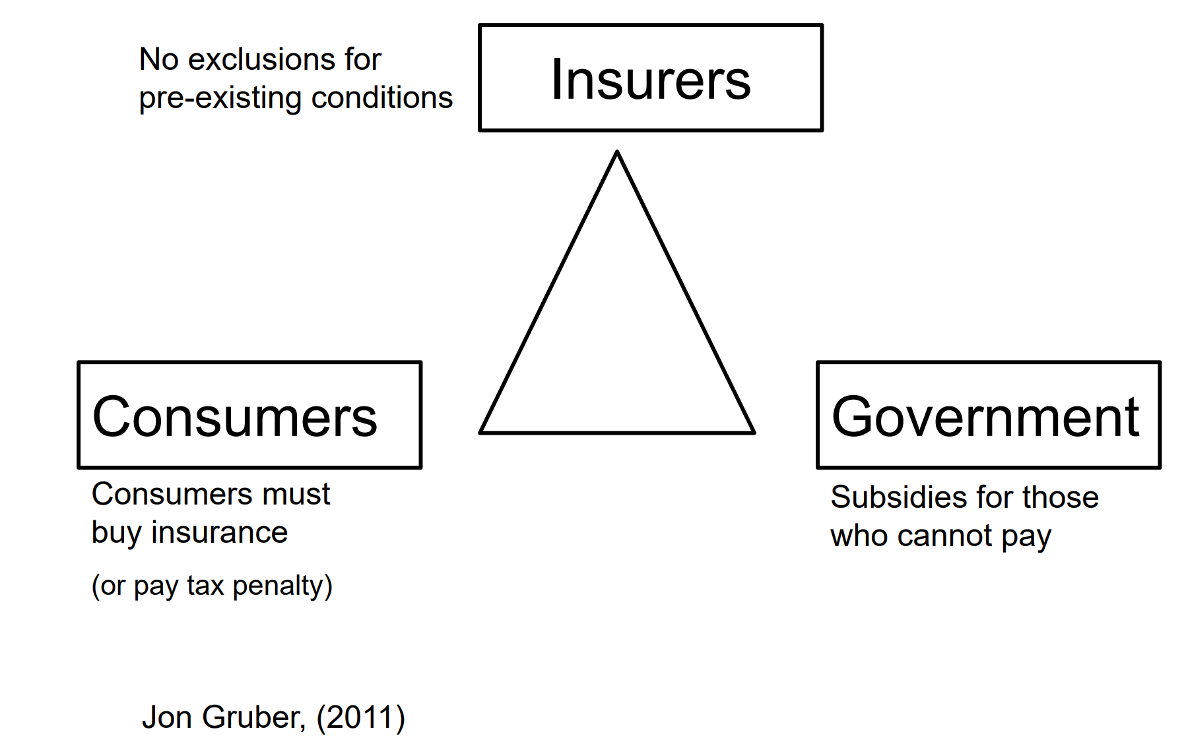
The Three Legs of the ACA: Reducing Adverse Selection

Slide 31
Other ACA Components
Medicaid expansions (ultimately left to states)
Establishment of new Marketplaces to buy insurance
Preventive care cost-sharing exemption
Dependent coverage extended until age 26
Insurance companies can’t drop you if you get sick
Tax credits for small businesses to offer insurance
Insurers are required to pay out a certain percentage of premium (at least 80-85%)

Slide 32
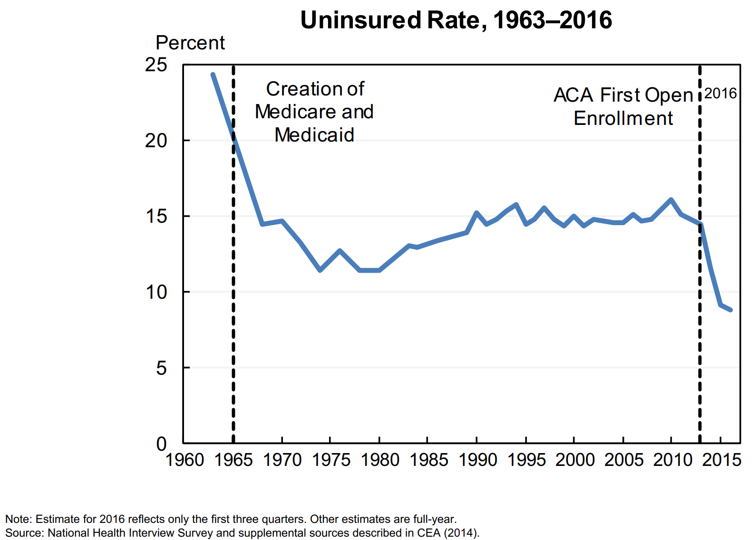
Effect 1: Reduction in Uninsurance Rate

Slide 33
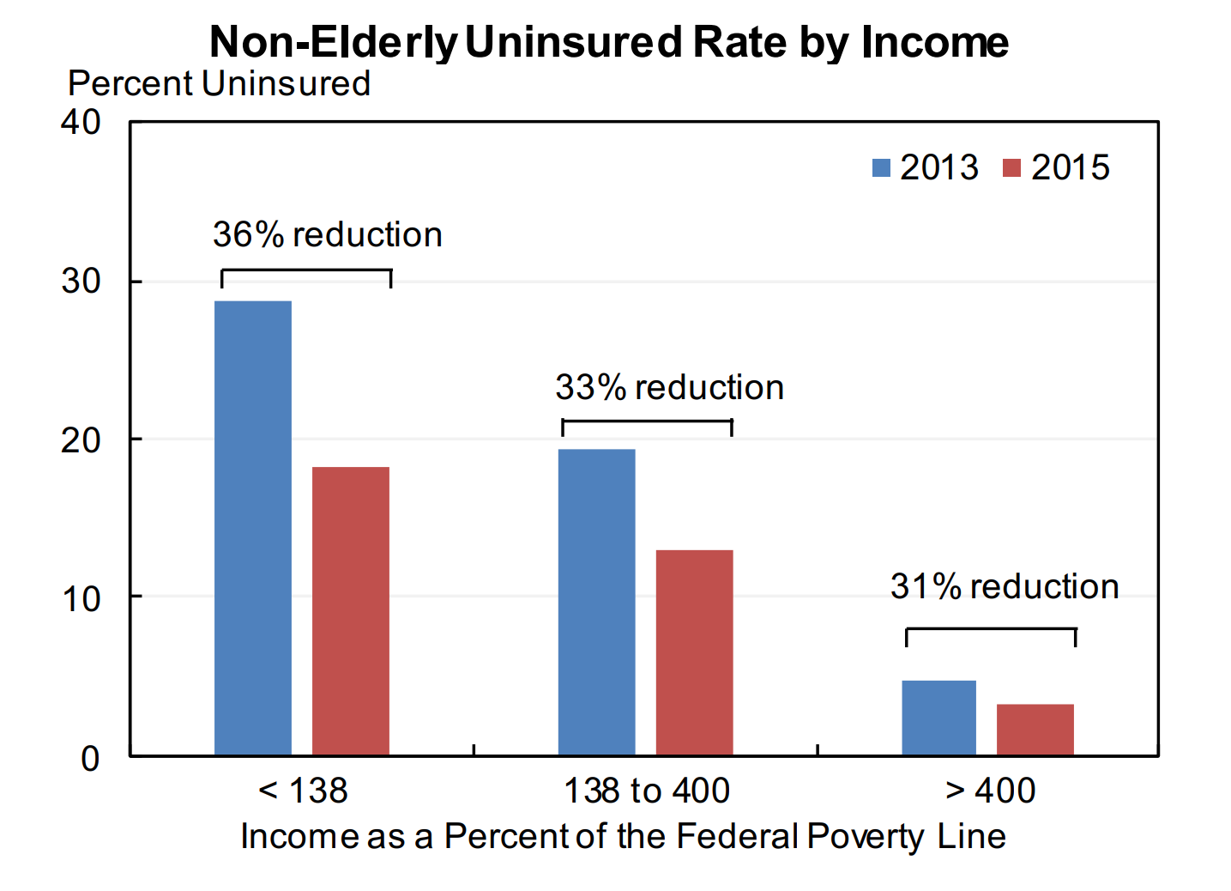
Effect 1: Reduction in Uninsurance Rate

Slide 34
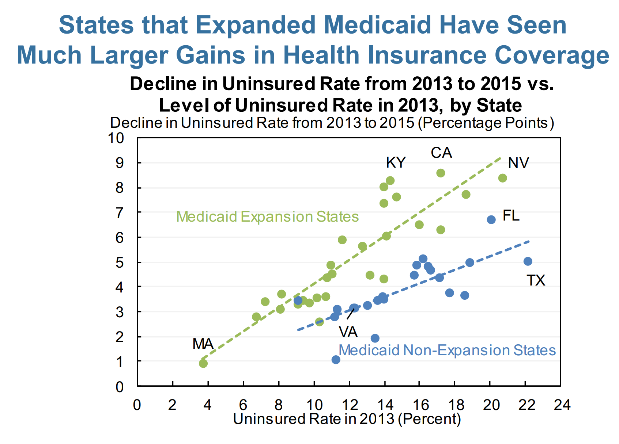
Effect 2: Reduction Larger in States that Expanded Medicaid

Slide 35
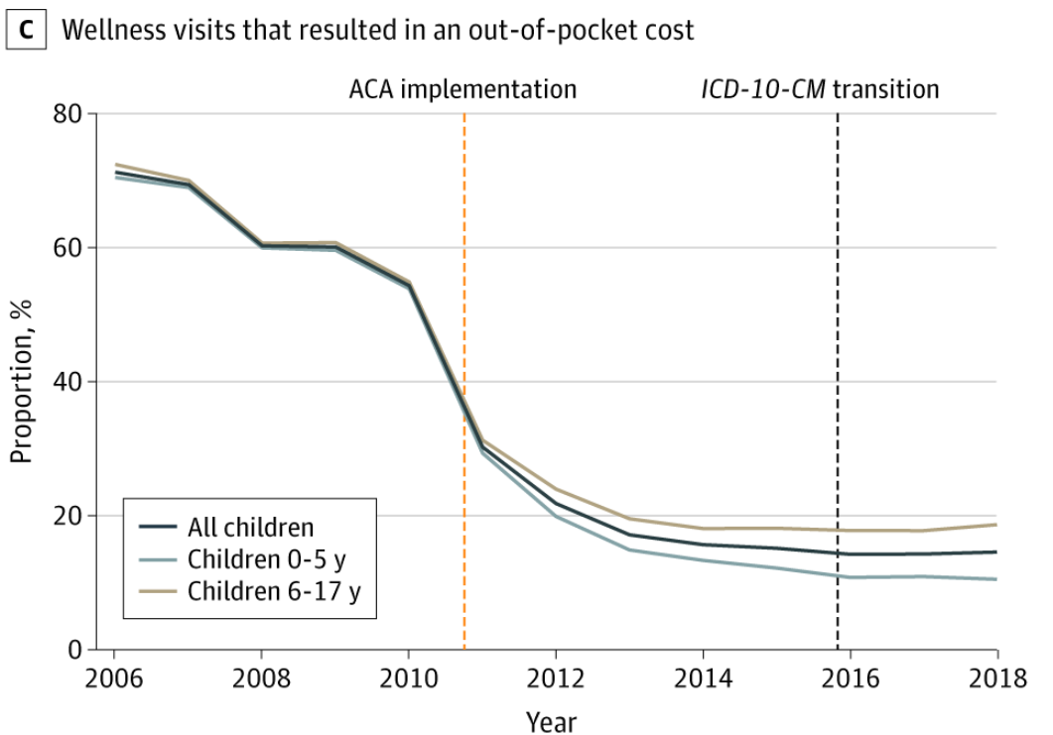
Effect 3: High-value health care is more affordable
Source: Shafer, Hoagland, and Hsu (2021). JAMA Network Open

Slide 36
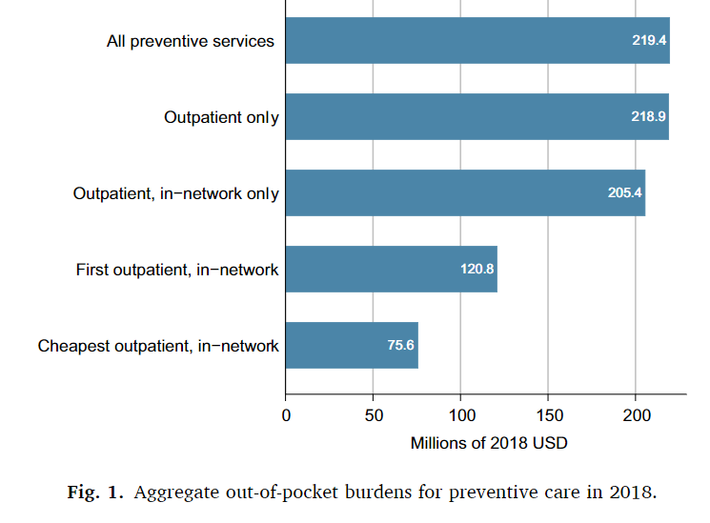
Lingering problems:
State-by-state implementation left remaining patchwork system
No large federal overhaul of private insurance
Preventive care policies not fully implemented: remaining costs

Slide 37
Summary
Moral hazard in health care
Additional work: talk about some of your own work.
Next time: adverse selection
What happens when people have private information about type?
How does this affect health choices?

