Slide 1
Advanced Health Economics
Lecture 2: Moral Hazard in Health Care
January 12, 2026
HAD 6750 • Alex Hoagland, Ph.D.

Slide 2
Last time:
Health can be modeled as a choice
Health evolves over time in response to investments
Thinking about how to set up a model, how to solve one, how to link it to empirical evidence

Slide 3
Last time:
Health can be modeled as a choice
Health evolves over time in response to investments
Thinking about how to set up a model, how to solve one, how to link it to empirical evidence
How does messing with the price of care (e.g., through insurance contracts) affect demand for services?
This time:
Notes:
We call this moral hazard

Slide 4
Introductory concepts

Slide 5
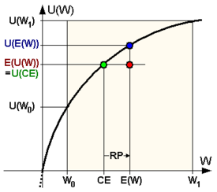
Risk Aversion
How do we model someone being risk averse?
Notes:
Risk aversion is the notion that expected utility over a gamble is lower than the utility of the expected value – having the uncertainty hurts! Mathematically, this means that the utility function is concave (u’’<0)

Slide 6
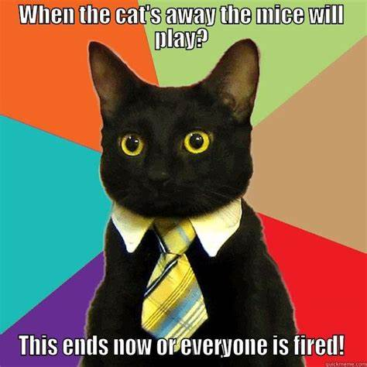
What do we mean by “moral hazard”?
In economics, moral hazard derives from principal-agent problem
Incentives are misaligned, and information asymmetry leads to deviations from optimal behavior
Example: store manager versus employee
Notes:
Another example for us to think through together: LLMs and university coursework. How is this private information? What does this imply for changes to an equilibrium? Think through what the equilibrium was before, what it is after, can we retain the “first best”?

Slide 7
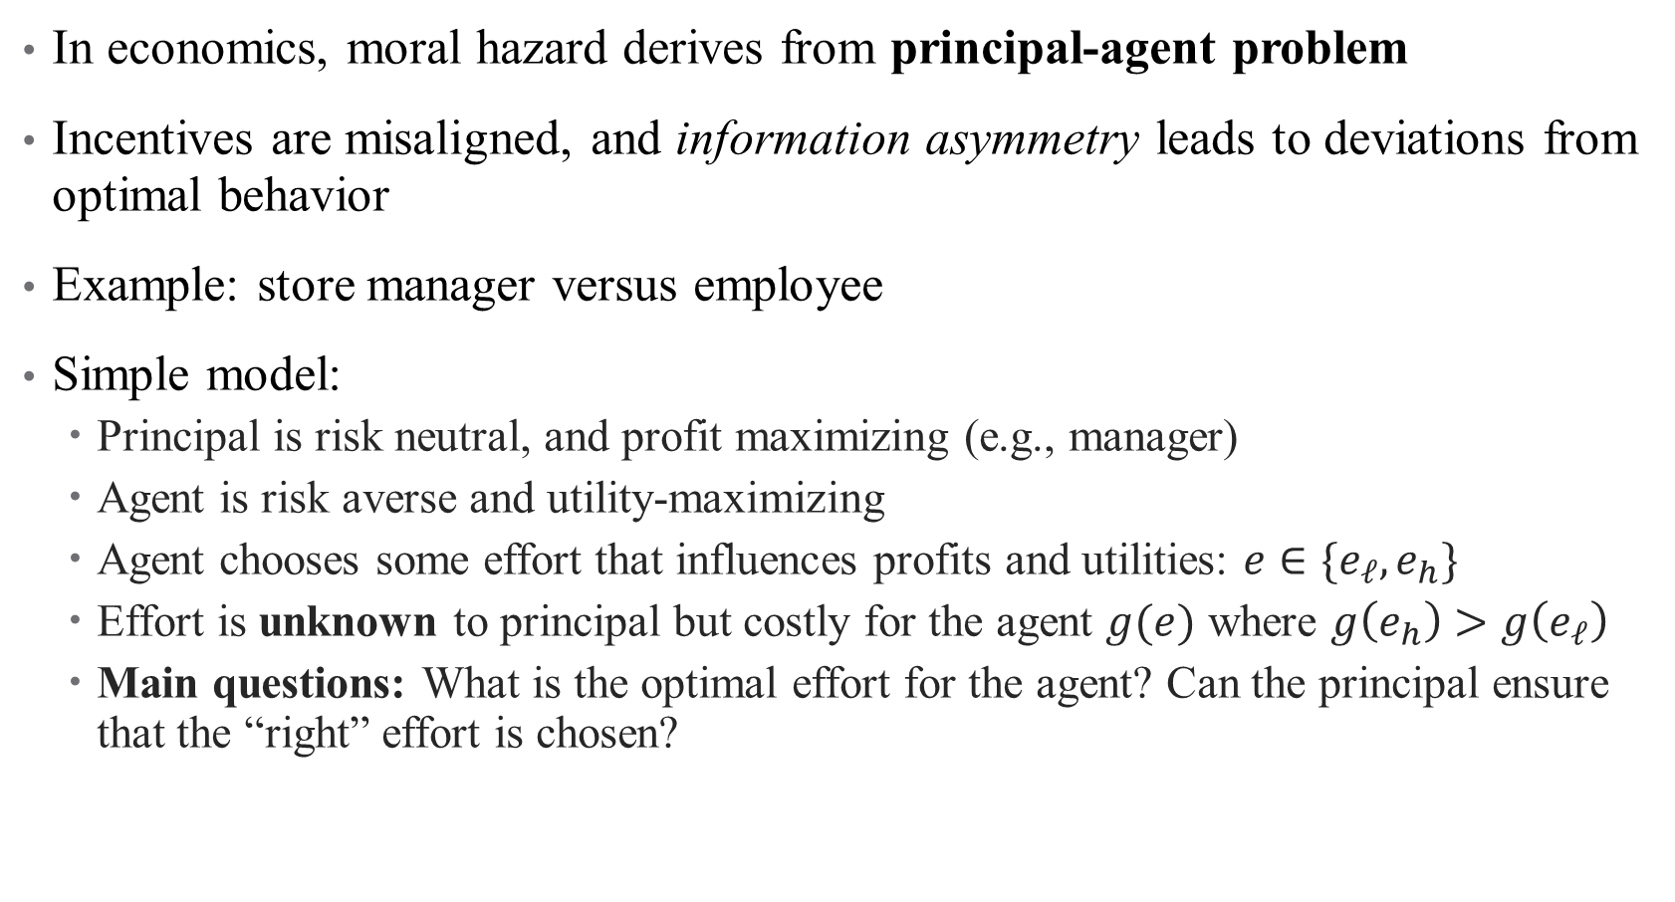
What do we mean by “moral hazard”?
In economics, moral hazard derives from principal-agent problem
Incentives are misaligned, and information asymmetry leads to deviations from optimal behavior
Example: store manager versus employee
Simple model:
  Principal is risk neutral, and profit maximizing (e.g., manager)
  Agent is risk averse and utility-maximizing
  Agent chooses some effort that influences profits and utilities: $e∈\{e_{ℓ}, e_{h}\}$
  Effort is unknown to principal but costly for the agent $g(e)$ where $g\left(e_{h}\right)>g\left(e_{ℓ}\right)$
  Main questions: What is the optimal effort for the agent? Can the principal ensure that the “right” effort is chosen?

Slide 8

Simple Model of Effort
  Suppose that principal offers agents a contract with wage $w(π)$
  Suppose also that $π\left(e_{h}\right)>π\left(e_{ℓ}\right)$(what does this mean in words?)
  Ideally, what would wage depend on?

Slide 9
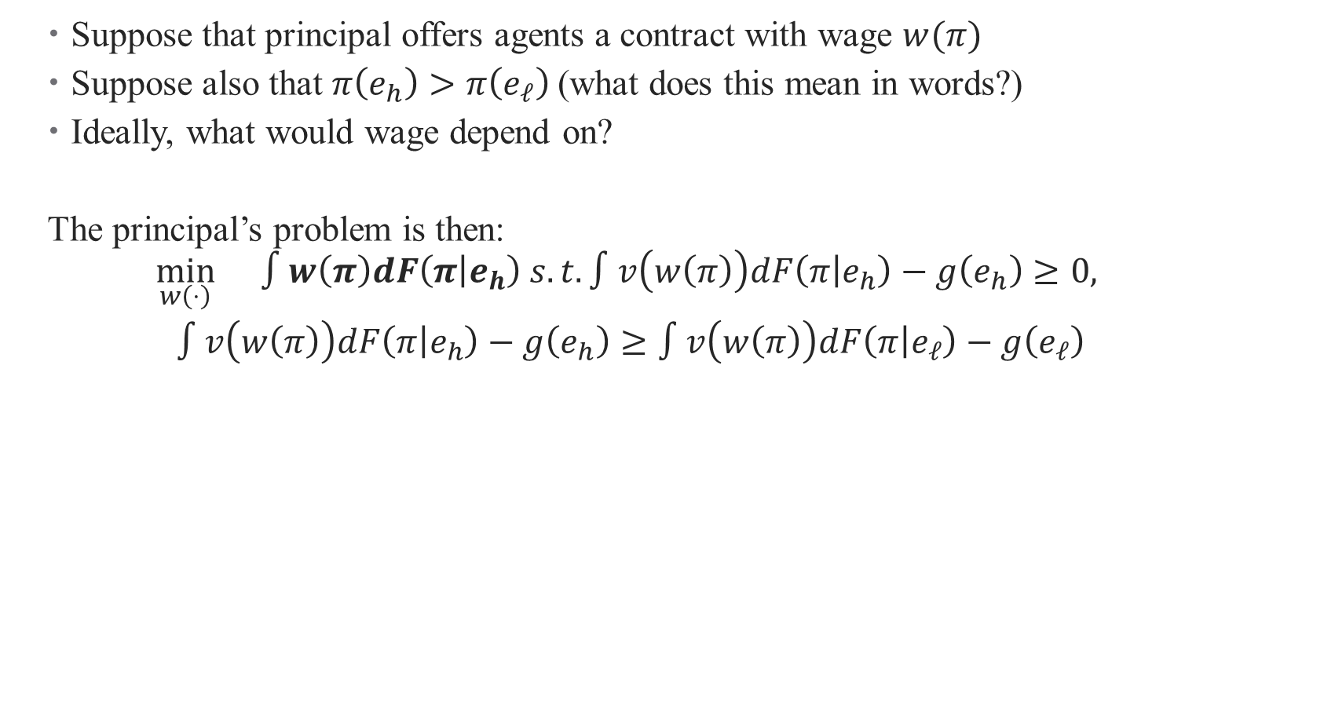
Simple Model of Effort
  Suppose that principal offers agents a contract with wage $w(π)$
  Suppose also that $π\left(e_{h}\right)>π\left(e_{ℓ}\right)$(what does this mean in words?)
  Ideally, what would wage depend on?
  The principal’s problem is then:
  $$\begin{aligned}\min_{w\left(⋅\right)}{}∫w\left(π\right)dF\left(π | e_{h}\right) s.t. ∫v\left(w\left(π\right)\right)dF\left(π | e_{h}\right)−g\left(e_{h}\right)≥0, \\ ∫v\left(w\left(π\right)\right)dF\left(π | e_{h}\right)−g\left(e_{h}\right)≥∫v\left(w\left(π\right)\right)dF\left(π | e_{ℓ}\right)−g\left(e_{ℓ}\right)\end{aligned}{}$$

Slide 10
Simple Model of Effort
  Suppose that principal offers agents a contract with wage $w(π)$
  Suppose also that $π\left(e_{h}\right)>π\left(e_{ℓ}\right)$(what does this mean in words?)
  Ideally, what would wage depend on?
  The principal’s problem is then:
  $$\begin{aligned}\min_{w\left(⋅\right)}{}∫w\left(π\right)dF\left(π | e_{h}\right) s.t. ∫v\left(w\left(π\right)\right)dF\left(π | e_{h}\right)−g\left(e_{h}\right)≥0, \\ ∫v\left(w\left(π\right)\right)dF\left(π | e_{h}\right)−g\left(e_{h}\right)≥∫v\left(w\left(π\right)\right)dF\left(π | e_{ℓ}\right)−g\left(e_{ℓ}\right)\end{aligned}{}$$
Participation
constraint
Incentive compatibility
constraint
Notes:
Do simpler example here, then come back to generals

Slide 11
Simple Model of Effort
  What’s the Lagrangian?

Slide 12

Simple Model of Effort
  What’s the Lagrangian?
  $$∫w\left(π\right)dF\left(π | e_{h}\right)−λ\left(∫v\left(w\left(π\right)\right)dF\left(π | e_{h}\right)−g\left(e_{h}\right)\right)−μ\left(∫v\left(w\left(π\right)\right)dF\left(π | e_{h}\right)−g\left(e_{h}\right)−∫v\left(w\left(π\right)\right)dF\left(π | e_{ℓ}\right)−g\left(e_{ℓ}\right)\right)$$

Slide 13
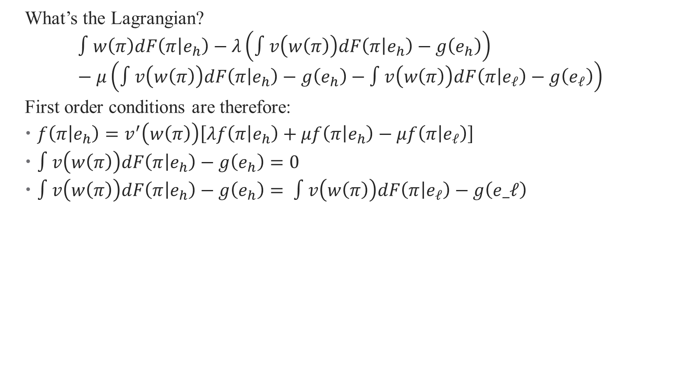
Simple Model of Effort
  What’s the Lagrangian?
  $$∫w\left(π\right)dF\left(π | e_{h}\right)−λ\left(∫v\left(w\left(π\right)\right)dF\left(π | e_{h}\right)−g\left(e_{h}\right)\right)−μ\left(∫v\left(w\left(π\right)\right)dF\left(π | e_{h}\right)−g\left(e_{h}\right)−∫v\left(w\left(π\right)\right)dF\left(π | e_{ℓ}\right)−g\left(e_{ℓ}\right)\right)$$
  First order conditions are therefore:
  $f\left(π | e_{h}\right)=v^{′}\left(w\left(π\right)\right)\left[λf\left(π | e_{h}\right)+μf\left(π | e_{h}\right)−μf\left(π | e_{ℓ}\right)\right]$
  $∫v\left(w\left(π\right)\right)dF\left(π | e_{h}\right)−g\left(e_{h}\right)=0$
  $∫v\left(w\left(π\right)\right)dF\left(π | e_{h}\right)−g\left(e_{h}\right)= ∫v\left(w\left(π\right)\right)dF\left(π | e_{ℓ}\right)−g\left(e_ℓ\right)$
Notes:
What do these conditions mean in words? Start with the last two – that both constraints bind (otherwise, effort would be “over-incentivized” by principal). The first one tells us about how wage varies with profits.

Slide 14
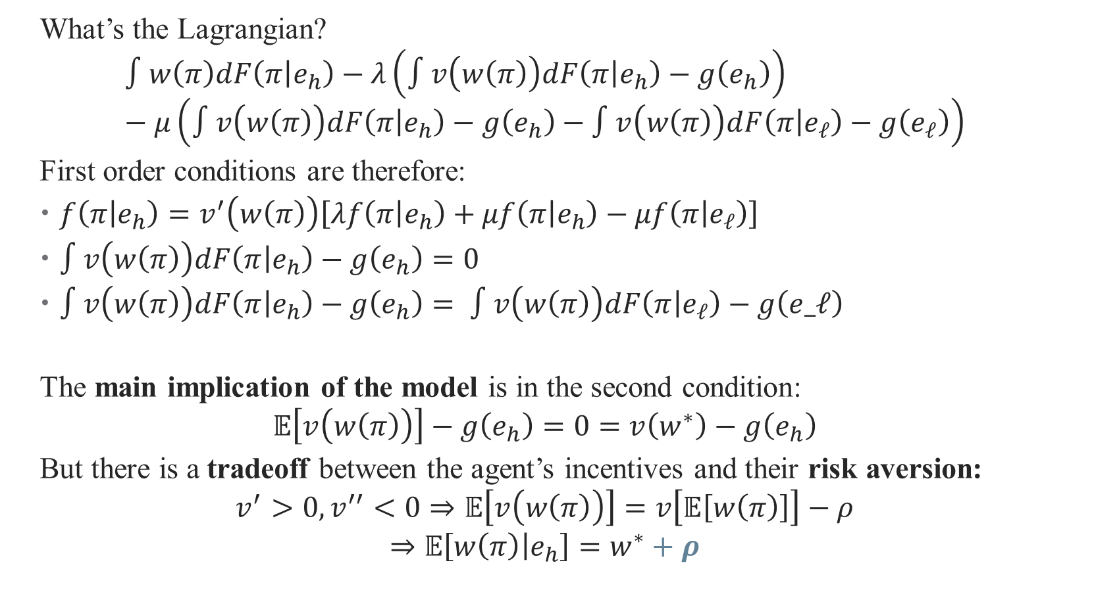
Simple Model of Effort
  What’s the Lagrangian?
  $$∫w\left(π\right)dF\left(π | e_{h}\right)−λ\left(∫v\left(w\left(π\right)\right)dF\left(π | e_{h}\right)−g\left(e_{h}\right)\right)−μ\left(∫v\left(w\left(π\right)\right)dF\left(π | e_{h}\right)−g\left(e_{h}\right)−∫v\left(w\left(π\right)\right)dF\left(π | e_{ℓ}\right)−g\left(e_{ℓ}\right)\right)$$
  First order conditions are therefore:
  $f\left(π | e_{h}\right)=v^{′}\left(w\left(π\right)\right)\left[λf\left(π | e_{h}\right)+μf\left(π | e_{h}\right)−μf\left(π | e_{ℓ}\right)\right]$
  $∫v\left(w\left(π\right)\right)dF\left(π | e_{h}\right)−g\left(e_{h}\right)=0$
  $∫v\left(w\left(π\right)\right)dF\left(π | e_{h}\right)−g\left(e_{h}\right)= ∫v\left(w\left(π\right)\right)dF\left(π | e_{ℓ}\right)−g\left(e_ℓ\right)$
  The main implication of the model is in the second condition:
  $$𝔼\left[v\left(w\left(π\right)\right)\right]−g\left(e_{h}\right)=0=v\left(w^{∗}\right)−g\left(e_{h}\right)$$
  But there is a tradeoff between the agent’s incentives and their risk aversion:
  $$v^{′}>0, v^{′′}<0⇒𝔼\left[v\left(w\left(π\right)\right)\right]=v\left[𝔼\left[w\left(π\right)\right]\right]−ρ$$
  $$⇒𝔼\left[w\left(π\right) | e_{h}\right]=w^{∗}+ρ$$
Notes:
Notes: suppose that we had some w* that we call the first best (what we would pay in an ideal world where effort is observable). can cancel out the g() function here, don’t need to know that. Then the risk aversion tells us that the expected value and expected utility aren’t the same (there’s a risk premium)

Slide 15
Moral Hazard in Health Care
  Main takeaway: moral hazard drives wedge between agents with private information
    “Effort” decreases with insurance (example: locking your car)
  What kinds of private information exist in health care?
Notes:
Another example: eating at a buffet

Slide 16
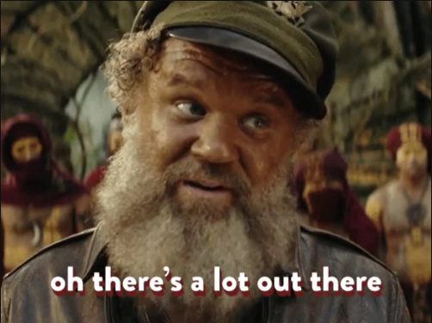
Moral Hazard in Health Care
  Main takeaway: moral hazard drives wedge between agents with private information
  What kinds of private information exist in health care?

Slide 17
Moral Hazard in Health Care
  Main takeaway: moral hazard drives wedge between agents with private information
  What kinds of private information exist in health care?
  When we talk about moral hazard in health care, though, we usually mean:
  Less about “effort” for health (although this exists)
  See Ehrlich and Becker (1972) for a model
Notes:
Insurance may reduce the investments from the Grossman model, as individuals don’t need to prevent the costs of lsos. But why doesn’t this make as much sense?

Slide 18
Moral Hazard in Health Care
  Main takeaway: moral hazard drives wedge between agents with private information
  What kinds of private information exist in health care?
  When we talk about moral hazard in health care, though, we usually mean:
  Less about “effort” for health (although this exists)
  More about price responsiveness arising from insurance
    Dates back to Arrow (1963): “The Welfare Economics of Medical Care”
    Most recently, refers to the price elasticity of demand for health care, conditional on underlying health status
    This affects price of services, optimal contract design, and level of utilization
Notes:
Each of these is covered by a paper in the folder.

Slide 19

Moral Hazard in Health Care
  Two types of moral hazard: ex-ante and ex-post
  Ex-ante moral hazard: behavior changes before an event happens
Notes:
Think back to lecture 1 – can we guess what these might be? Ex ante moral hazard is more effort based

Slide 20
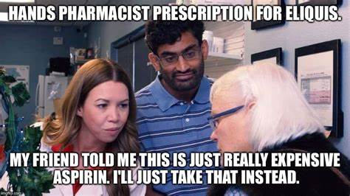
Moral Hazard in Health Care
  Two types of moral hazard: ex-ante and ex-post
  Ex-ante moral hazard: behavior changes before an event happens
  Ex-post moral hazard: behavior changes after an event happens
Notes:
If consumers don’t face the costs of medications, is this likely to happen? Ex-post moral hazard is more common and more about price responsiveness

Slide 21

Why is Moral Hazard Bad?
  Moral hazard creates a tradeoff between protecting against risk (which is good for risk averse people!) and optimal health behaviors (also good!)
  In short, moral hazard moves us away from a first best equilibrium
Notes:
Health insurance involves a fundamental tradeoff between risk spreading and appropriate incentives. Increasing the generosity of insurance spreads risk more broadly but also leads to increased losses because individuals choose more care (moral hazard) and providers supply more care (principal-agent problems).
Also: Optimal insurance plans would pay for treatment only if the individual would have chosen the same treatment had he borne the full bill. The thought experiment here is whether the person would pay for the medical expenditure in expectation, before he knew his condition. For example, suppose that a person has income of $25,000, and faces a 1 percent probability he will have a serious illness. If he could commit in advance, he would agree to receive $50,000 of medical care when sick in exchange for a $500 premium. If fully insured, however, the individual will choose to consume $60,000 of care. The moral hazard in this example is $10,000 – the additional spending beyond the optimal amount of care he would contract for in advance of being sick.

Slide 22
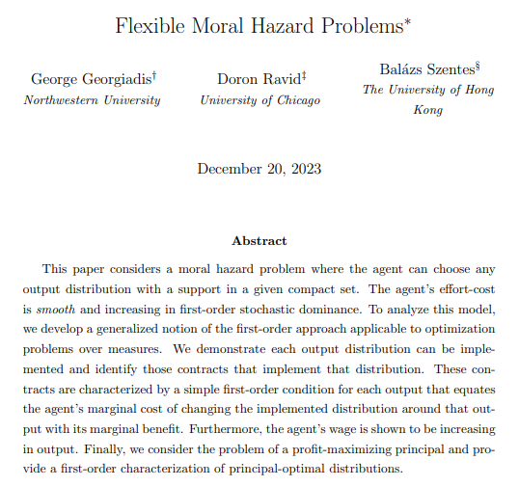
What links effort and marginal costs?
  Marginal costs and information both determine optimal contracts!
  What is the marginal cost of choosing the optimal distribution? Marginal benefit?
  How does insurance change this?

Slide 23
Zeckhauser (1970)
“Medical Insurance: A Case Study of the Tradeoff between Risk Spreading and Appropriate Incentives” Journal of Economic Theory

Slide 24

Model Setup
  Consumers have two states of the world: sick and healthy
  Assume that probability $p=Pr⁡(sick)$ is known
  There is a loss $s$ from sickness:
  $$𝔼\left[U\right]=\left(1−p\right)U\left(w\right)+pU\left(w−s\right)$$

Slide 25
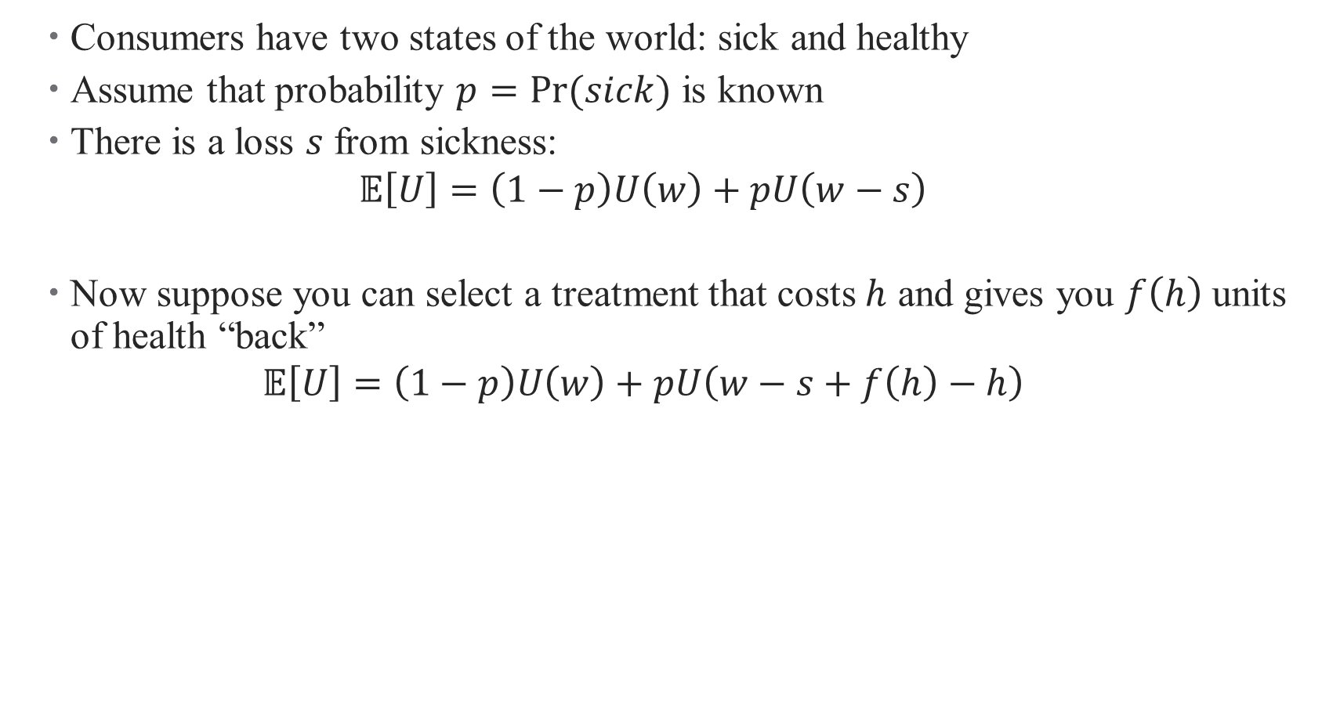
Model Setup
  Consumers have two states of the world: sick and healthy
  Assume that probability $p=Pr⁡(sick)$ is known
  There is a loss $s$ from sickness:
  $$𝔼\left[U\right]=\left(1−p\right)U\left(w\right)+pU\left(w−s\right)$$
  Now suppose you can select a treatment that costs $h$ and gives you $f\left(h\right)$ units of health “back”
  $$𝔼\left[U\right]=\left(1−p\right)U\left(w\right)+pU\left(w−s+f\left(h\right)−h\right)$$
Notes:
What would you do in the “ex-post” case (i.e., when you know you’re already sick)? Choose the level of h that maximizes the return f(h)-h. Call this h^* and note that it is a fixed number given f()

Slide 26

Model Setup
  Under insurance, consumers pay premium $π$ and receive $τ$ when they fall ill:
  $$𝔼\left[U\right]=\left(1−p\right)U\left(w−π\right)+pU\left(w−s−π+τ+f\left(h^{∗}\right)−h^{∗}\right)$$
  What is the optimal insurance (that is, relationship between $π, τ, p,$and $s$)?
Notes:
Note: Use a zero-profit condition for the insurer to identify the optimal relationship between tau and pi (that is, subject to pi = tau * p). Should get tau^* = s – f(h) + h and pi = tau* times p. Full insurance is optimal where the insurer pays for you to seek treatment h

Slide 27

Moral Hazard: What if illness is unverifiable?
  Now suppose states of the world aren’t known (e.g., lower back pain)
  Insurer sets up a contract where $τ=\left(1−θ\right)h$
  How do consumers choose $h^{∗}$?
Notes:
That is, now there is some coinsurance – the payment will cover a fraction of the cost of treatment

Slide 28




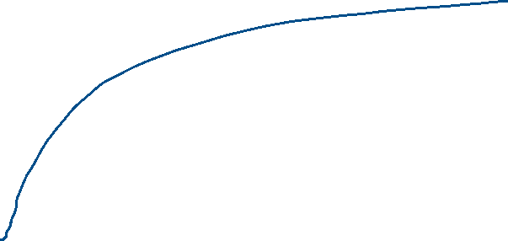




Moral Hazard: What if illness is unverifiable?
  Insurer sets up a contract where $τ=\left(1−θ\right)h$
  How do consumers choose $h^{∗}$? Now, $f^{′}\left(h^{∗}\right)=θ$
Notes:
The coinsurance rate determines treatment choices (note that h is verifiable, but s isn’t) – now h depends on coinsurance rate!. Figure goes here (when there is no coinsurance)

Slide 29
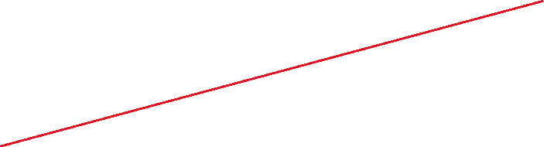

Moral Hazard: What if illness is unverifiable?
  Insurer sets up a contract where $τ=\left(1−θ\right)h$
  How do consumers choose $h^{∗}$? Now, $f^{′}\left(h^{∗}\right)=θ$
Notes:
Now coinsurance moves the ray towards the x-axis – take it up parallel and find the tangent point

Slide 30
Moral Hazard: What if illness is unverifiable?
  Insurer sets up a contract where $τ=\left(1−θ\right)h$
  How do consumers choose $h^{∗}$? Now, $f^{′}\left(h^{∗}\right)=θ$
Notes:
Now coinsurance moves the ray towards the x-axis – take it up parallel and find the tangent point

Slide 31





Moral Hazard: What if illness is unverifiable?
  Insurer sets up a contract where $τ=\left(1−θ\right)h$
  How do consumers choose $h^{∗}$? Now, $f^{′}\left(h^{∗}\right)=θ$
Notes:
As theta moves to 0 (meaning as consumers pay less and less for care), h star goes up! This is moral hazard: h’(theta) < 0.

Slide 32

Moral Hazard: What if illness is unverifiable?
  Now the insurer is choosing $π$ and $θ$ to maximize:
  $$\max_{π,θ} \left(1−p\right)U\left(w−π\right)+pU\left(w−π−s+f\left(h\left(θ\right)\right)−θh\left(θ\right)\right)$$
  $$s.t. π=p\left(1−θ\right)h(θ)$$
Notes:
Derive the first order conditions, say that full equilibrium is then derived in the paper. Add additional figures here.

Slide 33


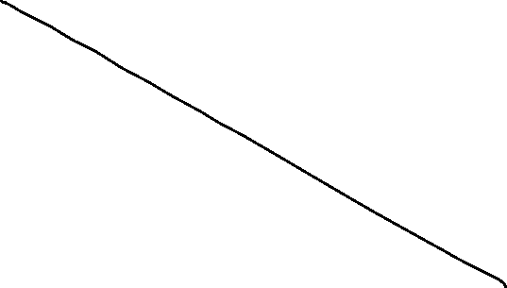

Moral Hazard: What if illness is unverifiable?
  Now the insurer is choosing $π$ and $θ$ to maximize:
  $$\max_{π,θ} \left(1−p\right)U\left(w−π\right)+pU\left(w−π−s+f\left(h\left(θ\right)\right)−θh\left(θ\right)\right) s.t. π=p\left(1−θ\right)h(θ)$$
Notes:
Deadweight loss from moral hazard lowering marginal costs of care

Slide 34

Moral Hazard: What if illness is unverifiable?
  Now the insurer is choosing $π$ and $θ$ to maximize:
  $$\max_{π,θ} \left(1−p\right)U\left(w−π\right)+pU\left(w−π−s+f\left(h\left(θ\right)\right)−θh\left(θ\right)\right) s.t. π=p\left(1−θ\right)h(θ)$$
Notes:
Deadweight loss from moral hazard lowering marginal costs of care

Slide 35




Moral Hazard: What if illness is unverifiable?
  Now the insurer is choosing $π$ and $θ$ to maximize:
  $$\max_{π,θ} \left(1−p\right)U\left(w−π\right)+pU\left(w−π−s+f\left(h\left(θ\right)\right)−θh\left(θ\right)\right) s.t. π=p\left(1−θ\right)h(θ)$$
Notes:
Deadweight loss from moral hazard lowering marginal costs of care

Slide 36

Key Takeaways
  There is a tradeoff between risk and inefficiency – the optimal $θ∈\left(0,1\right)$
Insurer
Moral hazard!
Provider
Consumer
Notes:
Derive the first order conditions, say that full equilibrium is then derived in the paper. Add additional figures here.

Slide 37
Model Evaluation
What is the contribution of the research overall?
How does the theoretical model fit into (1)?
Where is the model’s cleverness?
Where is the model lacking for me?
Notes:
This is a readings class, so we’ll be doing a deep dive into each model.

Slide 38

Loss from Moral Hazard: Individual
  To quantify loss, compare equilibrium across case where illness is verifiable and case where it is private information
  Let’s move to a continuous setup to see this more cleanly:
  Case 1:
  $$\max_{m\left(s\right)}{∫U\left[y−π−c\left(m\left(s\right)\right),H(s,m)\right]f\left(s\right)ds}$$
  The first order condition (with respect to what?) is
Notes:
Utility depends on income premium, cost of health care, and your own health. Now s is a continuous variable for health state, and consumers choose a function m(s)

Slide 39

Loss from Moral Hazard: Individual
  To quantify loss, compare equilibrium across case where illness is verifiable and case where it is private information
  Let’s move to a continuous setup to see this more cleanly:
  Case 1:
  $$\max_{m\left(s\right)}{∫U\left[y−π−c\left(m\left(s\right)\right),H(s,m)\right]f\left(s\right)ds}$$
  The first order condition (with respect to what?) is
  $$H_{m}U_{H}=𝔼[U_{y−π−c\left(m\left(s\right)\right)}]$$
  How do we interpret this?
Notes:
Gain in utility from spending an additional dollar on health production (think Grossman!) against the weighted average expenditure of consumption in different illness states (think Grossman again)!

Slide 40
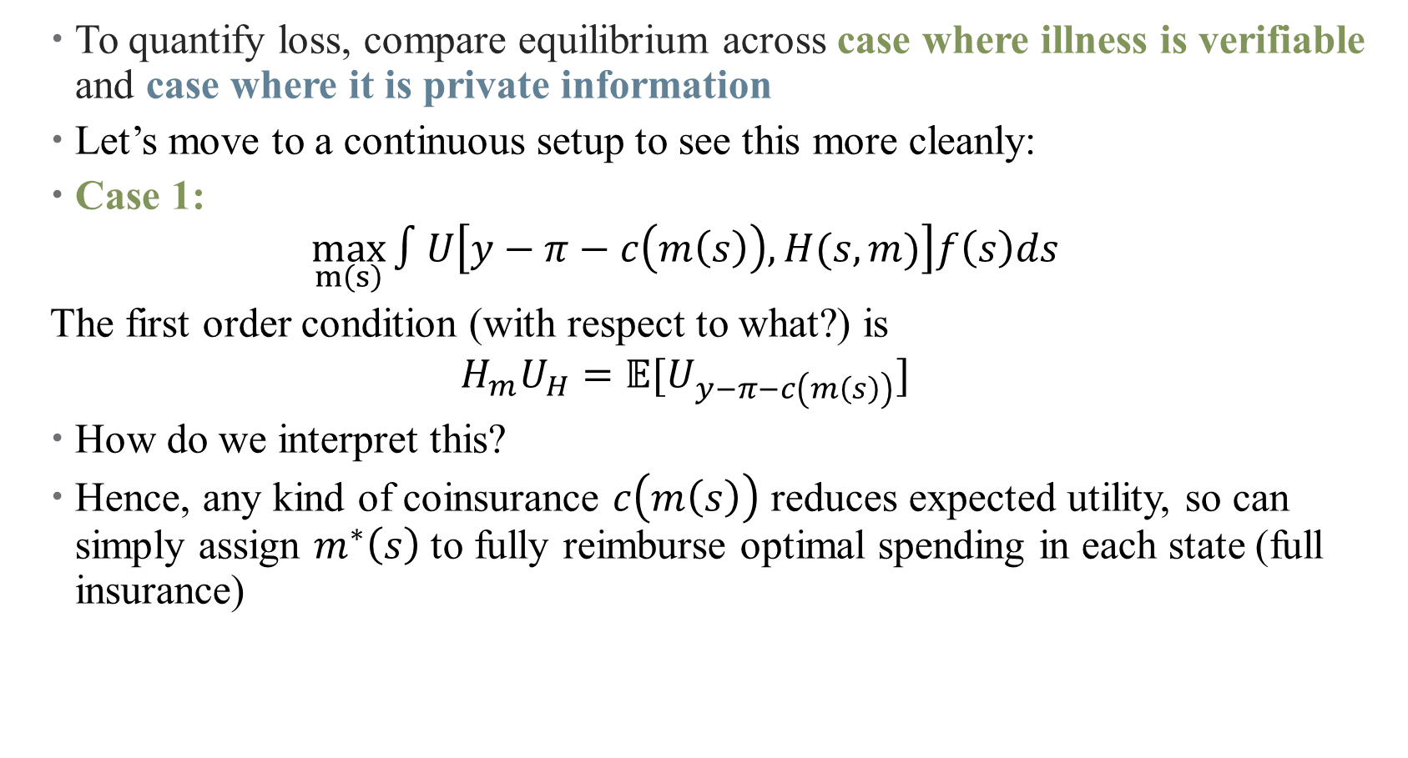
Loss from Moral Hazard: Individual
  To quantify loss, compare equilibrium across case where illness is verifiable and case where it is private information
  Let’s move to a continuous setup to see this more cleanly:
  Case 1:
  $$\max_{m\left(s\right)}{∫U\left[y−π−c\left(m\left(s\right)\right),H(s,m)\right]f\left(s\right)ds}$$
  The first order condition (with respect to what?) is
  $$H_{m}U_{H}=𝔼[U_{y−π−c\left(m\left(s\right)\right)}]$$
  How do we interpret this?
  Hence, any kind of coinsurance $c\left(m\left(s\right)\right)$ reduces expected utility, so can simply assign $m^{∗}\left(s\right)$ to fully reimburse optimal spending in each state (full insurance)

Slide 41
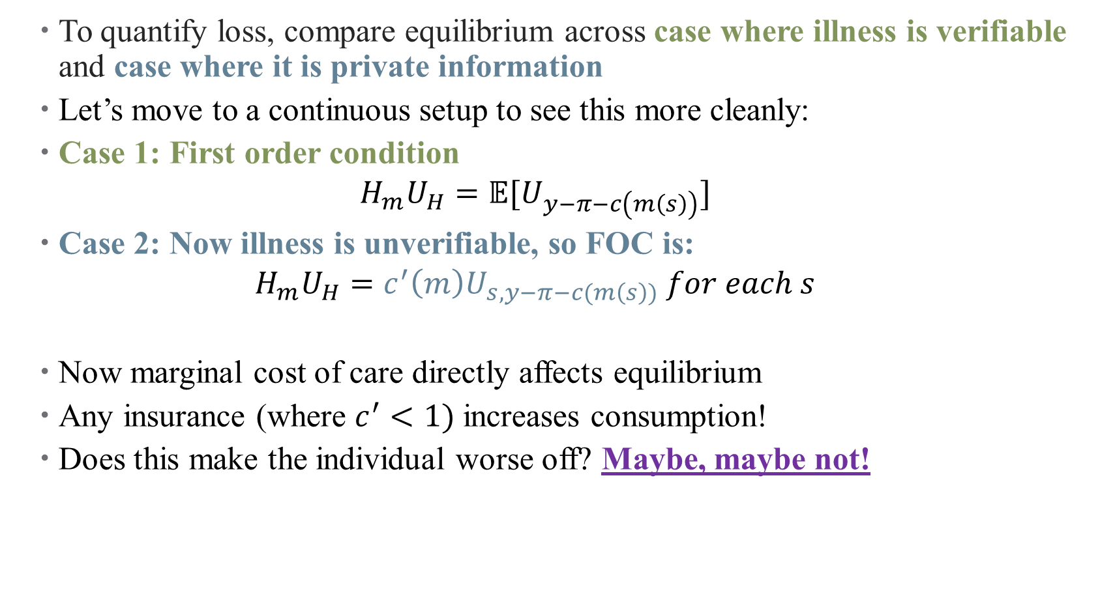
Loss from Moral Hazard: Individual
  To quantify loss, compare equilibrium across case where illness is verifiable and case where it is private information
  Let’s move to a continuous setup to see this more cleanly:
  Case 1: First order condition
  $$H_{m}U_{H}=𝔼[U_{y−π−c\left(m\left(s\right)\right)}]$$
  Case 2: Now illness is unverifiable, so FOC is:
  $$H_{m}U_{H}=c^{′}\left(m\right)U_{s,y−π−c(m\left(s\right))} for each s$$
  Now marginal cost of care directly affects equilibrium
  Any insurance (where $c^{′}<1)$ increases consumption!
  Does this make the individual worse off? Maybe, maybe not!
Notes:
Think about the tradeoff between lower prices and over-consumption. Is it gonna kill me to have an extra preventive screening? Maybe not. Is it gonna harm me to have to ration care because its expensive? Almost certainly!

Slide 42
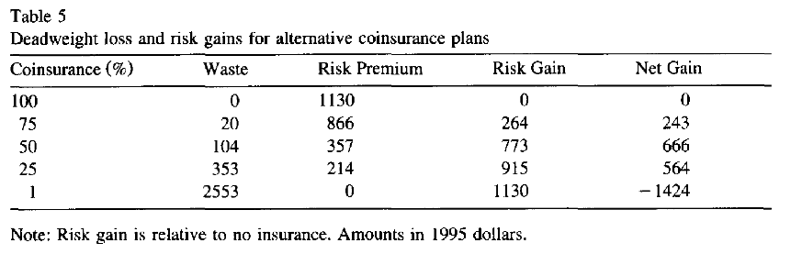
Loss from Moral Hazard: Social
  There is a tradeoff between risk protection and moral hazard
  More you try to protect, more people will over-consume!
  Source: Manning & Marquis (1996, JHE)
Notes:
Look at Kowalski (2015, nonlinear budget set JMP) if you want more details here.

Slide 43
(Some) Empirical Evidence

Slide 44
Other Key Takeaways
  Hence, existence, magnitude, and nature of moral hazard response is a key input into optimal design of insurance
  Could high health spending be reduced through consumer cost sharing?
    High-deductible health plans
    Managed care
  Are there other (more Canadian) ways to reduce over-consumption?
Notes:
Essentially, demand for health services is endogenous – change prices, you change demand. Makes policy evaluation tricky!

Slide 45
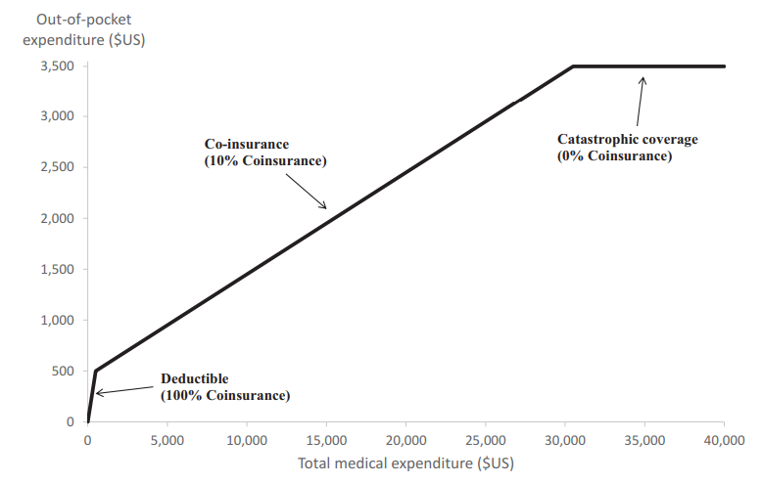
Ways to Combat Moral Hazard
  Managed care
  Adjusted insurance contracts
Notes:
Wonky contracts aim to balance risk spreading against increased utilization. This is what most contracts look like.

Slide 46
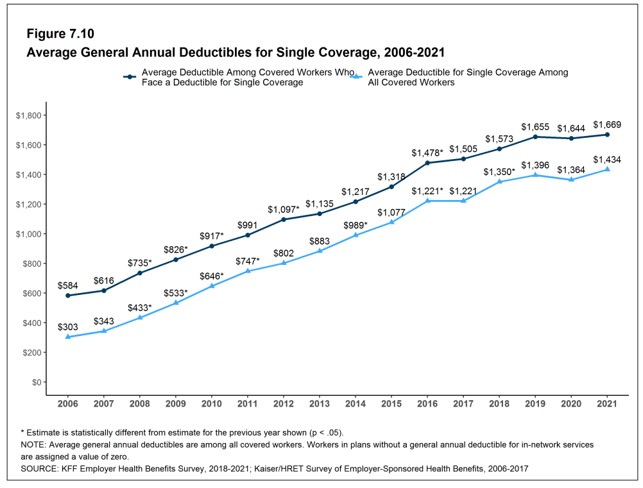
Cost-Sharing in Practice
  It’s complicated
  Canada: “first-dollar” coverage is prohibited by law for most services
  US: cost-sharing is on the rise
  What’s the tradeoff?
  Source: https://files.kff.org/attachment/Report-Employer-Health-Benefits-2021-Annual-Survey.pdf
Notes:
Canada: the absence of any charge for publicly insured health care services at the point of consumption. This feature is mandated by the Canada Health Act along with a prohibition on extra-billing by health care providers. Are there problems with this? Canadians don’t even see their bills! What’s the tradeoff with the US?

Slide 47
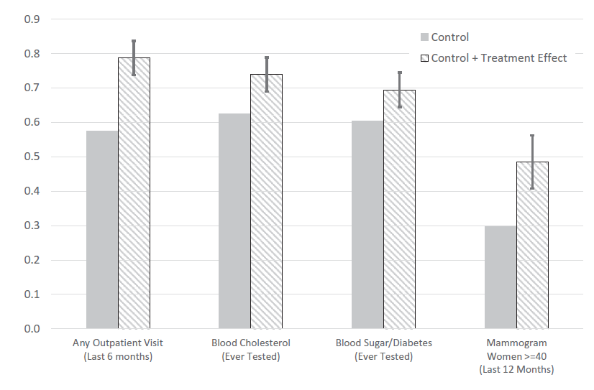
Insurance Increases Takeup
Source: Einav and Finkelstein (2018)
Notes:
OHE. Empirical evidence of moral hazard? Have to think carefully about identification

Slide 48
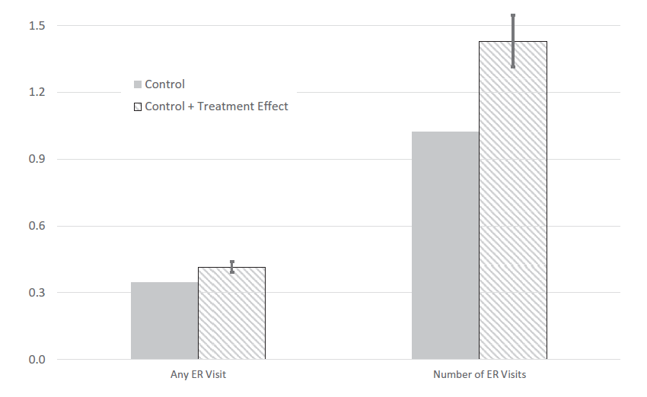
Insurance Increases Takeup…but Margins Matter!
Source: Einav and Finkelstein (2018)
Notes:
Oregon Health Experiment .Empirical evidence of moral hazard? Have to think carefully about identification

Slide 49
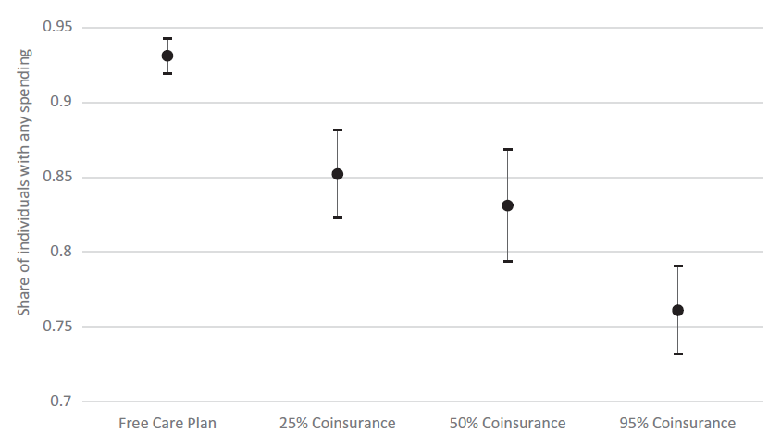
Insurance Increases Takeup…but Margins Matter!
Source: Einav and Finkelstein (2018)
Notes:
RAND Health Experiment. What does this imply about welfare costs? What do we need for our model to think about these tradeoffs? Think about what this might look like in a Canadian context?

Slide 50
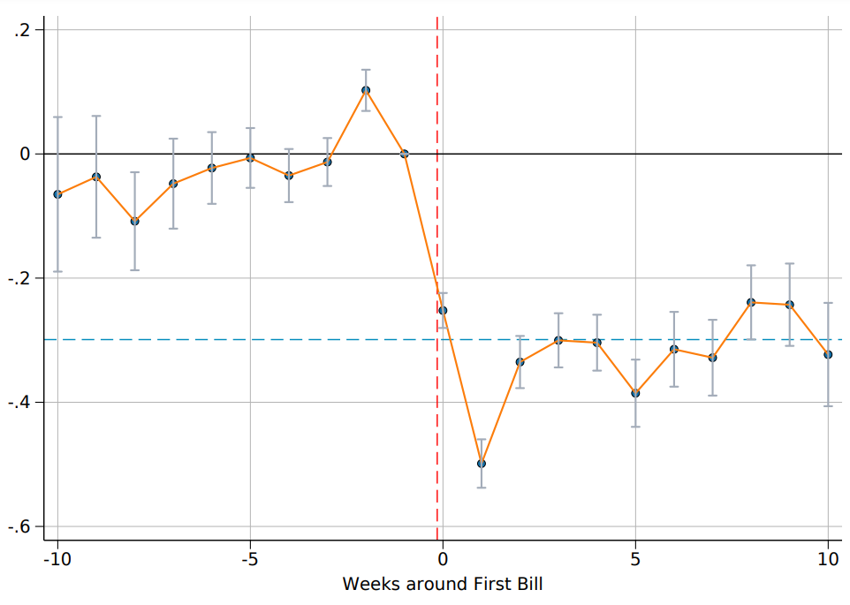
Some other evidence (Anderson et al., 2024)
Source: Anderson, Hoagland, and Zhu (2024 J Public Economics)

Slide 51
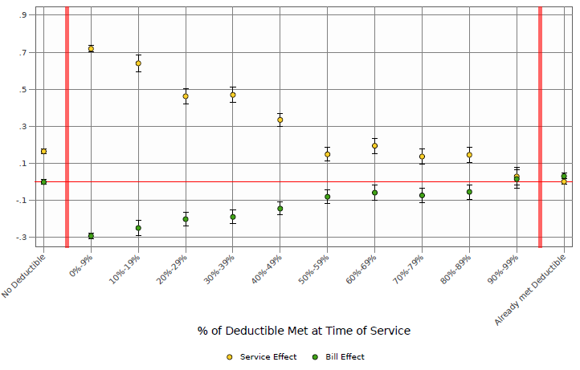
Some other evidence (Anderson et al., 2024)
Source: Anderson, Hoagland, and Zhu (2024 J Public Economics)

Slide 52
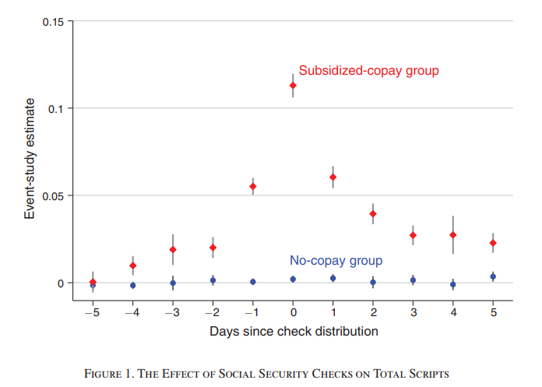
Some other evidence (Gross et al., 2022)
Source: Gross, Layton, and Prinz (AER: Insights 2022)
Notes:
Moral hazard is directly tied to liquidity and income constraints!

Slide 53
Health Costs of Cost-Sharing (or Rationing?)
What happens when patients suddenly stop their medications?
Paper studies health consequences of drug interruptions caused by “large, abrupt, and arbitrary changes in price.”
Identification strategy: donut hole and birth month (what’s the research design?).
  “A nonlinear contract structure causes drug prices to vary by birth month for enrollees in their first year of coverage.”
  “Critically, however, the cap is not prorated, giving all enrollees the same “pre-donut budget” whether they enroll early or late in the year. By the time a later enrollee spends her first dollar, an earlier enrollee has been spending down her budget for months, approaching the donut hole. Because Part D eligibility begins in the month someone turns 65, birth month generates exogenous budget variation in the first year of enrollment.”
“Those facing smaller budgets consume fewer drugs and die more: mortality increases 0.0164 percentage points per month (13.9%) for each $100 per month budget decrease (24.4%).”
  Patients stop taking drugs that are both high value and suspected to cause life-threatening withdrawal syndromes when stopped.
  Using machine learning, we identify patients at the highest risk of drug-preventable adverse events. Contrary to the predictions of standard economic models, high-risk patients (e.g., those most likely to have a heart attack) cut back more than low-risk patients on exactly those drugs that would benefit them the most (e.g., statins).
  Finally, patients appear unaware of these risks.
Source: Chandra, Flack, Obermeyer (2024 QJE)
Notes:
There are potential health effects of moral hazard (would be interesting to study this in Canada as well through rationing – very open to chatting more about this!)

Slide 54
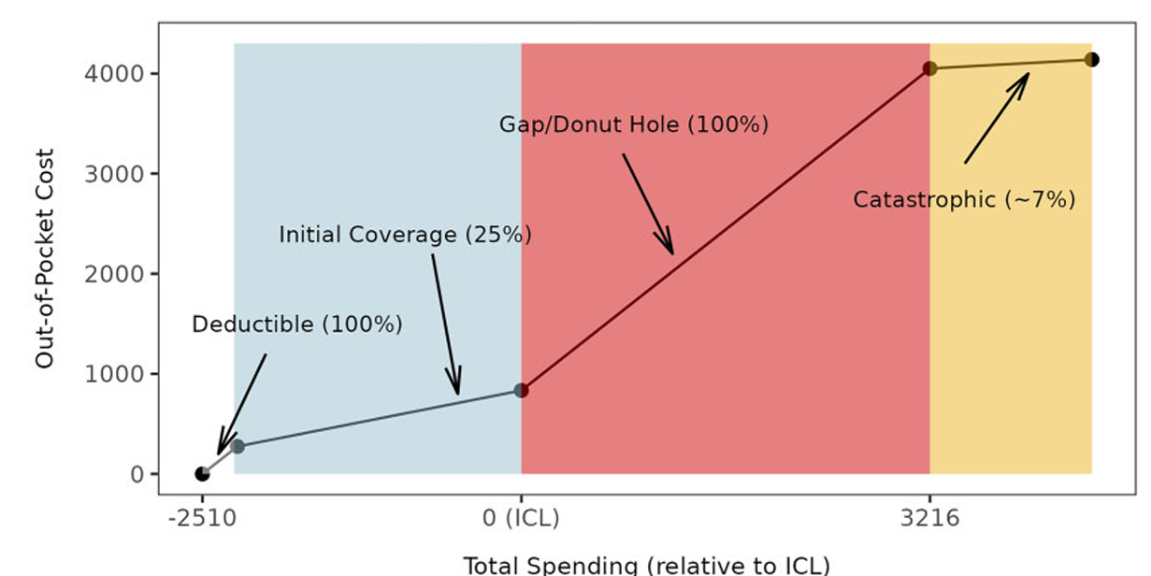
Health Costs of Cost-Sharing (or Rationing?)
Source: Chandra, Flack, Obermeyer (2024 QJE)
Notes:
Use birth month as an IV here.

Slide 55
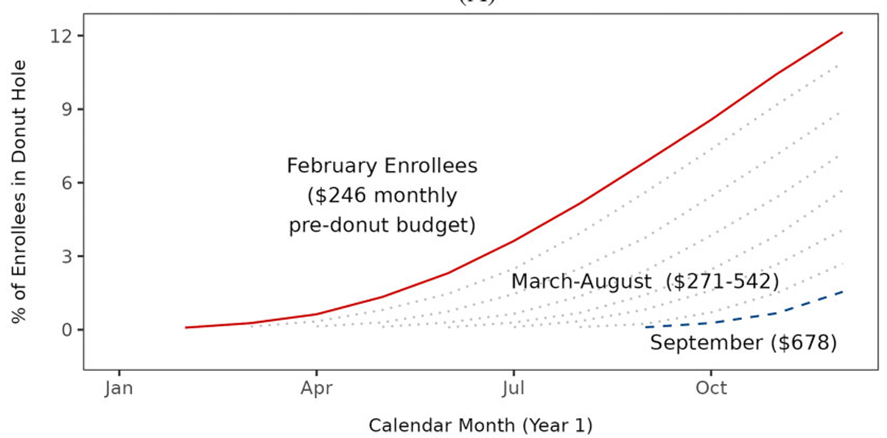
Health Costs of Cost-Sharing (or Rationing?)
Source: Chandra, Flack, Obermeyer (2024 QJE)
Notes:
Use birth month as an IV here. Nice evidence of first stage?

Slide 56
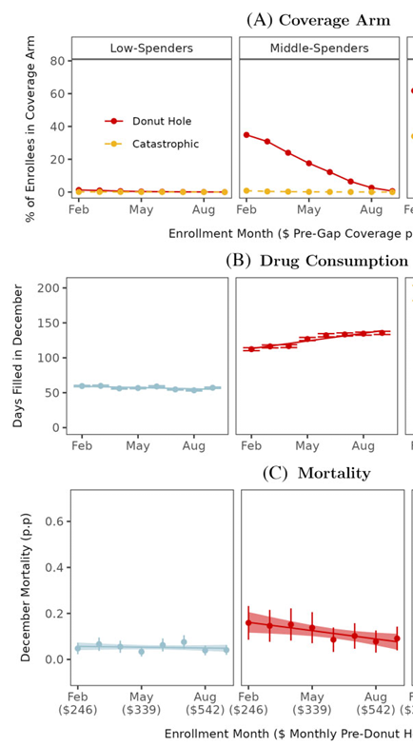
Health Costs of Cost-Sharing (or Rationing?)
Source: Chandra, Flack, Obermeyer (2024 QJE)
Notes:
Results shown graphically – the first column has flat lines (no effect of birth month on outcomes). The middle column is the main result – later enrollment means (lower prices) means more consumption and lower mortality. Among high-spenders, there’s some weirdness going on – look into the paper for more of that

Slide 57
Other Key Takeaways
  Hence, existence, magnitude, and nature of moral hazard response is a key input into optimal design of insurance
  Could high health spending be reduced through consumer cost sharing?
    High-deductible health plans
    Managed care
  For a summary of empirical work, see Einav and Finkelstein (2014)
    Demand for health care is elastic
    Individuals are overly-sensitive to current prices
    Deductibles and other cost-sharing incentives don’t do much!
    Behavioral responses may complicate this! (e.g., if patients don’t know prices)

Slide 58
Some concerns with moral hazard
  Are consumers forward-looking? Shouldn’t they be?
    Mixed evidence here – best summary is (Hong and Mommaerts, 2022)
Notes:
Just has a few paragraphs in intro but covers many papers here.

Slide 59

Some concerns with moral hazard
  Are consumers forward-looking? Shouldn’t they be?
    Mixed evidence here
  Who is the principal, and who is the agent?
    Do patients really know best? Are insurers the “agents”? How do we navigate three-way relationships?

Slide 60
Some concerns with moral hazard
  Are consumers forward-looking? Shouldn’t they be?
    Mixed evidence here
  Who is the principal, and who is the agent?
    Do patients really know best? Are insurers the “agents”? How do we navigate three-way relationships?
Symptomatic of larger question: how is the model useful, and where is it not?
Notes:
Question we should be asking ourselves all the time in this course. All model are wrong some are useful. Other questions: what about value of services? Are prices/insurance tied to value?

Slide 61
Presentations
Notes:
Add slides on Einav et al here. (gets us to empirics)

Slide 62
Summary
Prices matter for demand (lol)!
If you mess with prices, you increase risk protection, but do so at the risk of increasing unnecessary consumption of services?
Next time: adverse selection
What happens when people have private information about type?
How does this affect health choices?

