Slide 1
Advanced Health Economics
Lecture 3: Adverse Selection
January 24, 2024
HAD 6750 • Alex Hoagland, Ph.D.
Notes:
Case study: https://www.axios.com/2024/01/05/america-generic-drug-shortage-reasons?utm_source=newsletter&utm_medium=email&utm_campaign=newsletter_axiosvitals&stream=top

Slide 2
Last time: Moral Hazard
Moral hazard in health care
Do people exert effort to preserve health?
Do people “consume more health care” when they are insured?
How can elastic demand be curbed?

Slide 3
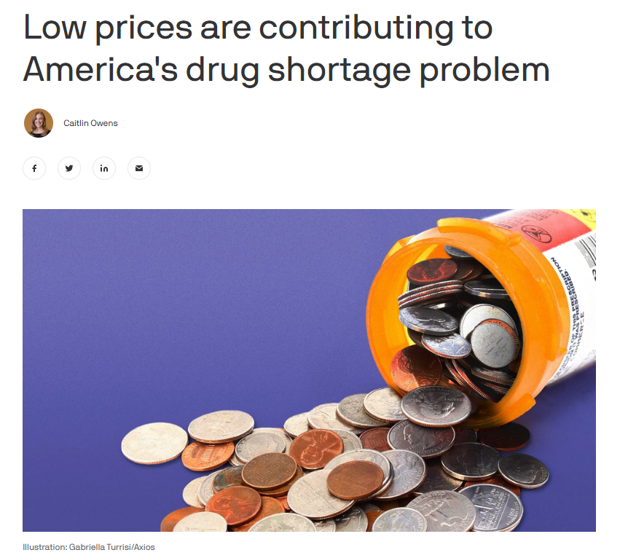
Last time: Moral Hazard
Notes:
Shortages of lifesaving cancer drugs, children's Tylenol and ADHD drugs have made headlines over the last year.

Slide 4
Last time: Moral Hazard
Moral hazard in health care
Do people exert effort to preserve health?
Do people “consume more health care” when they are insured?
How can elastic demand be curbed?
What happens when people have private information about type?
How does this affect health choices?
This time: Adverse Selection

Slide 5
What is Adverse Selection?
Another form of asymmetric information
Moral hazard was a form of “hidden action”
Adverse selection is a form of “hidden type”
Notes:
Do we remember what AI is?

Slide 6
What is Adverse Selection?
Another form of asymmetric information
Moral hazard was a form of “hidden action”
Adverse selection is a form of “hidden type”
Think about the market for health insurance
Who would have the greatest demand for protection?
Who do insurers/regulators/government want to be insured the most?
Notes:
Note: answers differ for each of these!

Slide 7
What is Adverse Selection?
Another form of asymmetric information
Moral hazard was a form of “hidden action”
Adverse selection is a form of “hidden type”
Think about the market for health insurance
Who would have the greatest demand for protection?
Who do insurers/regulators/government want to be insured the most?
Adverse Selection threatens markets
If I can keep my risk hidden, can I get better outcomes?
Can people find out my risk?
Equilibria are distorted (pooling versus screening equilibria)
Notes:
Note: answers differ for each of these! One minute video: https://www.youtube.com/watch?app=desktop&v=tyzf3T2LASs&autoplay=1&ab_channel=OneMinuteEconomics

Slide 8
Akerlof’s Market for Lemons
We are looking to buy a used car
Assumption 1: Heterogeneity in car quality
Car valuation v is distributed uniformly on interval [$1,000, $9,000]
Assumption 2: Car sellers know valuation
Assumption 3: Car quality is unknown to buyer
Notes:
Classic paper – nobel prize winning, < 15 pages.

Slide 9

Akerlof’s Market for Lemons
We are looking to buy a used car
Assumption 1: Heterogeneity in car quality
Car valuation v is distributed uniformly on interval [$1,000, $9,000]
Assumption 2: Car sellers know valuation
Assumption 3: Car quality is unknown to buyer
Information asymmetry
Notes:
One minute video: https://www.youtube.com/watch?app=desktop&v=tyzf3T2LASs&autoplay=1&ab_channel=OneMinuteEconomics

Slide 10
Akerlof’s Market for Lemons
We are looking to buy a used car
Assumption 1: Heterogeneity in car quality
Car valuation v is distributed uniformly on interval [$1,000, $9,000]
Assumption 2: Car sellers know valuation
Assumption 3: Car quality is unknown to buyer
Information asymmetry
What will be the equilibrium price / quantity of cars sold in this market?
Notes:
One minute video: https://www.youtube.com/watch?app=desktop&v=tyzf3T2LASs&autoplay=1&ab_channel=OneMinuteEconomics

Slide 11
Akerlof’s Model: Solution
What is the expected value to a buyer from buying a car?

Slide 12
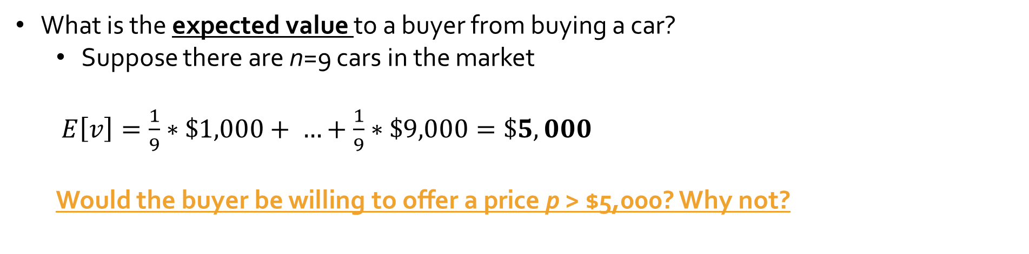
Akerlof’s Model: Solution
What is the expected value to a buyer from buying a car?
Suppose there are n=9 cars in the market
$E\left[v\right]=\frac{1}{9}∗\$1,000+ …+\frac{1}{9}∗\$9,000=\$5,000$
Would the buyer be willing to offer a price p > $5,000? Why not?

Slide 13
Akerlof’s Model: Solution
What is the expected value to a buyer from buying a car?
Suppose there are n=9 cars in the market
$E\left[v\right]=\frac{1}{9}∗\$1,000+ …+\frac{1}{9}∗\$9,000=\$5,000$
Would the buyer be willing to offer a price p > $5,000? Why not?
But remember that the sellers know their car’s value!
Which sellers would accept a price p = $5,000?

Slide 14
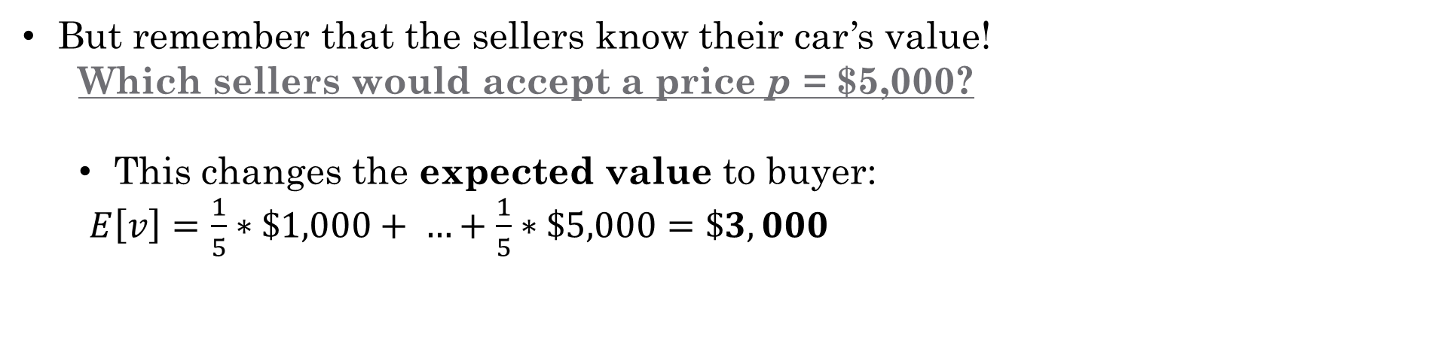
Akerlof’s Model: Solution
What is the expected value to a buyer from buying a car?
Suppose there are n=9 cars in the market
$E\left[v\right]=\frac{1}{9}∗\$1,000+ …+\frac{1}{9}∗\$9,000=\$5,000$
Would the buyer be willing to offer a price p > $5,000? Why not?
But remember that the sellers know their car’s value!
Which sellers would accept a price p = $5,000?
This changes the expected value to buyer:
$E\left[v\right]=\frac{1}{5}∗\$1,000+ …+\frac{1}{5}∗\$5,000=\$3,000$

Slide 15
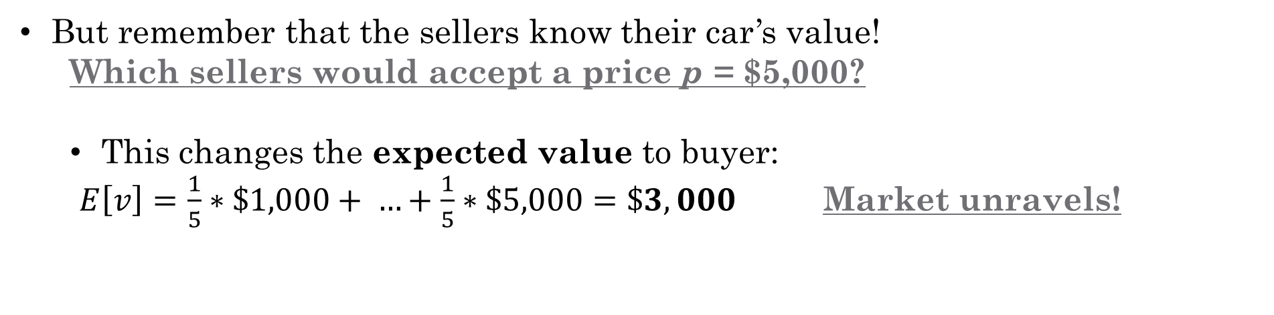
Akerlof’s Model: Solution
What is the expected value to a buyer from buying a car?
Suppose there are n=9 cars in the market
$E\left[v\right]=\frac{1}{9}∗\$1,000+ …+\frac{1}{9}∗\$9,000=\$5,000$
Would the buyer be willing to offer a price p > $5,000? Why not?
But remember that the sellers know their car’s value!
Which sellers would accept a price p = $5,000?
This changes the expected value to buyer:
$E\left[v\right]=\frac{1}{5}∗\$1,000+ …+\frac{1}{5}∗\$5,000=\$3,000$ Market unravels!

Slide 16
Adverse Selection in Health Care
What is the hidden information?

Slide 17
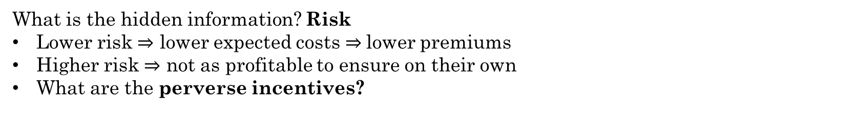
Adverse Selection in Health Care
What is the hidden information? Risk
Lower risk $⇒$ lower expected costs $⇒$lower premiums
Higher risk $⇒$ not as profitable to ensure on their own
What are the perverse incentives?

Slide 18
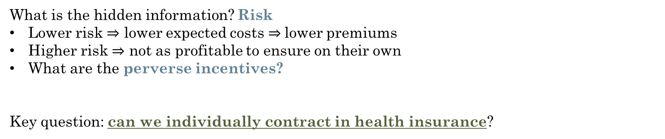
Adverse Selection in Health Care
What is the hidden information? Risk
Lower risk $⇒$ lower expected costs $⇒$lower premiums
Higher risk $⇒$ not as profitable to ensure on their own
What are the perverse incentives?
Key question: can we individually contract in health insurance?

Slide 19
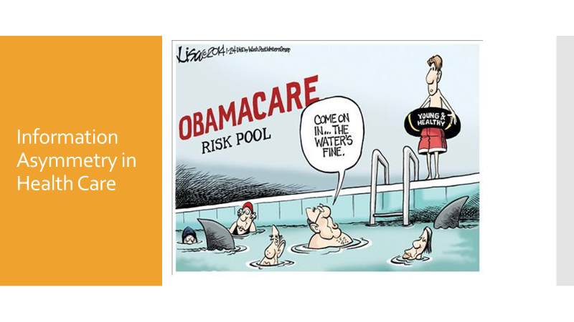
Adverse Selection in Health Care

Slide 20
Rothschild & Stiglitz (1976)
“Equilibrium in competitive insurance markets: an essay on the economics of imperfect information” Quarterly Journal of Economics

Slide 21
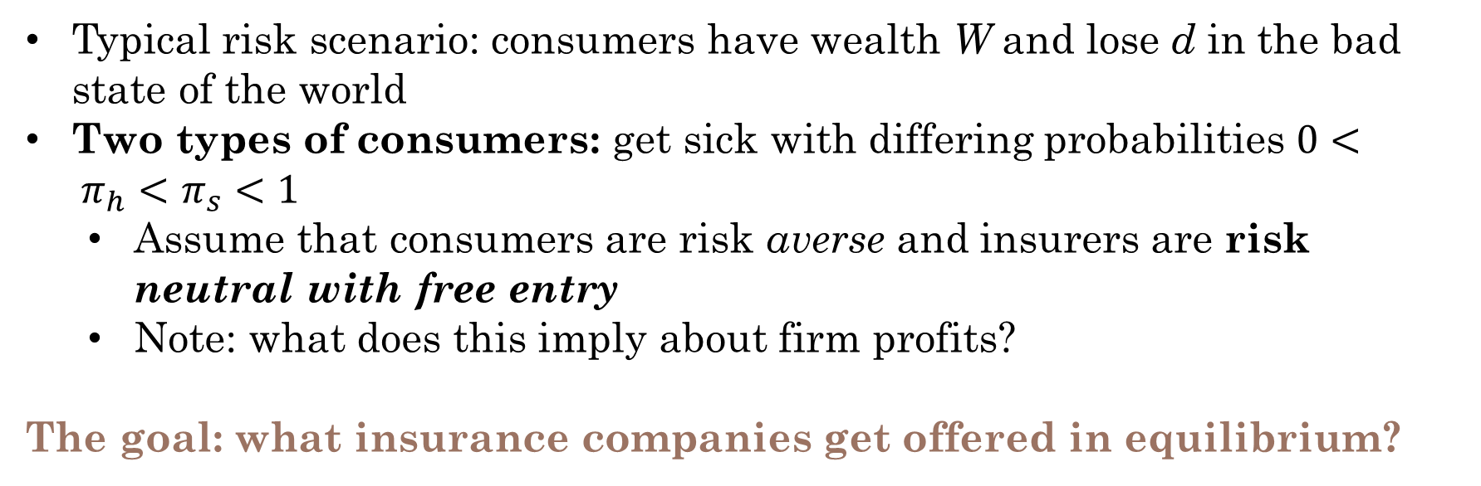
Information Asymmetry in Insurance
Typical risk scenario: consumers have wealth W and lose d in the bad state of the world
Two types of consumers: get sick with differing probabilities $0< π_{h}<π_{s}<1$
Assume that consumers are risk averse and insurers are risk neutral with free entry
Note: what does this imply about firm profits?
The goal: what insurance companies get offered in equilibrium?
Notes:
Quick digression: what are our equilibrium conditions? (1) No contract makes less than 0 in E(pi), and (2) No contract has positive profit in E(pi)

Slide 22
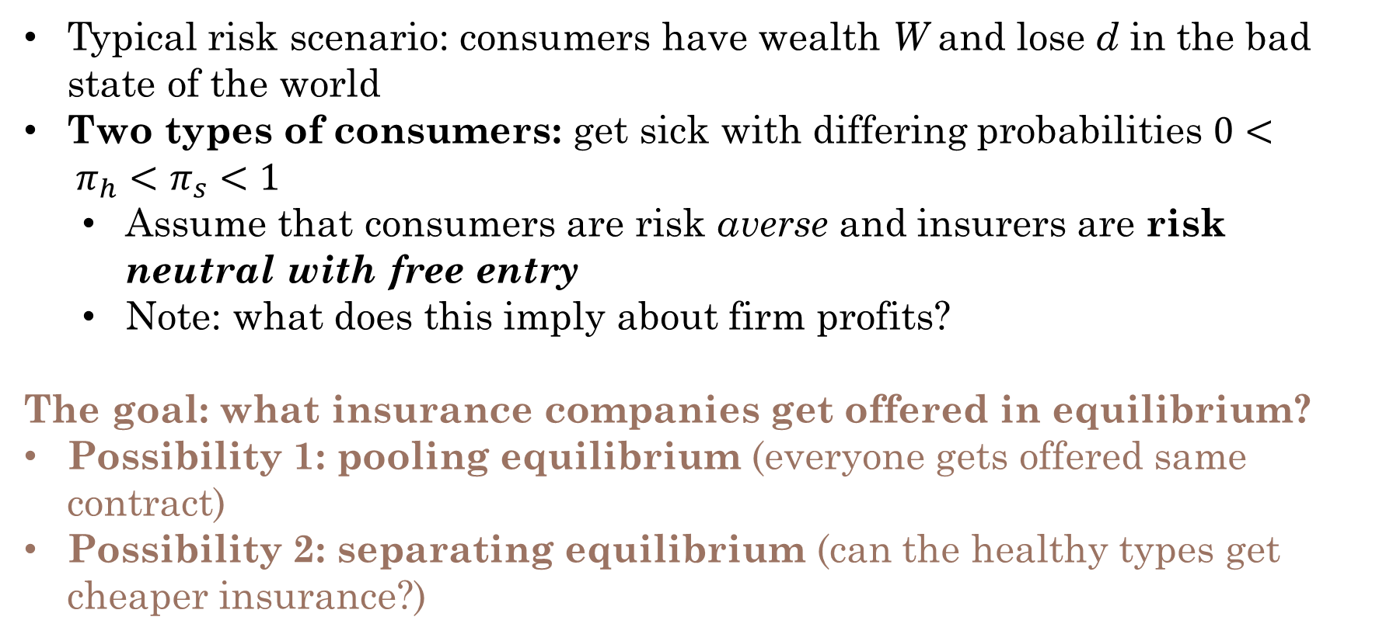
Information Asymmetry in Insurance
Typical risk scenario: consumers have wealth W and lose d in the bad state of the world
Two types of consumers: get sick with differing probabilities $0< π_{h}<π_{s}<1$
Assume that consumers are risk averse and insurers are risk neutral with free entry
Note: what does this imply about firm profits?
The goal: what insurance companies get offered in equilibrium?
Possibility 1: pooling equilibrium (everyone gets offered same contract)
Possibility 2: separating equilibrium (can the healthy types get cheaper insurance?)

Slide 23
Case 1: What would happen with full information?
What contracts would be offered if information could not be hidden?
Notes:
Under full information, consumers get charged a premium equal to their expected loss, which is type specific. Separating equilibrium (show this on board)

Slide 24
Case 2: Separating Equilibrium?
What contracts would be offered if information could not be hidden?
Now, what happens when information is hidden? Can we preserve the separating equilibrium?
Notes:
Show that the screening equilibrium works, but needs to be adjusted apart (pictures, then math?)

Slide 25
Case 2: Pooling Equilibrium?
What contracts would be offered if information could not be hidden?
Now, what happens when information is hidden? Can we preserve the separating equilibrium?
What is the next best option?
Notes:
Show graphical illustration for pooling equilibrium. Discuss takeaways for each type (low type is fine, high type is worse off)

Slide 26
Rothschild and Stiglitz (1976): Takeaways
The presence of hidden risk information makes markets unstable
Consider extending this model:
Continuum of consumers
Barriers to entry for insurers
Multidimensional risk
Each of these may make the insurance market more unstable!
So what can we do in practice?
Notes:
Briefly talk about the ACA.

Slide 27
Mini Referee Report
What do you think about these papers?
Any concerns?
Anything clever?
What would you extend?
Notes:
Akerlof -> RS gives us individual decisions in health. What would be interesting is: what about markets?

Slide 28
Einav & Finkelstein (2011)
“Selection in Insurance Markets: Theory and Empirics in Pictures”
Journal of Economic Perspectives.

Slide 29
Main Paper Goals
Graphical framework for selection in insurance markets
Basic theory + welfare implications

Slide 30
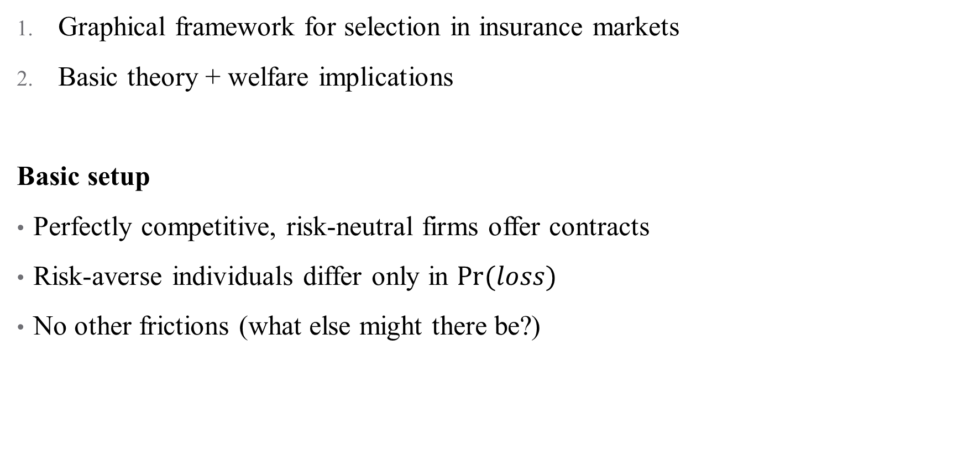
Main Paper Goals
Graphical framework for selection in insurance markets
Basic theory + welfare implications
Basic setup
Perfectly competitive, risk-neutral firms offer contracts
Risk-averse individuals differ only in $Pr⁡(loss)$
No other frictions (what else might there be?)
Notes:
How believable are these assumptions? How are they similar/different to what we read above? Other frictions include administrative costs, processing claims costs (insurer overhead), wait times to seek care, etc.

Slide 31
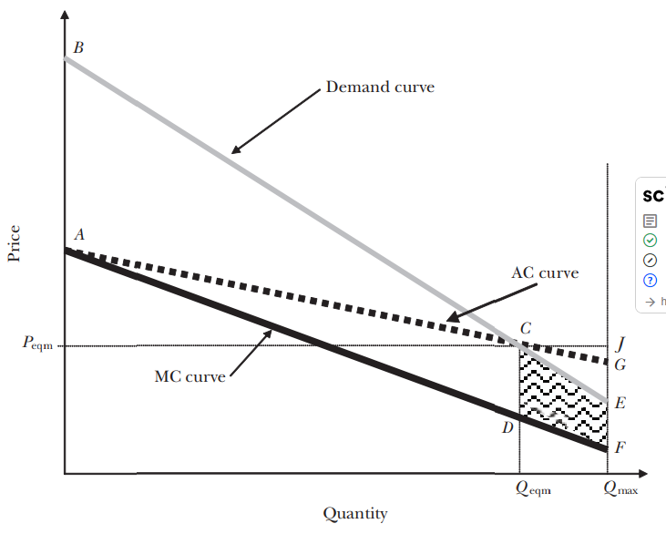
Adverse Selection in the Textbook Setting
Notes:
Let’s talk about this in pieces: (1) demand curve just shows WTP of consumers to buy/not buy the contract – so it slopes down (lower price, more people buy).
(2) MC captures individual variation in risk – for some individuals, MC of insurance is high (those with the highest WTP for insurance). Hence, it’s downward sloping – this is adverse selection (the most expensive people to cover are also those that want insurance the most)
(3) Difference between 1 and 2 is the risk premium (since all individuals are risk averse, this is always positive) – hence D > MC always
(4) Now the (pooled) equilibrium: one price set where D = AC (for risk-neutral insurers, ZPC). AC is the average cost of all enrollees up to that point.
(5) This is the eqbm, but the efficient allocation would be where D = MC – this isn’t possible because firms wouldn’t break even.
(6) DWL is identified as the difference in surplus between these two allocations

Slide 32
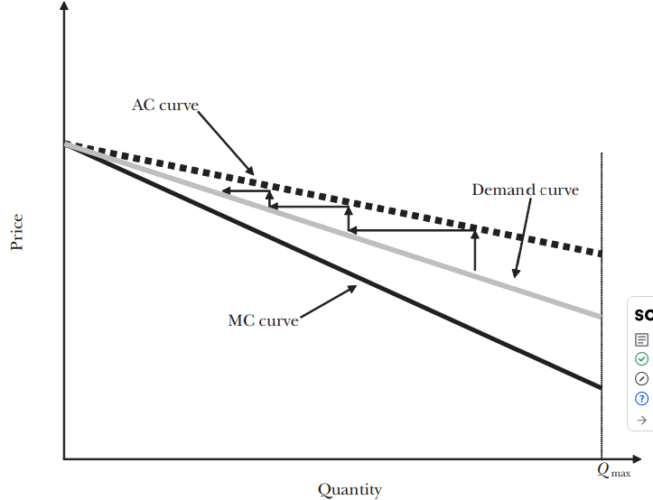
How might this lead to unravelling?
Notes:
Here, the AC curve always lies above the demand curve even though the MC curve is always below it. As a result, the competitive equilibrium is that no individual in the market is insured, while the efficient outcome is for everyone to have insurance.
Death spiral: if insurance pricing is naively set but dynamically adjusted to reflect AC from previous period the market will gradually shrink until it completely disappears.

Slide 33
What does this figure get us?
Help us look at policy options:
What happens if we mandate insurance coverage?
Notes:
Why is modeling in this way helpful? Mandating insurance coverage will achieve the efficient outcome, but will hurt insurers in different ways depending on the market (complete unraveling, welfare loss in F1)

Slide 34
What does this figure get us?
Help us look at policy options:
What happens if we mandate insurance coverage?
What happens if we subsidize coverage?
What happens if we stratify pricing based on groups (how would you model a separating equilibrium?)
Notes:
This would shift demand out, reducing under-insurance (could calculate this in a P-set). Could even give a large enough subsidy to get everyone insured. Separating equilibrium would be multiple graphs

Slide 35
What does this figure get us?
Help us look at policy options:
What happens if we mandate insurance coverage?
What happens if we subsidize coverage?
What happens if we stratify pricing based on groups (how would you model a separating equilibrium?)
Allow us to “strategically complicate” based on our setting:
Administrative costs of insurance
Preference heterogeneity
Others?
Notes:
We might want to add “some” features of reality but not all of them to handle our unique case.

Slide 36
Example: Advantageous Selection
Suppose we think that people differ not just in risk but in risk aversion
Classic models don’t allow for preference heterogeneity (difficult to incorporate!)
But there’s recent work showing heterogeneity is rampant:
Automobile (Cohen and Einav, 2007), reverse mortgages (Davidoff and Welke, 2007), health (Fang, Keane, and Silverman, 2008), LTC (Finkelstein and McGarry, 2006)
One central question: could this result in advantageous selection?
Notes:
Could it be the case tha twe actually get the most lucrative people (lowest risk, highest risk aversion) to buy insurance?

Slide 37
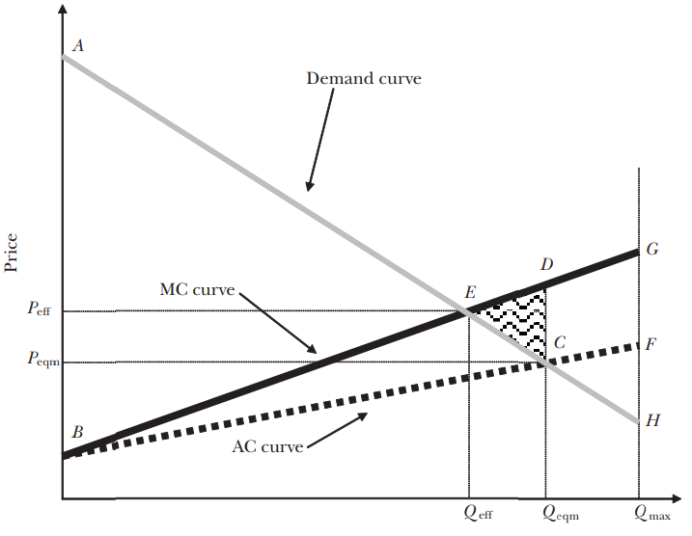
Advantageous Selection in This Framework
Notes:
If high-risk individuals are less risk averse and heterogeneity in risk aversion is sufficiently large, we may get this! How does this differ from previous framework? MC is upward sloping because of advantageous selection and this makes AC also upward sloping. Without loading costs, we would get optimal outcome – frictions may even lead to over-insurance depicted here.

Slide 38
What does this framework get us?
Help us look at policy options:
Allow us to “strategically complicate” based on our setting
Visually depict empirical tests for selection (including assumptions)
What are some issues?
Notes:
We might want to add “some” features of reality but not all of them to handle our unique case.

Slide 39
What does this framework get us?
Help us look at policy options:
Allow us to “strategically complicate” based on our setting
Visually depict empirical tests for selection (including assumptions)
What are some issues?
Heterogeneity in coverage options (moving towards the RS model)
Imperfect competition (what about consolidation? Dynamics?)
What about endogenous creation of contracts in response to selection?
Notes:
How would you choose between this framework and the RS model? Depends on the question/context! Graphical approaches don’t work so well in higher dimensions (hence vector calculus). Problem 3 is the most tricky – how does this affect welfare if there are no good contracts?

Slide 40
Mini Referee Report
What do you think about these papers?
Any concerns?
Anything clever?
What would you extend?
Notes:
Akerlof -> RS gives us individual decisions in health. What would be interesting is: what about markets?

Slide 41
Geruso et al. (2019)
“The Two Margin Problem in Insurance Markets”
The Review of Economics and Statistics (RESTAT)

Slide 42
Motivation
Insurance literature has focused on two types of selection
Extensive margin: Insured vs. uninsured (participation in the market)
Consequences: incomplete take-up of insurance, high gross prices
Eg., Hackmann, Kolstad, and Kowalski (2015)
Intensive margin: Generous vs. skimpy plans (within the market)
Consequence: inefficiently low coverage, skimpy plans dominate the market
E.g., Handel, Hendel, and Whinston (2015)
Analysis is simplified by focusing just one margin: Single price; sufficient stat.
Typically treated in isolation, but what if they interact?
Example: Mandate Penalty
Extensive:
Impose penalty for uninsurance
Bring healthy consumers into market
Good
Marginal healthy consumers enroll in skimpy plans
Lowers avg cost and thus price of skimpy plans
Some consumers move from generous to (now cheaper) skimpy plans
Intensive:
Bad
Notes:
Tim Layton’s slides – helps to see what the optimal presentation of a paper like this looks like. Plus his animations are amazing.

Slide 43
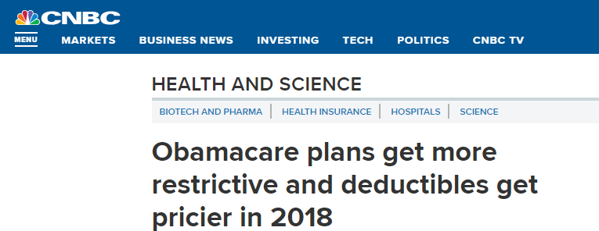

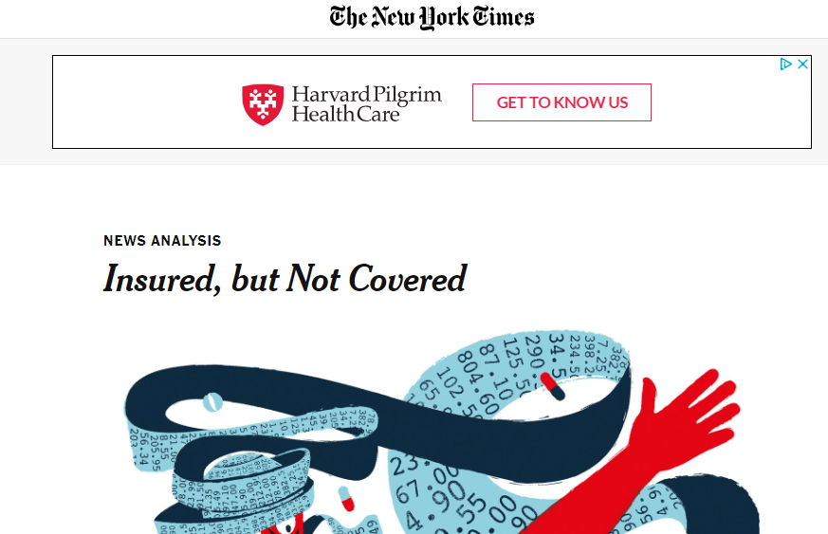
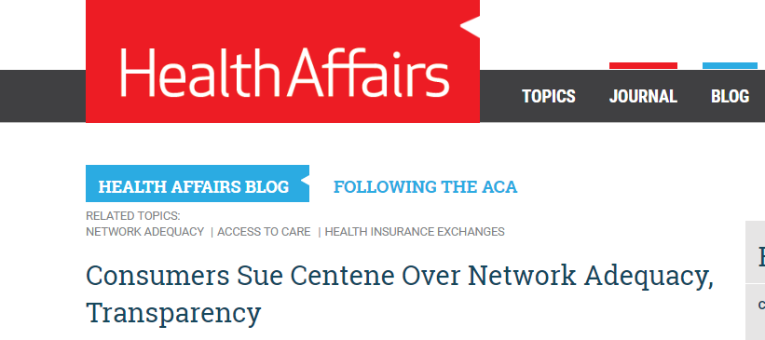
Motivation
Symptoms of both problems observed in the ACA Exchanges:
Dominated by narrow networks and/or skimpy coverage

Slide 44
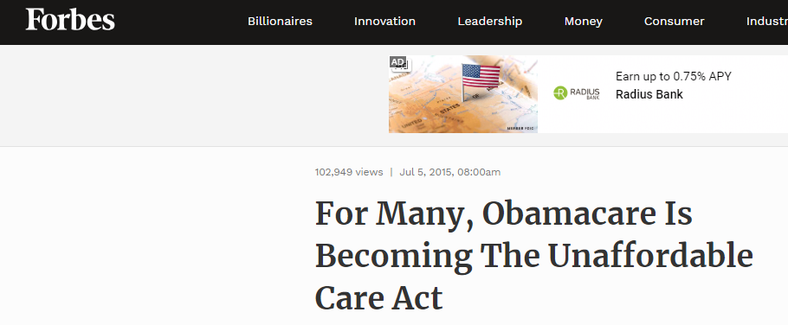
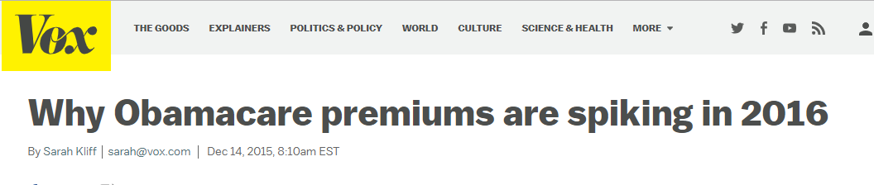
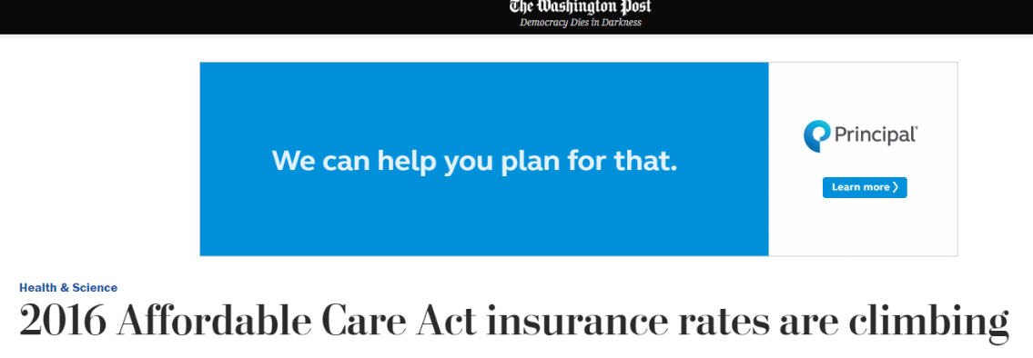
Motivation
Symptoms of both problems observed in the ACA Exchanges:
Perception of high, unaffordable prices – especially for unsubsidized

Slide 45
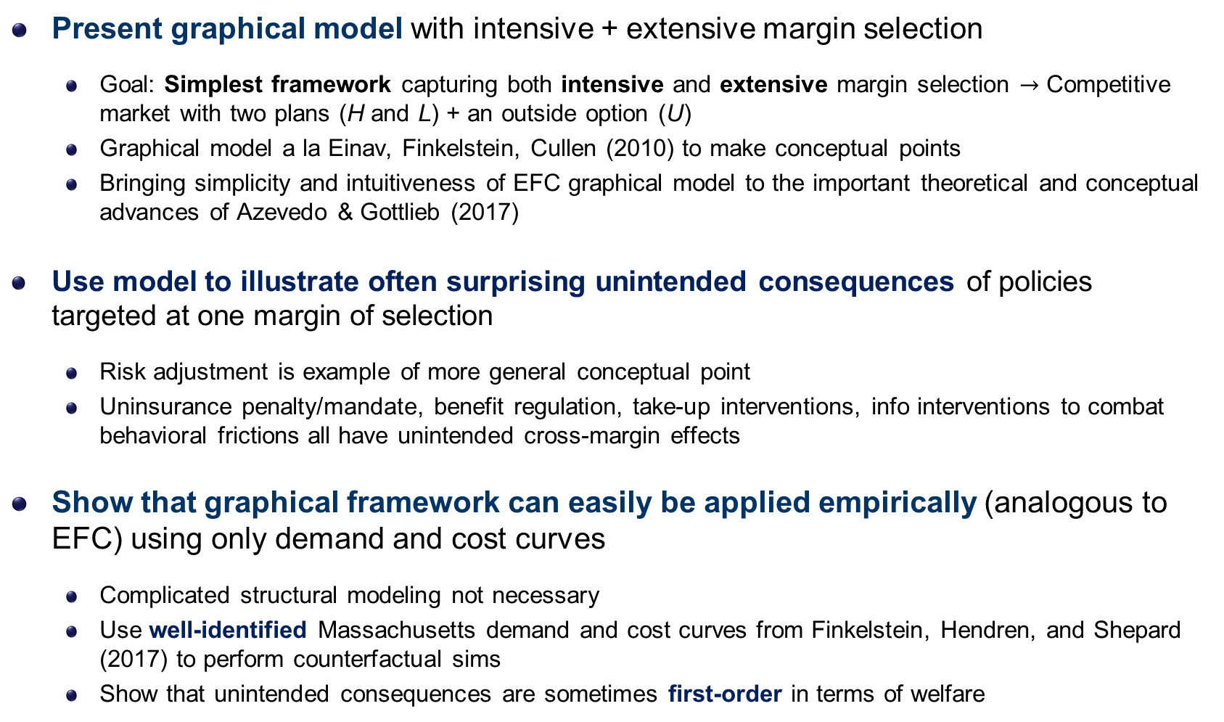
Overview of Paper
Present graphical model with intensive + extensive margin selection
Goal: Simplest framework capturing both intensive and extensive margin selection $→$ Competitive market with two plans (H and L) + an outside option (U)
Graphical model a la Einav, Finkelstein, Cullen (2010) to make conceptual points
Bringing simplicity and intuitiveness of EFC graphical model to the important theoretical and conceptual advances of Azevedo & Gottlieb (2017)
Use model to illustrate often surprising unintended consequences of policies targeted at one margin of selection
Risk adjustment is example of more general conceptual point
Uninsurance penalty/mandate, benefit regulation, take-up interventions, info interventions to combat behavioral frictions all have unintended cross-margin effects
Show that graphical framework can easily be applied empirically (analogous to EFC) using only demand and cost curves
Complicated structural modeling not necessary
Use well-identified Massachusetts demand and cost curves from Finkelstein, Hendren, and Shepard (2017) to perform counterfactual sims
Show that unintended consequences are sometimes first-order in terms of welfare
Notes:
Improve this slide in future talks

Slide 46
Contributions
Make clear the unintended cross-margin effects of common policies
Current PF/Sufficient stats models can’t do so because these model one margin
I/O hasn’t focused on this tradeoff even though models are often flexible enough to do so in principle.
Exceptions: Azevedo and Gottlieb (2016) and Saltzman (2019)
Bring the literature closer to current policy practice. Regulators already understanding this at some level.
E.g., for 2019 CMS is allowing states to weaken risk adjustment in marketplaces
Apparent goal is reducing uninsurance
But…RA operates on intensive margin; transfers between plans. So CMS is relaxing an intensive margin policy to address extensive margin
Current frameworks cannot capture this
Provide a clear, transparent (EFC-like) framework for policy evaluation, future empirical work, teaching

Slide 47
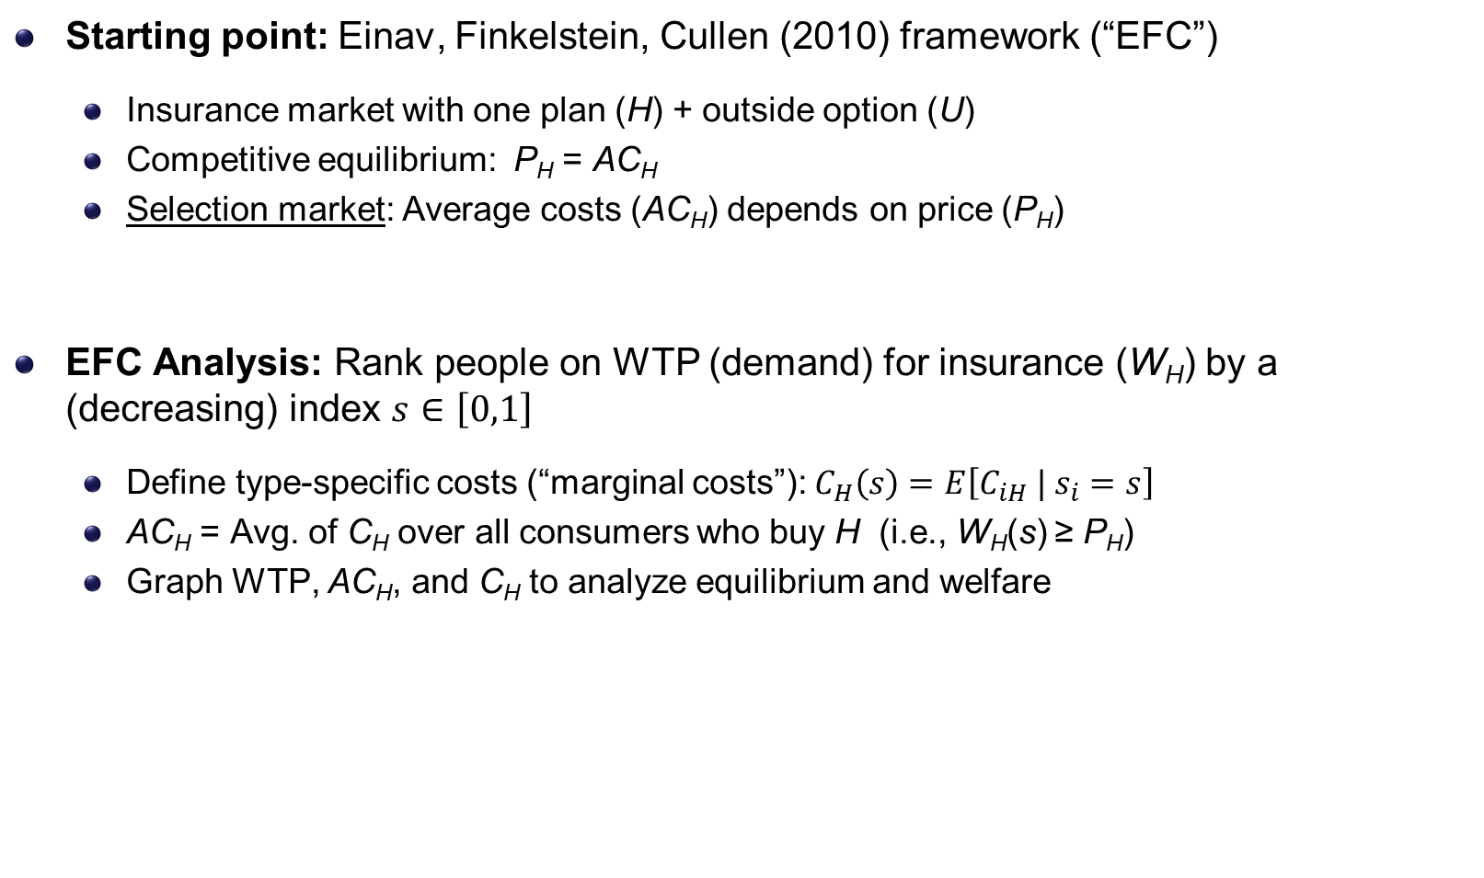
Setup and Model
Starting point: Einav, Finkelstein, Cullen (2010) framework (“EFC”)
Insurance market with one plan (H) + outside option (U)
Competitive equilibrium: P_{H} = AC_{H}
Selection market: Average costs (AC_{H}) depends on price (P_{H})
EFC Analysis: Rank people on WTP (demand) for insurance (W_{H}) by a (decreasing) index $s∈\left[0,1\right]$
Define type-specific costs (“marginal costs”): $C_{H}\left(s\right)=E\left[C_{iH} | s_{i}=s\right]$
AC_{H} = Avg. of C_{H} over all consumers who buy H (i.e., W_{H}(s) ≥ P_{H})
Graph WTP, AC_{H}, and C_{H} to analyze equilibrium and welfare
Notes:
This is the same paper we were just looking at, but with equations added. Second bullet here is how the graph is created.

Slide 48

EFC (2010) Model with Adverse Selection
$
WTP (demand)
W_{H}
Average cost in H (adverse selection → AC_{H} slopes down)
P_{H}*
AC_{H}(s)
Type-specific costs (“marginal cost”)
Welfare loss from adverse selection
C_{H}(s)
s
Buy H
Uninsured
$$s_{}^{∗}\left(P_{H}^{∗}\right)$$

Slide 49
Extending EFC to Two Plans: Vertical Model
Two plans (H, L) compete in exchange with an outside option (U)
Each plan sets single community rated price (P_{H} and P_{L})
Each price has WTP W_{H,i} > W_{L,i} ≥ 0 = W_{U,i} for all consumers
Key Assumption: Vertical model (H > L > U) (Finkelstein, Hendren, and Shepard)
Implication: Highest WTP types buy H; middle buy L; lowest get U
Notes:
Would be good to simplify this slide – way too much
Also, can we switch to no-subsidy case – want to keep WH and WL as the key stats

Slide 50
Vertical Model: Demand, Consumer Sorting
$
W_{H}(s)
W_{L}(s)
s
Consumer WTP type

Slide 51
Vertical Model: Demand, Consumer Sorting
$
W_{H}(s)
W_{L}(s)
P_{L}^{cons}
s
Consumer WTP type

Slide 52

Vertical Model: Demand, Consumer Sorting
$
W_{H}(s)
W_{L}(s)
P_{L}^{cons}
s
$$s_{LU}^{ }$$
Consumer WTP type

Slide 53
Vertical Model: Demand, Consumer Sorting
$
W_{H}(s)
W_{L}(s)
P_{L}^{cons}
Insured
Uninsured
s
$$s_{LU}^{ }$$
Consumer WTP type
Extensive margin

Slide 54
Vertical Model: Demand, Consumer Sorting
$
W_{H}(s)
W_{L}(s) = D_{L}(s)
P_{L}^{cons}
Insured
Uninsured
s
$$s_{LU}^{ }$$
Consumer WTP type
Extensive margin

Slide 55
Vertical Model: Demand, Consumer Sorting
$
W_{H}(s)
Prefer H to L if: W_{H} – W_{L} > P_{H} – P_{L}
D_{L}(s)
P_{L}^{cons}
Insured
Uninsured
s
$$s_{LU}^{ }$$
Consumer WTP type
Extensive margin

Slide 56


Vertical Model: Demand, Consumer Sorting
$
W_{H}(s)
Prefer H to L if: W_{H} – W_{L} > P_{H} – P_{L}
(W_{H} – W_{L}) + P_{L} > P_{H}
D_{H}(P_{L}) $≡$
D_{L}(s)
P_{L}^{cons}
Uninsured
s
$$s_{LU}^{ }$$
Consumer WTP type
Extensive margin

Slide 57
Vertical Model: Demand, Consumer Sorting
$
W_{H}(s)
Prefer H to L if: W_{H} – W_{L} > P_{H} – P_{L}
(W_{H} – W_{L}) + P_{L} > P_{H}
D_{H}(P_{L}) $≡$
D_{L}(s)
P_{L}^{cons}
Uninsured
s
$$s_{LU}^{ }$$
Consumer WTP type
Extensive margin

Slide 58
Vertical Model: Demand, Consumer Sorting
$
W_{H}(s)
Prefer H to L if: W_{H} – W_{L} > P_{H} – P_{L}
(W_{H} – W_{L}) + P_{L} > P_{H}
D_{H}(P_{L}) $≡$
D_{L}(s)
P_{L}^{cons}
Uninsured
s
$$s_{LU}^{ }$$
Consumer WTP type
Extensive margin

Slide 59

Vertical Model: Demand, Consumer Sorting
$
W_{H}(s)
Prefer H to L if: W_{H} – W_{L} > P_{H} – P_{L}
(W_{H} – W_{L}) + P_{L} > P_{H}
D_{H}(s;P_{L})
D_{H}(P_{L}) $≡$
P_{H}^{cons}
D_{L}(s)
P_{L}^{cons}
Uninsured
s
$$s_{HL}^{ }$$
$$s_{LU}^{ }$$
Consumer WTP type
Extensive margin

Slide 60
Vertical Model: Demand, Consumer Sorting
$
W_{H}(s)
Prefer H to L if: W_{H} – W_{L} > P_{H} – P_{L}
(W_{H} – W_{L}) + P_{L} > P_{H}
D_{H}(s;P_{L})
D_{H}(P_{L}) $≡$
P_{H}^{cons}
D_{L}(s)
P_{L}^{cons}
Buy H
Buy L
Uninsured
s
$$s_{HL}^{ }$$
$$s_{LU}^{ }$$
Consumer WTP type
Intensive margin
Extensive margin

Slide 61
Vertical Model: Demand, Consumer Sorting
$
W_{H}(s)
D_{H}(s;P_{L})
Now, we have demand curves for H and L. But note that D_{H} depends on P_{L}.
P_{H}^{cons}
D_{L}(s)
P_{L}^{cons}
Buy H
Buy L
Uninsured
s
$$s_{HL}^{ }$$
$$s_{LU}^{ }$$
Consumer WTP type
Intensive margin
Extensive margin

Slide 62

Vertical Model: Demand, Consumer Sorting
$
W_{H}(s)
D_{H}(s;P_{L})
P_{H}^{cons}
D_{L}(s)
P_{L}^{cons}
s
Buy H
Buy L
Uninsured
$$s_{HL}^{ }$$
$$s_{LU}^{ }$$
Consumer WTP type
Intensive margin
Extensive margin

Slide 63

Vertical Model: Demand, Consumer Sorting
$
W_{H}(s)
D_{H}(s;P_{L})
P_{H}^{cons}
D_{L}(s)
P_{L}^{cons}
Buy L
s
Buy H
Uninsured
$$s_{HL}^{ }$$
$$s_{LU}^{ }$$
Consumer WTP type
Intensive margin
Extensive margin

Slide 64
Equilibrium: Jointly determining $P_{L}$ and $P_{H}$
$
Now, we bring it all together
s
Notes:
Make sure to mention that DH’ is an equilibrium object → Depends on PL
This is a key reason for the interaction of extensive margin selection → Policies that affect PL will also affect DH

Slide 65

Equilibrium: Jointly determining $P_{L}$ and $P_{H}$
$
Start by specifying $P_{L}$
AC_{H}(s_{HL})
W_{H}
D_{L}
s
Notes:
Make sure to mention that DH’ is an equilibrium object → Depends on PL
This is a key reason for the interaction of extensive margin selection → Policies that affect PL will also affect DH

Slide 66

Equilibrium: Jointly determining $P_{L}$ and $P_{H}$
$
Start by specifying $P_{L}$
AC_{H}(s_{HL})
W_{H}
P_{L}
D_{L}
s
Buy L
Uninsured
$$s_{LU}(P)$$
Notes:
Make sure to mention that DH’ is an equilibrium object → Depends on PL
This is a key reason for the interaction of extensive margin selection → Policies that affect PL will also affect DH

Slide 67

Equilibrium: Jointly determining $P_{L}$ and $P_{H}$
$
$P_{L}$ implies a demand curve for H
D_{H}(P_{L})
AC_{H}(s_{HL})
W_{H}
P_{L}
D_{L}
s
Buy L
Uninsured
$$s_{LU}(P)$$
Notes:
Make sure to mention that DH’ is an equilibrium object → Depends on PL
This is a key reason for the interaction of extensive margin selection → Policies that affect PL will also affect DH

Slide 68

Equilibrium: Jointly determining $P_{L}$ and $P_{H}$
$
Which implies an equilibrium price of H
P_{H}^{e}(P_{L})
D_{H}(P_{L})
AC_{H}(s_{HL})
W_{H}
P_{L}
D_{L}
s
Buy H
Buy L
Uninsured
$$s_{HL}(P)$$
$$s_{LU}(P)$$
Notes:
Make sure to mention that DH’ is an equilibrium object → Depends on PL
This is a key reason for the interaction of extensive margin selection → Policies that affect PL will also affect DH

Slide 69
Equilibrium: Jointly determining $P_{L}$ and $P_{H}$
$
Which implies an average cost curve for L
P_{H}^{e}(P_{L})
D_{H}(P_{L})
AC_{H}(s_{HL})
D_{L}
W_{H}
P_{L}
AC_{L}(s_{LU} | P_{H})
s
Buy H
Buy L
Uninsured
$$s_{HL}(P)$$
$$s_{LU}(P)$$
Notes:
Make sure to mention that DH’ is an equilibrium object → Depends on PL
This is a key reason for the interaction of extensive margin selection → Policies that affect PL will also affect DH

Slide 70

Equilibrium: Jointly determining $P_{L}$ and $P_{H}$
$
Which implies an equilibrium price of L
P_{H}^{e}(P_{L})
D_{H}(P_{L})
AC_{H}(s_{HL})
D_{L}
W_{H}
P_{L} ^{e}(P_{H})
AC_{L}(s_{LU} | P_{H})
s
Buy H
Buy L
Uninsured
$$s_{HL}(P)$$
$$s_{LU}(P)$$
Notes:
Make sure to mention that DH’ is an equilibrium object → Depends on PL
This is a key reason for the interaction of extensive margin selection → Policies that affect PL will also affect DH

Slide 71
Equilibrium: Jointly determining $P_{L}$ and $P_{H}$
$
Which implies a new demand curve for H
P_{H}^{e}(P_{L})
D_{H}(P_{L})
AC_{H}(s_{HL})
D_{L}
W_{H}
P_{L} ^{e}(P_{H})
AC_{L}(s_{LU} | P_{H})
s
Buy H
Buy L
Uninsured
$$s_{HL}(P)$$
$$s_{LU}(P)$$
Notes:
Make sure to mention that DH’ is an equilibrium object → Depends on PL
This is a key reason for the interaction of extensive margin selection → Policies that affect PL will also affect DH

Slide 72

Equilibrium: Jointly determining $P_{L}$ and $P_{H}$
$
Which implies a new equilibrium price of H
P_{H}^{e}(P_{L})
D_{H}(P_{L})
AC_{H}(s_{HL})
D_{L}
W_{H}
P_{L} ^{e}(P_{H})
AC_{L}(s_{LU} | P_{H})
s
Buy H
Buy L
Uninsured
$$s_{HL}(P)$$
$$s_{LU}(P)$$
Notes:
Make sure to mention that DH’ is an equilibrium object → Depends on PL
This is a key reason for the interaction of extensive margin selection → Policies that affect PL will also affect DH

Slide 73
Equilibrium: Jointly determining $P_{L}$ and $P_{H}$
$
Which implies a new average cost curve for L
P_{H}^{e}(P_{L})
D_{H}(P_{L})
AC_{H}(s_{HL})
D_{L}
W_{H}
P_{L} ^{e}(P_{H})
AC_{L}(s_{LU} | P_{H})
s
Buy H
Buy L
Uninsured
$$s_{HL}(P)$$
$$s_{LU}(P)$$
Notes:
Make sure to mention that DH’ is an equilibrium object → Depends on PL
This is a key reason for the interaction of extensive margin selection → Policies that affect PL will also affect DH

Slide 74
Equilibrium: Jointly determining $P_{L}$ and $P_{H}$
$
Which implies a new average cost curve for L
P_{H}^{e}(P_{L})
D_{H}(P_{L})
AC_{H}(s_{HL})
D_{L}
W_{H}
P_{L} ^{e}(P_{H})
AC_{L}(s_{LU} | P_{H})
s
Buy H
Buy L
Uninsured
$$s_{HL}(P)$$
$$s_{LU}(P)$$
Notes:
Make sure to mention that DH’ is an equilibrium object → Depends on PL
This is a key reason for the interaction of extensive margin selection → Policies that affect PL will also affect DH

Slide 75

Equilibrium: Jointly determining $P_{L}$ and $P_{H}$
$
Which implies a new equilibrium price of L
P_{H}^{e}(P_{L})
D_{H}(P_{L})
AC_{H}(s_{HL})
D_{L}
W_{H}
P_{L} ^{e}(P_{H})
AC_{L}(s_{LU} | P_{H})
s
Buy H
Buy L
Uninsured
$$s_{HL}(P)$$
$$s_{LU}(P)$$
Notes:
Make sure to mention that DH’ is an equilibrium object → Depends on PL
This is a key reason for the interaction of extensive margin selection → Policies that affect PL will also affect DH

Slide 76


Equilibrium: Jointly determining $P_{L}$ and $P_{H}$
$
Which gives us an equilibrium price vector!
P_{H}^{e}(P_{L}^{e})
D_{H}(P_{L}^{e})
AC_{H}(s_{HL})
D_{L}
W_{H}
P_{L} ^{e}(P_{H}^{e})
AC_{L}(s_{LU} | P_{H}^{e})
s
Buy H
Buy L
Uninsured
$$s_{HL}^{e}(P^{e})$$
$$s_{LU}^{e}(P^{e})$$
Notes:
Make sure to mention that DH’ is an equilibrium object → Depends on PL
This is a key reason for the interaction of extensive margin selection → Policies that affect PL will also affect DH

Slide 77
Summary: Equilibrium in Vertical H-L-U Model
Build on EFC (2010) framework to show competitive equilibrium in the vertical H-L-U model graphically
Need demand and average cost curves for both H and L
Equilibrium occurs where D_{H} = AC_{H} and D_{L} = AC_{L}
New feature: D_{H} and AC_{L} are equilibrium objects that are affected by the price of the other plan
Lower P_{L} → Reduces demand for H (D_{H})
Lower P_{H} → Reduces average cost of L (AC_{L})
This creates the interactions b/n selection margins central to our paper
Critically, can also use the framework to analyze market welfare
Important because we’ll show that many policies improve coverage on one margin but worsen it on the other: Welfare is ambiguous

Slide 78
$
W_{H} (s)
W_{L}(s)
C_{L}(s)=C_{H}(s)
s
Notes:
Title: Welfare: H Plan Optimal for Everyone

Slide 79



$
A
B
W_{H} (s)
E
W_{L}(s)
C
G
H
C_{L}(s)
F
I
D
J
s
Buy H
Buy L
Uninsured
$$s_{HL}^{e}(P^{e})$$
$$s_{LU}^{e}(P^{e})$$
$$s_{LU}^{∗}$$
Notes:
Title: Welfare: H Plan Optimal for Everyone

Slide 80
$
A
B
W_{H} (s)
E
W_{L}(s)
C
G
Market Surplus
H
C_{L}(s)
F
I
D
J
s
Buy H
Buy L
Uninsured
$$s_{HL}^{e}(P^{e})$$
$$s_{LU}^{e}(P^{e})$$
$$s_{LU}^{∗}$$
Notes:
Title: Welfare: H Plan Optimal for Everyone

Slide 81
$
A
B
W_{H} (s)
E
W_{L}(s)
C
Extensive Margin Loss
G
Market Surplus
H
Too many uninsured
C_{L}(s)
F
I
D
J
s
Buy H
Buy L
Uninsured
$$s_{HL}^{e}(P^{e})$$
$$s_{LU}^{e}(P^{e})$$
$$s_{LU}^{∗}$$
Notes:
Title: Welfare: H Plan Optimal for Everyone

Slide 82
$
A
B
W_{H} (s)
Intensive Margin Loss
E
Too few in H
W_{L}(s)
C
Extensive Margin Loss
G
Market Surplus
H
C_{L}(s)
F
I
D
J
s
Buy H
Buy L
Uninsured
$$s_{HL}^{e}(P^{e})$$
$$s_{LU}^{e}(P^{e})$$
$$s_{LU}^{∗}$$
Notes:
Title: Welfare: H Plan Optimal for Everyone

Slide 83
$
A
W_{H}^{Net}(s) = W_{H}(s) – ∆C_{HL}(s)
B
Moral hazard difference b/n H and L plans
W_{H} (s)
Intensive Margin Loss
E
W_{L}(s)
C
Extensive Margin Loss
G
Market Surplus
H
C_{L}(s)
F
I
D
J
s
Buy H
Buy L
Uninsured
$$s_{HL}^{e}(P^{e})$$
$$s_{LU}^{e}(P^{e})$$
$$s_{LU}^{∗}$$
Notes:
Title: Welfare: H Plan Optimal for Everyone

Slide 84
$
A
B
W_{H} (s)=
W_{H}^{Net}(s) = W_{H}(s) – ∆C_{HL}(s)
Moral hazard difference b/n H and L plans
Intensive Margin Loss
E
W_{L}(s)
C
Extensive Margin Loss
G
Market Surplus
H
C_{L}(s)
F
I
D
J
s
Buy H
Buy L
Uninsured
$$s_{HL}^{e}(P^{e})$$
$$s_{LU}^{e}(P^{e})$$
$$s_{LU}^{∗}$$
Notes:
Title: Welfare: H Plan Optimal for Everyone

Slide 85




$
W_{H}^{Net}(s) = W_{H}(s) – ∆C_{HL}(s)
W_{H} (s)
A
Moral hazard difference b/n H and L plans
Intensive Margin Loss
B
E
W_{L}(s)
Extensive Margin Loss
G
Market Surplus
K
H
C_{L}(s)
F
I
D
J
s
Buy H
Buy L
Buy L
Unins.
Uninsured
$$s_{HL}^{e}(P^{e})$$
Too many in L
$$s_{HL}^{∗}$$
Too many unins.
$$s_{LU}^{e}(P^{e})$$
$$s_{LU}^{∗}$$
Notes:
Title: Welfare: H Plan Optimal for Everyone

Slide 86
What does this paper tell us?
Once again, ways to “strategically complicate” the state space we’re considering
When is this useful? When you want to study the interaction of two effects!
When is it not useful? When assumptions don’t hold (perfect ordering)
Shows the unintended effects of policy may be first-order if you ignore a margin
Since prices/quantities are equilibrium objects, policies affecting one margin may change another!
A strong mandate meant to increase takeup (in MA) could reduce the generosity of plans by 35%!
In the other direction, strengthening risk adjustment (increasing plan generosity) could reduce extensive margin participation by 60%!
Considering both margins is necessary for optimal policy

Slide 87
Summary
Private information distorts demand for services!
People have information about their own risk
Sometimes on multiple dimensions
Government intervention may be needed to mitigate risks
Mandates, risk adjustment, subsidies (oh my!)
But may also have unintended consequences!
Next time: provider payment
Thinking about supply of healthcare rather than demand

Slide 88
Presentations

Slide 89
The Affordable Care Act
Notes:
If there’s time

Slide 90
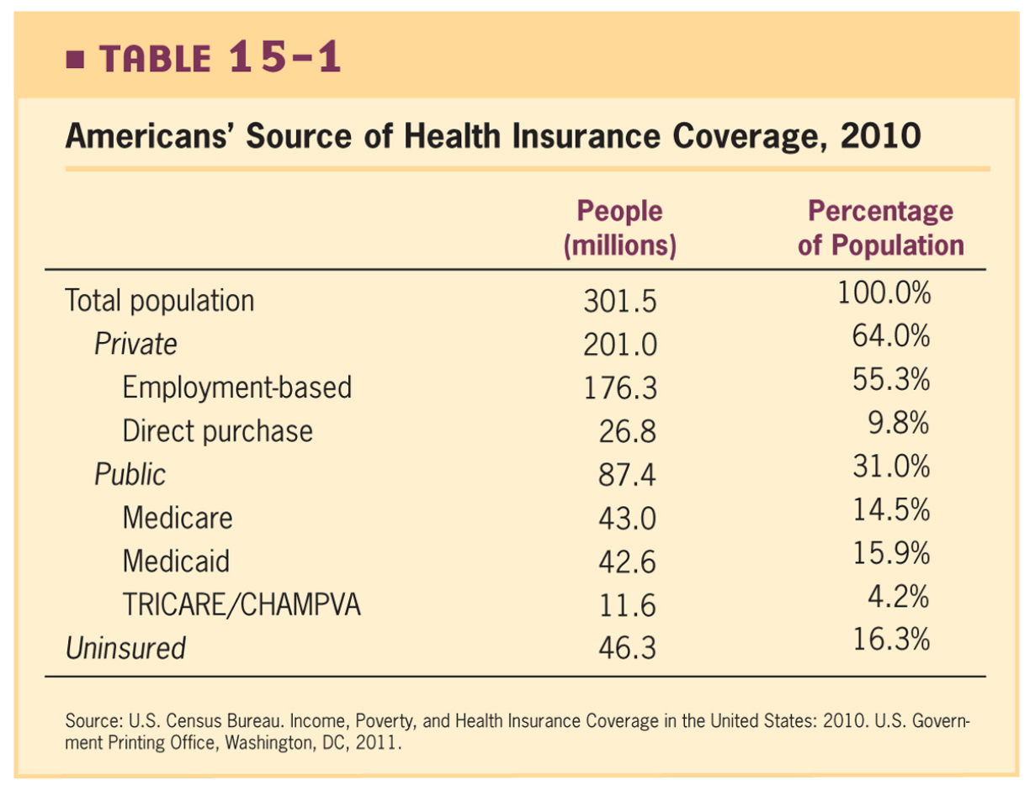
Adverse Selection in Health Insurance pre-ACA
Biggest problem: high variance in expected costs
Why would most insurance be from private insurers?
Why would we care about these?

Slide 91
Adverse Selection in Health Insurance pre-ACA
Biggest problem: high variance in expected costs
Why would most insurance be from private insurers?
Risk pooling
Failure in non-group markets
Why would we care about these?
Externalities
Paternalism
Job lock

Slide 92
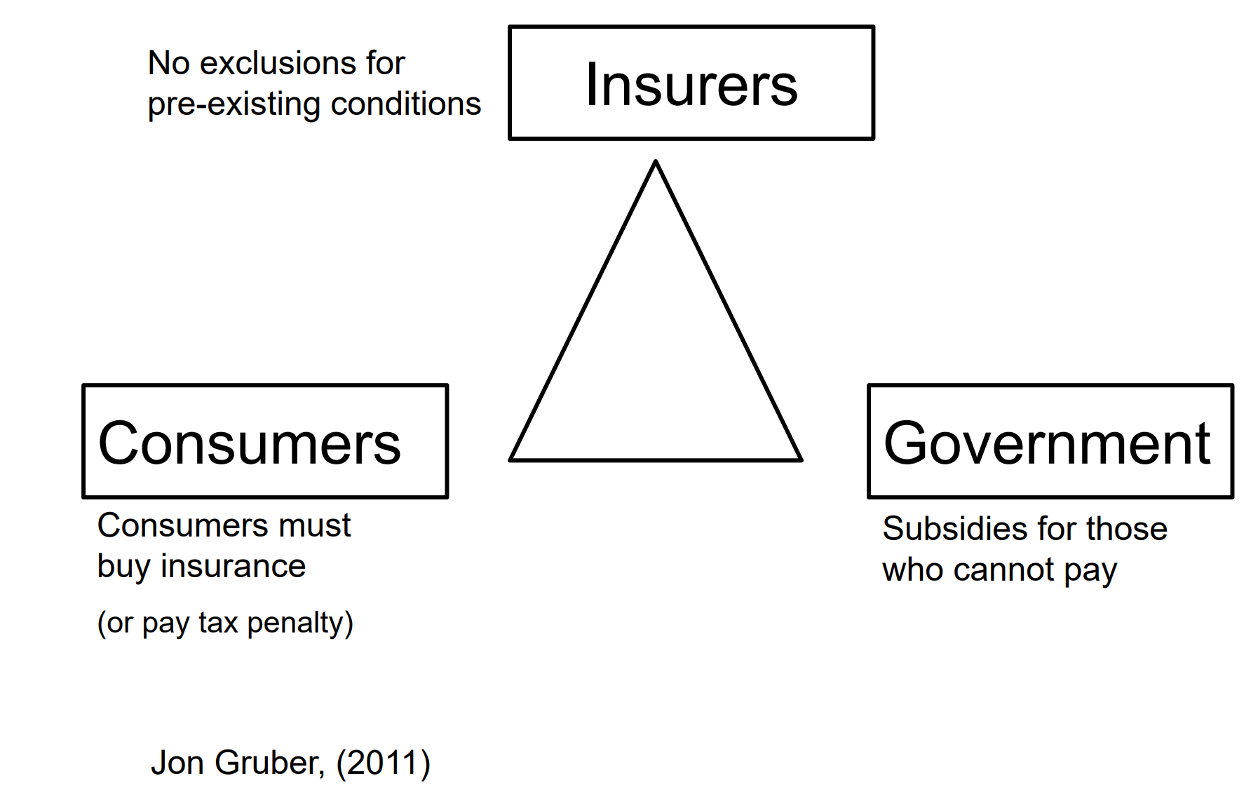
The Three Legs of the ACA: Reducing Adverse Selection

Slide 93
Other ACA Components
Medicaid expansions (ultimately left to states)
Establishment of new Marketplaces to buy insurance
Preventive care cost-sharing exemption
Dependent coverage extended until age 26
Insurance companies can’t drop you if you get sick
Tax credits for small businesses to offer insurance
Insurers are required to pay out a certain percentage of premium (at least 80-85%)

Slide 94
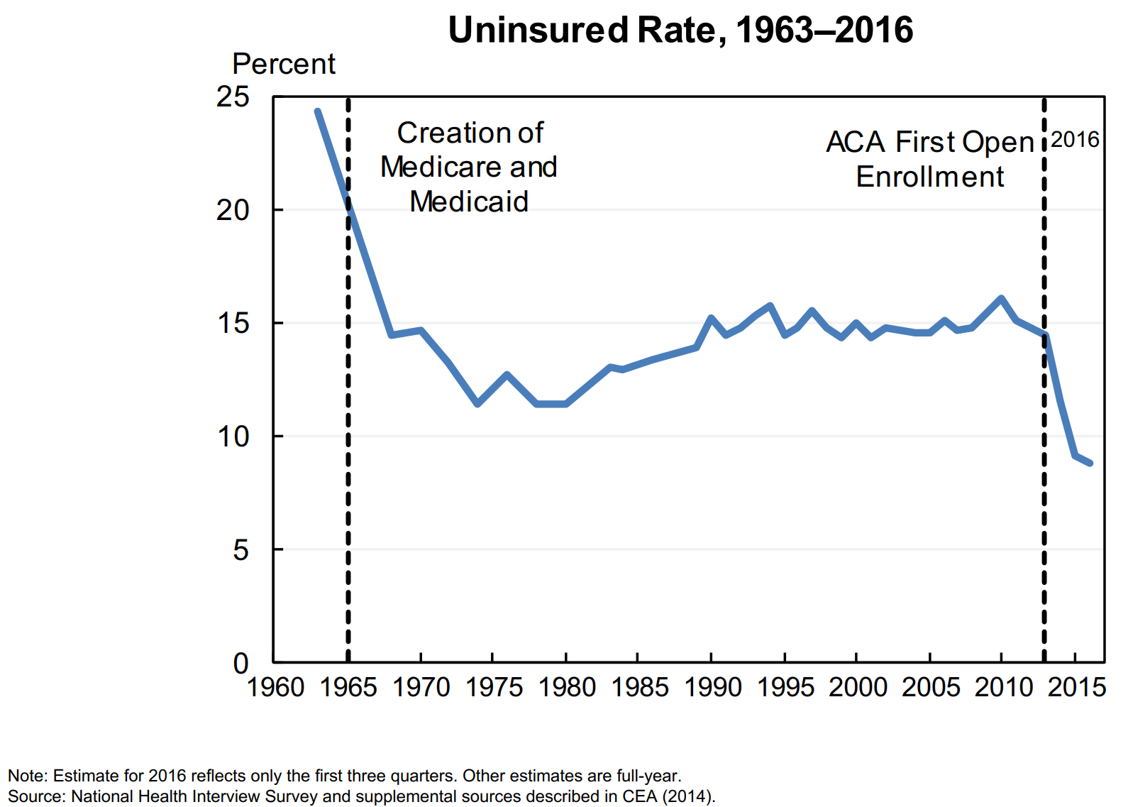
Effect 1: Reduction in Uninsurance Rate

Slide 95
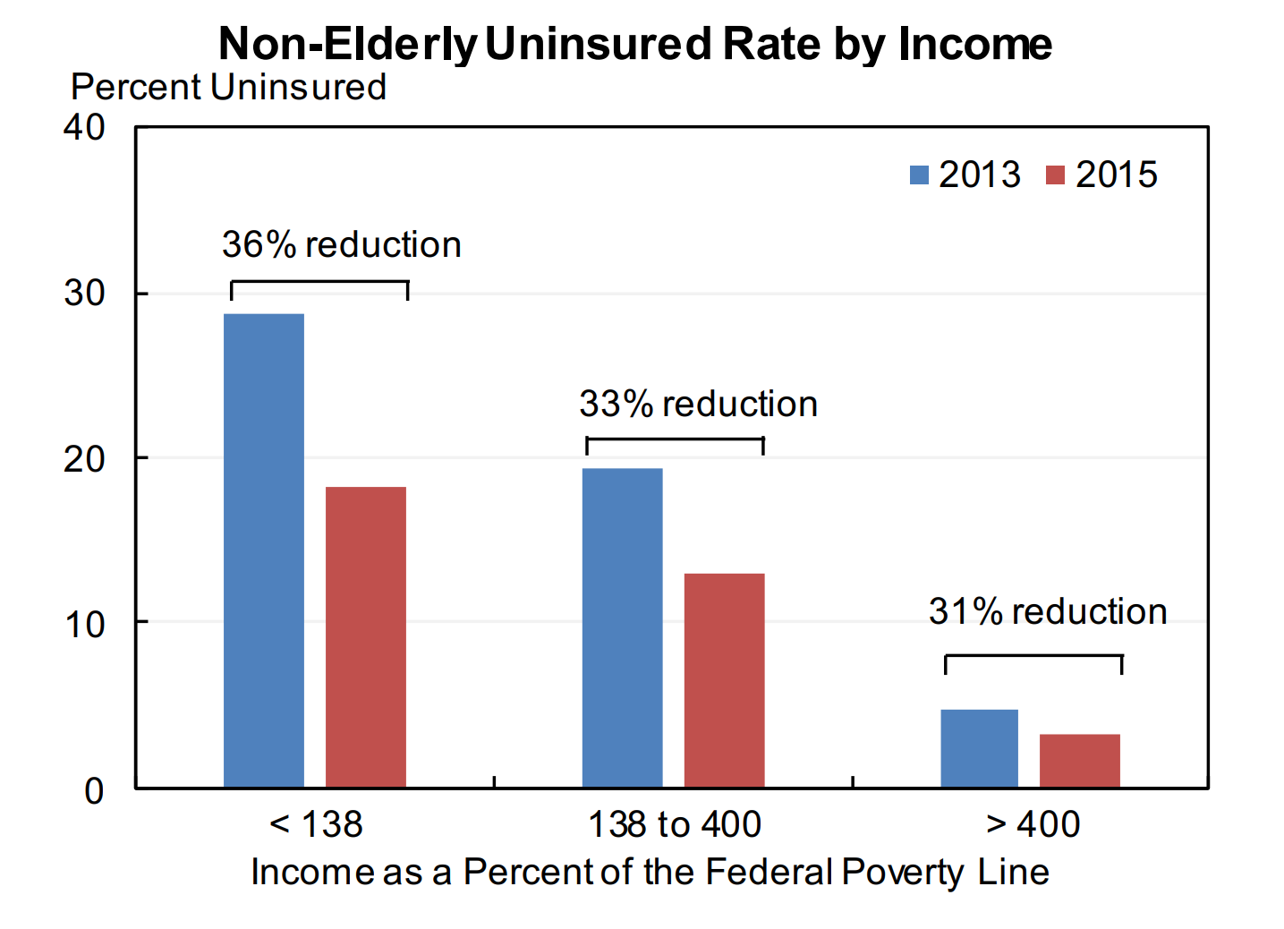
Effect 1: Reduction in Uninsurance Rate

Slide 96
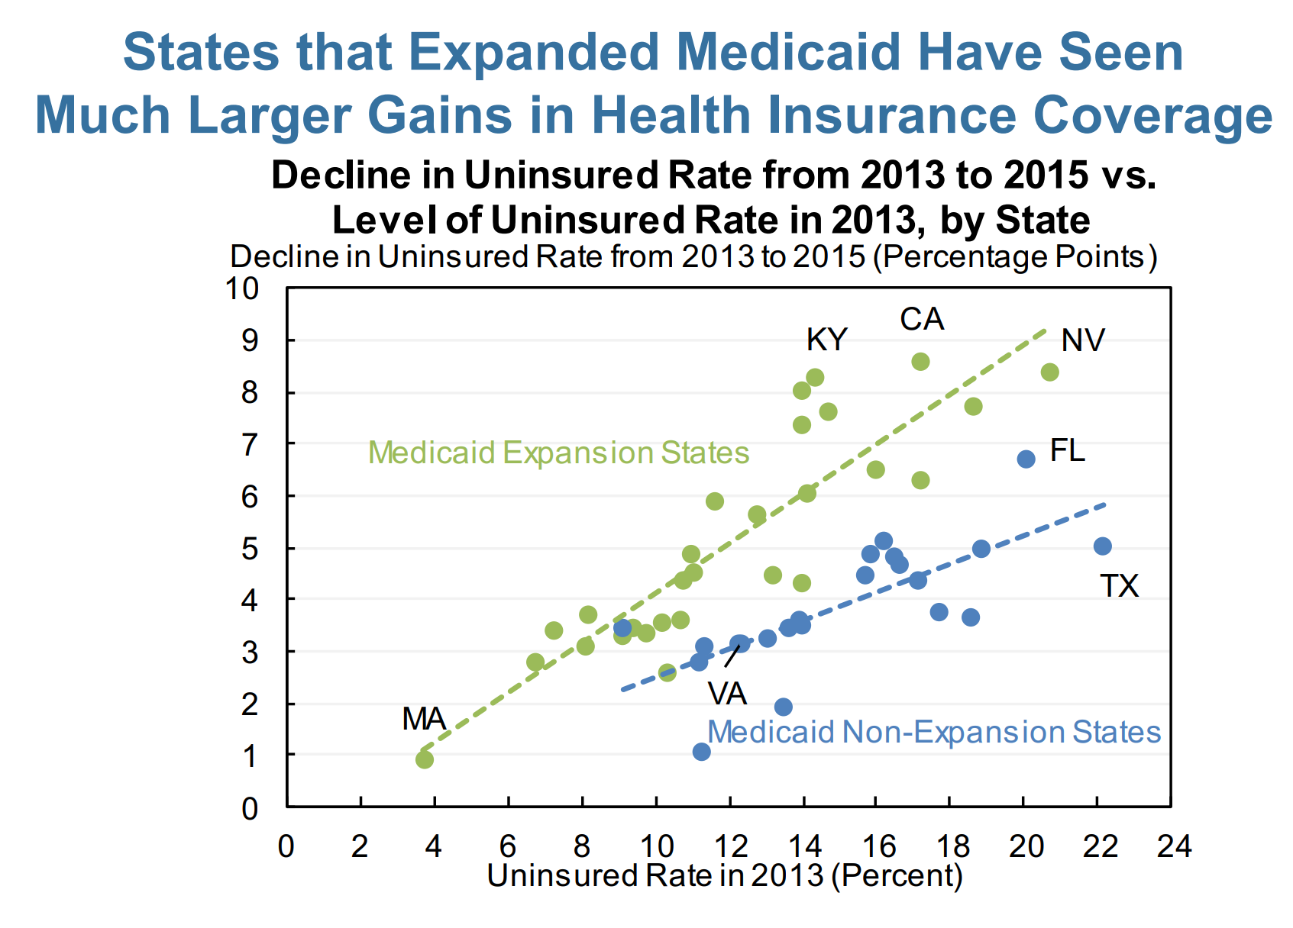
Effect 2: Reduction Larger in States that Expanded Medicaid

Slide 97
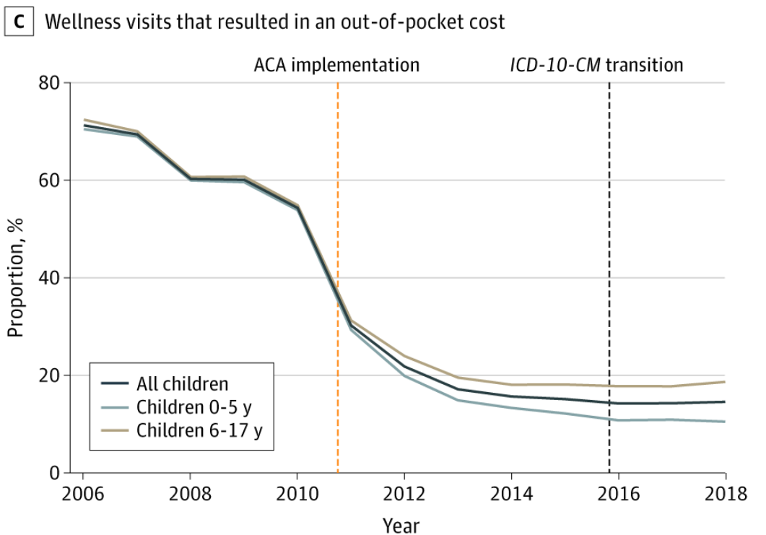
Effect 3: High-value health care is more affordable
Source: Shafer, Hoagland, and Hsu (2021). JAMA Network Open

Slide 98
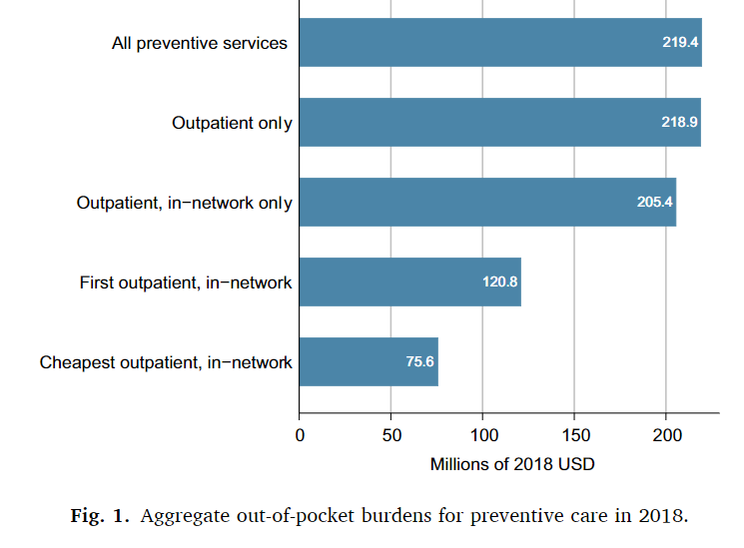
Lingering problems:
State-by-state implementation left remaining patchwork system
No large federal overhaul of private insurance
Preventive care policies not fully implemented: remaining costs

