Slide 1
Advanced Health Economics
Lecture 1: Introduction + Demand for Health Care
January 11, 2023
HAD 6750 • Alex Hoagland, Ph.D.
Notes:
To add for next time – how does Grossman model vary predictions over the life-cycle? Slides were a little bit long (didn’t get to discussion on model) and the integral was surprising to students – walk through it more. Another thing to add for next time: notes from the Darden et al. paper?

Slide 2
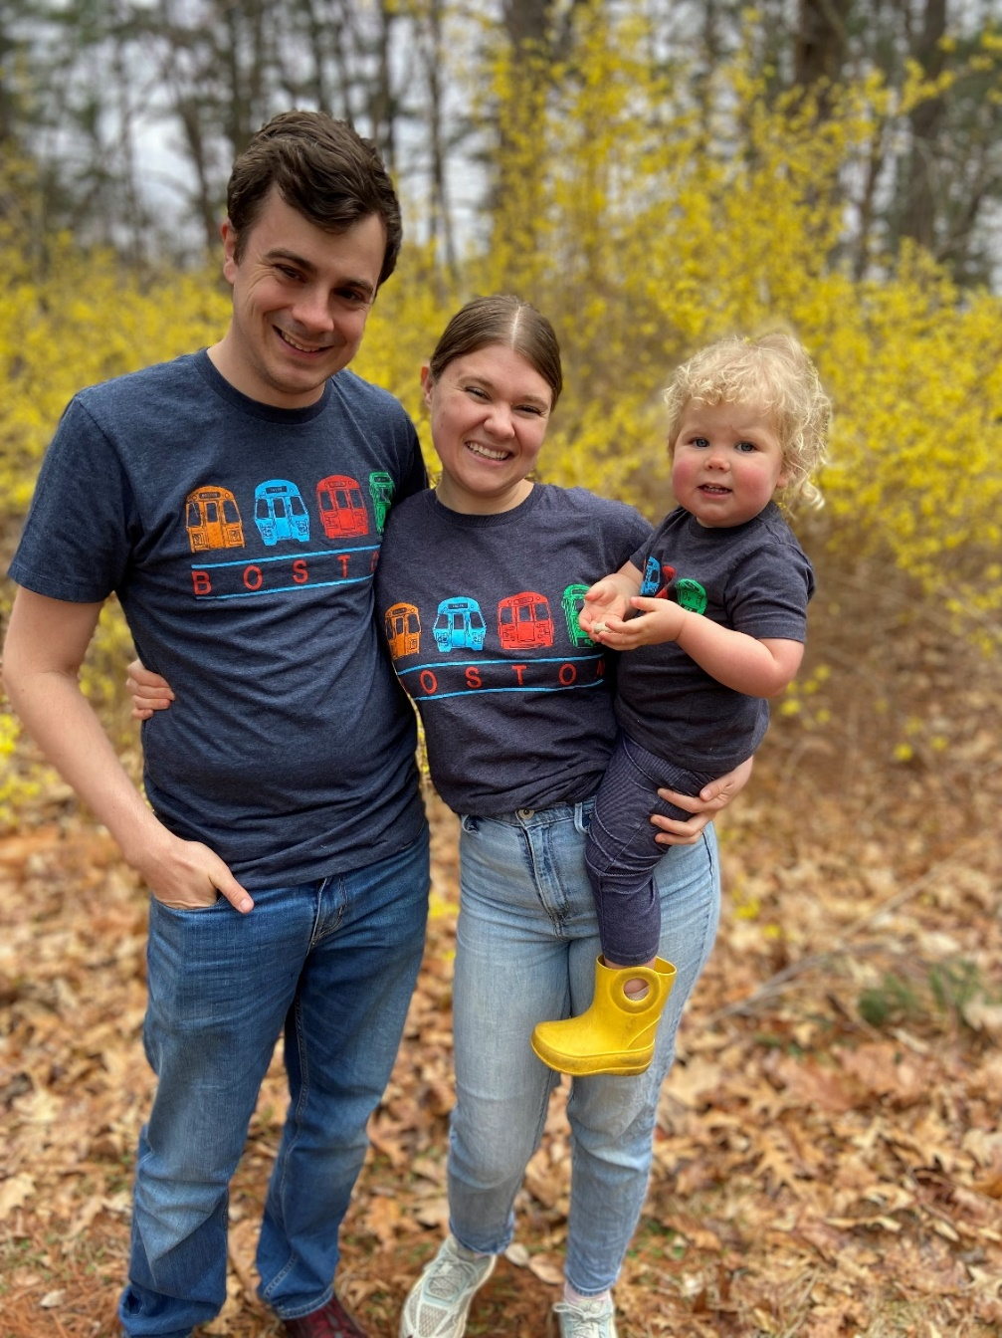
Introductions

Slide 3
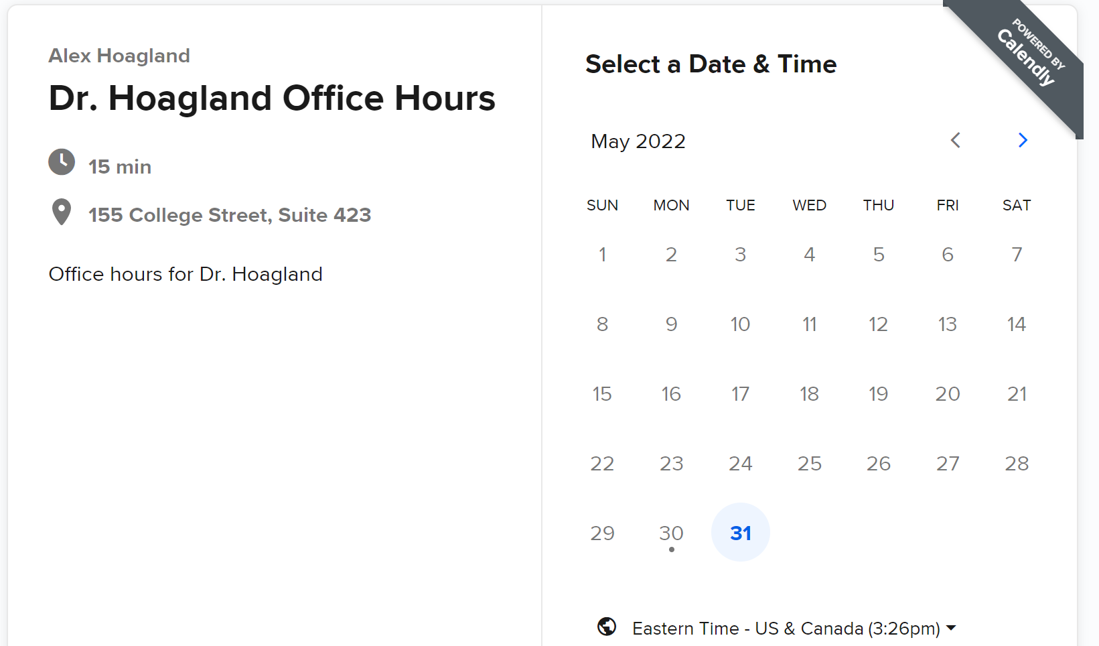
Introduction & Syllabus
Booking office hours: calendly.com/Hoagland-office-hours/had5744-2022f
In-person/Zoom: T/W/F: 10:00 to 11:00
Note that Tuesdays are by Zoom only
Notes:
Pretty flexible, just email me

Slide 4
Introduction & Syllabus
Github repo
Contains all relevant course materials
Readings, presentation options, some slides
Notes:
Slides will be loose this time

Slide 5
Introduction & Syllabus
Github repo
Contains all relevant course materials
Readings, presentation options, some slides
Hypothesis for group annotation: tutorial on Quercus

Slide 6
Introduction & Syllabus
Evaluation Criteria
Presentation: 1 presentation, worth 30% of the final grade
Referee Report: 1 referee report, worth 20% of the final grade
Paper Proposal: worth 50% of the final grade.

Slide 7
Introduction & Syllabus
Evaluation Criteria
Presentation: 1 presentation, worth 30% of the final grade
Options for papers are on syllabus/GitHub
The topics you choose for the presentation and referee report should be different.
20–30-minute presentation (15 slides max):
1. Motivation
2. Contribution
3. Walk-through of the model (focus 1)
4. Summary of any empirical analyses or additional findings
5. Your own thoughts on the paper’s strengths and weaknesses (focus 2).
Presentations will be given on the day the topic is covered in class.
If you haven’t already, please tell me what you’d like to present!

Slide 8
Presentation Schedule
Date | Presentation
Feb. 1 | Sarah Kipping: Zhang, X., & Sweetman, A. (2018). Blended capitation and incentives: Fee codes inside and outside the capitated basket.
Feb. 8 | Casey Chu: Chan, D. C. (2016). Teamwork and moral hazard: Evidence from the emergency department.
Feb. 15 | Nan Chen: Jimenez, D., & Smith, P. C. (2005). Decentralisation of Health Care and Its Impact on Health Outcome (Vol. 10).
Mar. 1 | Yuying Feng (?)
Mar. 8 | Allan Tran: Currie, J., Zivin, J. G., Mullins, J., & Neidell, M. (2014). What Do We Know About Short- and Long-Term Effects of Early-Life Exposure to Pollution?
Mar. 15 | Peiya Cao (?)
Mar. 22 | Pratyasha Acharya: Bhargava, S., Loewenstein, G., & Sydnor, J. (2017). Choose to Lose: Health Plan Choices from a Menu with Dominated Option.
Mar. 29 | Guan Wang: Acemoglu D, Linn J. Market Size in innovation: theory and evidence from the pharmaceutical industry. 2004
Notes:
Note about auditing students – please present!

Slide 9
Introduction & Syllabus
Evaluation Criteria
Referee Report: 1 referee report, worth 20% of the final grade
Same paper choice sets (but different topic)
Referee report should include:
1. Brief summary of the paper (1-2 paragraphs)
2. Major concerns you have, including any potential flaws
3. Minor concerns you have, including ideas for extensions
Focus on the theory as much as possible
3 pages max
Reports are due one week after the topic has been covered in class.
Notes:
Late reports will be discounted by 10 percentage points per day late. Show sample in class next time. Don’t have to tell me ahead of time (no commitment)

Slide 10
Introduction & Syllabus
Evaluation Criteria
Paper Proposal: worth 50% of the final grade.
Project should be purely theoretical or use theory to ground empirical work
Must have a model!
Your proposal should:
1. Pose an academic research question
2. Conduct a thorough literature review
3. Present a stylized model (note: you do not have to solve your model or incorporate all complexity)
4. If applicable, carefully describe the ideal data and empirical strategy you would use for empirically testing your model.
This proposal could become a part of your thesis or a publishable paper!
Proposals are due on the last day of class.
Please prepare a 20-30-minute presentation detailing your proposal
Notes:
Late proposals will be discounted by 10 percentage points per day late. Presentations will be given during the last two lectures of the semester.

Slide 11
Economic Modeling
Notes:
Pause for any other syllabus / logistics questions?

Slide 12
What is economics?
What is it generally?
What’s its role in health policy evaluation / health services research?
What does it bring to the table for you?
Notes:
Open discussion. Some thoughts: optimization subject to constraints. Thinking carefully about all sides of a tradeoff. Thinking through how people make choices, and what kinds of preferences/incentives lead to that choice (this is all built into modeling)

Slide 13
What is economics?
Interaction of individual agents’ behaviors
Optimization subject to constraints
Not just cost-effectiveness analysis!
Instead, thinking carefully about how policies and decisions change incentives and therefore behavior
Notes:
Some thoughts: optimization subject to constraints

Slide 14

What is economics?
Interaction of individual agents’ behaviors
Optimization subject to constraints
Not just cost-effectiveness analysis!
Instead, thinking carefully about how policies and decisions change incentives and therefore behavior
Notes:
Video – none of this will be new to you, but I want us to (a) see some real health economists talking (we’ll read papers by all of these people!) and (b) see how they talk about things differently than non-econs. Think about what is surprising to you? What casts things in a new light, what lines up with your priors, what ruffles your feathers? It’s from a US perspective but I don’t think that matters much here (or does it to you? Why? )

Slide 15
What distinguishes health economics from health services research?
Notes:
Think carefully about patient/provider behaviors, clarify incentives, causal impacts + distributional effects

Slide 16
What distinguishes health economics from health services research?
Economic analysis applied to health care
Prioritizes clear discussion of assumptions (incentives, preferences, etc.)
This is why modeling is so important!
This framework lends itself to clean empirical research:
Causal inference
Distributional impacts of policies
Clean identification of tradeoffs
Again, not just cost-effectiveness analysis!
Notes:
Think carefully about patient/provider behaviors, clarify incentives, causal impacts + distributional effects. Tradeoffs highlighted in next slide.

Slide 17
Example: Tradeoffs and Incentives
Notes:
Here’s the problem: expensive gas prices. Solution: a proposed price freeze.

Slide 18
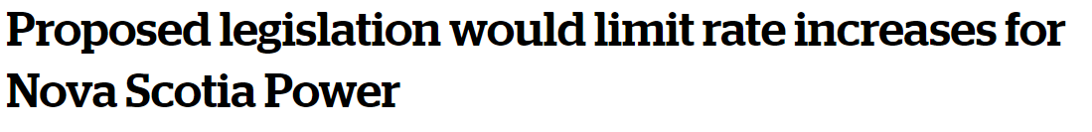
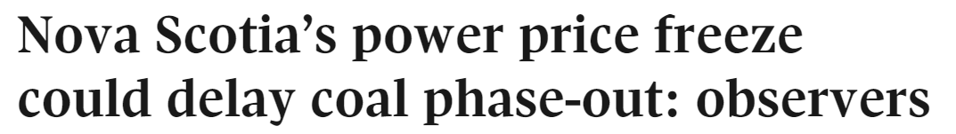
Example: Tradeoffs and Incentives
Notes:
How do we think about this? Two sides of the story – do we help people now, or do we think about dynamic incentives?

Slide 19

Tradeoffs and Incentives
Notes:
Frequent political discussions involve “head in the sand”

Slide 20
Tradeoffs and Incentives
Economic modeling allows us to think about:
Tradeoffs in a formal setting
How incentives change behavior
Short- versus long-run impacts
Typically, models allow us to say something about:
Equilibrium Concepts: how does the game “shake out” when all incentives are modeled formally?
Comparative Statics: how does solution depend based on (causal) pathways?
Counterfactuals: how would we predict world to change based on alternative values for exogenous variables?
Notes:
So a toy model here would have what? Some notion of time, with actions today affecting states tomorrow. Some measure of externalities from natural gas production. Some way to think about welfare across time.

Slide 21
What kinds of models?
Mathematical
Definitions of states, agents, and decisions
Equilibrium defined based on payoffs and interactions across agents
Notes:
Models will help us formalize the economic concepts coming into play in our settings. So like Lagrangians

Slide 22
What kinds of models?
Mathematical
Definitions of states, agents, and decisions
Equilibrium defined based on payoffs and interactions across agents
Graphical
Simpler visualizations of mathematical equilibria
Captures main insights of models
Notes:
We’ll do less of 3, but there is a continuum, not dichotomy here

Slide 23
What kinds of models?
Mathematical
Definitions of states, agents, and decisions
Equilibrium defined based on payoffs and interactions across agents
Graphical
Simpler visualizations of mathematical equilibria
Captures main insights of models
Empirical
Structural estimation
Links to econometrics
Notes:
We’ll do less of 3, but there is a continuum, not dichotomy here

Slide 24
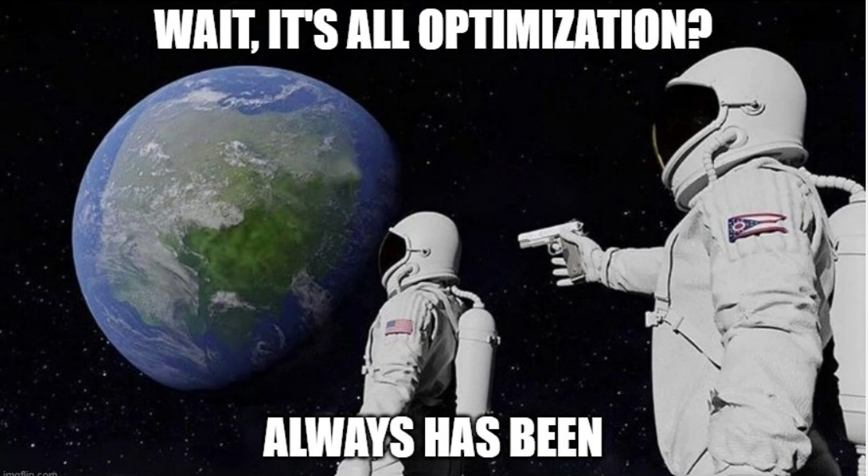
Notes:
Basically, what we’re doing in this class is discussing optimization – that’s what models show for us

Slide 25
What should we get from this class?
Careful reading/discussion of classic & cutting-edge theoretical tools in HE
Please read the papers and come ready to discuss!
As you read, think about the following questions:
What is the contribution of the research overall?
Notes:
This is a readings class, so we’ll be doing a deep dive into each model.

Slide 26
What should we get from this class?
Careful reading/discussion of classic & cutting-edge theoretical tools in HE
Please read the papers and come ready to discuss!
As you read, think about the following questions:
What is the contribution of the research overall?
How does the theoretical model fit into (1)?
Advances a new theory of behavior?
Testable empirical implications?
Combines/remixes tools from existing work?
Notes:
This is a readings class, so we’ll be doing a deep dive into each model.

Slide 27
What should we get from this class?
Careful reading/discussion of classic & cutting-edge theoretical tools in HE
Please read the papers and come ready to discuss!
As you read, think about the following questions:
What is the contribution of the research overall?
How does the theoretical model fit into (1)?
Advances a new theory of behavior?
Testable empirical implications?
Combines/remixes tools from existing work?
Where is the model’s cleverness?
Is it in what is presented/emphasized?
Is it in what is omitted?
Is it in how behavior is described?
Notes:
This is a readings class, so we’ll be doing a deep dive into each model.

Slide 28
What should we get from this class?
Careful reading/discussion of classic & cutting-edge theoretical tools in HE
Please read the papers and come ready to discuss!
As you read, think about the following questions:
What is the contribution of the research overall?
How does the theoretical model fit into (1)?
Advances a new theory of behavior?
Testable empirical implications?
Combines/remixes tools from existing work?
Where is the model’s cleverness?
Is it in what is presented/emphasized?
Is it in what is omitted?
Is it in how behavior is described?
Where is the model lacking for me?
How is this model a simplification of the real world?
Where does that make the model weak?
How might the model be altered or extended?
Notes:
This is a readings class, so we’ll be doing a deep dive into each model.

Slide 29
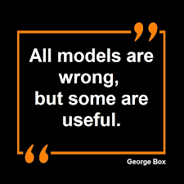
Model Limitations

Slide 30
Basic Example: Modeling Demand
Notes:
Notes on the intuition behind Lagrangians: https://medium.com/@andrew.chamberlain/a-simple-explanation-of-why-lagrange-multipliers-works-253e2cdcbf74

Slide 31
Grossman (1972)
In Determinants of Health (pp. 6-41). Columbia University Press.

Slide 32
Does health happen to you, or do you choose it?
What are the dynamic results of “health” decisions?
Diet, exercise
Preventive screenings
Etc.
The Grossman model thinks of health behaviors as investments into health
Notes:
So we’re going to expand a model of demand and think about demand for health states

Slide 33
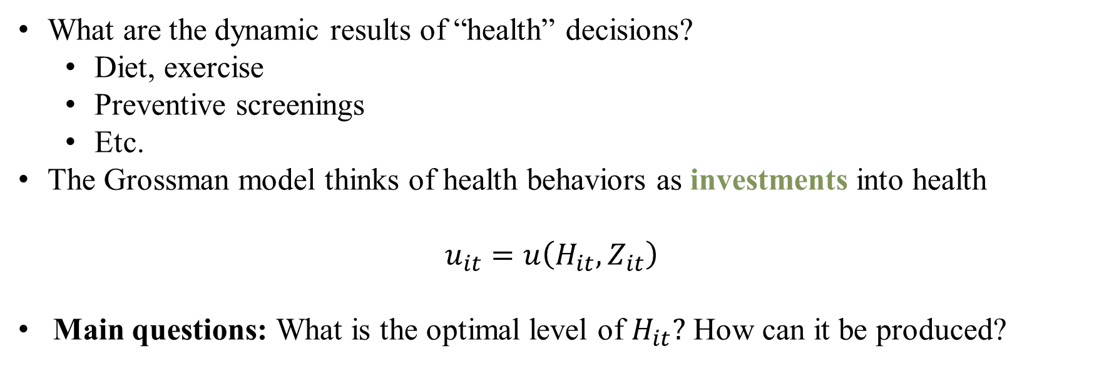
Does health happen to you, or do you choose it?
What are the dynamic results of “health” decisions?
Diet, exercise
Preventive screenings
Etc.
The Grossman model thinks of health behaviors as investments into health
$$u_{it}=u\left(H_{it},Z_{it}\right)$$
Main questions: What is the optimal level of $H_{it}?$ How can it be produced?
Notes:
Little u is our index. H_i is health status and Z_i is consumption of everything else (food, opera, etc.). For now we are starting with one period. The central question is (a) why do different people make different choices about health? (Answer is, unsurprisingly, different preferences)

Slide 34

Does health happen to you, or do you choose it?
What are the dynamic results of “health” decisions?
Diet, exercise
Preventive screenings
Etc.
The Grossman model thinks of health behaviors as investments into health
$$u_{it}=u\left(H_{it},Z_{it}\right)$$
Main questions: What is the optimal level of $H_{it}?$ How can it be produced?
Note: where is health care in this model?
Notes:
Health care (vaccines etc) only appear as they influence H. So you could write H as a function of all health services. This is one of Grossman’s points: people don’t consume cardiac stress tests, they consume good health – how does that change the model?

Slide 35
Investing in Health
What does the unconstrained problem look like? What are the choice variables? What is the optimum?

Slide 36
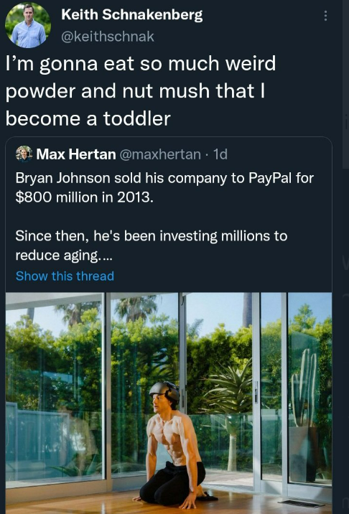
Is this realistic?
What good is a model without tradeoffs?
How valid are its predictions?
Notes:
How do we make a model like this realistic? Diminishing returns to investment, tradeoffs between consumption of health and other goods.

Slide 37
Investing in Health
What does the unconstrained problem look like? What are the choice variables? What is the optimum?
What kinds of constraints might exist?
Notes:
Health care (vaccines etc) only appear as they influence H. So you could write H as a function of all health services.

Slide 38

Investing in Health
What does the unconstrained problem look like? What are the choice variables? What is the optimum?
What kinds of constraints might exist?
$$Θ=T^{W}+T^{ℓ}+T^{H}+T^{S},$$
$T^{W}:$time working
$T^{ℓ}:$time in leisure
$T^{H}:$time in health production (e.g., what is this?)
$T^{S}:$time sick
What does the constrained problem look like now?
Notes:
Also what other kinds of constraints could exist? Note that there is still no relationship between health production and these obscure time components. How do we link them?

Slide 39
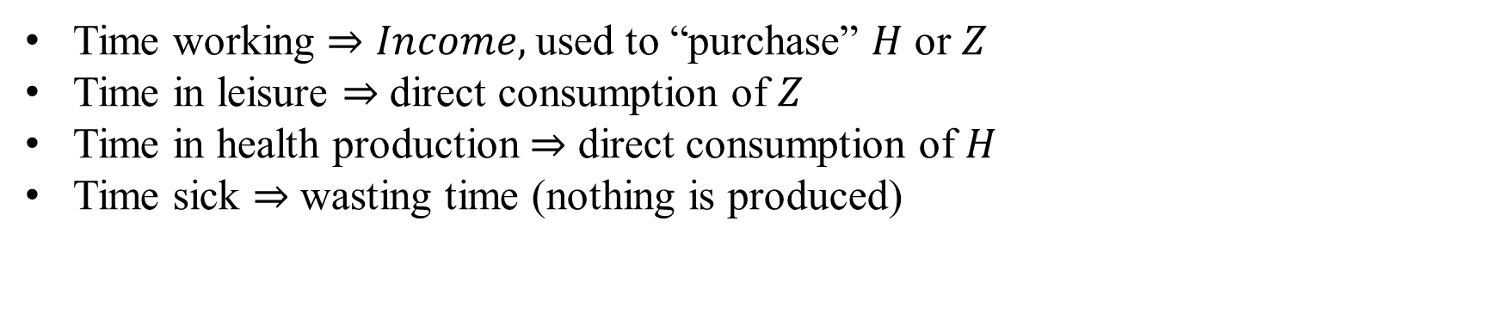
Linking Health Production and Time
Time working $⇒Income,$used to “purchase” $H$ or $Z$
Time in leisure $⇒$ direct consumption of $Z$
Time in health production $⇒$ direct consumption of $H$
Time sick $⇒$ wasting time (nothing is produced)
Notes:
Time sick is this model’s “outside option” – the base that all other model characteristics are related to (kind of like omitted category in dummy variables)

Slide 40

Linking Health Production and Time
Time working $⇒Income,$used to “purchase” $H$ or $Z$
Time in leisure $⇒$ direct consumption of $Z$
Time in health production $⇒$ direct consumption of $H$
Time sick $⇒$ wasting time (health influences this!)
Hence, we can convert time constraints to budget constraints:
$$Y_{t}=wT^{W}$$
$$p_{h}h_{it}+p_{z}z_{it}≤Y_{t}+y(H_{it})$$
Notes:
Here, lower case variables indicate inputs into big variables H and Z. Since health influences time sick, you can allow H to influence total income (by reducing sick time)

Slide 41

Linking Health Production and Time
Time working $⇒Income,$used to “purchase” $H$ or $Z$
Time in leisure $⇒$ direct consumption of $Z$
Time in health production $⇒$ direct consumption of $H$
Time sick $⇒$ wasting time (health influences this!)
Hence, we can convert time constraints to budget constraints:
$$Y_{t}=wT^{W}$$
$$p_{h}h_{it}+p_{z}z_{it}≤Y_{t}+y(H_{it})$$
We can also write a law of motion for how health evolves over time:
$$\frac{∂H}{∂t}=G\left(h_{it}\right)−δH$$
Notes:
The change in H in each period is the investment in each period minus depreciation (at rate \delta). This treats health as a durable good, part of human capital. One way to get varying predictions over life-cycle—let delta be a function of age.

Slide 42

Formal Statement of the Problem
Now that we have a sense of the evolution of $H$, we can write dynamic problem:
$$\max_{H,Z}{}U_{i}=\int_{0}^{T}{u\left(H_{it},Z_{it}\right)e^{−ρt}dt }$$
Continuous discounting at rate $ρ$: see https://demonstrations.wolfram.com/ContinuousAndDiscreteTimeDiscounting/
Assume that $u_{H}>0, u_{HH}<0, u_{Z}>0,u_{ZZ}<0,u_{HZ}>0$
Notes:
Assume individuals live for T periods. Little u is our index. What do each of these assumptions on u mean?

Slide 43

Formal Statement of the Problem
Now that we have a sense of the evolution of $H$, we can write dynamic problem:
$$\max_{H,Z}{}U_{i}=\int_{0}^{T}{u\left(H_{it},Z_{it}\right)e^{−ρt}dt }$$
Continuous discounting at rate $ρ$
Assume that $u_{H}>0, u_{HH}<0, u_{Z}>0,u_{ZZ}<0,u_{HZ}>0$
Subject to:
$$\frac{∂H}{∂t}=G\left(h_{it}\right)−δH \left(1\right)Law of motion$$
$$p_{z}z_{it}+p_{h}h_{it}=wT^{w}+y(H_{it}) \left(2\right)Budget constraint \left(per−period\right)$$
Notes:
Note that we assume no savings, so budget constraint is met ni each period. Can endogenize the

Slide 44
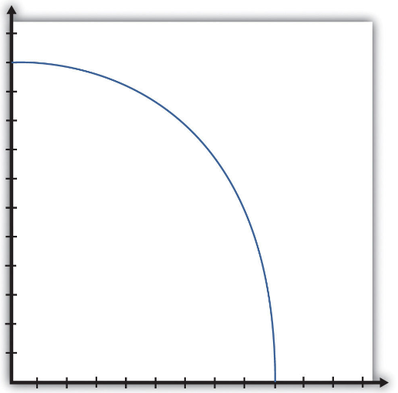
Visualizing the Problem
How do our assumptions change the production possibilities frontier?
Consumption
Health state
Notes:
This is a typical PPF, without complementarities – is it different? Not WLOG, but let’s see this --given complementarities between H and Z – as H gets lower, your income will fall, and hence you can’t just increase Z (Z will be limited as well)

Slide 45
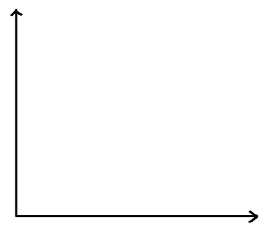
Visualizing the Problem
How do our assumptions change the production possibilities frontier?
Consumption
Health state
Notes:
Instead, this is the PPF – low H means low consumption. So what part of this shape will be used (where is the free lunch region) ?

Slide 46
Visualizing the Problem
What does an equilibrium look like?
Consumption
Health state
Notes:
Instead, this is the PPF – low H means low consumption. So what part of this shape will be used (where is the free lunch region) ? Is this WLOG different from initial (not really). If you were to make assumptions about complementarities, this shape could be different, but we’re not that in the weeds here.

Slide 47
Visualizing the Problem
What does an equilibrium look like?
Consumption
Health state
Notes:
Also note that as a person gets sicker, the PPF shrinks inward (or at least, to the left0

Slide 48
Finding the Equilibrium
What is the Lagrangian?
Notes:
Note that we assume no savings, so budget constraint is met ni each period. Can endogenize the

Slide 49
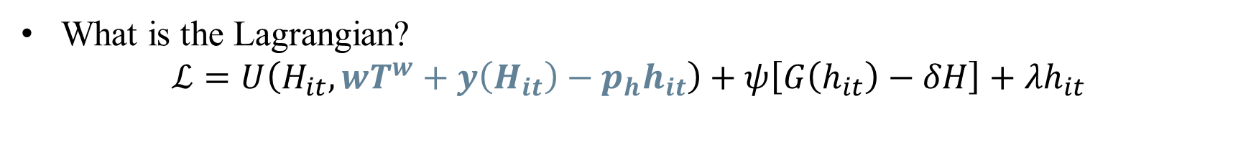
Finding the Equilibrium
What is the Lagrangian?
$$ℒ=U\left(H_{it}, wT^{w}+y\left(H_{it}\right)−p_{h}h_{it}\right)+ψ\left[G\left(h_{it}\right)−δH\right]+λh_{it}$$
Notes:
Now we solved the budget constraint for Z and plugged it in (forgot to scale by pz). lambda incorporates the constraint that health investment must be nonnegative. How many choice variables are there now?

Slide 50
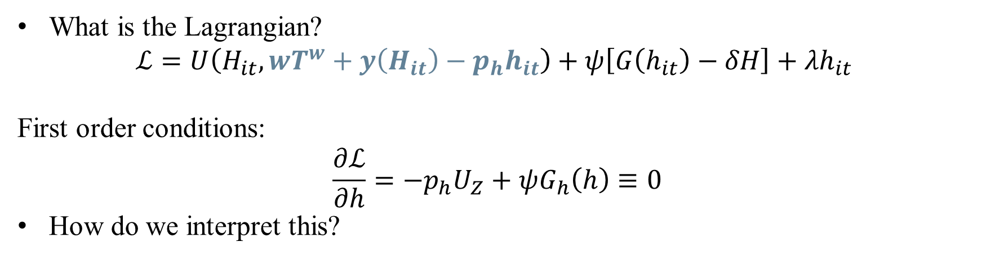
Finding the Equilibrium
What is the Lagrangian?
$$ℒ=U\left(H_{it}, wT^{w}+y\left(H_{it}\right)−p_{h}h_{it}\right)+ψ\left[G\left(h_{it}\right)−δH\right]+λh_{it}$$
First order conditions:
$$\frac{∂ℒ}{∂h}=−p_{h}U_{Z}+ψG_{h}\left(h\right)≡0$$
How do we interpret this?
Notes:
Marginal benefit = marginal cost! G() is the marginal benefit and U_z is the cost of not consuming z

Slide 51

Main Model Takeaways
So why do we care?
Shows that health production can be modeled as a stock/investment
Helps to model long term decision-making for health
How has this model been used empirically?
To theoretically justify SES Health Gradient
Model health optimally deteriorating with age
What limitations exist?
Requires certainty – known function $G\left(⋅\right)$
No savings
Others?
Notes:
Changes in wages over time, completely forward-looking decision-making (this is the biggest drawback in my book), no uncertainty. Talk a little bit more about how to use he model to look at variations across individuals but also across time (aging)

Slide 52
Discussions on Grossman
Zweifel, P. (2012). “The Grossman model after 40 years”. The European Journal of Health Economics
Kaestner, R. (2013). “The Grossman model after 40 years: a reply to Peter Zweifel”. The European Journal of Health Economics

Slide 53
Critique: Zweifel (2012)
The Grossman model has failed to be policy relevant
Assumes a long, fixed planning horizon – do people really plan 50 years out?
Assumes that return of investment is constant across health states
Notes:
Is this a critique we care about (multiple answers here)? Note the style of the critique – addresses core assumptions of the model. Can we weaken these assumptions? What would be the benefit of doing so? Note that critique 2 is broken out into multiple parts in the paper.

Slide 54
Critique: Zweifel (2012)
The Grossman model has failed to be policy relevant
Assumes a long, fixed planning horizon – do people really plan 50 years out?
Assumes that return of investment is constant across health states
“However, the acronym MGM already suggests that the model amounts
to something like the Hollywood dream factory Metro-Goldwyn-Mayer:
much elegance, very inspiring, but of limited relevance to the real world.”
“It is amazing that neither the reviewers nor the editors of
Health Economics recognized this. Or was there collusion
between the journal and the author, serving their shared
interest in keeping the MGM bandwagon rolling?
Notes:
He’s clearly got a bone to pick here – he had a kind of longstanding animosity here.

Slide 55

Critique: Zweifel (2012)
The Grossman model has failed to be policy relevant
Assumes a long, fixed planning horizon – do people really plan 50 years out?
Assumes that return of investment is constant across health states
Fundamental critique: Grossman predicts (models?) co-movement of $h$ and $H$
But in empirical work, sicker people (lower$H$) are found to visit the doctor more frequently (higher $h)$! What do we think of this critique?
Thankfully, he proposes an alternative model, based on stochastic state dependence
Your health investment return is random
Your health therefore is random…
But it depends a lot on where you were yesterday
Notes:
Basically, he says, the model doesn’t match the empirics. This is a pretty common critique of modeling. Zweifel’s model matches the empirics and has similar results to the MGM otherwise, so is a plausible candidate for a new model.

Slide 56
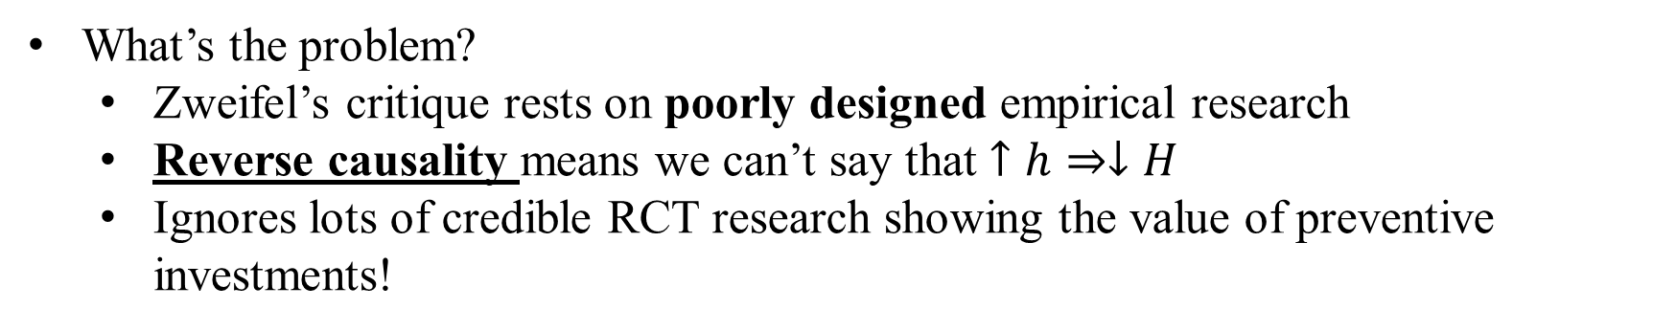
Response: Kaestner (2013), Laporte (2014)
What’s the problem?
Zweifel’s critique rests on poorly designed empirical research
Reverse causality means we can’t say that $↑h⇒↓H$
Ignores lots of credible RCT research showing the value of preventive investments!
Notes:
Sure you go to the dentist if you have cavities but this doesn’t mean brushing your teeth is bad

Slide 57
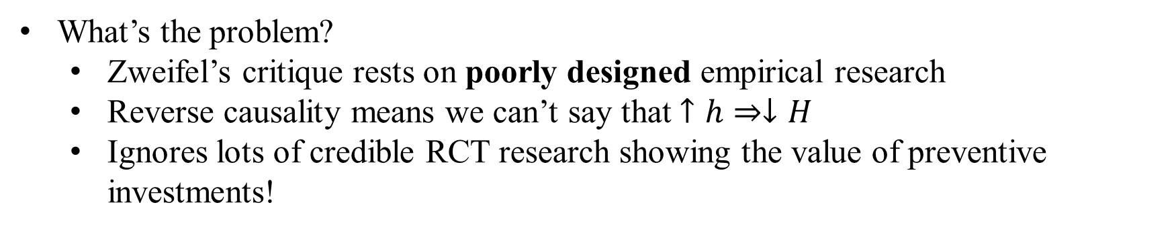
Response: Kaestner (2013), Laporte (2014)
What’s the problem?
Zweifel’s critique rests on poorly designed empirical research
Reverse causality means we can’t say that $↑h⇒↓H$
Ignores lots of credible RCT research showing the value of preventive investments!
“Zweifel suggests, disconcertingly, that there is a conspiracy within the health economics community to shield the Grossman model from meaningful criticism (‘‘Or was there collusion between the journal and the author, serving
their shared interest in keeping the MGM bandwagon rolling?’’). This barely disguised (as a question) accusation is unjustified and disingenuous.”
“Is the Grossman model perfect? No, but it provides a logically consistent framework to: (1) explain observed differences in health, investments in health including medical care, and consumption; and (2) evaluate public and private policies to affect these outcomes. It is as relevant today as it was 40 years ago.”
Notes:
Sure you go to the dentist if you have cavities but this doesn’t mean brushing your teeth is bad

Slide 58

Response: Kaestner (2013), Laporte (2014)
What’s the problem?
Zweifel’s critique rests on poorly designed empirical research
Reverse causality means we can’t say that $↑h⇒↓H$
Ignores lots of credible RCT research showing the value of preventive investments!
Laporte (2014) walks through a credible way to test this claim:
Zweifel is treating $H$ effectively as non-durable in his critique
That’s the opposite of what Grossman assumed!
You can show directly that higher levels of $H$ may reduce $h$ tomorrow, but this is because of the lower returns from increasing an already high level of health
Still can’t say anything about how $h_{t}$ affects $H_{t+1}$
Notes:
e.g., if you regress h on H, you treat H as a flow (non-durable) not a stock (durable). If you have time, you can show this: go to page 6 of Audrey’s paper and walk through the math on the whiteboard

Slide 59
Jacobson (2000)
“The family as producer of health—an extended Grossman model.” Journal of Health Economics.
Notes:
Now we’ll look briefly at some extensions of the model and some critiques, just to get the ideas flowing.

Slide 60

Spin on a Classic: who produces health?
Main update on question: what if families produce health together?
Notes:
Specifically, what if families produce health for each other? Mechanism is the same: investment benefits affect future time for earning income and consumption.

Slide 61
Spin on a Classic: who produces health?
Main update on question: what if families produce health together?
Family members’ investments spill over to others’ health
What questions does this allow us to answer?
Notes:
Why is this model extension useful? Should we do it just for its own sake? No! But we can consider something new: how families value health within households (who gets to go to the doctor when budgets are tight)

Slide 62
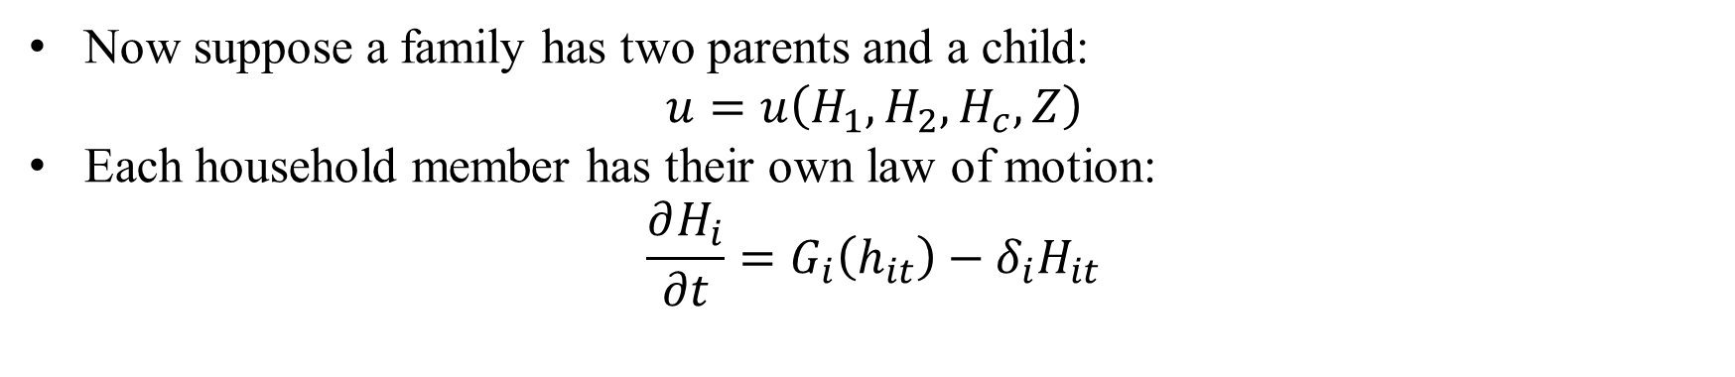
Updated Problem
Now suppose a family has two parents and a child:
$$u=u\left(H_{1},H_{2},H_{c},Z\right)$$
Each household member has their own law of motion:
$$\frac{∂H_{i}}{∂t}=G_{i}\left(h_{it}\right)−δ_{i}H_{it}$$
Notes:
We can bundle Z at the household level – why does this simplification make sense?

Slide 63

Updated Problem
Now suppose a family has two parents and a child:
$$u=u\left(H_{1},H_{2},H_{c},Z\right)$$
Each household member has their own law of motion:
$$\frac{∂H_{i}}{∂t}=G_{i}\left(h_{it}\right)−δ_{i}H_{it}$$
Suppose, though that the child’s production function depends on parental investment:
$$G_{c}=G_{c}\left(h_{c}, h_{1},h_{2};E_{1},E_{2}\right)$$
Time constraints also evolve for each family member to take care of one’s own sick time and child’s sick time, when needed (how would you write these?)
Notes:
Here, E variables indicate relative productivity of household members in producing health (in old model, we could just normalize this to 1, but want to model potential comparative advantages in health production). Note that E_c is normalized to be 1 or 0 (depending on if child produces health or not). This could be measured empirically (Grossman suggested education, hence the E, but there are obviously problems with that).

Slide 64
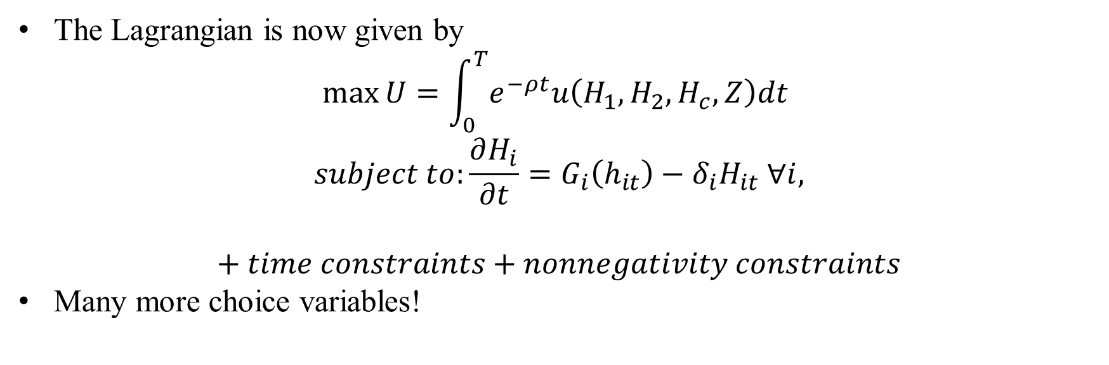
Updated Problem
The Lagrangian is now given by
$$\max{U}=\int_{0}^{T}{e^{−ρt}u\left(H_{1},H_{2},H_{c},Z\right)dt }$$
$$subject to:\frac{∂H_{i}}{∂t}=G_{i}\left(h_{it}\right)−δ_{i}H_{it} ∀i,$$
$$+ time constraints+nonnegativity constraints$$
Many more choice variables!

Slide 65
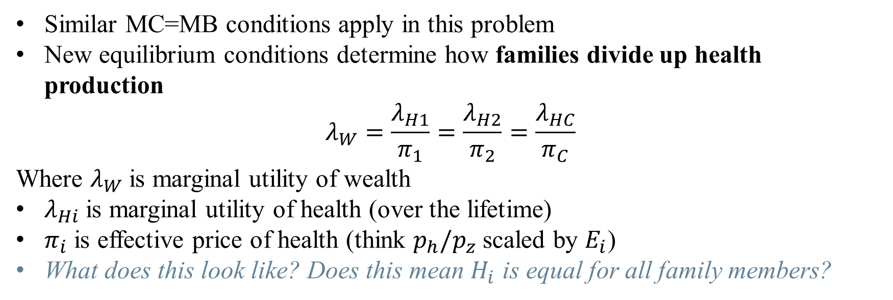
Key Insight
Similar MC=MB conditions apply in this problem
New equilibrium conditions determine how families divide up health production
$$λ_{W}=\frac{λ_{H1}}{π_{1}}=\frac{λ_{H2}}{π_{2}}=\frac{λ_{HC}}{π_{C}}$$
Where $λ_{W}$ is marginal utility of wealth
$λ_{Hi}$ is marginal utility of health (over the lifetime)
$π_{i}$ is effective price of health (think $p_{h}/p_{z}$ scaled by $E_{i}$)
What does this look like? Does this mean $H_{i}$ is equal for all family members?
Notes:
Solution requires optimal control theory, which we won’t touch. Hence, family invests in health until the rate of marginal utilities of (lifetime) health to effective price of health for all family members is equal and equal to the marginal utility of wealth – this is how goods are divided up in micro theory of demand. Health stock need not be equal for family members depending on productivity!
Findings: 1. So those who value health more or produce it more efficiently will end up with more health (does this make sense? I can see it either way)
2. Health spills over across homes – parents with higher health will have children with higher health than parents with lower health (intergenerational spillovers)

Slide 66

Key Insight
Similar MC=MB conditions apply in this problem
New equilibrium conditions determine how families divide up health production
$$λ_{W}=\frac{λ_{H1}}{π_{1}}=\frac{λ_{H2}}{π_{2}}=\frac{λ_{HC}}{π_{C}} \left(1\right)$$
Where $λ_{W}$ is marginal utility of wealth
$λ_{Hi}$ is marginal utility of health (over the lifetime)
$π_{i}$ is effective price of health
What does this look like? Does this mean $H_{i}$ is equal for all family members?
Note that you can rearrange (1) to get $λ_{W}π_{c}=λ_{Hc}$
Families whose wealth constraint is binding ($λ_{W}>0)$ value marginal change in child’s health more than unconstrained (wealthy) families.
Further, children with unhealthy parents tend to be less healthy, so should also value more investments. Does this make sense as a prediction?
Notes:
The main punch from the extension: think about liquidity constrained households. More $ has to be spent to bring up parents’ health to meet equation (1) , so less resources for child. But not true that households that are poorer seek out greater health interventions (why not?)

Slide 67
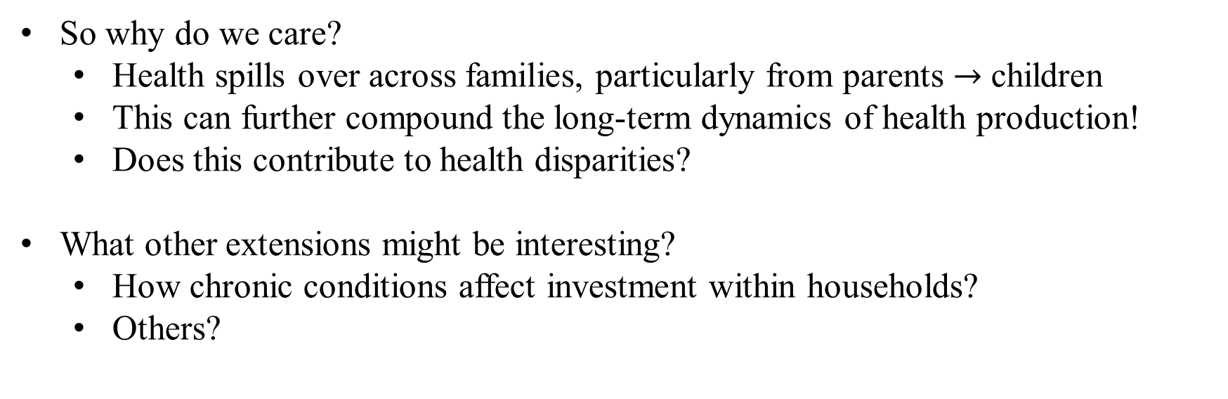
Main Model Takeaways
So why do we care?
Health spills over across families, particularly from parents $→$ children
This can further compound the long-term dynamics of health production!
Does this contribute to health disparities?
What other extensions might be interesting?
How chronic conditions affect investment within households?
Others?
Notes:
We’ll get to talking about disparities.

Slide 68
Summary
Health can be modeled as a choice
Health evolves over time in response to investments
Small decisions add up to large changes in health
Accounting for spillovers within households may explain disparities in investments
Is the empirical evidence consistent with these predictions? Meh.
Is the model trash? Also meh.
Next time: moral hazard in health care
How does messing with the price of care affect demand for services?

