Slide 1
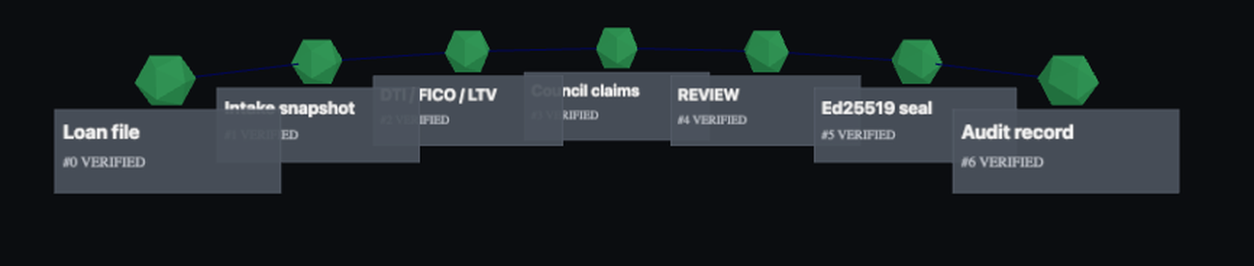
CAPSTONE IN COMPUTER SCIENCE I
Shadow
A Cryptographically Verifiable Evidence and Spatial
Audit System for AI-Assisted Decisions
From AI answers to independently verifiable decision evidence.
Alex Ji
M.S. Computer Science
Yeshiva University
Practice presentation
2026-07-21
Real render — Shadow 3D audit arc · research prototype

Slide 2
THE TRUST GAP
An answer is not an evidence record
≠
AI ANSWER
“Approve the loan.”
fluent · unverifiable
EVIDENCE RECORD
source → tool action → sequence → signature → verifier
structured · signed · independently checkable
SOURCE
What did it rely on?
ACTION
What did it do?
INTEGRITY
Was it changed after?
INDEPENDENCE
Can someone else verify it?
Ordinary logs are mutable and platform-specific; a model’s explanation is generated prose, not a record.
Alex Ji · Shadow · Capstone I
2

Slide 3
PROJECT EVOLUTION
From more opinions to verifiable evidence
ORALLEXA
Multiple AI perspectives debate an answer
↓
THE LESSON
More voices do not create verifiability
↓
SHADOW
Portable evidence + independent verification
Trust moved down a layer — from the voices to the evidence beneath them. A refinement, not a failure.
Alex Ji · Shadow · Capstone I
3

Slide 4
HOW SHADOW RECORDS EVIDENCE
A cryptographically bound sequence
✓
Source
doc
Action
tool
Event
seq 2 · a3f9…
Hash chain
commits prev
Ed25519 seal
batch root
Verify
independent
Change one earlier event → the first broken link and its downstream impact become visible.
VERIFIES OFFLINE
SHA-256 + Ed25519
Alex Ji · Shadow · Capstone I
4

Slide 5
SYSTEM ARCHITECTURE
One core, three profiles, many surfaces
EXPERIENCES
CLI · MCP (11) · HTTP · verify.html · Unity Shadow Lens · Three.js replay · 3 explainers
MIXED MATURITY
PROFILES
banking-v1 · data-science-v1 · coding-agent-v1
ONE GRAMMAR
SHADOW CORE
canonical events · hash chain · Ed25519 · source maps · claim–evidence graph · ingest audit
HOST-TESTED
A portable evidence bundle flows through every layer — verifiable by anyone, offline. Interface maturity is labelled, not hidden.
Alex Ji · Shadow · Capstone I
5

Slide 6
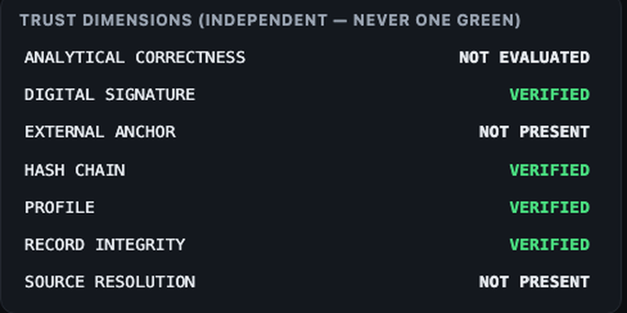
THREE PROFILES, ONE GRAMMAR
Same machinery, domain-specific evidence
BANKING
DATA SCIENCE
CODING AGENT
document → risk claim → source quote
dataset → model → metric → selection
issue → tool call → diff → tests → commit
DATASET
versioned input
+ added verified path
+ guard on ingest
− removed silent skip
MODEL
tool/model action
METRIC
scored
tests ✓✓
commit a3f9…
SELECTION
✓ chosen
live audit-chain fixture (real render)
Underneath, identical: sequence → hash chain → signature → source resolution
Alex Ji · Shadow · Capstone I
6

Slide 7
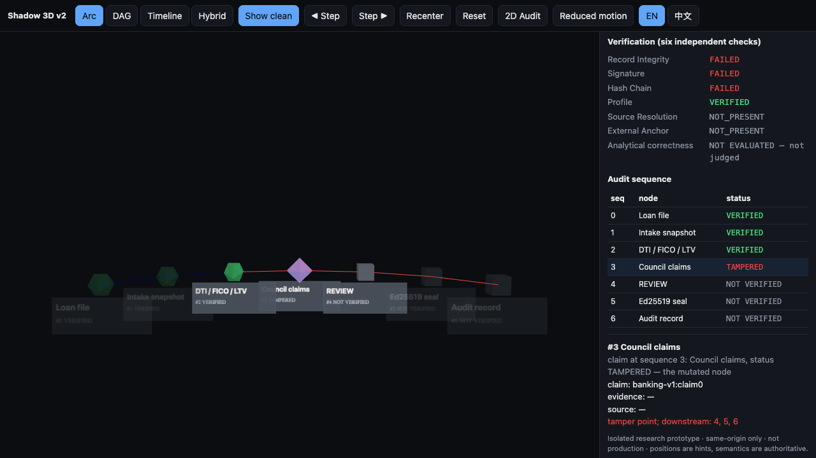
THE KEY MOMENT
Exact tamper localization
Spatial replay fixture — first failed sequence 3
1
Seq 3 — TAMPERED
the mutated Council-claims node
2
Downstream 4, 5, 6
NOT VERIFIED — chain invalidated
3
Analytical correctness
NOT EVALUATED — not judged
Shadow reports:
first failed seq: 3
reason: prev_hash_mismatch
downstream: 4, 5, 6
Integrity failure does not determine analytical correctness — the two stay independent.
Alex Ji · Shadow · Capstone I
7

Slide 8
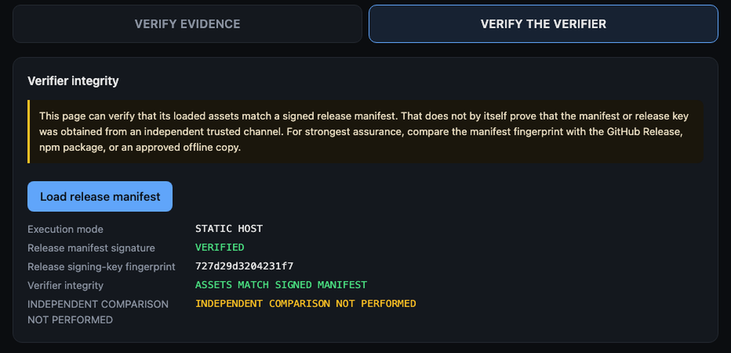
VERIFY THE VERIFIER
Can you trust the verifier page itself?
1
Manifest signature
VERIFIED
2
Assets match
SIGNED MANIFEST
3
Independent comparison
NOT PERFORMED
A page hashing itself is not independent trust.
Signing today is a FIXTURE release key, not production.
Real render — Verify-the-Verifier (fixture release key)
Alex Ji · Shadow · Capstone I
8

Slide 9
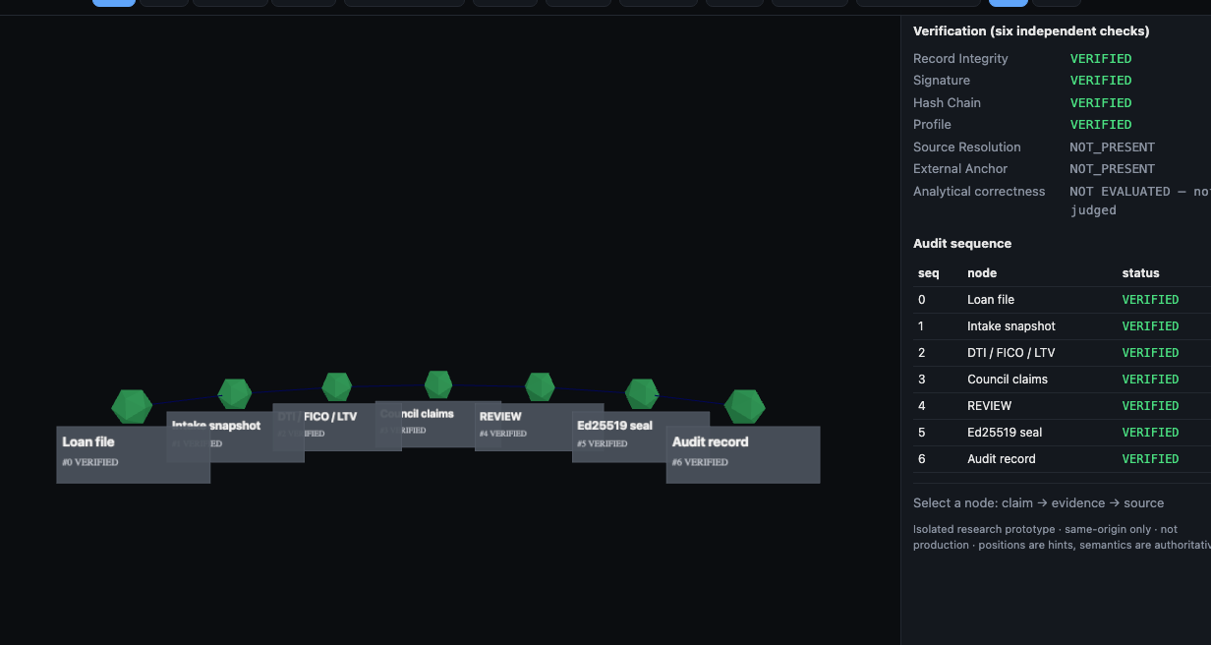
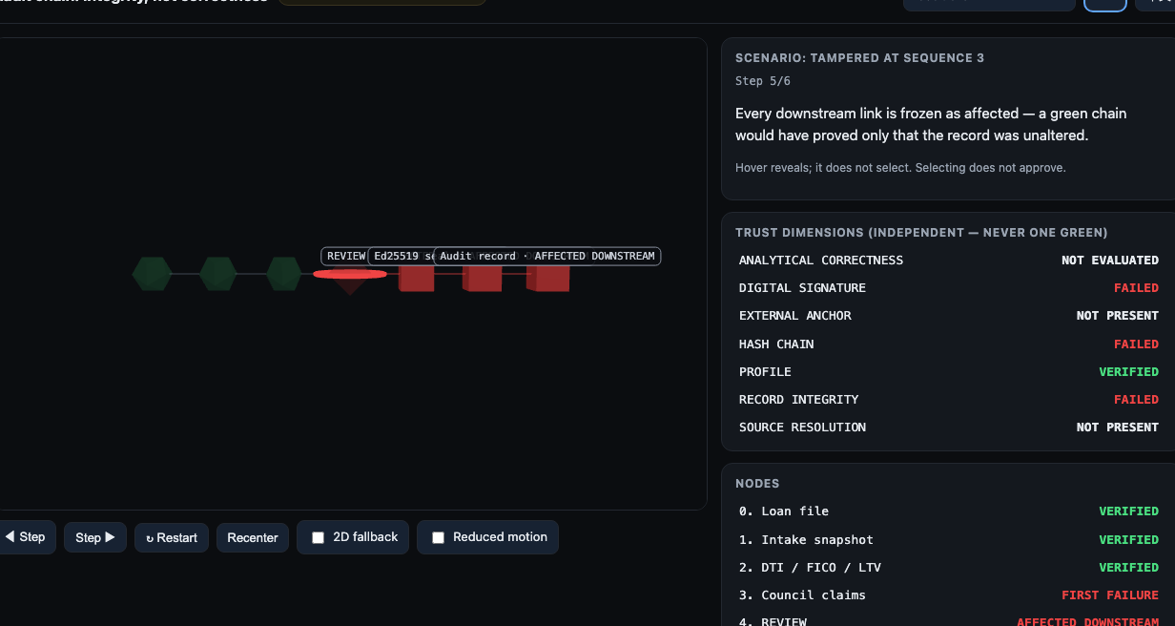
SPATIAL AUDIT REPLAY
3D for sequence, provenance, tamper propagation
THREE.JS — arc layout · browser-rendered
THREE.JS — tamper cascade · browser-rendered
THREE.JS STORY ADAPTER host-tested contract + browser-rendered · 5 layouts + 2D fallback
SHARED SCENE / STORY CONTRACT authored + host-tested (shadow-3d-scene-v1)
UNITY SHADOW LENS unity-authored · C# contract-drift host-tested · Android-built
device-validation pending · not pictured (no Game View capture)
Honest bounds:
· not eye tracking
· no 6DoF claim on mock
· no user study yet (RQ4)
Alex Ji · Shadow · Capstone I
9

Slide 10
EVALUATION AND EVIDENCE
Measured today — not inferred
BROWSER
Chromium 149 · EN + 简体中文 · 0 external requests · 0 CSP violations · offline verify
1,892
of 1,895 host tests
ANDROID
APK built · 24.4 MB · SHA-256 recorded · NOT device-validated
0 failed
3 skipped (env-gated)
36 suites
SPATIAL
Scene + story contract host-tested · Three.js adapter host-tested + browser-rendered · Unity C# contract-drift tested · no user study
Re-run 2026-07-21 on feat/shadow-shared-story-adapters @ 5f655e8.
Alex Ji · Shadow · Capstone I
10

Slide 11
CURRENT STATE AND CAPSTONE II
Accurate statuses, not blanket ‘pending’
NOW
NEXT — CAPSTONE II
✓ Core evidence + hash-chain verification
○ Unity production integration + editmode/playmode
✓ Claim–evidence graph (host-tested)
○ Beam Pro device validation
✓ Bilingual offline verifier · 3 explainers
○ XREAL native input / camera path
✓ Shared scene + story contract — authored + host-tested
○ Device performance measurement
✓ Three.js story adapter — host-tested + browser-rendered
○ Spatial-vs-2D user study (RQ4)
✓ Unity C# contract-drift tested · Android build
○ Production signing · KMS/HSM · governance
Ingest audit: structural host-tested · semantic production-evaluation pending — not device-pending.
Alex Ji · Shadow · Capstone I
11

Slide 12
CONTRIBUTION
Shadow does not ask an auditor to
trust the AI’s answer.
It gives them evidence they can
independently verify.
Sequence. Sources. Signatures. Exact tamper location.
Integrity — not correctness.
github.com/alex-jb/shadow-mentor · Thank you — questions welcome.

Slide 13
BACKUP · IMPLEMENTATION STATUS
Capability ladder — nothing over-claimed
Evidence schema · hash chain · Ed25519
HOST-TESTED
Offline browser verifier (EN + zh-CN)
BROWSER-RENDERED / RECORDED
Verify-the-Verifier manifest
FIXTURE-SIGNED
Claim–evidence graph · 3 explainers
HOST-TESTED
Shared scene + guided-story contract
AUTHORED + HOST-TESTED
Three.js story adapter
HOST-TESTED · BROWSER-RENDERED
Unity Shadow Lens
UNITY-AUTHORED · C# DRIFT-TESTED · DEVICE-PENDING
Android mock APK
ANDROID-BUILT (not device-validated)
Ingest audit — structural / semantic
HOST-TESTED / PRODUCTION-PENDING
Spatial comprehension benefit (RQ4)
NOT IMPLEMENTED — no user study
Alex Ji · Shadow · Capstone I
13

Slide 14
BACKUP · CRYPTOGRAPHIC TRUST BOUNDARY
What a valid signature does and does not prove
ESTABLISHES
DOES NOT ESTABLISH
✓ The bytes match the sealed record
✗ That the cited source was truthful
✓ The chain is unbroken (or where it breaks)
✗ That the conclusion is correct
✓ The batch root was signed by a known key
✗ That signing is production-grade
✓ Conformance to a domain profile
✗ That any regulation mandates it
Alex Ji · Shadow · Capstone I
14

Slide 15
BACKUP · LIMITATIONS
Stated directly
— Evidence is fixture data; limited live-provider validation
— Production signing not implemented (fixture release key)
— Unity is authored + C# contract-drift-tested — not editmode/playmode-run, not device-validated
— Device validation pending (Beam Pro); XREAL native not integrated
— No completed user study — RQ4 spatial benefit unproven
— Semantic ingest audit: production evaluation pending (structural is host-tested)
— No proof of source truth; no proof of analytical correctness
— No production KMS/HSM, key rotation, or durable storage
Alex Ji · Shadow · Capstone I
15

Slide 16
BACKUP · DEMO FALLBACK PLAN
Never depend on a live device
A · Live app
serve verifier package locally
B · Browser package
open the frozen offline package
C · Recorded video
Open bookmarked fallback video (Shadow verify full demo)
D · Slide screenshots
embedded figures — one keystroke away
Decision rule: if the live app doesn’t come up cleanly in 20 seconds, open the bookmarked fallback video and keep talking.
Alex Ji · Shadow · Capstone I
16

