Slide 1
CAPSTONE IN COMPUTER SCIENCE I
Shadow
A Cryptographically Verifiable Evidence and Spatial
Audit System for AI-Assisted Decisions
From Multi-Agent Answers to Independently Verifiable AI Decision Evidence
Alex Ji · M.S. Computer Science · Yeshiva University
Practice presentation · 2026-07-21

Slide 2
THE PROBLEM
An AI answer is not verifiable evidence
AI ANSWER
“Approve the loan.”
≠
VERIFIABLE EVIDENCE
checkable by someone else
Ordinary logs are mutable and platform-specific. A model’s explanation is generated prose, not a record.
Source provenance
what did it rely on?
Tool / model actions
what did it actually do?
Tamper detection
was it changed after the fact?
Independent check
can someone else verify it, offline?
Shadow · Capstone I · Alex Ji
2 / 12

Slide 3
PROJECT EVOLUTION
From more opinions to verifiable evidence
→
→
Orallexa
The lesson
Shadow
multi-agent debate
(bull · bear · judge)
more opinions
≠ more trust
portable, verifiable
evidence layer
Trust moved down a layer — to the evidence underneath, not the voices on top.
A refinement of the original research question, not a project that failed.
Shadow · Capstone I · Alex Ji
3 / 12

Slide 4
WHAT SHADOW RECORDS
The evidence lifecycle
Source
Agent /
Tool Action
Evidence
Event
Hash
Chain
Signature
Independent
Verification
• Each event is structured and canonically serialized.
• Each event commits to the previous one — change an early event, everything after it breaks.
• The sealed batch root is signed (Ed25519). Anyone can verify the record — including offline.
Shadow · Capstone I · Alex Ji
4 / 12

Slide 5
ARCHITECTURE
One core, three profiles, many surfaces
CORE
canonical evidence schema · signed hash-chain record · source maps verifier · claim–evidence graph · ingested-output audit (structural)
host-tested
PROFILES
banking-v1 · data-science-v1 · coding-agent-v1
one verification grammar across domains
INTERFACES
CLI · MCP (11 tools) · HTTP · browser verify.html | Unity Shadow Lens · Three.js replay · Android mock
verifier: browser-rendered · Unity/3D: prototypes, device-validation pending
Interfaces are not equally mature — the deck labels which is which.
Shadow · Capstone I · Alex Ji
5 / 12

Slide 6
THREE PROFILES, ONE GRAMMAR
Same machinery across domains
Banking
document → risk claim → source
Data Science
dataset → model → metric
Coding Agent
issue → diff → tests → commit
Underneath, the same verification grammar: sequence → hash chain → signature → source resolution.
Shadow · Capstone I · Alex Ji
6 / 12

Slide 7
THE KEY MOMENT
Tamper demonstration
PRISTINE
seq 0
seq 1
seq 2
seq 3
seq 4
seq 5
TAMPERED — one field changed at seq 2
↑ first failed sequence
seq 0
seq 1
seq 2 ✗
seq 3
seq 4
seq 5
The verifier names the exact first failed sequence — not “something is wrong.”
Everything after it is invalidated — the signature covered a chain that no longer exists.
Even in failure, integrity and correctness stay separate — it never says the conclusion was right.
Shadow · Capstone I · Alex Ji
7 / 12

Slide 8
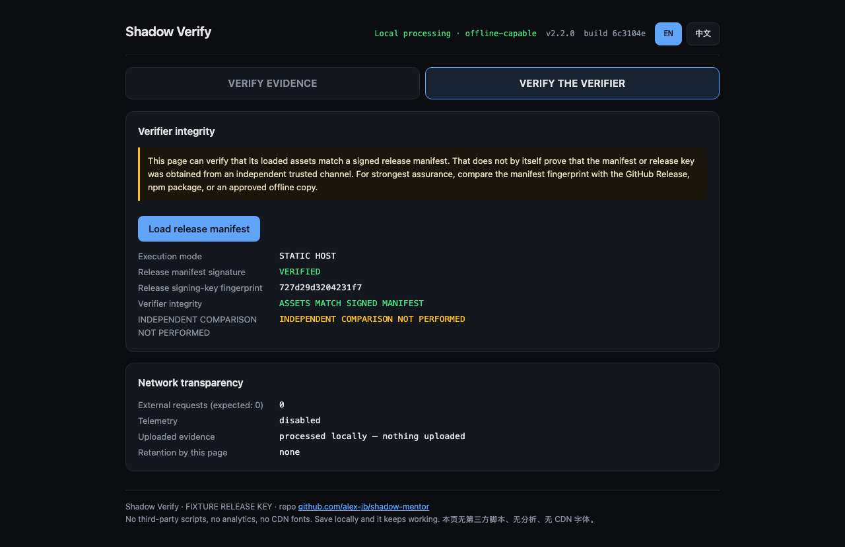
VERIFY THE VERIFIER
Can you trust the verifier page itself?
It carries a signed fixture manifest — ASSETS MATCH SIGNED MANIFEST.
Real trust needs an out-of-band check: asset hashes vs. a manifest from a separate channel, and the release-key fingerprint compared independently — INDEPENDENT COMPARISON NOT PERFORMED.
A page hashing itself is not trust.
Real render — Verify-the-Verifier (fixture manifest)
Current signing is fixture, not production.
Shadow · Capstone I · Alex Ji
8 / 12

Slide 9
THE SPATIAL EXPERIENCE
3D for sequence, provenance, and tamper replay
Unity Shadow Lens + Three.js replay
• Three workspaces; provenance audit arc; Verify / Tamper / Reset
• Head-directed focus (gaze hover)
• A precise 2D fallback always remains
• Android mock APK built — 24.4 MB, hashed
Stated honestly
✗ NOT eye tracking — hover only
✗ No RGB capture
✗ No 6DoF on the mock build
○ Android APK is built, not device-validated
○ Beam Pro / XREAL validation pending
○ No user study yet — 3D benefit unproven
Shadow · Capstone I · Alex Ji
9 / 12

Slide 10
EVALUATION
What is real today, measured honestly
1,824 / 1,827
Chromium 149
24.4 MB APK
No user study
host tests pass
(3 skipped · 0 failed)
browser verifier
EN + 简体中文 · 0 external
Android mock built
(not device-validated)
3D comprehension
not yet proven (RQ4)
Browser acceptance run in real Chromium (Playwright): 8 flows, English + Simplified Chinese,
CSP with 0 external requests / 0 violations, offline verification — real screenshots, not mock-ups.
Shadow · Capstone I · Alex Ji
10 / 12

Slide 11
WHERE IT STANDS
Implemented now vs. Capstone II
IMPLEMENTED NOW
PENDING — CAPSTONE II
✓ Deterministic evidence + hash chain
○ Beam Pro / XREAL device validation
✓ Independent + offline verification
○ Shared Unity / Three.js scene contract
✓ Exact tamper localization
○ User study — does 3D actually help?
✓ Bilingual verifier (EN / zh-CN)
○ Semantic audit of ingested output
✓ Android mock build
○ Production signing · KMS / HSM
Fixture-signed · device-pending · no correctness claim — stated plainly, not oversold.
Shadow · Capstone I · Alex Ji
11 / 12

Slide 12
CONTRIBUTION
Shadow does not ask the auditor to
trust the AI’s answer.
It gives them evidence they can
independently verify.
The sequence, the sources, the signature — and, if it was tampered with, the exact break.
Integrity, not correctness.
Thank you — questions welcome.

