Slide 1
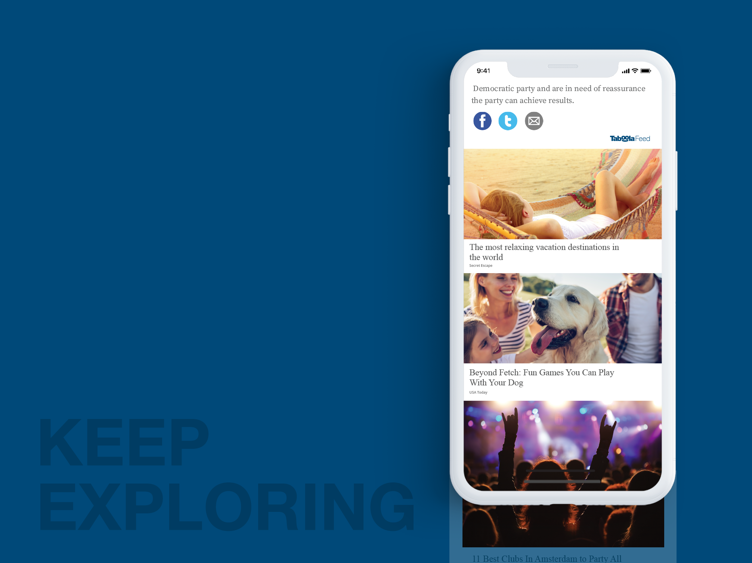
Publisher Config Tool
for DeeperDive powered by Taboola ⓒ
11.11.2025
TA Israel

Slide 2
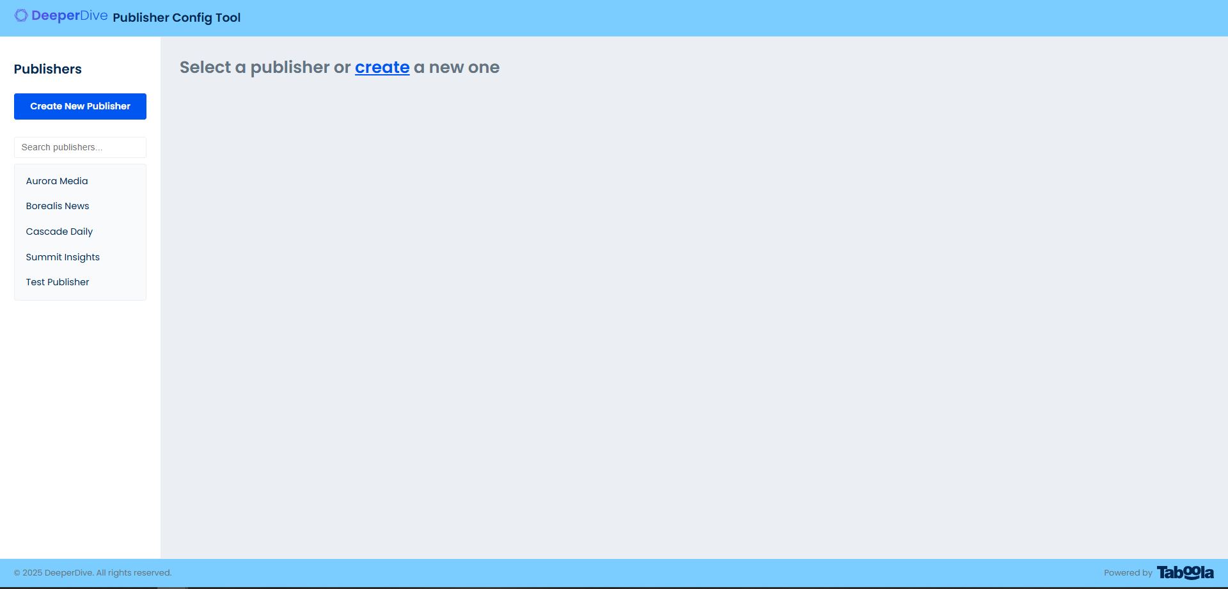
Main page

Slide 3
Main page
Buttons to add new publisher
Search input in real time
List of already added publishers

Slide 4
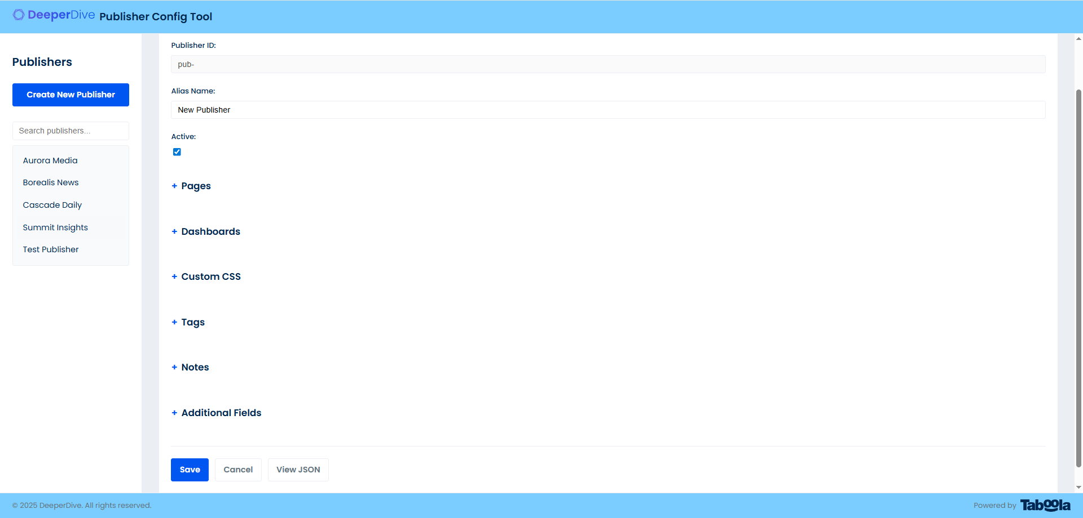
Create

Slide 5
Create
Publisher Id.
This form disabled and will take data from Allias Name field
Active/inactive checkbox
Collapsible fields
Functional buttons section

Slide 6
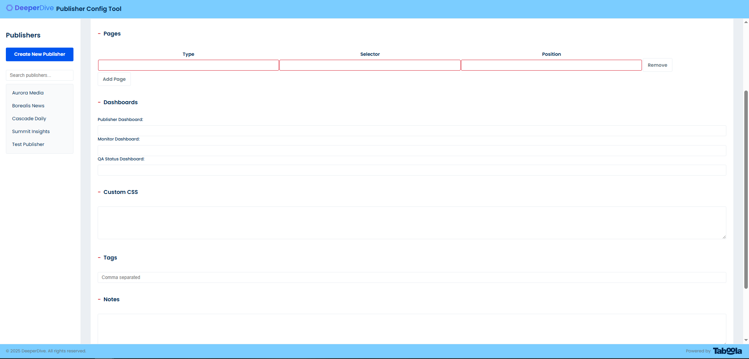
Fields

Slide 7
Fields
The fields correspond to strings in the JSON but do not require special formatting. Some of them required.

Slide 8
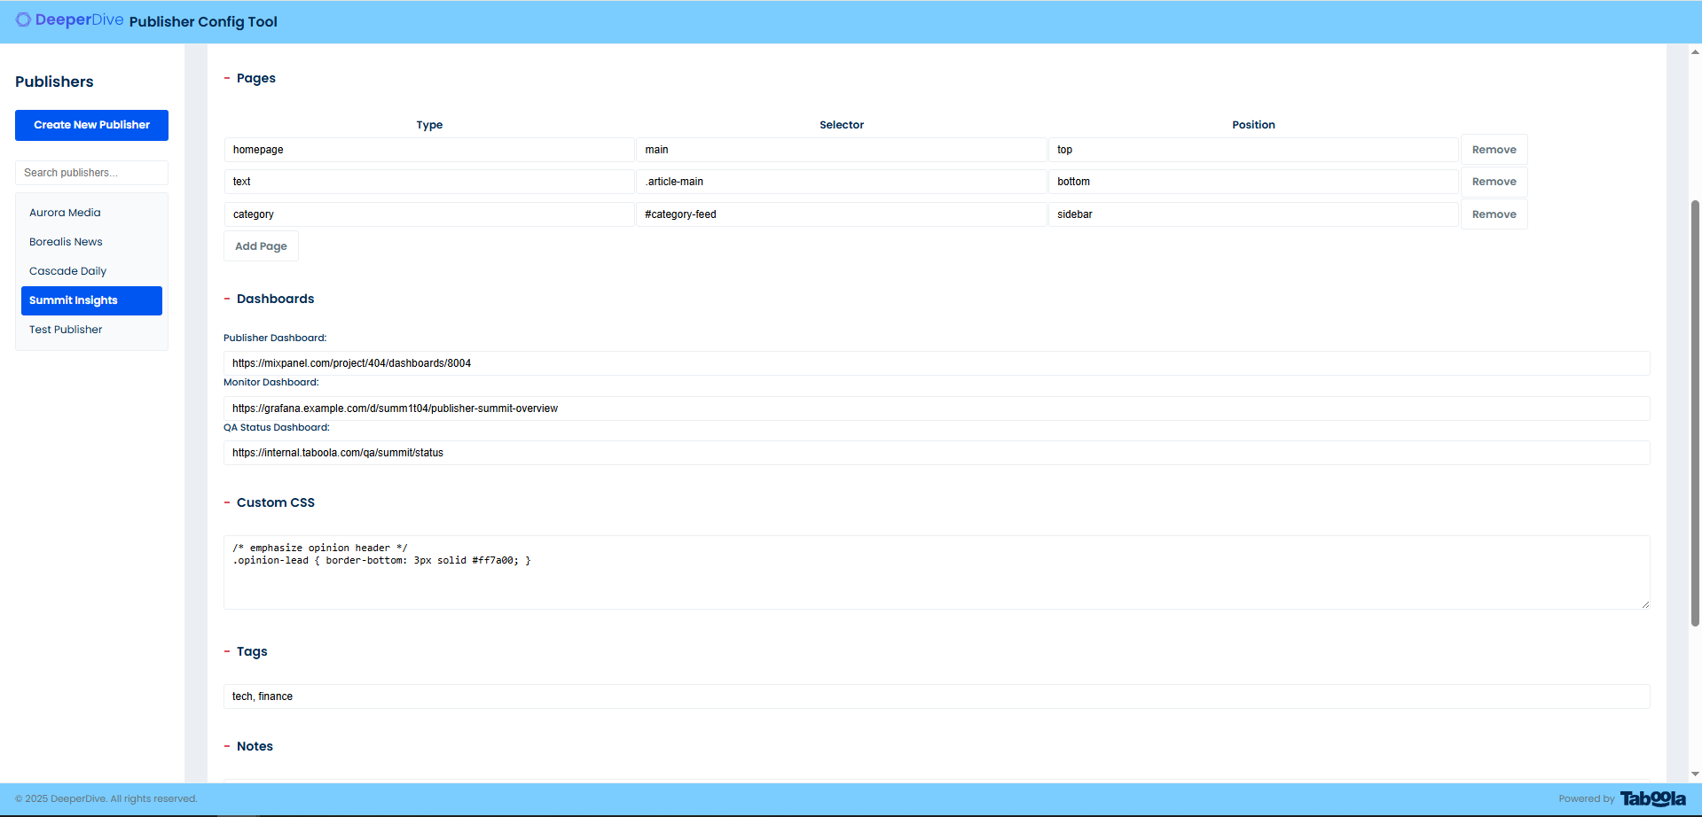
Fields example
User can add and remove pages.
The fields have a validation of content.
For example: user can’t put url without https://

Slide 9
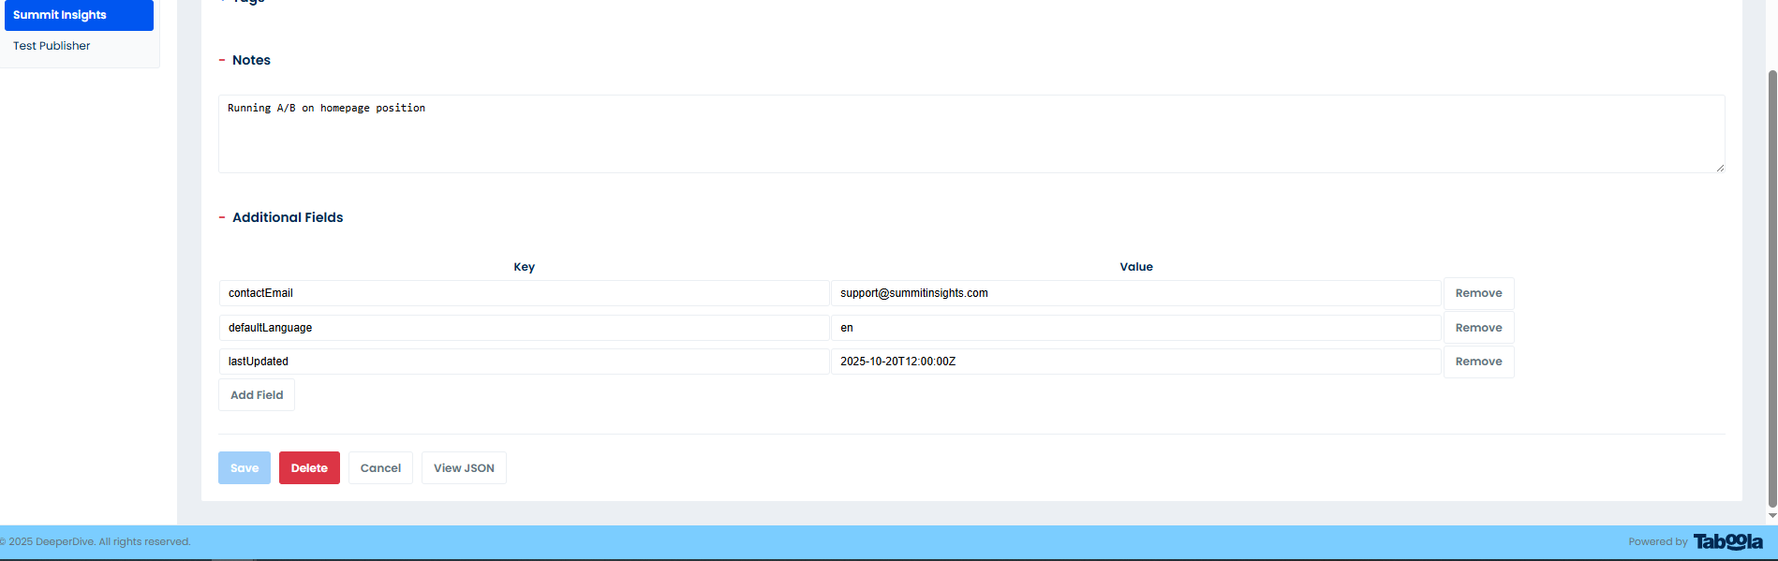
Extra fields
User can add and any additional fields
The SAVE button will be disabled if any required field is incomplete or contains a validation error

Slide 10
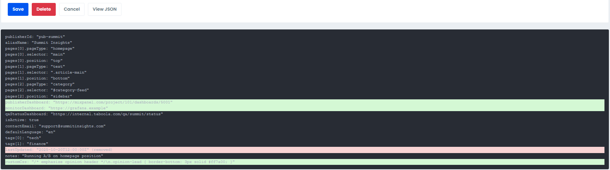
JSON viewer
The JSON viewer is opened and closed using a button
JSON viewer is updating in realtime. It shows any changing of fields.

Slide 11
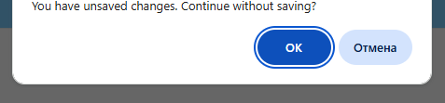
Saving data
If the user tries to close the tab, or clicks the CANCEL button, another publisher, the CREATE button, or the HOME button, a browser system message will appear. This prevents exiting without saving and losing data.

Slide 12
THANK YOU
for your attention!
with regards
Alex Manis

