Slide 1

Student-Initiated Learning
Alex Martino
Cherie Chung
Ian C. Lundy
Steve Silvius

Slide 2
Process
What we wanted, but couldn’t find.
Architecture Class
Education Research
Engineering
Practical Ruby Programming Course

Slide 3
Problem Statement
There is a disconnect between what students want to learn, the courses offered, and awareness of alternate paths.

Slide 4
Verifying Our Problem n = 107
There is a problem
The demand isn’t met

Slide 5
Verifying Our Problem n = 107
Groups help

Slide 6
Verify Our Findings
Students prefer class and structure.

Slide 7
Our Platform - Pathways
file:///Users/aomartino93/Desktop/Pathways/index.htm

Slide 8
Confirm Our Viability
Data from students
Integrate with University Data Systems
Registrar
Hoya Link
LinkedIn API
Produces data/relevant feedback for the University

Slide 9
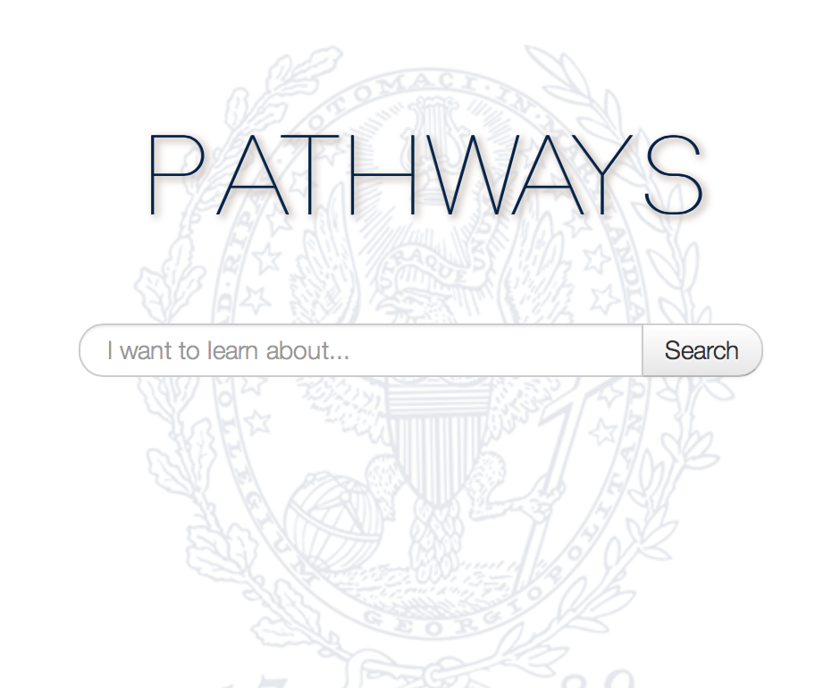
Choice. Convenience. Control.

