Slide 1







Slide 2
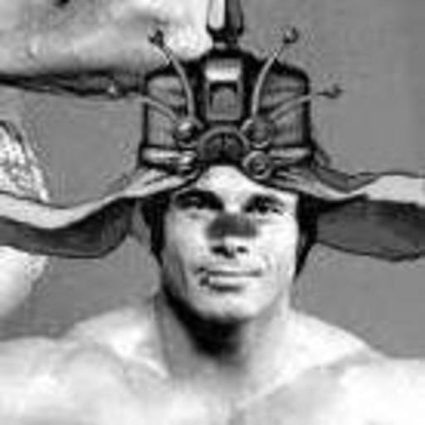


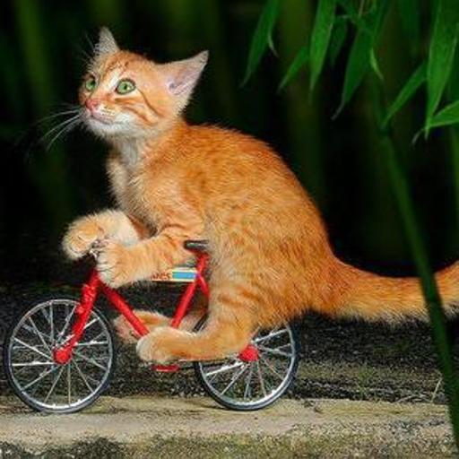

Alexander
Matt
Jon
Ryan
Cole

Slide 3


Slide 4
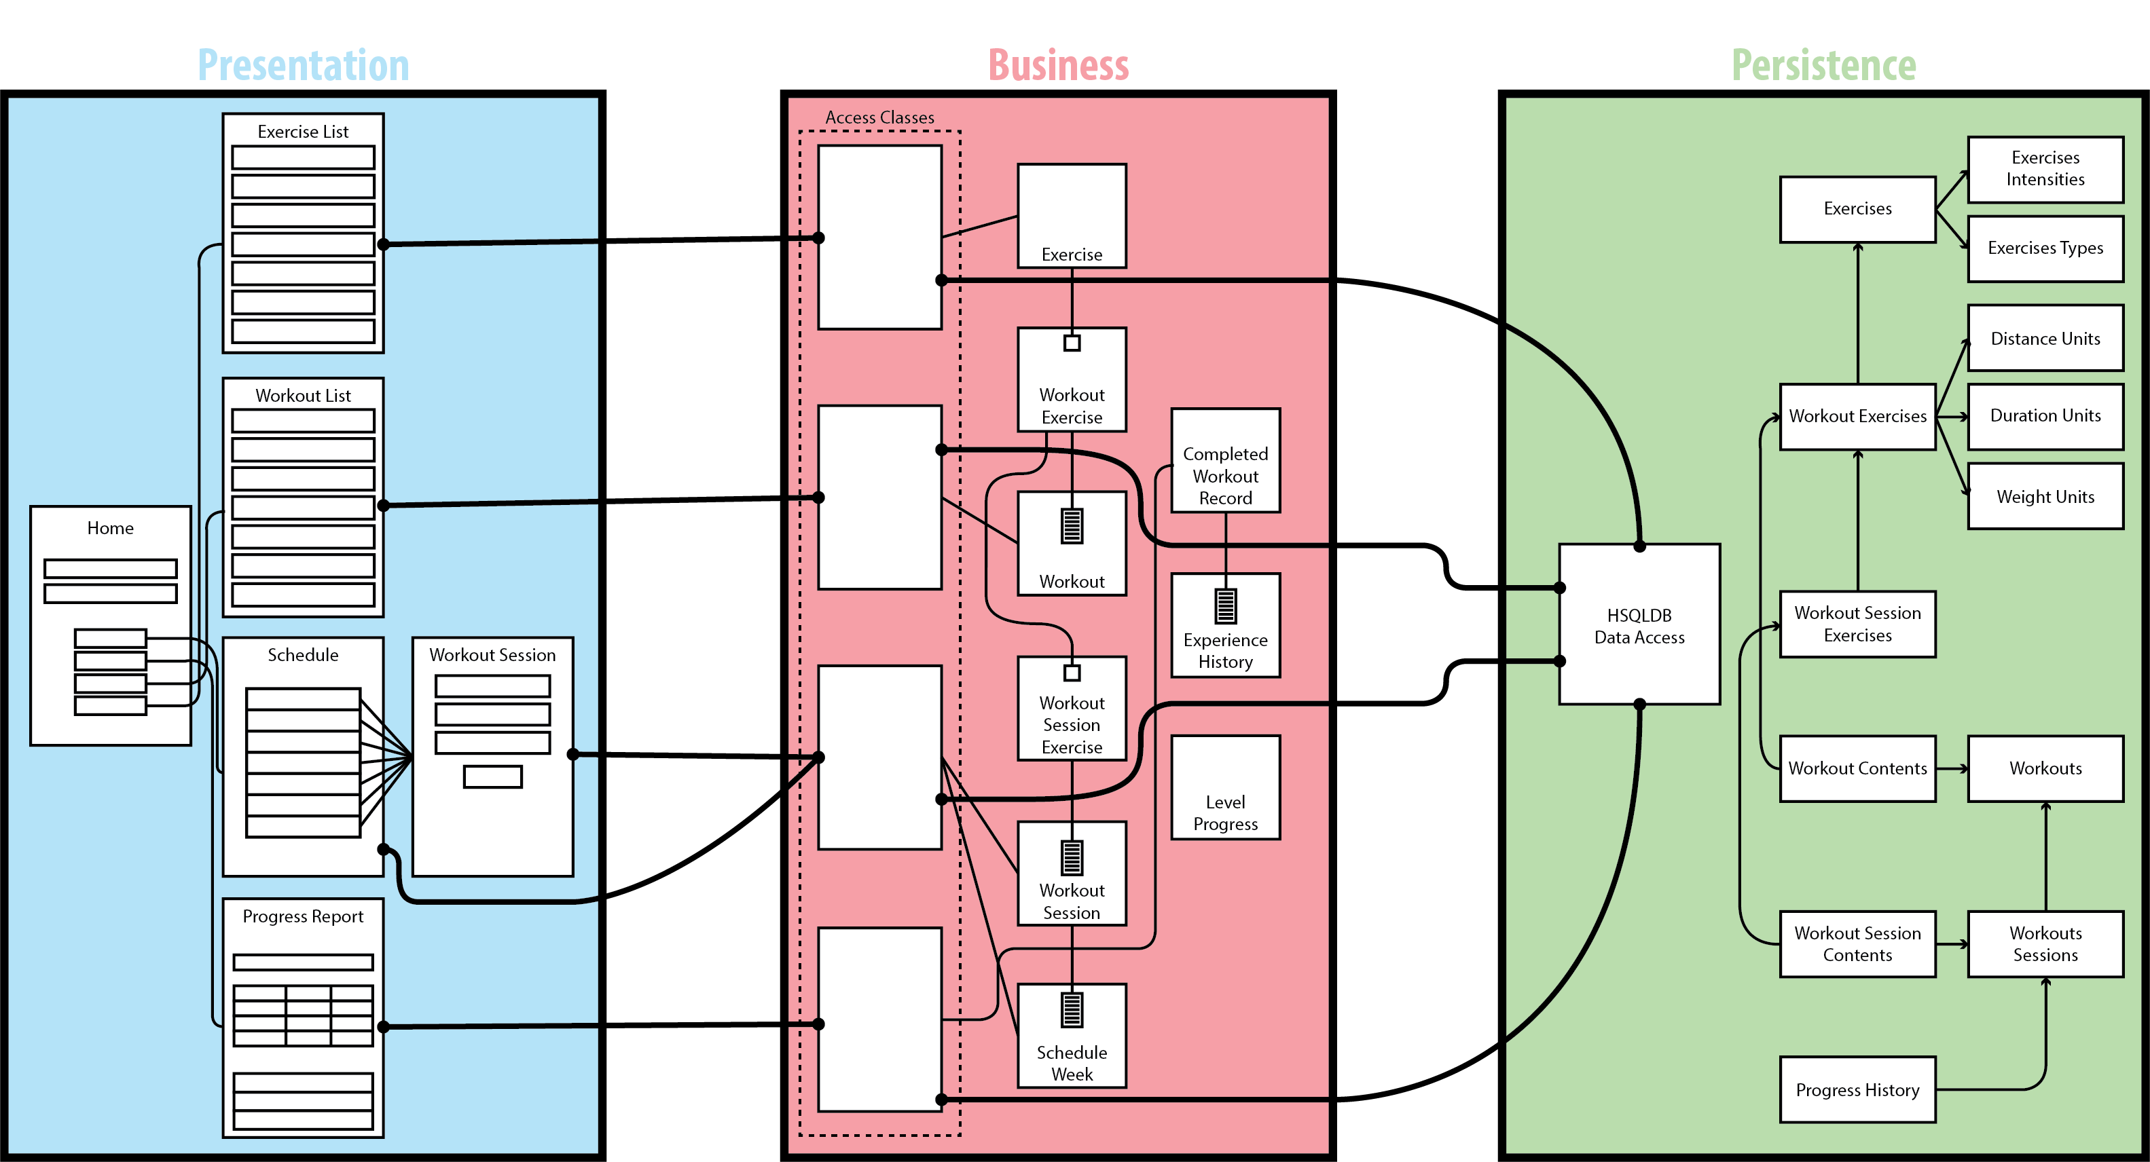

Slide 5
Exercise
Workout
ExerciseDetails
WorkoutSession
WorkoutExercise
WorkoutDetails
ListedExercise
ModifiableWorkout
SuggestedExercise
TrackableWorkout
TrackableExercise
WorkoutSessionExercise

Slide 6
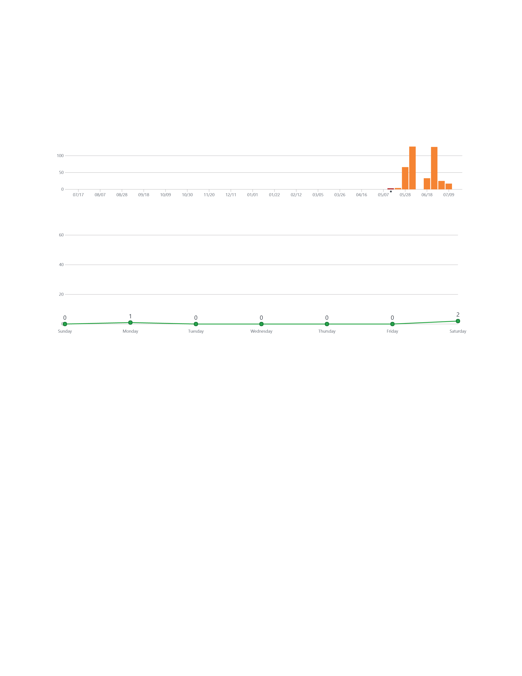

Slide 7
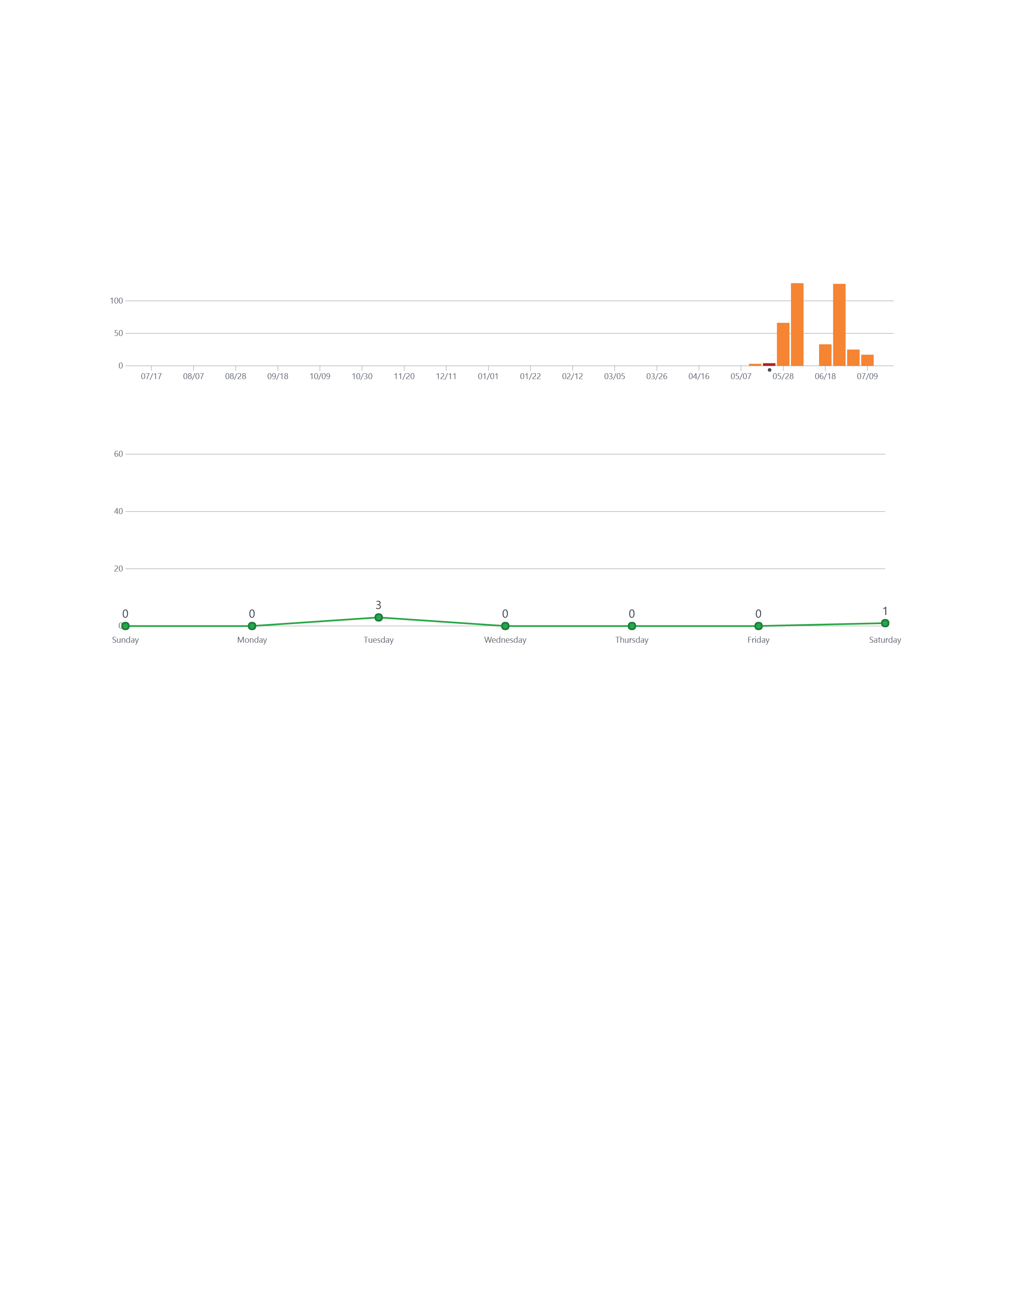

Slide 8
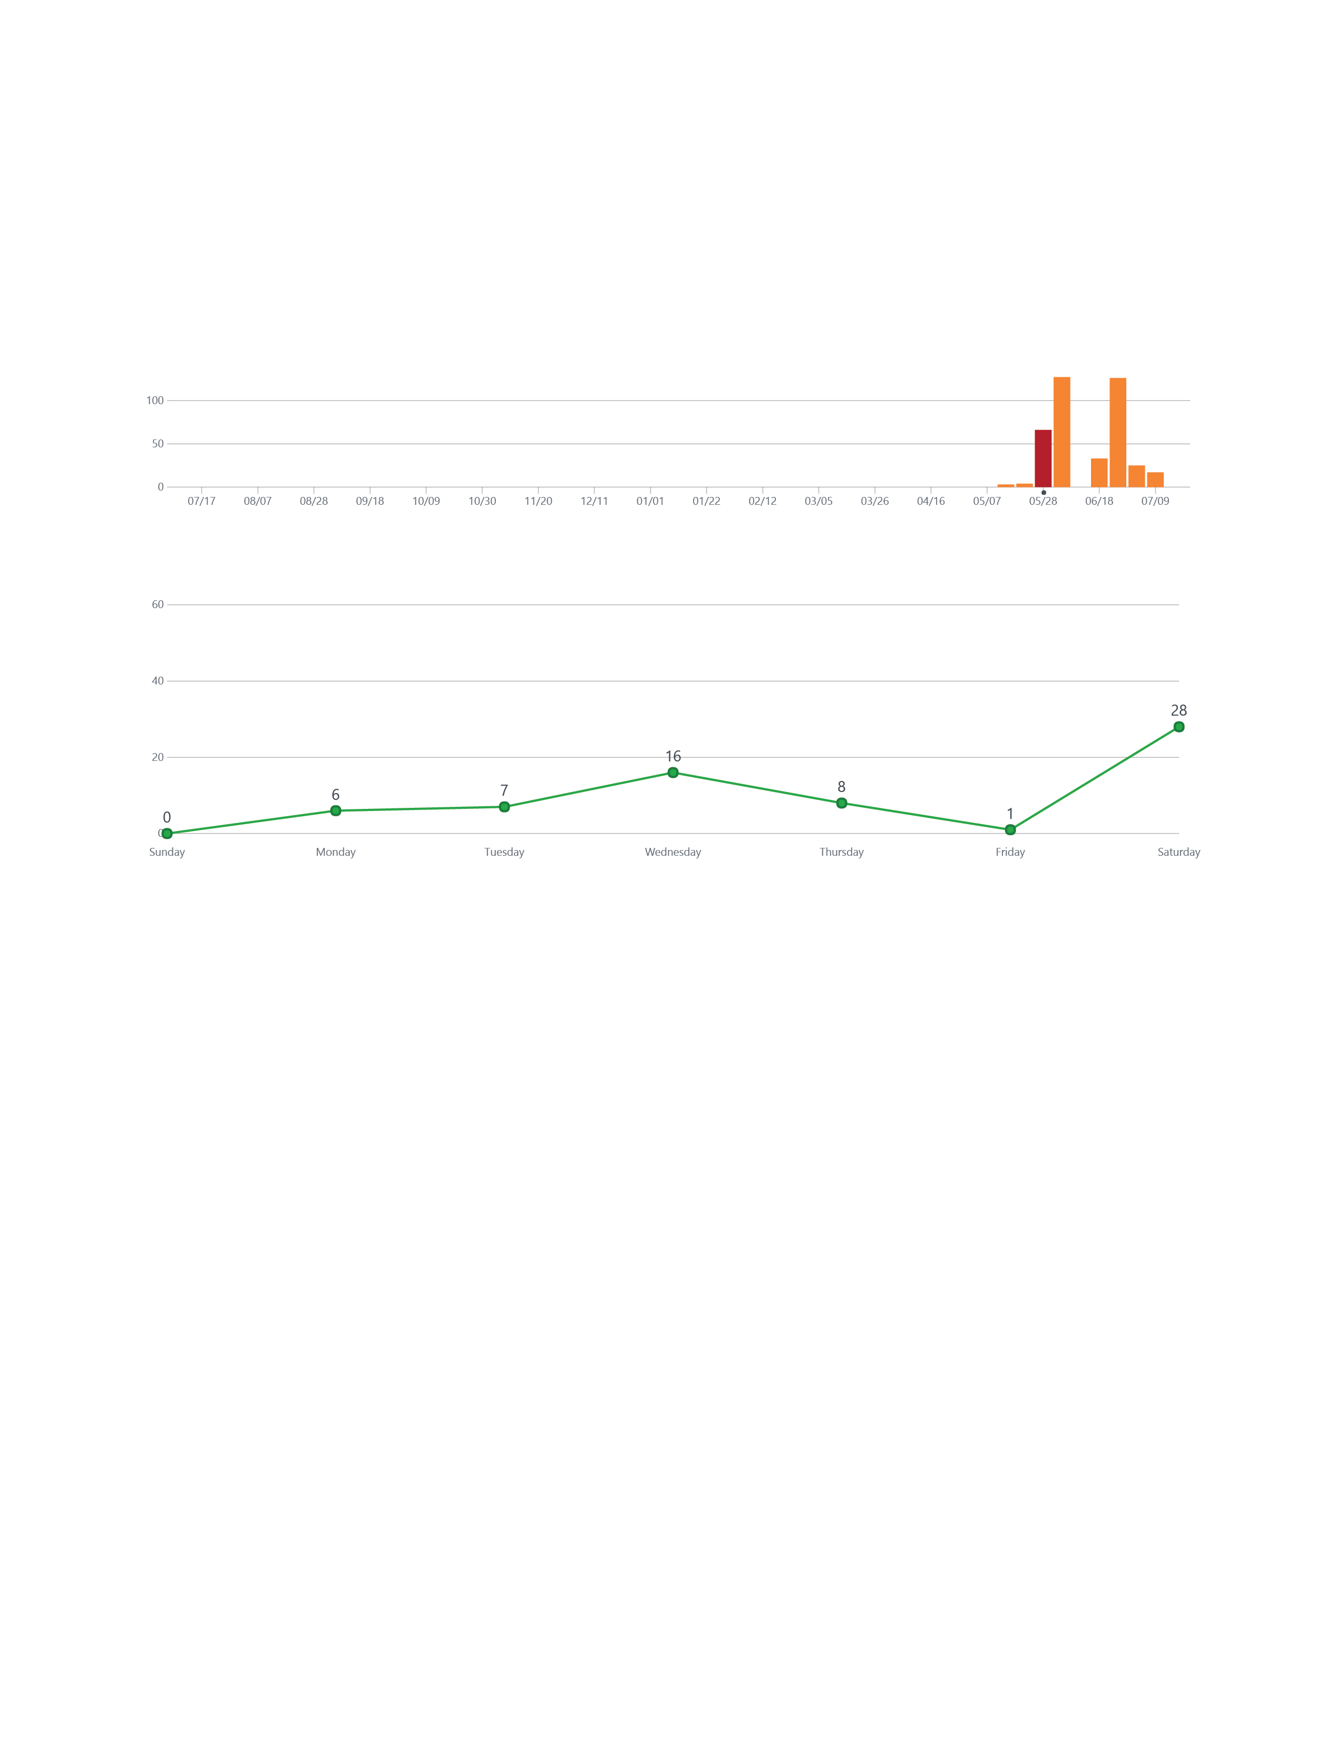

Slide 9
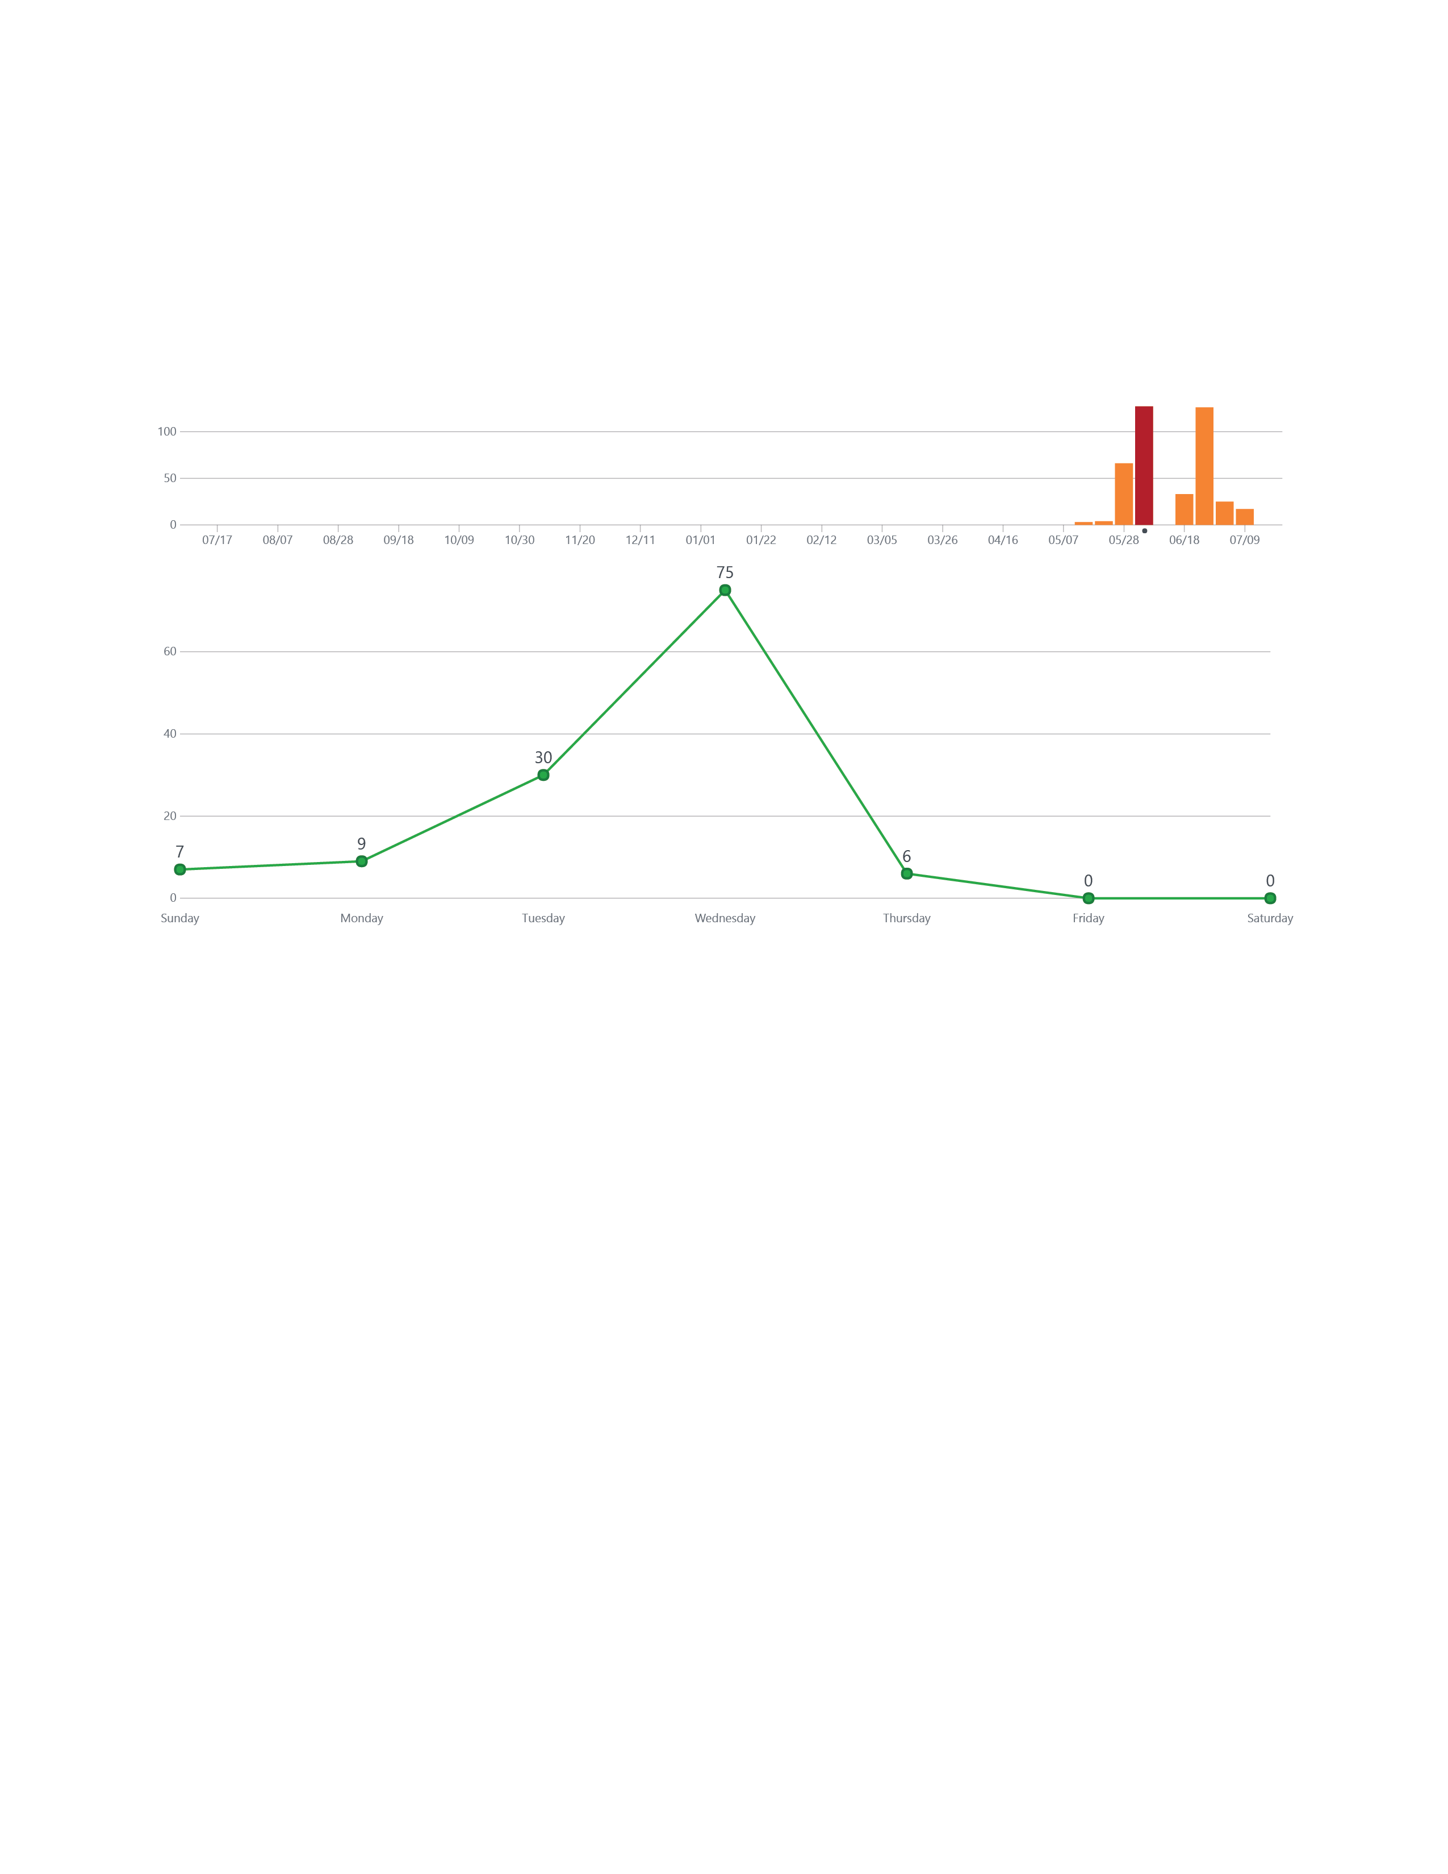
Iteration 1
Due Date

Slide 10
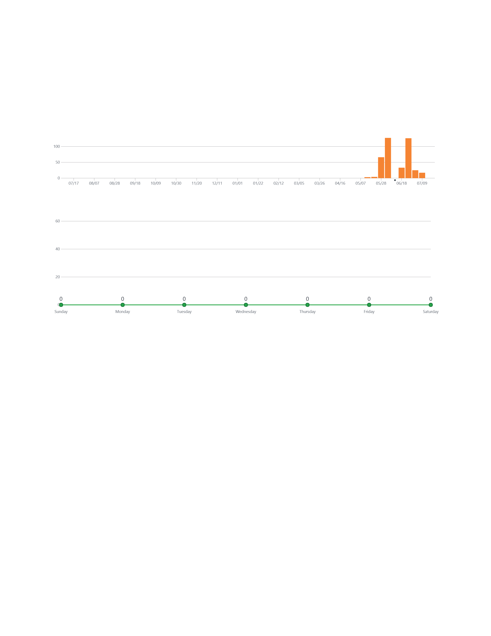

Slide 11


Slide 12
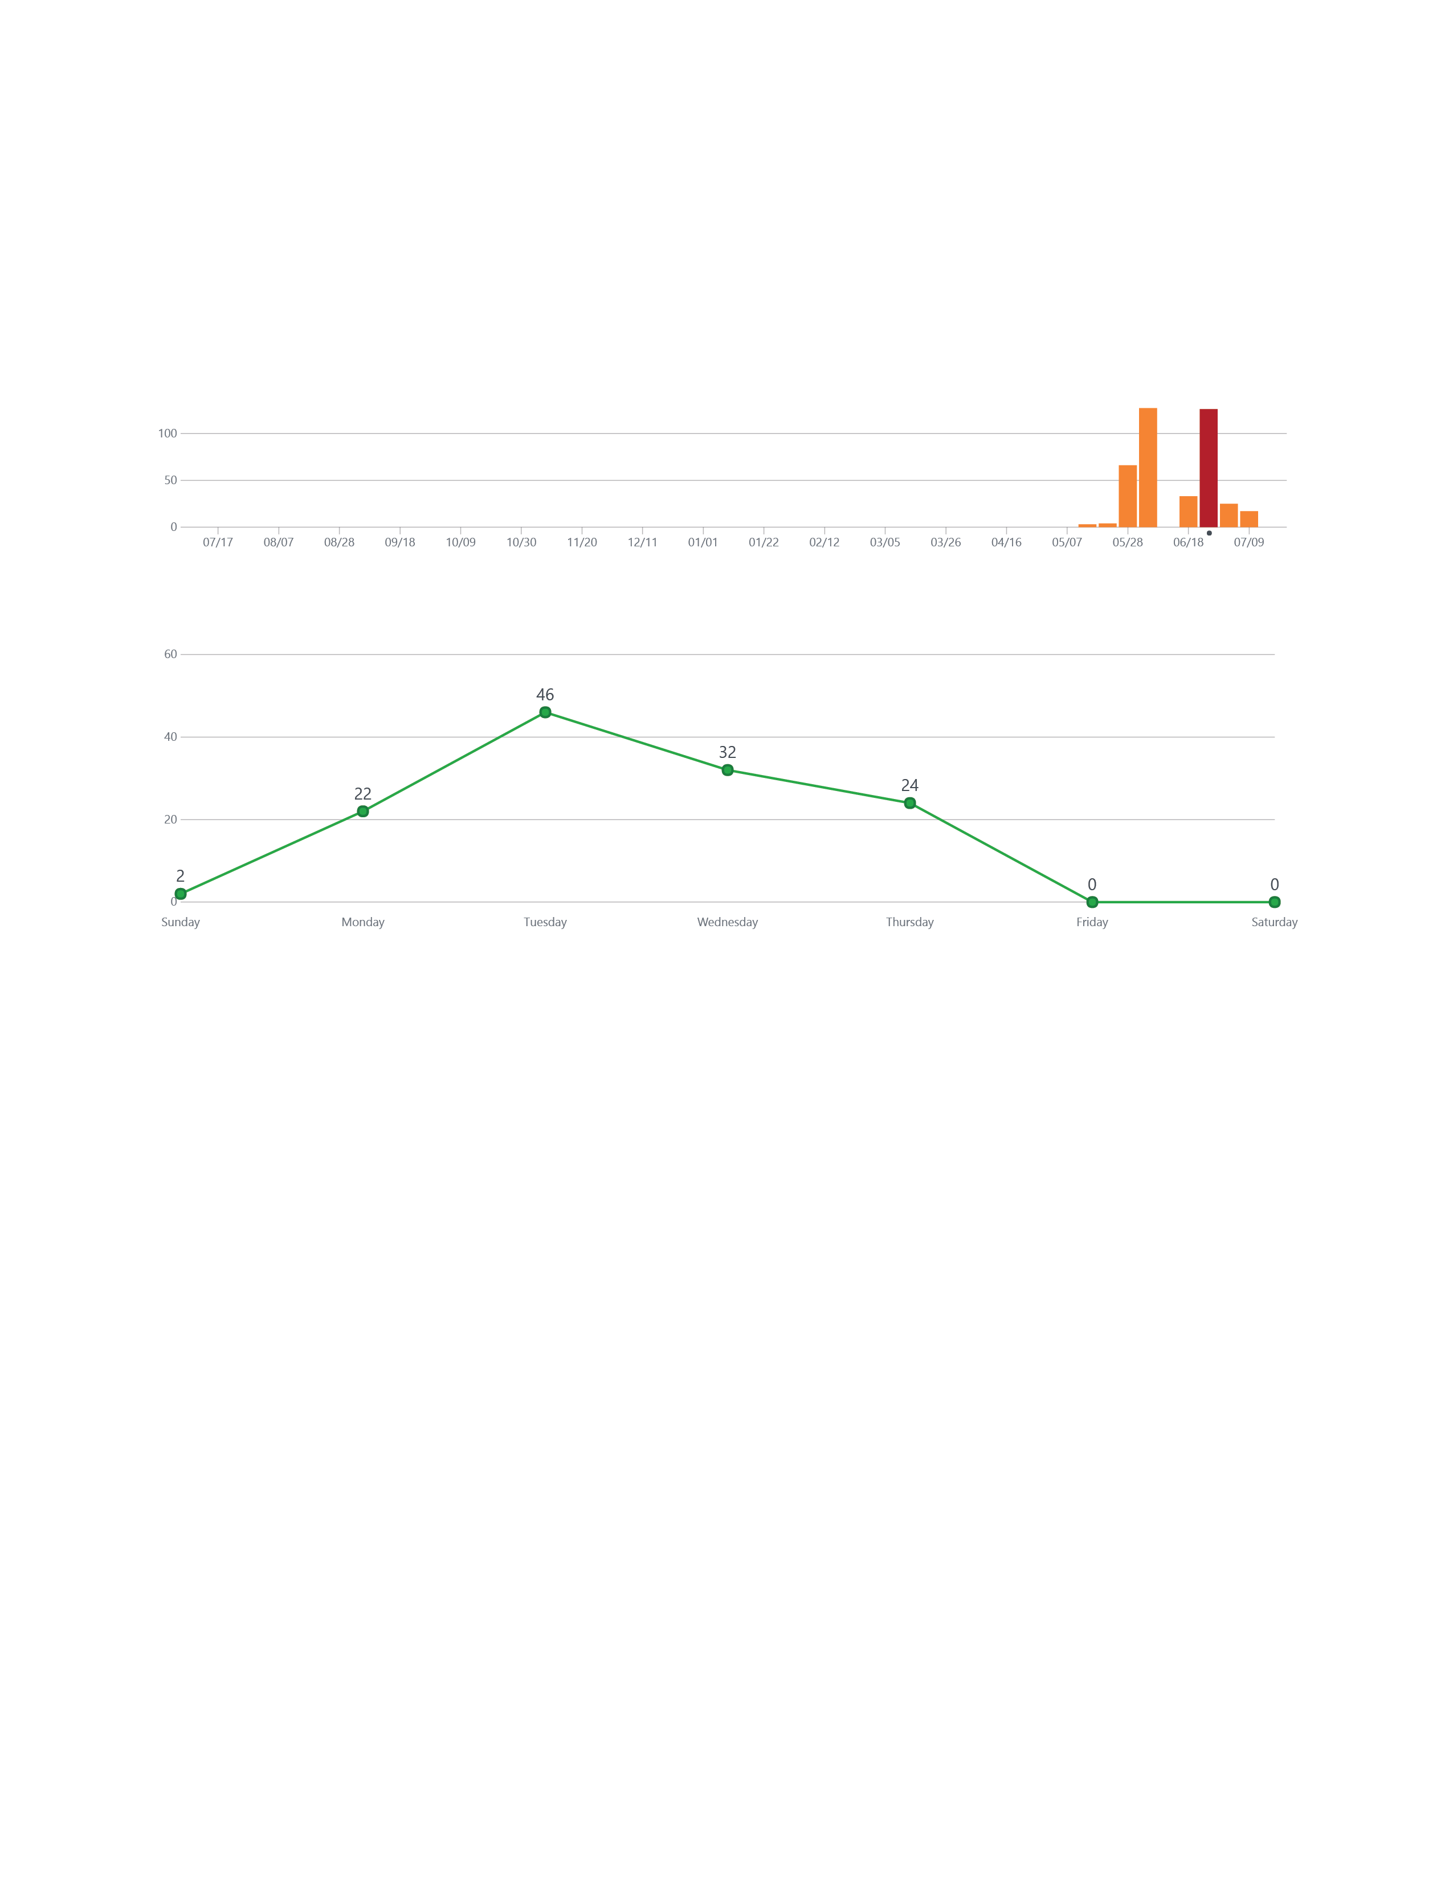
Iteration 2
Due Date

Slide 13
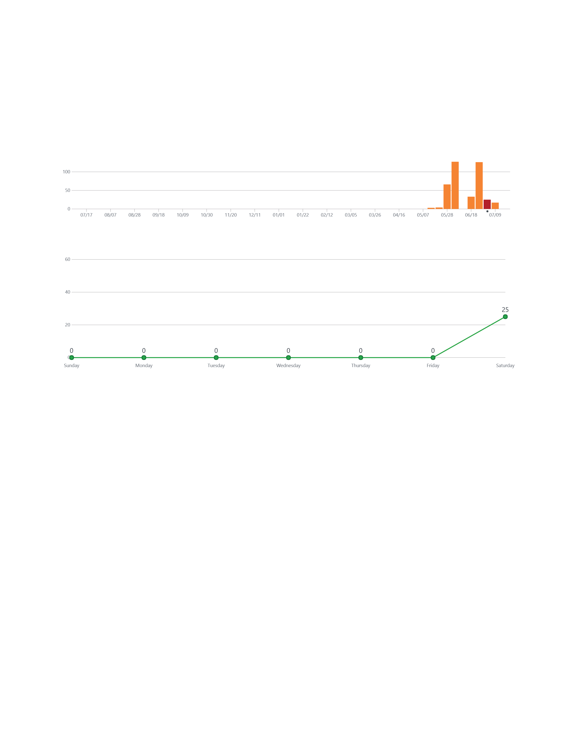

Slide 14
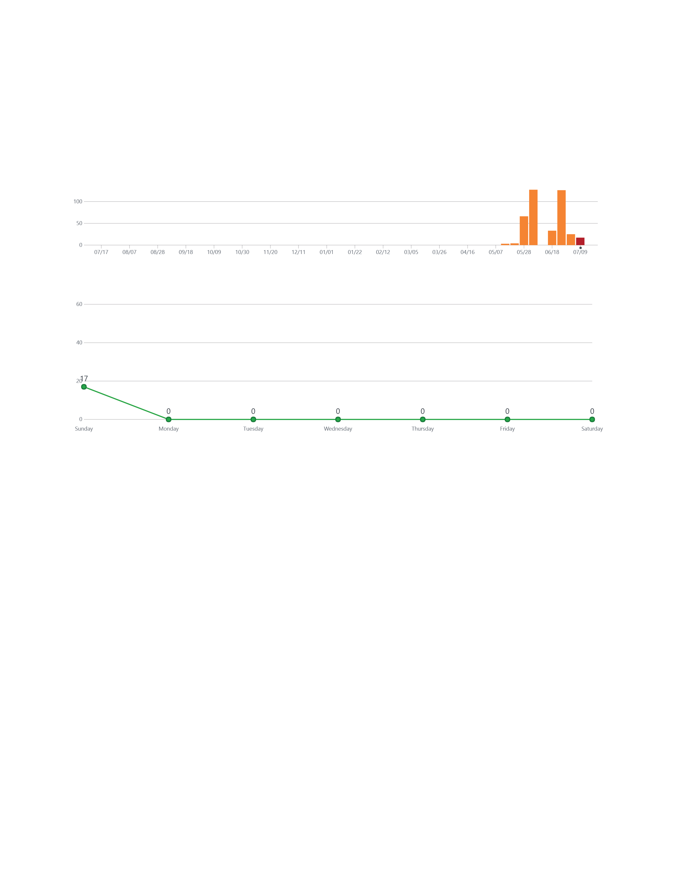
Today
Iteration 3
Due Date

Slide 15
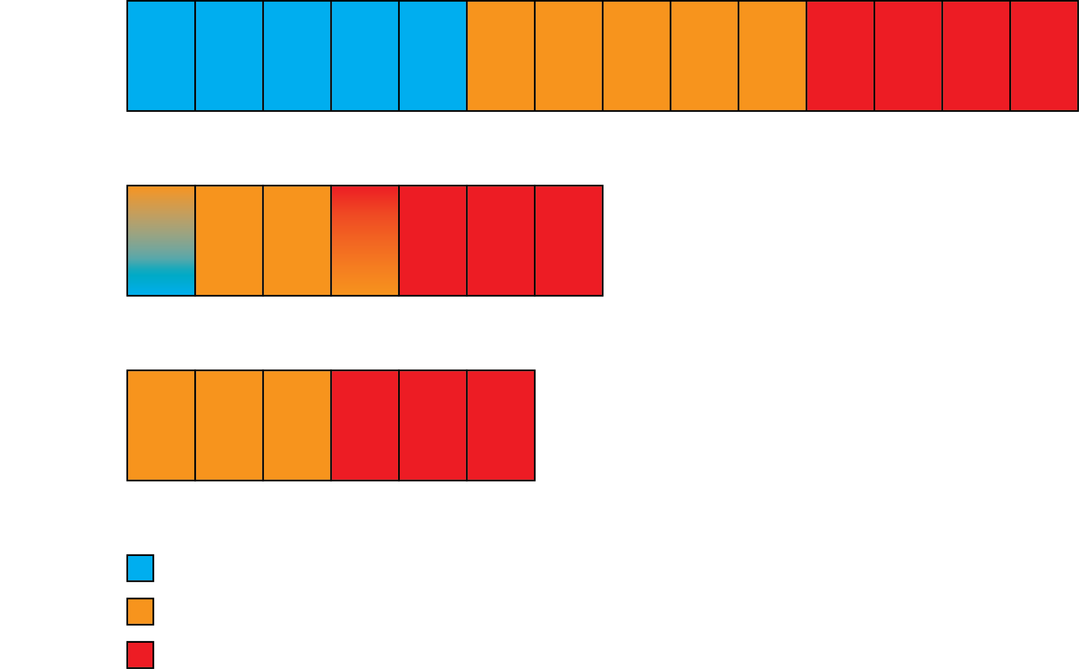

Slide 16
Workout of the Day
User Profile
Workout Summary
Custom Exercises
Sharing Workouts
Challenge Your Friends
Leaderboard

Slide 17
Custom Workouts

Slide 18
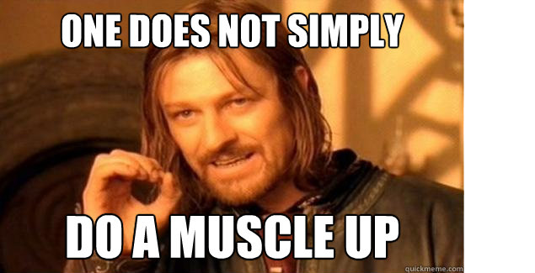

Slide 19
