Slide 1


Simplified Trips-on-Project Software presented at the 15th TRB Conference on Planning Applications Atlantic City, NJ May 17, 2015

Slide 2
Agenda
STOPS and the FTA Capital Grant Investment Program
How STOPS works
How to work STOPS (abbreviated version)
How to work STOPS (detailed version)
Experiences of early STOPS adopters

Slide 3
1. STOPS and the FTA Capital Investment Grant program

Slide 4
Trips-on-Project forecasting
Topics
FTA motivations
Options for project sponsors
Implications for FTA reviews
Availability of STOPS and tech support
Plans for upgrades and extensions

Slide 5
FTA motivations
Streamlining
Project-evaluation measures
Mobility → trips on project (total, transit-dependent)
Environment → change in auto vehicle-miles traveled
Cost effectiveness → project cost per trip on project
Travel forecasting
FTA to provide a simplified method
Simplified method to be “good enough”
Reductions in level of effort (sponsors and FTA)

Slide 6
FTA motivations (continued)
Resulting design standards for STOPS
Focus on the purpose: trips on major-capital projects → sTOPs
Urban fixed-guideways: BRT, streetcar, LR, CR, HR
Use readily-available inputs
Do not require any primary data collection
Rely on public, standardized data sources where possible
Keep it simplified for users
Provide a graphical user interface
Limit the number of switches, levers, and dials
Make it reasonably accurate
Calibrate with data on many existing systems/lines
Adjust to local conditions
Operate on Windows-based computer with no additional software requirements

Slide 7
Options for project sponsors
Project sponsors may prepare forecasts with:
Regional travel models
Incremental models
STOPS
Sponsors may provide to FTA forecasts from:
Regional travel models only
Incremental travel models only
STOPS only
Any combination of the above
Augmented with “special market” models, as needed
Augmented with “special market” models, as needed

Slide 8
Implications for FTA reviews
Source of forecast | FTA review of formally submitted forecasts
 | Transit rider survey data | Properties of the travel model | Validation vs. current riders | Plausibility of forecasts
Regional model
Incremental model
STOPS
Substantial scrutiny
Modest scrutiny
Limited scrutiny
Note that these reviews pertain to formally submitted forecasts. They do not reflect any technical assistance that FTA may have provided to sponsors during the development of forecasting methods or forecasts.

Slide 9
FTA reviews of STOPS-based forecasts – fall 2014
Procedure
Triage review
Consistency of STOPS implementation with current recommendations
Plausibility of predictions of key ridership characteristics and trips on the project
Decision on detailed review
Detailed review
Potential sources of uncertainties
STOPS rerun(s) to test possible implications of uncertainties
Decision on further work with the project sponsor

Slide 10
FTA reviews of STOPS-based forecasts – fall 2014
Outcomes for the class of 2014 (7 proposed projects using STOPS)
Triage reviews: 7
Detailed reviews, reruns: 4
Discussion with sponsor: 3
Work with sponsor: 2
Revised final predictions: 3 (one +, one –, and one – –)
Effort
Two months; FTA staff and contractor
Deadline imposed by schedule for annual report to congress
For 2015, timelines for early submittal of ridership-related materials
Prepared with locally developed forecasting methods
Prepared with STOPS

Slide 11
Availability of STOPS and technical support
Download from the FTA website
http://www.fta.dot.gov/grants/15682_15620.html
Software and User Guide
Sample application
Census data including the 2000 CTPP
Request help (after good-faith local effort)
FTA – contact information on STOPS page
Assistance from FTA contractor at FTA discretion

Slide 12
2. How STOPS WORKS

Slide 13
Overview
2.0 How STOPS works
2.1 An overview
2.2 Evolution of STOPS
2.3 Some details of STOPS v1.50
2.4 Tests against national ridership experience

Slide 14
2.1 An overview

Slide 15
General characteristics
Modified 4 step trip-based model
Highway impedances and SE inputs from regional models maintained by MPOs
Transit paths and impedances directly from transit schedules in GTFS format
Trip generation and distribution replaced by CTPP seed matrix used to develop person trip tables
Standard nested logit mode choice model
Automatic calibration
User-specified region-wide unlinked transit trips
Transit shares by attraction district from CTPP
Optionally, observed transit boardings by station group

Slide 16
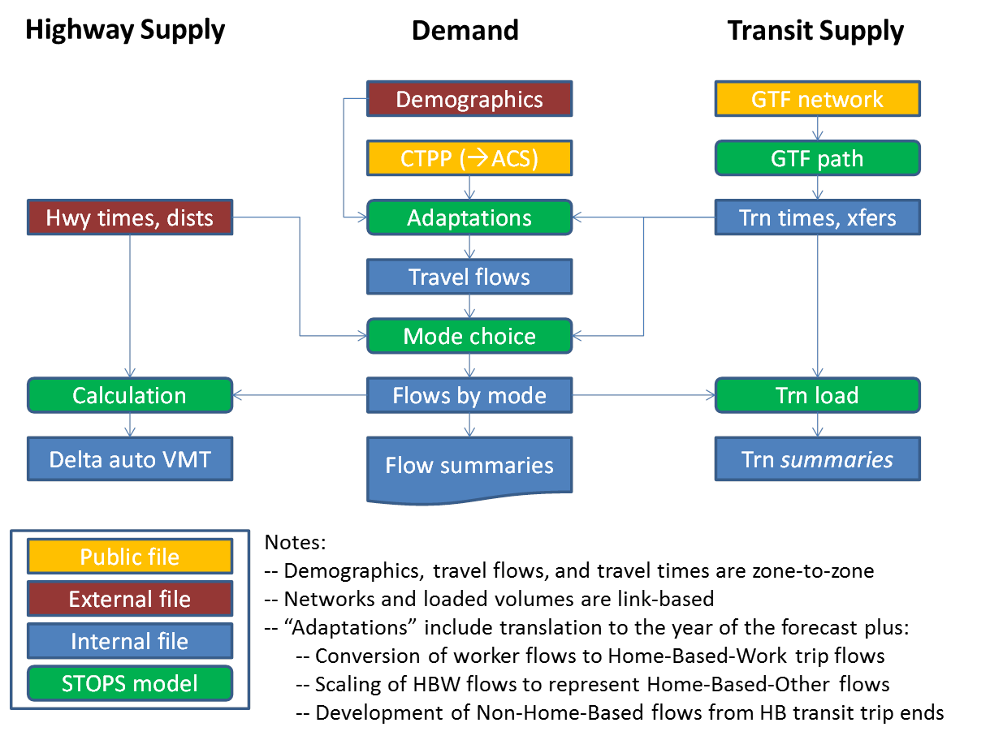
STOPS components

Slide 17
Key characteristics
Person trips
CTPP replaces trip generation and distribution (for ALL trip purposes)
Focus on transit-candidate person trips
No special markets
Transit
GTFS replaces coded abstract transit network
Schedule-based path-builder replaces traditional path-builders
Highway
No internal representation of the highway network
No assignment, loadings, or loaded conditions
One model to describe transit behavior in dozens of metro areas and differences in actual ridership before and after project implementation in some areas

Slide 18
2.2 Evolution of stops

Slide 19
Evolving understanding of realities
Initial vision:
Single purpose: predict trips on the project
ARRF with variable access-mode-specific catchment areas
No applications where transit-ready models already exist
Small projects in smaller metro areas
Transparency more important than processing efficiency
No requirement for commercial software for travel forecasting, GIS

Slide 20
Evolving understanding of realities
Evolved vision
Priority FTA support for project-trip forecasts; help with other uses
ARRF-like approach inadequate to the task of project-level forecasts
Applications in metro areas with well-developed travel models
Projects of all sizes in metro areas of all sizes
Processing efficiency crucial for huge problem sizes
Still no commercial software, but looking for a GTFS editor

Slide 21
Learning from early applications
Unintended situations arose requiring additional error detection
NHB components generated too many trips between and within geographically large or separate CBDs
Single departure time (7:30 am) resulted in:
Volatile results for longer headway services
Peak service for very long (e.g., commuter rail) trips occurred before assumed departure time
Station-group factoring may have misled forecasts for new stations
Processing too slow and capacity too limited for very large metro areas
Large CTPP zones in some metro areas distorted forecasts, maybe by a lot

Slide 22
Updating the software
Version 1.01 – official release in September, 2013
Version 1.02 – official release FTA in February, 2014
Version 1.03 – various interim releases throughout 2014
Version 1.50 – official release on May 6, 2015
New non-home-based components
Higher limits on number of zones and stations
Revised path-builder
Revised coefficients and nesting structure for mode choice model
Revised national calibration
Expanded options for local calibration against station-group counts
Additional output tables consistent with CGI reporting instructions

Slide 23
Upgrades and extensions
STOPS v2.01 (beta release anticipated winter, 2015-2016)
Update to CTPP from the American Community Survey
Portal for special-market trips from external methods
Options for easier GTFS editing
Steps
Incremental method based on local rider-survey data
Several components from STOPS
GTFS transit representation and schedule-based path-builder
Growth factoring over time with population/employment projections
Highway impedances from the regional travel model

Slide 24
2.3 some details of stops v1.50

Slide 25
Details of STOPS v1.50
Components
Highway components
Transit network
Travel demand and adaptations
Mode choice
Automatic adjustments
Special markets

Slide 26
STOPS components

Slide 27
Highway components
Highway impedances
Zone-to-zone from the regional travel model
Current year (and future years, if needed)
Calculation of change in person-miles of highway travel (PMHT)
For each year of interest
PMHT(I,J) = ∑ [highway person-trips(i,j) x highway distance(i,j)
+ auto-access trips(i,j) x auto-access distance(i,s)]
Where: I, i = production district and zone
J, j = attraction district and zone
s = stop used for park-ride or kiss-ride access
∑ = sum over all i,j within each I,J
PHMT change(I,J) = Build PMHT(I,J) minus No-build PMHT(I,J)

Slide 28
STOPS components

Slide 29
Transit network
General Transit Feed Specification (GTFS)
Key attributes
Current-year data on actual service!
Vetted by transit agencies (with inputs from AVLs, operators, and riders)!
No aggregation (headways) into coded networks with uncertain runtimes!
Download (sometimes public; more often from transit agencies)
Edits to represent:
Current-year No-build (if needed)
Current-year Build (including adjustments to current routes)
Future-year(s) No-build and Build (if considered)

Slide 30
Transit network
Designation of stations
Aggregation of stop-IDs (train platforms, bus bays, directional stops)
Degree of vertical separation (for inclusion in impedances)
Flags on new stations (that are part of “the project”)
Counts (for use in local calibration)
Designation of park-ride lots
Location (that STOPS links to proximate stops)
Type (that defines the catchment area)
Cost (in minutes to represent parking price, shadow price, vertical separation, others)

Slide 31
Transit network (continued)
STOPS generation of access, egress, and transfer connections
Access, egress: For each zone centroid and each eligible transit stop
Walk: airline distance +10% at 3 mph to/from useful stops within 1.0 miles
KnR: airline distance at 25 mph to any stop within 3.0 miles or a park-ride lot (using the park-ride rules); and
PnR: airline distance at 25 mph to user-designated park-ride lots within catchment distance specified for the lot (3, 6, 10, or 25 miles depending on the nature of the lot)
Transfers: For any pair separated by <0.25 airline miles
Stop-to-stop or PnR lot-to-stop

Slide 32
Transit path-building in STOPS GTF Path
Paths and impedances
Two time periods
AM peak (one of six possible arrival times 8:00 and 9:00 am)
Midday (one of six possible arrival times between 1:00 and 2:00 pm)
Three access type
Walk
Kiss-Ride
Park-Ride
Three path types
FG only
Bus only
FG-bus

Slide 33
Transit path-building in STOPS GTF Path (continued)
Schedule-based path selection
Motivated by required arrival time (no more than 5 minutes late)
No headways; instead:
Actual individual vehicle trips
Actual vehicle-arrival times at stops (based on actual running times)
Generalized cost (in weighted minutes) for selection of best path
In-vehicle time (weight = 1.0 minute per minute)
Walk time (weight = 1.1 minutes per minute)
PnR and KnR time (weight = 1.5 minutes per minute)
Wait time (weight = 1.0 minutes per minute)
Wait time
Transfers:
Actual waiting time between vehicle-1 arrival and vehicle-2 departure
Minus any stop-stop walk time (to avoid double-counting those minutes)
Arrival-time difference: absolute value of desired-minus-actual arrival times
First wait: none (perfect scheduling of departure)
Boarding (5.0 minutes each) to account for uncertainties and inconvenience

Slide 34
Transit path-building in STOPS GTF Path (continued)
Attributes skimmed from each best path
Origin-zone and destination-zone
Origin access mode
Origin access time
Transfer walk time
Destination egress (walk) time
First wait time plus arrival-time difference
Transfer wait time
Number of boardings
In-vehicle time (fixed guideway and bus, separately)
Indicator of travel on “the project”
Path details (for up to four transit boardings)
Boarding and alighting stops
Mode (GTFS type)
GTFS trip_id
For
mode choice
For transit trip loading and summaries

Slide 35
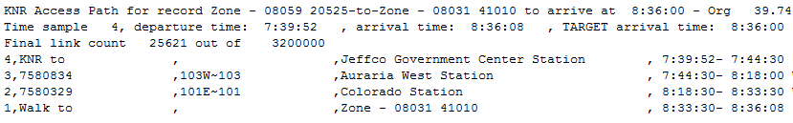
Transit path-building in STOPS GTF Path (continued)
Sample path report

Slide 36
Transit-trip loading
Immediately after mode choice for each production-attraction pair
Have: transit trips by
Auto ownership
Trip purpose
Origin access mode
Path type
Accumulate: across each transit boarding, stratified by transit-trip characteristics
Daily total of boardings on each route by origin mode of access
Daily total of boardings at each station by station mode of access
Station-station flows for project-related stations

Slide 37
STOPS components

Slide 38
Travel demand
Topics
CTPP
Demographics
Adaptations
HBW
HBO
NHB
Cloning zones
Growth factoring
Mode choice
Reporting

Slide 39
CTPP (2000, for now)
Workers by:
Residence location and workplace location, and
Household auto ownership, and
Usual main mode to work
User selections to control CTPP data acquisition by STOPS
Geography: the single type of geography that STOPS will use
Tracts – good, because tracts are defined everywhere
Block groups – better, because they are smaller but used only where selected by MPO/Census Bureau
TAZs – best, because designed for forecasting but used only where selected by MPO
State(s), up to three
MPO, if geography is TAZs or block groups

Slide 40
Demographics
GIS layer that includes:
MPO’s TAZ boundaries in latitude/longitude coordinates
Must be consistent for all MPO-sourced files
Demographics for every year of interest
Highway time/distance file with current year, three horizon years
Do not have to be consistent with boundaries of census zones
For up to five years (2000, current year, three horizon years)
Population in each TAZ
Employment in each TAZ

Slide 41
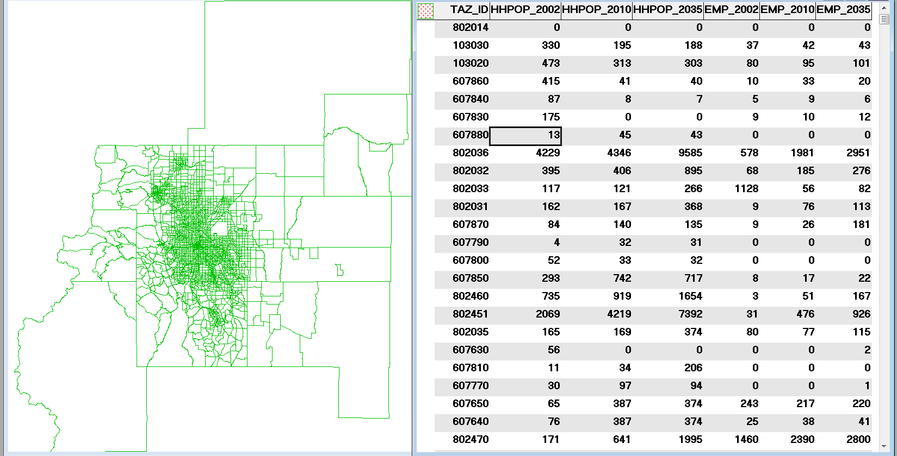
Sample demographic file

Slide 42
Adaptations
Why the context demands adaptability
The kinds of adaptations made on the demand-side of STOPS

Slide 43
Adaptations (continued)
Transit survey
(in calibration cities)
Person trips that are transit candidates
Non-work mode shares
CTPP worker flows by i, j, mode
Existing transit trips using each transit service (and ultimately the project
Transit supply by i, j, path type
Transit paths
What we know
What we must invent
What we need

Slide 44
Adaptations: Trip rates
Trip rates: purpose-specific trips per CTPP worker(i,j)
Derived from NCHRP Report 716 (Quick Response #2), 1997
HBW trips
Constant trip rate t(a) for each auto-ownership class
Calibration parameter C for all auto-ownership classes
Calibrated so that
Normalized CTPP transit share x [C x t(a) x CTPP workers(a)]
= linked HBW transit trips in rider-survey datasets
Where the CTPP transit share is normalized to match:
User-provided HBW linked trips on transit, or
User-provided unlinked trips (assuming 40% HBW and 1.4 boards/linked trip)
HBO and NHB trips
Computations similar to HBW trips but:
Scaled to shares of travel by purpose reported in NCHRP 716
Decayed with increasing distance
Calibrated with same approach as HBW trips
Transit.candidate.trips(i,j,purp) = workers(i,j) x trip.rate(purp)

Slide 45
Adaptations: Trip rates (continued)
Thoughts on CTPP flows representing HBO travel (in the cloud)
Observations / hypotheses
HBO is largest fraction of total person trips but not the largest fraction of transit trips
HBW and HBO transit trips appear to have similar patterns but with shorter HBO trip lengths
Same economic drivers (work force and employment) produce and attract both kinds of travel
Implementation within STOPS
HBO trips start with CTPP JTW flows (like HBW trips)
HBO-specific trip rates
HBO trips drop off more quickly with distance than do HBW trips

Slide 46
Adaptations: Trip rates (continued)
Thoughts on CTPP flows representing NHB travel (in the cloud)
Observations / hypotheses
Workers holding jobs in a neighborhood are attracted to economic activities located in places similar to the residents living in that neighborhood
NHB transit trips have a shorter average trip length than HBW trips
Implementation in broad strokes within STOPS
NHB person trip flows from a zone are scaled by
(total CTPP attractions in zone) / (total CTPP productions in zone)
NHB-specific trip rates
NHB trips drop off more quickly with distance than do HBW trips

Slide 47
Adaptations: Trip rates (continued)
Trip rates applied to CTPP worker flows
Transit-candidate trips(i,j) per CTPP worker(i,j)
Sources
HBW
NCHRP 716 HBW trip rates
Adjusted to match on-board survey trips while holding CTPP transit shares
HBO
= HBW rate x (4.0) (the ratio of NHTS HBO/HBW fractions of all travel)
x 0.37 for 0-car households only, to avoid inflating mode choice K’s
NHB
= HBW rate x (2.1) (the ratio of NHTS NHB/HBW fractions of all travel)
x 0.21 for 0-car households only, to avoid inflating mode choice K’s
 | 0 car | 1 car | 2+ cars
HBW | 1.32 | 1.44 | 1.56
HBO | 1.78 | 5.20 | 5.60
NHB | 0.54 | 2.79 | 3.00

Slide 48
Adaptations: Trip rates (continued)
Non-work Decay Multiplier versus Distance
Decay Multiplier
Distance from i to j (miles)

Slide 49
Adaptations: Growth factoring between years
Basic approach within STOPS
Compute Y2000 home-end and work-end zone trip ends from existing CTPP JTW
Estimate forecast year zone trip ends based on increase in zone population (home-end) and employment (work-end)
IPF CTPP to match future trip ends

Slide 50
Adaptations: Growth factoring between years (continued)
User-selected options for estimating trip-end growth
District level: Compute district level population and employment growth ratio and apply to all zones in district
Zone level:
Compute 2000 CTPP home trip-ends to population ratio
Apply ratio to forecast year zone population to compute future home trip ends
Repeat for work trip ends using employment as basis for growth

Slide 51
Adaptations: Cloning zones for growth factoring
Problems can occur in high-growth areas
Sparse residential areas in 2000 that are well populated in forecast year
Sparse employment areas in 2000 have many jobs in forecast year
Solution
User assigns one or more “clone” zones for each high-growth zone
STOPS
Applies trip patterns (e.g., destinations) from clone zones to the high-growth zone
Factors trip patterns to maintain trip- ends consistent with forecast-year population and employment
Considerations
Clone zones must be nearby so that its trip patterns are reasonable for the high-growth zone
Clone zones must (in aggregate) have development types in 2000 similar to expected development in the high-growth zone for horizon year

Slide 52
Mode choice
Nested logit model
Discrete choices
Auto, non-motorized
Transit (walk, knr, pnr) x (bus only, fixed-guideway only, bus-and-fixed-guideway)
Segmentation
Trip purposes: home-based work, home-based other, non-home-based
Car ownership: 0 car, 1 car, 2+ cars
Times of day: peak (for HBW trips), mid-day for non-work trips
Parameters
Nesting coefficients:
0.7 for auto/walk
0.7 for transit access mode choice
0.7 x fixed guideway “visibility” (0.1 ≤ visibility ≤ 1.0) for path type choice
Coefficients on travel times and transit number of transfers
Static constants:
Auto, by trip purpose and household auto-ownership
Transit, by trip purpose, access mode, and household auto-ownership
Path-type constants
Local-calibration constants for auto, by attraction district and auto-ownership

Slide 53
Mode choice tree structure
All-mode person trips
Non-transit
Transit
φ=0.7
φ=0.7
Auto
Walk
Walk
KNR
PNR
φ=0.7*Vis
φ=0.7*Vis
φ=0.7*Vis
Key:
Vis=Guideway visibility factor
FGO=Fixed guideway only
FGB=Fixed guideway+bus
Bus= Bus only
FGO
FGB
Bus
FGO
FGB
Bus
FGO
FGB
Bus

Slide 54
Mode choice (continued)
Coefficients
In-vehicle minutes: -0.030 (x 0.8 for fixed-guideway time)
Walk minutes: 1.0 x C(in-vehicle time)
First-wait minutes: 1.0 x C(in-vehicle time)
Transfer-wait minutes: 1.0 x C(in-vehicle time)
Number of transfers: 5 minutes per transfer

Slide 55
Mode choice (continued)
Adjustments
Park-ride circuity
Walk circuity
Short FG time on FG/bus path
Very long walk
PnR/KnR short transit IVTT
Auto penalty = f(emp density)

Slide 56
Mode choice: static constants
 | 0 car | 1 car | 2+ cars
HBW | 0.00 | 0.00 | 0.00
HBO | -1.58 | -47.26 | -24.84
NHB | -0.36 | -76.76 | -56.19
K auto
in minutes added to auto utility
 | 0 car | 1 car | 2+ cars
HBW | 93.62 | 60.64 | 69.08
HBO | 89.76 | 69.01 | 55.73
NHB | 74.50 | 55.73 | 73.34
K kiss-ride
in minutes added to kiss-ride utility
 | 0 car | 1 car | 2+ cars
HBW | 102.20 | 19.56 | 19.09
HBO | 106.88 | 47.69 | 50.77
NHB | 96.61 | 38.93 | 47.46
K park-ride
in minutes added to park-ride utility

Slide 57
Mode choice: path-type constants
Path-type constants in minutes of in-vehicle time
Added as penalties to transit utility expressions
 |  | 0 car | 1 car | 2+ cars
Walk | Bus/FG | 0 | 0 | 11.25
 | Bus only | 0 | 15 | 22.5
Kiss-ride | Bus/FG | 0 | 7.5 | 11.25
 | Bus only | 0 | 15 | 22.5
Park-ride | Bus/FG | 22.5 | 22.5 | 22.5
 | Bus only | 22.5 | 22.5 | 22.5

Slide 58
Automatic adjustments with local data
Mode choice
Constants derived from CTPP attraction shares, by autos owned
Specific to trip attractions in user-defined districts
Employed conventionally in utility expressions
Total unlinked transit trips
Single, fine-tuning factor
System-wide trips for all trip purposes
Adjusts trips from mode-choice and transit paths to match user-provided target
Boardings by station-group (SG)
IPF of SG-to-SG flows
Depending on method, improves agreement with actual SG counts for existing stations

Slide 59
Special markets
No explicit treatment of special markets
Students
Out-of-town visitors
International border crossings
Special events (baseball!)
Airport access trips by air passengers
Access to other inter-city terminals
Inter-city travel
Until STOPS v2.0 is available
Where special market trips are sizable and relevant to the project
Calibrate STOPS with special market trips removed from calibration counts
Use local special market procedures to estimate project ridership
Manually report sum of STOPS and local special market models
Where special markets are modest or not relevant to the project
Run STOPS with total ridership used for calibration but review for distortions

Slide 60
2.4 Tests against National ridership experience

Slide 61
National calibration
Approach – single version of STOPS applied to:
A national collection of transit systems/projects
With both static (single time point) and dynamic (before/after) cases
Employing full local data and automated adjustments
Through many (many!) iterations and model adjustments
Observations on residuals versus rider-survey data in previous trials
Hypotheses on behaviors not yet captured
Revised relationships, new variables, and/or updated parameters
New application to full set of urban areas
Repeat until plausible explanation of behavior yields an acceptable fit of the data
More influence from the dynamic-calibration cases
No case-specific or type-specific factors or rules introduced to match the data

Slide 62
National calibration (continued)
Evaluation measures
Static cases
Linked transit trips by purpose, autos owned, access mode, path type
Geographic distribution of transit travel patterns
Unlinked trips by fixed-guideway mode (light rail, commuter rail, etc.)
Boardings by station group (before station-group adjustments)
Before-and-after cases
Change in linked transit trips
Trips on projects

Slide 63
National calibration (continued)
Some problems that led to STOPS revisions
Overestimates for close-in urban commuter rail stations
Overestimates for underground and elevated stations
Poorly represented PnR capture areas
Incorrect transfer rates
Heavy-handed influence of station-group factors on new stations
Missing ridership at stations serving universities
Struggles with NHB trips
Inappropriateness of conventional parameters for path choice and mode choice in a setting where schedule-based wait times are available from GTFS data

Slide 64
Calibration data
Systems with rider survey data
Metro area | Comm. rail | Heavy rail | Light rail | Streetcar | BRT | Total
Atlanta |  | 1 |  |  |  | 1
Charlotte * |  |  | 1 |  |  | 1
Denver * |  |  | 1 |  |  | 1
Phoenix |  |  | 1 |  |  | 1
San Diego | 1 |  | 2 |  |  | 3
Salt Lake City * | 1 |  | 1 |  | 1 | 3
Subtotal | 2 | 1 | 6 | 0 | 1 | 10
* Indicates survey data on ridership both before and after recent project openings

Slide 65
Calibration data
Systems with count data only
Metro area | Comm. rail | Heavy rail | Light rail | Streetcar | BRT | Total
Chicago | 1 | 1 |  |  |  | 2
Houston |  |  | 1 |  |  | 1
Kansas City |  |  |  |  | 1 | 1
Minneapolis * | 1 |  | 1 |  |  | 2
Nashville * | 1 |  |  |  |  | 1
Norfolk * |  |  | 1 |  |  | 1
Portland * | 1 |  | 1 | 1 |  | 3
San Jose |  |  | 1 |  |  | 1
SE Florida | 1 | 1 |  |  |  | 2
Seattle | 1 |  | 1 | 1 |  | 3
St. Louis |  |  | 1 |  |  | 1
Tacoma |  |  |  | 1 |  | 1
Subtotal | 6 | 2 | 7 | 3 | 1 | 19
Total | 8 | 3 | 13 | 3 | 2 | 29
* Indicates count data on ridership both before and after recent project openings

Slide 66
National calibration: results

Slide 67
Observations from calibration
Details matter
Effective district and station group definitions
Accurate count data
Accounting for special markets
Don’t be misled by the previous slide. Forecasting is still an uncertain business and that uncertainty must be communicated to decision-makers. Uncertainties include:
The characteristics of the project itself
Background assumptions for population, employment,
Differentiation from competing transit systems
The accuracy of the forecasting tools

Slide 68
Recap
STOPS is…
Data-driven adaptation of conventional trip-based model
Demand from CTPP
Transit supply from GTFS schedule data
Calibrated with national information on project ridership
Adjusted to match local conditions using actual ridership experience
More than a sketch planning model
STOPS still requires careful attention to detail to generate reasonable forecasts

Slide 69
3. How to work STOPS (Abbreviated version)

Slide 70
Steps to develop STOPS forecasts
Testing and Core Adjustment
Preparation of Forecasts
Station Group Calibration and Review
Implementation
Making forecast-ready

Slide 71
Implementation
Set geographic context
Geography type
Geographic modeling area
Assemble data
CTPP
Regional transit schedules
Transit ridership counts
Prepare other inputs
Population and employment forecasts
Highway travel times
Station file
District definitions

Slide 72
Making forecast-ready
Start simple
Current year demographics
Existing transit system
Required input data (CTPP, GTFS, station file, district file, total unlinked trips)
Count data (existing fixed-guideway stations)
Station-group calibration approach set to “01-No Group Calibration”
Make adjustments
Beginning with error correction
Ending with fine-tuning
District definitions
Station groups
Calibration methodology
Station penalties

Slide 73
Preparation of forecasts
Code project service plan
Edit existing GTFS to represent project
Engage schedule-writers to use their scheduling software
Represent growth in demographics
Review change in forecasted population and employment
Identify places where simple growth factoring unlikely to succeed
Clone zones where necessary
Prepare forecast-year files
Confirm that STOPS properly represents growth in travel demand
Confirm plausibility of forecasted project ridership
Remember FTA’s message from the past 25 years:
Use the forecasting results to tell a coherent story about the role of the project in the regional transit and transportation system

Slide 74
4. How to work STOPS (Abbreviated version)

Slide 75
Topics
Steps to develop STOPS forecasts
Implementation
Making forecast-ready
Preparation of forecasts
Output reports and graphics
Uses for STOPS forecasts
QC of ridership forecast prepared with other method(s)
Support of request to FTA

Slide 76
Steps to develop STOPS forecasts
Testing and Core Adjustment
Preparation of Forecasts
Station Group Calibration and Review
Implementation
Making forecast-ready

Slide 77
Implementation
Geographic scope of the analysis
Relevance
Only for mega-regions: scope may be some subset of the region
For all other metro areas: scope should be the entire region
Dimensions
Geographic area
Extent of the transit system
Considerations
Importance of travel markets to the project
Focus of calibration on markets relevant to the project
Processing time, file sizes, and (maybe) STOPS capacity
Representation in STOPS
Geographic area: flags on individual CTPP zones
Transit system: inclusion of GTFS files from individual transit providers

Slide 78
Implementation (continued)
Data
2000 Census and CTPP files (from the FTA website)
Boundary files for Census geography in the appropriate state(s)
CTPP journey-to-work tabulations (selected tables from Parts I, II, and III)
Boundary files for census blocks
GTFS file(s)
Current file for each relevant transit agency
Publicly available:
https://code.google.com/p/googletransitdatafeed/wiki/PublicFeeds
http://www.gtfs-data-exchange.com
Available only from the agency: make direct request to agency staff
Not available: ask anyway; most scheduling software have GTFS as option
Data from rider counts and surveys
Total boardings on the “included” system (required by FTA)
Boardings at existing fixed-guideway stations (required by FTA)
Boardings at bus stops in the corridor (good practice)
System-wide total linked transit-trips by trip purpose (optional)

Slide 79
Implementation (continued)
Data (continued)
Files from the regional travel model
Zone-level boundary file
MPO adopted population and employment
Years: 2000, current, and (if applicable) horizon year(s)
Zone-to-zone highway impedances
Peak-period time and distance
Years: current and (if applicable) horizon year(s)
Requirements:
Consistent zone numbers for both files
Consistent set of 2000, current, and horizon forecasts
Boundaries
Definitions of “employment”
Forecast series/vintage and/or methodology

Slide 80
Implementation (continued)
Other input files
Fixed-guideway stations and selected bus stops (manually coded)
Station name
Latitude and longitude
GTFS stop_id
Station group
Grade separation
Boarding count
Time penalties
Definitions of districts (manually coded)
Aggregations of census zones
Uses within STOPS
Calibration of attraction-district transit constants in mode choice
For growth factoring CTPP flows with population & employment changes
For reporting of the forecasts

Slide 81
Making forecast-ready
Testing and core adjustments
Start simple
Current year demographics
Existing transit system
Required input data (CTPP, GTFS, station file, district file, total unlinked trips)
Count data (existing fixed-guideway stations)
Station-group calibration approach set to “01-No Group Calibration”
Make adjustments beginning with error correction and ending with fine-tuning
Station group adjustments and final review

Slide 82
Testing and core adjustments
CTPP district calibration and total unlinked trips, no station group calibration
If problems with getting unadjusted STOPS estimates to match observed regional unlinked trips or station group boardings, look for:
Mechanical errors
Missing attribute information (time, cost, user preferences) that describe components of the transit system
Special markets not represented in STOPS (and ought not match)
Problems with “observed” data
Repeat until confident that STOPS understands markets as well as possible before introducing station group boarding calibration

Slide 83
Testing: assessment of fit to the data
Basic measures – predicted versus actual:
Total unadjusted system-wide unlinked trips
Boardings by station-group
Boardings on individual routes
Advanced measures (if data are available) – predicted vs. actual:
District-to-district linked trips
Station-group to station-group unlinked transit trips

Slide 84
Local calibration: assessment of fit to the data
Total unadjusted system-wide unlinked trips
Regional calibration factor computed by STOPS
target unlinked transit trips
Factor = --------------------------------------
raw unlinked transit trips
Goal: modest calibration factor in the range of 0.7 to 1.3
Factors outside the range
Not necessarily fatal but need to be investigated and understood
Most likely cause is transfer rate that is different from assumption of 1.4 assumed by STOPS in calculation of linked trips from system-wide unlinked trips (when the user does not provide information on system-wide linked trips)
Remedy: specify the number of system-wide linked HBW trips

Slide 85
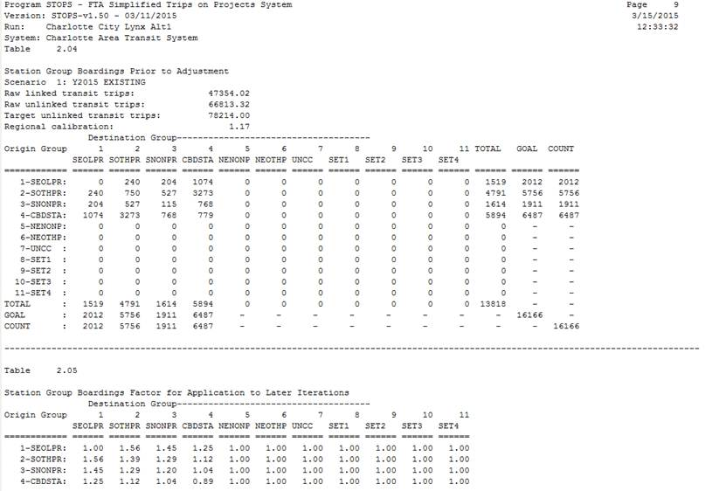


Assessment of fit to the data (continued)
Table 2.04 reports results without any station-group calibration
Regional calibration factor is between 0.7 and 1.3

Slide 86
Assessment of fit to the data (continued)
Boardings by station-group
Comparisons
For existing fixed-guideway stations (required by FTA)
For bus stops in a subarea (good practice)
Goal is to have station group boardings* differ from goals by 40% or less so that when station group calibration is applied it will fine-tune results rather than make major adjustments
Focus attention on:
High-volume station groups
Station groups that will influence trips-on-project forecasts
Factors outside of range, minimize risk to project forecasts
Identify other factors affecting station use and represent with time penalties
Include project stations and all nearby stations or stops in same group
Plan on using station group calibration methods 6, 7, or 8
* Remember, at this stage, station-group calibration is set to option 01 - no calibration

Slide 87
Assessment of fit to the data (continued)
Table 2.04 (continued) reports results without any station-group calibration
Pre-station- calibration group boardings differ from goals by less than 30%

Slide 88
Assessment of fit to the data (continued)
Boardings on individual routes
Comparisons
Table 10.01 – predicted total boardings by route and access mode
Compare predicted boardings for the existing system against actual boardings
Goals
For routes (in some cases, groups of routes) in the project corridor: ±30 %
For routes elsewhere: correct order of magnitude

Slide 89
Advanced assessment of fit to the data
With a reliable on-board survey dataset, tabulate:
District-to-district linked trips by:
Trip purpose
Access mode
Path type
Autos owned
With reliable data on station-to-station unlinked trips, tabulate:
Station-group to station-group unlinked trips
Compare against analogous tables from the STOPS report file
District-to-district: Tables 15.01 through 350.01
Station-group to station-group: Table 3.01
Station-to-station: Tables 15.02 through 350.02

Slide 90
Core adjustments: find and fix mechanical errors
Common mechanical errors
Incorrect specification of geography type for CTPP data
Missing or inconsistent zone-level population and employment
Reliance on incorrect field in shape file to identify zone number
Specified date not found in provided GTFS file(s)
Missing stop_id’s in the station file
Absent park-ride file where park-ride lots exist or will exist
Coordinates in some files not in latitude-longitude system
Inconsistent geographic coverage among:
CTPP flows
GTFS files
Total unlinked and linked transit trips
Boardings at stations and stops
Changes to input files not captured in subsequent reapplication
GTFS filenames too long

Slide 91
Core adjustments: address other problems
Appropriate actions depend on the nature of the problem
No action
Problems relatively minor in extent or magnitude
Calibration discrepancies not likely to affect project ridership
Broad adjustments
Refine estimate of region-wide unlinked transit trips
Add estimate of linked transit trips by purpose
Refine district definitions for CTPP transit-shares
Specific adjustments
Clone zones to improve grasp of growth patterns 2000→current
Refine station-groupings
Represent additional local conditions

Slide 92
Core adjustments: address other problems (continued)
Refine estimate of region-wide unlinked transit trips
In some situations, the correct number of unlinked transit trips may not be apparent
STOPS application considers only a portion of the metropolitan area
GTFS provided for a subset of all transit operators
Remedy: initial run with best first estimate but then evaluate region-wide scaling, station boardings, route boardings to refine unlinked trip estimate to minimize all factoring
Add estimate of linked transit trips by purpose
When transfer rates substantially different from 1.4, STOPS may need a heavy adjustment factor to match region-wide unlinked trips
Remedy: Provide linked trip totals so that STOPS does not have to estimate linked trips by purpose

Slide 93
Core adjustments: address other problems (continued)
Refine district definitions for CTPP transit-shares
Initial district level calibration may have missed key attraction locations:
Specific high transit-share locations diluted inside a larger district
Large, dispersed, low-transit areas co-mingled with denser, more urban, moderate transit share areas
Remedy: revise district system to reflect:
Distinct geographic areas with similar urban form
Areas with particularly high or low existing transit shares
Avoid creating too many districts
CTPP transit trip estimates may become too “lumpy” in lower-ridership areas
Human reviewers unable to grasp tables larger than 20x20

Slide 94
Core adjustments: address other problems (continued)
Clone zones to improve grasp of growth patterns 2000→current
Zones with large change in population and employment may have changes in trip patterns that are greater than simple growth in trip ends
Agrarian town →suburban bedroom community
Suburban bedroom community → major employment activity center
Employment center → mixed-use urban community
Remedy: clone zones to copy trip patterns from nearby areas that were similar in 2000 to what exists in the forecast year in the rapidly-growing zone

Slide 95
Core adjustments: address other problems (continued)
Refine station/stop-groupings
Have station/stop groups represent geographically contiguous areas organized around:
Existing fixed guideway
Line (e.g., north commuter rail, west LRT)
Area type along a line (e.g., CBD, CBD fringe, urban, suburban)
Other corridors (including corridors with the project)
Bus stops in project corridor by area type

Slide 96
Core adjustments: address other problems (continued)
Application of specific calibration adjustments
Add station/stop penalties to account for:
Differences in fare policy
Conditions that make some stations more or less accessible
Public perceptions of individual operating agencies/services
Other large patterns in differences between observed and estimated ridership
Penalties established through hypothesis, trial, and error.
Hypotheses are essential-- they help define what adjustments are applied to new stations or stops
Station/stop penalties are a new STOPS capability and guidance is limited until more experience is gained

Slide 97
Station group adjustments and final review
Select appropriate method(s) for station group calibration factors
01 – no calibration: STOPS default
06 – static factors: STOPS computes factors for each i-j pair and uses identical factors for each scenario.
07 – district path and access type constants (limited magnitude): STOPS computes production and attraction district constants with impact limited to 0.6 to 1.4
08 – district path and access type constants (full adjustment): STOPS computes production and attraction district constants with impact limited to 0.3 to 2.0
09 – factors based on boarding and alighting station: full factoring to match existing counts that are applied to no-build and build scenarios based on station groups used in each scenario
Calibration approaches are a new feature of STOPS and best practices are still emerging

Slide 98
Initial thoughts on calibration approach
Method | Advantages | Disadvantages | Application
01 – no calibration | No station group “hammers” that may distort results | May not match observed station counts well | Early testing, cases where STOPS naturally matches counts, cases where un-factored results are to be analyzed
06 – static calibration | Good match to counts. Distortions are held constant, less likely to cause unpredictable changes in total linked or unlinked trips | Station adjustments not transferred to similar stations on project unless zone already served by same station group
07 – district (limited) | Similar to conventional district level calibration, generates system unlinked trips equal to input number, incremental linked and unlinked trips respond properly to changes in service | May not match station group volumes well. District factors calibrated separately for each access mode and path type. Station adjustments not transferred to projects that change access or path type | May be best approach when model adjustments of under 40% are required to match counts and when district station counts include facilities with same access and path type as those envisioned for project
continued

Slide 99
Initial thoughts on calibration approach (cont’d)
Method | Advantages | Disadvantages | Application
08 – district (full) | Same as Type 7 but may have better match to counts | Same as Type 7 but with better calibration | Similar to 7 but when higher levels of factoring required
09 – full calibration | Good match to counts. Adjustments developed for station groups applied to new stations with same groups. | Factors may lead to illogical shifts in total unlinked or linked transit trips | Cases where project stations are related to existing station counts with little chance of changing station groups.

Slide 100
Preparation of forecasts
A calibrated model is just the beginning of the forecasting process
Coding project service plan
Representing growth in demographics
Confirming plausibility of forecasted project ridership

Slide 101
Coding transit alternatives
Create new GTFS folder with alternative:
Engage schedule-writers to use existing tools to generate new project schedule; or
Manually edit existing GTFS to represent project

Slide 102
Coding transit alternatives (continued)
Some thoughts on a productive strategy
Structure coding changes into groups. Examples
Changes related to the project
The project itself
Direct competitors
Feeder services
Intersecting crosstown routes
Distant parallel services
Changes to the overall transit system required to represent horizon year background services
New fixed guideway services previously committed for implementation
Expansion of bus services to newly developed areas (in vicinity of the project)
Reconfiguration of service (e.g., grid system of routes to hub-and-spoke)
Expansion of bus services to newly developed areas (not near project)

Slide 103
Coding transit alternatives (continued)
Some thoughts on a productive strategy (continued)
Build each alternative on the appropriate antecedent
For each scenario, concentrate on coding a GTFS file set with an appropriate level of changes before coding the next scenario
For new scenario
Code highest priority change first
Run STOPS and record changes in project ridership
Code and run next highest priority changes. Repeat until expected changes in project ridership are small in comparison to the effort required to code the next round of changes
For final run in each year, no-build and build must be consistent in terms of geographic coverage and service levels
1
2
3
Current Year Existing
Current Year No-Build
Current Build
Horizon Year No-Build
Horizon Year Build
5
4

Slide 104
Representing demographic growth
Parallel to process used to represent growth from 2000 to today (discussed earlier)
Since growth to the future cannot be observed, extra attention required concerning plausibility of inputs and resulting trip growth in STOPS
This needs to emphasize the need for another look at corridor growth and consideration of extra steps (cloning) that might be necessary to properly represent future travel

Slide 105
Confirming plausibility
Everything that FTA has said for the last 25 years still pertains to forecasts generated by STOPS
Use the forecasting results to tell a coherent story about the role of the project in the regional transit and transportation system

Slide 106
Output reports and graphics
The information required to tell the story of the project comes from STOPS reports and graphical outputs
STOPS generates 1,021 tables (and up to 14 sub-tables for each main table) with each run. The key is finding what you need.
The report begins with an index of all tables that helps the user locate the information being sought

Slide 107
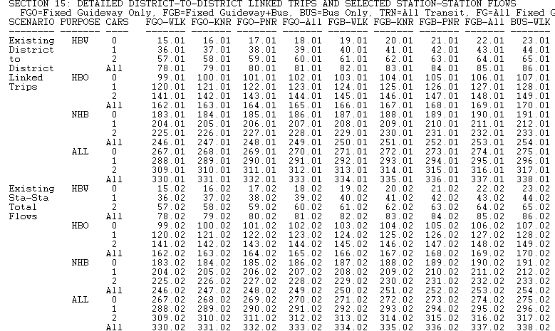
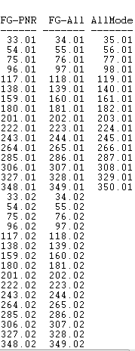
STOPS table index
…

Slide 108
Output reports and graphics (continued)
Useful reports that help support the story of the project:
District population and employment (Table 12.01)
District-to-district person travel patterns
Available for each scenario, trip purpose, auto ownership level (“AllMode” in index)
Transit trip patterns
Available for each scenario, trip purpose, auto ownership level, access mode, path type (Linked Trips in index)
Transit volumes
Station-station unlinked trips available for each scenario, trip purpose, auto ownership level, access mode, path type (Sta-Sta in index)
Route level ridership (Table 10.01 and 10.02)
Change in auto mode PMT (Table 8.01)

Slide 109
Output reports and graphics (continued)
Change in transit service levels
See GTFPath path report files in skims\ subdirectory
Provides listing of selected path for each scenario, access mode, path type, and time period for zone-zone pairs where both the origin and destination zone are named in the district file
STOPS can also display selected transit trip table information using linked GIS functions

Slide 110
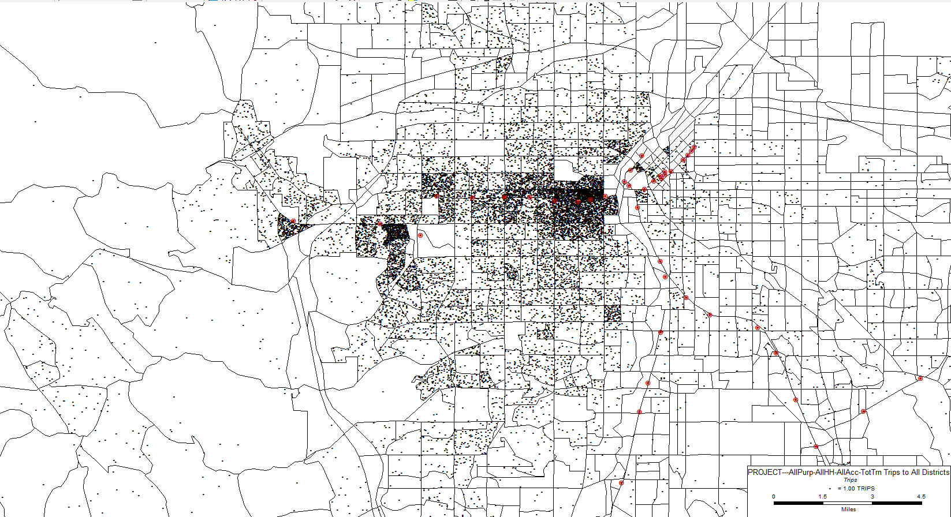
Sample graphical output

Slide 111
Uses of STOPS
QC of ridership forecast prepared with other method(s)
Comparison of two forecasts can provide more than twice the insights of either forecast separately
Details matter in the comparison
Travel markets
Market shares
Changes in transit level-of-service caused by the project
Differences in outcomes should be explored:
Data sources?
Coding errors?
Differences in model response/elasticity?
Results lead to two useful outcomes:
Better understanding of the project’s contributions to mobility
Identification of potential uncertainties and their sources

Slide 112
Uses of STOPS (continued)
Support of request to FTA for engineering-entry / funding
All information for New Starts templates is in STOPS outputs
No additional tabulations are needed to satisfy the reporting requirements in the results report
Project sponsors provide to FTA a copy of the entire STOPS implementation (inputs and reports)
Satisfying the reporting requirements
Allowing FTA to test answers most questions that may arise without having to bug the sponsor about them
Project sponsor still required to prepare the story of the mobility benefits of the project from the forecasts

Slide 113


