Slide 1
Student Academic Monitoring
and Support System
What the system does
Student records
A simple Python program for early student support and academic risk monitoring.
Store name, ID, units and scores
This presentation explains the problem, my solution, design, key code, testing and how to use the system.
Risk calculation
Average, grade and support level
Problem
Solution
Testing
Attendance feature
Extension for better monitoring
Data persistence
Github Repo Link:
https://github.com/alex-njugi/samss-project
Save and load JSON records

Slide 2
Problem definition and solution
Problem
My solution
Academic performance is harder to monitor when records are scattered or manual.
I built SAMSS as a command-line Python program that registers students, calculates academic results, classifies risk, stores records, and includes attendance tracking as an extension feature.
Departments need a simple way to identify students who may be at risk early.
Average score
Grade
Without clear tracking, support can come too late.
Risk level
Attendance
This project focuses on the academic monitoring part of the wider student-support challenge.

Slide 3
Core features of the system
Main capabilities
Menu-driven interface
Register student details, unit names and scores
Compute average score automatically
===== SAMSS Menu =====
1. Register student
2. View all students
3. Search student by ID
4. Update attendance
5. Show moderate/high risk students
6. Save records
7. Exit
Assign grades from A to E
Classify students as Low, Moderate or High risk
Validate IDs, names, scores and attendance ranges
View, search, update and save records through one menu
The menu keeps the program easy to use and easy to demonstrate.

Slide 4
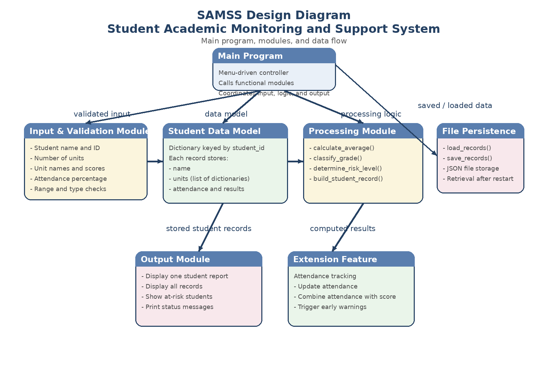
Design approach
How I designed it
System diagram
I used top-down design to split the system into small functions.
A dictionary stores student records using the student ID as the key.
Each student stores a list of units and scores.
Calculation logic is separated from user input and output.
This makes the code easier to maintain and extend.

Slide 5
Key code example
build_student_record()
Why I chose it
def build_student_record(name, student_id, units, attendance):
average_score = calculate_average(units)
return {
'name': name,
'student_id': student_id,
'units': units,
'attendance': attendance,
'average_score': round(average_score, 2),
'grade': classify_grade(average_score),
'risk_level': determine_risk_level(average_score, attendance),
}
It combines several functions into one complete record.
It avoids repeating calculations in many places.
It gives one clear structure for each student.
It makes future features easier to add.

Slide 6
Testing, validation and storage
Validation
Testing
Storage
Empty names are rejected
Average score calculation
{
"STU001": {
"name": "Alex Njugi",
"average_score": 75.0,
"grade": "A",
"risk_level": "Low"
}
}
Student IDs must be unique
Empty unit list
Unit count must be between 1 and 12
Grade boundaries
Scores and attendance stay within 0-100
Risk level with attendance
Invalid menu choices are handled
Record creation
Records are saved to samss_records.json and loaded again the next time the program runs.

Slide 7
How to use it and final evaluation
How to use the program
Conclusion
SAMSS solves the core monitoring problem clearly.
1
1. Run
python3 samss.py
The code is modular and easy to explain.
2
2. Use menu
Validation and tests support correctness.
Register, search, update, save
At a larger scale, a database and richer interface would be better.
3
3. Test
python3 -m unittest discover -s tests -v
4. Github Repo Link https://github.com/alex-njugi/samss-project
SAMSS helps identify students who may need support early.
4

