Slide 1
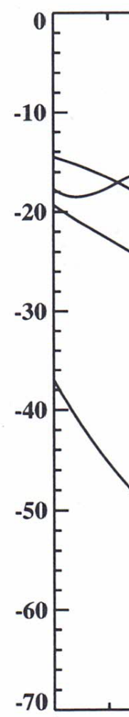
100 C
-18

Slide 2
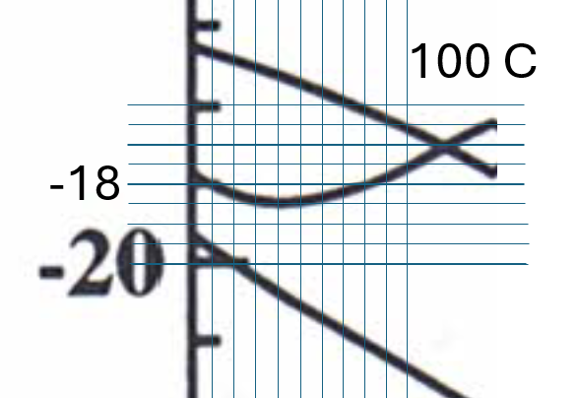
Alumel Seebeck Coefficient
Handbook of Temperature Measurement Vol.3,
Theory and Practice of Thermoelectric Thermometry, Robin E. Bentley, Page 31
T(C) | 0 | 10 | 20 | 30 | 40 | 50 | 60 | 70 | 80 | 90 | 100
S(uV/K) | -17.7 | -18.0 | -18.3 | -18.4 | -18.5 | -18.4 | -18.3 | -18.2 | -18.0 | -17.8 | -17.6
T | 5 | 15 | 25 | 35 | 45 | 55 | 65 | 75 | 85 | 95 | 105
S | -17.9 | -18.1 | -18.3 | -18.5 | -18.5 | -18.4 | -18.3 | -18.1 | -17.9 | -17.7 | -17.5

Slide 3
Type K Seebeck coefficients
Handbook of Temperature Measurement Vol.3,
Theory and Practice of Thermoelectric Thermometry, Robin E. Bentley, Appendix
Calculated from the above book, based on hot junction emf relative to cold junction at 0C
T (C) | 5 | 15 | 25 | 35 | 45 | 55 | 65 | 75 | 85 | 95
S(uV/K) | 39.7 | 40.1 | 40.5 | 40.9 | 41.1 | 41.3 | 41.5 | 41.6 | 41.5 | 41.4

