Slide 1
Obesity has been considered a risk factor for increased mortality in the ICU based on increased comorbidities. However, the lower mortality of these patients with sepsis is known as the "obesity paradox". The aim is to determine the impact of obesity on crude mortality in ICU in septic and non-septic patients and which factors are associated in each case
Sepsis and obesity: size matters in more than one way
Helena Blanch Manzano, Marco Marotta Pais, Luis Nakayama, Alex Pardo, Jonathan Patscheider, Marcos Perez Carrasco, Verónica Santos Pulpón

Slide 2
Introduction
Sepsis
Body extreme response to an infection. It is a life-threatening medical emergency. Sepsis happens when an infection you already have triggers a chain reaction throughout your body.
Obesity
Obesity is defined as abnormal or excessive fat accumulation that presents a risk to health. A body mass index (BMI) over 25 is considered overweight, and over 30 is obese. Global pandemic.

Slide 3
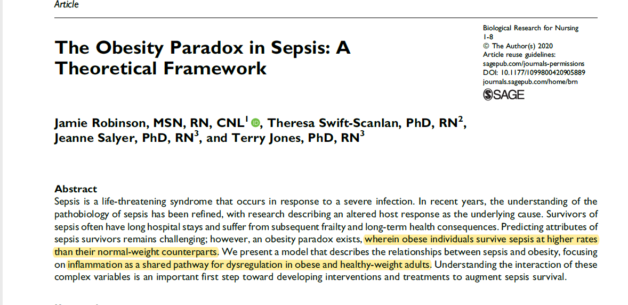

Slide 4
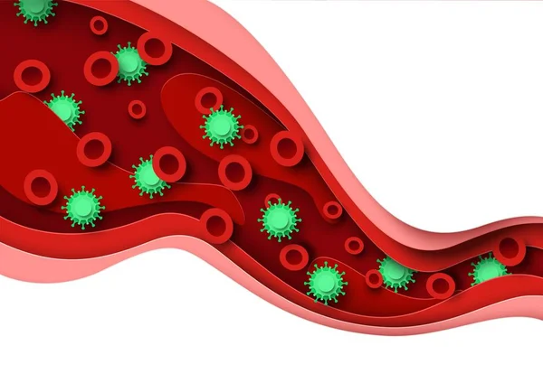
Objective
To determine the impact of obesity on crude mortality in ICU in septic and non-septic patients and which factors are associated in each case in 2 hospitals from Catalonia.

Slide 5
Methods and materials
Septic patients
Obese patients
Antibiotic treatment on first 24 hours
BMI were stratified by:
Underweight < 18.5
Normal Weight 18.5-24.9
Overweight > 25 <30
Obesity grade 1 30 <39
Obesity grade 2 >35 <39
Obesity grade 3 >40
Sequential Organ Failure Assessment (SOFA) 0-24 points: Predicts ICU mortality based on lab results and clinical data that assess neurological, cardiovascular, respiratory, hematologic and renal parameters. Score ≥ 2

Slide 6
Methods and materials
ICUICS Database which includes 21,139 patients in 6 Catalan hospitals
Selected patients form Hospital Universitari Vall d’Hebron and Hospital Universitari Joan XXIII:
7,764
Neurocritic, pregnant, post surgical patients were excluded using diagnosis at the admission or mesures.
Final Cohort: 6,721 pacients

Slide 7
Methods and materials
Exploratory data analysis
Logistic Regression
Correlation analysis
Random Forest
SHapley Additive exPlanations (SHAP)

Slide 8
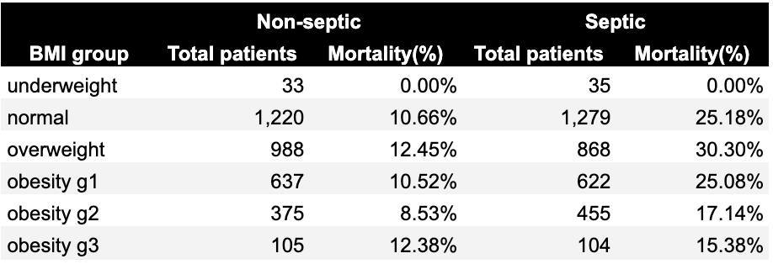
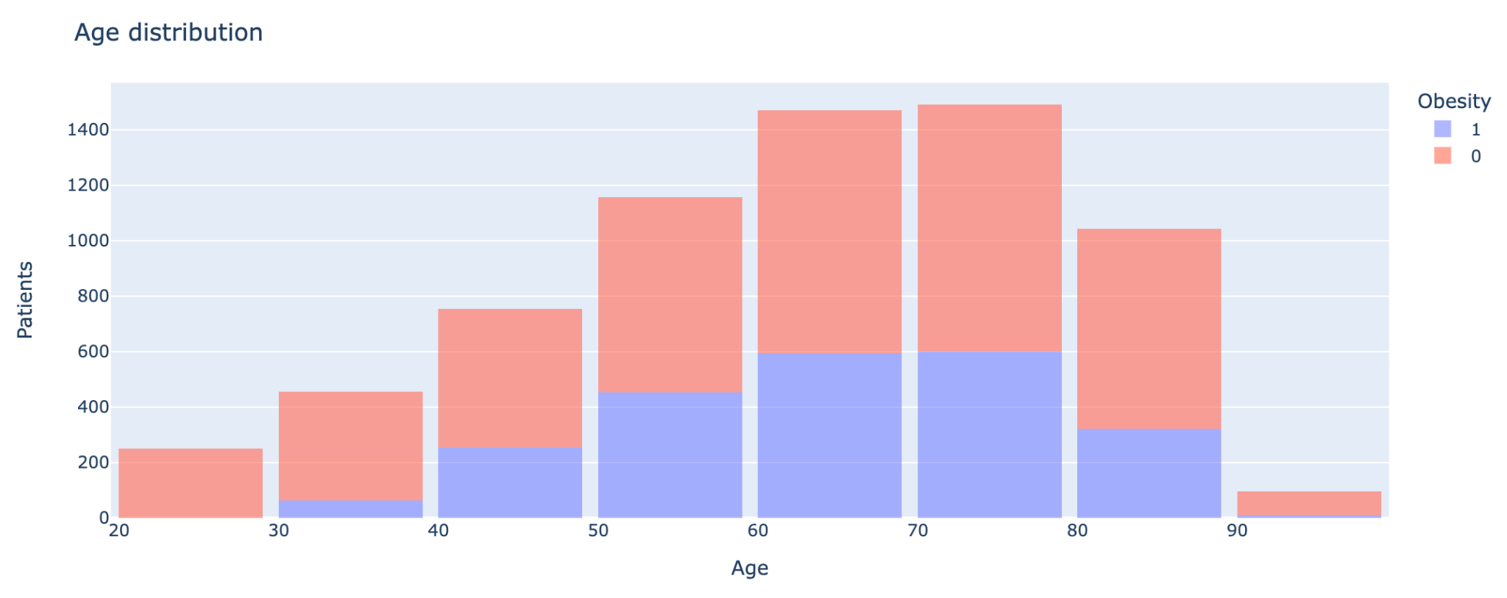
Results

Slide 9
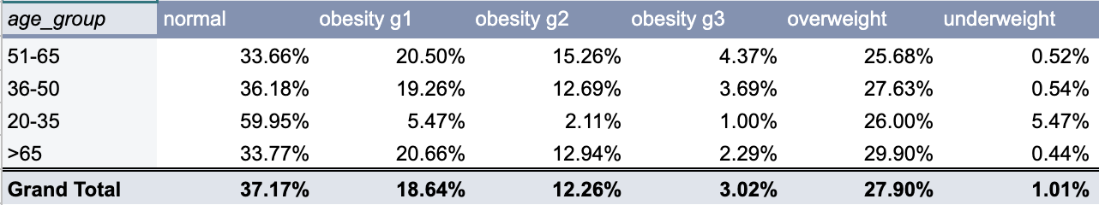
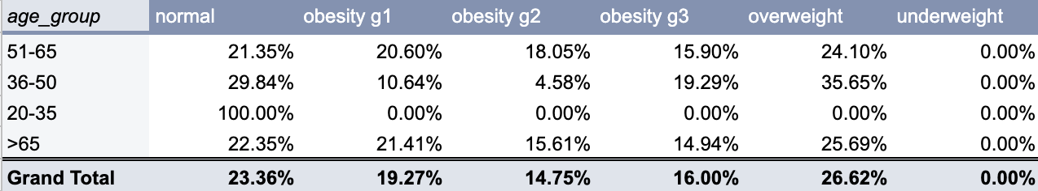
Results
Patient distribution
Deaths according to groups

Slide 10
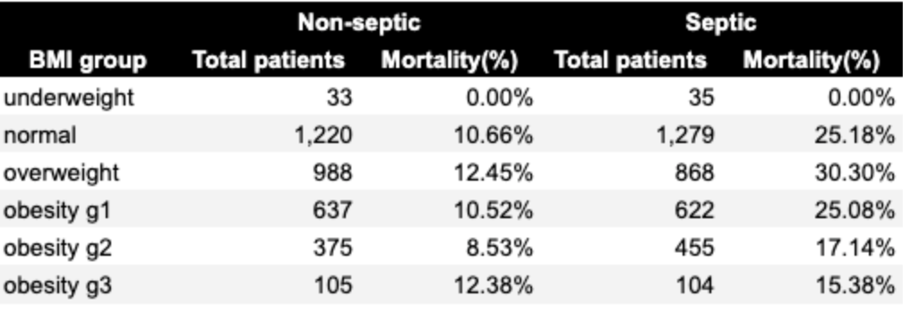
Results

Slide 11
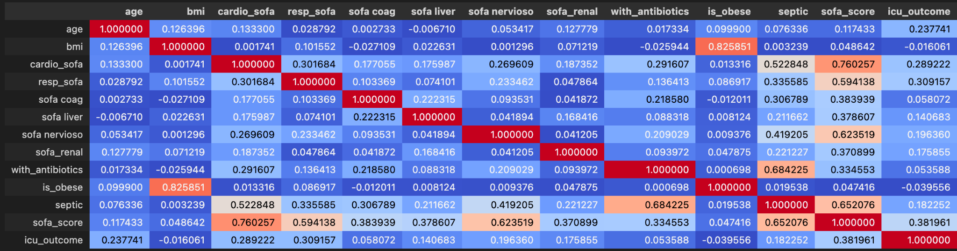
Results
Death outcome correlations
sofa_score 0.381961
resp_sofa 0.309157
cardio_sofa 0.289222
age 0.237741
sofa_nervioso 0.196360
septic 0.182252
sofa_renal 0.175855
sofa_liver 0.140683
sofa_coag 0.058072
with_antibiotics 0.053588
bmi -0.016061
is_obese -0.039556

Slide 12
Results
Logistic Regression
Coefficients - ICU death outcome
Age 3.27
Sofa score 5.25
Antibiotics -0.81
Obesity -0.4
Sepsis 0.38

Slide 13
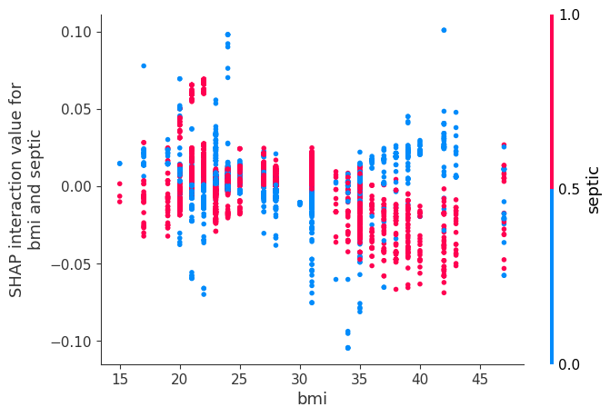
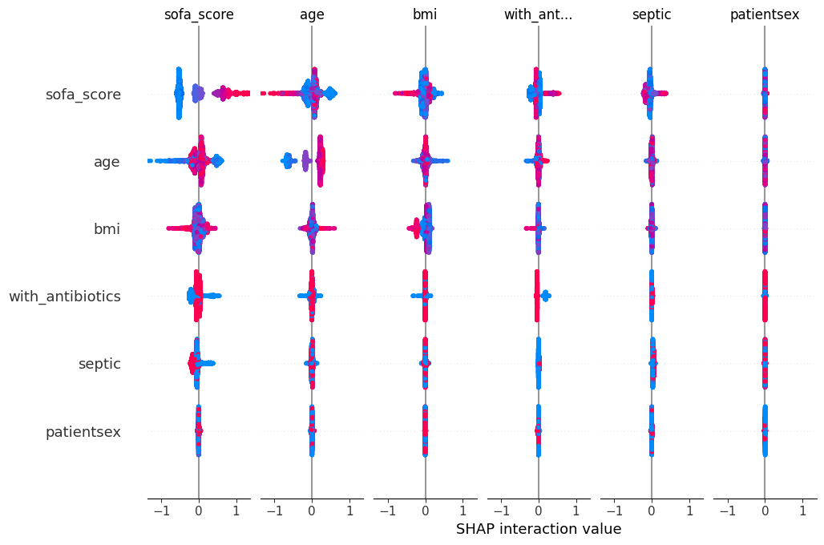
Results
Random Forest
SHapley Additive exPlanations (SHAP)

Slide 14
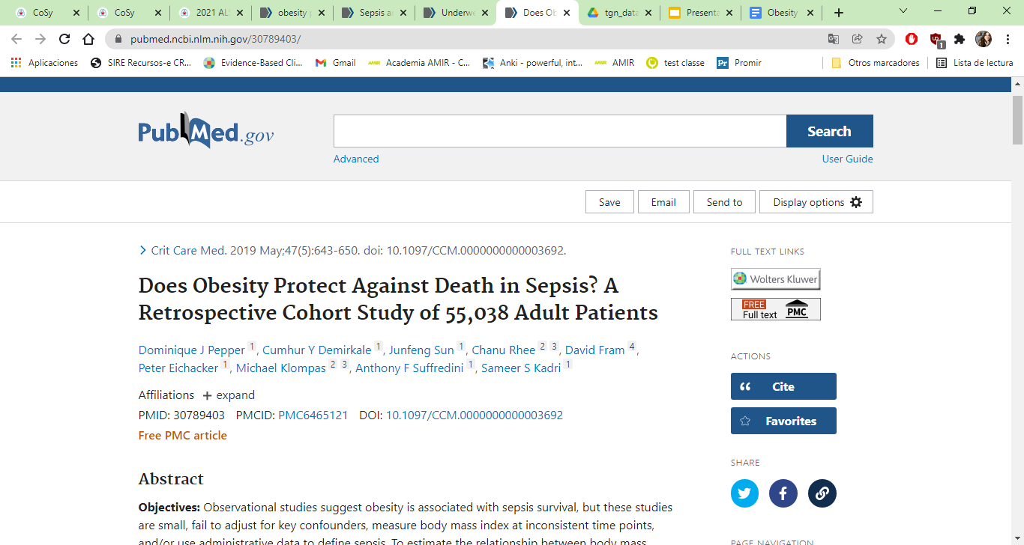
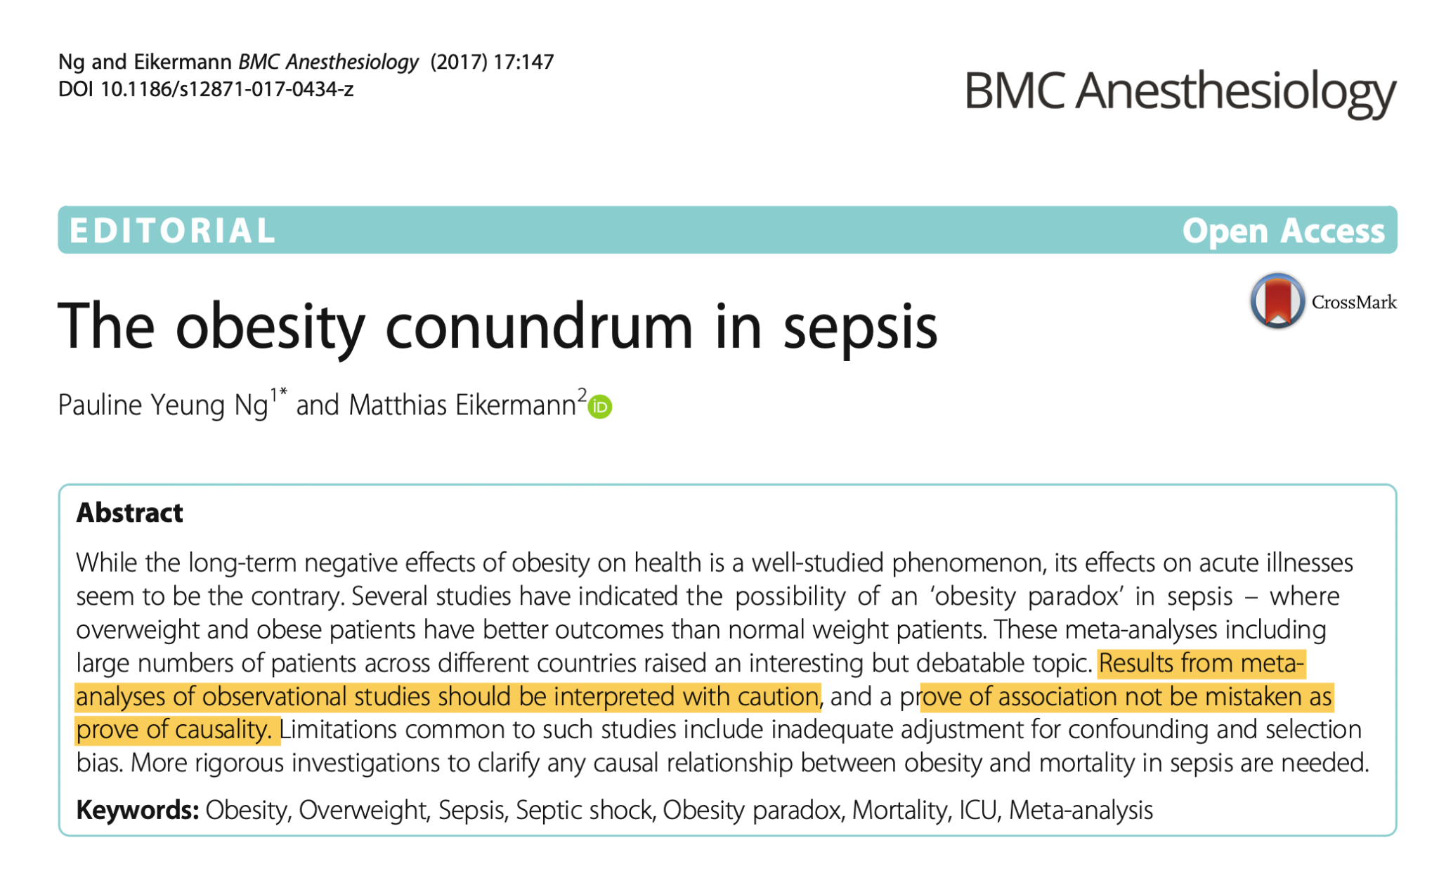
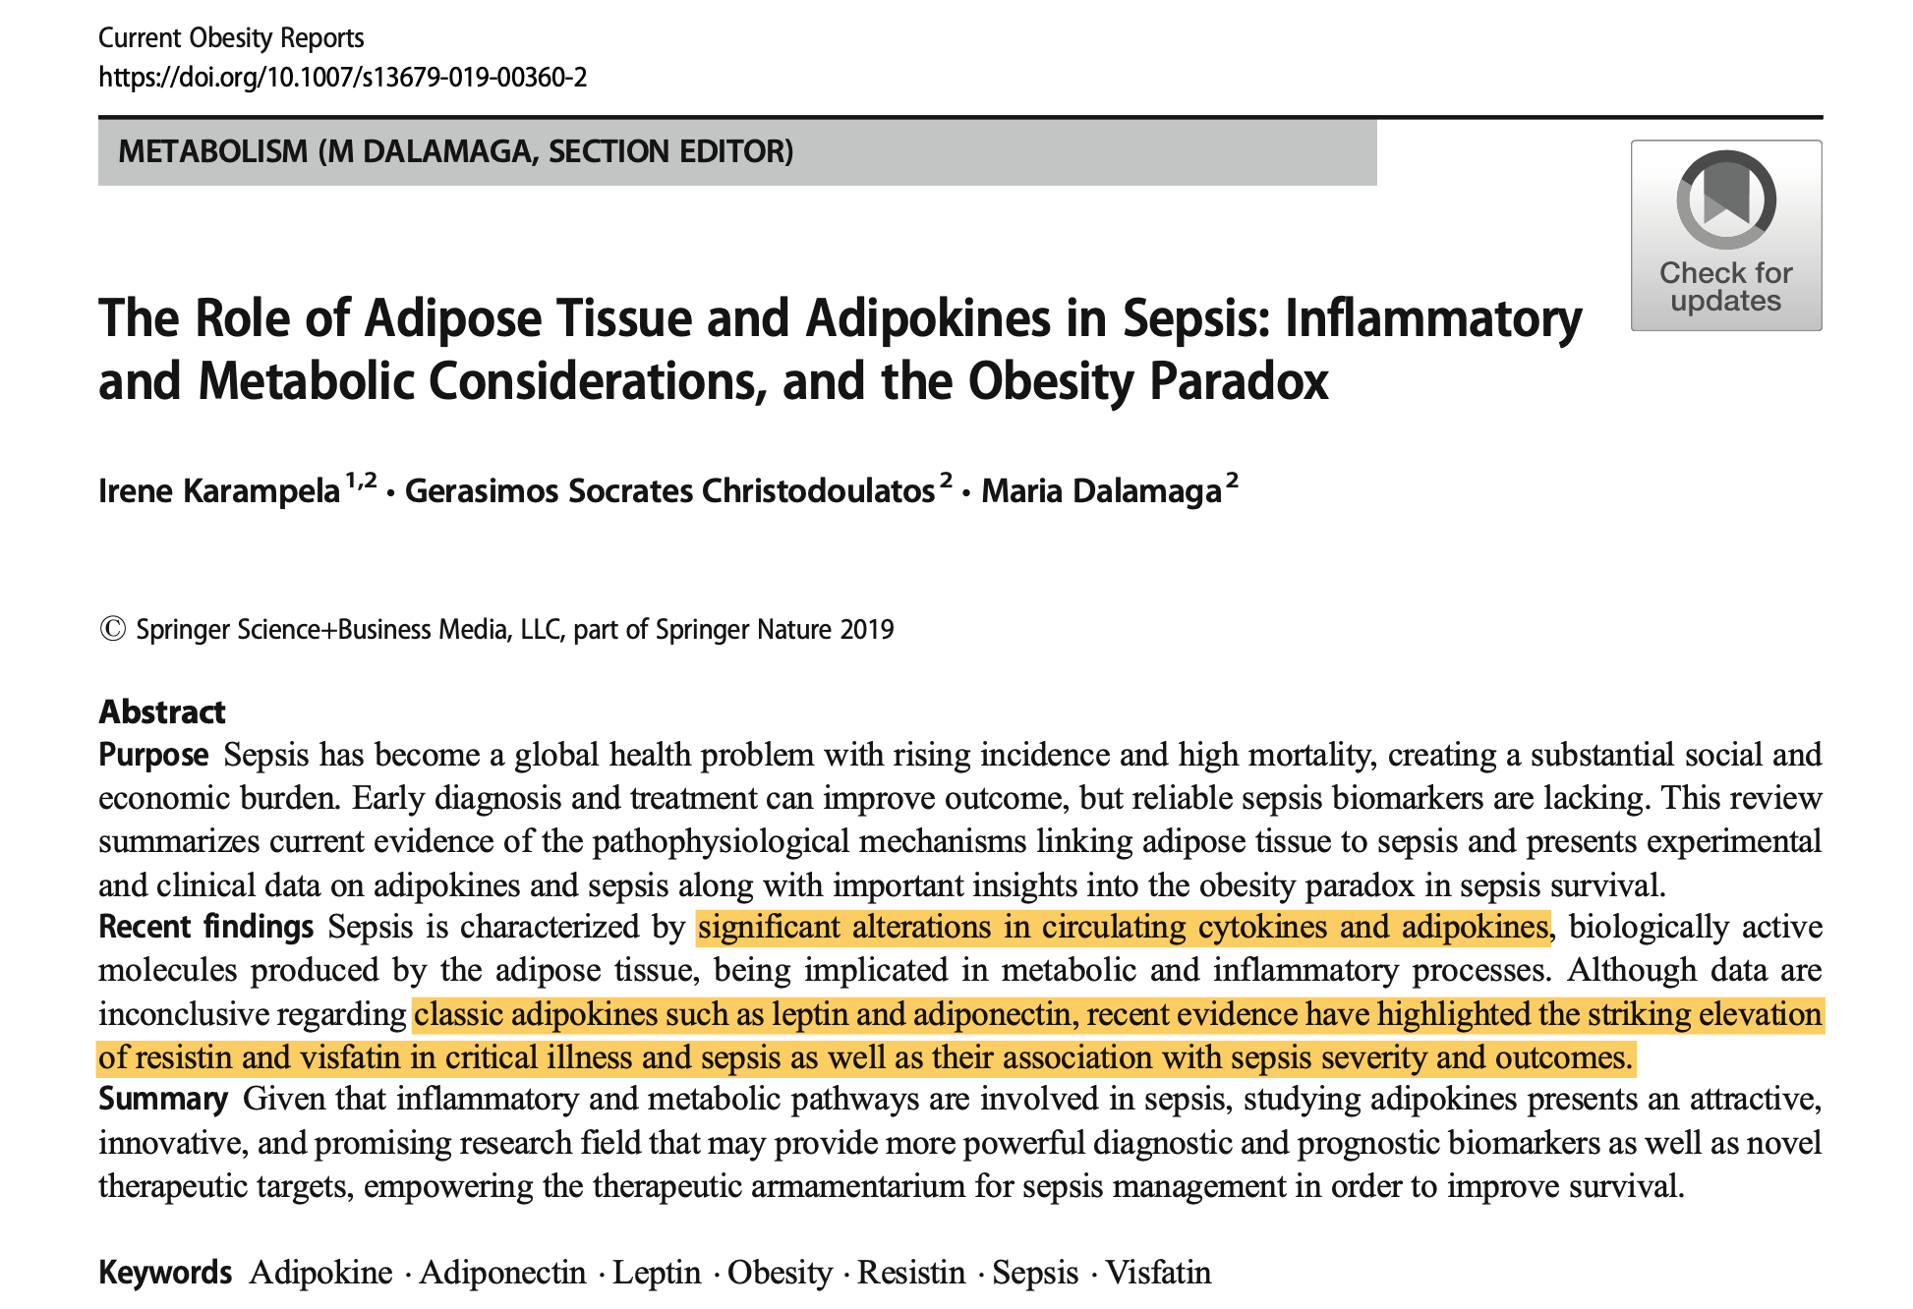
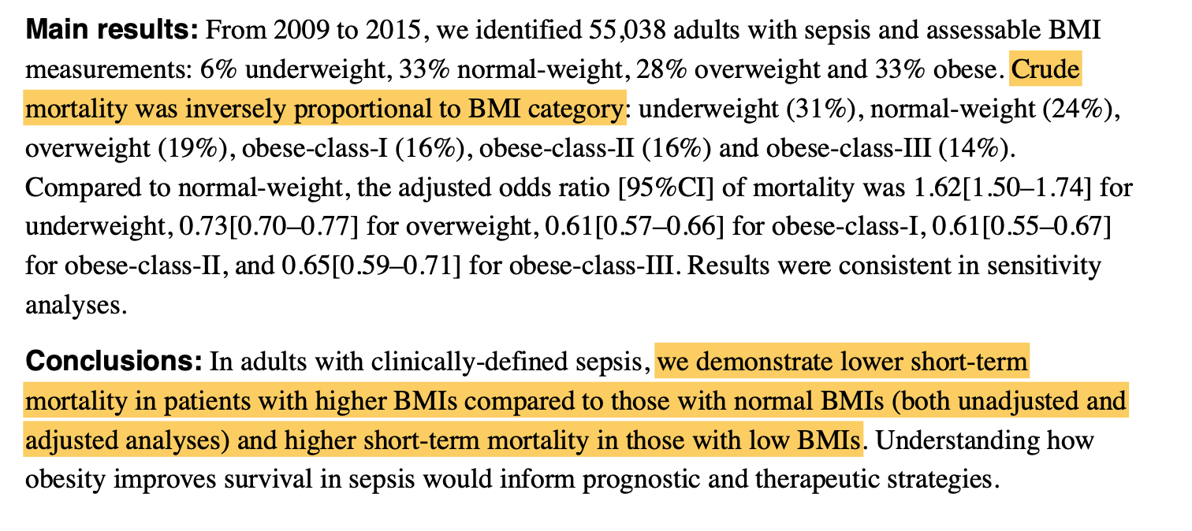
Discussion

Slide 15
Limitations
Non available variables (e.g.. Laboratory table, hemocultures)
Challenges in harmonizing different hospital data

Slide 16
Next steps
Expand the analysis to all ICUICS hospitals
Causal inference analysis

