Slide 1
Element gallery
research-slides-skill · every slide names the layout elements it uses
Built from example-slides.xml with research-slides-skill gallery
elements: title · text · inline a, code, muted · outline="none"
2

Slide 2
Section divider
A rule, a title, a subtitle — nothing else
elements: shape prst="rectangle" (the rule) · title · text
2

Slide 3
<text> — paragraphs and inline runs
A bold run, an italic run, and monospace code in one paragraph.
A real hyperlink: python-pptx docs; a muted owner tag at the end.
run takes explicit color, size, bold, italic, font.
Nesting composes: italic throughout, bold here, italic again.
A line break inside a paragraph
renders as a real paragraph break, so it survives the Google Slides import.
elements: title · text with p · inline b, i, code, a, muted, run, br
2

Slide 4
<bullets> — levels and numbering
bullet="•" (default), level= to indent
bullet="arabic" (auto-numbered)
Top-level point
A sub-point, indented once
Indented twice; wrapped lines align under the text, not the glyph
Back to the top level
Scaffold the deck: title and dividers
Fill one section at a time
Build, check fidelity, look at the PNGs
(a single li can override its own bullet)
elements: title · text · bullets with li level= · bullets bullet="arabic"
2

Slide 5
<shape> — a native flow, no image
Pull request merged (CI green)
Every merge to main builds a versioned artifact.
Canary takes 5% of traffic for 30 minutes before the full rollout.
A failed health check rolls back automatically.
Canary deploy · 5% of traffic, 30 min soak
Full rollout or automatic rollback
Three stages; the health check decides between the last two.
elements: title · bullets · shape prst="rounded-rectangle" · shape prst="down-arrow" · caption
2

Slide 6
<shape> — a tier ladder
Fastest at the top; each tier below covers more and costs more.
unit — pure functions, milliseconds, thousands of cases
integration — real database, one service at a time
contract — recorded requests between services
end-to-end — a browser against a staging cluster
manual — release checklist, once per release
elements: title · text · shape prst="rounded-rectangle" x5 (single-hue fill ramp)
2

Slide 7
<shape> — a taxonomy with a severity ramp
Sev 3 — degraded — e.g. search results load slowly
Sev 2 — feature down — e.g. POST /checkout returns 500
Sev 1 — outage — e.g. login fails for every user
elements: title · shape prst="rounded-rectangle" with mixed inline runs (b, run, code)
2

Slide 8
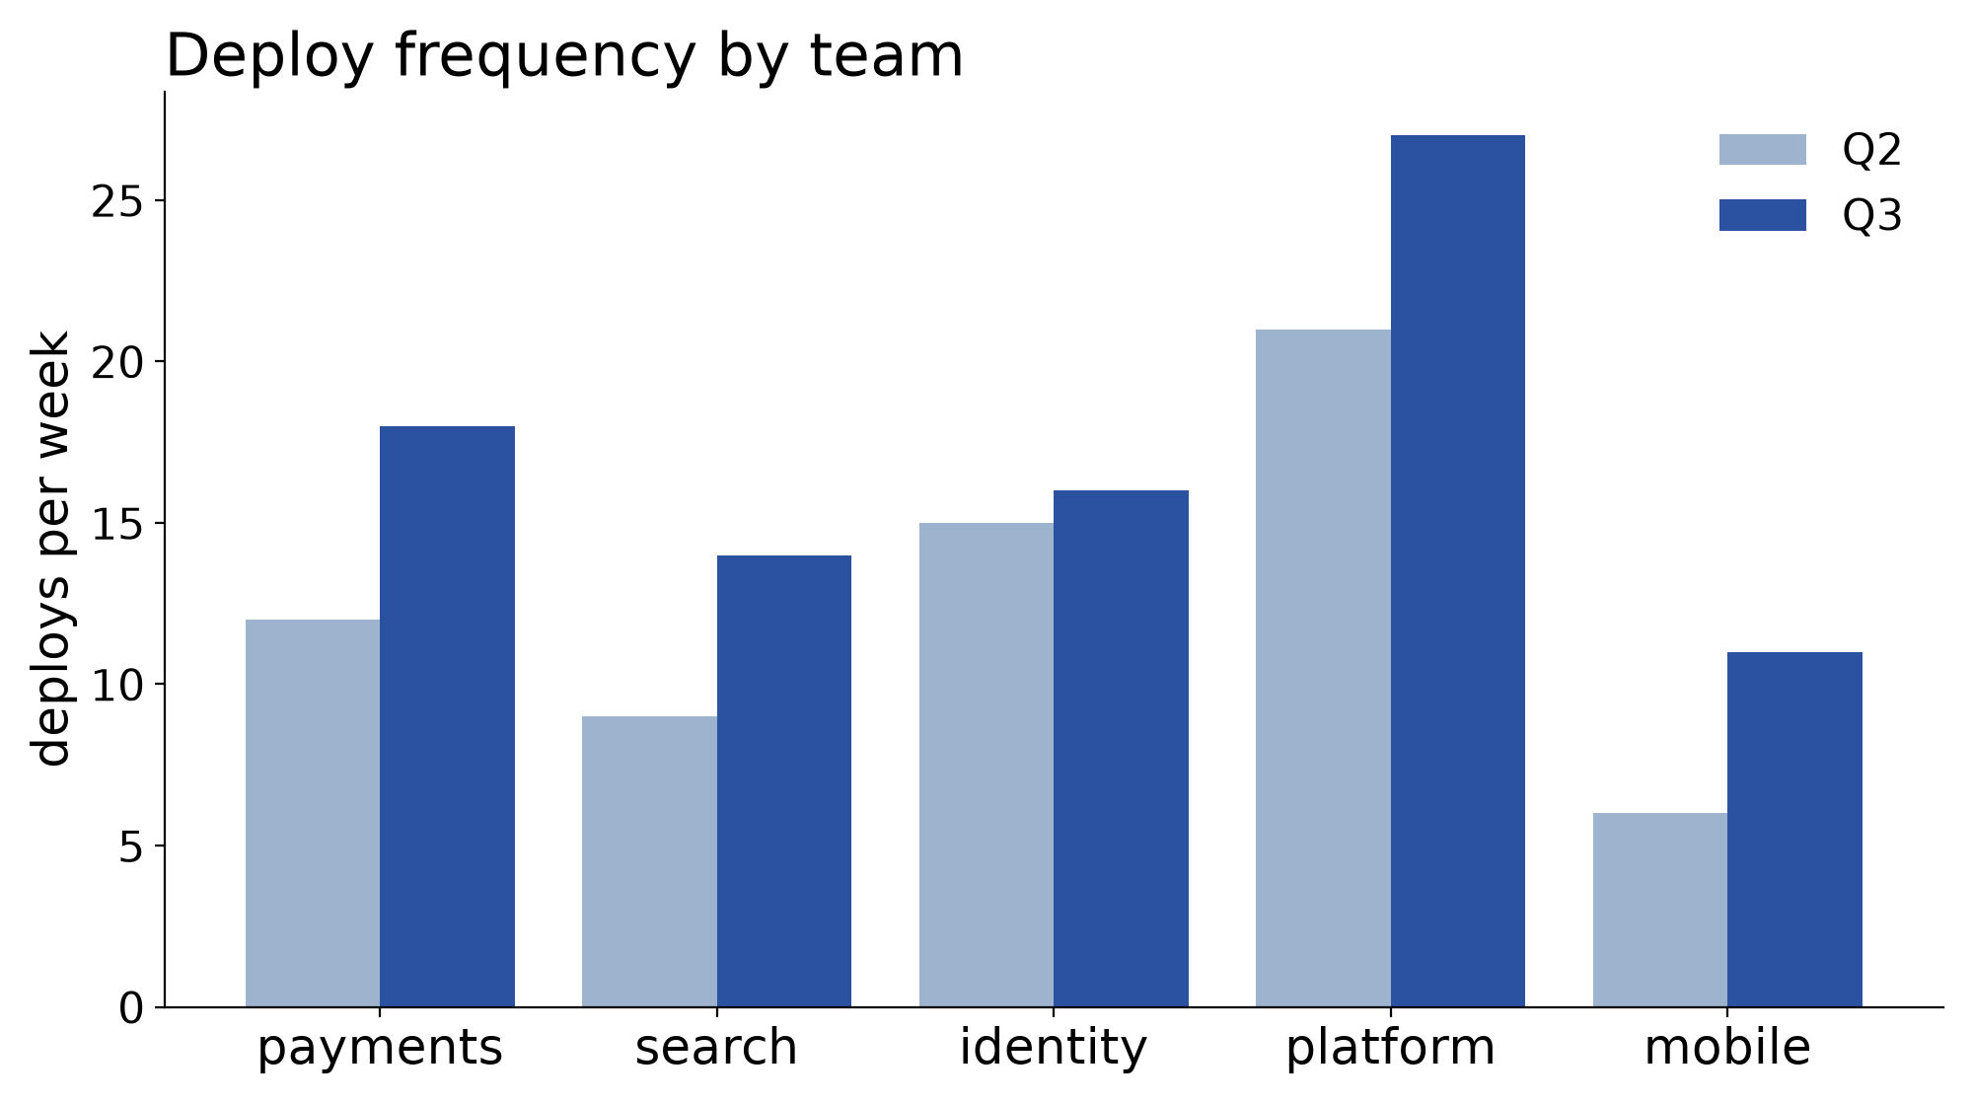
<image> — a results slide with caption and provenance
Rendered at 16:9 with oversized fonts so it reads at slide size; numbers come from the data, not the XML.
elements: title · image src= w= (fit="contain") · caption · source href=
data ↗
2

Slide 9
Pattern — data-led intro: input card, then outcomes
CI: test_payment_webhook FAILED (timeout 30s)
retry 1 of 2 …
What happens — the first retry recovers most runs; the second rarely helps:
Retry 1
✓ recovers — 412 of 480 failures (86%)
Retry 2
marginal — recovers 9 more; 59 are real failures
elements: title · shape prst="rectangle" (mono card) · text · shape prst="rounded-rectangle" x2 · source
data ↗
2

Slide 10
<columns> — a two-column compare
1 · Lockfile
2 · Ranges
exact versions, resolved once, committed
floors only; resolution happens at install time
requests==2.32.3
urllib3==2.2.2
certifi==2024.7.4 # transitive, pinned too
Trade-off: a range picks up security fixes for free, but two installs a week apart can differ — so builds are reproducible only with a lockfile as well.
elements: title · columns gap= · column w="50%" · text · shape prst="rectangle"
2

Slide 11
<table> — a configuration matrix
environment | replicas | autoscale | database
dev | 1 | off | shared, reset nightly
staging | 2 | off | snapshot of production
production | 6–24 | on | primary + two replicas
elements: title · table cols= align= row-height= rules="rows" · tr · td color=
2

Slide 12
<turn> — transcript cards
user
Hi, I was charged twice for order #48213. Can you refund one of them?
agent
I can see two charges of $42.00 on 14 Jan. I have refunded the duplicate;
it should appear on your statement within 5 business days.
result · AUDIT
refund(order=48213, charge=ch_2, amount=42.00) -> ok
Cards are one shape each: a small context label above a mono body.
elements: title · turn actor="user" · turn actor="agent" · turn actor="result" tag= · caption
2

