Slide 1
The electric future of mobility

Slide 2
Some numbers
$28 billion invested in EV (Electric Vehicle) companies in 2020 alone¹
5 million liters of gas saved as of 2020 for Lime riders alone²
Electric cars sales are growing at a 40% year-over-year rate³
Source: MarketWatch (2021)
Source: Lime (2020)
Source: IEA (2020)

Slide 3
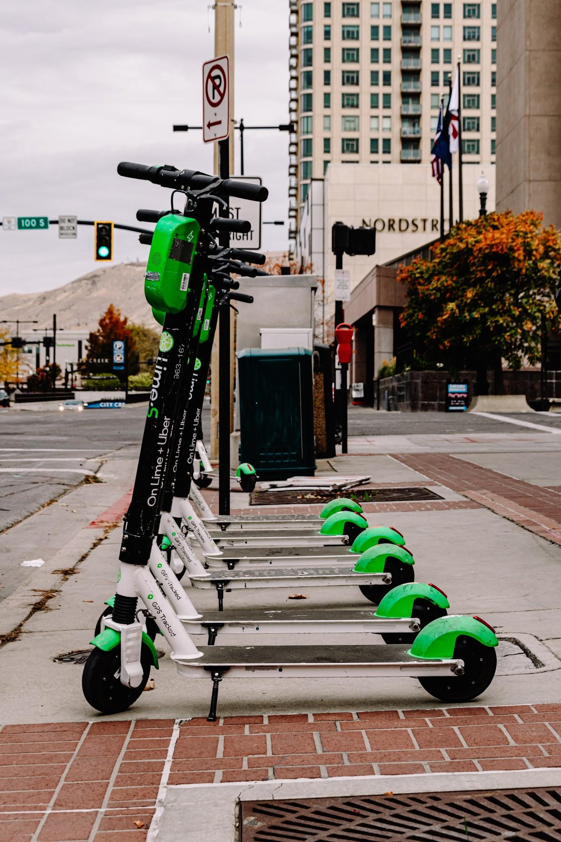
The last mile
One of the biggest areas of improvement in mobility right now is the “last mile” one.
Solving this in the right way could lead to a huge reduction in CO₂ emissions.
In fact about 20% of all the trips in the US are less than a mile in length¹.
Source: NHTS (2009)

Slide 4
Not only electric scooters
Another sector that is booming in popularity is the electric cars one.
In the freight industry electric trucks are starting to appear.

Slide 5
What does the future look like?
Fully autonomous driving
Connected cars
Widespread shared micromobility options (bikes, scooters, ...)
The benefits of reaching these goals are:
Less car accidents
Less rush hour traffic
Less air pollution

Slide 6
The time is right for electric cars - in fact the time is critical.
- Carlos Ghosn

