Slide 1
LIBOR Interest Rate Model
DEEP DIVE ANALYSIS
By Alex Yau

Slide 2
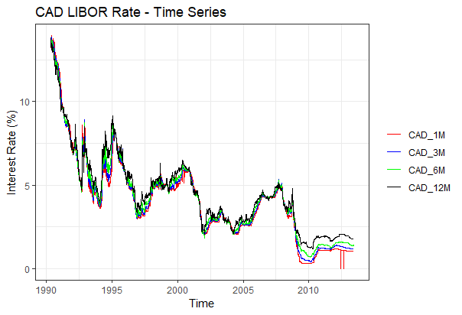
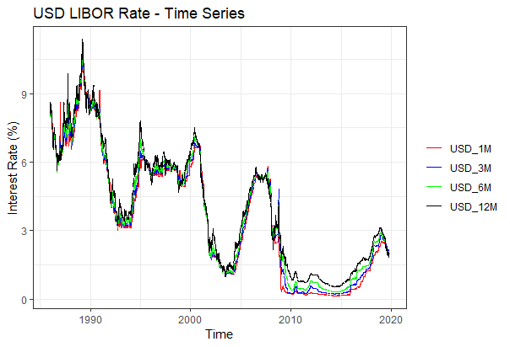
IR Time series

Slide 3
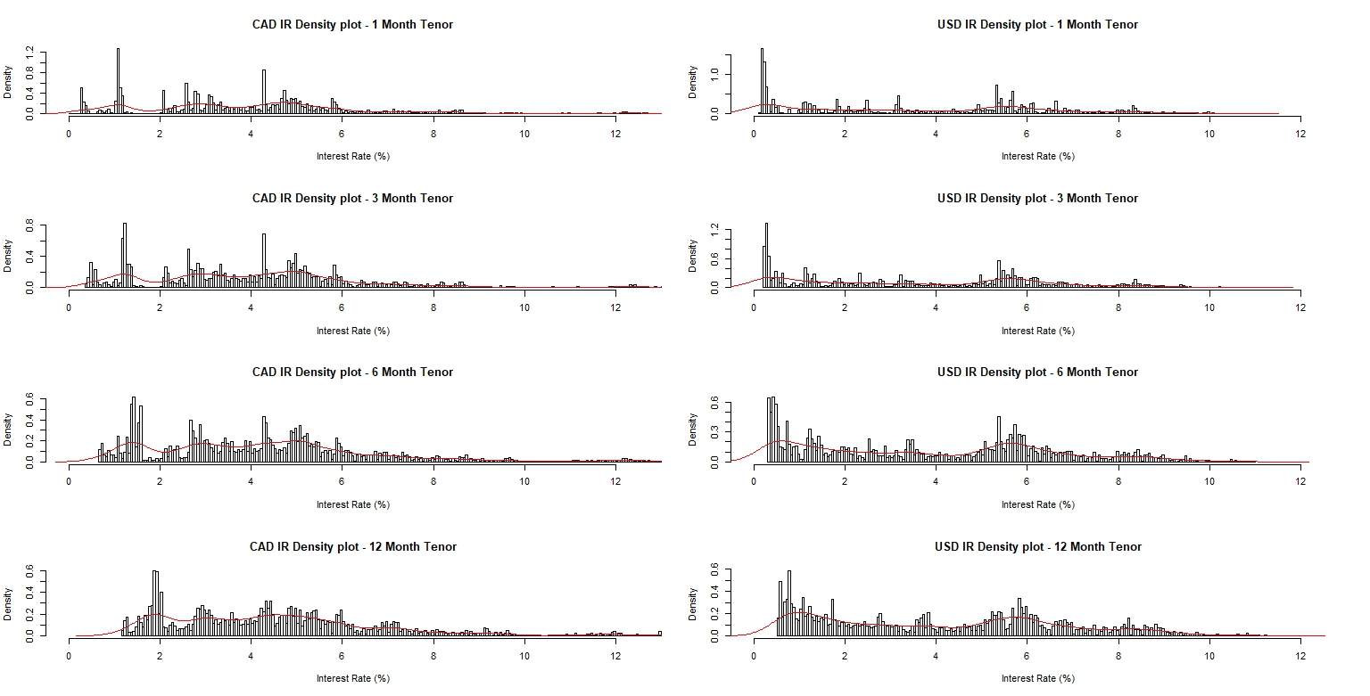
IR Histograms and Densities

Slide 4
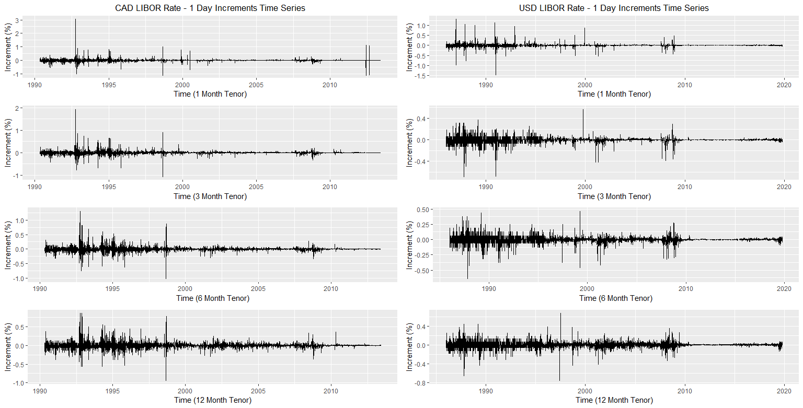
IR 1-Day Increments Time Series

Slide 5
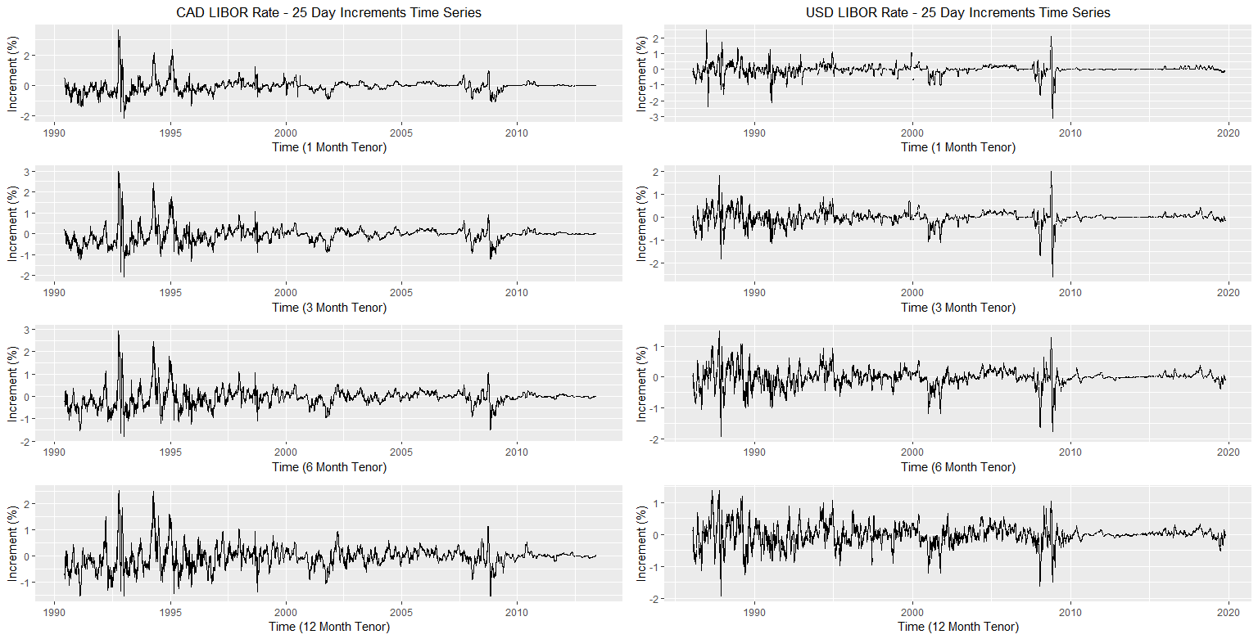
IR 25-Day Increments Time Series
Notes:
Longer tenors tend to be noisier and exhibit more Brownian motion

Slide 6
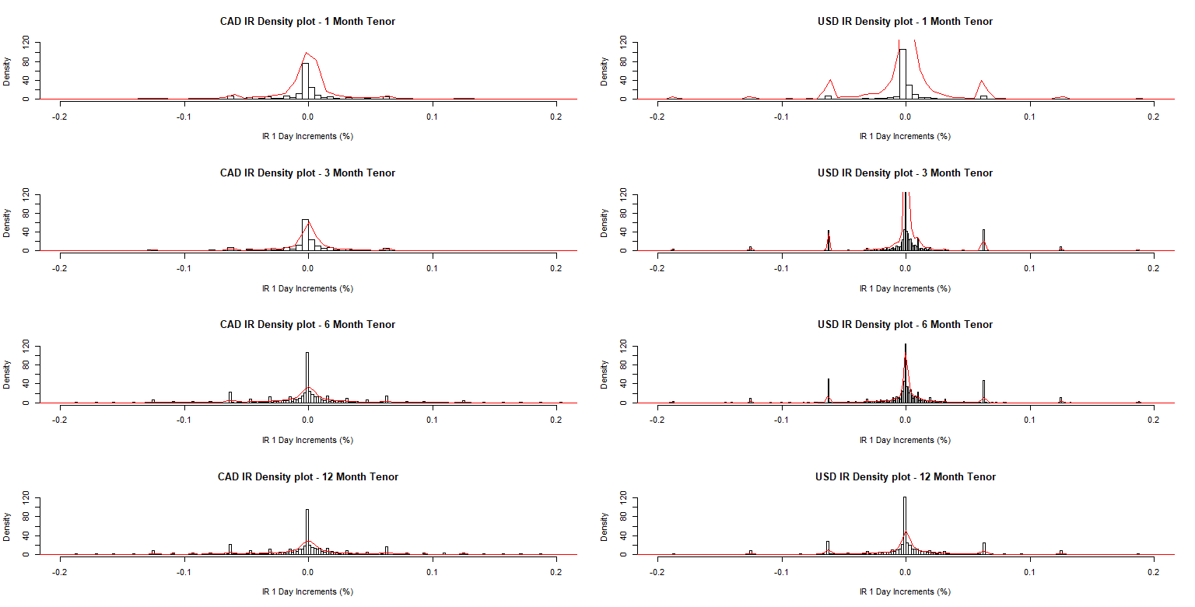
IR 1-Day Increment Histograms and Densities
Notes:
Cute peaks at around +-0.06% and +-0.12&

Slide 7
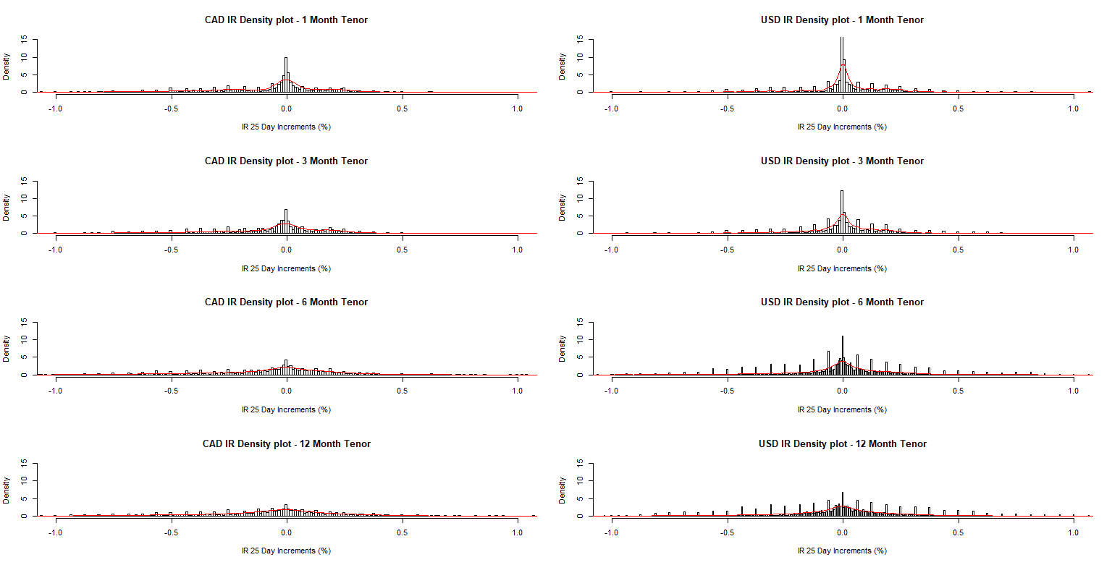
IR 25-Day Increment Histograms and Densities
Notes:
Much more small peaks, looking like periodicity

Slide 8
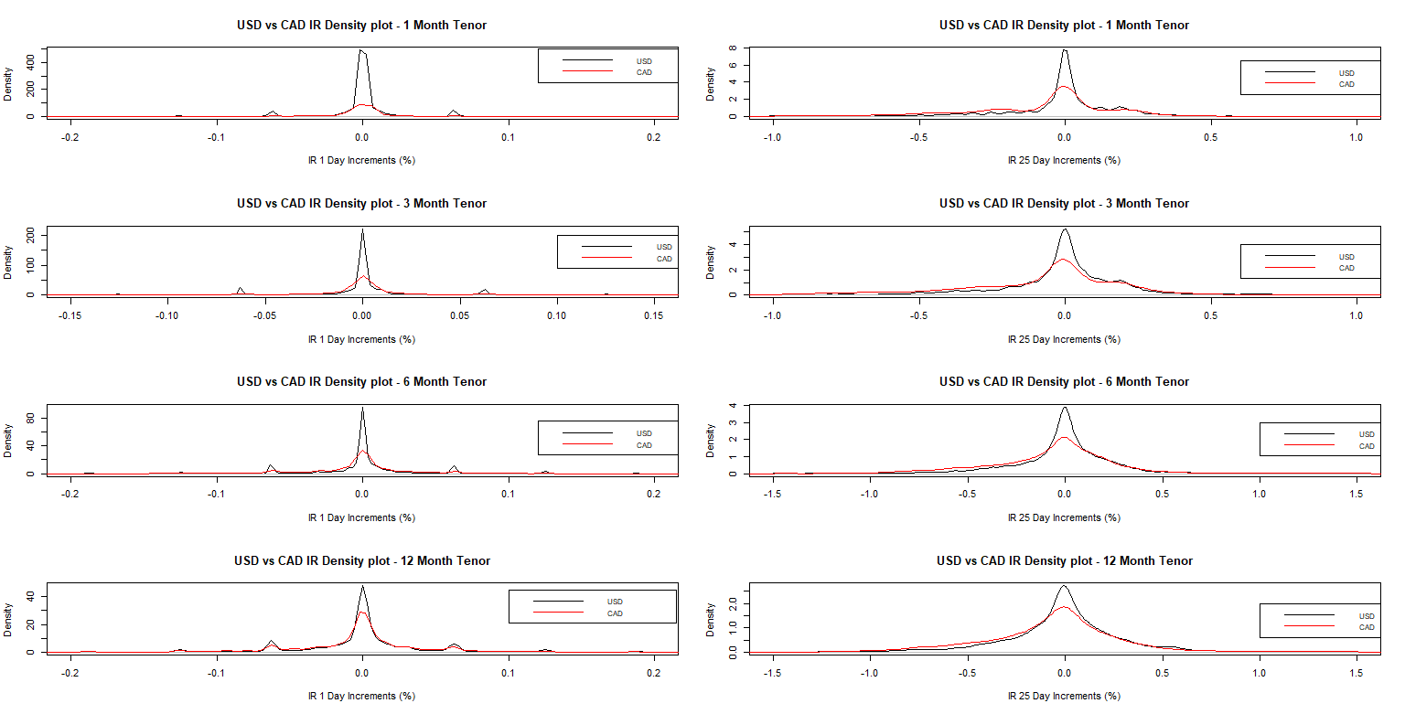
IR Increment Densities – USD vs CAD
Notes:
SAME AMOUNT OF SAMPLE POINTS IN EACH DISTRIBUTION, 5000. ---- CAD tends to be more fat-tailed, USD more thin-tailed

Slide 9
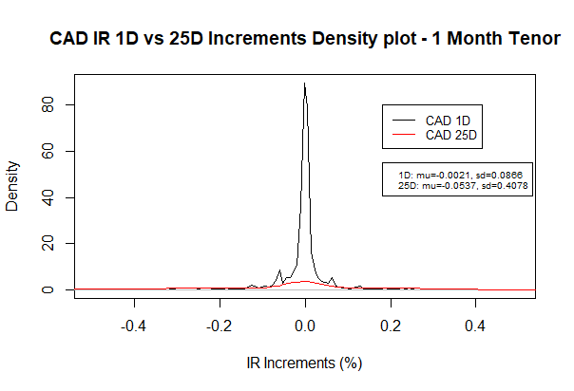
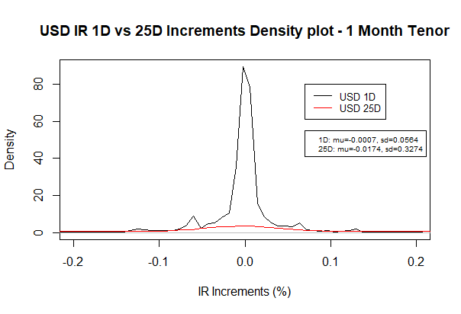
IR Increment Densities – 1-Day vs 25-Day

Slide 10
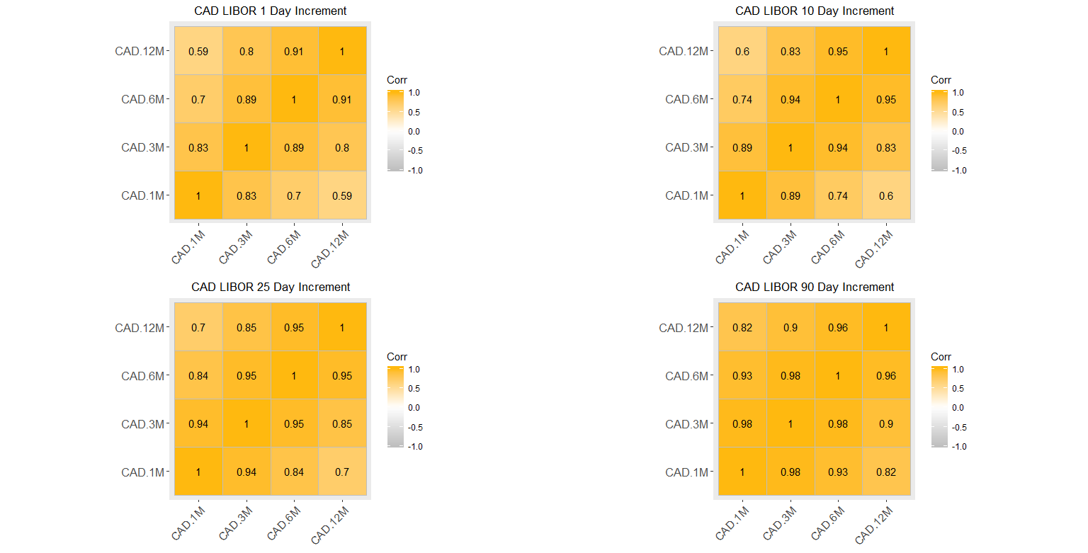
CAD Corrplot – Increment vs Tenure

Slide 11
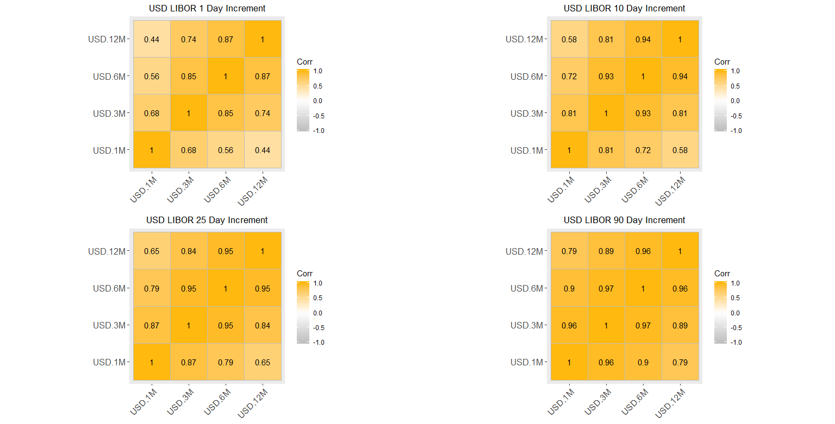
USD Corrplot – Increment vs Tenure
Notes:
Increasing period of increments tends to increase correlation between the tenors of the same increment

Slide 12
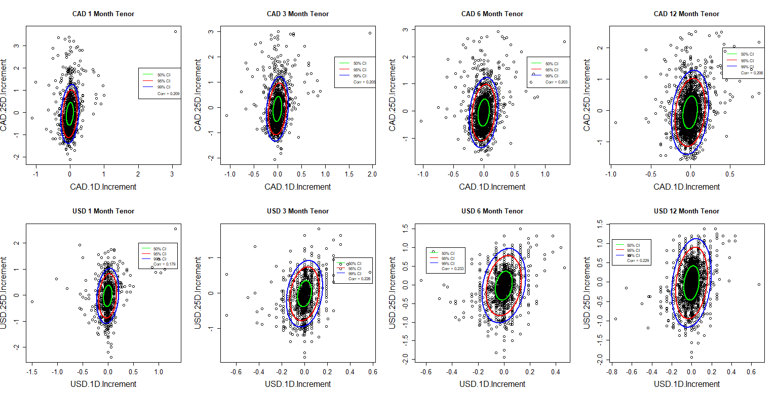
Multivariate Correlation Analysis – 1D vs 25D
Notes:
Slightly positive correlation between 1D and 25D increment in each currency, with Pearson Coefficient around 0.2 for all

Slide 13
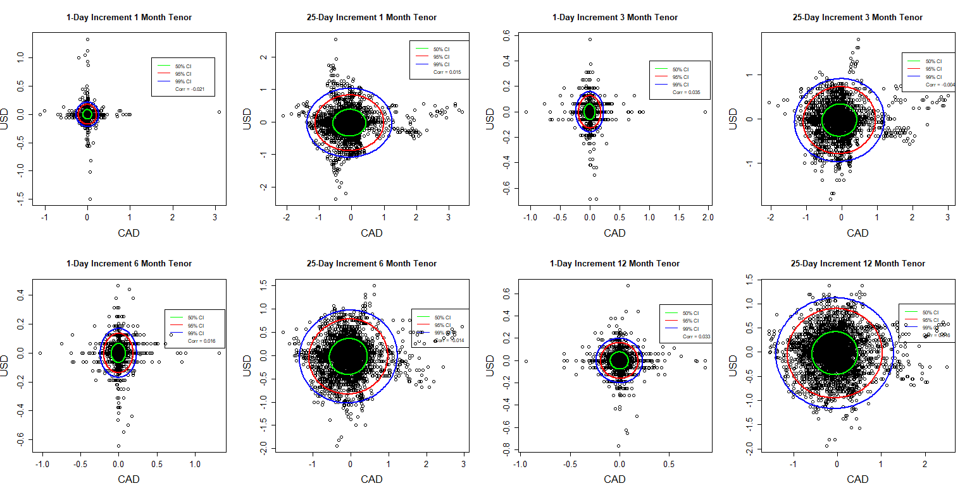
Multivariate Correlation Analysis – USD vs CAD
Notes:
Basically no correlation between USC and CAD of the same increment and tenor. Pearson Coefficient of about 0

Slide 14
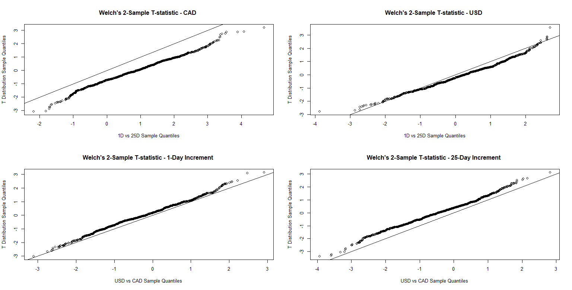
Welch’s 2-Sample T-Test Simulation – 1 Month Tenor
Notes:
Take a small sample from each distribution, perform Welch’s 2-sample t-test, replicate a t-distribution using the t-statistic from the t-test, do QQ plot against a random t-distribution.
If points form a straight line with y=x slope, the distributions between the 2 samples are very similar.
If the slope is same but the line is deviated, the parameters, such as mean and s.d., are different

Slide 15
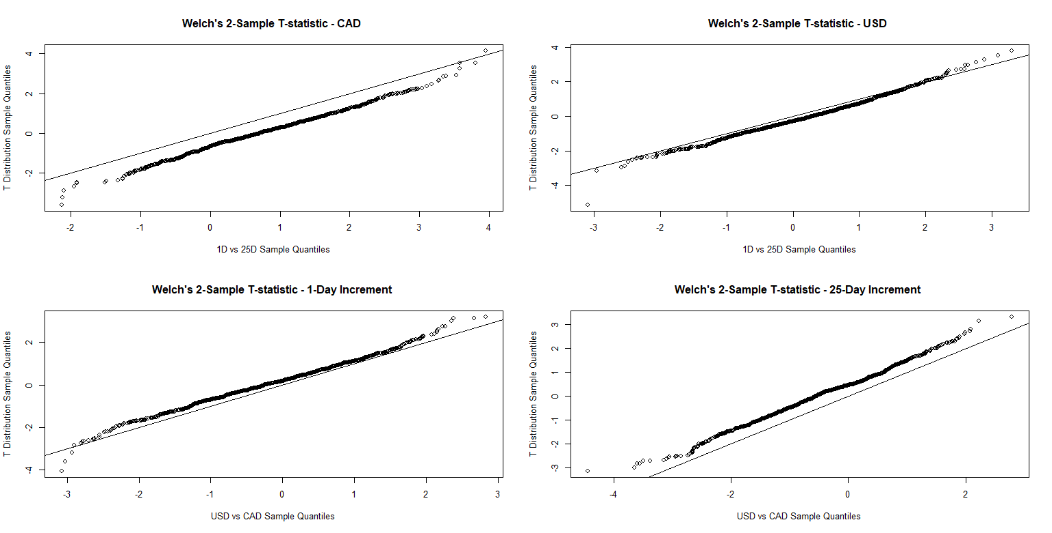
Welch’s 2-Sample T-Test Simulation – 6 Month Tenor

Slide 16
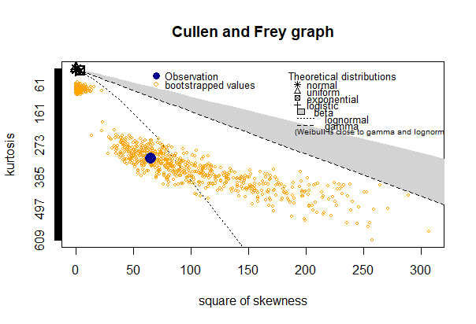
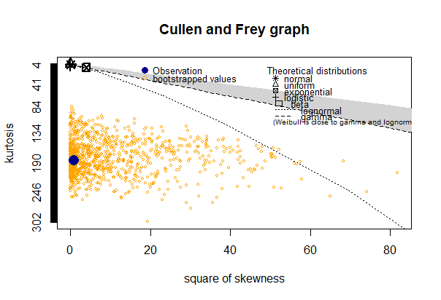
Distribution Fitting
CAD
USD

Slide 17
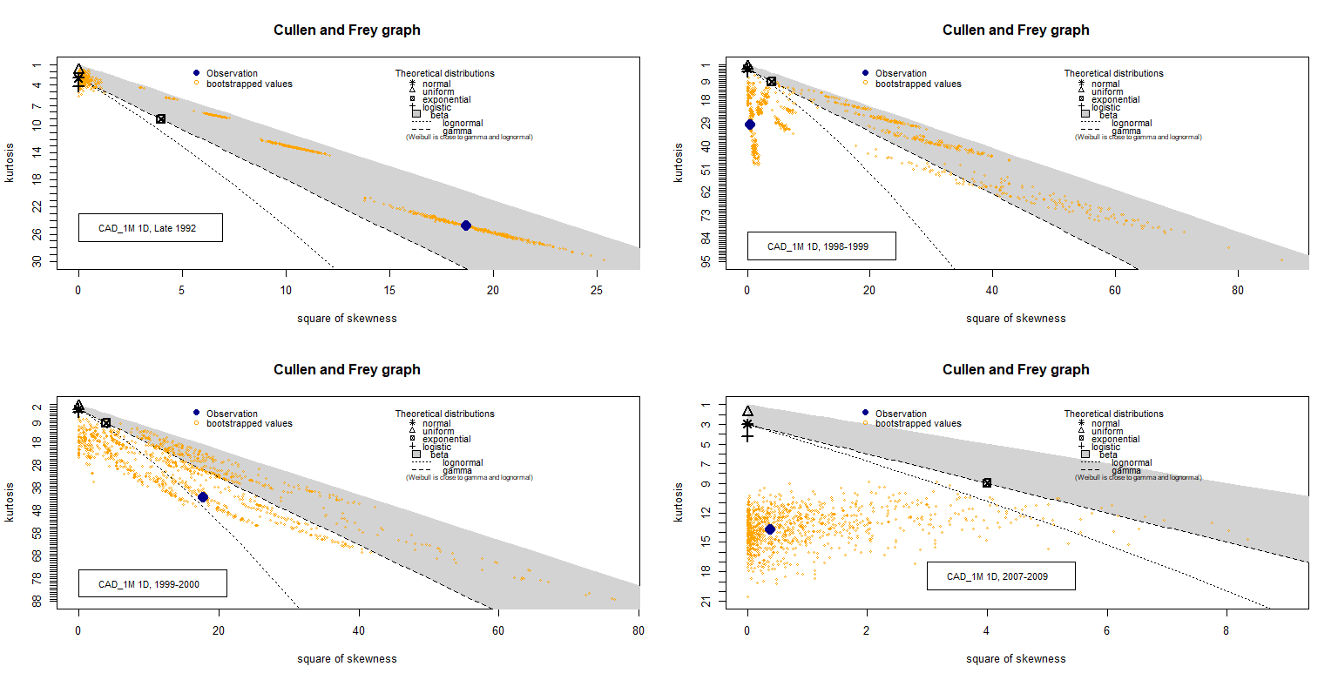
CAD Observations
Notes:
CAD – 1992 Late September, 3% 1D increment

Slide 18
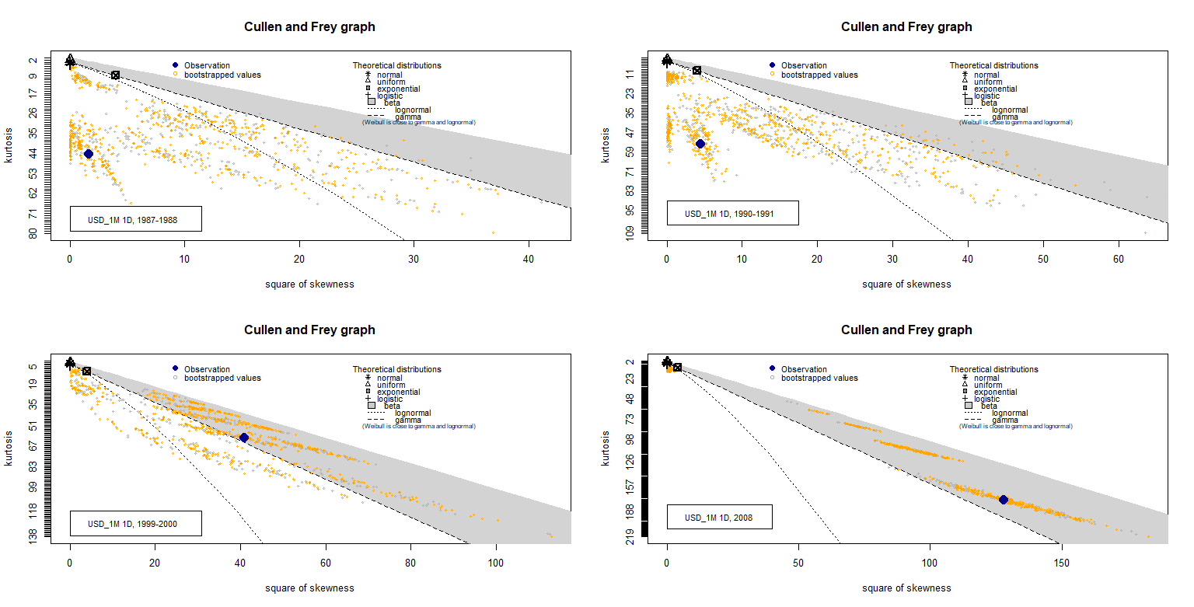
USD Observations

Slide 19
requirements
A statistical description for the state variable processes
A process of how interest rate derivatives will be priced from these statistical descriptions

