Slide 1
Statistics in R
Presenter : Hamed Zakeri
Supervisor: Dr. Dmitry Vyushin

Slide 2
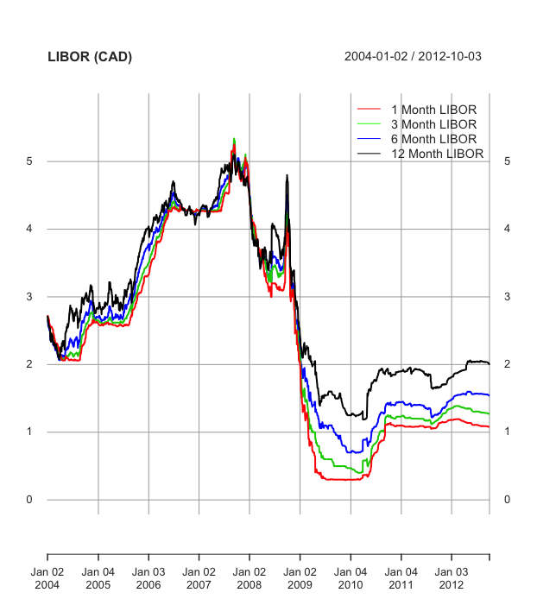
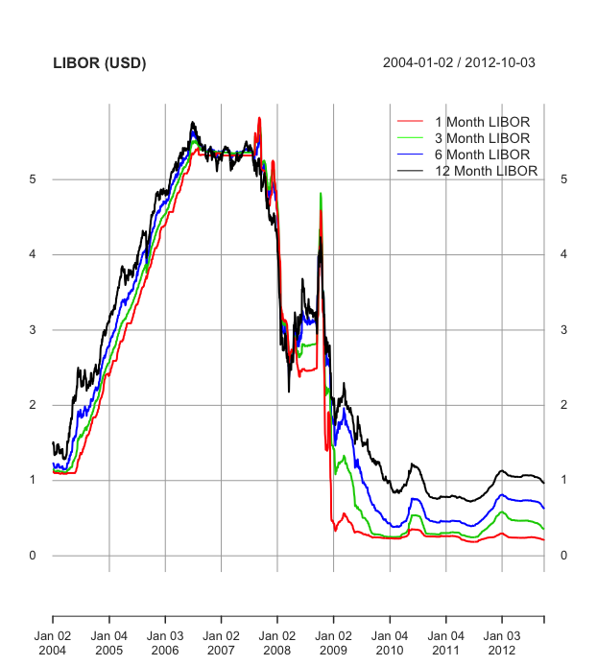
LIBOR RATES FROM 2004-2012
Filter Out Non-Business Days

Slide 3
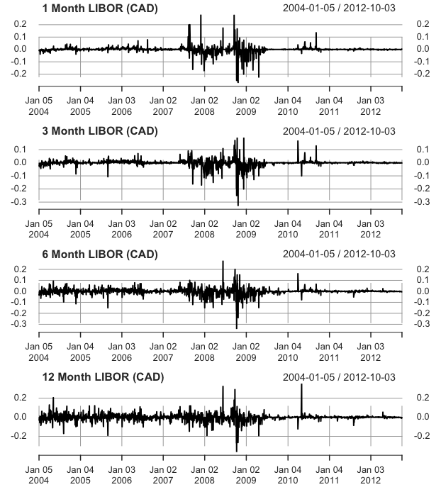
1-day Increment time Series (CAD)

Slide 4
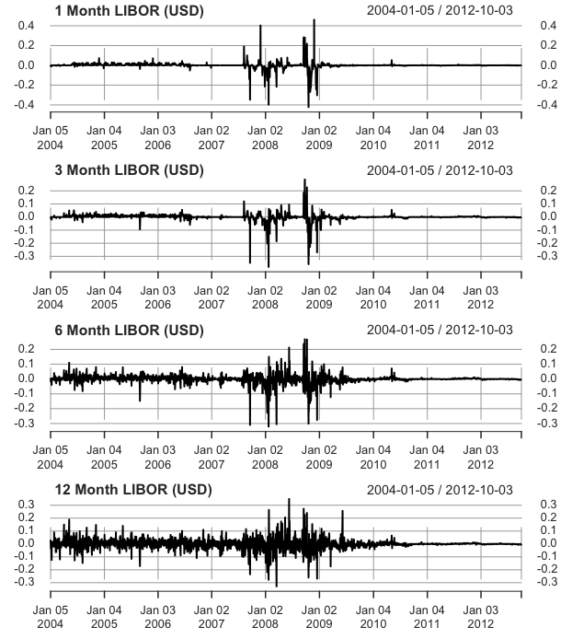
1-day Increment time Series (USD)

Slide 5
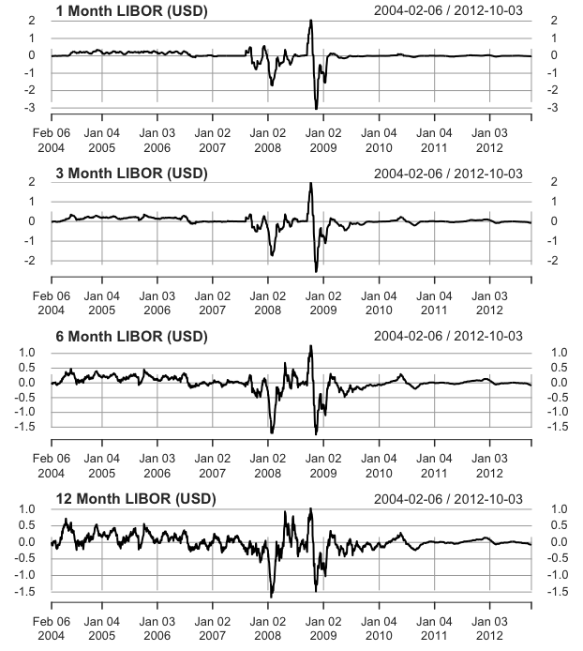
25-day Increment time Series (USD)

Slide 6
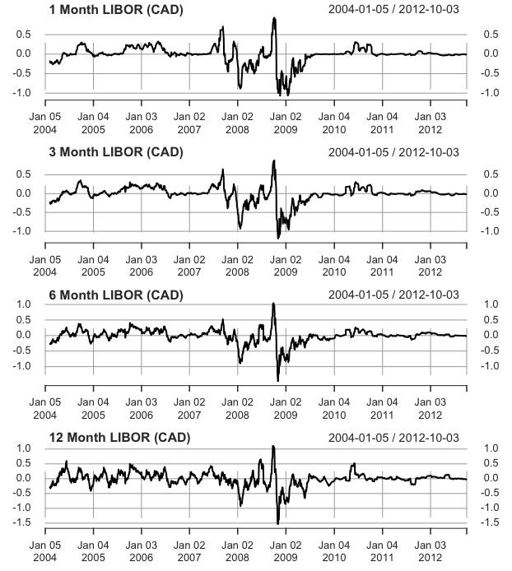
25-day Increment time Series (CAD)

Slide 7
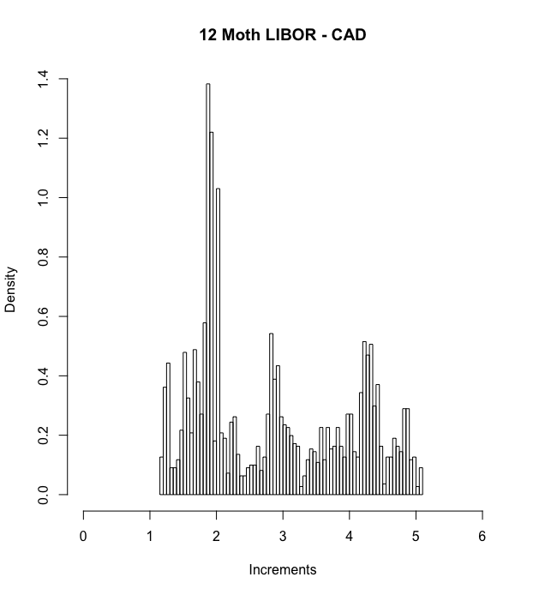
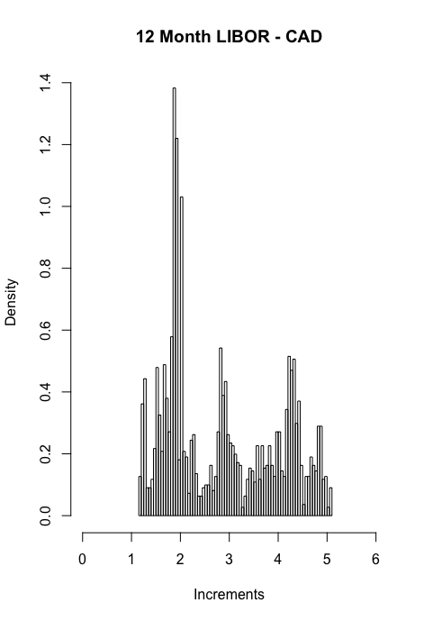
Fitting Distributions

Slide 8
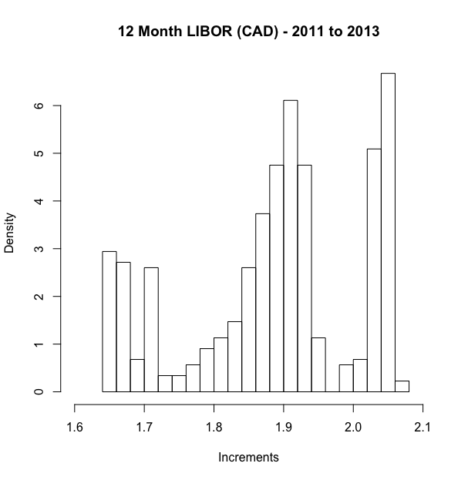
Modelling on Shorter time period

Slide 9
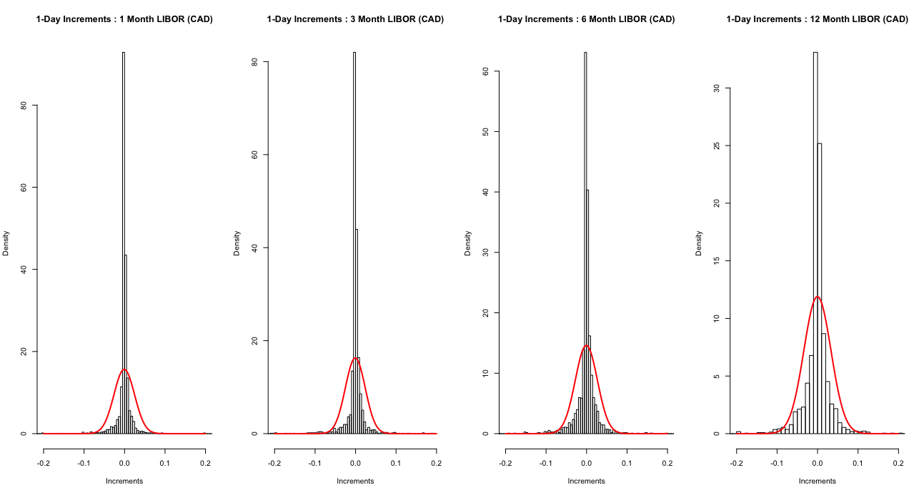
Fitting Distributions – Gaussian Distribution

Slide 10
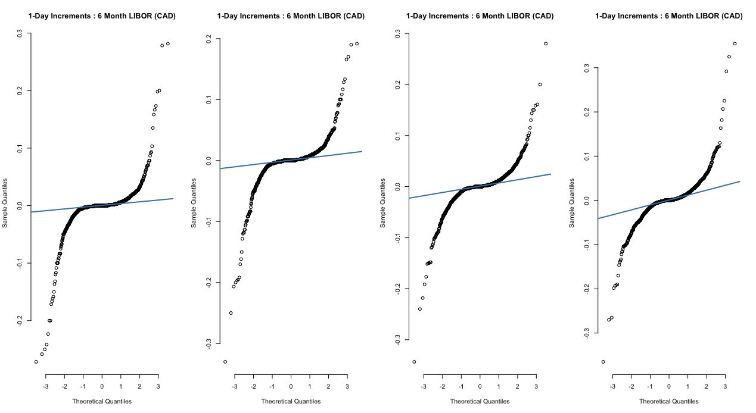
Distribution Fit Assessment
Shapiro-Wilk test of normality → p-values << 0.01

Slide 11
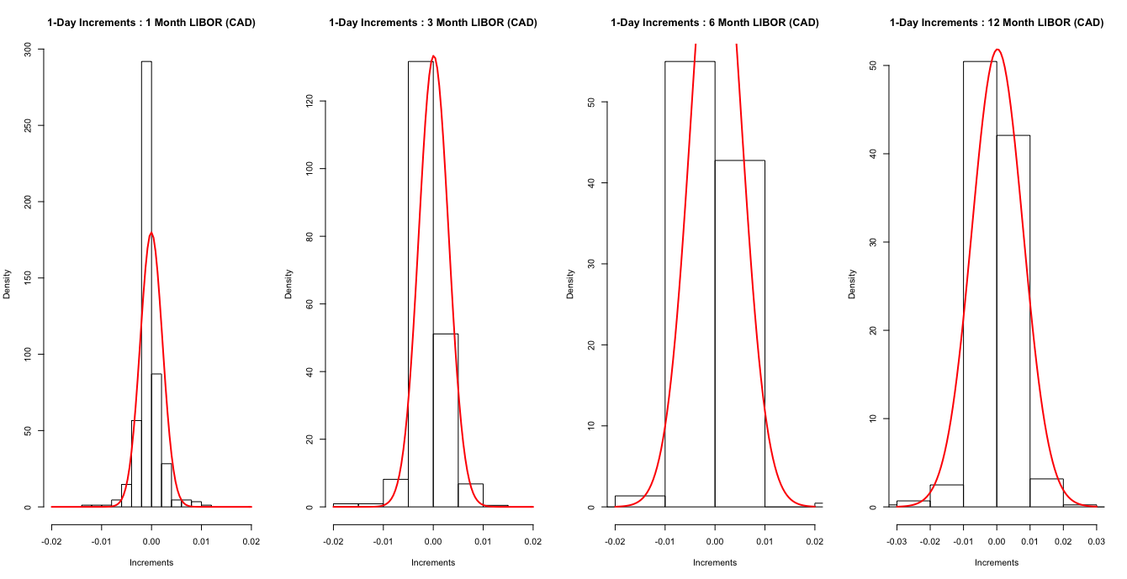
Fitting distributions on shorter time period

Slide 12
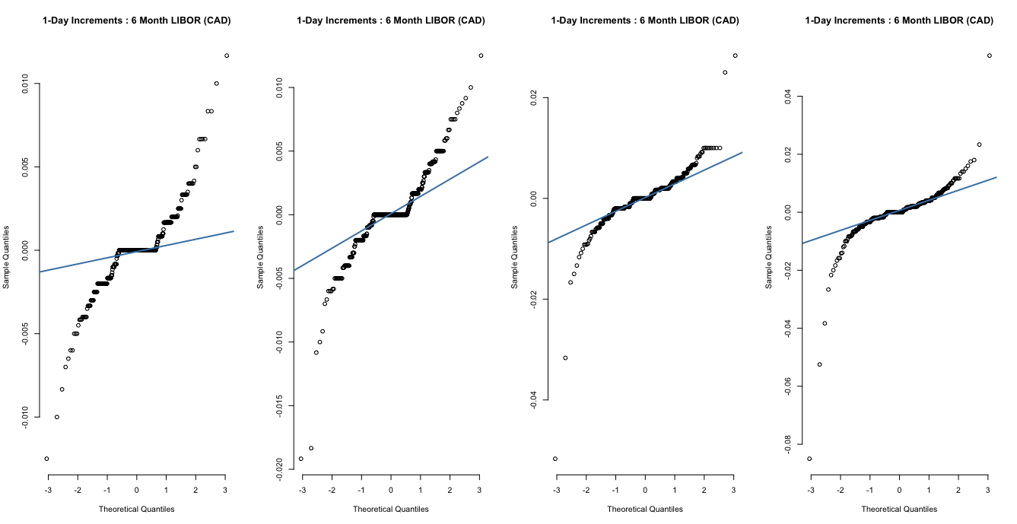
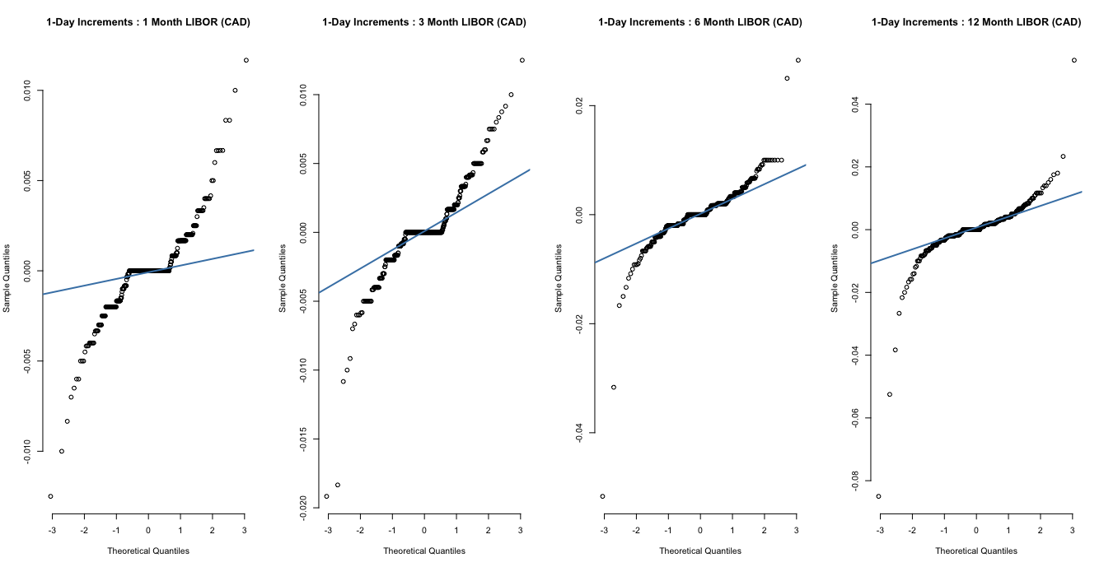
Assessing Fitted distributions

Slide 13
Standard deviation : 1-Day and 25-Day increment
Tenor - Increment | 1M - 1D | 3M - 1D | 6M – 1D | 12 M-1D | 1M - 25D | 3M -25D | 6M-25D | 12M - 25D
CAD | 0.026 | 0.025 | 0.027 | 0.034 | 0.240 | 0.227 | 0.227 | 0.247
USD | 0.034 | 0.028 | 0.031 | 0.041 | 0.387 | 0.345 | 0.297 | 0.287
F-TEST to compare two Variances. Null hypothesis is that the ratio of the variances of the populations from which samples were drawn is equal to 1.

Slide 14
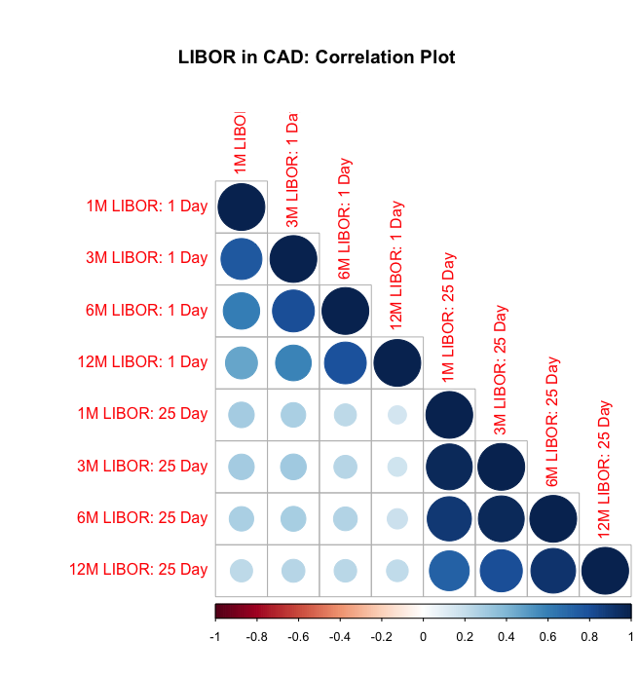
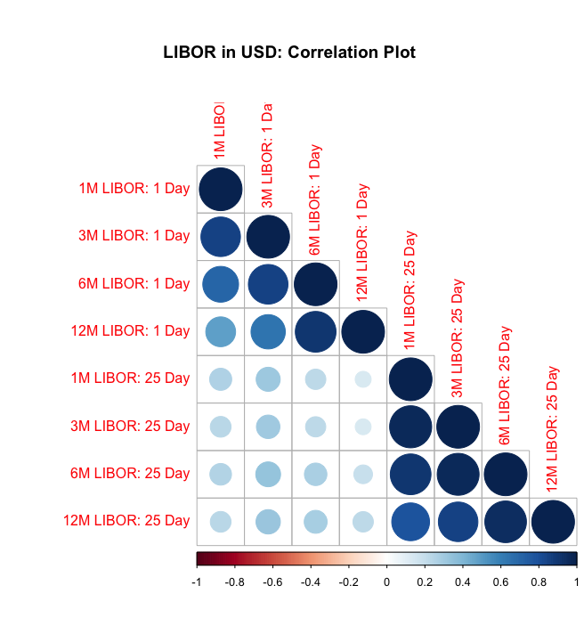
correlation matrix

Slide 15
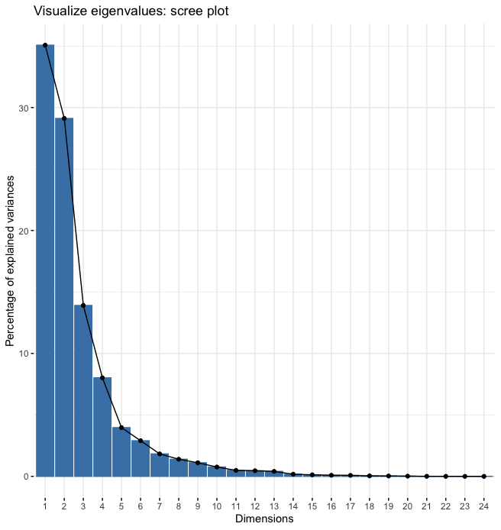
principal component analysis
Where the first 3 principle component explain 78.09% of the total variation in the data.

Slide 16
webpages and links to the relevant packages will be posted on the slack page.

