Slide 1
PuG Symposium Heidelberg 2026 Neuroscientific Perspectives on Personality
Alexander Strobel
Faculty of Psychology
The problem of weak associations between personality and neurocognitive measures

Slide 2
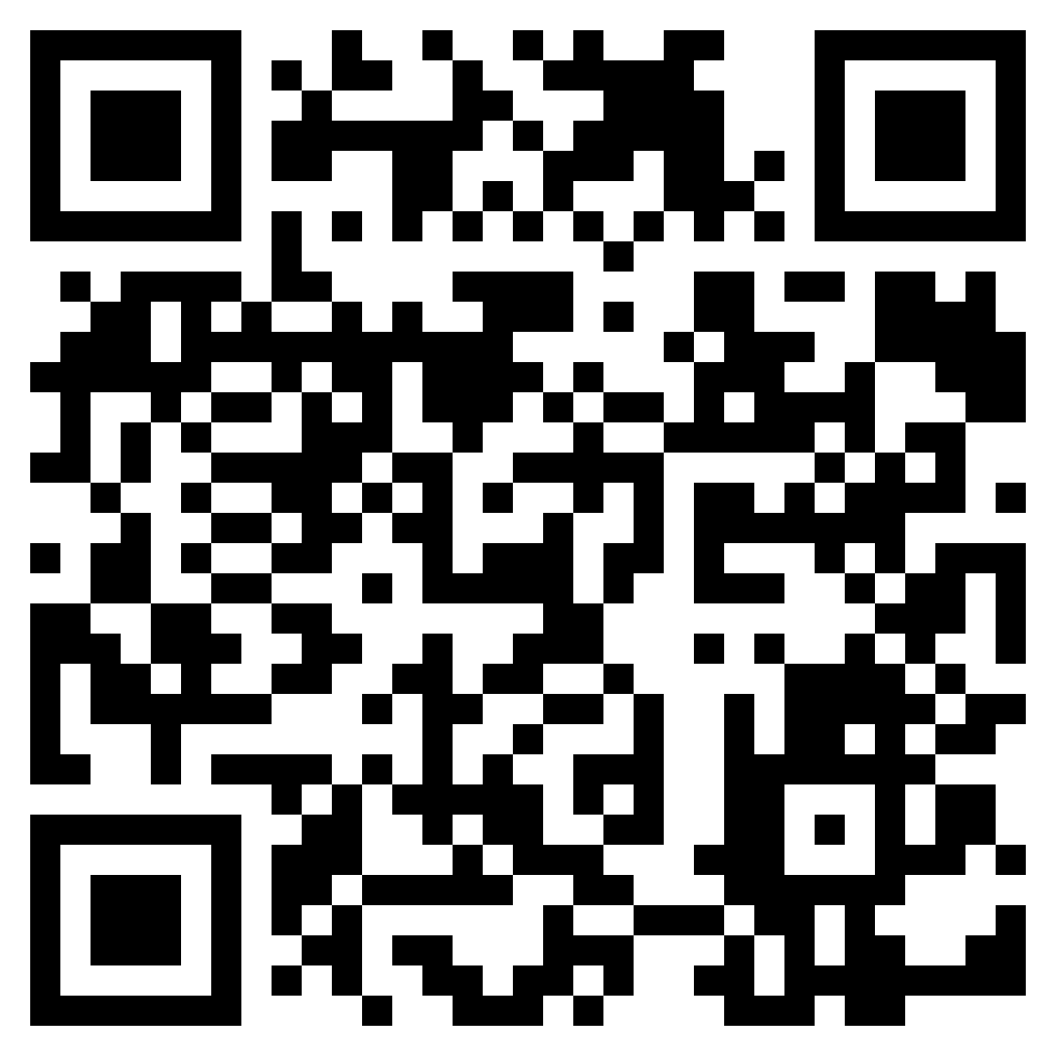
Weak associations between personality and neurocognitive measures Outline
Introduction
Problem outline
Technical issues
Reliability
Range restriction
Conceptual issues
Brunswik asymmetry
Strong vs. weak situations
Integration
For slides, literature and code of this presentation, see: https://github.com/alex-strobel/PuG-2026-Talk

Slide 3
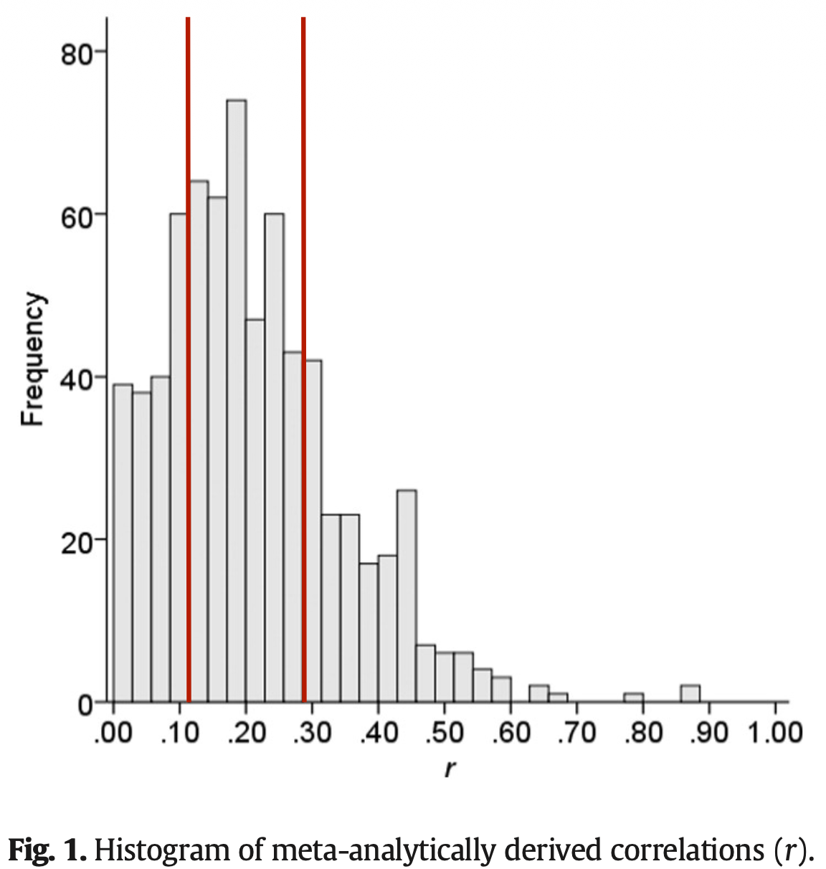
Weak associations between personality and neurocognitive measures Introduction: Problem outline
Problem outline
What is a weak association in the first place?
Cohens convention does not pass the empirical test for individual differences research (and many other psychology subdisciplines!), most effects seem to be around r ~ .10-.30.
Then why do others observe strong associations so often?
Biopsychological research is not likely to come up with stronger effects, but its effects need to be strong to show up in small samples (and to get published)
But I don’t find even any significant medium associations?
Power is maybe too low (required sample sizes to detect effects of r = .10/.20/.30 associations are N = 780/193/85 at a power of 80%)
But even then, my effects are smaller as to be expected?
This may be a consequence of publication bias (see Open Science Collaboration, 2005), but also simply due to technical issues …
Cohen (1988)
weak
medium
strong
Gignac & Szodorai (2016)
Gignac, G. E. & Szodorai, E. T. (2016). PAID, 102, 74-78. http://doi.org/10.1016/j.paid.2016.06.069

Slide 4
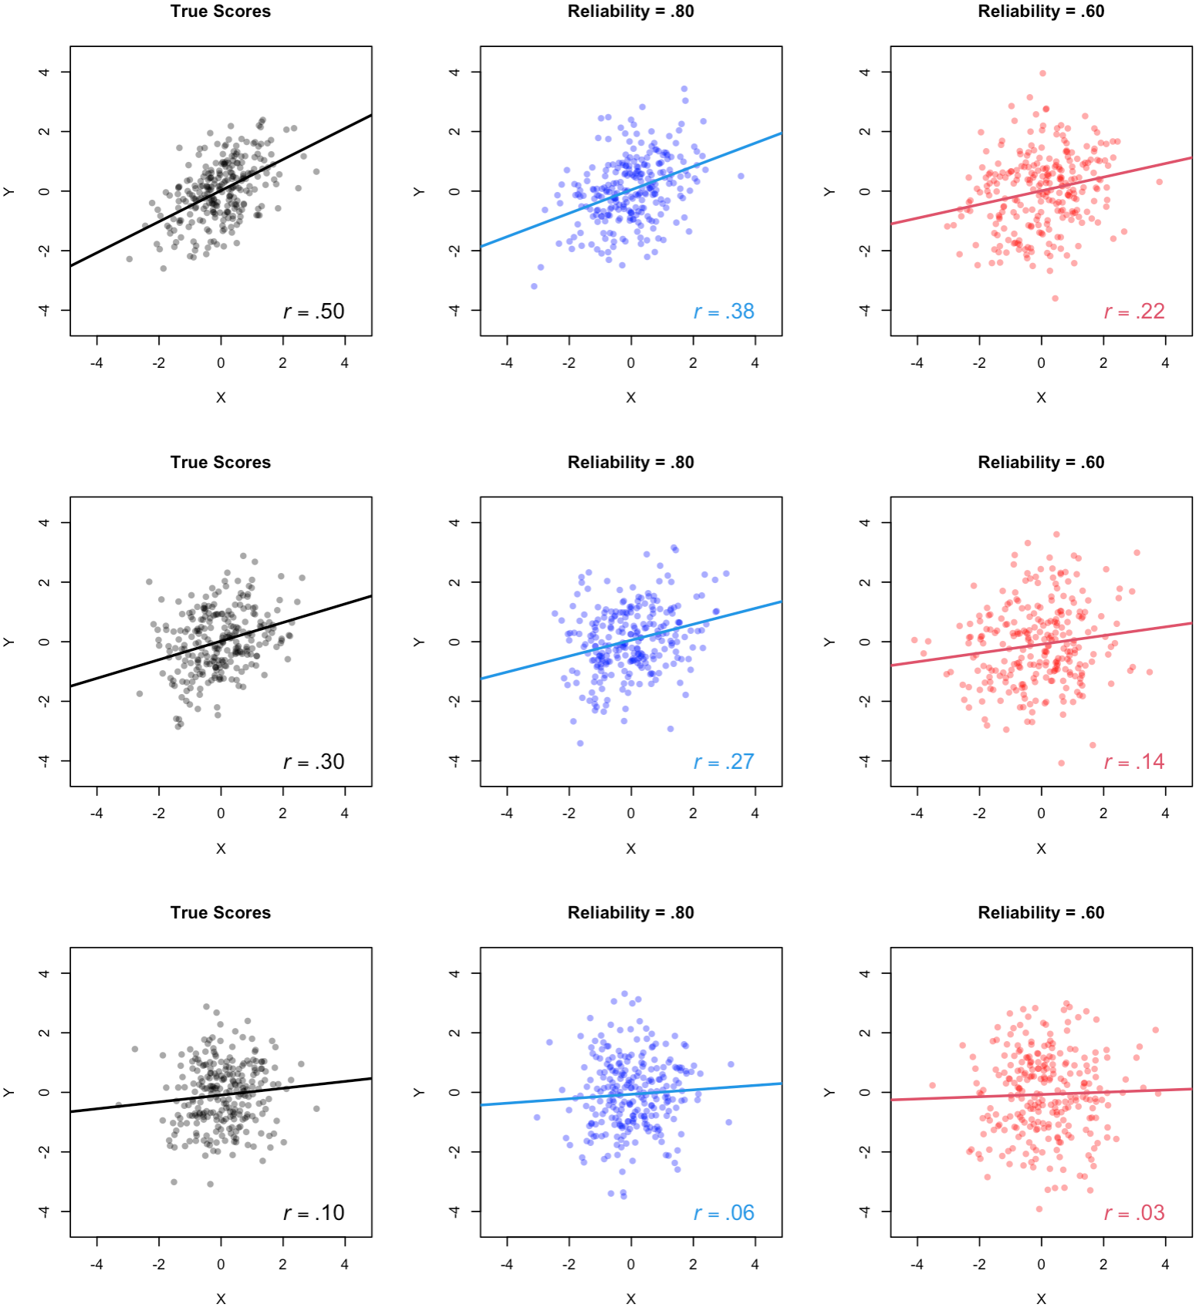
Weak associations between personality and neurocognitive measures Technical issues: Reliability
True Scores
Rel = .80
Rel = .60
Correlation attenuation
the observed correlation between two variables is weaker than their "true" relationship due to unreliability in the data and/or measurement error
Suboptimal reliability is a pervasive issue
Intelligence research: ~ .90 (own estimate)
Personality research: ≤ .80 (own estimate)
Cognitive research: ~ .60 (Enkavi et al., 2019)
Imaging research: ~ .40 (Elliott et al., 2020)
Consequences
use high reliability measures / capture measurement error
correct expected effect size for reliability of your measures for estimation of required sample size at a given 𝛼 and 1-𝛽
correct observed r for attenuation: r_{true} = r_{obs}/sqrt(Rel_{X} * Rel_{Y})
r = .50
r = .38
r = .22
data simulated with R
r = .30
r = .27
r = .14
r = .10
r = .06
r = .03
Enkavi, A. Z. et al. (2019). PNAS, 116(12), 5472-5477. https://doi.org/10.1073/pnas.1818430116
Elliott, M. L. et al. (2020). Psych Sci, 31(7), 792­–806. https://doi.org/10.1177/095679762091678

Slide 5
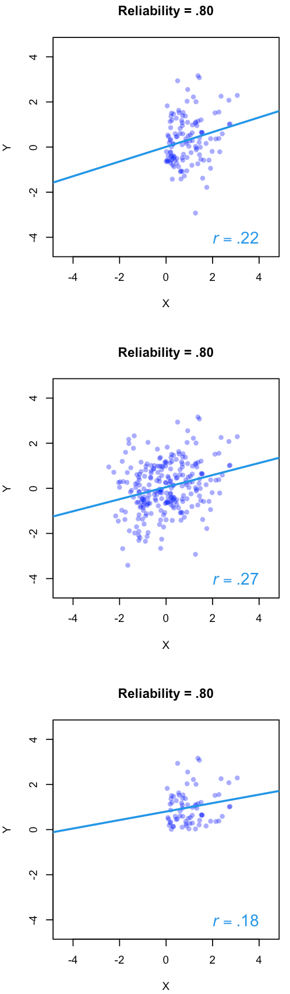
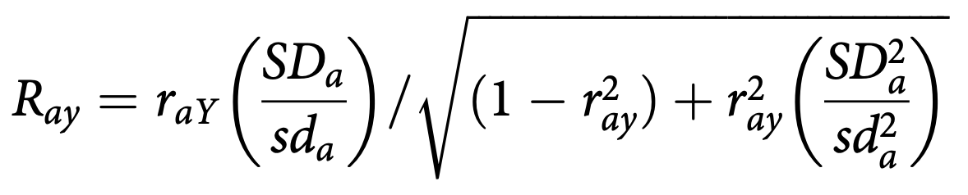
Weak associations between personality and neurocognitive measures Technical issues: Range restriction
True Scores
Rel = .80
Correlation attenuation
the observed correlation between two variables is weaker than their "true" relationship due to restriction of variance in the data
Range restriction is an issue in psychological research
Participants often young and intellectually capable (and WEIRD)
Fictitious example: r_{true} = .30 between age and working memory is r_{obs} = .27 due to reliability issues, and r_{obs} = .22/.18 due to range restriction (only young/young and capable individuals)
Consequences
examine individuals from general population (not psychology plus architecture and engineering students ;-)
if variances in general population are known, correct observed r for range restriction – easiest case, variance restriction only in a:
restricted by X
r = .22
unrestricted
data simulated with R
r = .30
r = .27
restricted by X & Y
r = .18
Details and further correction methods: Carretta, T. R. & Ree, M. J. (2022). Milit Psychol, 34(5), 551–569. https://doi.org/10.1080/08995605.2021.2022067

Slide 6
Weak associations between personality and neurocognitive measures Conceptual issues: Brunswik asymmetry
lP3a @ 3 Pos x 4 Blocks
Brunswik asymmetry (in terms of generality)
correlations between a trait and a specific behavior are often smaller than those between the trait and more general behavior
Generality asymmetry is often a problem in psychology
example here: we try to link a rather broad trait like Need for Cognition (NFC) to very specific EEG measures in a novelty oddball task (here: the late P3a in some block at some electrode)
.20
Fz
.25
Cz
.18
Pz
.24
Fz
.27
Cz
.17
Pz
NFC
.20
Fz
.22
Cz
.10
Pz
.22
Fz
.30
Cz
.22
Pz
unpublished results from an investigation into the relation of NFC and the Novelty lP3a, see Enge, S. et al (2008). PSPB, 34(6), 862-874. https://doi.org/10.1177/0146167208315556

Slide 7
Weak associations between personality and neurocognitive measures Conceptual issues: Brunswik asymmetry
Brunswik asymmetry (in terms of generality)
correlations between a trait and a specific behavior are often smaller than those between the trait and more general behavior
Generality asymmetry is often a problem in psychology
example here: we try to link a rather broad trait like Need for Cognition (NFC) to very specific EEG measures in a novelty oddball task (here: the late P3a in some block at some electrode)
correlations usually smaller for more asymmetrical associations
Fz
Cz
Pz
Fz
Cz
Pz
NFC
lP3a avg
.26
Fz
Cz
Pz
Fz
Cz
Pz
unpublished results from an investigation into the relation of NFC and the Novelty lP3a, see Enge, S. et al (2008). PSPB, 34(6), 862-874. https://doi.org/10.1177/0146167208315556

Slide 8
Weak associations between personality and neurocognitive measures Conceptual issues: Brunswik asymmetry
Brunswik asymmetry (in terms of generality)
correlations between a trait and a specific behavior are often smaller than those between the trait and more general behavior
Generality asymmetry is often a problem in psychology
example here: we try to link a rather broad trait like Need for Cognition (NFC) to very specific EEG measures in a novelty oddball task (here: the late P3a in some block at some electrode)
correlations usually smaller for more asymmetrical associations
Consequences
try to associate constructs rather than specific measures via aggregation/structural equation modelling (and by doing so, also get rid of measurement error, see above)
considerably more effort when using more than one measure of IV and DV; arriving at a proper SEM can be a p*** in the a**
Fz
B1
Cz
Pz
Fz
B2
Cz
Pz
NFC
lP3a
.35
Fz
B3
Cz
Pz
Fz
B4
Cz
Pz
unpublished results from an investigation into the relation of NFC and the Novelty lP3a, see Enge, S. et al (2008). PSPB, 34(6), 862-874. https://doi.org/10.1177/0146167208315556

Slide 9
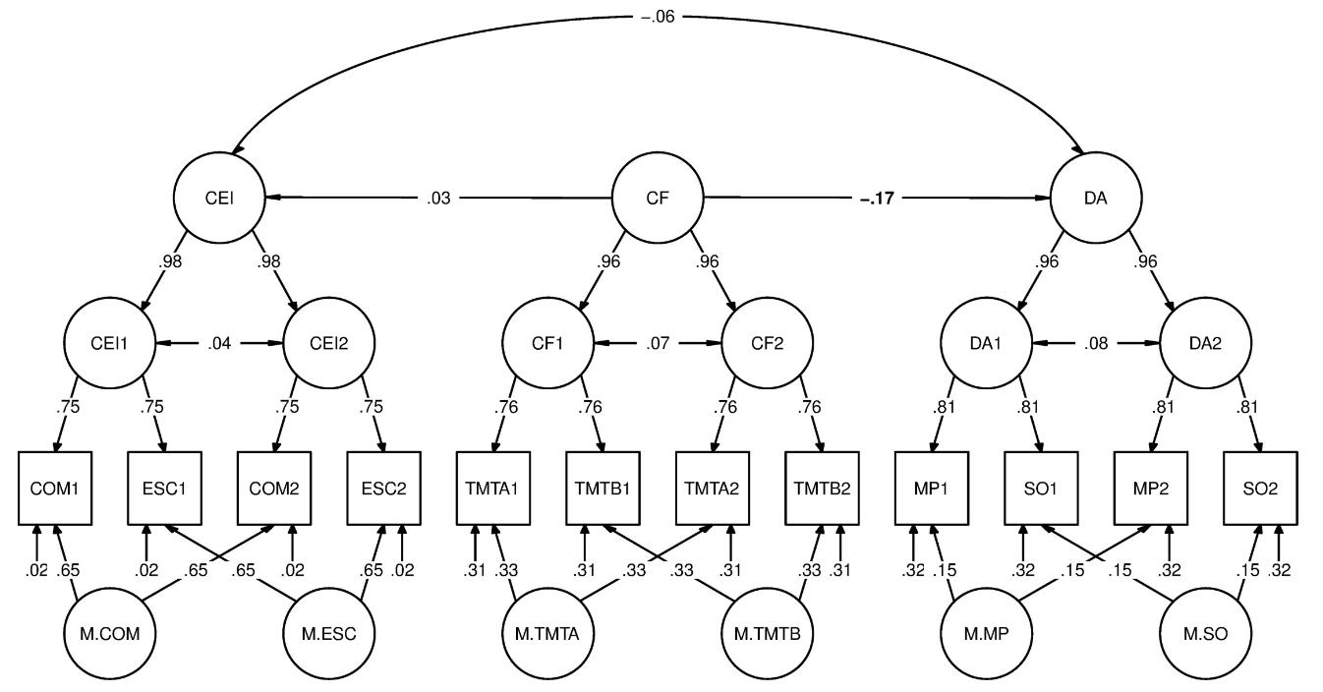
Weak associations between personality and neurocognitive measures Conceptual issues: Strong vs. weak situations
Strong vs. weak situations
cf. Mischel: strong situations minimize, weak situations maximize individual differences
Situational affordance is an issue in cognitive studies
experimental paradigms often designed to minimize the influence of individual differences in order to maximize situational influence
individuals with different trait levels tend to behave similar due to situation strength, resulting in weak associations
-.06
CEI
.03
CF
-.17*
DA
Strobel et al. (2020): in a sample of N = 217 university students, trait Cognitive Effort Investment, CEI, was not related to Demand Avoidance, DA (controlled for cognitive functioning, CF) likely because the task was optimized to demonstrate that DA is a general phenomenon
Strobel, A., … Kührt, C. (2020). PLoS ONE, 15(10), e0239817. https://doi.org/10.1371/journal.pone.0239817

Slide 10
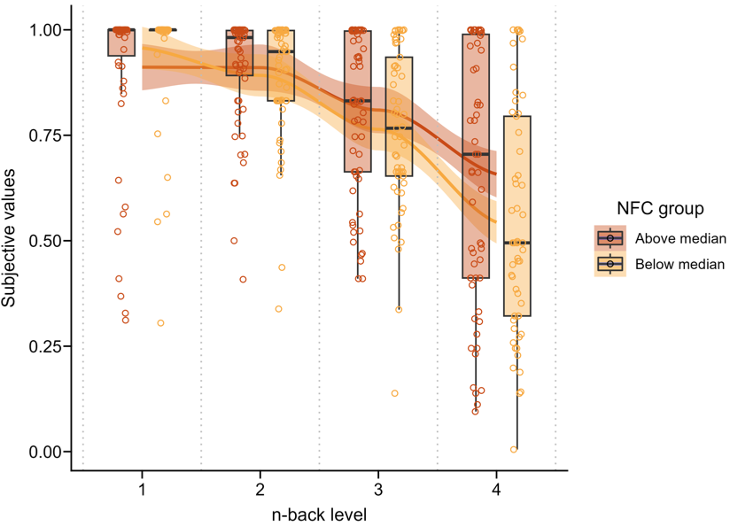
Weak associations between personality and neurocognitive measures Conceptual issues: Strong vs. weak situations
Strong vs. weak situations
cf. Mischel: strong situations minimize, weak situations maximize individual differences
Situational affordance is an issue in cognitive studies
experimental paradigms often designed to minimize the influence of individual differences in order to maximize situational influence
individuals with different trait levels tend to behave similar due to situation strength, resulting in weak associations
if situation strength is reduced like in the n-back task and individuals are asked for subjective values of different n-back levels, the expected nonlinear person × situation interaction associations shows up
tasks like the Novelty Oddball or measurements under resting conditions also create rather weak situations
NFC Group
Subjective Value
Above Median
Below Median
n-back Level
Zerna, Scheffel et al. (2023): in a sample of N = 116 university students, high vs. low NFC individuals showing expected patterns of subjective values over n-back levels
Zerna, J., Scheffel, C. et al. (2023). SciRep, 13, 19501. https://doi.org/10.1038/s41598-023-44349-3

Slide 11
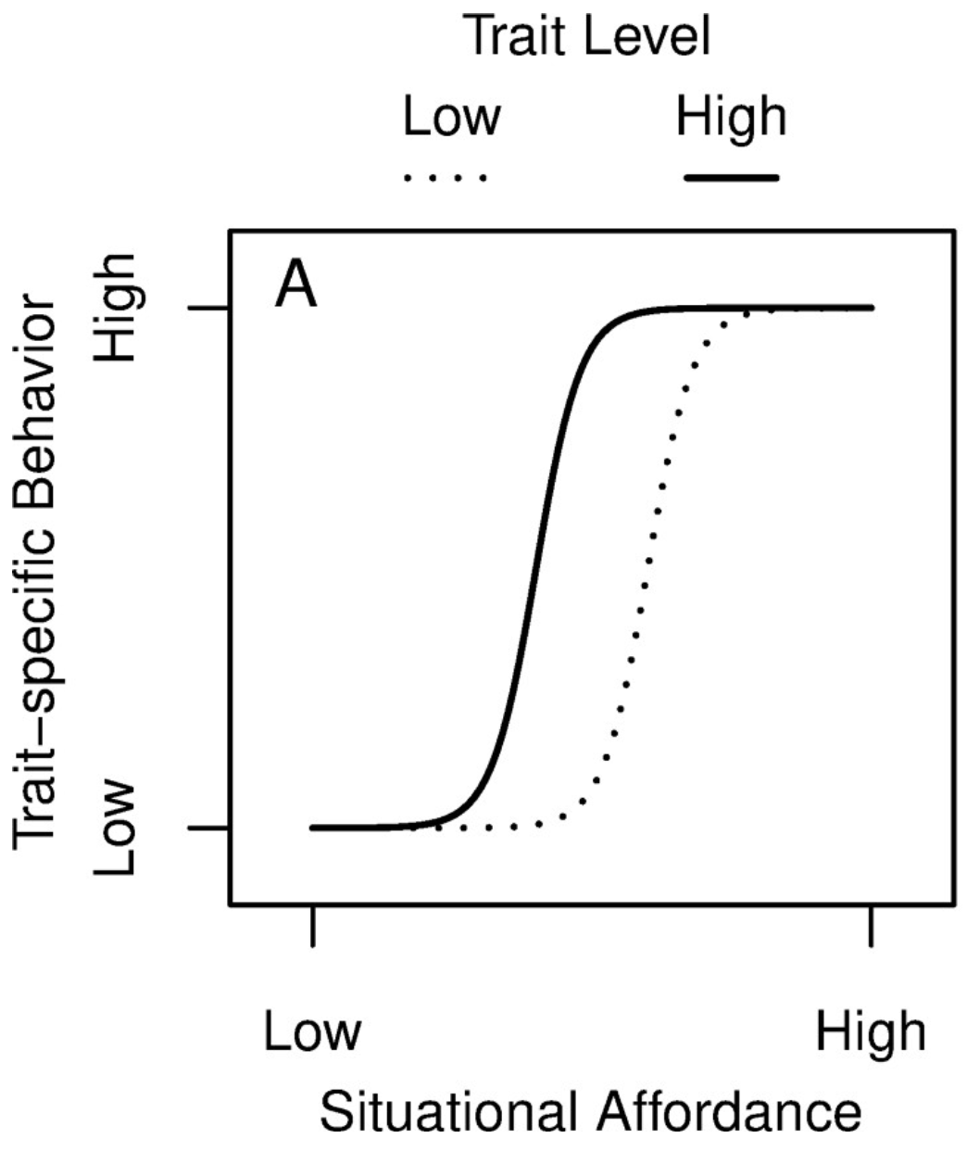
Weak associations between personality and neurocognitive measures Conceptual issues: Strong vs. weak situations
Strong vs. weak situations
cf. Mischel: strong situations minimize, weak situations maximize individual differences
Situational affordance is an issue in cognitive studies
experimental paradigms often designed to minimize the influence of individual differences in order to maximize situational influence
individuals with different trait levels tend to behave similar due to situation strength, resulting in weak associations
Consequences
establish experimental or ecological situations with medium situation strength so that individuals can behave in line with their dispositions
Fig. adapted from Strobel, A., … Kührt, C. (2020). PLoS ONE, 15(10), e0239817. https://doi.org/10.1371/journal.pone.0239817

Slide 12
Weak associations between personality and neurocognitive measures Integration: Summary and suggestions
Problem
in individual differences research, medium associations can be assumed at best, but they may appear weak because of …
Unreliability of the measures used
carefully select measures and/or measurement models to avoid and/or correct for attenuation
Variance restriction of the samples examined
carefully select samples and/or know true variances of your measures to correct for restriction
Generality asymmetry of the measures employed
make sure that X and Y are of the same generality level (aggregation/SEM, also captures error)
Strong vs. weak measurement situations
establish experimental or ecological situations with medium situation strength so that individuals can behave in line with their dispositions
Suggested reading: DeYoung, C. G., Hilger, K., et al. (2025). J Cogn Neurosci, 37(6), 1023-1034. https://doi.org/10.1162/jocn_a_02297

Slide 13
Thank you!
Details? https://github.com/alex-strobel/PuG-2026-Talk
Questions? alexander.strobel@tu-dresden.de

