Slide 1
„Fontinator“: font style detection in python
project members: Sebastian Lobsinger (traditional)
Markus-Jonathan Wendler (traditional)
Oliver Feucht (NN)
Alexander Taubert (CNN)
Hochschule Esslingen, Intelligent Data Analytics, Project "Fontinator"

Slide 2
Structure
Overview
Data Generation
Font recognition with traditional methods of machine learning
Font recognition with neural network
Font recognition with convolutional neural network
Hochschule Esslingen, Intelligent Data Analytics, Project "Fontinator"

Slide 3
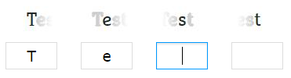
Overview
Why Font Recognition?
Market research
  Identifont (not able to upload pictures)
    90 questions, result = 1043 possible fonts found
  WhatTheFont (glyph extraction is given – input characters is needed)
  Fontspring matcherator (good)
Hochschule Esslingen, Intelligent Data Analytics, Project "Fontinator"

Slide 4
Overview
Aim:
  font recognition tool should be able to identify
  a font only by its picture and fast in processing
General conditions:
  12 fonts given, 3 different data sets with more than 100 text images for each data set
Hochschule Esslingen, Intelligent Data Analytics, Project "Fontinator"

Slide 5
Introduction
Data Generation
Problem:
Getting data for training and testing
Solution:
Developed a DataGenerator which allows to create custom images
Advantages:
Infinite train/test data
Data is already labeled
Allows using custom fonts
Fast changes possible
(Fontsize, text position, …)
Hochschule Esslingen, Intelligent Data Analytics, Project "Fontinator"
Notes:
First Problem on Project Start: How can we get a lot of images to train and test our approaches for font detection?
Especially for Neural networks you need a lot of training data!

Slide 6
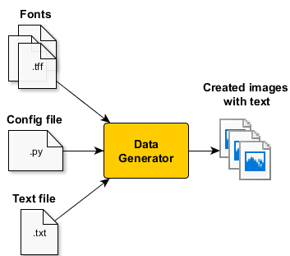
Function of DataGenerator
Data Generation
The font files used for creating text
Config Params:
Font size
Image count
Random factors
…
Text used for random text generation
Hochschule Esslingen, Intelligent Data Analytics, Project "Fontinator"

Slide 7
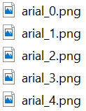
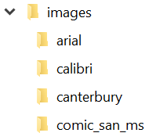
Image Data Structure
Data Generation
Generates a labeled folder per font
Each folder contains several images
Hochschule Esslingen, Intelligent Data Analytics, Project "Fontinator"

Slide 8
Generated Training Images
Data Generation
Facts:
png files
Random text
RGB images (3 Channels)
Fixed size (1200px*40px)
Example Images:
Hochschule Esslingen, Intelligent Data Analytics, Project "Fontinator"

Slide 9
„Fontinator“: traditional methods of machine learning
project members: Sebastian Lobsinger (traditional)
Markus-Jonathan Wendler (traditional)
Hochschule Esslingen, Intelligent Data Analytics, Project "Fontinator"

Slide 10
The idea
robustness against false classification
  separate text image to individual glyphs
  classify all glyphs individually
  majority voting to identify the font
performance
  search for significant features
  compute only the necessary amount of features
Hochschule Esslingen, Intelligent Data Analytics, Project "Fontinator"

Slide 11
Concept
training data
create images for each character(80 chars, 12 fonts)
extract features for each character image
normalize the feature vector
train classifier with the training data and labels
save classifier for later usage
Hochschule Esslingen, Intelligent Data Analytics, Project "Fontinator"

Slide 12
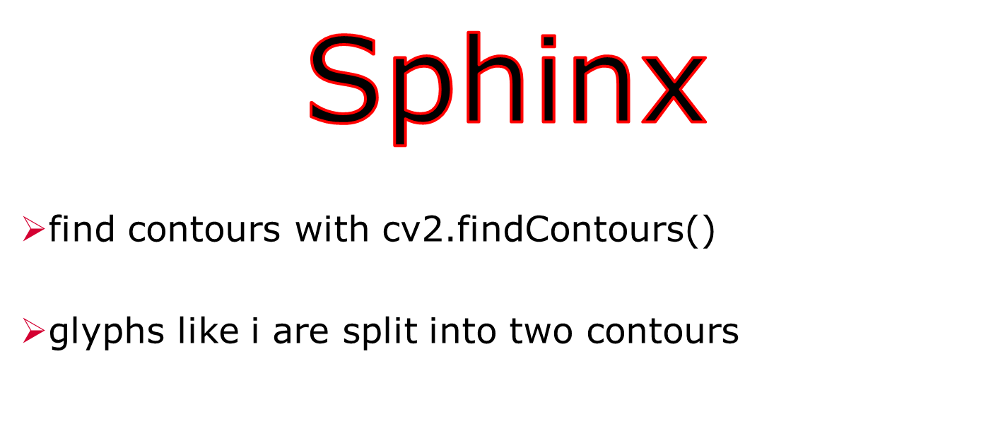
Concept
glyph extraction
feature extraction
classification
Hochschule Esslingen, Intelligent Data Analytics, Project "Fontinator"

Slide 13
Concept
glyph extraction
feature extraction
classification
Sphinx
detect typographical lines
  helps to identify the glyphs
combine the found contours to glyphs
crop each glyph
top line
middle_line
ground_line
base line
Hochschule Esslingen, Intelligent Data Analytics, Project "Fontinator"

Slide 14


Concept
glyph extraction
feature extraction
classification
Which features are useful to distinguish between font types?
  feature should describe individual characteristics of one font type
count
holes
relation between black and white pixels
Hochschule Esslingen, Intelligent Data Analytics, Project "Fontinator"

Slide 15

Concept
glyph extraction
feature extraction
classification
don‘t use too many features
combine the features, so it‘s independent from size (e.g. perimeter divided by skeletation)
summarize features to one feature vector
normalize the feature vector
Hochschule Esslingen, Intelligent Data Analytics, Project "Fontinator"

Slide 16
Concept
glyph extraction
feature extraction
classification
One-Nearest-Neighbor classifier
load classifier from saved file
classifier predicts font for each glyph
majority voting to identify the font of the whole image
Hochschule Esslingen, Intelligent Data Analytics, Project "Fontinator"

Slide 17
system architecture
extractGlyphes.py
extractFeatures.py
classifier.py
used as library
trainer.py
test.py
Fontinator.py
creates
uses
uses
classie.pickle
labels.pickle
Hochschule Esslingen, Intelligent Data Analytics, Project "Fontinator"

Slide 18
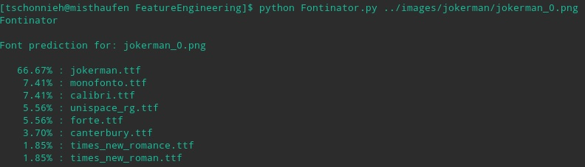
Result
test image: jokerman_0.png
result:
Hochschule Esslingen, Intelligent Data Analytics, Project "Fontinator"

Slide 19
Concept
glyph extraction
feature extraction
classification
Used features:
amount of black pixels
length of perimeter
amount of pixels while glyph is a skeleton
mean horizontal position of black pixels
mean vertical position of black pixel
amount of horizontal edges
amount of connected components
amount of holes
horizontal variance (position of black pixels)
Vertical variance (position of black pixels)
Hochschule Esslingen, Intelligent Data Analytics, Project "Fontinator"

Slide 20
„Fontinator“: Font recognition with neural network
project members: Oliver Feucht (NN)
Alexander Taubert (CNN)
Hochschule Esslingen, Intelligent Data Analytics, Project "Fontinator"
Notes:
Alex and I tryed to classify the images by neuronal networks.
Alex: Convolutional Neuronal Networks
My approach: Fully Connected Neuronal Net

Slide 21
General Approach
Fully Connected Neural Net
Prediction/Evaluation of new data:
Preprocessing (images, opt.: labels)
Load trained model from disk
Compile model
Predict labels for
new images
Opt.: Evaluation
Training:
Preprocessing (images and labels)
Define structure of NN model
Compile model
Train model
Save model on disk
Hochschule Esslingen, Intelligent Data Analytics, Project "Fontinator"
Notes:
Compile model -> performance increase
Save model -> Fast reusability of trained model (No training process for future prediction)

Slide 22
Preprocessing
Fully Connected Neural Net
Dimensions = 3
Shape=(40,1200,3)
Dimensions = 2
Shape=(40,1200)
Dimensions = 1
Shape=(48000)
0 | 0 | 1 | 0
0 | 1 | 1 | 0
0 | 0 | 1 | 0
0 | 0 | 1 | 0
0
0
1
…
1
0
RGB Image
Binarization
Flatten
48000 input features for Neural Network
Hochschule Esslingen, Intelligent Data Analytics, Project "Fontinator"
Notes:
Flatten = Concat all columns of the matrix to one big vector

Slide 23
Network Structure
Fully Connected Neural Net
# Defining the Network structure
model = Sequential()
model.add(Dense(2400, input_shape=(48000), activation='relu'))
model.add(Dropout(rate=0.2))
model.add(Dense(120, activation='relu'))
model.add(Dropout(rate=0.2))
model.add(Dense(60, activation='relu'))
model.add(Dense(12), activation='softmax'))
Input
(48000)
Dense
(2400)
Dropout
(20%)
Dense
(120)
Dropout
(20%)
Dense
(60)
Dense
(12)
Output
Softmax
(12)
Hochschule Esslingen, Intelligent Data Analytics, Project "Fontinator"
Notes:
Dense(12) -> 12 classification labels -> One Hot Encoding
Softmax -> mapps output to Probabilities. Sum of all outputs is 1

Slide 24
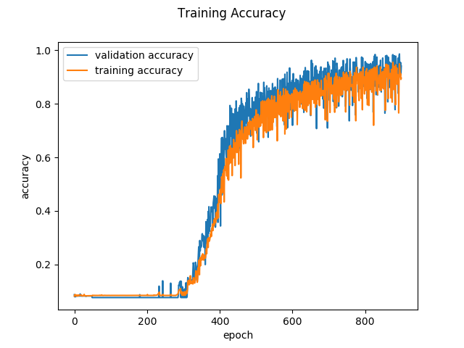
Training Accuracy
Fully Connected Neural Net
Size of training set
~30000 images
1000 Epochs
Training Time
on 6 CPU cores
~ 18h
Size of the
saved model
~ 500mb
Hochschule Esslingen, Intelligent Data Analytics, Project "Fontinator"

Slide 25
Preprocessing
Convolutional Neural Net
Shape=(40,1200,3)
Shape=(40,1200,3)
RGB Image
As Matrix
Rgb | Rgb | Rgb
Rgb | Rgb | Rgb
Rgb | Rgb | Rgb
Benefits
  Neighborhood correlation
  Efficiency (small and accurate)
Hochschule Esslingen, Intelligent Data Analytics, Project "Fontinator"

Slide 26
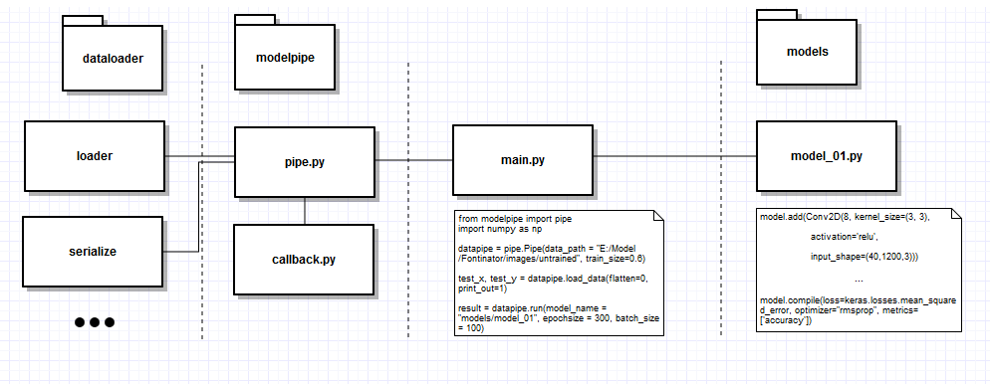
Architecture
Convolutional Neural Net

Slide 27
Model 1 – Basic Model
Convolutional Neural Net
model.add(Conv2D(8, kernel_size=(3, 3), activation='relu‘, input_shape=(40,1200,3)))
model.add(MaxPooling2D(pool_size=(2, 2)))
model.add(Conv2D(16, kernel_size=(3, 3), activation='relu'))
model.add(MaxPooling2D(pool_size=(2, 2)))
model.add(Conv2D(24, kernel_size=(3, 3), activation='sigmoid'))
model.add(MaxPooling2D(pool_size=(2, 2)))
model.add(Dropout(0.2))
model.add(Flatten())
model.add(Dense(256, activation='relu'))
model.add(Dropout(0.4))
model.add(Dense(len(classes), activation='softmax'))
Convolution Layers
Fully Connected Layers

Slide 28
Model 2 – Extra Conv2D Layer
Convolutional Neural Net
model.add(Conv2D(8, kernel_size=(3,3), activation='relu‘, input_shape=(40,1200,3)))
model.add(MaxPooling2D(pool_size=(2, 2)))
model.add(Conv2D(16, kernel_size=(3, 3), activation='relu'))
model.add(MaxPooling2D(pool_size=(2, 2)))
model.add(Conv2D(24, kernel_size=(3, 3), activation='sigmoid'))
model.add(Conv2D(24, kernel_size=(3, 3), activation='sigmoid'))
model.add(MaxPooling2D(pool_size=(2, 2)))
model.add(Dropout(0.2))
model.add(Flatten())
model.add(Dense(256, activation='relu'))
model.add(Dropout(0.4))
model.add(Dense(len(classes), activation='softmax'))

Slide 29
Model 3 – Extra Dense Layer
Convolutional Neural Net
model.add(Conv2D(8, kernel_size=(3,3), activation='relu‘, input_shape=(40,1200,3)))
model.add(MaxPooling2D(pool_size=(2, 2)))
model.add(Conv2D(16, kernel_size=(3, 3), activation='relu'))
model.add(MaxPooling2D(pool_size=(2, 2)))
model.add(Conv2D(24, kernel_size=(3, 3), activation='sigmoid'))
model.add(MaxPooling2D(pool_size=(2, 2)))
model.add(Dropout(0.2))
model.add(Flatten())
model.add(Dense(256, activation='relu'))
model.add(Dense(256, activation='relu'))
model.add(Dropout(0.4))
model.add(Dense(len(classes), activation='softmax'))

Slide 30
Model 4 – Less Filters
Convolutional Neural Net
model.add(Conv2D(4, kernel_size=(3,3), activation='relu‘, input_shape=(40,1200,3)))
model.add(MaxPooling2D(pool_size=(2, 2)))
model.add(Conv2D(8, kernel_size=(3, 3), activation='relu'))
model.add(MaxPooling2D(pool_size=(2, 2)))
model.add(Conv2D(16, kernel_size=(3, 3), activation='sigmoid'))
model.add(MaxPooling2D(pool_size=(2, 2)))
model.add(Dropout(0.2))
model.add(Flatten())
model.add(Dense(256, activation='relu'))
model.add(Dropout(0.4))
model.add(Dense(len(classes), activation='softmax'))

Slide 31
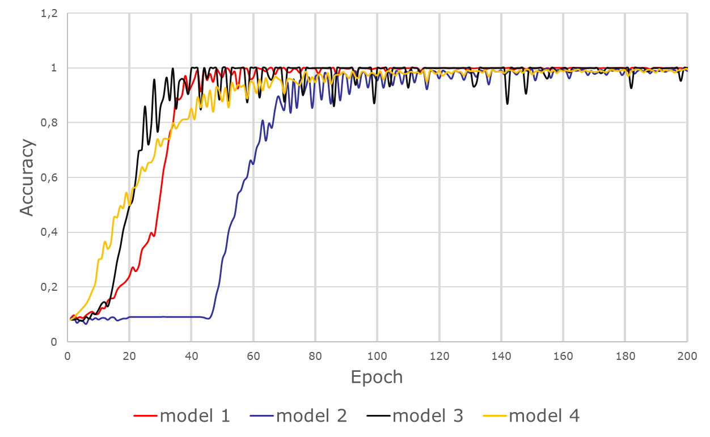
Preprocessing
Convolutional Neural Net

Slide 32
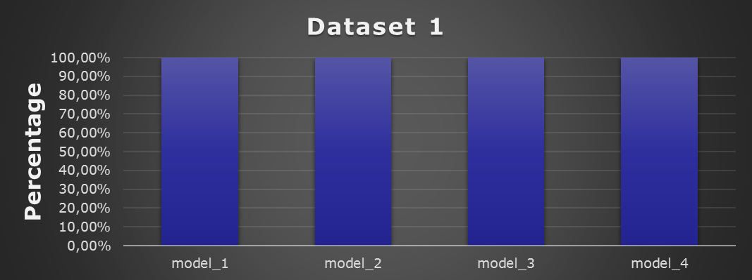
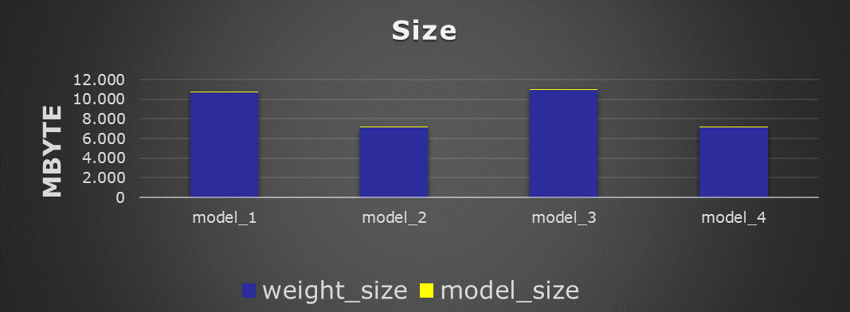
Preprocessing
Convolutional Neural Net

Slide 33
Preprocessing
Convolutional Neural Net
Not every CNN works
Small changes could break the CNN
Random does matter
Bigger != better
Fast or nothing

Slide 34

Comparison
 | traditional | NN | CNN
Dataset 1 | 100.00% | 99.33% | 100.00%
Dataset 2 | 99.79% | 94.42% | 98,67%
Dataset 3 | 57.83% | 16.00% | 22.17%
Dataset 1: known text, fixed font size and padding
Dataset 2: unknown text, fixed font size and padding
Dataset 3: unknown text, variation of font size and padding
Hochschule Esslingen, Intelligent Data Analytics, Project "Fontinator"

