Slide 1
Croco-2DGameEngine
github: https://github.com/alex-zhang/Croco-2DGameEngine
Alex.Zhang

Slide 2
2D Scene.
Starling based.
Entity-Component architecture.
Rapid application development.

Slide 3
Before We Start

Slide 4
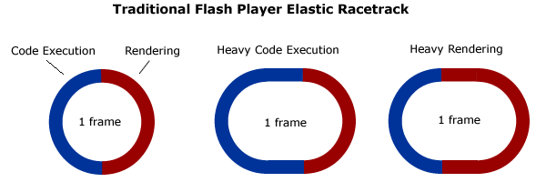
Flash Player Elastic Racetrack：
最早由Ted Patrick提出， 已得到官方的认可
http://tedpatrick.com/2005/07/19/flash-player-mental-model-the-elastic-racetrack/
Note： No ActionScript on the stack when rendering is in progress except BitmapData.draw, but rendering doesn’t call back to AS and AS waits the renderer to complete the operation

Slide 5
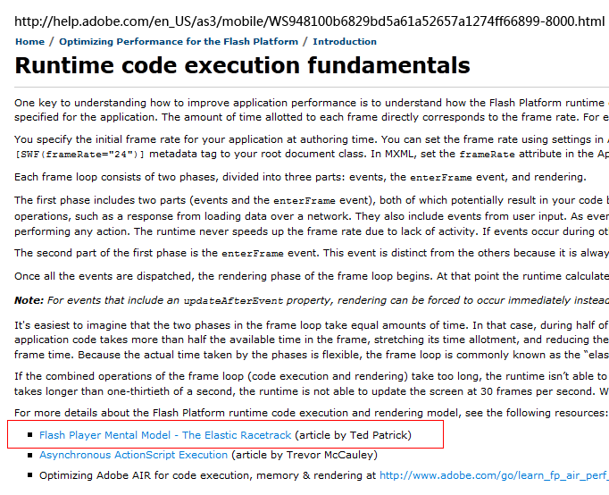
Flash Player Elastic Racetrack ：

Slide 6
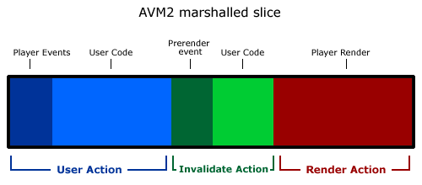
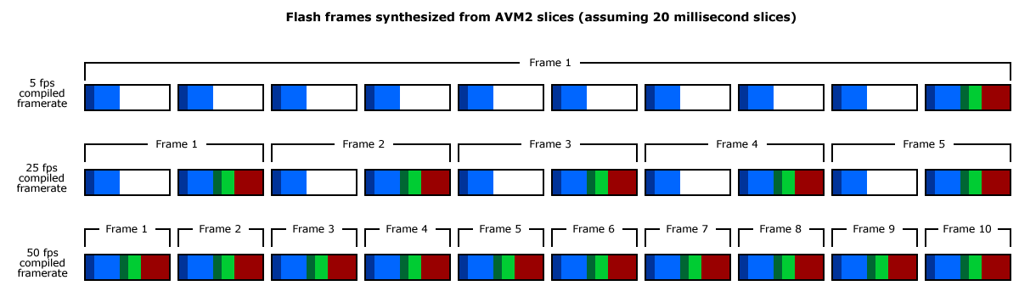
Flash Player Elastic Racetrack ： (Demo）
而Sean Christmann将这个理论进一步扩展成了“切片”模型
http://www.craftymind.com/2008/04/18/updated-elastic-racetrack-for-flash-9-and-avm2/
Demo: /可变跑道/...

Slide 7
Agenda
Starling
Entity-Component System
Engine Introduction

Slide 8
Starling
Principle.
Coordinate in 3D.
Graphics rendering pipeline.
Framework code quick view.

Slide 9
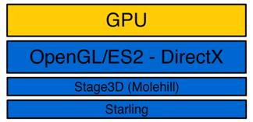
Starling - Principle

Slide 10
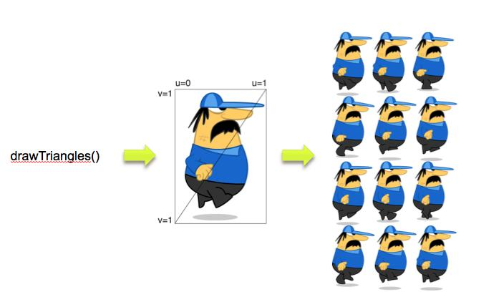
Starling - Principle

Slide 11
Starling - Coordinate

Slide 12
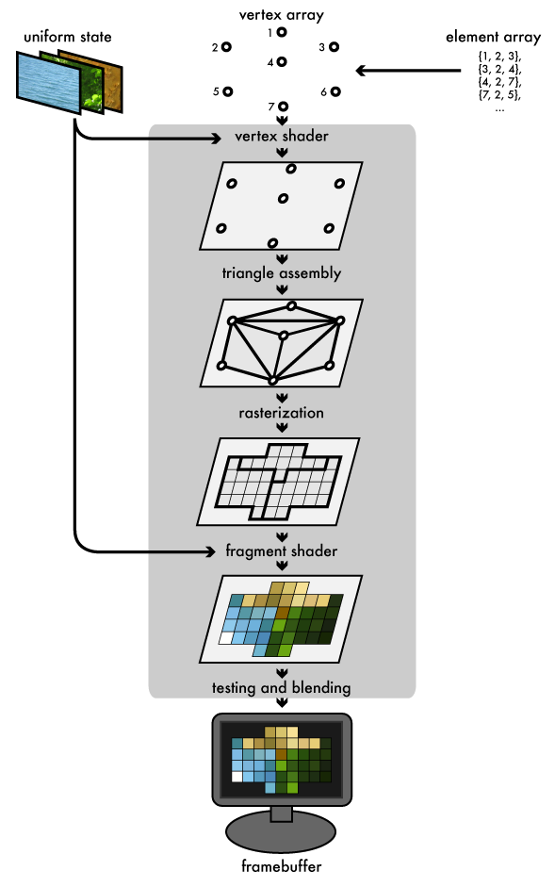
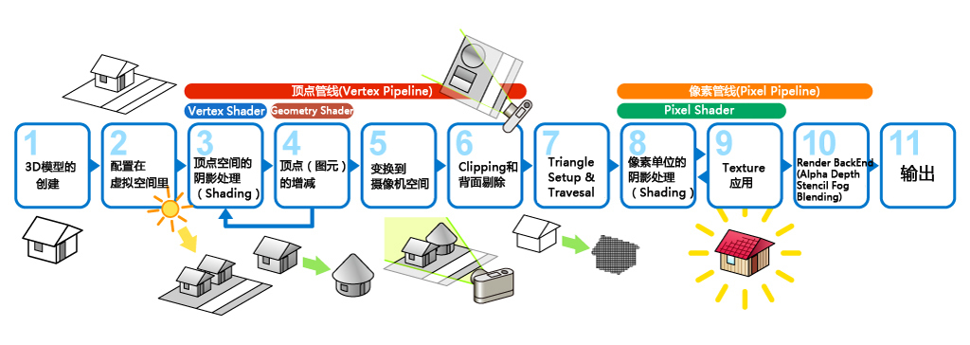
Starling - Graphics Pipeline

Slide 13
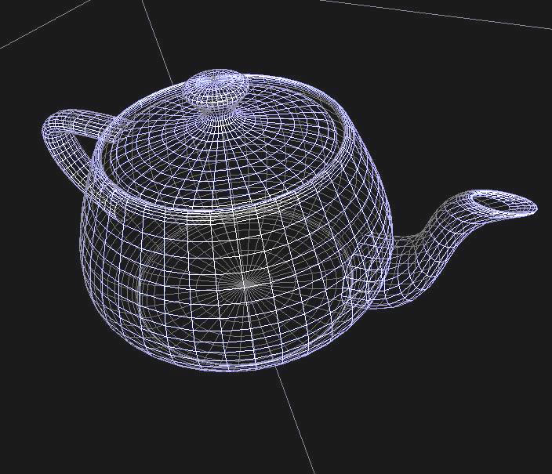
Starling - Graphics Pipeline
Vertex.
Model ->View->Project Transform

Slide 14
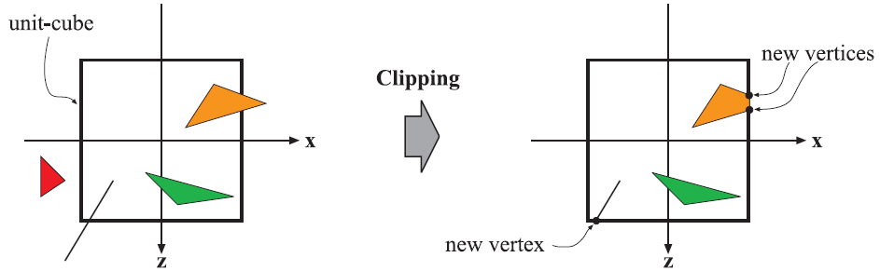
Starling - Graphics Pipeline
Vertex.
Model ->View->Project Transform

Slide 15
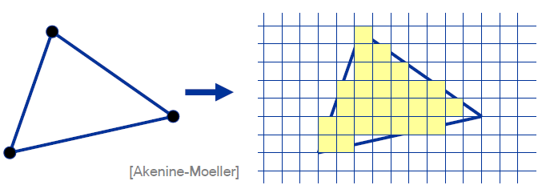
Starling - Graphics Pipeline
Vertex.
Model ->View->Project Transform

Slide 16
?

Slide 17
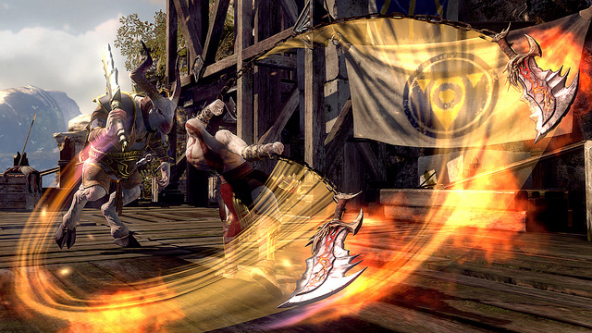
Starling - Framework code quick view
Code here >

Slide 18
?

Slide 19
Entity-Component System

Slide 20
Engine Introduction

Slide 21
Links：
http://gaming.adobe.com
http://chaimzane.iteye.com/blog/1868401
http://duriansoftware.com/joe/An-intro-to-modern-OpenGL.-Chapter-1:-The-Graphics-Pipeline.html

Slide 22
END

