Slide 1


Slide 2

Alexander Zyl
.NET Developer
azyl@scnsoft.com

Slide 3
A new child

Slide 4


Non-relational storages
NoSQL
Server A
Server B
Server C

Slide 5
NoSQL solutions in Azure
Column Family Store
Key/Value Store
HBase
Redis
TS
TS

Slide 6
DocumentDB
Features:
Fully managed
Schema agnostic
Scalable
Tunable consistency levels
Tunable indexing policies
Familiar SQL syntax for querying
JavaScript execution

Slide 7





DocumentDB resource model
REST API
DocumentDB Infrastructure

Slide 14
Logical containers
Physical containers

Slide 15
What about cost?

Slide 16
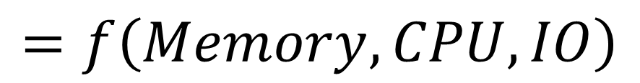
RU
Request Unit
$$=f\left(Memory, CPU, IO\right)$$

Slide 17
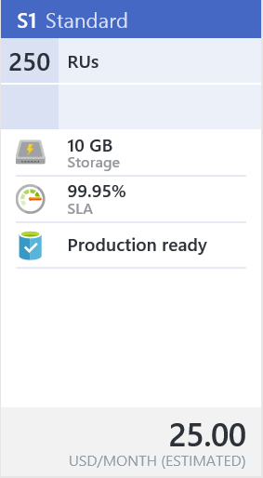
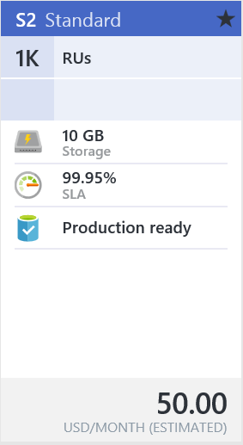
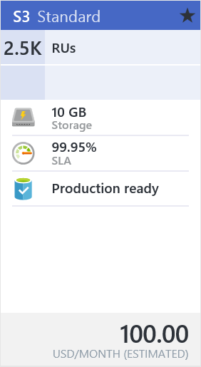
Performance levels
20
RUs per second
20
20
RUs per second
250 RUs per second
1k RUs per second
2.5k RUs per second
RUs per second
RUs per second

Slide 18
How to model data?

Slide 19
{
"Id": 44,
"ReleaseYear": "2014",
"Make": "Aston Martin",
"Vin": "2G1WT58KX79250102",
"Model": "DBS",
"Dealer": {
"Name": "Atlant-M",
"Address": "Some st. 9"
},
"GPSLocation": {
"Latitude": 44.6516185,
"Longitude": -63.5820275
},
"StatusData": […]
}

Slide 20
Approaches to document modeling
Reference data
Embed data

Slide 21
Storing unrelated documents

Slide 22
Modeling relations

Slide 23
Vehicle document:
{
"Id": 44,
"ReleaseYear": "2014",
"Make": "Aston Martin",
"Vin": "2G1WT58KX79250102",
"Model": "DBS",
"Dealer": {
"Name": "Atlant-M",
"Address": "Some st. 9"
},
"GPSLocation": {
"Latitude": 44.6516185,
"Longitude": -63.5820275
},
"StatusData": [
{ "Id": 1, "TimeStamp": "2014-07-04", "EngineOn": true, "FuelLevel": 40 },
{ "Id": 2, "TimeStamp": "2014-07-04", "EngineOn": false, "FuelLevel": 33 },
{ "Id": 999, "TimeStamp": "2014-08-12", "EngineOn": true, "FuelLevel": 23 }
]
}
Bad design

Slide 24
Modeling relations
When to embed:
One-to-few relations
Infrequent changes
Embedded data has bounds
Notes:
More samples?

Slide 25
Vehicle document:
{
"Id": 44,
"ReleaseYear": "2014",
"Make": "Aston Martin",
"Vin": "2G1WT58KX79250102",
"Model": "DBS",
"Dealer": {
"Name": "Atlant-M",
"Address": "Some st. 9"
},
"GPSLocation": {
"Latitude": 44.6516185,
"Longitude": -63.5820275
},
"StatusData": [
{ "Id": 1, "TimeStamp": "2014-07-04", "EngineOn": true, "FuelLevel": 40 },
{ "Id": 2, "TimeStamp": "2014-07-04", "EngineOn": false, "FuelLevel": 33 },
{ "Id": 999, "TimeStamp": "2014-08-12", "EngineOn": true, "FuelLevel": 23 }
]
}

Slide 26
Modeling relations
When to embed:
One-to-few relations
Infrequent changes
Embedded data has bounds
When to reference:
One-to-many relations
Many-to-many relations
Data changes frequently
Unbounded reference
Notes:
More samples?

Slide 27
Vehicle document:
{
"Id": 44,
"ReleaseYear": "2014",
"Make": "Aston Martin",
"Vin": "2G1WT58KX79250102",
"Model": "DBS",
"Dealer": {
"Name": "Atlant-M",
"Address": "Some st. 9"
},
"GPSLocation": {
"Latitude": 44.6516185,
"Longitude": -63.5820275
},
"StatusData": [
{ "Id": 1, "TimeStamp": "2014-07-04", "EngineOn": true, "FuelLevel": 40 },
{ "Id": 2, "TimeStamp": "2014-07-04", "EngineOn": false, "FuelLevel": 33 },
{ "Id": 999, "TimeStamp": "2014-08-12", "EngineOn": true, "FuelLevel": 23 }
]
}
VehicleLocation document:
{
"VehicleId": 44,
"GPSLocation": {
"Latitude": 44.651617,
"Longitude": -63.582027
}
}
Vehicle document:
{
"Id": 44,
"ReleaseYear": "2014",
"Make": "Aston Martin",
"Vin": "2G1WT58KX79250102",
"Model": "DBS",
"Dealer": {
"Name": "Atlant-M",
"Address": "Some st. 9"
},
"StatusData": [
{ "Id": 1, "TimeStamp": "2014-07-04", "EngineOn": true, "FuelLevel": 40 },
{ "Id": 2, "TimeStamp": "2014-07-04", "EngineOn": false, "FuelLevel": 33 },
{ "Id": 3, "TimeStamp": "2014-07-04", "EngineOn": true, "FuelLevel": 23 },
{ "Id": 999, "TimeStamp": "2014-08-12", "EngineOn": true, "FuelLevel": 23 }
]
}

Slide 28
Vehicle document:
{
"Id": 44,
"ReleaseYear": "2014",
"Make": "Aston Martin",
"Vin": "2G1WT58KX79250102",
"Model": "DBS",
"Dealer": {
"Name": "Atlant-M",
"Address": "Some st. 9"
},
}
Vehicle
{
"Id": 44,
"ReleaseYear": "2014",
"Make": "Aston Martin",
"Vin": "2G1WT58KX79250102",
"Model": "DBS",
"Dealer": {
"Name": "Atlant-M",
"Address": "Some st. 9"
},
"StatusData"95,: [
{ "Id": 1, "TimeStamp": "2014-07-04", "EngineOn": true, "FuelLevel": 40 },
{ "Id": 2, "TimeStamp": "2014-07-04", "EngineOn": false, "FuelLevel": 33 },
{ "Id": 3, "TimeStamp": "2014-07-04", "EngineOn": true, "FuelLevel": 23 },
{ "Id": 999, "TimeStamp": "2014-08-12", "EngineOn": true, "FuelLevel": 23 }
]
}
VehicleStatus documents:
{ "Id": 1, "TimeStamp": "2014-07-04", "EngineOn": true, "FuelLevel": 40, "VehicleId": 44 },
{ "Id": 2, "TimeStamp": "2014-07-04", "EngineOn": false, "FuelLevel": 33, "VehicleId": 44 },
{ "Id": 3, "TimeStamp": "2014-07-04", "EngineOn": true, "FuelLevel": 23, "VehicleId": 44 },
{ "Id": 4, "TimeStamp": "2014-07-05", "EngineOn": true, "FuelLevel": 10, "VehicleId": 44 },
{ "Id": 5, "TimeStamp": "2014-07-06", "EngineOn": false, "FuelLevel": 55, "VehicleId": 44 },
{ "Id": 999, "TimeStamp": "2014-08-12", "EngineOn": true, "FuelLevel": 23, "VehicleId": 44 }

Slide 29
Indexing

Slide 30
Documents in a collection
{
"id": 4,
"text": "Hello",
"user": {
"name": "Jerome",
"nickname": "@juim"
},
"entities": {
"hashtags": [
{
"text": "#rutib",
"indices": [ 10, 26 ]
}
]
}
}
{
"id": 16,
"text": "Bonjour",
"user": {
"name": "Francois",
"nickname": "@franky"
},
"entities": {
"hashtags": [
{
"text": "#heof"
}
]
}
}

Slide 31
Index tree

Slide 32
What we can control
Automatic indexing
Manual include
Manual exclude

Slide 33
What we can control
Indexing modes
Automatic indexing
Manual include
Manual exclude

Slide 34
What we can control
Indexing modes
Consistent
Lazy
None

Slide 35
What we can control
Indexing modes
Consistent
Lazy
None
Per-field indexing policies

Slide 36
Building paths
{
"id": 16,
"text": "Bonjour",
"user": {
"name": "Francois",
"nickname": "@franky"
},
"entities": {
"hashtags": [
{ "text": "#heof" }
]
}
}
_.text
_.user.name
_.entities.hashtags
_.entities.hashtags[0].text

Slide 37
Building paths
Applicable wildcards:
? – single selection
/text/?
/user/nickname/?
/entities/hashtags/[]/text/?

Slide 38
Building paths: examples
{
"id": 4,
"text": "Hello",
"user": {
"name": "Jerome",
"nickname": "@juim"
},
"entities": {
"hashtags": [
{
"text": "#rutib",
"indices": [ 10, 26 ]
}
]
}
}
/text/?

Slide 39
Building paths: examples
{
"id": 4,
"text": "Hello",
"user": {
"name": "Jerome",
"nickname": "@juim"
},
"entities": {
"hashtags": [
{
"text": "#rutib",
"indices": [ 10, 26 ]
}
]
}
}
/user/nickname/?

Slide 40
Building paths
Applicable wildcards:
? – single selection
* – recursive selection
/text/?
/user/nickname/?
/entities/hashtags/[]/text/?
/user/*
/entities/*
/entities/hashtags/[]/*

Slide 41
Building paths: examples
{
"id": 4,
"text": "Hello",
"user": {
"name": "Jerome",
"nickname": "@juim"
},
"entities": {
"hashtags": [
{
"text": "#rutib",
"indices": [ 10, 26 ]
}
]
}
}
/user/*

Slide 42
Building paths: examples
{
"id": 4,
"text": "Hello",
"user": {
"name": "Jerome",
"nickname": "@juim"
},
"entities": {
"hashtags": [
{
"text": "#rutib",
"indices": [ 10, 26 ]
}
]
}
}
/entities/hashtags/*

Slide 43
Applying rules
Indexing options:
Include to index
Exclude from index

Slide 44
Applying rules
Index kinds:
Hash – equality queries
SELECT *
FROM collection c
WHERE c.prop = 'value'

Slide 45
Applying rules
Index kinds:
Hash – equality queries
Range – range + OrderBy queries
SELECT *
FROM collection c
WHERE c.prop = 'value'
SELECT *
FROM collection c
WHERE c.prop >= 15
ORDER BY c.prop

Slide 46
Applying rules
Index kinds:
Hash – equality queries
Range – range + OrderBy queries
Spatial – ST_DISTANCE, ST_WITHIN
SELECT *
FROM collection c
WHERE c.prop >= 15
ORDER BY c.prop
SELECT *
FROM collection c
WHERE ST_DISTANCE(c.Location, {
"type": "Point",
"coordinates": [-122.19, 47.36]
}) < 100 * 1000

Slide 47
Applying rules
Index precision:
For numbers: 1-8 bytes
For strings: 1-100 bytes

Slide 48
Data consistency

Slide 49



Offered consistency models
Strong consistency
Eventual consistency
DocumentDB
Strong consistency
Eventual consistency
Session
Bounded staleness

Slide 50
Strong consistency

Slide 51
Strong consistency: Write operation

Slide 52
Strong consistency: Read operation

Slide 53
Eventual consistency

Slide 54
Eventual consistency: Write operation

Slide 55
Eventual consistency: Read operation

Slide 56
Session consistency

Slide 57
Session: Write operation

Slide 58
Session: Read operation

Slide 59
Bounded staleness

Slide 60
Bounded staleness: Write operation

Slide 61
Bounded staleness: Read operation

Slide 62
Scalability issues
Out of space
>
Data
Collection

Slide 63

Scalability issues
Out of space
>
Too many requests
Data
Collection

Slide 64
Solutions?
Vertical scaling

Slide 65
Solutions?
Vertical scaling
Horizontal scaling

Slide 66
Collection = Partition

Slide 67
Partitioning our data

Slide 68
Partitioning our data

Slide 69
Partitioning strategies
Hash partitioning

Slide 70
Partitioning strategies
Range partitioning

Slide 71
Partitioning strategies
Lookup partitioning

Slide 72
Use Cases

Slide 73
Use Cases: user-defined data

Slide 74
Use Cases: storing and analyzing logs

Slide 75
Use Cases: storing materialized views

