Slide 1
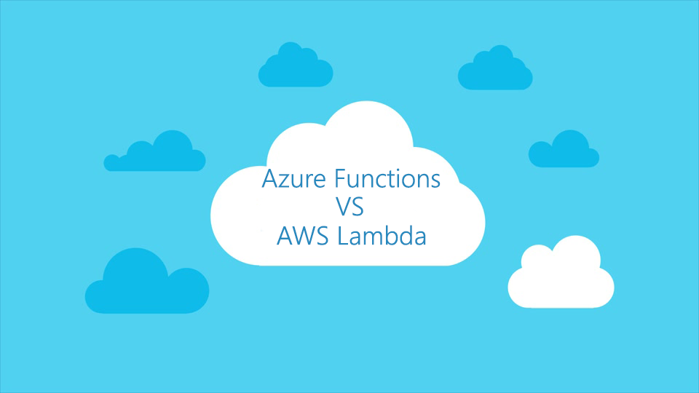

Slide 2

Alexander Zyl
Senior Software Engineer
azyl@scnsoft.com

Slide 3
Serverless solutions

Slide 4
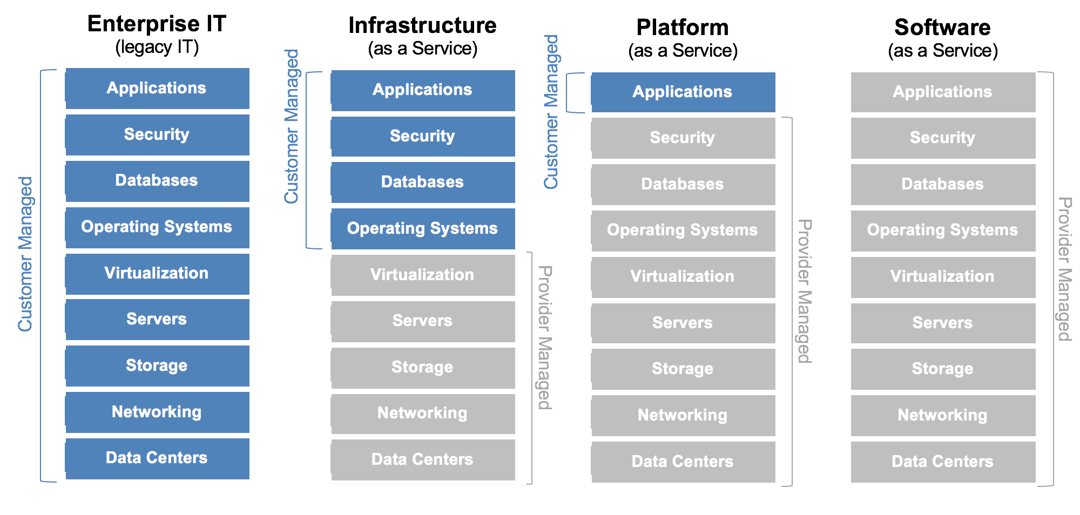

Slide 5
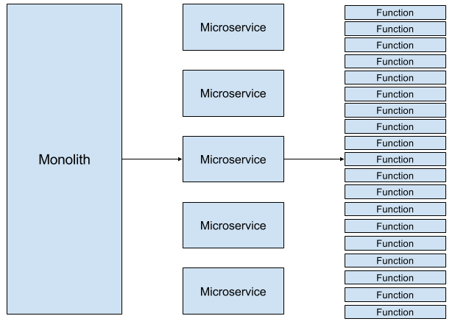

Slide 6
Use Cases
Mobile backend
Data processing
Event processing
Scheduled tasks

Slide 7
Azure WebJobs

Slide 8
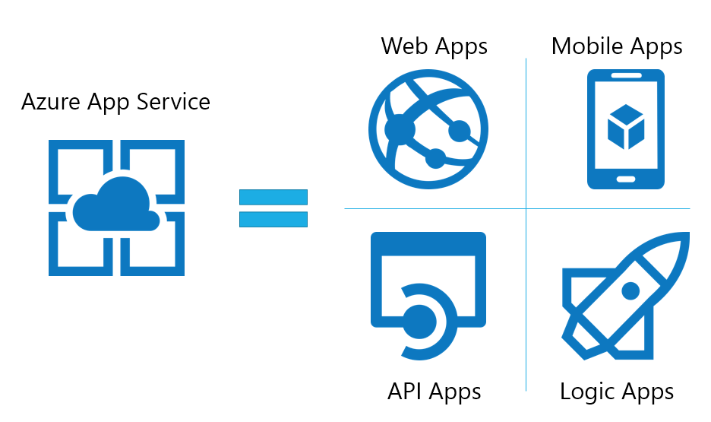

Functions Apps

Slide 9
What is function?

Slide 10
Function Types
Triggered by event source
On-Demand
Scheduled

Slide 11
Functions: Azure way

Slide 13
Binding: before and after

Slide 16
Functions: Lambda way

Slide 18

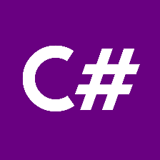



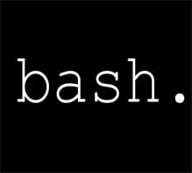



Supported languages

Slide 19


Features comparison
 | Azure Functions | AWS Lambda
Input/Output binding |  | -
Multiple trigger source
HTTP functions out-of-the box |  | -
Automatic package restore support | + | -
Code sharing | + | -
Per-Function monitoring | + | +
IDE support | - | +
Number of supported languages | 7 | 3
Wide list of deployment options | + | -
Debugging | Remote | -
Testing | Remote | Local

Slide 20
Demo

Slide 23
Pull model:
Event Models: Pull and Push
Push model:

Slide 24
Event models: Azure way
Pull model

Slide 25
Event models: Azure way
Push model

Slide 26
Event models: Lambda way
Pull model
Push model

Slide 27
AWS Role-based authorization

Slide 28
AWS Identity-based authorization

Slide 29
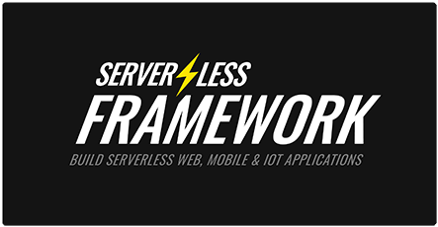

Slide 30
Architecture: Functions

Slide 31
Architecture: Lambda

Slide 32
What about cost?

Slide 33

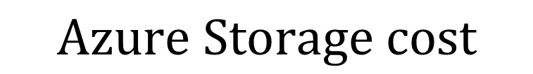


Pricing
$$\frac{Allocated RAM}{1024} ∗Total Execution Time ∗GB\backslash sec Cost$$
$$1$$
$$2$$
$$Total Request count∗Request Cost$$
$$3$$
$$Azure Storage cost$$

Slide 34
Resources
AWS Lambda documentation:
https://aws.amazon.com/documentation/lambda/
Azure Functions documentation:
https://azure.microsoft.com/en-us/documentation/services/functions/
SDK repositories
https://github.com/Azure/azure-webjobs-sdk
https://github.com/Azure/azure-webjobs-sdk-script
https://github.com/Azure/azure-webjobs-sdk-extensions

Slide 35
Q&A

