Slide 1
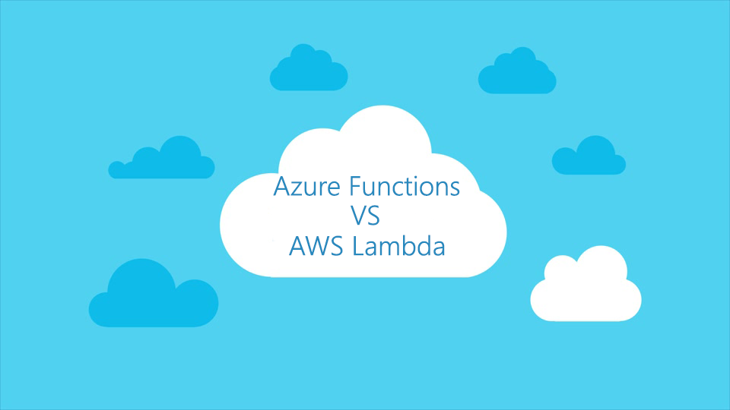

Slide 2


Slide 3

Alexander Zyl
Senior Software Engineer
alex.zyl@outlook.com
https://facebook.com/zyl.alex

Slide 4
‘As-a-Service’

Slide 6
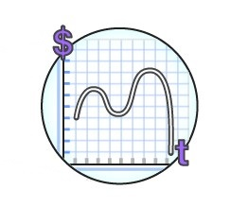
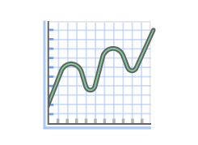

FaaS benefits
No servers to manage
Continuous scalability
Cost effectiveness

Slide 7
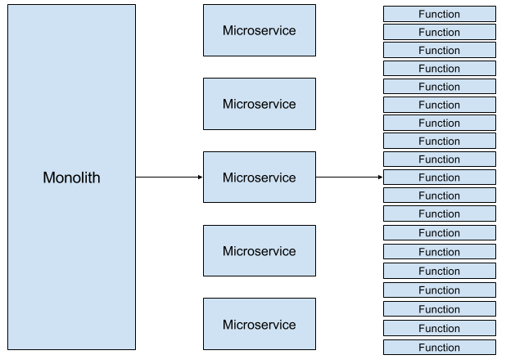

Slide 8
Use cases
Mobile backend
Serverless websites
Data processing
Event processing
Scheduled tasks

Slide 9




Back in 2014
Azure App Service (PaaS)
Azure VM (IaaS)
Amazon EC2 (IaaS)
AWS Elastic Beanstalk (PaaS)

Slide 10
Azure WebJobs

Slide 11
Azure WebJobs

Slide 12

AWS Lambda
Zero administrative
Autoscaling
Fine-grained pricing
Bring your own code

Slide 13
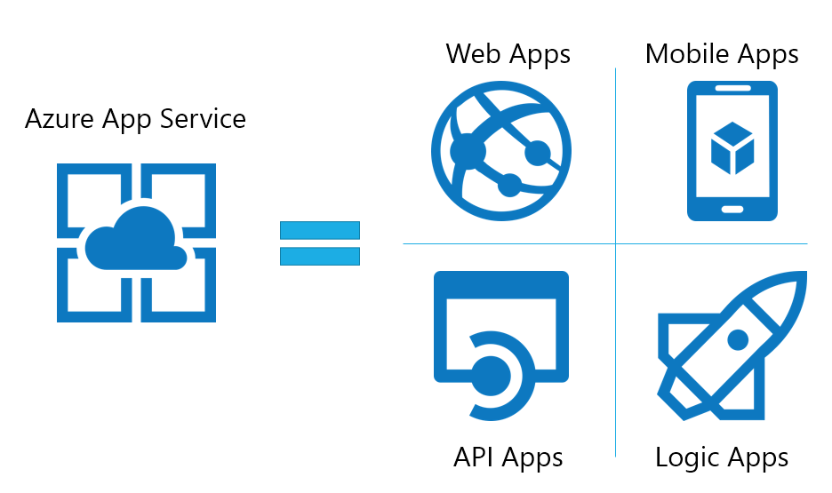

App Service Eco-System
Functions Apps

Slide 14
Azure Functions
Code
Config
Language Runtime C#, Node.js, F#, PHP, etc.
WebJobs Script Runtime Azure Functions Host – Dynamic Compilation, Language abstractions, etc.
WebJobs Core
Programming model, common abstractions
WebJobs Extensions
Triggers, input and output bindings
App Service Dynamic Runtime Hosting, CI, Deployment Slots, Remote Debugging, etc.

Slide 15
What is function?

Slide 16
Function types
Triggered by event source
On-Demand
Scheduled

Slide 17
Functions: Azure way

Slide 20
Binding: before and after

Slide 24
Functions: Lambda way

Slide 26

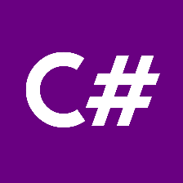







Supported languages

Slide 27
Demo

Slide 28
Sends
Image
Sends
Triggers
Stores

Slide 30
Pull model:
Event Models: Pull and Push
Push model:

Slide 31
Event models: Azure way
Pull model

Slide 32
Event models: Azure way
Push model

Slide 33
Event models: Lambda way
Pull model
Push model

Slide 34
Lambda function:
Has its own unique id (ARN)
arn:aws:lambda:eu-central-1:854958518097:function:QueuePoller
Has role with permissions

Slide 35
AWS Authorization types
Role-based
Identity-based

Slide 36
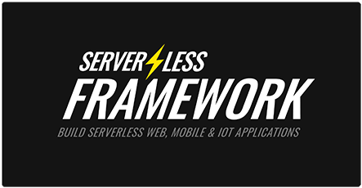

Slide 37
Architecture: Azure Functions

Slide 38
Architecture: Azure Functions

Slide 39
Architecture: AWS Lambda

Slide 40
What about cost?

Slide 41

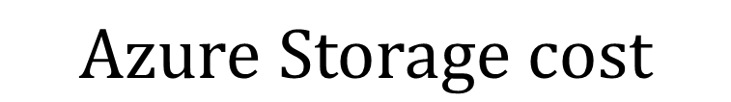
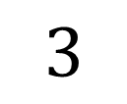

Pricing
$$\frac{Allocated RAM}{1024} ∗Total Execution Time ∗GB\backslash sec Cost$$
$$1$$
$$2$$
$$Total Request count∗Request Cost$$
$$3$$
$$Azure Storage cost$$

Slide 42


Features comparison
 | Azure Functions | AWS Lambda
Input/Output binding |  | -
Deep integration with other services
Multiple trigger source
HTTP functions out-of-the box
Automatic package restore support
Code sharing
Call function from another function |  | +
IDE support | - | +
Number of supported languages | 7 | 3
Wide list of deployment options | + | -
Debugging | Local/Remote | Local
Testing | Local/Remote | Local/Remote

Slide 43
Resources
AWS Lambda documentation:
https://aws.amazon.com/documentation/lambda/
Azure Functions documentation:
https://azure.microsoft.com/en-us/documentation/services/functions/
SDK repositories:
https://github.com/Azure/azure-webjobs-sdk
https://github.com/Azure/azure-webjobs-sdk-script
https://github.com/Azure/azure-webjobs-sdk-extensions

Slide 44
Q&A

