Slide 1
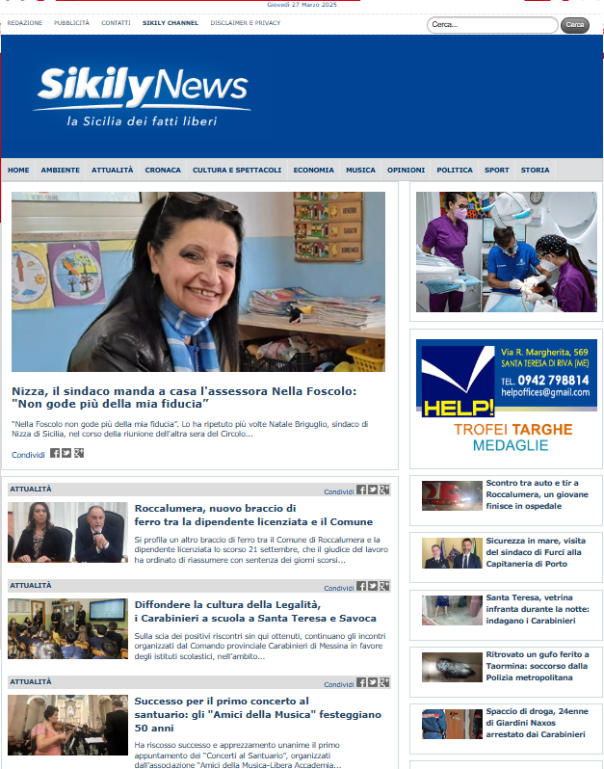
https://www.sikilynews.it/
Alex Pagano 1000033894

