Slide 1


Combine molecular dynamic and machine learning for prediction of ligands dissociation and binding kinetics
Project Progress
Fu Xiao
02/06/2025

Slide 2
CONTENTS
01
PART ONE
Backgrounds
02
PART TWO
Experiment
03
Results
PART THREE
04
Research Plan
PART FORE

Slide 3
2. Experiment
LiGaMD3
Systems | Production | Server | Systems | Production | Server | Systems | Production | Server | Systems | Production | Server
4EK4 | S1,4,7,8 | Anvil
4FKG | S1,3,6 | Anvil
4FKJ | S1,5,6 | Expanse
4FKQ | S1,2,4 | Expanse
5LO6 | S2,3,4,6 | Expanse
5LR1 | S2,4,6 | Expanse
5NYH | S4,6,10 | Expanse
5OD7 |  | Expanse
5OCI |  | L-longf
5ODX |  | L-longf
5LO5 | S2,3,4 | Expanse
5LQ9 | S1,2,3,5,6 | Expanse
5LR7 | S1,2,3,4,6 | Expanse
5LRZ | S1,2,3 | Expanse
5LS1 |  | Expanse
5T21

Slide 4
2. Experiment
LiGaMD3 for HSP - 5OCI
体系 | 配体 | atom_p | atom_l
5J20 | 6FJ :211 | 1261 (ASP79 OD2) | 28 (O1)
5J82 | 6GV :211 | 1266 (ASP79 OD2) | 28 (O2)
5J86 | 6GW :211 | 1266 (ASP79 OD2) | 28 (O1)
5J2X | 6DL :212 | 1261 (ASP79 OD2) | 1 (O2，配体第一个原子)
5J64 | 6G7 :211 | 1266 (ASP79 OD2) | 1 (O2，配体第一个原子)

Slide 5
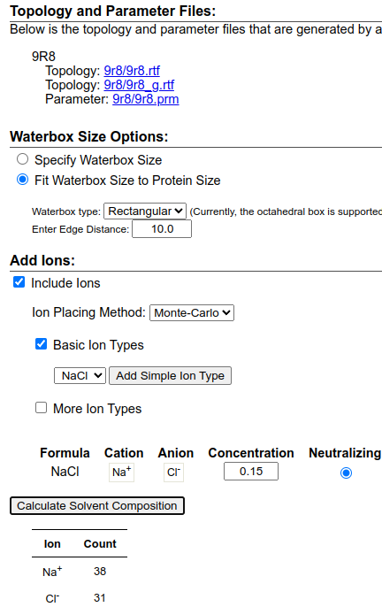
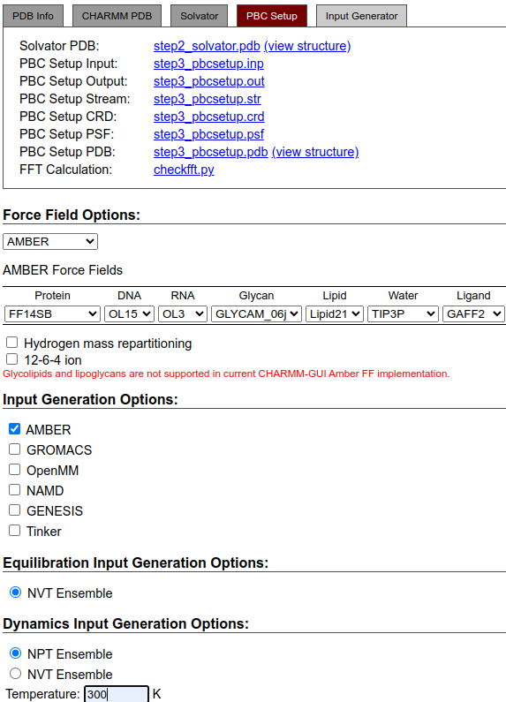
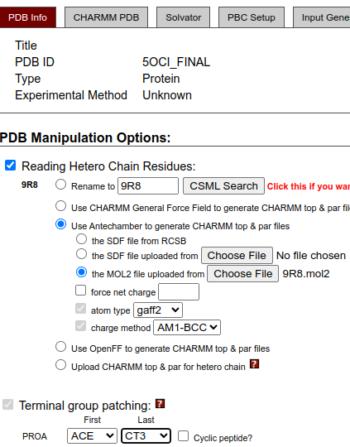
2. Experiment
LiGaMD3 for HSP - 5OCI

Slide 6
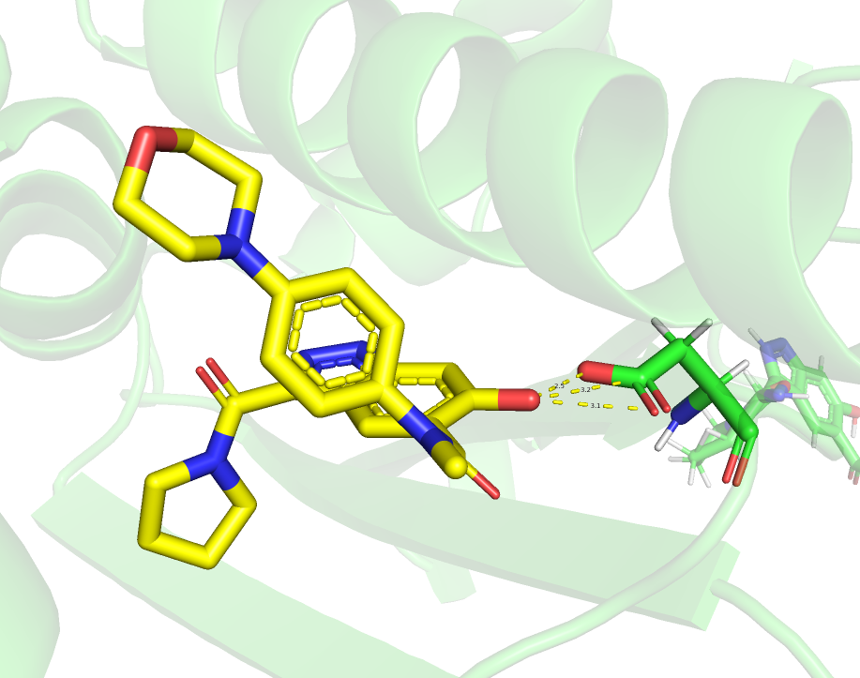
2. Experiment
LiGaMD3 for HSP - 5OCI
  ibblig = 1, nlig = 1, atom_p =1251, atom_l =31
  , dblig = 3,
natoms= 3329 // the number of protein atoms in the system.
natoms_max= 36200 // the total number of atoms in the system
ntwx= 1000 // the steps to write the trajectory (default)
ntwprt= natoms= 3329 // the number of protein complex atoms
igamd= 28 (default) // gamd
ntave= 4 x natoms_max = 4 x 36200 = 139428 ~ 200000
(Always make it a whole number)
ntcmd= 5 x ntave = 10 x 200,000 = 2,000,000
ntcmdprep= 2 x ntave = 2 x 200,000 = 400,000
ntebprep= 2 x ntave= 2 x 200,000 = 400,000
nteb= 45 x ntave= 100 x 200,000 = 20,000,000
nstlim= nteb + ntcmd= 20,000,000 + 2000,000 = 22,000,000
/500,000 = 44 ns
Bgpro2atm= 1, //Start atomic number of the protein region.
Edpro2atm= 3267, //End atomic number of the protein region.
Timask1: ‘:210' //Specifies atoms of the ligand. This variable has already been used in AMBER. The default is an empty string.
Scmask1: ‘:210' //Specifies atoms of the ligand that will be described using soft core in ambmask format. The
default is an empty string.
ASP/78-OD2-1251
9R8/ 210-O2-31

Slide 7
2. Experiment
LiGaMD3 for HSP - 5OCI

Slide 8

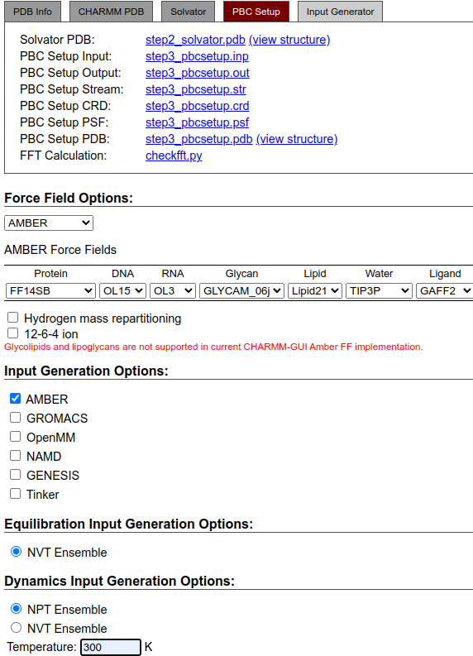
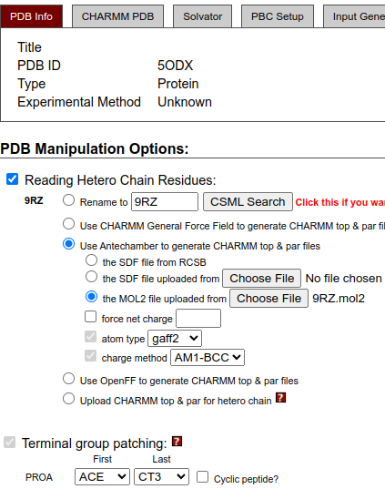
2. Experiment
LiGaMD3 for HSP - 5ODX

Slide 9
2. Experiment
LiGaMD3 for HSP - 5ODX
ibblig = 1, nlig = 1, atom_p =1266, atom_l =36, dblig = 2.6,
natoms= 3371 // the number of protein atoms in the system.
natoms_max= 34900 // the total number of atoms in the system
ntwx= 1000 // the steps to write the trajectory (default)
ntwprt= natoms= 3371 // the number of protein complex atoms
igamd= 28 (default) // gamd
ntave= 4 x natoms_max = 4 x 34900 = 139428 ~ 200000
(Always make it a whole number)
ntcmd= 5 x ntave = 10 x 200,000 = 2,000,000
ntcmdprep= 2 x ntave = 2 x 200,000 = 400,000
ntebprep= 2 x ntave= 2 x 200,000 = 400,000
nteb= 45 x ntave= 100 x 200,000 = 20,000,000
nstlim= nteb + ntcmd= 20,000,000 + 2000,000 = 22,000,000
/500,000 = 44 ns
Bgpro2atm= 1, //Start atomic number of the protein region.
Edpro2atm= 3304, //End atomic number of the protein region.
Timask1: ‘:212' //Specifies atoms of the ligand. This variable has already been used in AMBER. The default is an empty string.
Scmask1: ‘:212' //Specifies atoms of the ligand that will be described using soft core in ambmask format. The
default is an empty string.
ASP/79-OD2-1266
9RZ/ 212-O2-36

