Slide 1
HSP90 gives a scientific answer; rule value remains open
Can scientific reminders improve an autonomous agent’s answer?
One exposed question. Four original answers.
A finite-time result, plus a concrete applicability problem.
Audited HSP90 v3.4 report; developer verification | H07 H13 H18
1
Notes:
项目目标是理解异质蛋白资料。先介绍科学问题，再讨论规则是否帮助了回答。这里是开发观察，不能给总体正确率。
Claim IDs: H07 H13 H18

Slide 2
Different data describe different aspects of molecular behavior
Structure references → geometry
Trajectory readouts → sampled changes over time
NMR measurements → model-dependent experimental evidence
Audited HSP90 v3.4 report; developer verification | H14 H15 H20
2
Notes:
异质资料不是简单投票。几何位置、轨迹变化和核磁交换拟合回答不同问题。当前没有把这些量合成一个总分。NOE对原子近距离敏感，CPMG用于研究交换。
Claim IDs: H14 H15 H20

Slide 3
We ask whether closed-seeded trajectories show opening
In apo human HSP90α NTD, do closed-lid starts leave their initial conformation more readily than open-lid starts?
Which observed changes support that interpretation?
Audited HSP90 v3.4 report; developer verification | H01 H07 H20
3
Notes:
这是公开中文题目的英文摘要。原题还要求检查字段与论文状态定义的关系、实际计算、条件、时间和统计单位。NTD是N端ATP结合结构域，apo为无配体。
Claim IDs: H01 H07 H20

Slide 4
Henot et al. connect structure, NMR and finite trajectories
The ATP lid can adopt open-like and closed-like structures.
The paper reports stable open starts and heterogeneous closed starts.
A directional label is not the paper’s full state definition.
Henot et al., Nat Commun 13:7601 (2022), pp.5–6, Fig.4; doi:10.1038/s41467-022-35399-8 | H14 H15 H18
4
Notes:
Henot论文结合结构、NOE、CPMG及模拟，研究暂时出现的闭合状态。本题是现成且已暴露案例，适合开发诊断。作者开放稳定、闭合异质的判断来自其原生分析。
Claim IDs: H14 H15 H18

Slide 5
Both arms received the same finite trajectory evidence
20 trajectories per starting group
20–1020 ns; 1,001 saved points per trajectory
Derived geometry, contacts, summaries and paper sources
Original coordinates and full native NOE inputs were absent.
Audited HSP90 v3.4 report; developer verification | H01 H16 H20
5
Notes:
单位是轨迹，保存点存在时间相关性。起始来源不是当前突变身份。论文ff14SB与存档Zenodo AMBER99SB分开保留，名义帧数与实测、派生点数也分开。没有借目录名确定生产参数。
Claim IDs: H01 H16 H20

Slide 6
The comparison changes reminders, not agent autonomy
A: common data + tools + autonomous analysis
B: the same setup + selected rule text
Four fresh contexts: A1 → B1 → B2 → A2
No live scientific hints; no deterministic enforcement arm.
Audited HSP90 v3.4 report; developer verification | H07 H18
6
Notes:
开发者在运行前整理了字段、元数据和评价依据。模型自己选阅读与计算，收到真实工具返回后可以纠错。科学评价先看全文和来源，之后才看规则对应；这仍是开发者评价而非独立领域评分。
Claim IDs: H07 H18

Slide 7
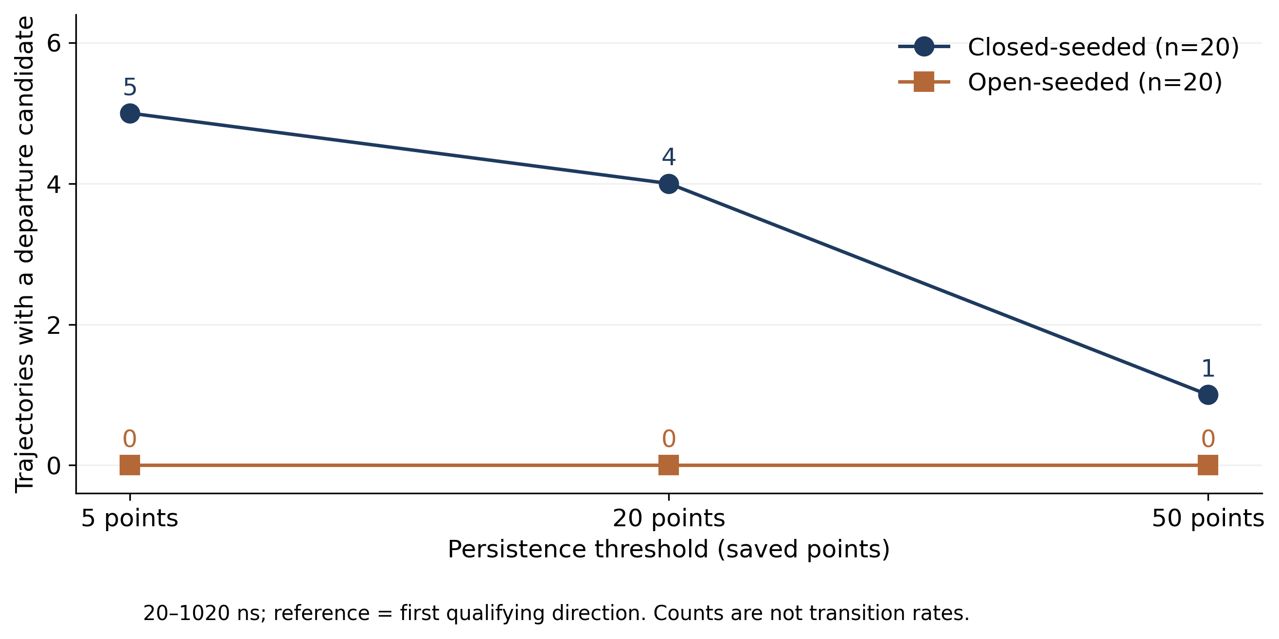
Closed starts show more directional departure candidates
Audited HSP90 v3.4 report; developer verification | H01 H02 H19
7
Notes:
每点是二十条轨迹中的候选数，5/20/50指保存点门槛。候选参考首个持续方向，并非必然参考起始结构。两组回返候选均零。线只是连接同一组，不代表拟合或置信区间。
Claim IDs: H01 H02 H19

Slide 8
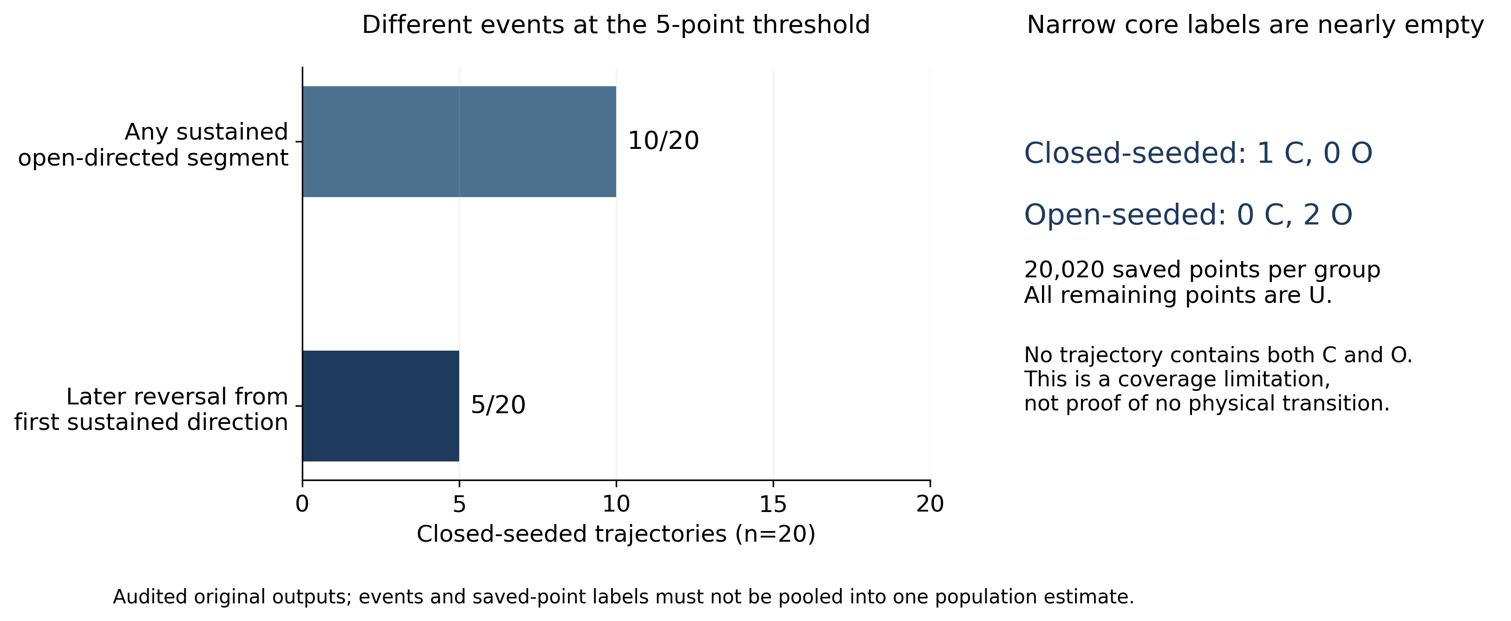
A sustained open segment is not the same as a transition
Audited HSP90 v3.4 report; developer verification | H03 H04 H05
8
Notes:
左侧10/20指曾出现至少五点开放段；5/20是后来相对首方向改变。右侧是保存点计数，核心覆盖极低。ES15有906点开放段，但50点门槛的首段已经开放。三个定义不能混成一个转换概率。
Claim IDs: H03 H04 H05

Slide 9
Three answers recover the counts; one confuses thresholds
Answer | Observed behavior | Limitation
A1 | Main counts + core coverage | Recovered from a failed request
B1 | Main counts + core coverage | Unequal-bin wording; RMP terms
B2 | Recomputed runs; added 10/20 | No numeric core audit; RMP terms
A2 | Conditions + some counts | Contradictory threshold counts
Four original outputs; total model cost $0.0757458
Audited HSP90 v3.4 report; developer verification | H08 H09 H10 H11
9
Notes:
两份规则组及A1主要计数正确。A2没有Python汇总，50点写0实际1，5点首方向写11/9实际15/5。B2补充10/20，B1有分箱措辞问题。原答案全部未修改；费用只是API费用。
Claim IDs: H08 H09 H10 H11

Slide 10
Selected rules carried method conditions into the wrong context
Generic provenance and uncertainty checks carried RMP and dye-model requirements.
Both B answers imported RMP wording.
Missing rule IDs are an output-design issue, not a scientific error.
Audited HSP90 v3.4 report; developer verification | H09 H12 H13
10
Notes:
选择器输出七条规则、八项义务，配对被保留，但规则原文可能不适用于本题。R0和染料可及体积是荧光模型条件。未明确适用关系就带入，会增加误导性限制。不能仅靠成功映射判断科学适用性。
Claim IDs: H09 H12 H13

Slide 11
Our result is compatible with the paper, but not a full replication
Paper statement | This round supports
Open starts remain stable | No opposite sustained-direction candidates
Closed starts: about 7 / 9 / 4 | Different event definitions; no numeric match claimed
Minor state from CPMG | Author-reported background, not a new MD estimate
Non-ergodic simulation | Finite-window, start-conditioned interpretation
Henot et al. (2022), Fig.4f–g and pp.5–6; audited paper crosswalk | H02 H14 H15 H20
11
Notes:
作者约7/9/4是同一分类下的构象类别；本轮5/4/1是三种门槛的方向事件。CPMG少数态3.2%是293K作者模型拟合，不能拿当前轨迹频率代替。没有原生输入就没有完整原生状态复现。
Claim IDs: H02 H14 H15 H20

Slide 12
Keep the result; resolve applicability before expanding
The scientific answer is auditable.
The incremental rule benefit is not established.
Current decision: stop automatic expansion.
Next science: compare directional segments with native NOE evidence.
Audited HSP90 v3.4 report; developer verification | H13 H17 H18 H21
12
Notes:
结论停留在有限窗口方向变化及规则适用性问题。按预定条件停止自动进入ADK或DHFR；这是开发投入决定。Pro已支持停止动作，过严的评价理由已修正。下一项科学建议先核查原生NOE对应，数据齐备性未确认。未修改冻结规则、未追加同题测试。下一版先明确科学问题与评价，不以保持规则架构为目标。
Claim IDs: H13 H17 H18 H21

