Slide 1
Open direction does not guarantee near-open NOE agreement
At 1 A, 9 of 10 closed-start traces with open-direction points
remain far from both references in at least half of those points.
Open-start control: 18 of 20 meet agreement criterion.
Same-source reanalysis | fixed project tolerances | 1
Notes:
τ为项目容差，不是作者零违例定义。9/10限定在有开放方向的闭合起始轨迹及其O点，非全轨迹科学错误。

Slide 2
We corrected a source-reader assumption before classification
80 native files match archived identities.
The old margin uses column 3: pseudo-distance violation.
Column 2 measures mean distance violation.
Reproduce old values with column 3; compare using column 2.
Same-source reanalysis | fixed project tolerances | 2
Notes:
第一次恒等检查失败，保留。分类前修订读取前提，没有改阈值；全40轨迹旧差值误差0。不是独立新实验。

Slide 3
Classification depends on a declared tolerance
Tolerance (A) Closed-start agreement / partial / relative
0.5 0 / 0 / 10
1.0 0 / 1 / 9
2.0 3 / 2 / 5
The other 10 closed-start traces have no open-direction points.
Same-source reanalysis | fixed project tolerances | 3
Notes:
开态近参照条件比例≥.8一致，两套均远比例≥.5相对偏好。0.5Å下开放控制仅7/20一致；不能选择最好看的阈值。

Slide 4
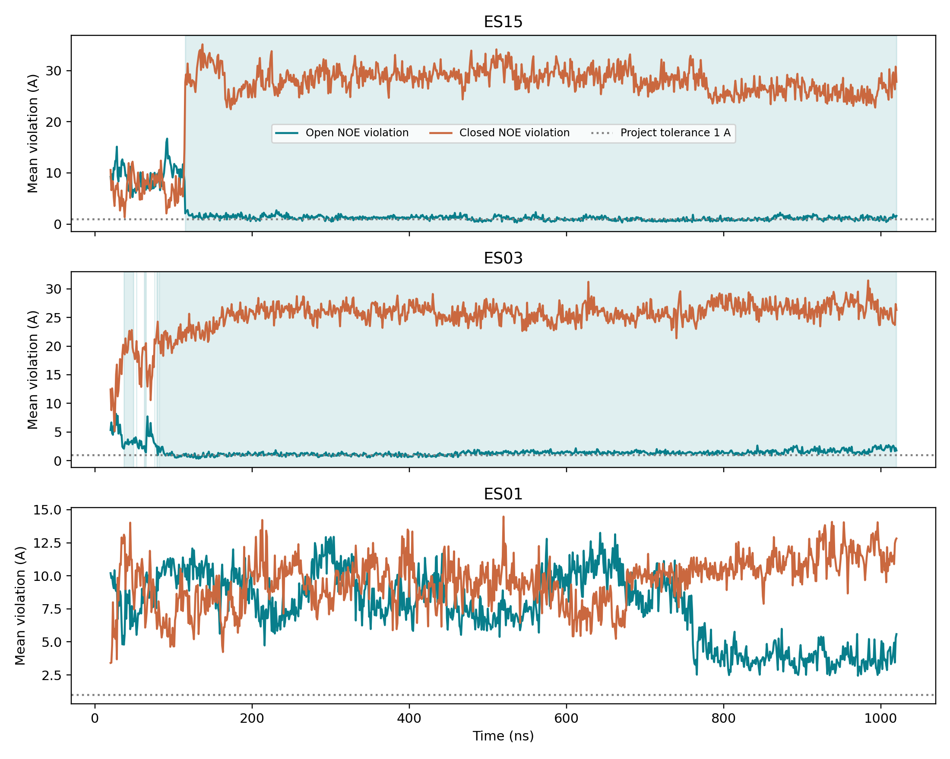
ES15 improves strongly, but the tolerance still matters
Same-source reanalysis | fixed project tolerances | 4
Notes:
ES15前100点Vo9.0741，末100点1.1154Å；O点中38.5%近开。ES03为22%。浅色带为派生O方向，灰线1Å。

Slide 5
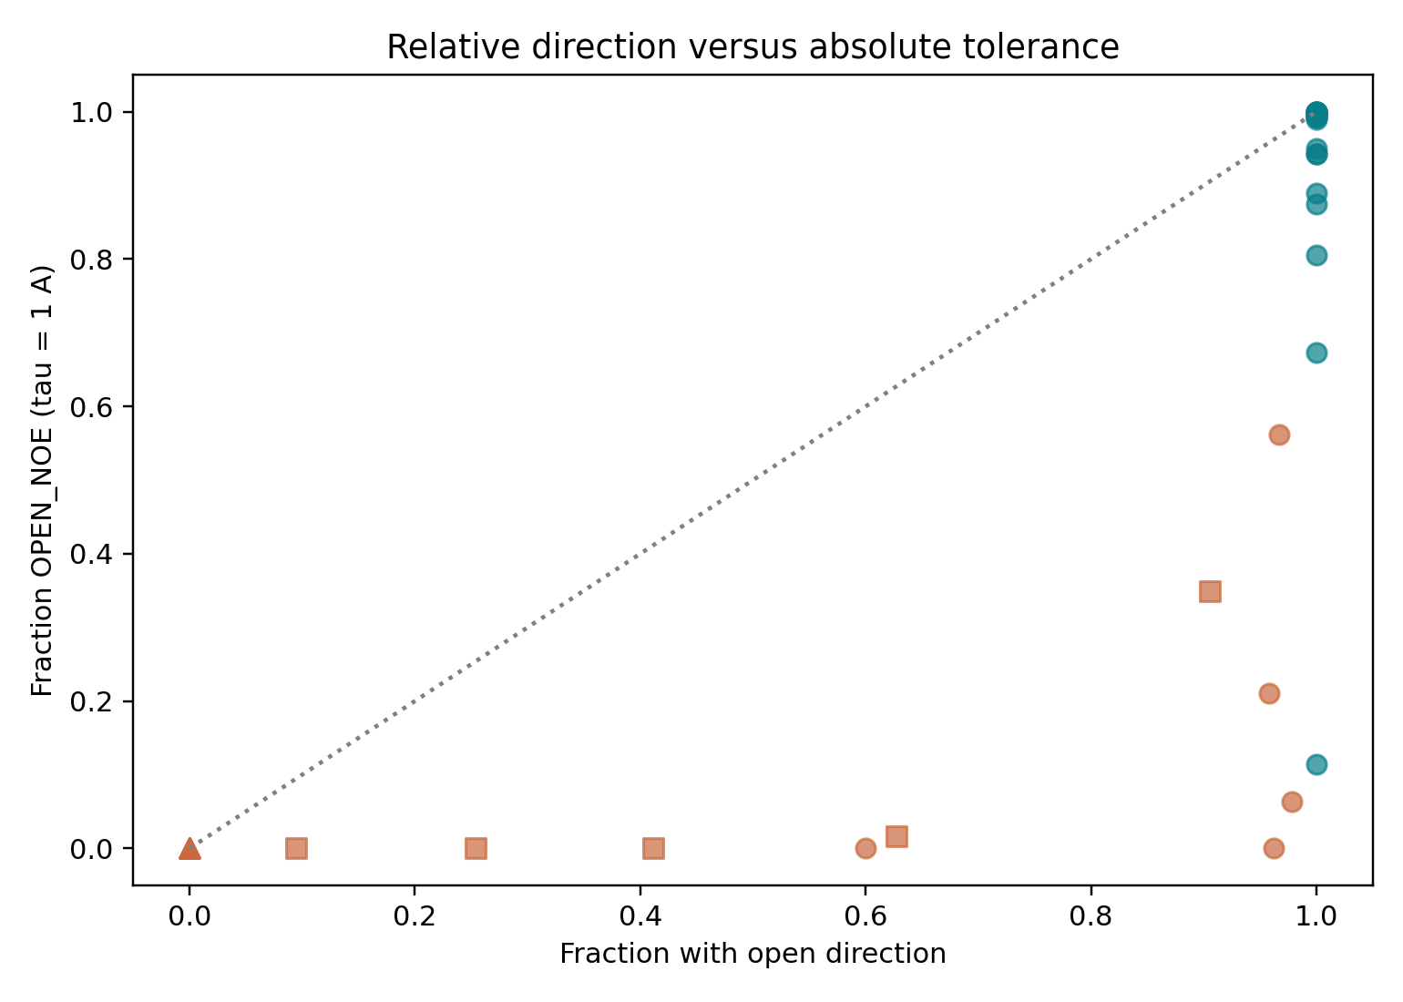
Relative direction and absolute closeness answer different questions
Same-source reanalysis | fixed project tolerances | 5
Notes:
横轴O方向比例，纵轴OPEN_NOE比例。圆首开、方先闭后开、三角只闭，蓝绿开放起始、橙闭合起始。重叠点不能目测数轨迹。

Slide 6
Two closed-start traces enter the open-start reference band
Pooled open-start 95th percentile: 1.32 A.
At least 50 consecutive points below that band:
ES04 from 188 ns; ES15 from 690 ns.
This is an empirical band from the same dataset.
Same-source reanalysis | fixed project tolerances | 6
Notes:
50保存点跨度49ns。闭合2/20，开放19/20达到；不是独立校准的物理状态。SI只标a-t未标ES，不猜逐轨迹映射。

Slide 7
The design implication: keep the observable definition visible
Retain the first-round directional counts.
Add absolute agreement and sensitivity before stronger claims.
40 trajectories, 40,040 rows, 3 figures; no new MD or model calls.
Rules rendering is fixed; second-system agent runs remain blocked.
Same-source reanalysis | fixed project tolerances | 7
Notes:
三科学问题分别答：部分明显降低；多数O点仍可同时偏离；ES04/15某些片段进入参照但不是完整状态复现。第二体系凭证与准入阻塞不改变本结果。

