Slide 1
Dynamics Atlas
What different measurements of a protein support together, and what four protein cases taught us about using rules
Zhenpeng Liu · UNC · 10 September 2026
The problem · where we started · what the rules contain · the workflow · four cases · what we tested · what changed · open questions
Notes:
Each page shows one slide, the notes for it underneath, and the sources behind it. The tables behind every number are in the data folder of the repository.
The story in one paragraph: we started with the idea that rules taken from methods papers could organize how an AI analyst works through heterogeneous protein data. We tried it on four real cases. The cases showed that scientific errors come in at different stages, some of them before any rule can act. When we tested four ways of using the rules, only one helped, and it was the one done by a person. So the question changed from whether more rules help to which knowledge belongs at which stage, and in what form. The last two slides set out the questions that decide the next step.
Sources: RESULTS.md, case by case https://github.com/alex051107/dynamics-atlas-harness/blob/overview/RESULTS.md | SOURCES.md, all papers https://github.com/alex051107/dynamics-atlas-harness/blob/overview/SOURCES.md

Slide 2
Different measurements of one protein see different things. What do they support together?
MD
atomic trajectories over time
NMR
distance restraints and exchange
SAXS
scattering averaged over the ensemble
FRET
a distance signal that depends on the dyes
Are two results about the same physical quantity?
Do they support a structural change, a population, or a rate?
What can we not tell apart with these data?
1
Notes:
This is the problem the project started from. For one protein we often have several kinds of data, and each observes a different aspect of the ensemble. MD gives coordinates frame by frame. NMR gives restraints that are averaged in a particular way, weighted toward short distances, and exchange information on specific time scales. SAXS averages the scattering of every molecule in the sample. FRET reports an efficiency that depends on where the dyes are and how they move.
Putting these side by side is easy. The hard part is to say what they support together without over-reading any of them. The three questions on the slide are the ones we keep returning to. Is it the same physical quantity? Does it support only a change in structure, or also how often a state is populated, or how fast it converts? And what can we simply not distinguish with the data we have? A common mistake, for example, is to read the fraction of simulation frames in a state as its population.
Sources: Li, Thomasen and Cossio 2026, Are we capturing the ensemble? https://rs-station.github.io/2026/08/31/are-we-capturing-the-ensemble.html

Slide 3
Our starting idea: rules taken from methods papers would organize the analysis.
Scientific question
Rules
33 from 11 papers
AI analyst chooses
and checks the analysis
Calculation
Bounded answer
Which analyses does this kind of data need?
Is any evidence missing before a conclusion can be drawn?
How far can the conclusion go?
The rules were meant to answer these three questions for the AI analyst at each step.
2
Notes:
Our first hypothesis was that cautions from the methods literature could help an AI analyst do three things: choose the analyses a given kind of data needs, notice when evidence is missing, and avoid conclusions that go beyond the data.
So we read 11 methods papers, mostly on smFRET, SAXS, cryo-EM and on combining several data types, and wrote 33 candidate rules, three per paper. The idea was that the rules would sit in the middle of the workflow, between the scientific question and the calculation, and that the analyst would consult them at each step. The next slide shows what the rules actually contain.
Sources: All 33 candidate rules https://github.com/alex051107/dynamics-atlas-harness/blob/overview/data/rules/RULES_TABLE.md | SOURCES.md, all papers https://github.com/alex051107/dynamics-atlas-harness/blob/overview/SOURCES.md

Slide 4
What the Rules Table contains: 33 rules from 11 papers, in four groups.
Group | Rules | What they cover | A real example (source paper) | How it reached the AI in our tests
Framing the question | 6 | claim level; when two measurements are not the same quantity; identifiability | A SAXS radius of gyration and an smFRET dye distance are different observables; matching the system does not make them directly comparable (Fuertes 2017) | sub-questions written by a person
Checking the data | 10 | what is measured; calibration; uncertainty; source quality; controls | FRET distance uncertainty must include corrections, R0 and dye motion, not only the spread of the histogram (Hellenkamp 2018) | a warning file placed with the data
Method guidance | 11 | forward models; reweighting; combining data; artifacts | Maximum-entropy reweighting combines sources while limiting departure from the MD prior; it does not discover states or rates (Bengtsen 2020) | rule text or short cards added to the question
Limits on the conclusion | 6 | fit is not validation; agreement is not proof; missing states | If the candidate structures omit a state, Bayesian SAXS refinement cannot create it (Shevchuk 2017) | one automatic check after the answer
3
Notes:
This is the table itself. Every rule has the same four parts: what the source paper actually showed, what we ask to be checked before using that kind of data, where the analysis should stop if the check cannot be made, and how far the lesson transfers beyond the paper.
For testing, we grouped the 33 rules by the job they do. Six are about framing the question, for example whether two measurements are the same quantity at all. Ten are about checking the data. Eleven are method guidance. Six are limits on what may be concluded. The examples are paraphrased from the table; the full table is in the appendix and on GitHub.
Two things about the table matter for the questions at the end. The source papers are mostly about FRET, SAXS and cryo-EM, and none is about MD-only analysis or about the proteins we then studied. And the rules are written as general checklists for a kind of data, not as conditions attached to a specific calculation.
Sources: All 33 candidate rules https://github.com/alex051107/dynamics-atlas-harness/blob/overview/data/rules/RULES_TABLE.md | SOURCES.md, all papers https://github.com/alex051107/dynamics-atlas-harness/blob/overview/SOURCES.md

Slide 5
The workflow a new system goes through, and where the rules entered.
1 Choose the question
2 Prepare the data
3 Frame the question
4 Analysis
5 Check the answer
6 Report
What happens
paper, SI, deposited data; the scientific question
per-frame tables, field definitions, physical checks
which difference to resolve; sub-questions; what a correct answer contains
the AI analyst reads the data and paper, writes and runs code, answers
automatic checks; one chance to revise
numbers linked to sources; limits stated
Done by
person
person + code
person
AI analyst
code
person
Rules entered as
—
a warning file (data-check rules)
sub-questions (framing rules)
text or cards (method rules)
one check (limit rules)
—
Problems we met
HSP90: first question asked only about direction
DHFR: periodic-image error; ADK: our own check was wrong
none; this helped
FRET conditions applied to an NMR question
tested that a number appears, not that it is right
—
4
Notes:
This is the whole workflow as it runs today, for any new system. A person chooses the question and collects the paper and the deposited data. The data are prepared into tables the analysis can use, with physical checks. A person frames the question: which difference we want to resolve, and what a correct answer must contain. The AI analyst then works in a closed workspace: it reads the data and the paper, writes and runs its own code, and submits an answer. Code checks the answer once, and a person writes the report with every number linked to its source.
The third row shows where the rules entered in our tests, one group at each stage. The last row shows where the problems we met actually appeared. Two of them sit before the analysis even starts: the loosely framed HSP90 question and the DHFR input error. That is a large part of why the question at the end is about stage as well as form.
Sources: RESULTS.md, case by case https://github.com/alex051107/dynamics-atlas-harness/blob/overview/RESULTS.md

Slide 6
Four real cases, each with the authors’ claim and what we wanted to test.
Case | Authors’ claim | What we wanted to test | What it exposed
HSP90 Henot 2022 | The closed state of the N-terminal domain is transiently populated (NMR exchange + 40 MD runs) | Does a run moving toward the open state also agree with the open-state NOEs? | Direction of change is not agreement with a state
Nanodisc Bengtsen 2020 | Reweighting MD against NMR, SAXS and SANS together fits all of them | Does fitting SAXS alone also improve NOE agreement? | One observable cannot stand in for another
DHFR Cetin 2023 | 4′-DTMP restores inhibition of L28R and sits closer to M20 and R28 | Do the deposited runs reproduce those contacts? | Errors can enter when the data are prepared
ADK Orädd 2021 | ATP triggers partial joint closure of LID and NMP over ~4.3 ms | What can the deposited ligand-free MD say about closure? | A check is right only for a given quantity
5
Notes:
We tried the idea on real systems: HSP90 first, then DHFR and ADK, and a nanodisc case that combines SAXS and NMR.
For each case we started from what the authors claim and chose one thing we could test with their deposited data. We did not try to reproduce whole papers. The question was always narrower: does a specific reading of the data hold, and what would an analysis, with or without rules, need to get it right?
Each case turned out to teach something different, and the problems did not sit at one stage. The next three slides give the science for each case.
Sources: Henot et al. 2022, Nat Commun https://doi.org/10.1038/s41467-022-35399-8 | Bengtsen et al. 2020, eLife https://doi.org/10.7554/eLife.56518 | Cetin et al. 2023, JCIM (PMC) https://pmc.ncbi.nlm.nih.gov/articles/PMC10428214/ | Orädd et al. 2021, Sci Adv https://doi.org/10.1126/sciadv.abi5514

Slide 7
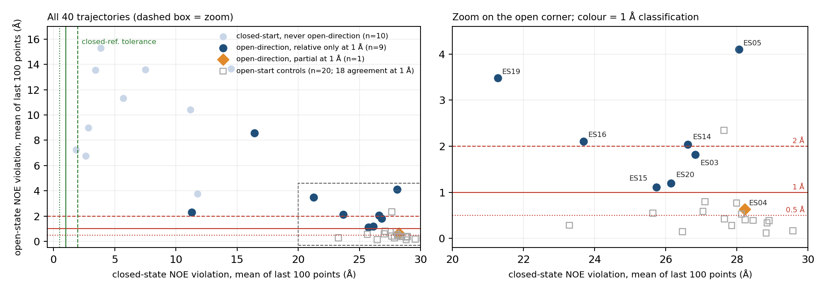
HSP90: moving toward the open state is not agreeing with it.
Tolerance | Closed-start runs that agree | Open-start runs that agree
0.5 Å | 0 of 10 | 7 of 20
1 Å | 0 of 10 | 18 of 20
2 Å | 3 of 10 | 19 of 20
10 of 20 closed-start runs move toward open
At 1 Å, 9 of them stay far from both references
The change is real: one run 9.1 → 1.1 Å
One point per trajectory (last 100 frames); colour = classification at 1 Å.
Direction of change ≠ agreement with a state ≠ a completed transition
6
Notes:
Authors’ claim. Henot and colleagues show that the closed state of the HSP90 N-terminal domain is transiently populated. NMR relaxation shows exchange on the millisecond scale. They ran 40 MD trajectories of 1 µs, 20 from the open crystal structure and 20 from a closed model, and used NOE violations to classify the closed-start runs as 7 near-closed, about 9 toward open and 4 neither.
What we tested. If a closed-start trajectory moves toward the open state by a relative measure, does it also agree with the open-state NOE restraints? Ten of the twenty closed-start runs show a sustained move toward open, close to the authors’ about nine. We then compared every run with the authors’ own NOE violation series. At 1 Å, nine of those ten spend most of that time far from both the open and the closed reference, one agrees partly, none agrees throughout. The 20 open-start runs pass the same test in 18 cases, so the test does detect agreement when it is there.
What it means. The movement is real: one run falls from 9.1 to 1.1 Å. But moving toward a state, agreeing with it, and completing a transition are three different claims, and these trajectories support the first. The tolerances are our own working definitions; appendix A1 discusses how agreement should be defined.
Sources: Henot et al. 2022, Nat Commun https://doi.org/10.1038/s41467-022-35399-8 | RESULTS.md, case by case https://github.com/alex051107/dynamics-atlas-harness/blob/overview/RESULTS.md

Slide 8
Nanodisc: fitting SAXS better did not fit NOE better.
Same weights applied to | Before | After fitting SAXS only | Change
SAXS disagreement (90 points) | 10.02 | 1.17 | −88 %
amide NOE disagreement (292 restraints) | 0.933 | 0.965 | +3 %
methyl NOE disagreement (40 restraints) | 3.89 | 4.47 | +15 %
Fitting one observable better does not mean explaining another
7
Notes:
Authors’ claim. Bengtsen and colleagues reweighted an MD ensemble of a nanodisc against NMR, SAXS and SANS together, with Bayesian maximum entropy, and obtained an ensemble consistent with all of them.
What we tested. What happens if the same ensemble is fitted to SAXS alone? Does agreement with the NOE data, which are then left out of the fit, improve as well? We applied the same weights to all three measures.
What we found. The SAXS disagreement falls by almost 90 percent. Both NOE measures get slightly worse, by 3 and 15 percent.
What it means. This does not show that the SAXS and NMR data contradict each other; it is a conditional result for this ensemble and error model. It shows that each observable constrains different aspects of the ensemble, which is the point of the ensemble blog by Li, Thomasen and Cossio. It is also the one case where the full rule text helped the AI analyst most.
Sources: Bengtsen et al. 2020, eLife https://doi.org/10.7554/eLife.56518 | RESULTS.md, case by case https://github.com/alex051107/dynamics-atlas-harness/blob/overview/RESULTS.md

Slide 9
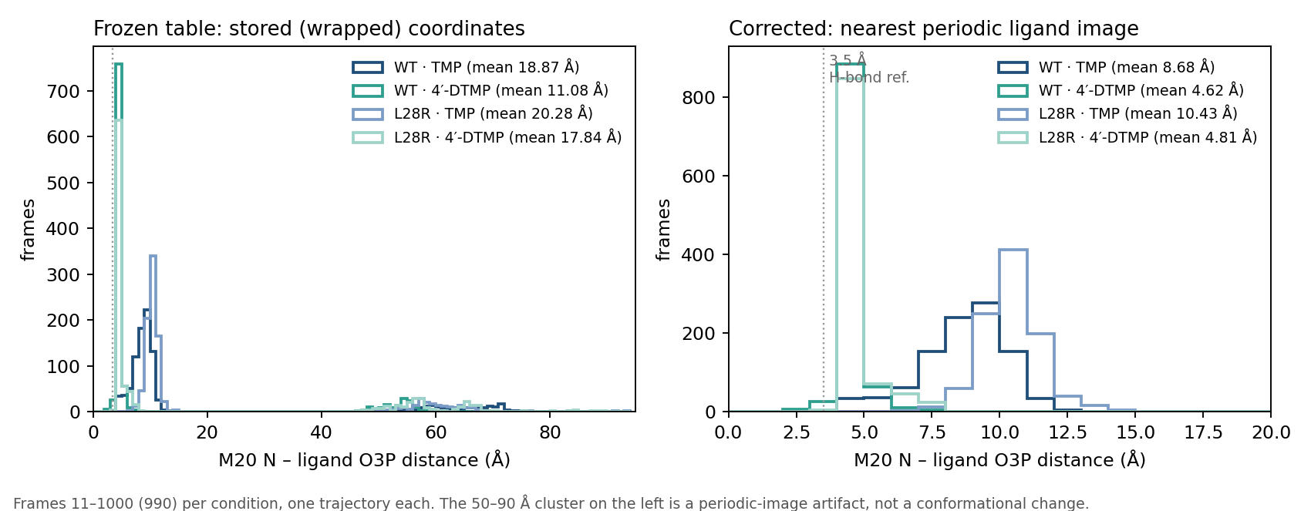
DHFR and ADK: a physical check has to follow the quantity measured.
ADK
After DHFR we wrote a check: distance > half box = error
ADK broke it: a 56 Å protein in a ~98 Å box, so 62–70 Å is real
Contact with a ligand: use the nearest periodic copy
Distance inside one protein: keep the molecule whole
DHFR distance before (left: periodic-image artifact at 46–94 Å) and after correction (right).
Written rules cannot rescue a wrong input, and a general rule for it can itself be wrong
8
Notes:
DHFR, authors’ claim. Trimethoprim loses potency against the L28R mutant and the analog 4′-DTMP restores it; in MD, 4′-DTMP sits closer to atoms of the M20 loop and R28. What we tested: do the deposited trajectories reproduce these contacts? Our first input table was built from stored coordinates, so in a group of frames the ligand was measured in a neighbouring periodic image, giving 46 to 94 Å. Both AI answers accepted these numbers; one called it conformational switching. After correction, M20 to the ligand falls from 8.7 to 4.6 Å in wild type and from 10.4 to 4.8 Å in L28R, and all six highlighted pairs move as in the paper.
ADK, authors’ claim. After ATP is released, time-resolved scattering shows the LID and NMP domains partly closing together over about 4.3 ms. What we tested: what can the deposited MD, which has no ATP or AMP, say about that? Very little: the domains show no net closure, and the conditions differ. But ADK broke the general check we had written after DHFR. The open protein is longer than half the box, so long distances inside it are real.
Together these say that a correct check depends on the quantity being measured, and that it has to happen when the data are prepared.
Sources: Cetin et al. 2023, JCIM (PMC) https://pmc.ncbi.nlm.nih.gov/articles/PMC10428214/ | Orädd et al. 2021, Sci Adv https://doi.org/10.1126/sciadv.abi5514 | RESULTS.md, case by case https://github.com/alex051107/dynamics-atlas-harness/blob/overview/RESULTS.md

Slide 10
We then tested four ways the rules could help, one at a time.
Kind of help | What we asked | What we saw
Framing: split the question into sub-questions | Does it reduce missed content? | More complete answers on both questions; not more accurate everywhere
Data check: a warning file about bad input | Does the AI notice and change its answer? | Listed in all 4 runs, opened in none
Method guidance: rule text or short cards | Better than a short protocol? | Better on the nanodisc, worse on HSP90
Limits: one automatic check after answering | Does it correct scientific errors? | Did not reduce errors
Each compared with the same setting without that help: same model, four runs each, answers scored against what the paper supports without knowing which version produced them. Numbers in appendix A2.
9
Notes:
After the cases we stopped treating the rules as one thing and tested each group in the stage where it belongs, against the same setting without it.
Framing helped: splitting the question made answers more complete on both questions tried, though not more accurate everywhere, and a person wrote the sub-questions. The data warning never reached the model: it saw the file name every time and never opened it. Method guidance was task-dependent: the full rule text gave the best answers on the nanodisc and the worst on HSP90, where a short seven-line protocol did better. The automatic check after the answer did not reduce errors.
These are small tests, four runs per version, on cases we had mostly seen during development. They are enough to decide what to build next, not to give an accuracy rate.
Sources: RESULTS.md, case by case https://github.com/alex051107/dynamics-atlas-harness/blob/overview/RESULTS.md

Slide 11
No stable benefit from the rules, and the failures had different causes.
Rule content
A correct FRET rule was applied to an NMR question
Delivery
The data warning existed but was never read
Checking
It tested whether a number appears, not whether it is right
The worst errors came earlier, where no rule acted: data preparation (DHFR) and a loosely framed question (HSP90).
So these results cannot yet tell us whether the Rules Table itself is the problem.
10
Notes:
It would be easy to summarise all this as the rules failed. That is not what we saw. There are three different kinds of failure.
One is about the rules themselves: in HSP90 a FRET rule about dye models and calibration was matched to an NMR question, because rules were selected by the type of data rather than by the calculation being done. One is about delivery: the right warning was available and simply never reached the analysis. One is about checking: the automatic check asked whether each number appears somewhere in the output, and a wrong number that was already in the output passed.
And the most serious errors happened before any rule could act. This is why I cannot tell, from these results alone, whether the problem is the table or the design around it. That is the first open question.
Sources: RESULTS.md, case by case https://github.com/alex051107/dynamics-atlas-harness/blob/overview/RESULTS.md | All 33 candidate rules https://github.com/alex051107/dynamics-atlas-harness/blob/overview/data/rules/RULES_TABLE.md

Slide 12
What changed: start from the scientific distinction; rules support it.
Before
Rules
organize the analysis
AI follows the rules
Now
What difference must we resolve?
structure · population · rate
What does each measurement observe?
Rules: source-linked knowledge that reminds, constrains and audits, at the step where it applies
The right physical and statistical analysis
Which alternatives remain distinguishable?
Bounded answer
11
Notes:
Before, the rules were the backbone of the analysis. Now we think the backbone should be the scientific distinction we want to resolve, whether it is a structural difference, a population or a rate, and what each measurement can actually say about it.
The rules do not disappear. They become supporting knowledge attached to the step where they apply: a data check at preparation, a caution about averaging at the analysis, a limit on the claim at the end. This is what the ensemble blog by Li, Thomasen and Cossio made clear to us: first ask which difference between ensembles survives measurement and processing, then choose the method. The blog does not prescribe any architecture, and our results do not yet justify one. That is what the two open questions are about.
Sources: Li, Thomasen and Cossio 2026, Are we capturing the ensemble? https://rs-station.github.io/2026/08/31/are-we-capturing-the-ensemble.html

Slide 13
Open question 1: are the rules themselves not good enough, or is the design around them wrong?
A. The rules are not good enough
Sources are mostly FRET, SAXS and cryo-EM; nothing covers MD-only analysis
Written as checklists for a kind of data, not as conditions on a specific calculation
No rule reviewed by a domain expert; one check I wrote was wrong
If so: better rules, from the right sources, tied to specific calculations, reviewed by an expert
B. The design around them is wrong
Correct rules still failed: text the AI may ignore, a warning it never opened, a check that tested the wrong thing
The worst errors came in data preparation and framing, where no rule acted
The only use that helped was done by a person
If so: change where and how knowledge enters the workflow, not the rules
Which explanation dominates, judged from the rules (appendix A3) and the four cases? Are these the right kind of rules for systems like HSP90?
12
Notes:
When we added rules, the answers did not get better. We see two explanations and cannot separate them ourselves.
The first is that the rules are not good enough. They come from methods papers about other techniques, they are written as general checklists rather than as conditions on a particular calculation, and nobody with domain expertise has reviewed them. If that is the main problem, the fix is better rules: from sources that match our systems, attached to specific calculations, and reviewed by a domain expert.
The second is that the overall design is wrong. Even correct rules failed because of how they entered the workflow, and the worst errors happened where the rules never act. If that is the main problem, improving the rules will not help much; we need to change where and how the knowledge enters.
A domain judgement decides which way to go. The most useful input would be a look at a few rules in appendix A3: are they correct, and useful for systems like HSP90?
Sources: All 33 candidate rules https://github.com/alex051107/dynamics-atlas-harness/blob/overview/data/rules/RULES_TABLE.md | RESULTS.md, case by case https://github.com/alex051107/dynamics-atlas-harness/blob/overview/RESULTS.md

Slide 14
Open question 2: if the rules are kept, in what form and at which stage should they support the analysis?
2 Prepare the data
3 Frame the question
4 Analysis
5 Check the answer
Outside the workflow
Rules could act as
checks written as code for the specific quantity
a template: which difference, what each measurement can say
(a) text the AI reads
(b) tools with preconditions the AI must call
limits on claims, checked by code or by a person
a reviewed reference for people
What we saw
essential, but must fit the quantity (DHFR, ADK)
helped, when written by a person
(a) no stable gain
(b) not tried on these cases
automatic number check failed
not tested
Where, and in which form, should this knowledge act? Should any of it stay out of the AI’s workflow altogether?
13
Notes:
If the rules stay, the second question is where they belong and what form they should take. The diagram lists the options stage by stage, with what our tests showed.
Before the analysis, rules could become checks written as code at data preparation. Our cases say these are essential but must be specific to the quantity measured. They could also become a framing template: which difference we want to resolve and what each measurement can say about it. Our only positive result was here, with a person writing the sub-questions.
During the analysis there are two forms. Text the AI reads is what we tested; it gave no stable gain. Tools with built-in preconditions, which the AI must call to run a registered analysis, are closer to our original idea. We built an early version in August, but only three HSP90-specific analyses existed, so it never had a real choice, and it was not tested on these cases.
After the analysis, rules could limit what may be claimed, checked by code or by a reviewer. Our automatic version failed. Or the knowledge could stay outside the AI workflow as a reviewed reference for people. The answer decides what we build next.
Sources: RESULTS.md, case by case https://github.com/alex051107/dynamics-atlas-harness/blob/overview/RESULTS.md | Li, Thomasen and Cossio 2026, Are we capturing the ensemble? https://rs-station.github.io/2026/08/31/are-we-capturing-the-ensemble.html

Slide 15
Appendix
A1 HSP90: defining agreement · A2 the four tests in numbers · A3 rules in full · A4 the 11 source papers

Slide 16
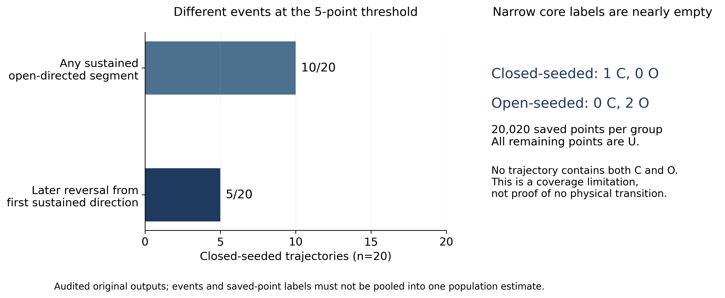
A1. HSP90: how should agreement with the open state be defined?
Paper: about 9 of 20 closed-start runs move toward open; ours: 10
We did not reproduce the paper’s 7 / 9 / 4 classification
1 µs runs with no returns: no populations or rates
0.5, 1 and 2 Å are our working tolerances, not calibrated boundaries
Closed-start runs: 10 of 20 move toward open; 5 of these first held a closed direction.
15
Notes:
This is the specific scientific question for HSP90. Our conclusion depends on how agreement with the open state is defined: over the tolerances we tried, between 0 and 3 of the 10 runs agree. We classified each run by the share of its open-direction time that lies within tolerance of the open-state NOE references.
The open-start runs give a sanity check: 18 of 20 agree at 1 Å. But the tolerance is still our own choice. A different definition, for example per restraint or with the NMR error model, would change the classification, and we would redo it that way.
Sources: Henot et al. 2022, Nat Commun https://doi.org/10.1038/s41467-022-35399-8

Slide 17
A2. The four tests in numbers (median of four runs)
Kind of help | Measure | Without | With
Framing | HSP90: sub-questions covered (of 3) | 2 | 2.5
Framing | ADK: sub-questions covered (of 3) | 2 | 3
Data warning | DHFR bad input detected | 0 of 4 | 0 of 4
Method guidance | HSP90: correct parts (of 5) | protocol 4.5 | rules 2 · cards 2.5
Method guidance | Nanodisc: correct parts (of 5) | protocol 4.5 | rules 5 · cards 4.5
Check after answer | Questions with fewer errors | — | 1 of 3
Three of the four cases were used while developing the rules; ADK was new to them. Framing added requirements written by a person.
16
Notes:
These are the numbers behind the test slide. Each version ran four times on the same model, and we compare medians. Answers were scored against what the paper supports, without knowing which version produced them. With four runs, these numbers guide a decision; they are not accuracy rates.
Sources: RESULTS.md, case by case https://github.com/alex051107/dynamics-atlas-harness/blob/overview/RESULTS.md

Slide 18
A3. Rules in full: five examples from the table
Rule (paper) | What the paper showed | What we asked to be checked | Where to stop
Fuertes 2017 | A SAXS radius of gyration and an smFRET dye distance are distinct observables with different averaging; matching system and condition does not make them directly comparable | observable, spatial support, averaging, inverse model | observables do not match
Hellenkamp 2018 | FRET distance uncertainty must include corrections, R0, dye motion and model assumptions, not only histogram spread | corrections, R0, dye volume, propagated uncertainty | uncertainty unresolved
Dimura 2020 | A good FRET fit cannot repair a fold or state missing from the initial candidates | dye restraint model, prior ensemble, fit objective | prior or model unresolved
Bengtsen 2020 | Maximum-entropy reweighting combines source-specific likelihoods while limiting departure from the MD prior; it does not discover states or kinetics | reweighting method, MD prior, source weights | integration unverified
Shevchuk 2017 | If candidate structures omit a state, Bayesian SAXS refinement cannot create it | coverage of the candidate set; missing states | missing state
17
Notes:
Five real rules, to show what the table contains. The Hellenkamp and Dimura rules are the FRET conditions that reached the HSP90 NMR question; all 33 rules are in appendix/RULES_TABLE.md on GitHub. Each is sound for the method it came from. For question 1 it would help to know whether rules written like this are the right kind of knowledge for systems like HSP90, and what is missing.
Sources: All 33 candidate rules https://github.com/alex051107/dynamics-atlas-harness/blob/overview/data/rules/RULES_TABLE.md

Slide 19
A4. The 11 methods papers behind the rules
Paper | Topic
Hellenkamp et al. 2018, Nat Methods | smFRET accuracy, multi-lab benchmark
Agam et al. 2023, Nat Methods | smFRET on proteins
Dimura et al. 2020, Nat Commun | FRET-assisted structural modelling
Fuertes et al. 2017, PNAS | SAXS versus FRET
Shevchuk and Hub 2017, PLoS Comput Biol | Bayesian SAXS refinement
Bengtsen et al. 2020, eLife | NMR + SAXS + SANS + MD
Hoff et al. 2024, PLoS Comput Biol | cryo-EM ensembles
Peter et al. 2022, Nat Commun | DEER versus FRET
Sanabria et al. 2020, Nat Commun | transient states
Steffen et al. 2021, Bioinformatics | FRET from MD
Wankowicz and Bonomi 2026, Nat Methods | ensemble prediction
18
Notes:
The source papers behind the 33 rules. Most concern smFRET, SAXS, cryo-EM and combining data types; none concerns MD-only analysis or the proteins in our cases. Links are in SOURCES.md on GitHub.
Sources: SOURCES.md, all papers https://github.com/alex051107/dynamics-atlas-harness/blob/overview/SOURCES.md

