Slide 1
TrpB MetaD Week 7 — Path realignment + Miguel parameters + pilot results
FP-034 re-aligned path · Miguel author contract · Pilot s=1→12.87 · 10-walker seeding plan · ML layer outlook
Zhenpeng Liu · 2026-04-24 · TrpB group meeting
5 topics · 10 slides · ~25 min

Slide 2
本周 5 个重点 (roadmap of this deck)
One slide per topic, in execution order
1 · Re-alignment (FP-034) Cross-species residue mapping bug → Needleman-Wunsch uniform +5 offset fix 4-layer verification: my NW, Codex NW, endpoint self-projection, independent PC crystal projection2 · Miguel author parameter contract (2026-04-23) Verbatim from first author email · corrects FP-031 (ADAPTIVE=DIFF) + FP-032 (units A/kcal) λ=80 on his path ↔ λ=100.79 on ours → ratio 1.26× self-consistent3 · Current results (s(t) trace + 2D (s,z) density) Pilot 45515869: 8 ns, min_s=1.000, max_s=12.867 (vs baseline 45324928: stuck at s<1.9 over 16 ns) 2D (s,z) JACS-style figure · start.gro sits at (s=7.09, z=1.68) — off-path, not biology4 · 10-walker seeding — how I chose the 10 frames Pick low-z frames from pilot, one per target_s bin (1..10); avoid FP-030 homogeneous start v2 crashed (LINCS blow-up, no equilibration) → v3 with EM+NVT settle queued5 · ML-layer future (1-2 slides) v1.2 → v2.0 pivot: F0 PathGate evaluator + external audit narrowed 5 ML extensions to MNG-lead Gate at 2026-05-01: WT FES convergence or ML layer suspended
Source: reports/GroupMeeting_2026-04-24_SELECTION_LOGIC.md (decision chain)
Slide 1 / 10 · roadmap

Slide 3
Topic 1 — Re-alignment: FP-034 cross-species residue mapping
1WDW-B (Pf, 385 aa) vs 3CEP-B (St, 393 aa) differ by +5 N-terminal residues
Naive path (what we had) Resid-number alignment: 97 ↔ 97
112 Cα identity: 6.2 %
O↔C endpoint RMSD: 10.89 Å
⟨MSD⟩ along path: 0.606 Å²
λ from ⟨MSD⟩: 3.80 Å⁻²
→ path literally mixed two residue sets
Sequence-aligned path (FP-034 fix) Needleman-Wunsch: uniform +5 offset
112 Cα mapped to true homologs
Identity: 59.0 % (9.5× better)
O↔C RMSD: 2.115 Å (5.1× tighter)
⟨MSD⟩: 0.0228 Å² (26.6× smaller)
λ: 100.79 Å⁻² (Branduardi compliant)
How the bug was silent for 3 weeks generate_path_cv.py line 182 COMPUTED a NW alignment · line 670 NEVER CONSUMED it Code ran clean, produced a usable-looking path.pdb — error only surfaced downstream as sampling failure4-layer independent verification (a) My NW · (b) Codex NW (score 286, identity 59.033 %, offset +5) · (c) endpoint round-trip · (d) 4 PC crystals projection
Source: replication/validations/failure-patterns.md (FP-034)
Source: replication/metadynamics/path_seqaligned/VERIFICATION_REPORT.md
Source: replication/metadynamics/path_seqaligned/REVERSE_SANITY_CHECK.md
Slide 2 / 10 · Topic 1 (1/2) · FP-034 root cause + verification

Slide 4
Topic 1 — 数值对比 + 生物学 sanity
Numbers show the fix works; PC crystals now sit mid-path
Metric | Naive path | Sequence-aligned | Change
Cα identity (112 residues) | 6.2 % | 59.0 % | 9.5× higher
O↔C endpoint RMSD (Å) | 10.89 | 2.115 | 5.1× tighter
⟨MSD⟩ along path (Å²) | 0.606 | 0.0228 | 26.6× smaller
λ = 2.3 / ⟨MSD⟩ (Å⁻²) | 3.80 | 100.79 | 26.5× larger
Ratio vs Miguel's λ=80 | 0.047× | 1.26× | in tolerance
5DW0 chain A (βPC) projection | s ≈ 1.07 (collapsed) | s = 9.46 (mid-path) | mid-path as expected
5DW3 chain A (βPC variant) | — | s = 8.51 | mid-path
5DVZ chain A (βPC holo) | s ≈ 1.07 | s = 5.37 | mid-path
4HPX chain B (Pf A-A) | s = 14.91 | s = 14.90 | near-C endpoint
Key biological sanity — 3 βPC crystals now sit s=5.4–9.5 On naive path all three collapsed to s ≈ 1.07 (indistinguishable from O) Corrected path exposes partial-closure geometry — meaningful for Aex1 reactive state downstream
Source: replication/metadynamics/path_seqaligned/VERIFICATION_REPORT.md
Source: https://doi.org/10.1063/1.2432340 (Branduardi, Gervasio, Parrinello 2007)
Slide 3 / 11 · Topic 1 (2/3) · numerical + biological sanity

Slide 5
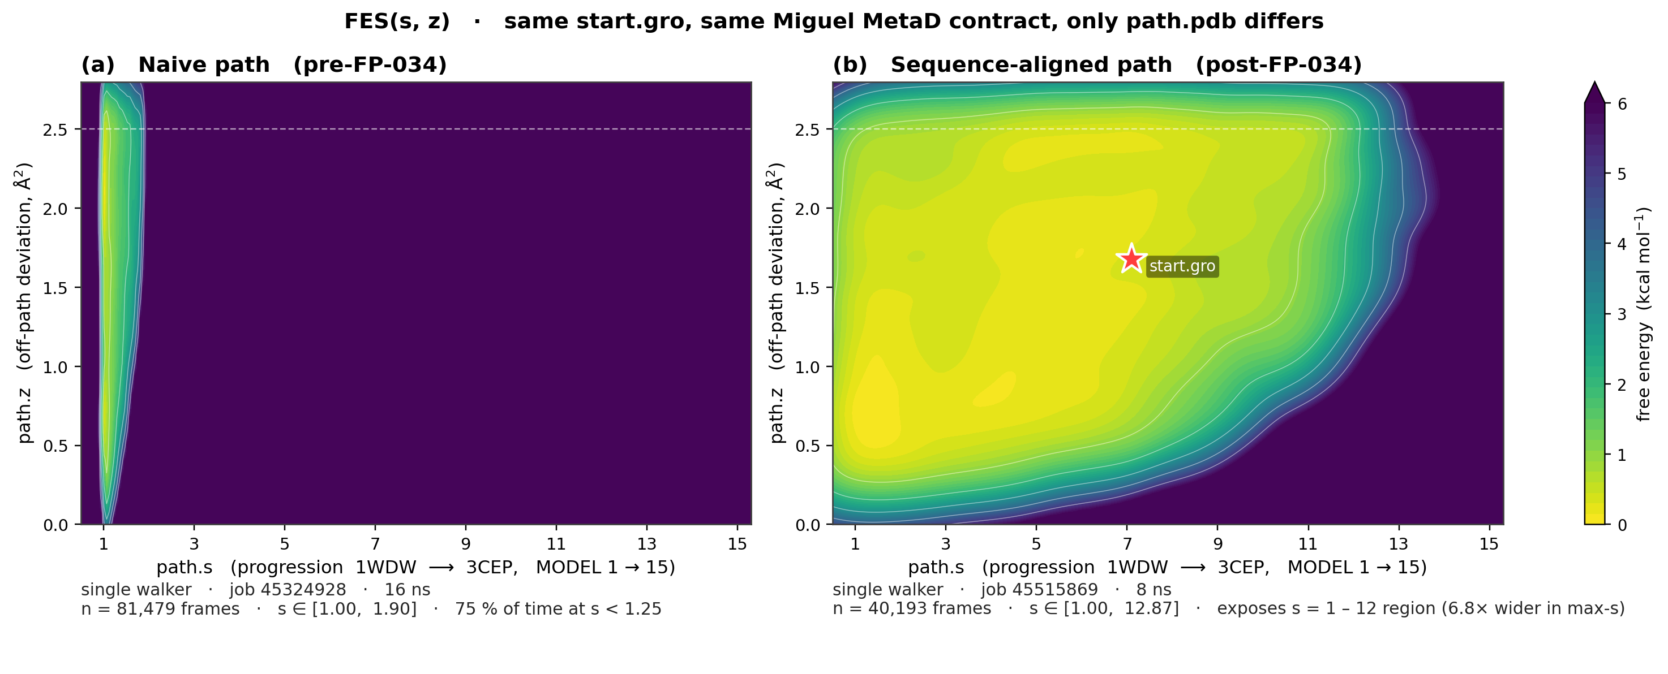
Topic 1 — 视觉 proof + start.gro s=7 的来历
Same start.gro, same Miguel params · naive path 塌到 s<2 · corrected path 铺开 s=1-12
图是怎么做出来的 左: baseline 45324928 (naive path, 16 ns) COLVAR 的 (s, z) 2D 密度 KDE 右: pilot 45515869 (corrected path, 8 ns) 同样的 2D 密度 KDE 两侧用同一色标 · start.gro (t=0) 位置用 ★ 标出 脚本: reports/figures/plot_sz_distribution.py (Python matplotlib gaussian_kde)start.gro 投到 s=7.09 不是 bug —— 是 linear-interp path 的已知性质 Kabsch 直接测量: vs 1WDW 1.59 Å · vs 3CEP 1.76 Å · vs MODEL 7 1.30 Å start.gro 离每个 MODEL 都很近 (差距只有 0.3-0.5 Å), 没有绝对的 'nearest' Branduardi soft-min: s = Σ i·exp(-λ·MSD_i) / Σ exp(-λ·MSD_i), 几乎等距时自然加权到中段 所以 s=7 只是几何软平均伪影, 不是 'Ain 真的在 PC basin' 的 biology claim z=1.68 Å² (mean_z=1.53) 佐证: walker 也不在 path 上, 是 off-path 投影
Source: reports/figures/sz_2d_distribution.png
Source: Branduardi, Gervasio, Parrinello 2007 JCP 126 054103 (soft-min definition)
Source: Belfast PLUMED tutorial (linear-interp path limitation)
Slide 4 / 11 · Topic 1 (3/3) · visual proof + start.gro soft-min 解释

Slide 6
Topic 2 — Miguel author parameter contract
First-author Miguel Maria-Solano email 2026-04-23 · verbatim METAD parameters
# Miguel's PLUMED contract (verbatim, 2026-04-23 email reply)
UNITS LENGTH=A ENERGY=kcal/mol # NOT nm / kJ (fixes FP-032)
METAD ARG=path.sss PACE=500 # MULTIPLE_WALKERS protocol
HEIGHT 0.15 kcal/mol # primary (0.3 = aggressive fallback)
BIASFACTOR 10 # primary (15 = aggressive fallback)
SIGMA ADAPTIVE=DIFF # NOT GEOM (fixes FP-031)
WALKERS_N 10 # shared HILLS, 10 independent walkers
TEMP 350 # thermophilic P. furiosus
LAMBDA 80 (A^-2) # self-consistent on HIS path; re-derive per-path
UPPER_WALLS ARG=path.zzz AT=2.5 KAPPA=500 # cap off-path excursion
What changed vs our prior attempts (and why each matters) ADAPTIVE = DIFF (not GEOM) — FP-031: GEOM projects σ onto wrong axis near path endpoints UNITS = A / kcal (not nm / kJ) — FP-032: SIGMA bookkeeping was off by unit conversion WALKERS_N = 10 with HEIGHT=0.15, BF=10 is the PRIMARY contract (aggressive 0.3/15 is fallback only) λ=80 is self-consistent on Miguel's path, NOT a universal constant · ours is 100.79 (ratio 1.26×, same regime)Why this is the single most important external input this week All earlier parameter debates (probe_sweep, wall4, piecewise-λ) terminated against this contract plumed_template.dat + ladder.yaml now code this as the frozen spec (YAML = source of truth)
Source: chatgpt_pro_consult_45558834/miguel_email.md
Source: replication/metadynamics/miguel_2026-04-23/plumed_template.dat
Source: replication/metadynamics/miguel_2026-04-23/ladder.yaml
Slide 5 / 11 · Topic 2 · Miguel contract (most-important input)

Slide 7
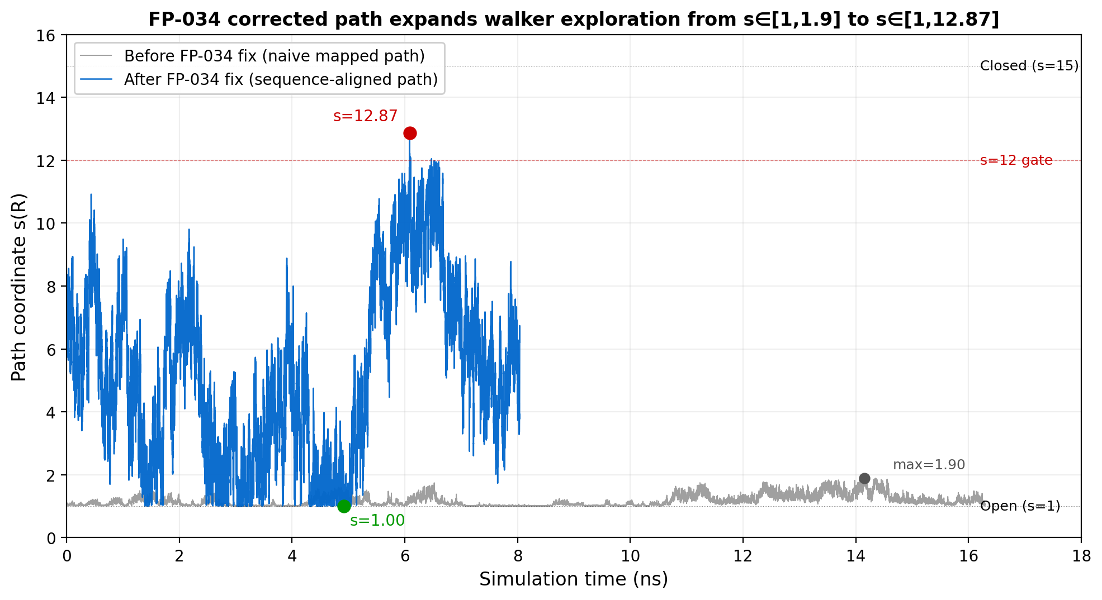
Topic 3 — Current results: s(t) trace (pilot vs baseline)
Pilot 8 ns samples s=1→12.87 · baseline 16 ns stuck at s<1.9
Pilot 45515869 (corrected path + Miguel params) min_s = 1.000 at t = 4920 ps max_s = 12.867 at t = 6085 ps ~4.3 ns plateau at max_s ≈ 10.9Baseline 45324928 (old naive path) max_s = 1.896 over 16 ns 75 % time at s<1.25 (trapped)Interpretation Corrected coord system exposes s=1–12 region NOT claiming 500× speedup — coord rescaling Real efficiency gain needs 10-walker FES
Source: raw COLVAR 45515869 + 45324928 2026-04-24
Slide 6 / 11 · Topic 3 (1/2) · s(t) trace

Slide 8
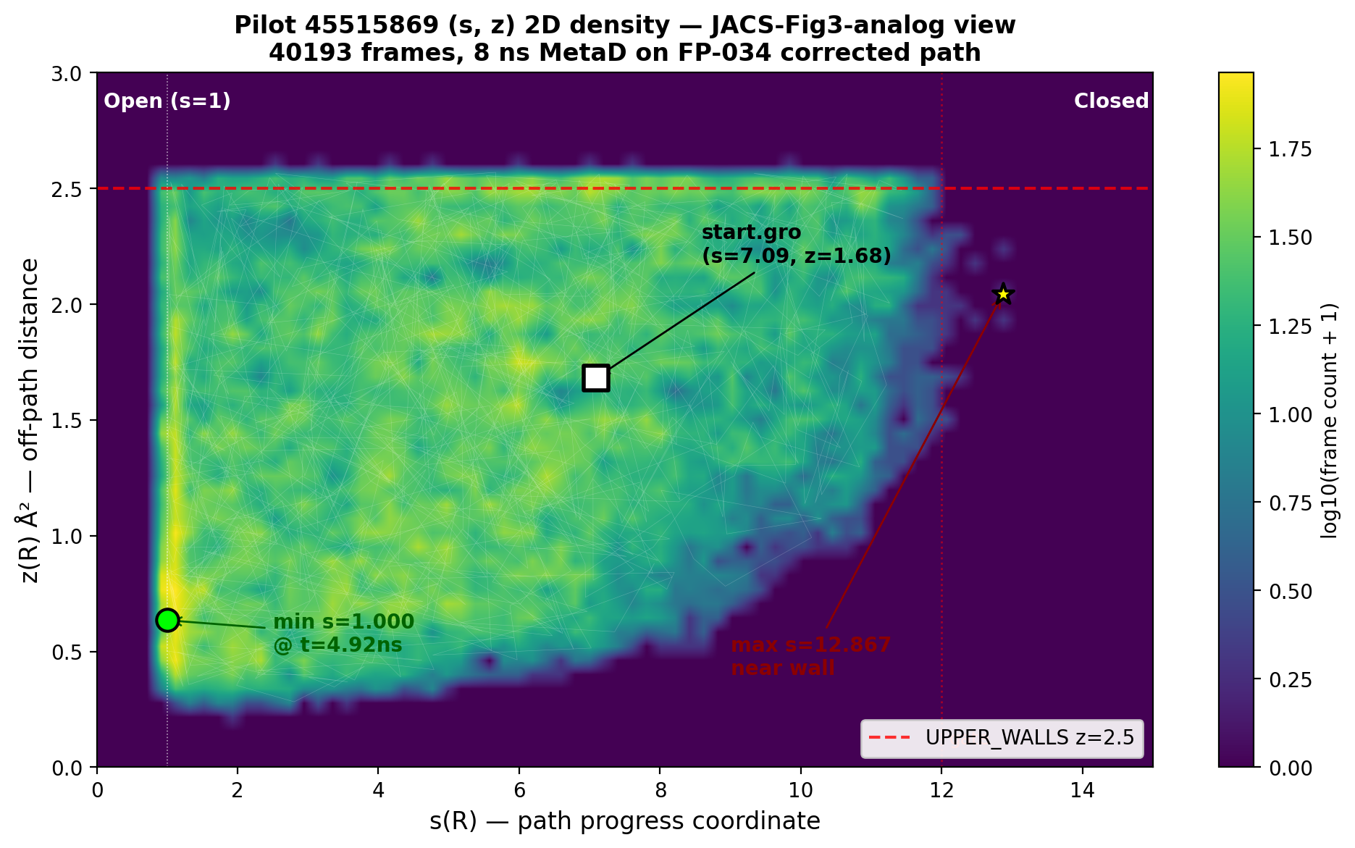
Topic 3 — Current results: 2D (s, z) density (JACS Fig 3 analog)
Pilot (s, z) density · start.gro endpoint off-path · max_s transient near wall
Start.gro (t = 0) annotation — off-path s = 7.09, z = 1.68 Å² (NOT a biological PC claim) Direct Kabsch vs 1WDW only 1.59 Å RMSD s=7 is linear-interp soft-min artifact (triangle inequality biases middle MODEL)Walker exploration Full s=1..12 sampled (see histogram s-bins) mean_z = 1.53 Å² (walker mostly off-path) max_z = 2.588 transient at s=12.87 (near UPPER_WALLS AT=2.5 — not crossed)What NOT to claim Not 'clean PC basin found' Not 'barrier crossed' (transient only) Is: coord system corrected, exploration opened
Source: reports/figures/sz_2d_pilot_jacs_style.png
Source: ChatGPT Pro verdict 2026-04-24
Slide 7 / 11 · Topic 3 (2/2) · (s,z) 2D · off-path honest framing

Slide 9
Topic 4 — 10-walker seeding 的故事: v1 → v2 → v3 (pending)
Two attempts both unusable · Codex diagnosed LINCS + seed-dup · v3 pipeline designed
Attempt | Job | Seed strategy | Outcome | Root cause
v1 | 45558834 | all 10 from same start.gro (cMD endpoint @ 50/100/.../500 ns) | scancel | FP-030 homogeneous start — no diversity, shared-HILLS degenerate
v2 | 45570699 | pick pilot COLVAR frame with target_s ∈ {1..10} + min z | FAILED exit 139 (all 10, 14 min – 3 h) | LINCS blow-up atoms 4463-4465 + seed-dup (w0=w1 at s=1.99, w5=w6 at s=6.60)
v3 | — | same as v2 + EM+NVT settle + unique-frame guard | pending (script written, awaiting PM go) | Codex root cause: seed .gro from pilot xtc carries biased-MetaD geometry stress; LINCS fails without relaxation
v3 minimal pipeline (Codex-verified) Step 1 · EM 1000 steps, emtol=1000 kJ/mol/nm (fix bad contacts) Step 2 · NVT 100 ps at 350 K, PLUMED OFF, gen_vel=yes (equilibrate + regenerate velocities) Step 3 · Production MetaD from nvt.cpt, PLUMED ON, shared HILLS_DIRAssertion suite added to materialize_v3.py unique-frame guard (no duplicate seed IDs) · std(seed_s) > 2.0 (diversity gate) · velocity-presence check in start.gro
Source: replication/metadynamics/miguel_2026-04-23/seqaligned_walkers_v2/
Source: replication/validations/failure-patterns.md (FP-030 homogeneous-start)
Slide 8 / 11 · Topic 4 · seeding rationale + v3 plan

Slide 10
Topic 5 — ML-layer future (audit result + v2.0 pivot)
External 2024-2026 prior art audit narrowed 5 ML extensions → 1 alive + 2 merged + 2 new
2026-04 audit verdict (5 original extensions)
v1.2 → v2.0 pivot + 2026-05-01 hard gate
A · CRR (catalytic-readiness reward for GRPO) — WEAKENED (PocketX/ResiDPO/ProteinZero prior art)B · PP-Prior (path-CV energy-guided diffusion) — WEAKENED (Enhanced Diffusion Sampling 2602.16634)C · LBP (learned bias potential) — DEAD (NN-VES / Deep-TICA / OPES+mlcolvar existing)D · TCR (FES-matching training loss) — DEAD-ish (Thermodynamic Interpolation JCTC 2024)E · MNG (Memory Necessity Gate) — ALIVE / LEAD (MEMnets is CV discovery, not runtime gate)Meta: 'cartridge itself is likely more novel than any individual ML layer on top'
v1.2 framing (PM-ratified 2026-04-22): 'cartridge owner' not 'replicator'v2.0 sharpen: F0 PathGate evaluator = concrete deliverable for Yu/Amin/RaswanthMNG-lead: lag-stratified Markov-vs-qMSM runtime trigger for MetaD rescueNew F · PLP-aware reactive PATHMSD (K82-PLP Schiff-base, Dunathan angle)New G · Generative-model physics-consistency audit (pip-installable wrapper)Hard gate 2026-05-01: if WT FES has no O/PC/C basins + no block CI + no PC crystal 2D projection → all ML layers SUSPENDIf gate passes: D2 API freezes, D3 demo on real cartridge, Aex1 variant FES next
Source: 新任务explore/MetaD_Cartridge_Feasibility_Memo_2026-04-22.md § 0.8 / § 1.5 / § 3.5-3.7
Source: 新任务explore/deep-research-report-3.md
Slide 9 / 11 · Topic 5 (1/2) · ML layer audit + v2.0 pivot

Slide 11
Topic 5 — 下周 + 下下周 concrete deliverables
Before kill-switch: D2 API spec + D3 lab-facing demo + 10-walker production
This week (D2 · API design, no implementation) replication/cartridge/API_DESIGN.md — signatures + I/O + one example call project_to_path(traj) → (s, z) · score_trajectory(s, z, p_ref) → JSD + state occupancy + rare-state recall · state_occupancy(traj, masks) → dictThis week (D3 · lab-facing demo, pick one) Yu demo (preferred): simple 1D/2D CV fails to distinguish PC from O → PATHMSD cartridge gives meaningful state diagnosis Amin demo (alt): STAR-MD / ConfRover public output scored through cartridge Deliverable: 1 Jupyter notebook OR 2-page write-upWeek after (10-walker production · v3) EM + NVT settle pipeline · Miguel primary params · target 30–50 ns/walker FES reconstruction · compare Fig 2a of JACS 2019 Block-analysis CI even if wide · PC crystal 2D occupancy projection2026-05-01 hard gate criteria (binary) WT FES shows O / PC / C basins + block CI defined + ≥2 PC crystals projected on 2D FAIL → all 5 ML extensions suspend, focus reverts to WT-only debugging PASS → D2 freezes, D3 runs, Aex1 becomes next target, MNG moves memo → scoping doc
Source: 新任务explore/MetaD_Cartridge_Feasibility_Memo_2026-04-22.md § 0.3 / § 0.8 / § 5
Slide 10 / 11 · Topic 5 (2/2) · D2 + D3 + 10-walker gate

Slide 12
Summary · Q & A
What I claim this week, what I DON'T claim, what's next
What I CLAIM this week Path CV fixed (FP-034 NW +5 offset) — 4-layer independent verification Miguel author contract locked (ADAPTIVE=DIFF, units A/kcal, λ=100.79 self-consistent 1.26× vs 80) Corrected path exposes s=1–12 region in pilot (baseline stuck at s<1.9) FailurePatterns.md grew 3 new entries (FP-031, FP-032, FP-034) — reusable for future variantsWhat I DON'T claim (anti-overclaim) NOT '500× speedup' — coord rescaling, not genuine MetaD efficiency NOT 'start.gro is Ain in PC basin' — s=7.09 is off-path soft-min artifact (z=1.68) NOT 'barrier crossed cleanly' — max_s=12.87 is single transient, not sustained NOT 'FES converged' — need 10-walker production firstWhat's next (concrete, binary) v3 10-walker with EM+NVT settle → FES with PC crystals projected D2 API spec + D3 lab-facing demo this week 2026-05-01 hard gate: pass or suspend ML-layer extensionsLesson to keep (most important takeaway) Cross-species PATH-CV construction MUST gate on sequence identity > 50 % — hard assertion added to all future path-builder scripts
Source: reports/GroupMeeting_2026-04-24_CHEATSHEET.md
Source: replication/validations/failure-patterns.md
Slide 11 / 11 · summary · Q & A

