Slide 1
GROUP 3 · PHASE 2 · FINAL PRESENTATION
Elderly Fall
Risk Analysis
LIAO Sen Chun · KONG Chak Pan
KWAN Kwan Ip · LAI Chi Fung

Slide 2

PROJECT GOALS
Our Primary Project Aims
Predicting Risk
"Early Warning"
• Establish a highly accurate and proactive early-warning system for care homes.
Explaining Why
"Interpretable"
• Transition from standard black-box models to a fully explainable AI logic.
Minimal Action
"Fair & Efficient"
• Target minimal, highly precise interventions instead of sweeping protocols.

Slide 3

THE PROBLEM — GLOBAL DATA
Falls Among the Elderly — A Growing Crisis
45.7M
NEW falls globally in 2021 (adults 65+)
https://www.cdc.gov/falls/data-research/index.html
43,020
older adults died from falls in 2024 (US)
https://injuryfacts.nsc.org/home-and-community/safety-topics/older-adult-falls/
+21%
fall death rate increased 2018 → 2024
https://www.nature.com/articles/s41514-025-00275-4
Falls are the leading cause of injury death in 65+ · and the rate is rising every year

Slide 4



WHY THIS SYSTEM
Stakeholders & Their Needs
Care Home Nurses
The Family of the Elderly
Clinicians
• Quick risk alerts
• Know WHO needs attention
• Reduce the incidence of falls
• Get early warnings without taking the elderly to the hospital.
• Actionable intervention
• Patient-specific advice

Slide 5
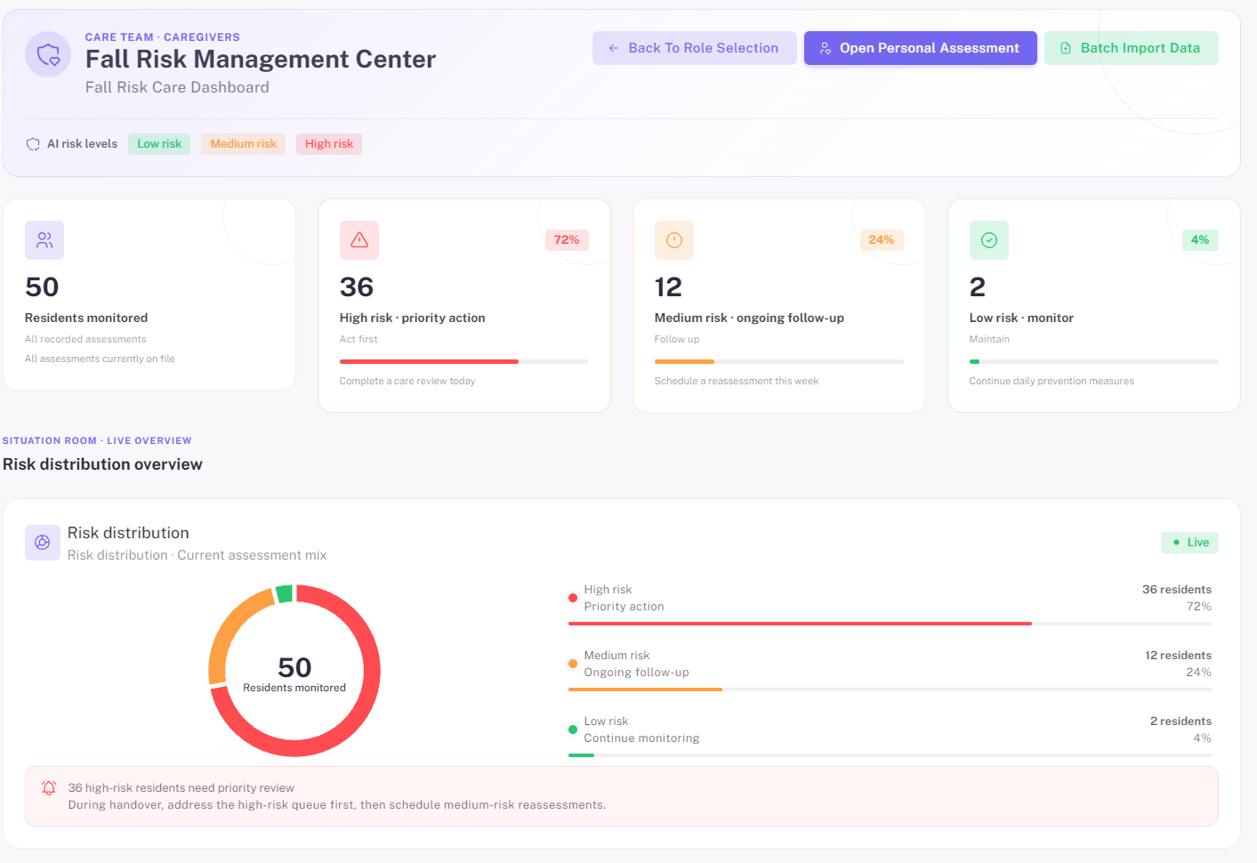
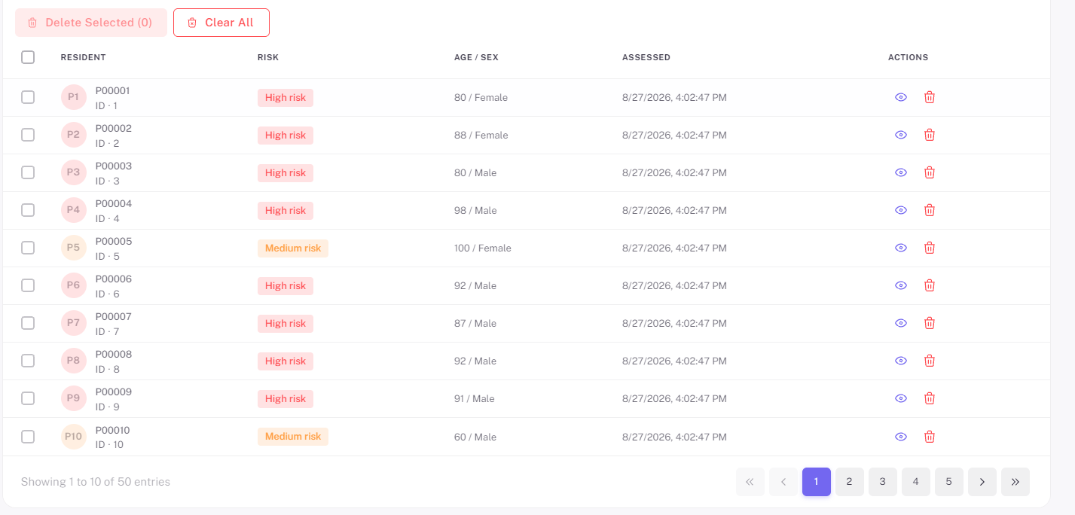
SYSTEM PREVIEW
Elderly Fall Risk Analysis Platform

Slide 6
WORKING PLAN
Work Flow Chart
01
1. Collect Data
Create CSV File
02
2. Data Cleaning
Handle Missing, Duplicate, and Invalid Data
03
3. Train Model
Train, Test, and Evaluate the Model
04
4. Build Backend
Build FastAPI Backend, Load Model and Create Prediction API
05
5. Develop App
Develop Web Application, Create UI and Connect to API
→
→
→
→

Slide 7
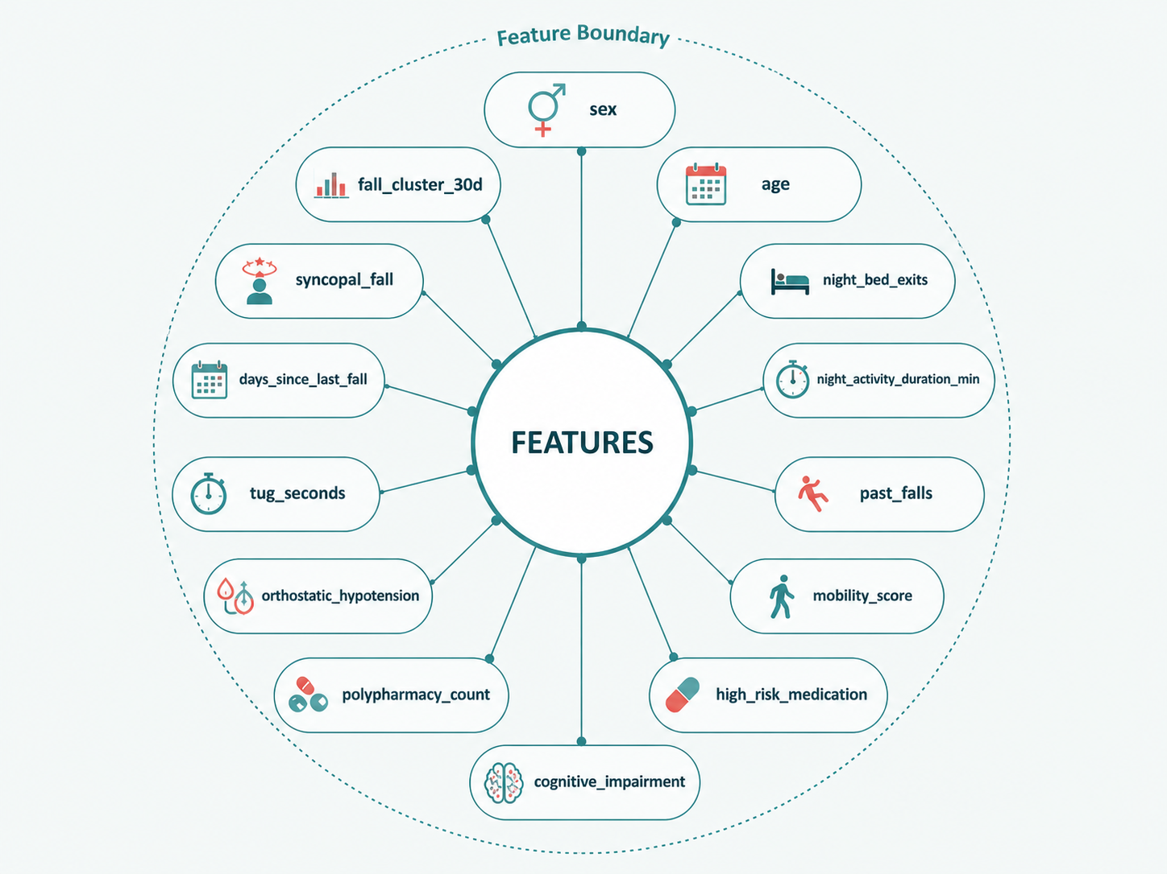
FEATURE ENGINEERING
14 x Clinical Features

Slide 8
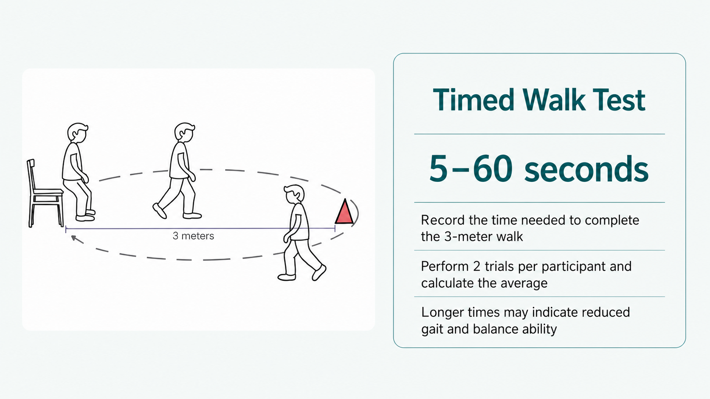
FEATURE ENGINEERING
TUG seconds
Schoene et al. (2013), J Am Geriatr Soc, 61(2), 202–208. https://pubmed.ncbi.nlm.nih.gov/23350947/

Slide 9
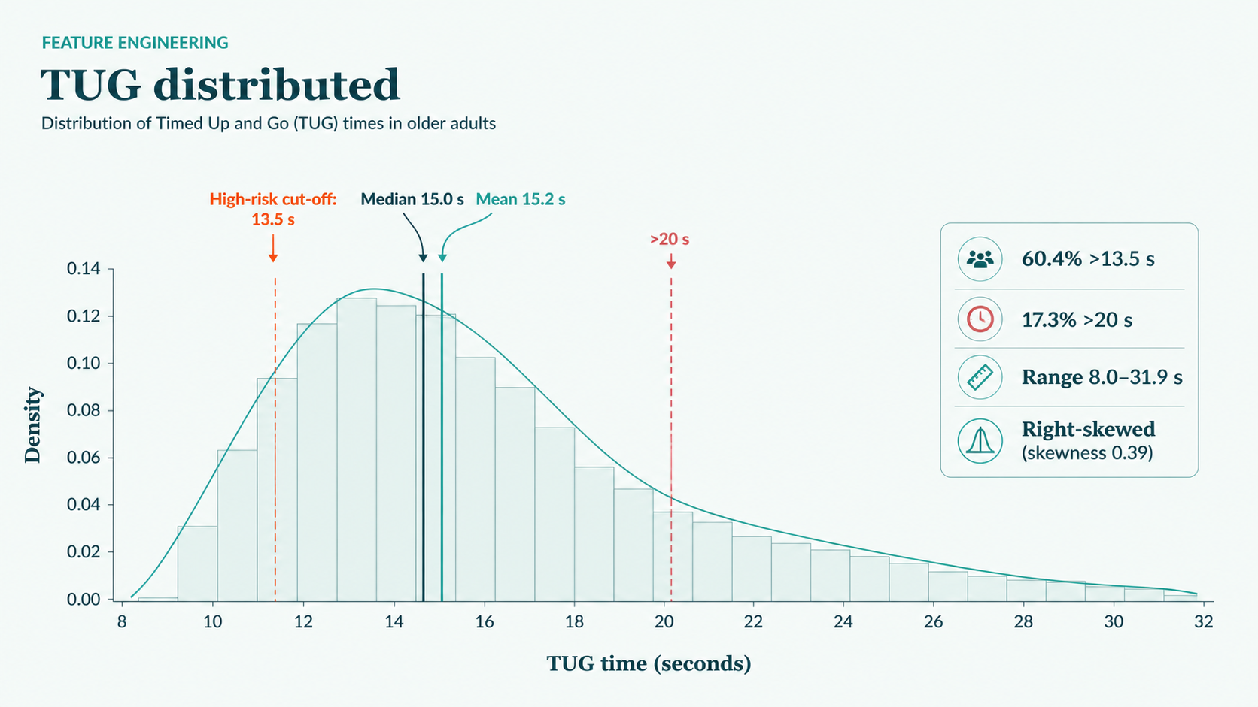
FEATURE ENGINEERING
TUG distributed
Bohannon RW (2006), J Geriatr Phys Ther, 29(2), 64–68. https://pubmed.ncbi.nlm.nih.gov/16914068/

Slide 10
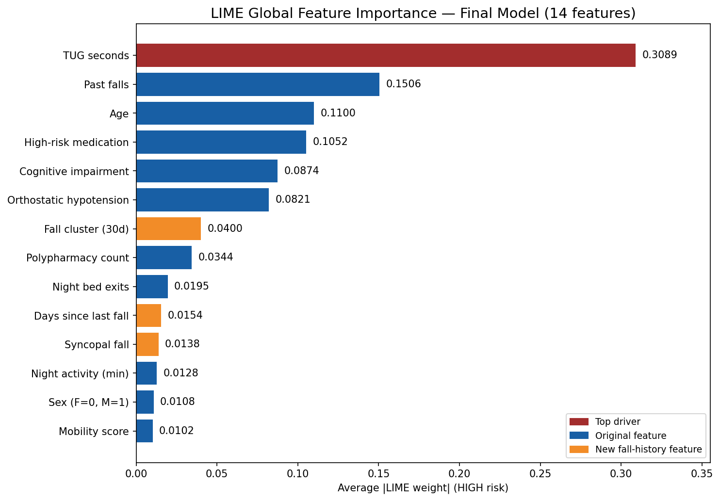
DATA ANALYSIS
Data Relationship
( To be completed by teammate )

Slide 11
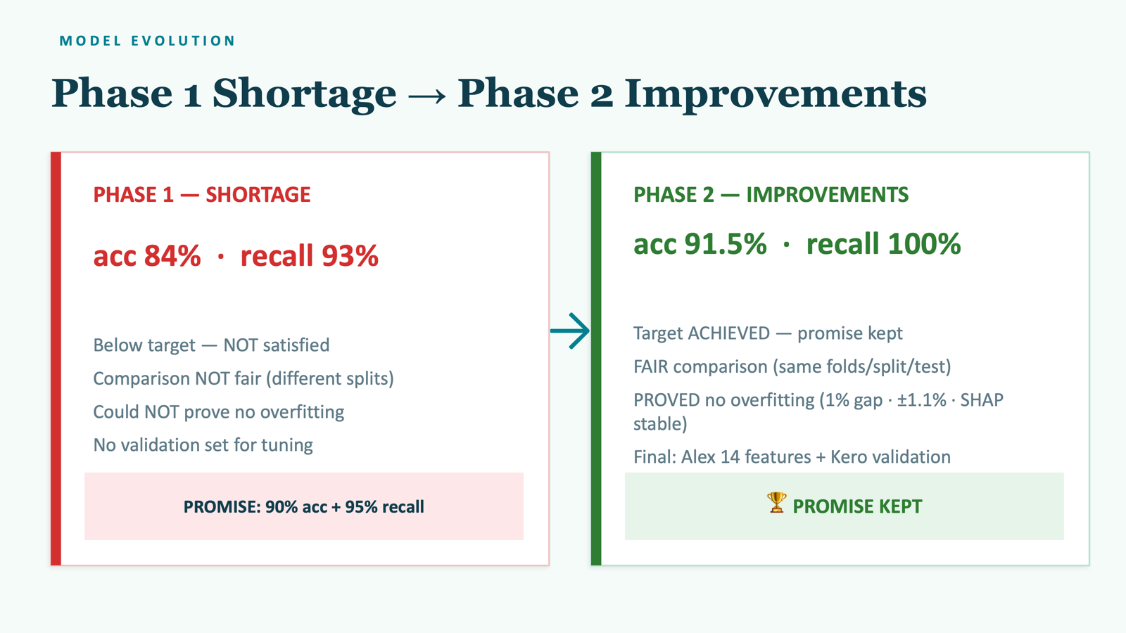

Slide 12
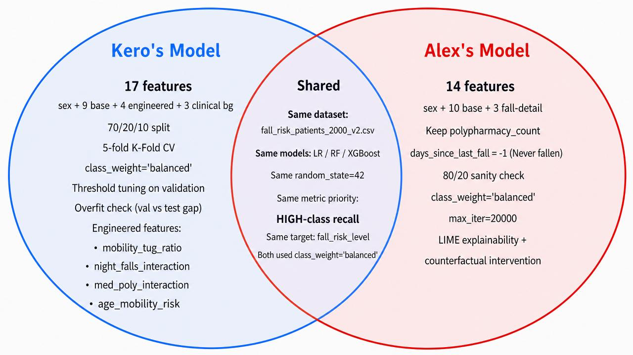
MODEL TRAINING
Model Comparison
( To be completed by teammate )

Slide 13
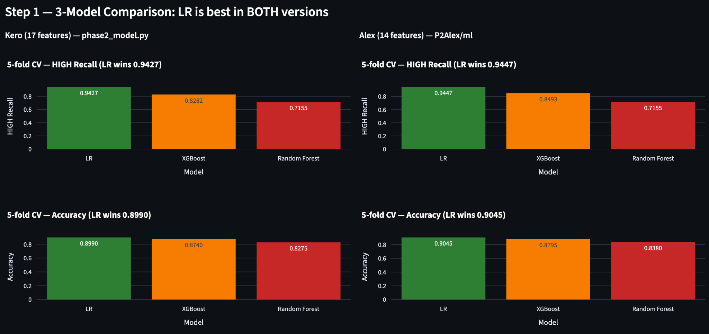
ASSISTANT ANALYSIS
Streamlit Data Table

Slide 14
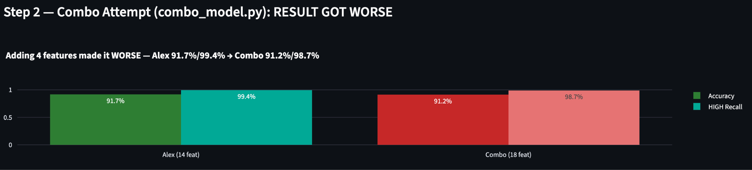
FAIR COMPARISON — SAME TEST, SAME PROTOCOL
More Features ≠ Better Model
WORSE!!
-0.5% acc -0.7% recall 1 HIGH MISSED

Slide 15
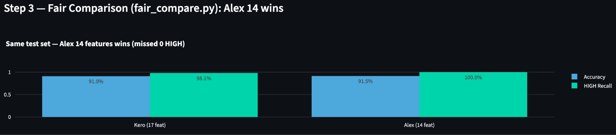
FAIR COMPARISON — SAME TEST, SAME PROTOCOL
Run Fair Test to Validate The Assumption
Same 5-fold · same 70/20/10 · same 200 test patients · same threshold 0.5 · same LR
KERO MISSED
ALEX NEVER
MISSED
🏆 ALEX MODEL
1 HIGH
WINS

Slide 16
PHASE 2 — GOAL ACHIEVED
🏆 We Kept the Promise
91.5%
100%
ACCURACY
HIGH RECALL
0 HIGH-risk patients missed · 53/53 caught
How: Alex 14 features + Kero validation (70/20/10, 5-fold, threshold, overfit check)

Slide 17
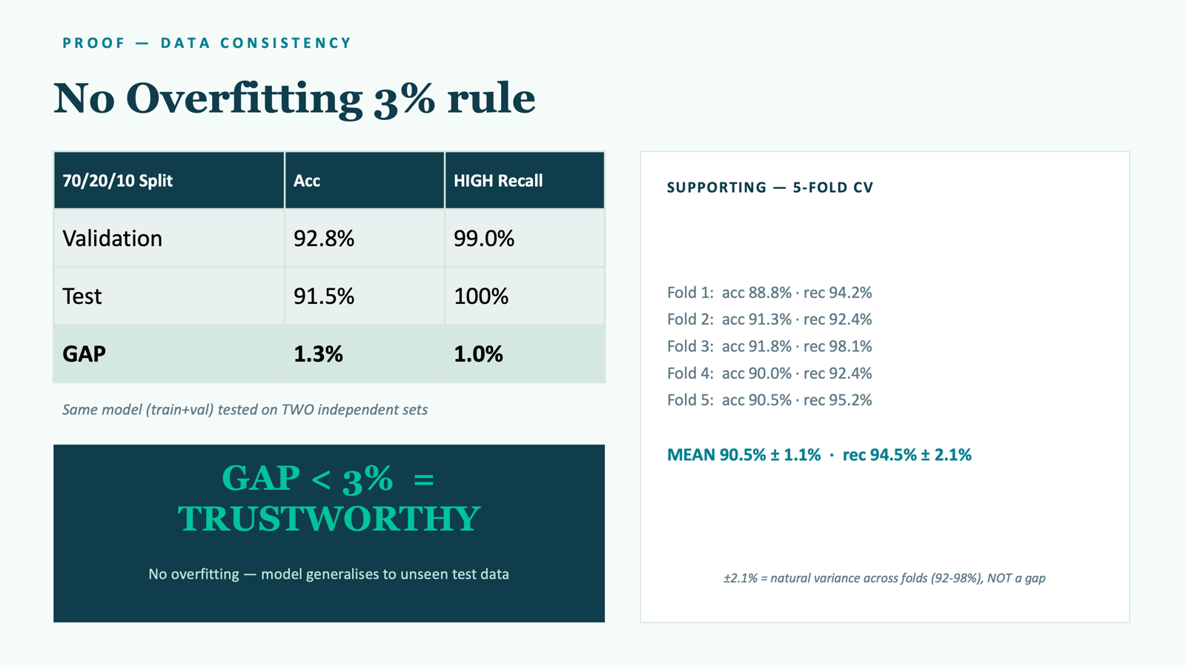

Slide 18
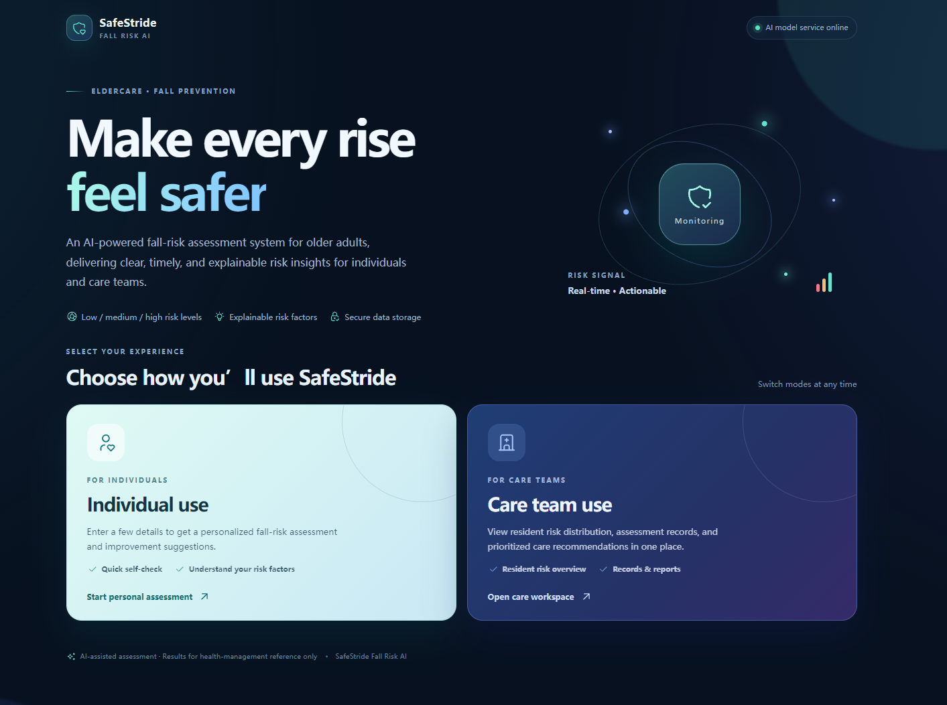
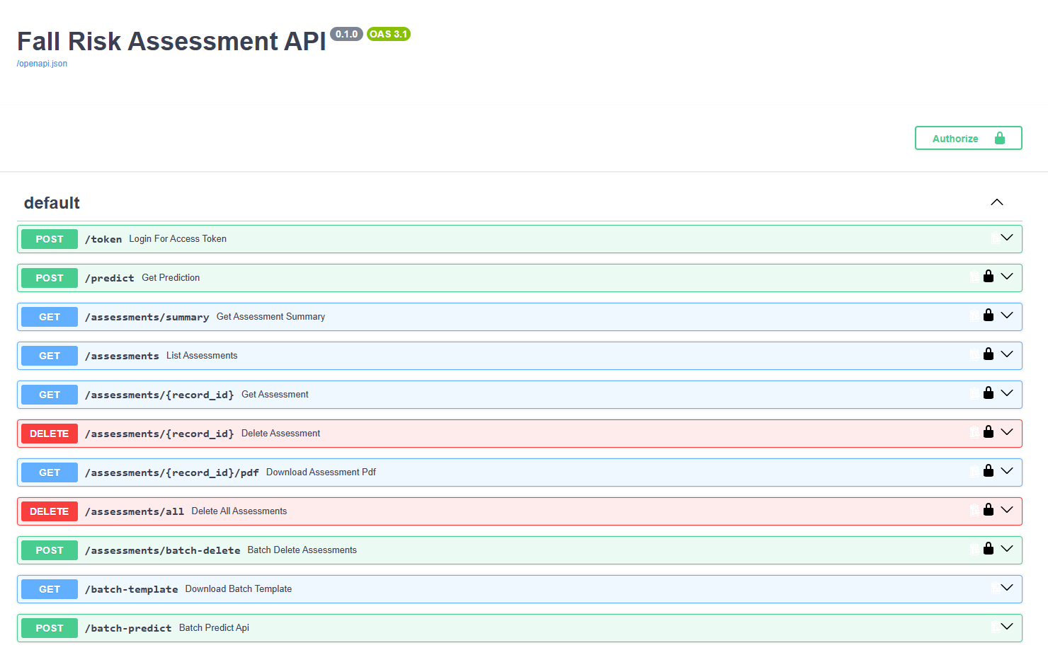
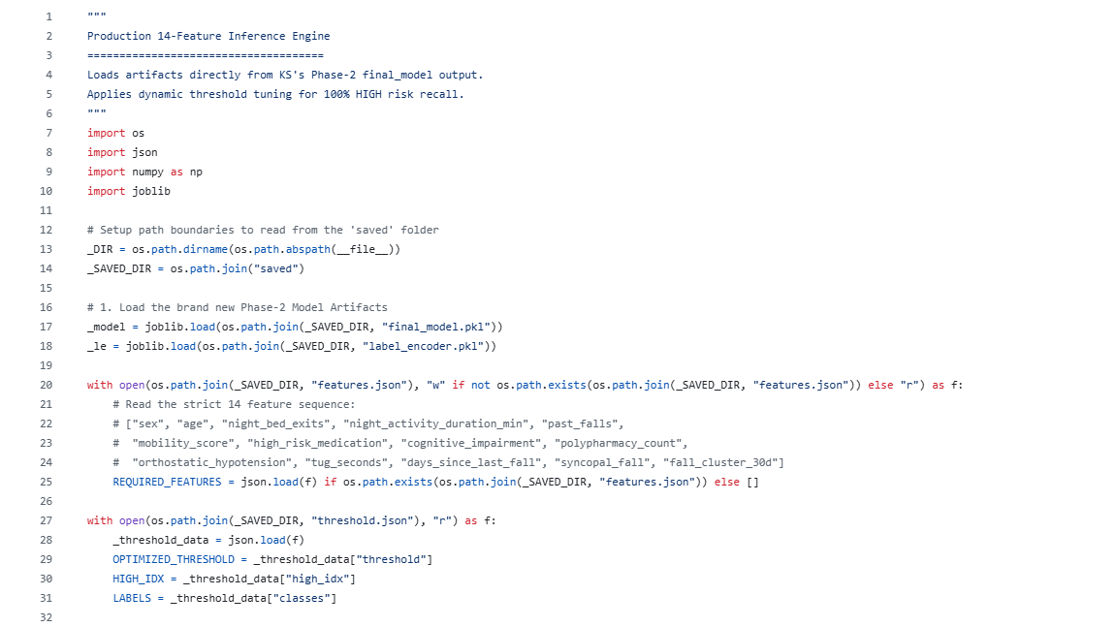
INTEGRATION
FastAPI Integration
dashboard
API
predict
vue + vite
FastAPI
predict.py
final_model.pkl
label_encoder.pkl
threshold.json

Slide 19
INTEGRATION
FastAPI Design

Slide 20
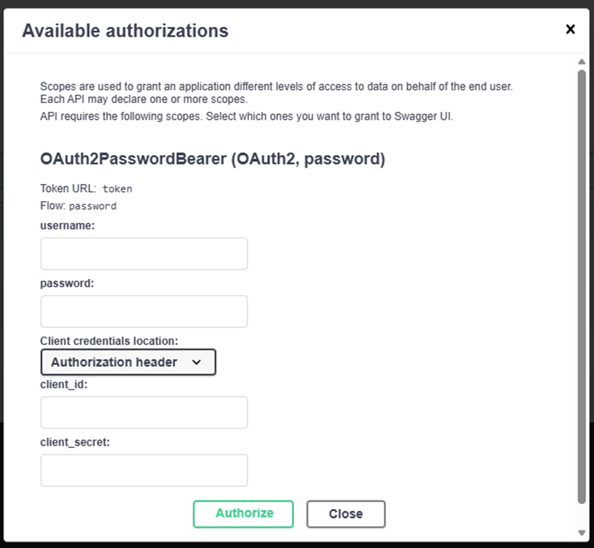
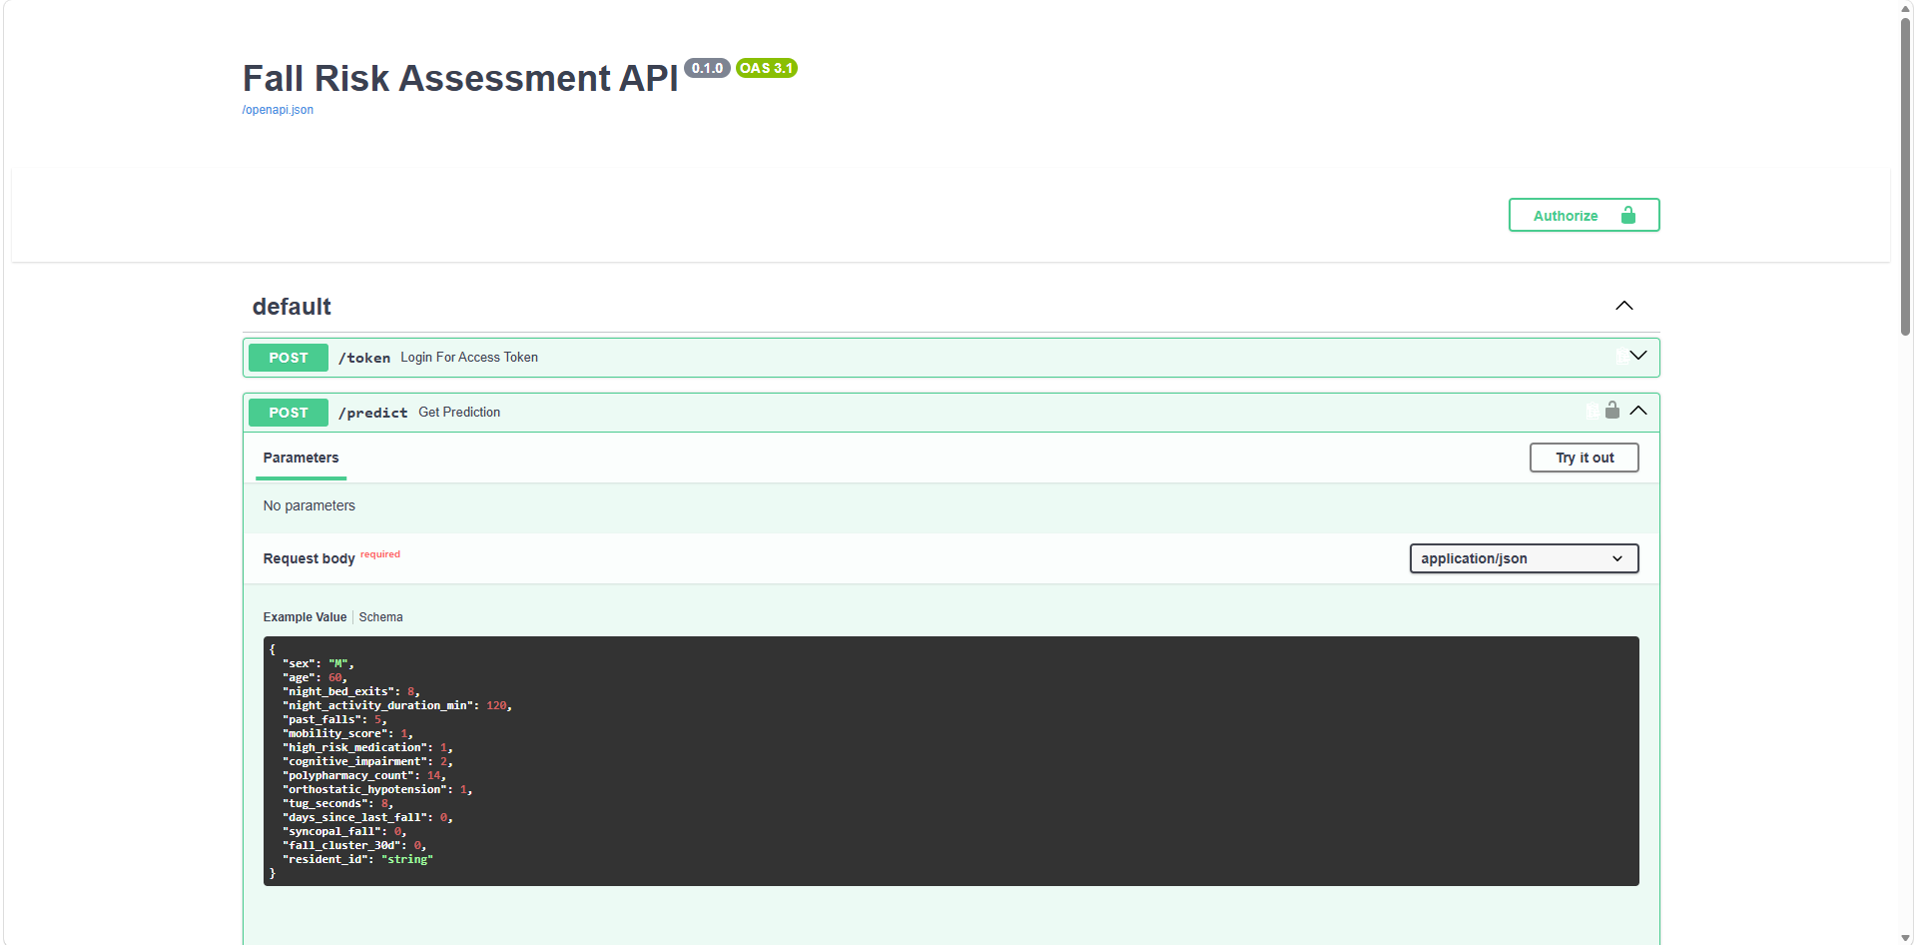
INTEGRATION
FastAPI Design - route protection

Slide 21
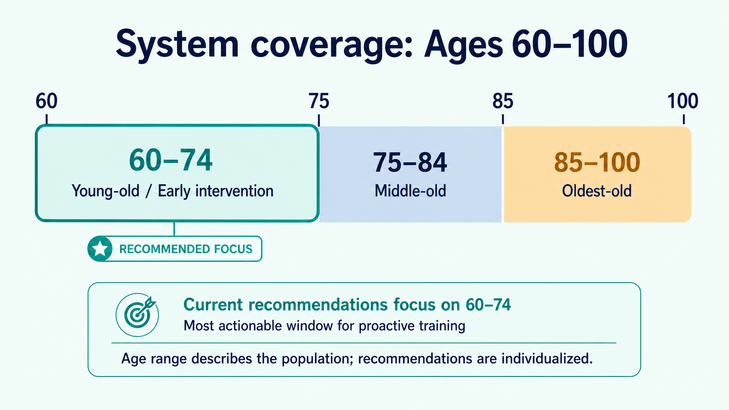
https://platform.who.int/docs/default-source/mca-documents/policy-documents/operational-guidance/EGY-CC-10-01-OPERATIONALGUIDANCE-2015-eng-Practice-Guidelines-Family-Physicians-All-Vols.pdf p275

Slide 22
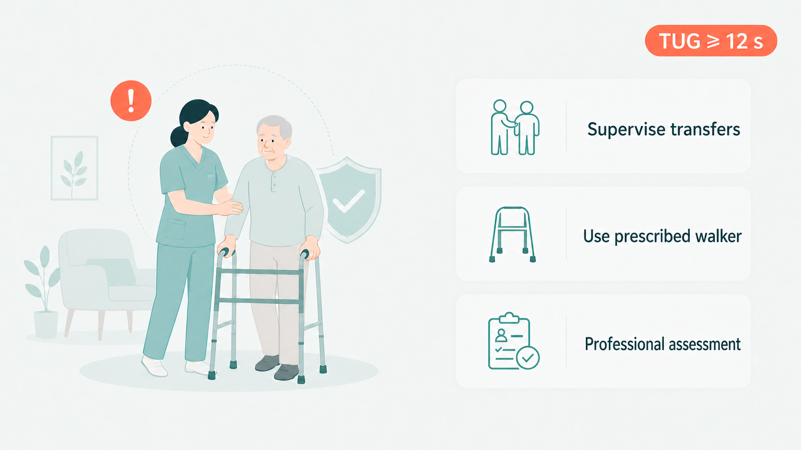
TUG Seconds Suggestion
https://www.cdc.gov/steadi/pdf/Steadi-Coordinated-Care-Plan.pdf
p17

Slide 23
DELIVERABLE
Website Design
Personal use
For use by nursing staff

Slide 24
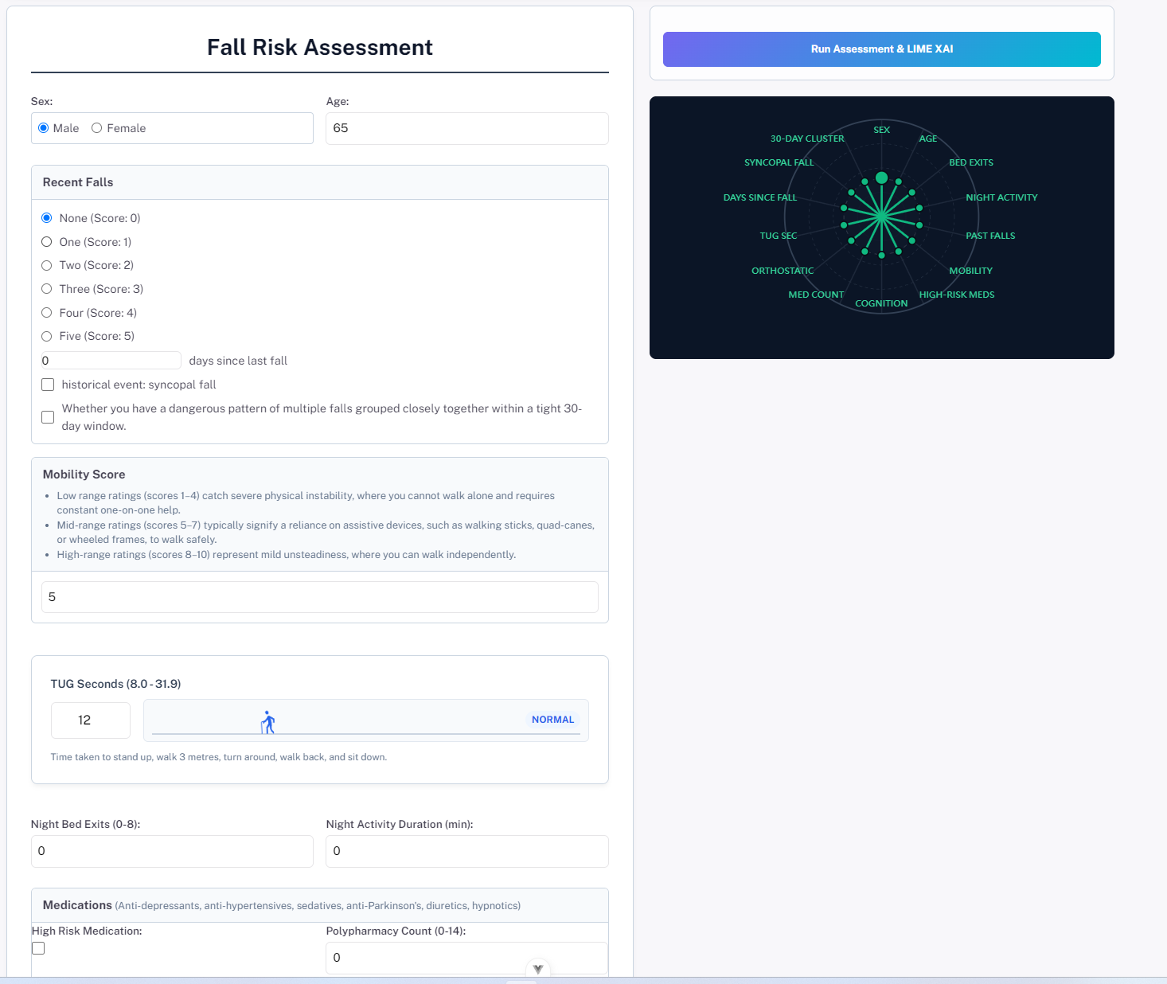
DELIVERABLE
Run assessment
Data Input Form Section

Slide 25
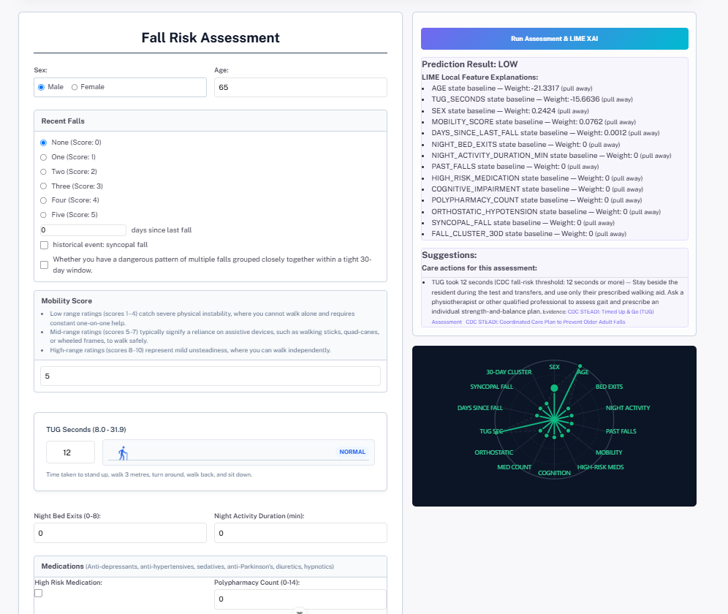
DELIVERABLE
predicted fall risk level
Suggestions
reasons and weight

Slide 26
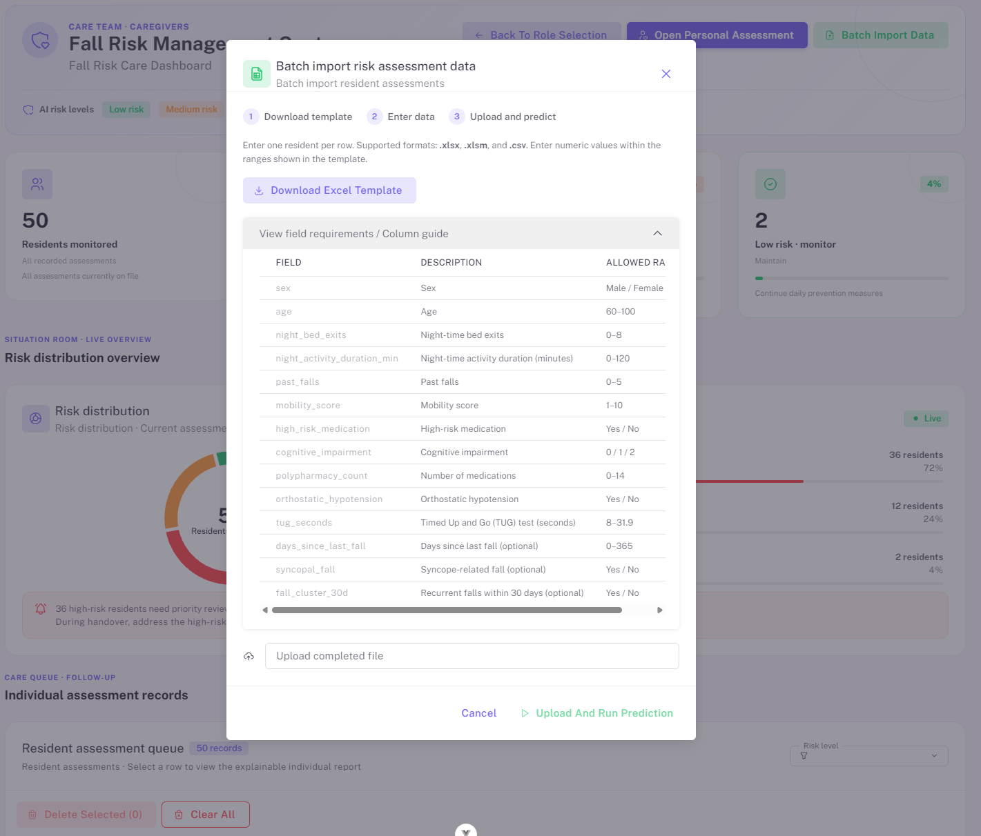
DELIVERABLE

Slide 27
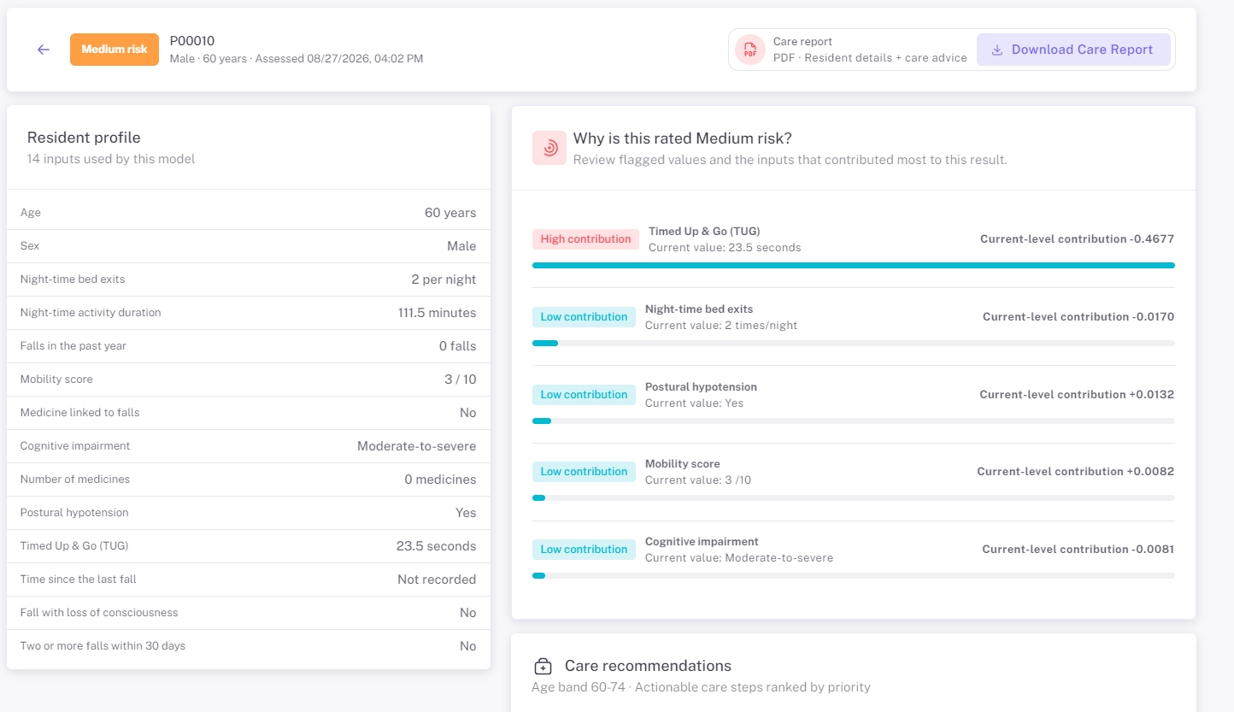
DELIVERABLE

Slide 28
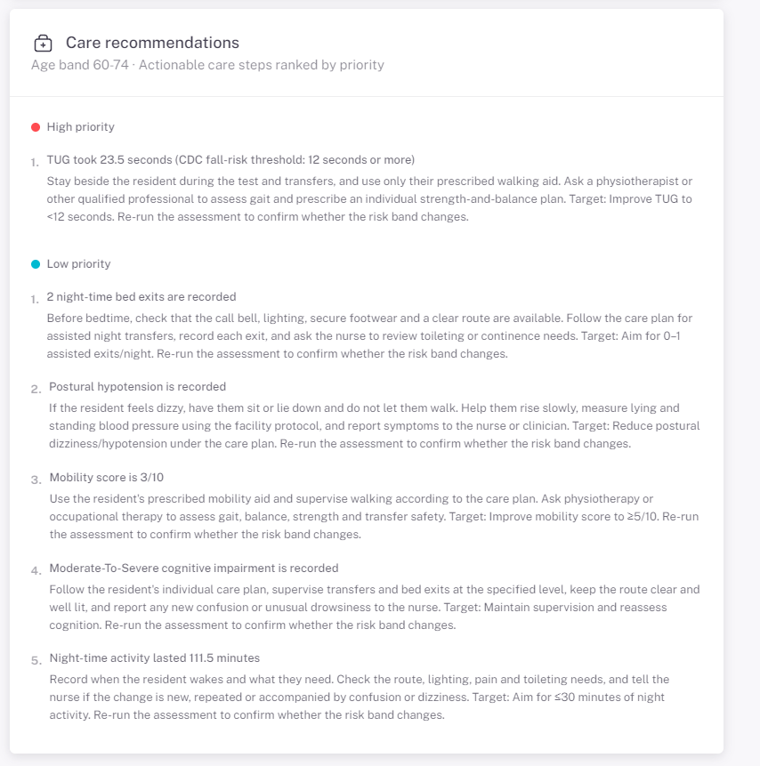
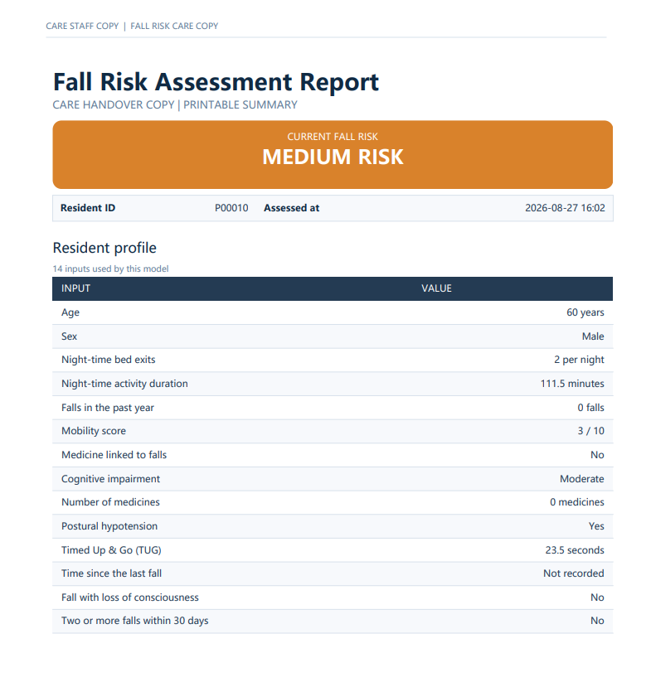
DELIVERABLE

Slide 29
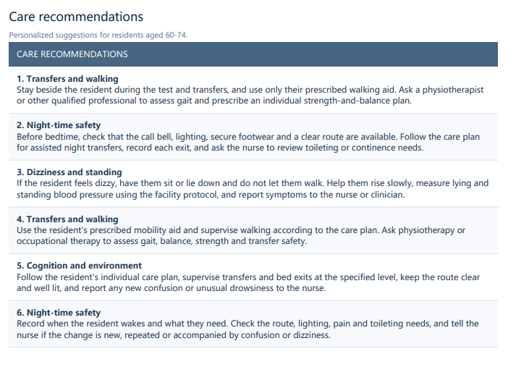
DELIVERABLE

Slide 30
HONEST REVIEW — COMMERCIAL READINESS
Limitations & Next Steps
⚠️
Limitations (Commercial)
🚀
Future Plan
Synthetic data only — no real hospital data
2,000 samples — small for clinical deployment
No temporal validation (new patients over time)
Single model (LR) — no ensemble robustness
No calibration / confidence intervals
Privacy & compliance not yet addressed
Collect REAL hospital data
Retrain + re-validate on real samples
Add calibration + confidence intervals
Ensemble (LR + XGB) for robustness
Deploy to cloud (Render/Streamlit Cloud)
Compliance: data privacy (PDPO)
Next step: upload to GitHub · review with supervisor early, not last minute

Slide 31
Demonstration

Slide 32

APPENDIX – FEATURE EXPLANATION
Efficacy of a Student-Led, Community-Based, Multifactorial Fall Prevention Program: Stay in Balance
https://www.frontiersin.org/journals/public-health/articles/10.3389/fpubh.2017.00030/full?utm_source=chatgpt.com
https://www.who.int/health-topics/ageing/improving-understanding-measurement-and-monitoring-of-healthy-ageing?utm_source=chatgpt.com#tab=tab_1

Slide 33
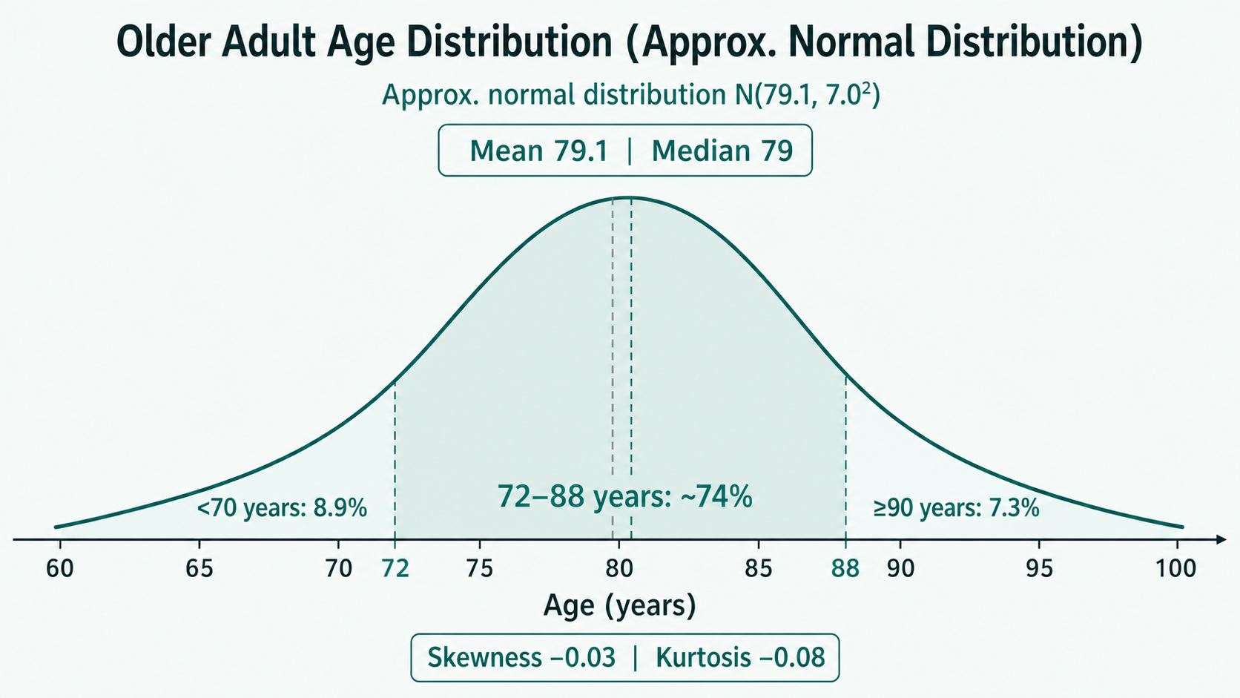
APPENDIX – FEATURE EXPLANATION
https://www.frontiersin.org/journals/public-health/articles/10.3389/fpubh.2017.00030/full

Slide 34
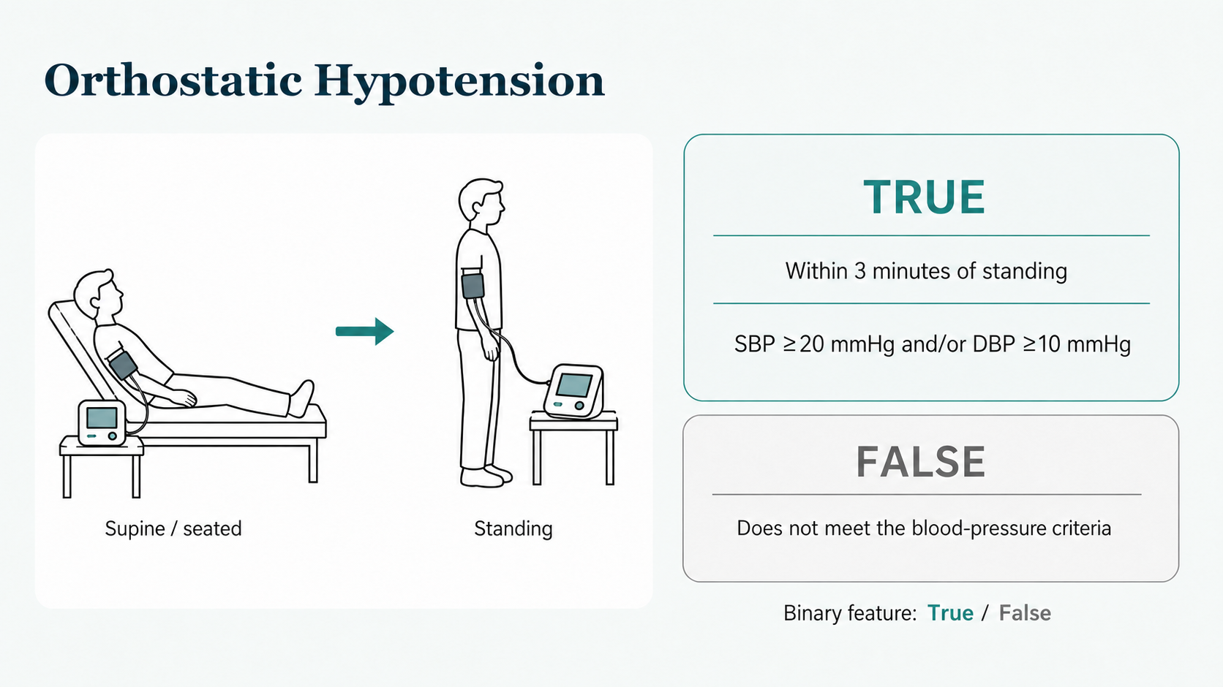
APPENDIX – FEATURE EXPLANATION
Orthostatic Hypotension
Mol A, et al. “Orthostatic Hypotension and Falls in Older Adults: A Systematic Review and Meta-analysis.” Journal of the American Medical Directors Association. 2019;20(5):589–597.e5. https://pubmed.ncbi.nlm.nih.gov/30583909/

Slide 35
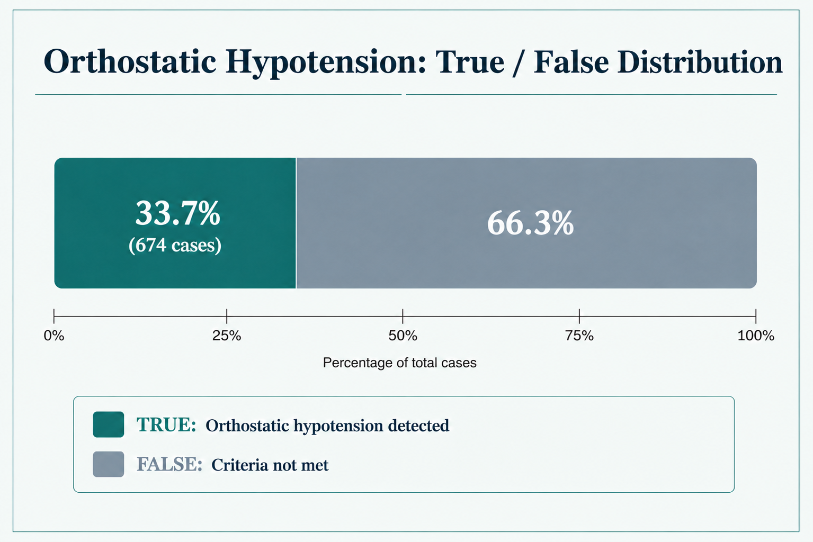
APPENDIX – FEATURE EXPLANATION
Orthostatic Hypotension distributed
Saedon NI, et al. Prevalence of initial orthostatic hypotension in older adults: a systematic review and meta-analysis. Age and Ageing. 2021;50(5):1520–1528.
https://pubmed.ncbi.nlm.nih.gov/34260686/

