Slide 1
COMP 5112 GDF RESEARCH METHODOLOGY
HANDWRITTEN DIGIT RECOGNITION
Instructor : Dr. Trevor Tomesh
Presented By :
Alex Christian
(1133629)

Slide 2
Introduction
What a wonderful thing it will be if technology can recognize our handwritten digits and respond appropriately.
Handwritten Digit Recognition is used to recognize the digits which are written by hand.
The uses of HWDR is very wide and its uses in automatic processing of bank cheques, postal addresses, sign verification and many more.
There is no computer which can beat the level of efficiency of human brain. These inefficiency of the computer has led to evolution of “Artificial Neural Network.”
They differ from the convolutional systems in the sense that rather than being programmed these system learn to recognize them.

Slide 3
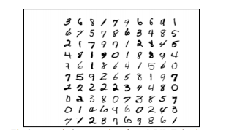
Dataset Description
Dataset :-
The MNIST dataset has been used here.
It contains 60,000 training images and 10,000 testing images.
Each image is size of 28x28, they are linearized of vector size of 1x784.

Slide 4
Implementation
CNN Model:-
For this approach I have used MNIST Dataset. I have preprocessed all the images with resizing it and made the training dataset to fit in the Model.
Image size for this approach is 28X28.
I have used CNN model for my implementation.

Slide 5
Implementation
FFNN:-
For this approach I have used MNIST Dataset. I have processed the linearized data to convert it into image form to fit in the Model.
Image size for this approach is 28X28.
I have used Feed Forward Neural Network, which is internally used multi-layer perceptron.

Slide 6
Implementation
MLP:-
For this approach I have used MNIST Dataset. I have processed the linearized data to convert it into image form to fit in the Model.
Image size for this approach is 28X28.
I have used multi-layer perceptron.

Slide 7
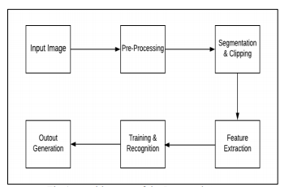
Workflow Diagram

Slide 8
Tools and libraries
Language : Python
Platform : Google Colab
Libraries : Keras, TensorFlow, Sklearn, Numpy, Pandas, Matplotlib

Slide 9
Results and Discussion
CNN:-
Training Accuracy: 99.53%
Testing Accuracy: 96.48%
FFNN:-
Training Accuracy: 99.46%
Testing Accuracy: 97.61%
MLP:-
Training Accuracy: 99.05%
Testing Accuracy: 92.22%

Slide 10
Problems
In real-time experiments, Handwritten Digit recognition frequently gives wrong prediction, or it fails to predict signs.
Due to dataset, we cannot fulfill all the requirements. Because some handwriting is varying so that sometimes its hard to predict numbers.

Slide 11
Future Work
Make custom dataset and perform experiments on it.
Improve Model accuracy and I will used different models.
I will look forward to build GUI for this project.

Slide 12
Thank You

