Slide 1

Data mining and visualisation to analyse how users consume content in IPTV services
5th July 2022
Bachelor's Degree
Final Project
Tutor: Miquel Oliver Riera
ALEX MARIN FELICES

Slide 2

Index
Introduction
Challenge definition
Objectives and motivation
State-of-the-art
IPTV vs OTT
Data pre-processing
Dataset and required data
Data preparation
Subthemes dataset
Data analysis: Results and evaluation
Data Visualization: Tableau Dashboards
Data Mining: Apriori Algorithm
Conclusions and Future Work
Bibliography

Slide 3

Introduction

Slide 4



Challenge definition

Slide 5

Objectives and motivation
OBJECTIVES
MOTIVATION
Routine consumption
Consumption patterns
Bands of higher utilisation
Live or VOD?
Relationships between subthemes
Behaviour based on device type
Decrease the time spent on the selection process.
Deep understanding of user behaviour in an IPTV platform.
Recommender system tailored to user consumption patterns.
Face the group viewing problem

Slide 6
State-of-the-art

Slide 7

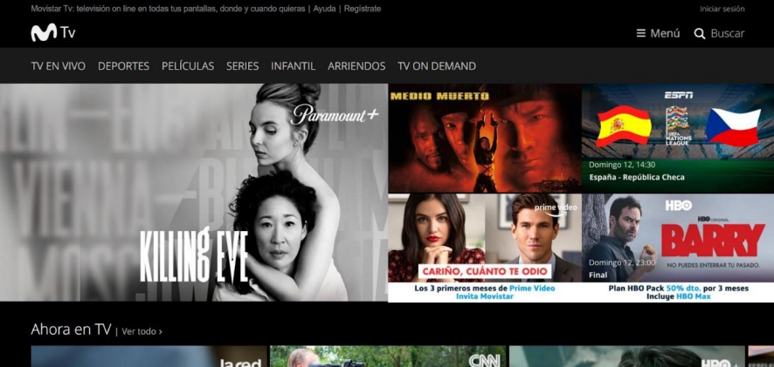
IPTV vs OTT
Internet Protocol Television (IPTV)
Electronic Program Guide (EPG)
Video On Demand (VOD)
Over-the-top (OTT) platforms
Movistar+ service
Channel zapping
Group viewing problem

Slide 8
Data pre-processing

Slide 9




DATA PRE-PROCESSING
Data pre-processing
DATA VISUALISATION
The majority of a Data Science project is dedicated to understand, clean and prepare the data provided, in this case, by Telefónica.
DATA MINING

Slide 10



DATASET
REQUIRED DATA
Movistar+, the IPTV service owned by Telefónica
Session data by 270 users from Chile between 31.10.21 and 31.12.21.
203,065 rows
41 columns
Session data: Session ID, User ID, Device, Service, Service Type, Duration
Time data: Program Start/End, Time Start/End
Content data: Channel, Program, Theme, Subtheme

Slide 11
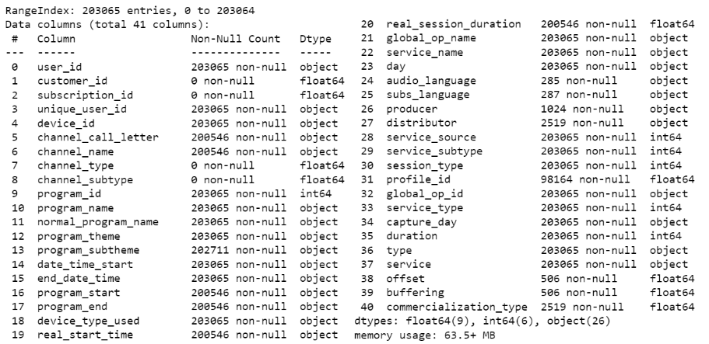
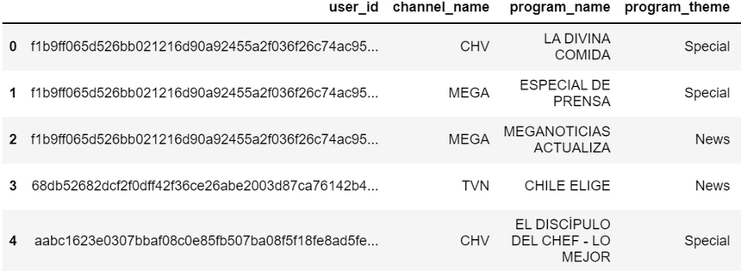
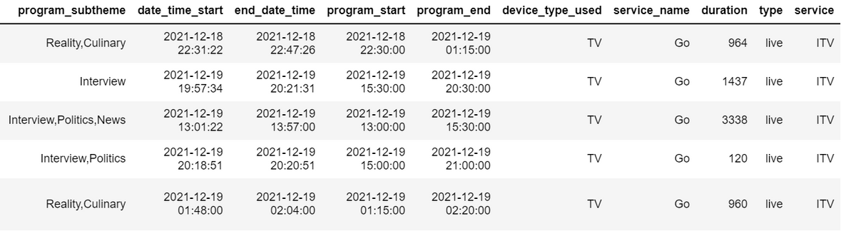
Data preparation
Merging all the data
Dealing with NaNs
Single valued columns
Repeated or equivalent columns
Data types and value modification
Final variables selection
Outliers
Auxiliary dataset
203,065 → 202,820 rows
41 → 14 columns

Slide 12



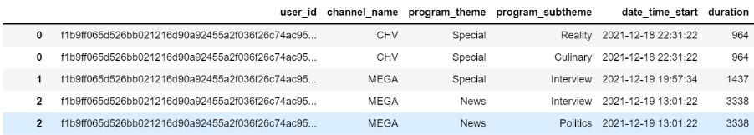
Subthemes dataset

Slide 13
Data analysis:
Results and evaluation

Slide 14
Data Visualization: Tableau Dashboards

Slide 15
DATA PRE-PROCESSING
Data visualisation
DATA VISUALISATION
Good visualisations of the data help to analyse and understand the underlying characteristics of the data
DATA MINING

Slide 16
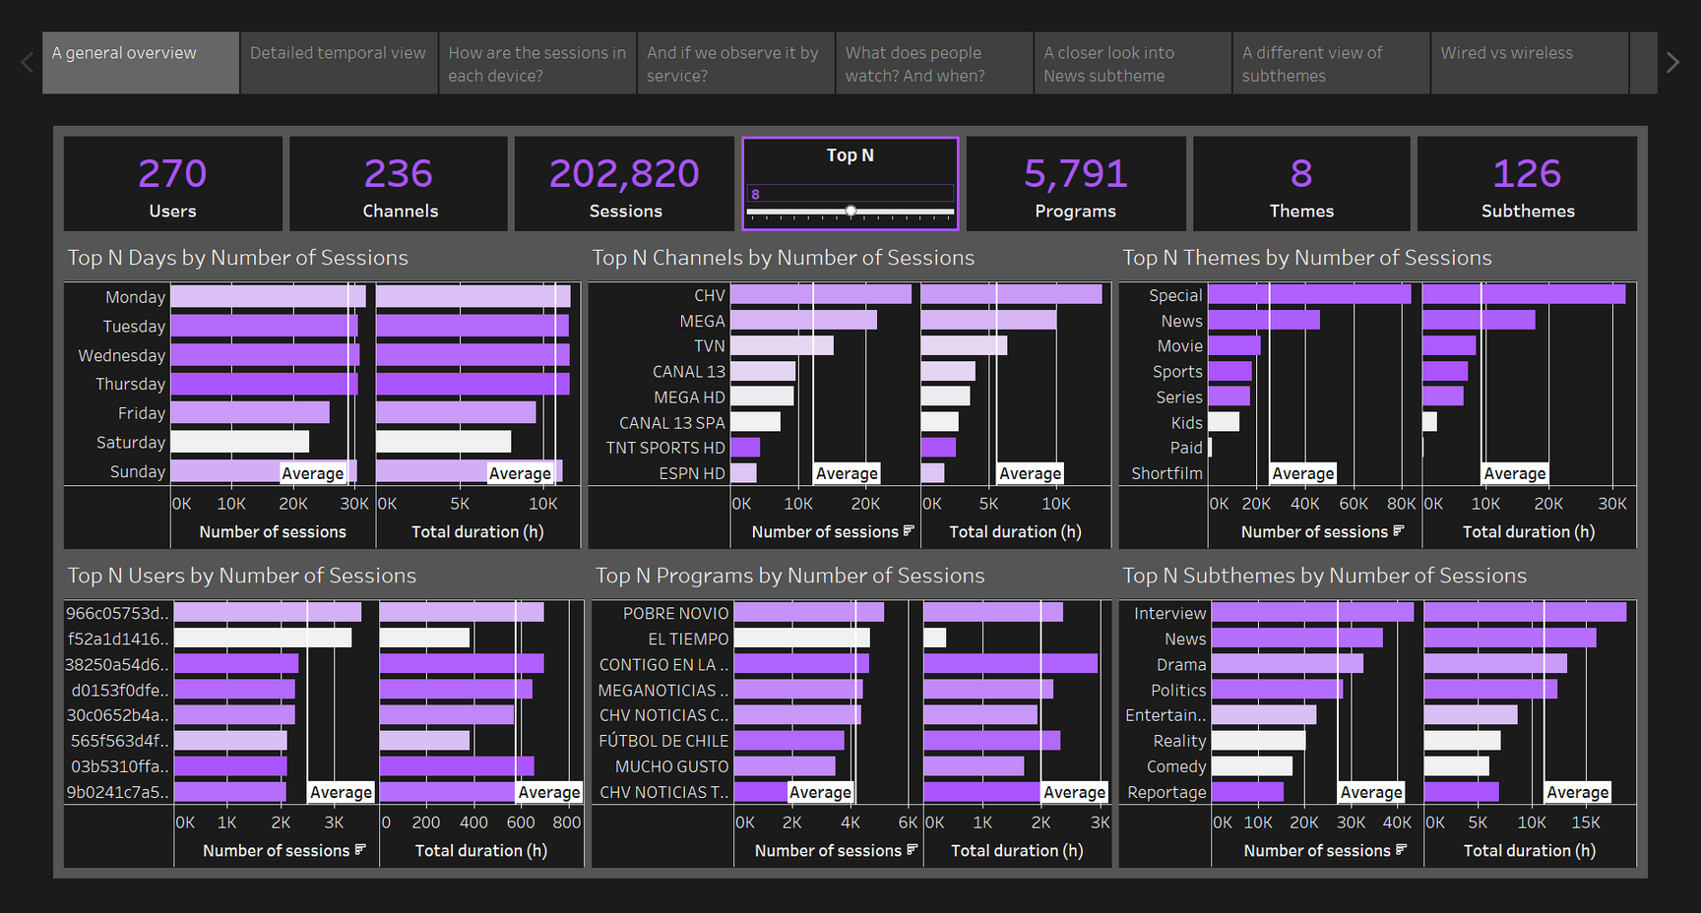
Dashboards

Slide 17
Data Mining:
Apriori Algorithm

Slide 18
DATA PRE-PROCESSING
Data mining
DATA VISUALISATION
Mining and identifying underlying patterns from data that can be many terabytes in size.
DATA MINING

Slide 19
Association rule mining
If => Then | Support (0.026) | Confidence (0.5) | Lift (5)
['Adventure'] => ['Animation'] | 0.03 | 0.58 | 9.91
['Animation'] => ['Adventure'] | 0.03 | 0.50 | 9.91
['Soap'] => ['Drama'] | 0.04 | 0.91 | 5.66
['Current Events', 'Politics'] => ['News'] | 0.03 | 0.98 | 5.39
['News', 'Interview'] => ['Politics'] | 0.09 | 0.77 | 5.53
['Politics'] => ['News', 'Interview'] | 0.09 | 0.67 | 5.53
If => Then | Support (0.022) | Confidence (0.95) | Lift (5)
['News', '21'] => ['Politics'] | 0.04 | 0.98 | 7.02
['21', 'Politics'] => ['News'] | 0.04 | 0.98 | 5.41
['News', '21', 'Interview'] => ['Politics'] | 0.03 | 1.00 | 7.11
['21', 'Interview', 'Politics'] => ['News'] | 0.03 | 1.00 | 5.48
['News', '21', 'STB IPTV'] => ['Politics'] | 0.02 | 0.98 | 7.00
['21', 'STB IPTV', 'Politics'] => ['News'] | 0.02 | 0.97 | 5.35

Slide 20
Conclusions and Future Work
What did we learn?
What to do next?
Big screen vs medium
Weekdays vs weekends
VOD and EPG
"Special" vs News Time windows
News subthemes
Expand countries to analyse
Further data mining
Create user clusterings
Create a recommender system

Slide 21
Bibliography
https://ww2.movistar.cl/
https://www.telefonica.com/es/
https://www.canva.com/
https://www.tableau.com/

Slide 22
Thank you for your attention!
Any doubts?
BACHELOR'S DEGREE FINAL PROJECT:
DATA MINING AND VISUALISATION TO ANALYSE HOW USERS CONSUME CONTENT IN IPTV SERVICES
Alex Marin Felices
05/07/2022

