Slide 1



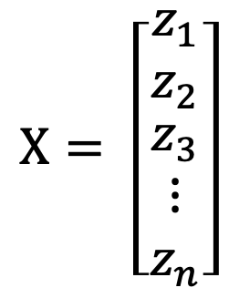




Tokens
Layers x Heads
Model Output
Projection Layer
Input Image
$$z_{1}$$
$$Χ= \left[\begin{matrix}z_{1} \\ z_{2} \\ \begin{matrix}z_{3} \\ ⋮ \\ z_{n}\end{matrix}\end{matrix}\right]$$
$$z_{2}$$
$$S =cos⁡_sim(Χ)$$
$$L_{div}= {\left\|ReLU\left(S −I\right)\right\|}_{F}^{2}$$
$$z_{3}$$
.
.
.
.
.
.
$$z_{n}$$

Slide 2



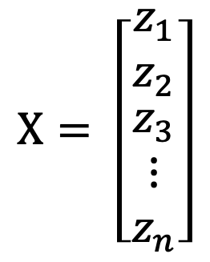
$$z_{1}$$
$$Χ= \left[\begin{matrix}z_{1} \\ z_{2} \\ \begin{matrix}z_{3} \\ ⋮ \\ z_{n}\end{matrix}\end{matrix}\right]$$
$$z_{2}$$
$$S =cos⁡_sim(Χ)$$
$$L_{div}= {\left\|ReLU\left(S −I\right)\right\|}_{F}^{2}$$
$$z_{3}$$
.
.
.
.
.
.
$$z_{n}$$

Slide 3




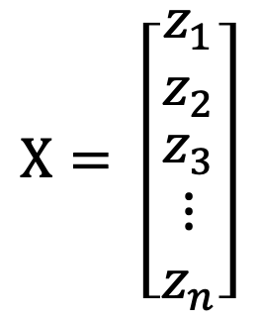

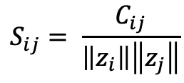


$$z_{1}$$
$$Χ= \left[\begin{matrix}z_{1} \\ z_{2} \\ \begin{matrix}z_{3} \\ ⋮ \\ z_{n}\end{matrix}\end{matrix}\right]$$
$$z_{2}$$
$$S_{nxn} =cos⁡_sim(Χ)$$
$$z_{3}$$
$$C=XX^{T}$$
$$S_{ij}= \frac{C_{ij}}{\left\|z_{i}\right\|\left\|z_{j}\right\|}$$
$$L_{div}= {\left\|ReLU\left(S −I\right)\right\|}_{F}^{2}$$
.
.
.
$$z_{n}$$

Slide 4
POST INGREDIENTS
Frontend
Backend
RESPONSE(Status, Data)
SEND TASK TO SQS
(job_id, ingredients)
RETURN TASK RESULT
Async Task Manager
SELECT TASK
FROM SQS
ROUTINE TASK
RETURN TASK
RESULTS
TASK RESPONSE
(RETURN RECIPES)
Semantic Similarity Model
Recipe Update Worker
UPDATE
RECIPE
QUERY RECIPES
QUERY RESULTS
Database
RETURN STATUS

Slide 5
POST INGREDIENTS
Frontend
Backend
RESPONSE(Status, Data)
SEND TASK TO SQS
(job_id, ingredients)
RETURN QUERY RESULT
(task_results / task_status)
QUERY
RESULTS
Async Task Manager
ROUTINE TASK
SELECT TASK
FROM SQS
UPDATE
RECIPE
Recipe Update Worker
Database
QUERY RECIPES AND UPDAT RESULTS
RETURN STATUS
Semantic Similarity Worker

