Slide 1
Efficient Vision Transformer with Decorrelated Attention Head Output
Alex (Yu-Hung) Kung
Notes:
Good afternoon, professor Brandon and classmates. My name is Alex, today I’m going to share my final project results, which is about efficient vision transformer with decorrelated atttention head output

Slide 2
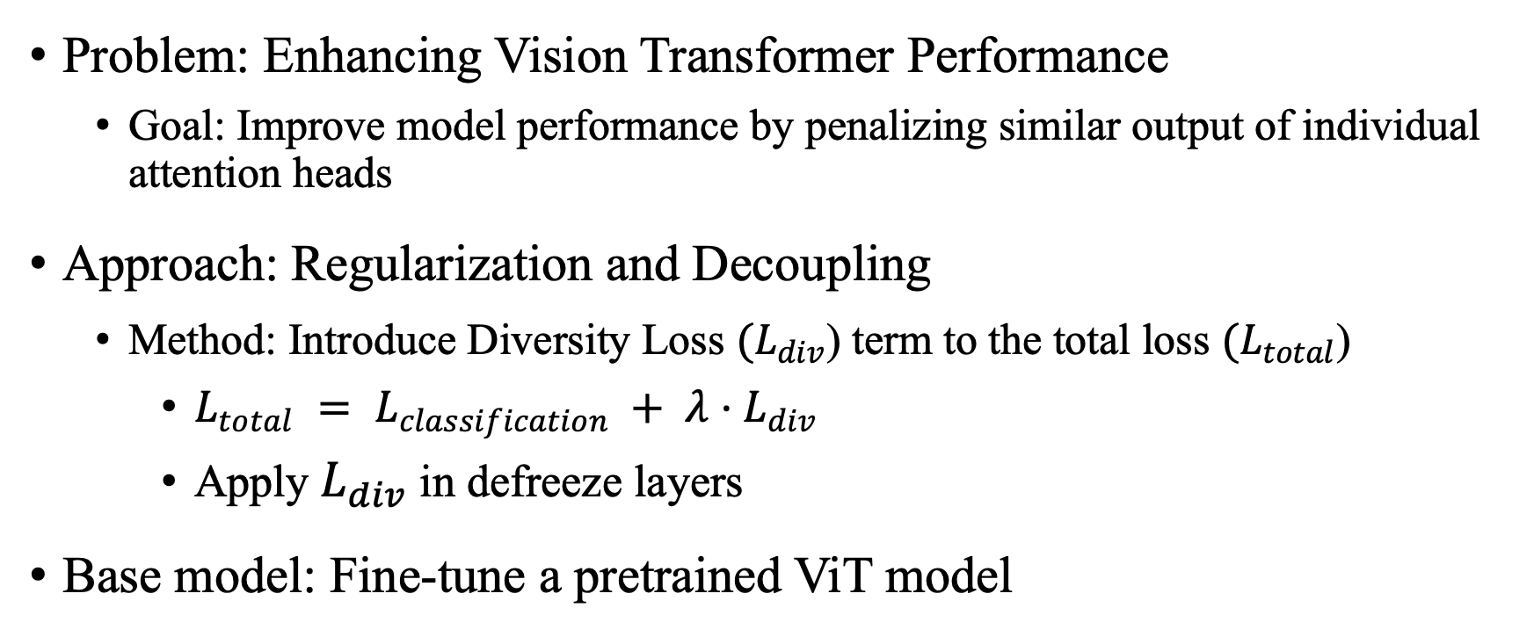
Problem and Approach
Problem: Enhancing Vision Transformer Performance
Goal: Improve model performance by penalizing similar output of individual attention heads
Approach: Regularization and Decoupling
Method: Introduce Diversity Loss ${(L}_{div}$) term to the total loss ${(L}_{total}$)
$L_{total} = L_{classification} + λ⋅L_{div}$
Apply $L_{div}$in defreeze layers
Base model: Fine-tune a pretrained ViT model
Notes:
Let's start with our problem and the approach we took.
The Problem is straightforward: Enhancing Vision Transformer Performance. Our Goal was to improve model performance by penalizing similar output vectors of individual attention heads.
Our Approach involved Regularization and Decoupling.
The Core Method was introducing a Diversity Loss (Ldiv​) term to the total loss function : Ltotal​=Lclassification​+λ⋅Ldiv​.
We applied this Ldiv​ in the defrozen layers while fine-tuning a pretrained ViT model.

Slide 3
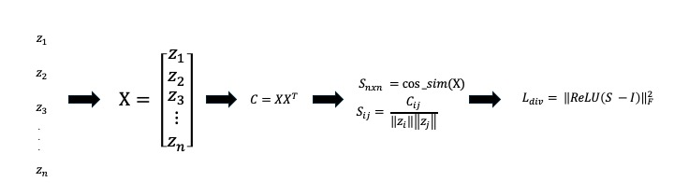

Diversity Loss Calculation
Diversity Loss Formula: $L_{div}={\left|\left|ReLU(S − I)\right|\right|}_{F}^{2}$
$S − I$: Reduce Self Similarity
ReLU: Focus on positive similarity
Notes:
This slide illustrates the computational flow and the formula for Ldiv​.
The Process:
We stack the output vectors zi​ from all n attention heads into a matrix X.
We then compute the Cosine Similarity Matrix S (Sn×n​) of X.
The Loss Formula is Ldiv​=∣∣ReLU(S−I)∣∣F2​.
The Function:
* S−I serves to Reduce Self Similarity. * The ReLU function is applied element-wise to Focus on positive similarityvalues.
We compute the Frobenius norm squared, which penalizes high positive correlation, pushing the attention heads toward statistical independence.

Slide 4


Result 1: $L_{div}$Limitation on CIFAR10
Dataset: CIFAR10
Pretrained model: ViT (google/vit-base-patch16-224-in21k)
High-Baseline, difficult to make improvement
Model | Defreeze Layer | $$λ$$ | Epoch | Train Loss | Val Loss | Accuracy
Baseline | 1 | 0 | 8 | 0.019 | 0.1537 | 95.95%
MyModel | 1 | 0.1 | 6 | 0.021 | 0.1504 | 96.85%
Baseline | 2 | 0 | 7 | 0.031 | 0.1716 | 96.35%
MyModel | 2 | 0.1 | 7 | 0.0751 | 0.1957 | 95.70%
Notes:
Our first experiment was on the standard CIFAR-10 dataset.
Since we used a pretrained ViT, the model started with a High-Baseline, making improvement difficult.
From the table:
* The Baseline model (λ=0, Defreeze Layer 1) achieved an accuracy of 95.95%. * Our best ViT-DeCV model (λ=0.1) reached 96.85%.
The maximum improvement was only 0.9%. This small gain initially suggested that the diversity loss might have limited efficacy for well-performing models.

Slide 5
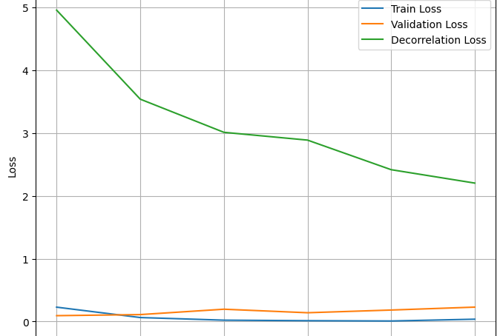
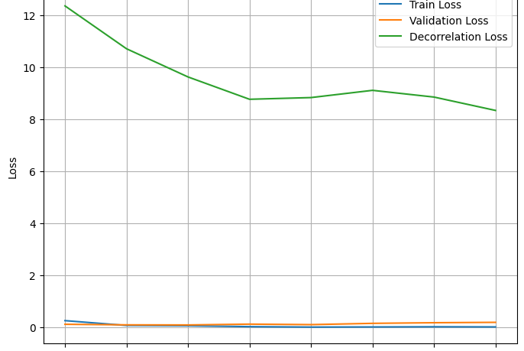

Result 1: ViT’s Natural Diversity
Decorrelation loss decreases when $λ=0$
Notes:
This learning curve explains why the improvement on CIFAR-10 was so small.
This graph shows the training curves for the baseline model where λ=0.
Notice the green line, representing the Decorrelation Loss. Even though λ=0 (no explicit penalty), the Decorrelation loss decreases throughout training.
Insight: This demonstrates that the ViT model inherently learns a degree of attention head diversity during standard classification training. Therefore, adding an extra statistical penalty yielded very limited marginal benefit.

Slide 6

Result 2: $L_{div}$establish stability on CIFAR100
Dataset: CIFAR100
Pretrained model: ViT (google/vit-base-patch16-224-in21k)
Train with different number of parameters, hyper-parameters, seeds, and calculate the average accuracy and its standard deviation
Nearly 3% improvement on accuracy
Smaller standard deviation, establish stability
Model | Defreeze layer | Lambda decorr | Learning rate | Accuracy | Standard Deviation
Baseline | 4 | 0 | 1e-4 | 83.75% | 0.06
MyModel | 4 | 1e-4 | 1e-4 | 86.63% | 0.001
Notes:
Given the limitations on CIFAR-10, we shifted to the more complex CIFAR-100 dataset.
In this experiment, we trained with different hyper-parameters and seeds, calculating the average accuracy and its standard deviation.
The table shows a significant result:
* The Baseline model (λ=0) achieved 83.75% accuracy, but with a standard deviation of 0.06. * Our ViT-DeCV model improved accuracy to 86.63% , which is nearly a 3% improvement. * Crucially, the standard deviation dropped drastically to 0.001.
Conclusion: Ldiv​ not only provided a substantial accuracy boost on a more complex task, but it also helped establish stability in training accuracy

Slide 7
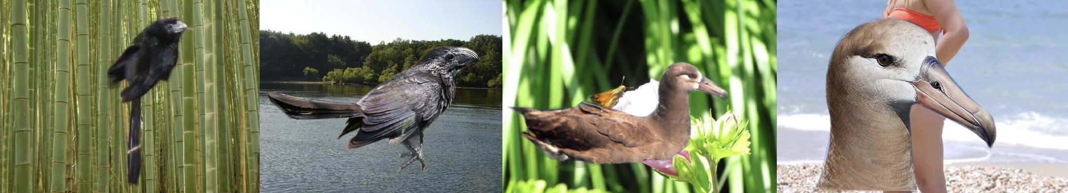

Result 3: $L_{div}$Improvement on Waterbird
Dataset: Waterbirds
Pretrained model: ViT-B-32
Trainable parameters: ~7.5M
Train with different seeds, and calculate the average accuracy and its standard deviation
Model | Defreeze layer | Lambda decorr | Learning rate | (0, 1) accuracy | (1, 0) accuracy | Full Accuracy | Standard Deviation
Baseline | 1 | 0 | 1e-4 | 70.17% | 50.59% | 82.08% | 0.0149
MyModel | 1 | 0.1 | 1e-4 | 73.61% | 52.31% | 83.62% | 0.02
Notes:
Next, we tested Ldiv​ on the Waterbirds dataset, a binary classification task notorious for scene-based bias.
We used ViT-B-32 as our pretrained model.
* The Baseline Full Accuracy was 82.08%. * Applying Ldiv​ (λ=0.1) raised the Full Accuracy to 83.62%, an improvement of 1.54%.
We also looked at robustness metrics. For instance, the (0,1) accuracy (Landbird on Water) increased from 70.17% to 73.61%.
Result: Ldiv​ provided a slight increase in robustness, but the improvement was marginal.

Slide 8

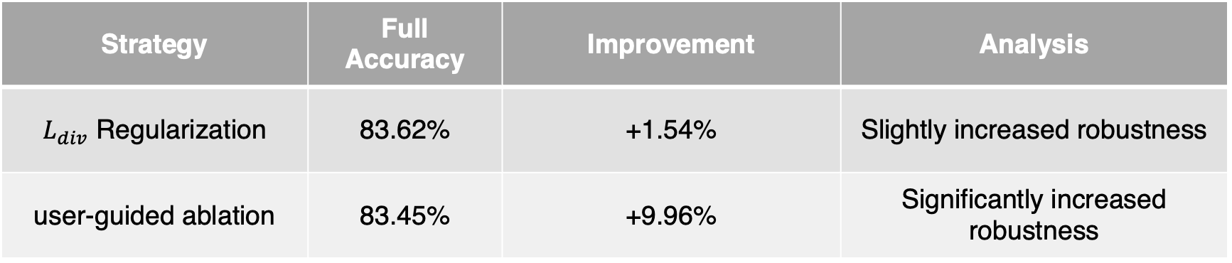
Result 3: Waterbirds - Loss vs. Ablation
Waterbirds dataset is known for scene-base bias
Fine-tune ViT-B-32 with $L_{div}$
User-guided ablation with ViT-L-14 with CLIP
Strategy | Full Accuracy | Improvement | Analysis
$L_{div}$ Regularization | 83.62% | +1.54% | Slightly increased robustness
user-guided ablation | 83.45% | +9.96% | Significantly increased robustness
Notes:
Now, we directly compare the Ldiv​ strategy with our second strategy: User-Guided Ablation.
We used Ldiv​ on ViT-B-32 and user-guided ablation on ViT-L-14 with CLIP. Both methods aim to solve the scene-based bias of Waterbirds.
The difference between these two models is ViT-L-14 is a more complex model, with deeper structure and larger scale, aiming to learn complex features.
Looking at the table:
* Ldiv​ Regularization provided an improvement of +1.54%. * The User-Guided Ablation achieved a massive improvement of +9.96%.
The Strong Contrast: The Ablation strategy achieved a six-fold greater improvement in robustness over the baseline (note: Ablation baseline was 73.49%), clearly showing the superior effect of a semantic intervention.

Slide 9
Why ablation works?
Method: Applied attention head ablation based on the TextSpan of each attention head using CLIP
TextSpan: Extract text description of each attention head, showing what the attention head learn
Select and ablate heads correlated with irrelevant or spurious features
Layer | Head | TextSpan | Insight
18 | 7 | Reflective pond scene | Related to the ‘scene’
18 | 8 | An image of Andorra | Related to ‘location / scene’
Notes:
So, why was the ablation strategy so dramatically effective?
We applied attention head ablation based on the TextSpan of each head using CLIP. TextSpan provides a text description of what the attention head learns.
This allowed us to manually select and ablate heads correlated with irrelevant or spurious features.
For example:
* Layer 18, Head 7 had the TextSpan 'Reflective pond scene'. This was clearly related to the scene.* We also removed Head 8, which was related to a 'location / scene'.
By eliminating these heads tied to spurious correlations, we forced the model to rely only on the bird features, leading to the substantial robustness gain.

Slide 10

Insights and Conclusion
$L_{div}$ limitation: Statistical Diversity Loss provides limited gain for already well-performing, pretrained ViT models (CIFAR10)
Natural Diversity: ViT models appear to inherently learn a degree of attention head diversity during standard training
Effective Strategy: The most significant performance increase came from driven interveniton (User-Guided Ablation)
Conclusion: The key to optimizing ViT performance lies in understanding and controlling the semantic roles of atttention heads, rather than solely enforcing statistical independence of their output vectors.
Notes:
Let’s summarize our key insights and conclusions.
* Ldiv​ limitation: Statistical Diversity Loss provides limited gain for already well-performing, pretrained ViT models like CIFAR-10. This is due to the ViT's Natural Diversity.
Ldiv​ Value: However, Ldiv​ effectively stabilized training accuracy on the more complex CIFAR-100 task. * Effective Strategy: The most significant performance increase came from the semantic-driven intervention(User-Guided Ablation). * Conclusion: The key to optimizing ViT performance lies in understanding and controlling the semantic roles of attention heads, rather than solely enforcing their statistical independence.

Slide 11
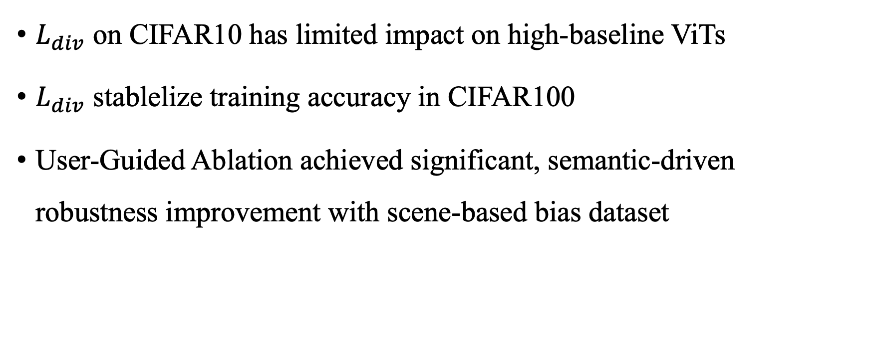
Summary
$L_{div}$ on CIFAR10 has limited impact on high-baseline ViTs
$L_{div}$ stablelize training accuracy in CIFAR100
User-Guided Ablation achieved significant, semantic-driven robustness improvement with scene-based bias dataset
Notes:
To quickly summarize our findings across all datasets:
1. Ldiv​ on CIFAR10 has limited impact on high-baseline ViTs.
2. Ldiv​ stabilized training accuracy in CIFAR100.
3. User-Guided Ablation achieved significant, semantic-driven robustness improvement with the scene-based bias dataset.

Slide 12
Reference
[1] DeCAtt: Efficient Vision Transformers with Decorrelated Attention Heads
[2] INTERPRETING CLIP’S IMAGE REPRESENTATION VIA TEXT-BASED DECOMPOSITION

Slide 13
Thanks for listening
Notes:
Thank you for your time. I am now open to questions.

