Slide 1

Efficient Vision Transformer with Decorrelated Attention Head Output
Alex (Yu-Hung) Kung
Notes:
Hello everyone, I am Alex. Today I am presenting my final project: "Efficient Vision Transformer with Decorrelated Attention Head Output."

Slide 2
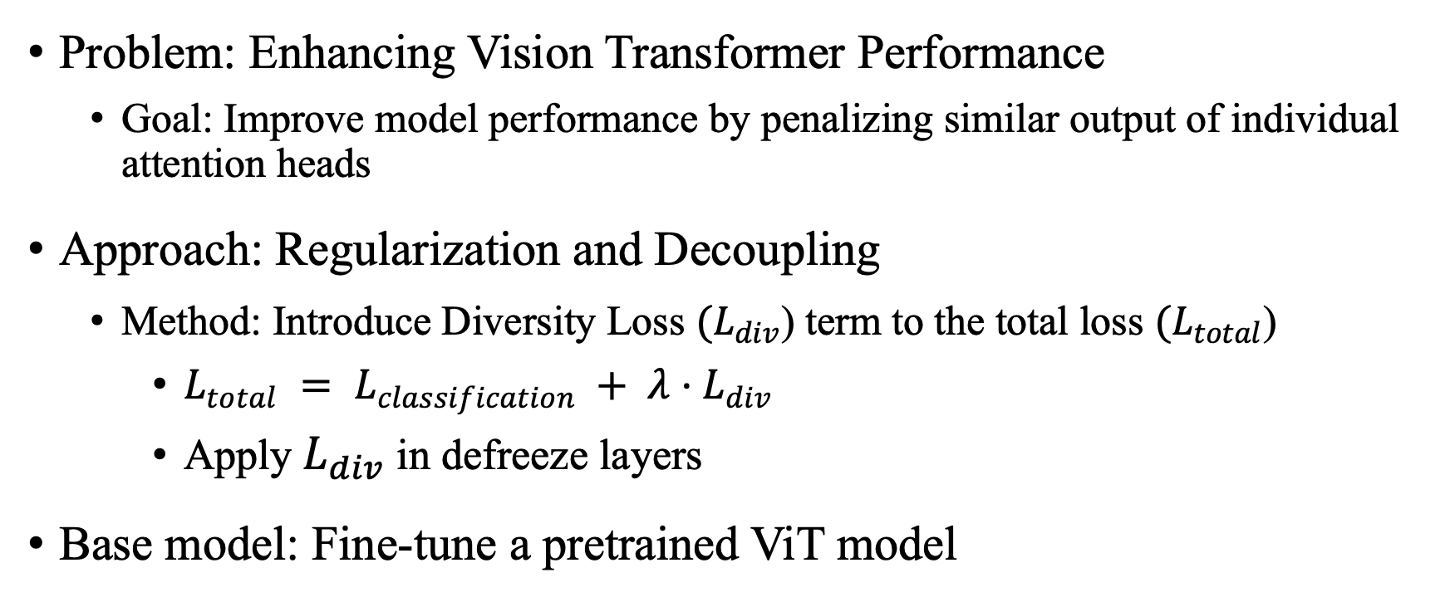
Problem and Approach
Problem: Enhancing Vision Transformer Performance
Goal: Improve model performance by penalizing similar output of individual attention heads
Approach: Regularization and Decoupling
Method: Introduce Diversity Loss ${(L}_{div}$) term to the total loss ${(L}_{total}$)
$L_{total} = L_{classification} + λ⋅L_{div}$
Apply $L_{div}$in defreeze layers
Base model: Fine-tune a pretrained ViT model
Notes:
My project addresses Redundancy in Vision Transformers. Since many attention heads learn identical features, my goal is to penalize this redundancy. I propose ViT-DeCV, which adds a Diversity Loss (Ldiv​) term to the total loss .

Slide 3
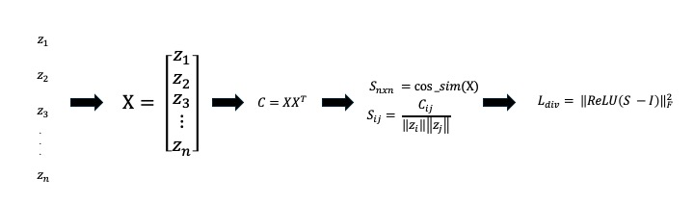
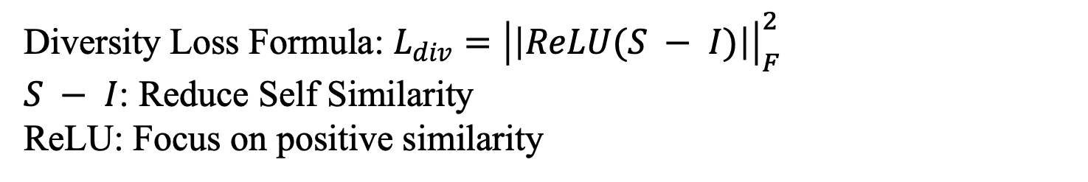
Diversity Loss Calculation
Diversity Loss Formula: $L_{div}={\left|\left|ReLU(S − I)\right|\right|}_{F}^{2}$
$S − I$: Reduce Self Similarity
ReLU: Focus on positive similarity
Notes:
So, how do we calculate this Diversity Loss? Please look at the diagram.
First, we take the output vectors from all attention heads in the last layer and stack them into a matrix X.
We then compute the Cosine Similarity Matrix (S).
Here is the crucial part: We subtract the Identity matrix (I) to remove self-similarity.
Then, we apply a ReLU function because we only want to penalize positive correlations(redundancy).
Finally, we calculate the Frobenius norm to get a single scalar value for our loss.

Slide 4
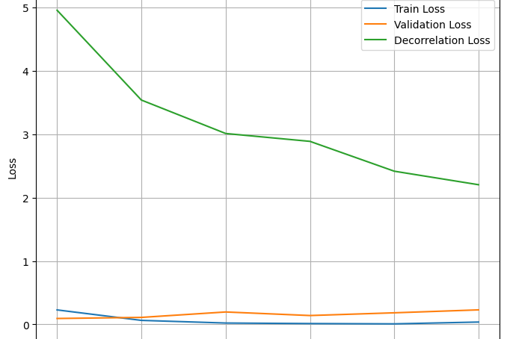
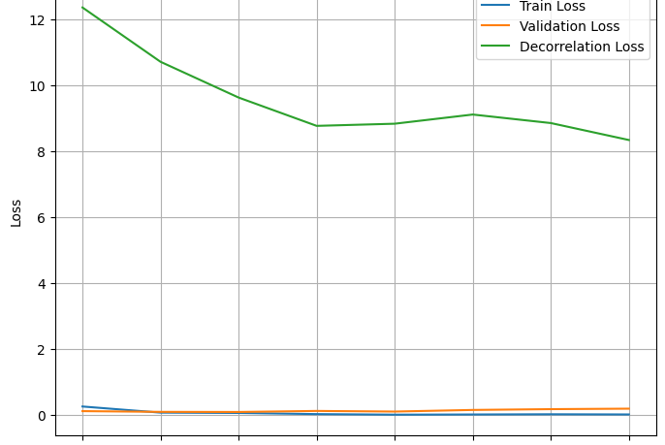

Result 1: ViT’s Natural Diversity
Decorrelation loss decreases when $λ=0$
Notes:
On CIFAR-10, we found something interesting. Look at the green curve: the decorrelation loss decreases naturally even without our penalty.

Slide 5


Result 1: $L_{div}$Limitation on CIFAR10
Dataset: CIFAR10
Pretrained model: ViT (google/vit-base-patch16-224-in21k)
High-Baseline, difficult to make improvement
Model | Defreeze Layer | $$λ$$ | Epoch | Train Loss | Val Loss | Accuracy
Baseline | 1 | 0 | 8 | 0.019 | 0.1537 | 95.95%
MyModel | 1 | 0.1 | 6 | 0.021 | 0.1504 | 96.85%
Baseline | 2 | 0 | 7 | 0.031 | 0.1716 | 96.35%
MyModel | 2 | 0.1 | 7 | 0.0751 | 0.1957 | 95.70%
Notes:
this proves Pre-trained ViTs possess "Natural Diversity." Because of this, adding my loss to a high-performing baseline like CIFAR-10 yielded only a marginal 0.9% improvement, as the model was already efficient.

Slide 6

Result 2: $L_{div}$establish stability on CIFAR100
Dataset: CIFAR100
Pretrained model: ViT (google/vit-base-patch16-224-in21k)
Train with different number of parameters, hyper-parameters, seeds, and calculate the average accuracy and its standard deviation
Nearly 3% improvement on accuracy
Smaller standard deviation, establish stability
Model | Defreeze layer | Lambda decorr | Learning rate | Accuracy | Standard Deviation
Baseline | 4 | 0 | 1e-4 | 83.75% | 0.06
MyModel | 4 | 1e-4 | 1e-4 | 86.63% | 0.001
Notes:
However, on the complex CIFAR-100 task, the method shines. Please focus on the Standard Deviation. While accuracy improved by 3%, the baseline variance was 0.06. With my Diversity Loss, it dropped to 0.001. This proves that Ldiv​ is a powerful Stabilizer, ensuring consistent performance across training runs

Slide 7
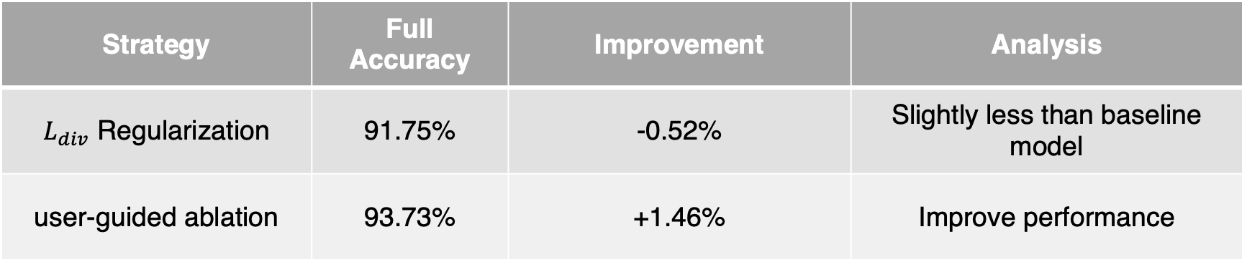

Result 3: Waterbirds - Loss vs. Ablation
Waterbirds dataset is known for scene-base bias
Fine-tune ViT-L-14 with $L_{div}$
User-guided ablation with ViT-L-14 using CLIP
Strategy | Full Accuracy | Improvement | Analysis
$L_{div}$ Regularization | 91.75% | -0.52% | Slightly less than baseline model
user-guided ablation | 93.73% | +1.46% | Improve performance
Notes:
Finally, on the Waterbirds dataset, I compared my Statistical Approach against a Semantic Approach (User-Guided Ablation). My Diversity Loss (Ldiv​) actually slightly hurt performance (-0.52%). In contrast, Semantic Ablation—removing heads focusing on backgrounds—improved accuracy by 1.46% . This shows that for fixing bias, Semantic Understanding is more effective than blind statistical orthogonality

Slide 8
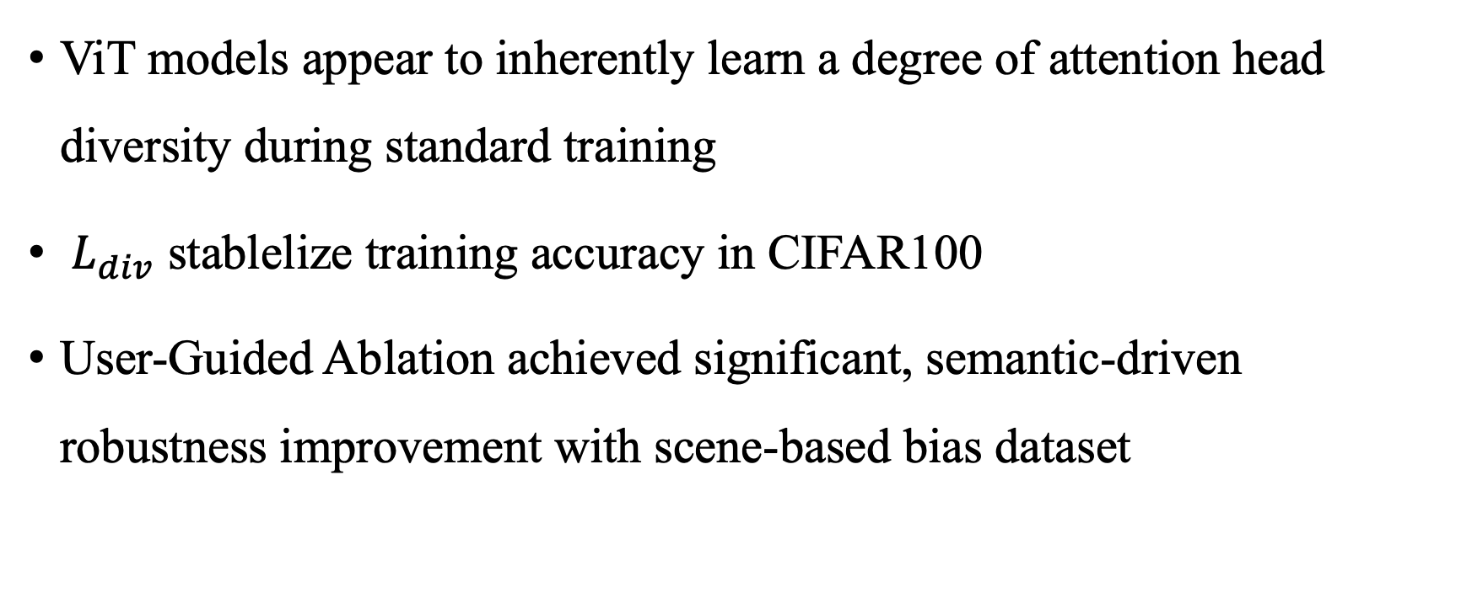
Summary
ViT models appear to inherently learn a degree of attention head diversity during standard training
${ L}_{div}$ stablelize training accuracy in CIFAR100
User-Guided Ablation achieved significant, semantic-driven robustness improvement with scene-based bias dataset
Notes:
To summarize my findings:
First is the Natural Diversity: ViT models naturally diversify themselves, limiting gains on simple tasks like CIFAR-10.
Second, the Stability: The proposed Diversity Loss is highly effective at stabilizing training, as seen in the significant standard deviation drop on CIFAR-100.
Third, the Difference between Semantic and Statistical optimization: For fixing bias and robustness, semantic interventions (such as Ablation) are more effective than purely statistical ones.

Slide 9
Reference
[1] DeCAtt: Efficient Vision Transformers with Decorrelated Attention Heads
[2] INTERPRETING CLIP’S IMAGE REPRESENTATION VIA TEXT-BASED DECOMPOSITION

Slide 10
Thanks for listening
Notes:
That concludes my presentation. Thank you for listening

