Slide 1


21EE6912 - MINI PROJECT / INTERNSHIP
IntelliLock: Dual Authentication Smart Door System
First Review
HARISH RAJ M (95072213013)
RAKESH KANNA V (95072213036)
THIVITH J (95072213051)
KARTHICK KUMAR M (95072213303)
Dr.A.Ravi Mr.J.Antony Robinson
HOD/EEE AP/EEE
Mini Project Mini Project
Guide Coordinator
Date: 26.02.2025
1
Notes:
1

Slide 2
Objectives of the project work
Enhance Security – Implement a dual authentication mechanism (keypad + fingerprint sensor) to improve access control.
Prevent Unauthorized Access – Restrict entry to authorized users by verifying both a passcode and biometric data.
Automate Door Locking – Use a servo motor to automatically lock and unlock the door based on authentication results.
User-Friendly and Cost-Effective – Develop a simple, affordable, and efficient smart door lock system using Arduino.

Slide 3
Abstract of the project work
IntelliLock is a smart door security system that uses dual authentication—a keypad PIN and a fingerprint sensor—to restrict unauthorized access. Built with Arduino Uno, a servo motor, and a relay module, the system ensures secure and automated door locking. If both credentials match, the door unlocks; otherwise, access is denied. This project offers a cost-effective and reliable security solution for homes and offices.

Slide 4
Introduction
Traditional locks can be easily bypassed, making security a critical concern. IntelliLock: Dual Authentication Smart Door System enhances security by combining keypad PIN entry and biometric fingerprint authentication. This ensures that only authorized users gain access.
The system is powered by Arduino Uno, which controls a servo motor to lock or unlock the door based on authentication. A relay module adds extra security, making it a cost-effective, reliable, and user-friendly solution for modern access control.

Slide 5
Base paper (Tile/ author name/year of publication/findings)
Title: Smart and Secure Door Lock with Dual-Factor Authentication for Restricted Access Control
Authors: S. S. Manivannan, S. S. Manivannan, S. S. Manivannan, S. S. Manivannan
Published in: Mathematical Statistician and Engineering Applications
Vol./Issue: Vol. 72, No. 1
Year of Publication: 2023
Link: https://www.philstat.org/index.php/MSEA/article/view/2373

Slide 6
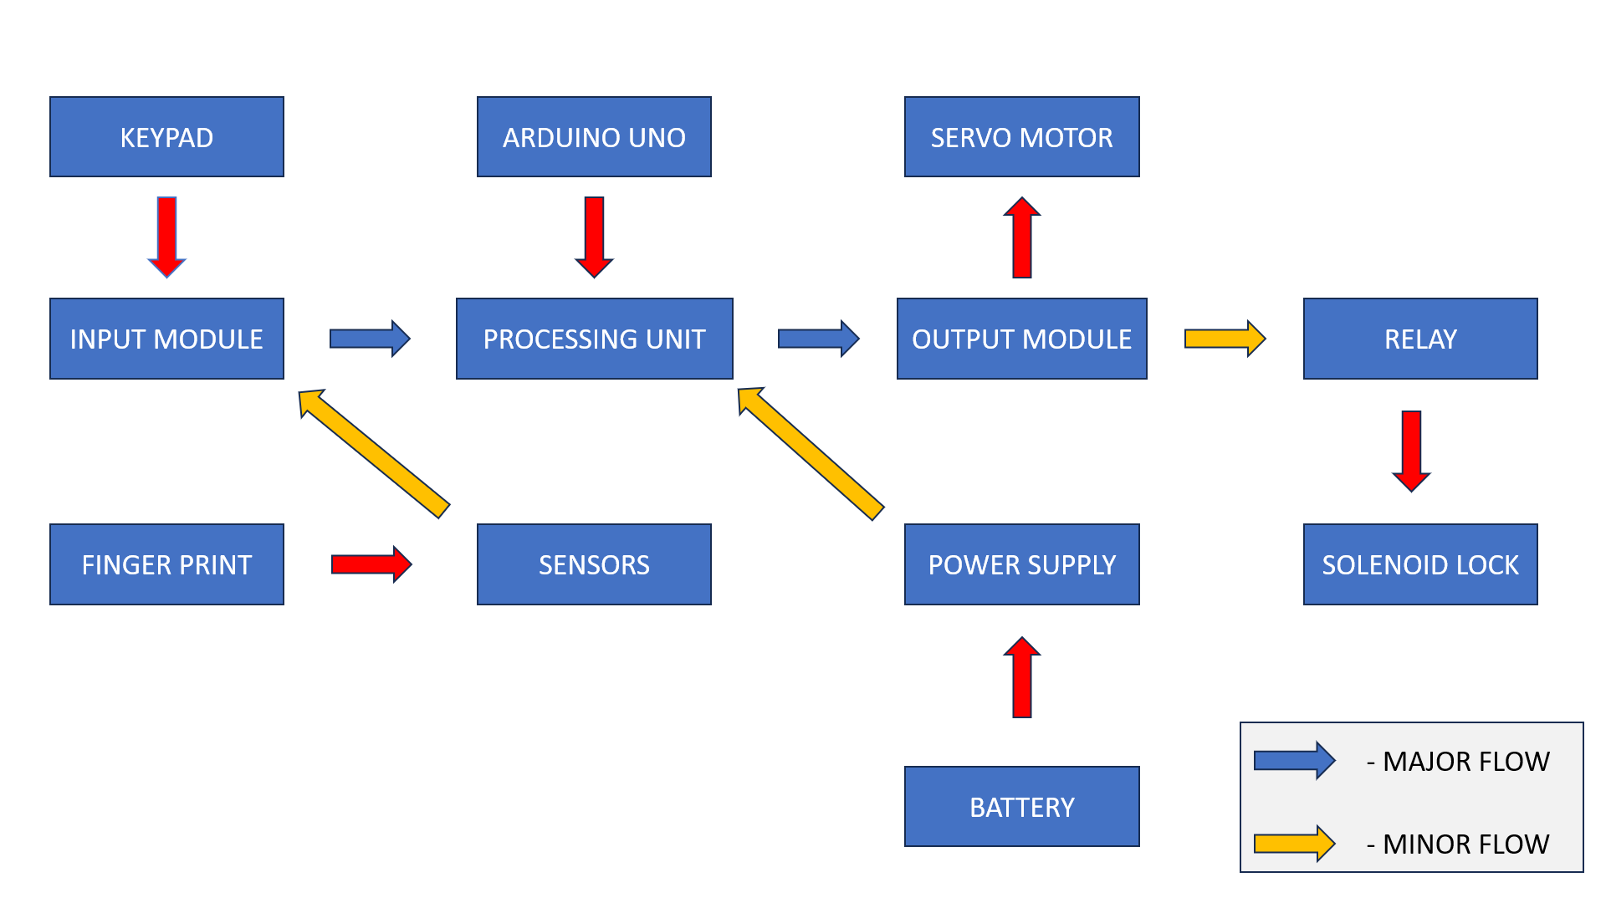
Block Diagram

Slide 7
Block Diagram Explanation
The system consists of:
Input Modules:
  Keypad – Enters the PIN for authentication.
  Fingerprint Sensor – Scans and verifies the user.
Processing Unit:
  Arduino Uno – Controls authentication and door operations.
Output Modules:
  Servo Motor – Unlocks the door on successful authentication.
  Relay Module – Enhances security by controlling external locks.
Power Supply:
  A 9V battery powers the system.
Working: The user enters a PIN, followed by a fingerprint scan. If both match, the servo motor unlocks the door; otherwise, access is denied. 🚪🔒

Slide 8
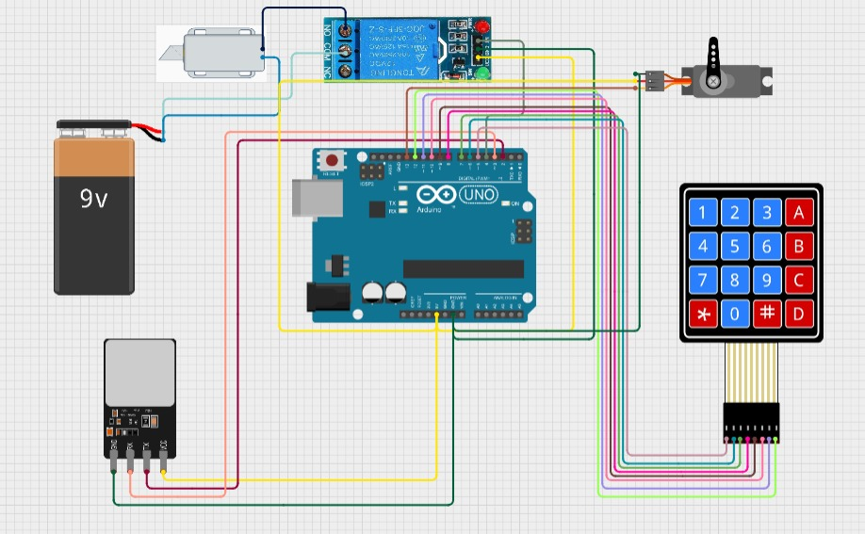
Circuit Diagram

Slide 9
Circuit Explanation
The IntelliLock: Dual Authentication Smart Door System is designed to enhance security using a dual authentication process. The circuit consists of the following components:
1. Power Supply:
A 9V battery provides power to the Arduino Uno and all connected components.
2. Input Components:
Keypad (4x4): Allows users to enter a PIN for the first authentication step.
Fingerprint Sensor: Captures and verifies the user’s fingerprint for the second authentication step.
3. Processing Unit:
Arduino Uno: Acts as the brain of the system, processing input from the keypad and fingerprint sensor and controlling the locking mechanism accordingly.

Slide 10
Circuit Explanation
4. Output Components:
Servo Motor: Unlocks the door when authentication is successful.
Relay Module: Adds an extra layer of security by controlling external locks or alarms.
Working Principle:
The user enters a PIN on the keypad. If correct, the system proceeds to fingerprint verification.
The fingerprint sensor scans and matches the stored fingerprint.
If both authentication steps are successful, the servo motor unlocks the door. Otherwise, access is denied.
This circuit provides a cost-effective, automated, and reliable security solution for restricted areas. 🚪🔒

Slide 11
Project Work Plan
Research & Component Selection (Week 1) – Select components and study existing systems.
Circuit Design & Hardware Setup (Week 2-3) – Assemble and test circuit connections.
Software Development (Week 4-5) – Write and debug Arduino code for authentication.
Testing & Final Integration (Week 6) – Test and optimize system performance.
Documentation & Presentation (Week 7-8) – Prepare reports, PPT, and final demonstration.

Slide 12
References
"Electric Line Man Safety with Password Based Circuit Breaker"
Authors: Shreya Laxman Dasar, Rutu Gomateshwar Kadage, Minakshi Popat Mane, Purva Shital Athane, Pravin Kumar Karve
Published in: International Journal of Research Publication and Reviews, Vol. 5, Issue 4, April 2024
Summary: This paper discusses a system designed to enhance the safety of electric linemen by implementing a password-based circuit breaker. The system ensures that maintenance personnel can safely work on electrical lines by controlling the circuit breaker through secure password authentication.
Link: https://ijrpr.com/uploads/V5ISSUE4/IJRPR24515.pdf

Slide 13
References
"A Systematic Literature Review of the Types of Authentication Safety Practices among Internet Users"
Authors: Krishnapriyaa Kovalan, Siti Zobidah Omar, Lian Tang, Jusang Bolong, Rusli Abdullah, Akmar Hayati Ahmad Ghazali, Muhammad Adnan Pitchan
Published in: International Journal of Advanced Computer Science and Applications (IJACSA), Vol. 12, No. 7, 2021
Link: https://thesai.org/Publications/ViewPaper?Code=IJACSA&Issue=7&SerialNo=92&Volume=12

Slide 14


