Slide 1

MultiLive: Adaptive Bitrate Control for Low-delay Multi-party Interactive Live Streaming
Live Streaming Group
Tsinghua University
9/17/2019

Slide 2

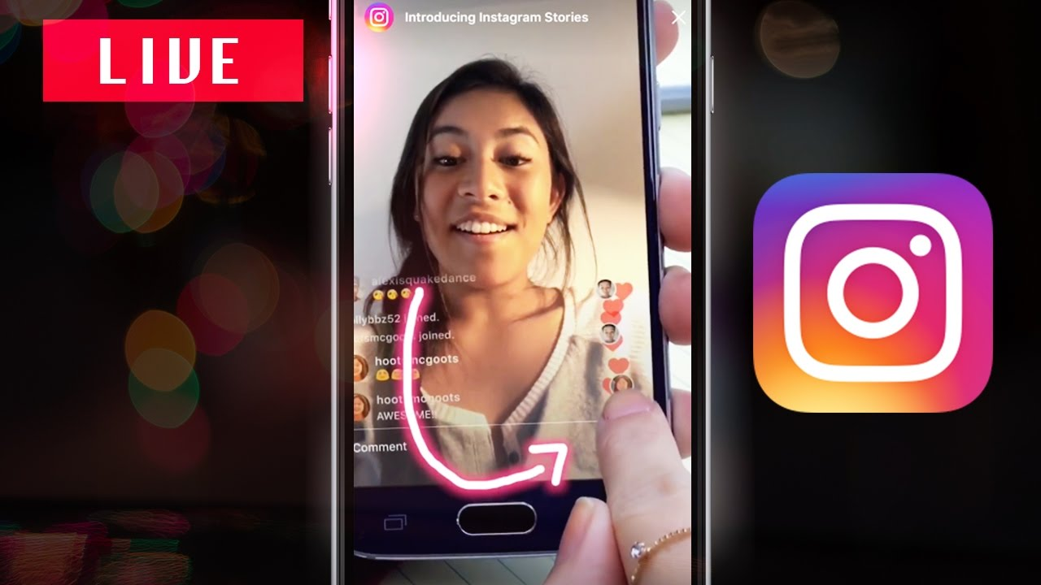
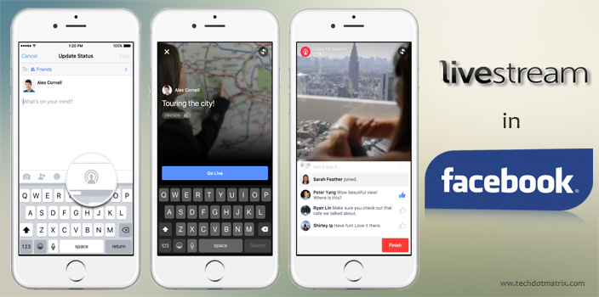
Background
Live streaming platforms have attracted millions of daily active users.
We have been witnessing a class of emerging scenarios, namely multiparty interactive live streaming.
It is a promising way, moving beyond video conferencing to supporting education and social interaction.

Slide 3
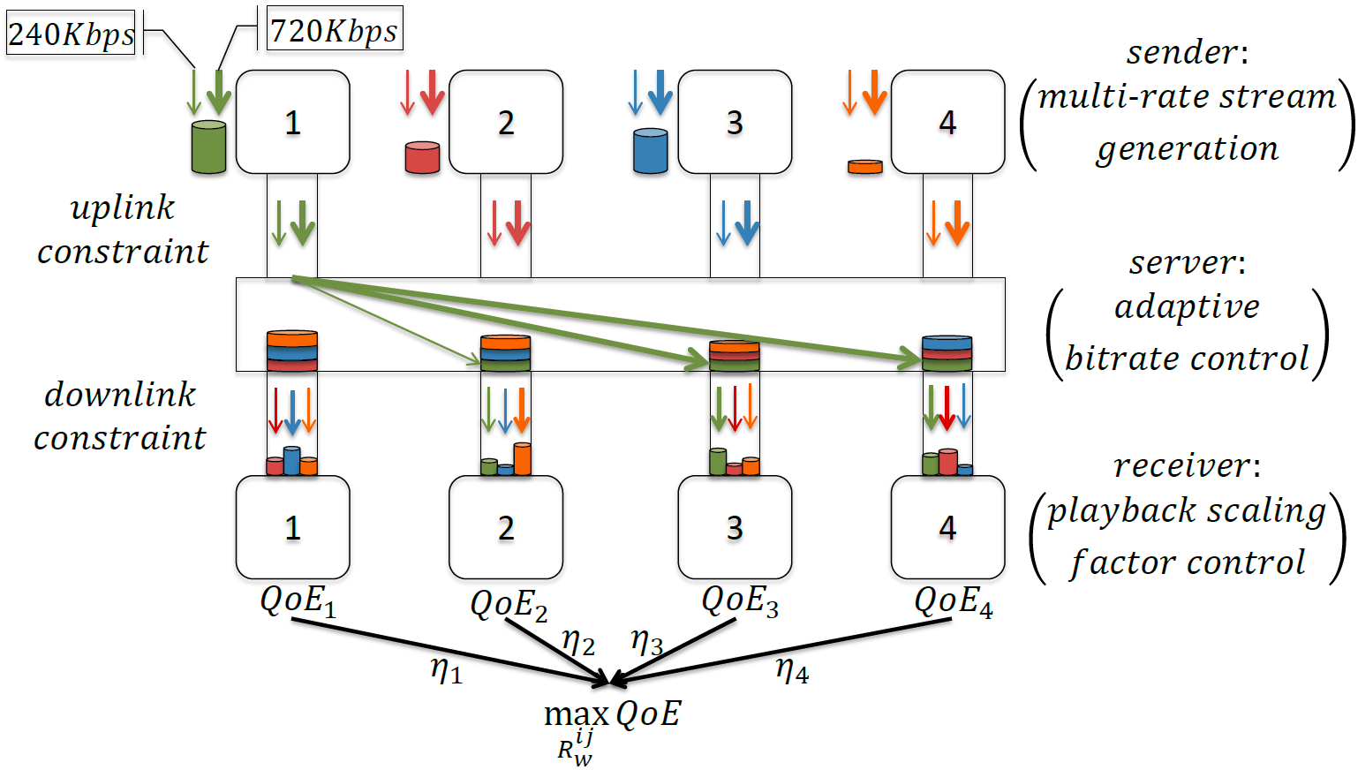
Architecture & Problem
In multiparty interactive live streaming, how to design the adaptive bitrate control algorithm?
That is, in different network conditions, how many streams are uploaded by each broadcaster, and what are their bitrates?

Slide 4
Challenges
The receivers’ multiple demands of bitrates cause the sender’s uplink to become a bottleneck.
Calculate the target bitrate for each pair of sender-receiver.
Cluster and aggregate the target bitrate according to the SVC requirements.
It is challenging to satisfy the receiver’s preferences for various senders whose disparate contents share the receiver’s downlink.
Dynamically adjust the weight of the broadcaster according to different scenarios and moments.
The definition of QoE can be considered in two levels. The global QoE should be the weighted sum of each broadcaster’s QoE; the QoE of each broadcaster depends on the situation in which he receives streams from others.
The estimates of both uplink and downlink throughput are inaccurate, resulting in inaccurate decision to adjust the bitrate.
Model a linear programming problem for the purpose of maximizing systematic QoE, and get the target bitrate for each pair of sender-receiver.
Continuously update the target bitrate through the buffer feedback adjustment mechanism to eliminate systematic errors.

Slide 5
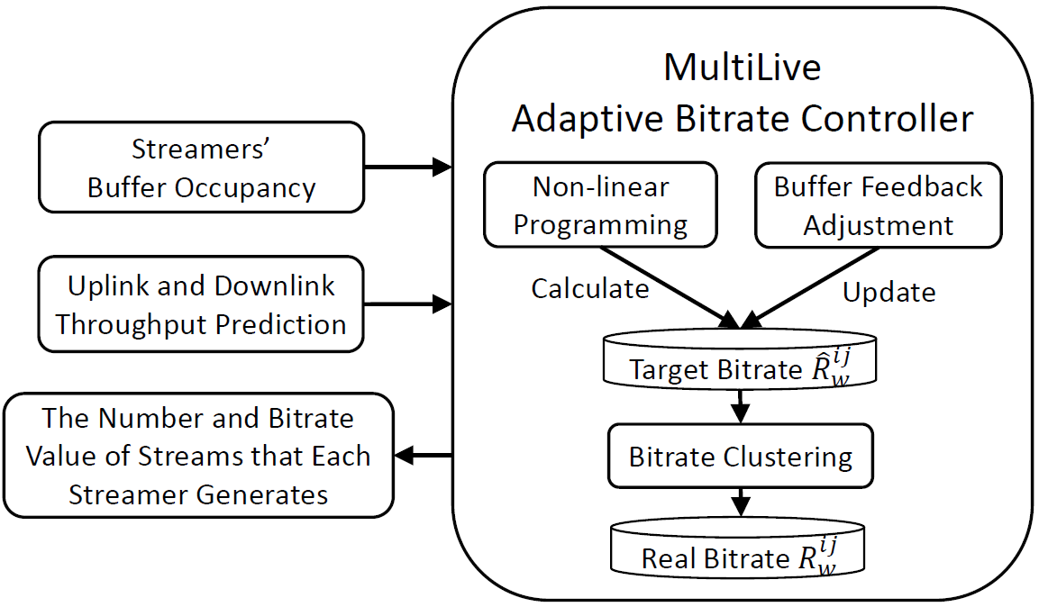
Algorithm workflow

Slide 6

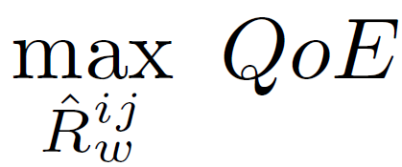
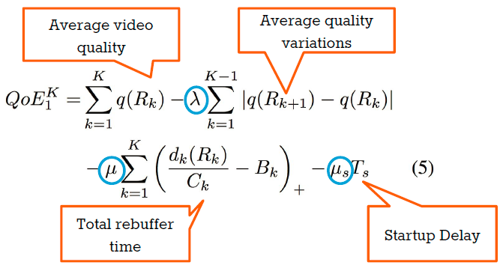
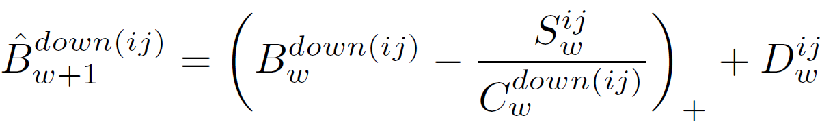




Design I
Build a non-linear programming solution for the purpose of maximizing systematic QoE, and then get the target bitrate for each pair of sender-receiver.

Slide 7

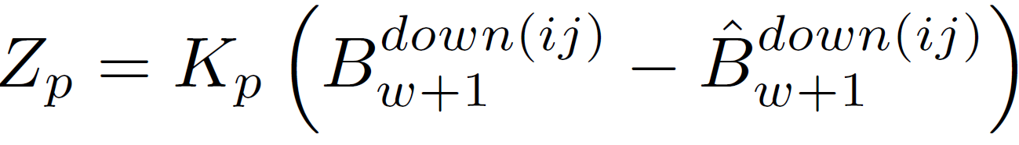
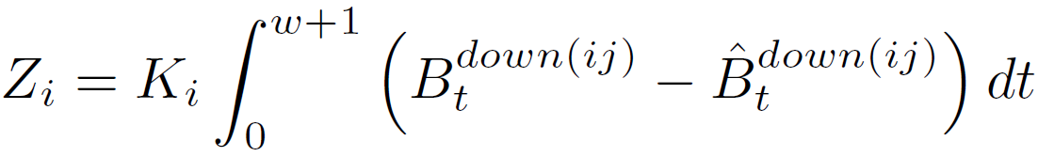
Design II
Update the target bitrate table based on the buffer feedback adjustment algorithm (PI controller).
Proportional controller calculates the difference between the current buffer and the target buffer to eliminate the prediction errors.
Integration controller integrates the difference between the current buffer and the target buffer to eliminate accumulated systematic errors.

Slide 8
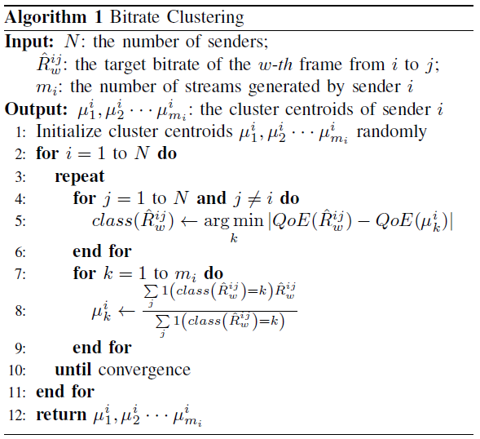
Design III
Cluster and aggregate the target streams according to the SVC requirements.
QoE distance
K-means clustering
dist = changes in QoE if
we send instead of
target bitrate requested by receiver
cluster centroid of sender

Slide 9


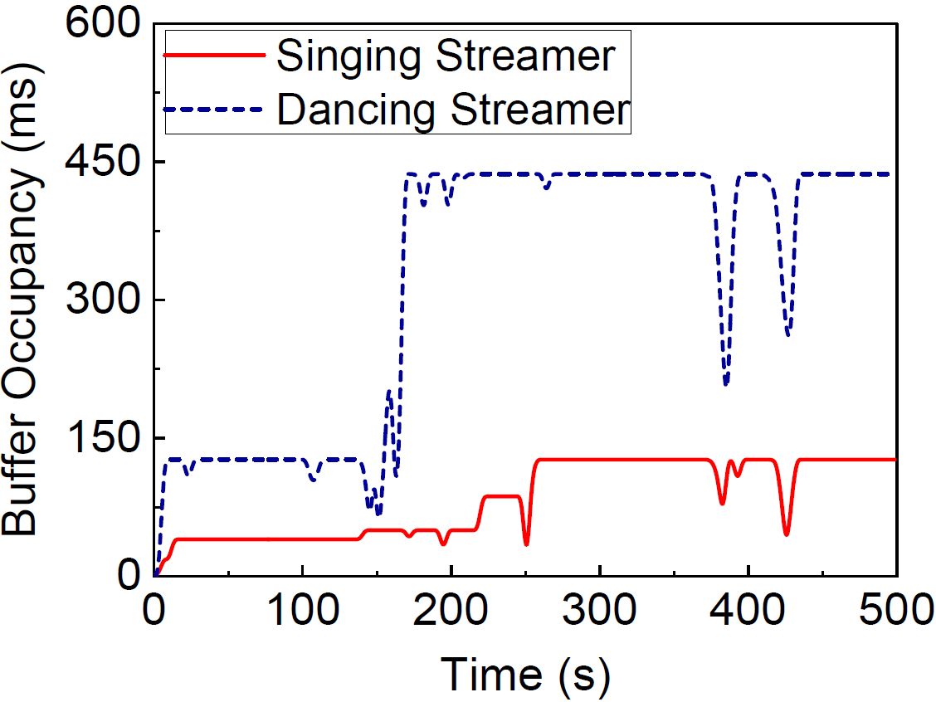
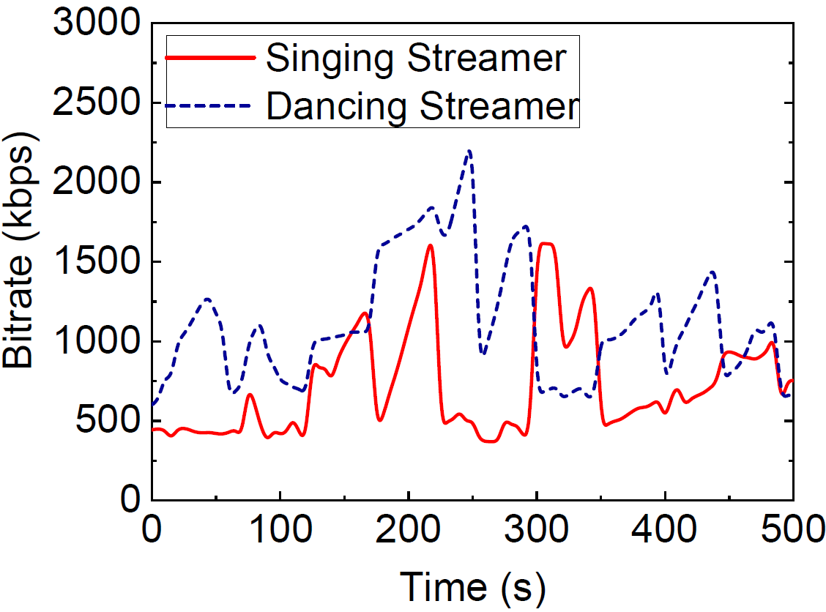

Implementation & Evaluation
The preference for multiple broadcasters
Bob and David are singing together in a chorus.
Alice is dancing for them.
Bob increases the delay penalty weight of David and increases the video quality weight of Alice.
Bob
David
Alice

Slide 10
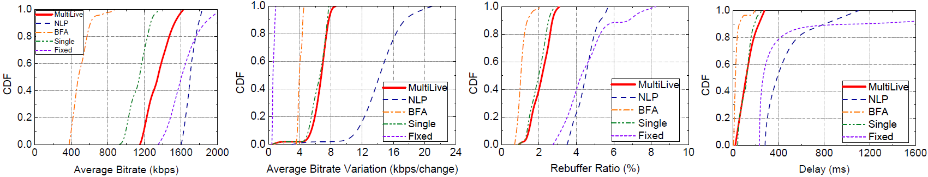
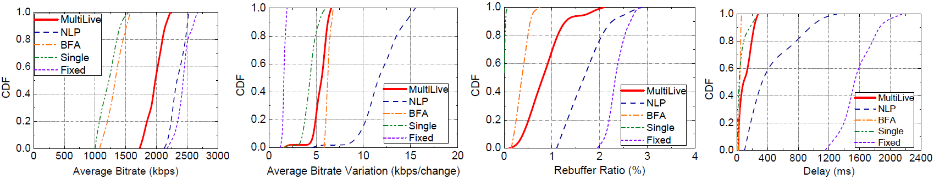
Implementation & Evaluation
Fine-grained QoE Performance for real industry dataset
Fine-grained QoE Performance for Belgium 4G/LTE dataset

Slide 11
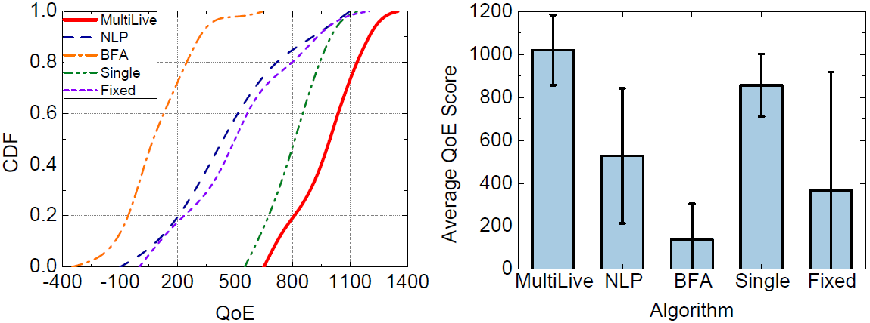
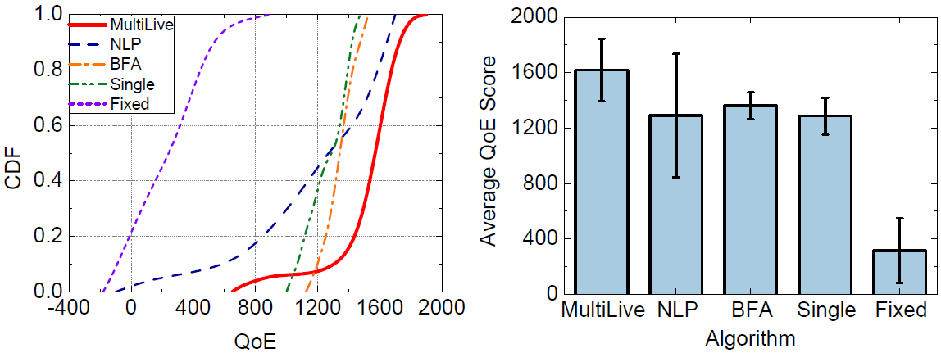
Implementation & Evaluation
Normalized QoE Performance for real industry dataset
Normalized QoE Performance for Belgium 4G/LTE dataset

Slide 12
Conclusion
We propose an architecture for multi-party interactive live streaming.
We build a QoE model and propose MultiLive, an adaptive bitrate control algorithm.
Specifically, we apply non-linear programming to get the target bitrate for each pair of online streamers, and adjust the bitrate according to the buffer feedback to avoid the accumulation of system errors. To alleviate the problem of limited uplink transmission rate, we use bitrate clustering to reduce the number of streams to transmit from a streamer.
Our results from extensive trace-driven simulations and test bed experiments demonstrate that MultiLive outperforms the fixed bitrate algorithm, with 2-5x improvement of the average QoE.
Furthermore, the end-to-end delay has been reduced to about 100 ms, which is much lower than 400 ms used as the delay threshold in existing schemes for video conferencing.

Slide 13
Related Work
Multiparty video conference (AgRank [TMM’17], vSkyConf [SIGCOMM Workshop’13])
They study the problem from a theoretical perspective and mainly focus on transcoding-server selection.
Broadcaster often interacts more intensively with other broadcasters during live broadcast.
Live streaming pays more attention to the user’s experience and aims to improve the QoE indicator.
Live streaming (QARC [MM’18], PIECE [MM’18], VDN [SIGCOMM’15], Crowdsource [INFOCOM’15])
They mainly consider one source and its delivery to a number of viewers, which is different from us.
They don’t consider the real-time interaction scenarios, in which the delay requirement will be harsh.
Previous ABR algorithms
Rate-based: pick bitrate based on predicted throughput (PANDA [JSAC’14], CS2P [SIGCOMM’16])
Buffer-based: pick bitrate based on buffer occupancy (BBA [SIGCOMM’14], BOLA [INFOCOM’16])
Hybrid: use both throughput prediction & buffer occupancy (PBA [HotMobile’15], MPC [SIGCOMM’15])
They focus on one-to-one bitrate adaptation problem in VoD streaming scenarios, rather than many-to-many in interactive live streaming scenarios.
They select from discrete bitrate gears instead of adjusting on continuous bitrate domain.

Slide 14
Q&A
Thanks!

