Slide 1

Improving Distributional Similarity with Lessons Learned from Word Embeddings
Omer Levy Yoav Goldberg Ido Dagan
Bar-Ilan University
Israel
Notes:
I’d like to talk to you about how word embeddings are really improving distributional similarity.
This is joint work with Yoav Goldberg and Ido Dagan.

Slide 2
Word Similarity & Relatedness
How similar is pizza to pasta?
How related is pizza to Italy?
Representing words as vectors allows easy computation of similarity
Notes:
If you’ve come to this talk, you’re probably all interested in measuring word similarity, or relatedness.
For example, how similar is pizza to pasta?
Or how related is pizza to Italy?
Representing words as vectors has become a very convenient way to compute these similarities,
For example, using their cosine.

Slide 3
Approaches for Representing Words
Distributional Semantics (Count)
Used since the 90’s
Sparse word-context PMI/PPMI matrix
Decomposed with SVD
Word Embeddings (Predict)
Inspired by deep learning
word2vec (Mikolov et al., 2013)
GloVe (Pennington et al., 2014)
Underlying Theory: The Distributional Hypothesis (Harris, ’54; Firth, ‘57)
“Similar words occur in similar contexts”
Notes:
There are two approaches for creating these vectors:
First, we’ve got the traditional count-based approach,
where the most common variant is the word-context PMI matrix.
The other, cutting-edge, approach, is word embeddings,
Which has become extremely popular with word2vec.
Now, the interesting thing…
…is that both approaches rely on the same linguistic theory: the distributional hypothesis.
<pause>
Now, in previous work, that I’ll talk about in a minute,
we showed that the two approaches are even more related.

Slide 4
Approaches for Representing Words
Both approaches:
Rely on the same linguistic theory
Use the same data
Are mathematically related
“Neural Word Embedding as Implicit Matrix Factorization” (NIPS 2014)
How come word embeddings are so much better?
“Don’t Count, Predict!” (Baroni et al., ACL 2014)
More than meets the eye…
Notes:
Not only are they based on the same linguistic theory,
They also use the same data,
And even have a strong mathematical connection.
If that’s the case, then how come word embeddings are so much better?
There’s even an ACL paper that shows it!
So today I’m going to try and convince you, that there’s more to this story, than meets the eye.

Slide 5
The Contributions of Word Embeddings
What’s really improving performance?
Novel Algorithms
(objective + training method)
Skip Grams + Negative Sampling
CBOW + Hierarchical Softmax
Noise Contrastive Estimation
GloVe
…
New Hyperparameters
(preprocessing, smoothing, etc.)
Subsampling
Dynamic Context Windows
Context Distribution Smoothing
Adding Context Vectors
…
Notes:
When you take a deeper look at the latest word embedding methods,
you’ll notice that they actually have 2 main contributions:
First, you’ve got the algorithms.
This is what seems to be the only contribution, or at least what gets papers into ACL :)
But a closer look reveals that these papers also introduce…
…new hyperparameters.
Now, some of these may seem like they’re part of the algorithms themselves,
But what I’m going to show you today,
is that they actually can be separated from their original methods,
and applied across many other algorithms.
So what’s really improving performance?

Slide 6
The Contributions of Word Embeddings
What’s really improving performance?
Novel Algorithms
(objective + training method)
Skip Grams + Negative Sampling
CBOW + Hierarchical Softmax
Noise Contrastive Estimation
GloVe
…
New Hyperparameters
(preprocessing, smoothing, etc.)
Subsampling
Dynamic Context Windows
Context Distribution Smoothing
Adding Context Vectors
…
Notes:
Is it the algorithms?

Slide 7
The Contributions of Word Embeddings
What’s really improving performance?
Novel Algorithms
(objective + training method)
Skip Grams + Negative Sampling
CBOW + Hierarchical Softmax
Noise Contrastive Estimation
GloVe
…
New Hyperparameters
(preprocessing, smoothing, etc.)
Subsampling
Dynamic Context Windows
Context Distribution Smoothing
Adding Context Vectors
…
Notes:
The hyperparameters?

Slide 8
The Contributions of Word Embeddings
What’s really improving performance?
Novel Algorithms
(objective + training method)
Skip Grams + Negative Sampling
CBOW + Hierarchical Softmax
Noise Contrastive Estimation
GloVe
…
New Hyperparameters
(preprocessing, smoothing, etc.)
Subsampling
Dynamic Context Windows
Context Distribution Smoothing
Adding Context Vectors
…
Notes:
Or maybe a bit of both?
<pause>

Slide 9
Our Contributions
Identifying the existence of new hyperparameters
Not always mentioned in papers
Adapting the hyperparameters across algorithms
Must understand the mathematical relation between algorithms
Notes:
So to answer this question, we did 3 things:
(1) First, we identified that these hyperparameters even exist.
This isn’t as easy as it sounds.
Many hyperparameters aren’t even mentioned in the papers, and if they are, it’s usually as a footnote.
Unless you dig into the code, you won’t have an exact picture of what’s really going on.
(2) After making a list of all these hyperparameters, we then adapted them across different methods.
Now, some hyperparameters look like they cannot be adapted,
But once we understood the deeper mathematical connection between the algorithms,
This process became a lot clearer.

Slide 10
Our Contributions
Identifying the existence of new hyperparameters
Not always mentioned in papers
Adapting the hyperparameters across algorithms
Must understand the mathematical relation between algorithms
Comparing algorithms across all hyperparameter settings
Over 5,000 experiments
Notes:
(3) Finally, we were able to apply almost every hyperparameter to every method,
and perform systematic “apples to apples” comparisons of the algorithms.

Slide 11
Background
Notes:
Let’s begin with some background,
Which is really important for understanding what these hyperparameters are,
And how we can adapt them across different methods.

Slide 12
What is word2vec?
Notes:
So what is word2vec?...

Slide 13
What is word2vec? How is it related to PMI?
Notes:
…And how is it related to PMI?

Slide 14
What is word2vec?
word2vec is not a single algorithm
It is a software package for representing words as vectors, containing:
Two distinct models
CBoW
Skip-Gram
Various training methods
Negative Sampling
Hierarchical Softmax
A rich preprocessing pipeline
Dynamic Context Windows
Subsampling
Deleting Rare Words
Notes:
Word2vec is *not* an algorithm.
It’s actually a software package
With two distinct models
Various ways to train these models
And a rich preprocessing pipeline

Slide 15
What is word2vec?
word2vec is not a single algorithm
It is a software package for representing words as vectors, containing:
Two distinct models
CBoW
Skip-Gram (SG)
Various training methods
Negative Sampling (NS)
Hierarchical Softmax
A rich preprocessing pipeline
Dynamic Context Windows
Subsampling
Deleting Rare Words
Notes:
Now, we’re going to focus on Skip-Grams with Negative Sampling,
Which is considered the state-of-the-art.

Slide 16
Skip-Grams with Negative Sampling (SGNS)
Marco saw a furry little wampimuk hiding in the tree.
“word2vec Explained…”
Goldberg & Levy, arXiv 2014
Notes:
So, how does SGNS work?
Let’s say we have this sentence,
(This example was shamelessly taken from Marco Baroni)

Slide 17
Skip-Grams with Negative Sampling (SGNS)
Marco saw a furry little wampimuk hiding in the tree.
“word2vec Explained…”
Goldberg & Levy, arXiv 2014
Notes:
And we want to understand what a wampimuk is.

Slide 18
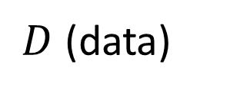
Skip-Grams with Negative Sampling (SGNS)
Marco saw a furry little wampimuk hiding in the tree.
words contexts
wampimuk furry
wampimuk little
wampimuk hiding
wampimuk in
… …
$D$ (data)
“word2vec Explained…”
Goldberg & Levy, arXiv 2014
Notes:
What SGNS does is take the context words around “wampimuk”,
And in this way,
Constructs a dataset of word-context pairs, D.

Slide 19

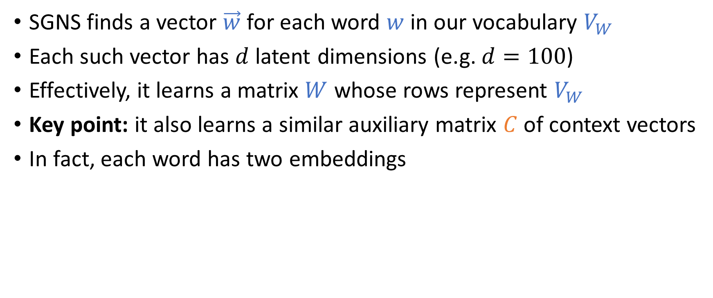








Skip-Grams with Negative Sampling (SGNS)
SGNS finds a vector $\vec{w}$ for each word $w$ in our vocabulary $V_{W}$
Each such vector has $d$ latent dimensions (e.g. $d=100$)
Effectively, it learns a matrix $W$ whose rows represent $V_{W}$
Key point: it also learns a similar auxiliary matrix $C$ of context vectors
In fact, each word has two embeddings
$$d$$
$$d$$
$$W$$
$w$:wampimuk $=(−3.1, 4.15, 9.2, −6.5,…)$
$$C$$
$$V_{W}$$
$$≠$$
$$V_{C}$$
$c$:wampimuk $=(−5.6, 2.95, 1.4, −1.3,…)$
“word2vec Explained…”
Goldberg & Levy, arXiv 2014
Notes:
Now, using D,
SGNS is going to learn a vector for each word in the vocabulary
A vector of say… 100 latent dimensions.
Effectively, it’s learning a matrix W,
Where each row is a vector that represents a specific word.
Now, a key point in understanding SGNS,
Is that it also learns an auxiliary matrix C of context vectors
So in fact, each word has two different embeddings
Which are not necessarily similar.

Slide 20
Skip-Grams with Negative Sampling (SGNS)
“word2vec Explained…”
Goldberg & Levy, arXiv 2014
Notes:
So to train these vectors…

Slide 21
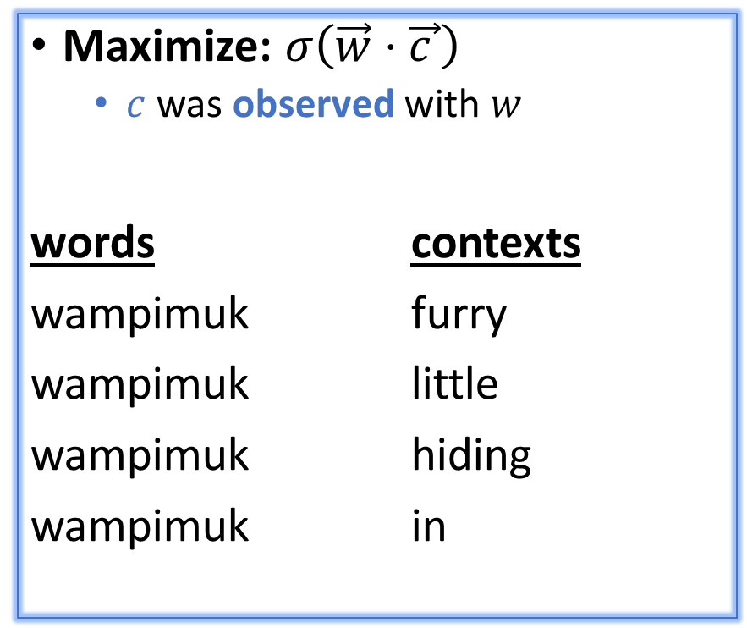
Skip-Grams with Negative Sampling (SGNS)
Maximize: $σ\left(\vec{w}⋅\vec{c_{ }}\right)$
$c$ was observed with $w$
words contexts
wampimuk furry
wampimuk little
wampimuk hiding
wampimuk in
“word2vec Explained…”
Goldberg & Levy, arXiv 2014
Notes:
…SGNS maximizes the similarity between word and context vectors that were observed together.

Slide 22
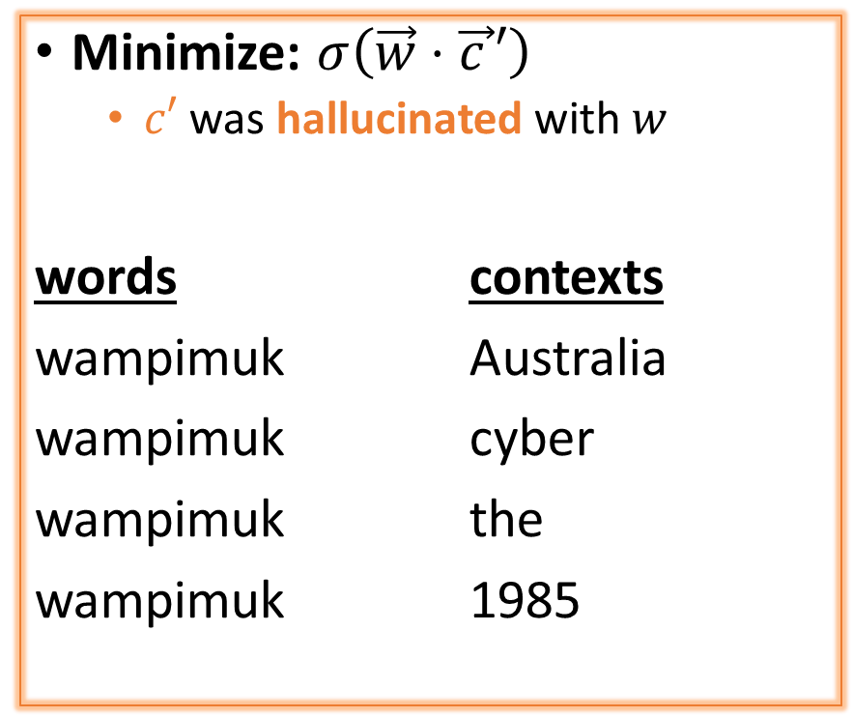
Skip-Grams with Negative Sampling (SGNS)
Maximize: $σ\left(\vec{w}⋅\vec{c_{ }}\right)$
$c$ was observed with $w$
words contexts
wampimuk furry
wampimuk little
wampimuk hiding
wampimuk in
Minimize: $σ\left(\vec{w}⋅\vec{c_{ }}′\right)$
$c′$ was hallucinated with $w$
words contexts
wampimuk Australia
wampimuk cyber
wampimuk the
wampimuk 1985
“word2vec Explained…”
Goldberg & Levy, arXiv 2014
Notes:
…and minimizes the similarity between word and context vectors hallucinated together.

Slide 23
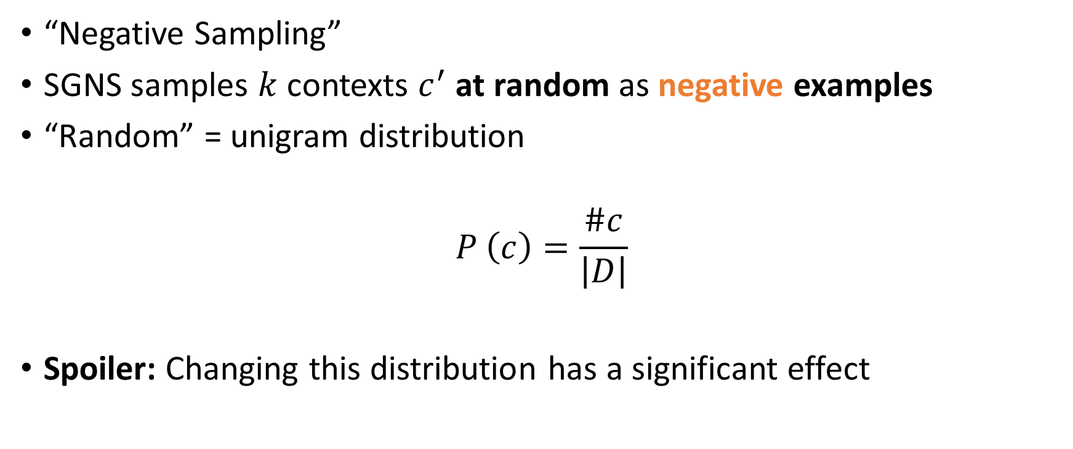
Skip-Grams with Negative Sampling (SGNS)
“Negative Sampling”
SGNS samples $k$ contexts $c^{′}$ at random as negative examples
“Random” = unigram distribution
$$P_{ }^{ }\left(c\right)=\frac{\#c}{\left|D\right|}$$
Spoiler: Changing this distribution has a significant effect
Notes:
Now, the way SGNS hallucinates is really important.
It’s actually where it gets its name from.
For each observed word-context pair,
SGNS samples k contexts at random,
As negative examples
Now, when we say random, we mean the unigram distribution
And Spoiler Alert: changing this distribution has quite a significant effect.

Slide 24
What is SGNS learning?
Notes:
Now that we have an idea of how SGNS works,
I’m going to show you that it’s learning something very familiar.

Slide 25







What is SGNS learning?
Take SGNS’s embedding matrices ($W$ and $C$)
$$d$$
$$d$$
$$W$$
$$C$$
$$V_{W}$$
$$V_{C}$$
“Neural Word Embeddings as Implicit Matrix Factorization”
Levy & Goldberg, NIPS 2014
Notes:
If we take the embedding matrices

Slide 26


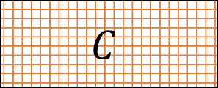

What is SGNS learning?
Take SGNS’s embedding matrices ($W$ and $C$)
Multiply them
What do you get?
$$d$$
$$W$$
$$V_{C}$$
$$C$$
$$V_{W}$$
$$d$$
“Neural Word Embeddings as Implicit Matrix Factorization”
Levy & Goldberg, NIPS 2014
Notes:
And multiply them
What do we get?

Slide 27





What is SGNS learning?
A $V_{W}×V_{C}$ matrix
Each cell describes the relation between a specific word-context pair
$\vec{w}⋅\vec{c}= ?$
$$d$$
$$V_{C}$$
$$W$$
$$?$$
$$V_{C}$$
$$C$$
$$=$$
$$V_{W}$$
$$d$$
$$V_{W}$$
“Neural Word Embeddings as Implicit Matrix Factorization”
Levy & Goldberg, NIPS 2014
Notes:
We get a pretty big, square matrix,
Where each cell describes the relation between a specific word, w,
With a specific context, c.

Slide 28

What is SGNS learning?
We proved that for large enough $d$ and enough iterations
$$d$$
$$V_{C}$$
$$W$$
$$?$$
$$V_{C}$$
$$C$$
$$=$$
$$V_{W}$$
$$d$$
$$V_{W}$$
“Neural Word Embeddings as Implicit Matrix Factorization”
Levy & Goldberg, NIPS 2014
Notes:
So in our NIPS paper, we proved that with enough dimensions and iterations…

Slide 29


What is SGNS learning?
We proved that for large enough $d$ and enough iterations
We get the word-context PMI matrix
$$d$$
$$V_{C}$$
$$W$$
$$M^{PMI}$$
$$V_{C}$$
$$C$$
$$=$$
$$V_{W}$$
$$d$$
$$V_{W}$$
“Neural Word Embeddings as Implicit Matrix Factorization”
Levy & Goldberg, NIPS 2014
Notes:
…SGNS will converge to the classic word-context PMI matrix…

Slide 30


What is SGNS learning?
We prove that for large enough $d$ and enough iterations
We get the word-context PMI matrix, shifted by a global constant
$Opt\left(\vec{w}⋅\vec{c}\right)=PMI\left(w,c\right)−\log{k}$
$$d$$
$$V_{C}$$
$$W$$
$$M^{PMI}$$
$$V_{C}$$
$$C$$
$$=$$
$$−\log{k}$$
$$V_{W}$$
$$d$$
$$V_{W}$$
“Neural Word Embeddings as Implicit Matrix Factorization”
Levy & Goldberg, NIPS 2014
Notes:
…with a little twist.
Now, recall that k is the number of negative samples generated for each positive example (w,c) \in D.
This is of course the optimal value, and not necessarily what we get in practice.

Slide 31
What is SGNS learning?
SGNS is doing something very similar to the older approaches
SGNS is factorizing the traditional word-context PMI matrix
So does SVD!
GloVe factorizes a similar word-context matrix
Notes:
So to sum it up, SGNS is doing what we’ve been doing in NLP for a couple of decades:
It’s factorizing the PMI matrix,
Apparently, just like SVD.
And, while I didn’t explain it, GloVe also factorizes a similar matrix.

Slide 32
But embeddings are still better, right?
Plenty of evidence that embeddings outperform traditional methods
“Don’t Count, Predict!” (Baroni et al., ACL 2014)
GloVe (Pennington et al., EMNLP 2014)
How does this fit with our story?
Notes:
But embeddings are still better, right?
There’s plenty of evidence,
Even a couple of papers.
So how does this fit with our story?

Slide 33
The Big Impact of “Small” Hyperparameters
Notes:
1.. 2..
<pause>

Slide 34
The Big Impact of “Small” Hyperparameters
word2vec & GloVe are more than just algorithms…
Introduce new hyperparameters
May seem minor, but make a big difference in practice
Notes:
So like I said at the beginning, word2vec and GloVe are more than just algorithms.
They introduce many new hyperparameters,
Which may seem minor,
but as it turns out, they make a pretty big difference in practice.

Slide 35
Identifying New Hyperparameters
Notes:
1.. 2..
<pause>

Slide 36
New Hyperparameters
Preprocessing (word2vec)
Dynamic Context Windows
Subsampling
Deleting Rare Words
Postprocessing (GloVe)
Adding Context Vectors
Association Metric (SGNS)
Shifted PMI
Context Distribution Smoothing
Notes:
So let’s make a list of all the new hyperparameters we found:
The first group of hyperparameters is in the pre-processing pipeline.
All of these were introduced as part of word2vec.
The second group contains post-processing modifications,
And the third group of hyperparameters affects the association metric between words and contexts.
This last group is really interesting, because to make sense of it,
you have to understand that SGNS is actually factorizing the word-context PMI matrix.

Slide 37
New Hyperparameters
Preprocessing (word2vec)
Dynamic Context Windows
Subsampling
Deleting Rare Words
Postprocessing (GloVe)
Adding Context Vectors
Association Metric (SGNS)
Shifted PMI
Context Distribution Smoothing
Notes:
We don’t have time to go over all of these…

Slide 38
New Hyperparameters
Preprocessing (word2vec)
Dynamic Context Windows
Subsampling
Deleting Rare Words
Postprocessing (GloVe)
Adding Context Vectors
Association Metric (SGNS)
Shifted PMI
Context Distribution Smoothing
Notes:
…so we’ll just look at these two:
Dynamic context windows
and
Adding context vectors
and finally…

Slide 39
New Hyperparameters
Preprocessing (word2vec)
Dynamic Context Windows
Subsampling
Deleting Rare Words
Postprocessing (GloVe)
Adding Context Vectors
Association Metric (SGNS)
Shifted PMI
Context Distribution Smoothing
Notes:
…we’ll look at Context Distribution Smoothing,
and see how we can adapt it to traditional count-based methods.

Slide 40
Dynamic Context Windows
Marco saw a furry little wampimuk hiding in the tree.
Notes:
So dynamic context windows
Let’s say we have our sentence from earlier,
And we want to look at a context window of 4 words around wampimuk.

Slide 41
Dynamic Context Windows
Marco saw a furry little wampimuk hiding in the tree.
Notes:
Now, some of these context words are obviously more related to the meaning of wampimuk than others.
The intuition behind dynamic context windows, is that the closer the context is to the target…

Slide 42
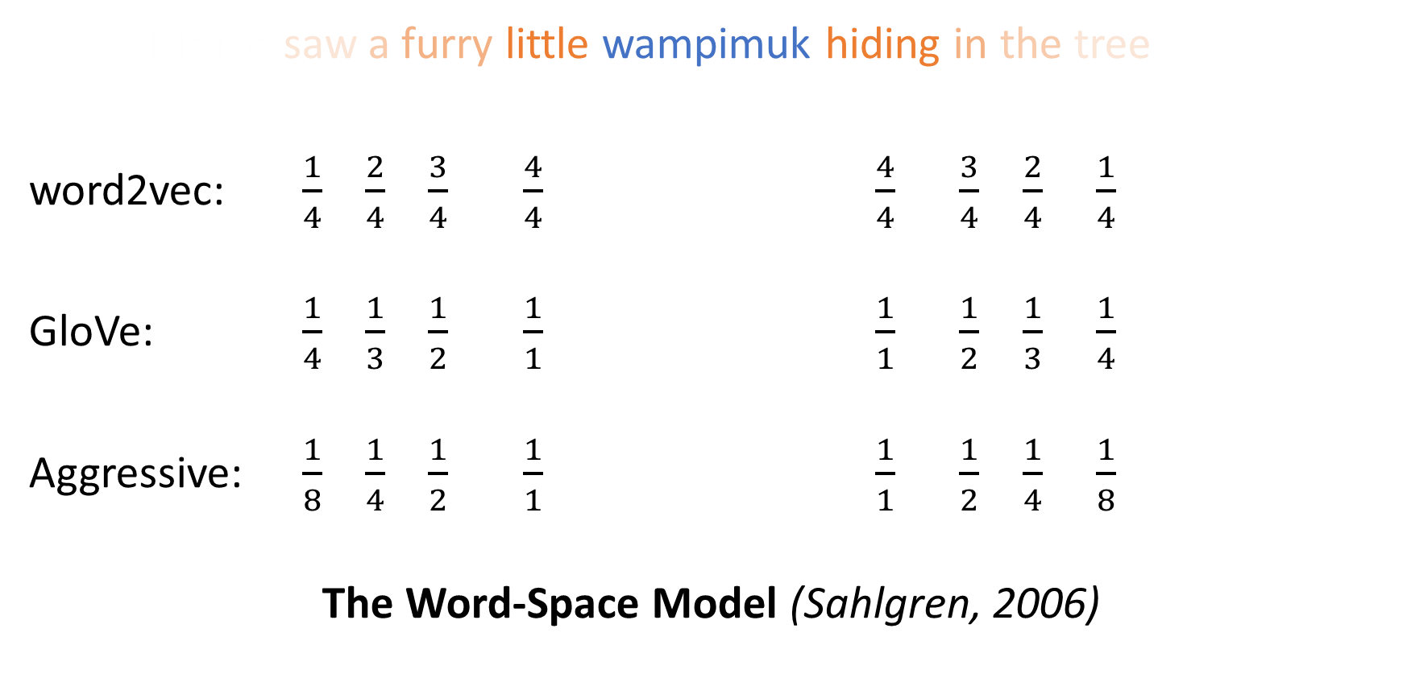
Dynamic Context Windows
Marco saw a furry little wampimuk hiding in the tree.
word2vec: $\frac{1}{4}$ $\frac{2}{4}$ $\frac{3}{4}$ $\frac{4}{4}$ $\frac{4}{4}$ $\frac{3}{4}$ $\frac{2}{4}$ $\frac{1}{4}$
GloVe: $\frac{1}{4}$ $\frac{1}{3}$ $\frac{1}{2}$ $\frac{1}{1}$ $\frac{1}{1}$ $\frac{1}{2}$ $\frac{1}{3}$ $\frac{1}{4}$
Aggressive: $\frac{1}{8}$ $\frac{1}{4}$ $\frac{1}{2}$ $\frac{1}{1}$ $\frac{1}{1}$ $\frac{1}{2}$ $\frac{1}{4}$ $\frac{1}{8}$
The Word-Space Model (Sahlgren, 2006)
Notes:
…the more relevant it is.
word2vec does just that, by randomly sampling the size of the context window around each token.
What you see here are the probabilities that each specific context word will be included in the training data.
GloVe also does something similar, but in a deterministic manner, and with a slightly different distribution.
There are of course other ways to do this,
And they were all, apparently,
Applied to traditional algorithms about a decade ago.

Slide 43

Adding Context Vectors
SGNS creates word vectors $\vec{w}$
SGNS creates auxiliary context vectors $\vec{c}$
So do GloVe and SVD
Notes:
The second hyperparameter I’d like to discuss is adding context vectors.
So, remember that SGNS doesn’t only create word vectors,
It also creates these auxiliary context vectors.
And, by the way, so do GloVe and SVD.

Slide 44
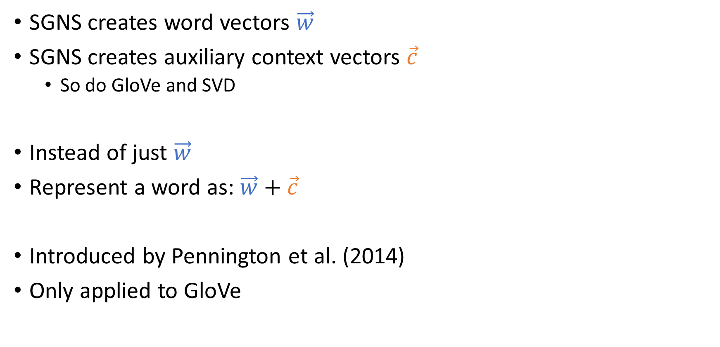
Adding Context Vectors
SGNS creates word vectors $\vec{w}$
SGNS creates auxiliary context vectors $\vec{c}$
So do GloVe and SVD
Instead of just $\vec{w}$
Represent a word as: $\vec{w}+\vec{c}$
Introduced by Pennington et al. (2014)
Only applied to GloVe
Notes:
So, each word has two representations, right?
So what if instead of using just the word vectors,
We’d also use the information in the context vectors,
to represent our words?
This trick was introduced as part of GloVe,
But it was also only applied to GloVe,
and not to the other methods.

Slide 45
Adapting Hyperparameters across Algorithms
Notes:
So now that we’ve made a list of these hyperparameters,
We want to be able to apply all of them to any other algorithm, right?
In some cases, like dynamic context windows, it’s pretty straightforward, because you’re just changing your preprocessing.
The next example, however, is slightly more complicated.

Slide 46

Context Distribution Smoothing
SGNS samples $c^{′}\sim P_{ }$ to form negative $(w,c′)$ examples
Our analysis assumes $P_{ }$ is the unigram distribution
$$P_{ }^{ }\left(c\right)=\frac{\#c}{\sum_{c^{′}∈V_{C}}{\#c^{′}}}$$
Notes:
Let’s talk about context distribution smoothing,
And see how we can adapt it to traditional PMI vectors.
<pause>
So remember that SGNS samples these negative contexts from some distribution?
And that I said that this distribution is the unigram distribution?
Well, I wasn’t completely honest with you…

Slide 47
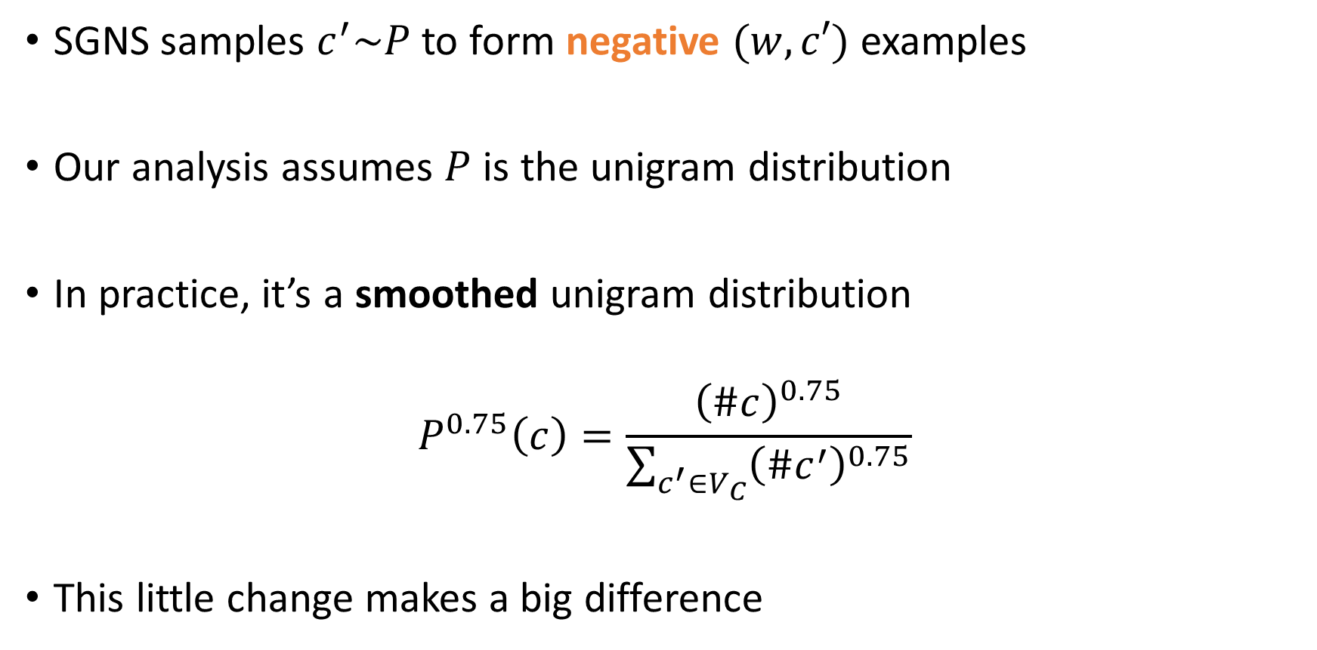
Context Distribution Smoothing
SGNS samples $c^{′}\sim P_{ }$ to form negative $(w,c′)$ examples
Our analysis assumes $P_{ }$ is the unigram distribution
In practice, it’s a smoothed unigram distribution
$$P_{ }^{0.75}\left(c\right)=\frac{{\left(\#c\right)}^{0.75}}{\sum_{c^{′}∈V_{C}}{{\left(\#c^{′}\right)}^{0.75}}}$$
This little change makes a big difference
Notes:
In practice, it’s actually a smoothed unigram distribution.
And this tiny little change, makes quite a big difference.

Slide 48
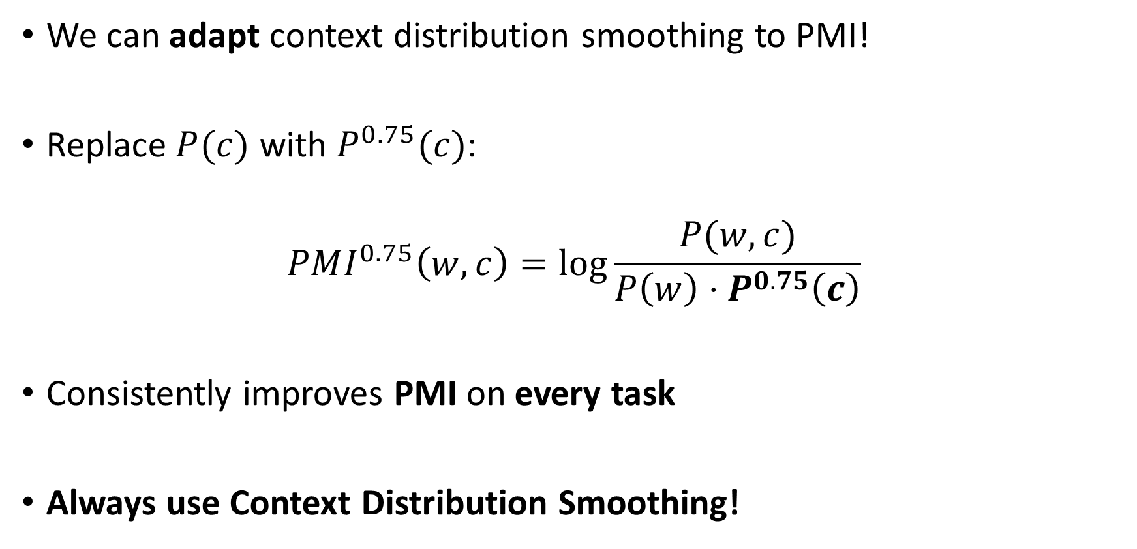
Context Distribution Smoothing
We can adapt context distribution smoothing to PMI!
Replace $P(c)$ with $P_{ }^{0.75}(c)$:
$$PMI^{0.75}\left(w,c\right)=\log{\frac{P(w,c)}{P\left(w\right)⋅P^{0.75}\left(c\right)}}$$
Consistently improves PMI on every task
Always use Context Distribution Smoothing!
Notes:
Now, what’s neat about context distribution smoothing
Is that we can adapt it to PMI!
This is done by simply replacing the probability of C with the smoothed probability.
Just like this:
And this tweak consistently improves performance on every task.
So if there’s one technical detail you should remember from this talk, it’s this:
Always use context distribution smoothing!

Slide 49
Comparing Algorithms

Slide 50
Controlled Experiments
Prior art was unaware of these hyperparameters
Essentially, comparing “apples to oranges”
We allow every algorithm to use every hyperparameter
Notes:
Previous work was unaware of these hyperparameters, or considered them part of the algorithm.
Essentially, they were comparing apples to oranges.
In our experiments, we allow every algorithm to use every hyperparameter.

Slide 51
Controlled Experiments
Prior art was unaware of these hyperparameters
Essentially, comparing “apples to oranges”
We allow every algorithm to use every hyperparameter*
* If transferable
Notes:
With a few exceptions,
Where we couldn’t find a way to adapt a specific hyperparameter to a specific method.

Slide 52
Systematic Experiments
9 Hyperparameters
6 New
4 Word Representation Algorithms
PPMI (Sparse & Explicit)
SVD(PPMI)
SGNS
GloVe
8 Benchmarks
6 Word Similarity Tasks
2 Analogy Tasks
5,632 experiments
Notes:
So overall, we ran a huge number of experiments.
We had 9 hyperparameters, 6 of which were new,
4 word representation algorithms,
And 8 different benchmarks.
Now, this ended up in over 5,000 experiments,
so I won’t be able to walk you through all the results,
but I can give you a taste.

Slide 53
Systematic Experiments
9 Hyperparameters
6 New
4 Word Representation Algorithms
PPMI (Sparse & Explicit)
SVD(PPMI)
SGNS
GloVe
8 Benchmarks
6 Word Similarity Tasks
2 Analogy Tasks
5,632 experiments
Notes:
What I’m going to do, is show you an example of how previous work compared algorithms,
And how things change when you compare apples to apples.

Slide 54
Hyperparameter Settings
Classic Vanilla Setting
(commonly used for distributional baselines)
Preprocessing
<None>
Postprocessing
<None>
Association Metric
Vanilla PMI/PPMI
Notes:
So for our example, we’re going to consider two hyperparameter settings:
First, we’ve got the classic vanilla setting
Which is what’s usually used to create baseline distributional representations.
This really is the simplest setting you can get.

Slide 55
Hyperparameter Settings
Classic Vanilla Setting
(commonly used for distributional baselines)
Preprocessing
<None>
Postprocessing
<None>
Association Metric
Vanilla PMI/PPMI
Recommended word2vec Setting
(tuned for SGNS)
Preprocessing
Dynamic Context Window
Subsampling
Postprocessing
<None>
Association Metric
Shifted PMI/PPMI
Context Distribution Smoothing
Notes:
On the other hand, we have the recommended setting of word2vec,
Which was tuned for SGNS…
…and does quite a bit more.
Now, when we just look at these 2 settings, side by side,
It’s easier to see that part of word2vec’s contribution is this collection of hyperparameters.

Slide 56
Experiments
Notes:
<pause>
So for our example, we’ll use the wordsim dataset to compare PPMI vectors,
a traditional distributional representation,
with SGNS embeddings.

Slide 57
Experiments: Prior Art
Experiments: “Apples to Apples”
Experiments: “Oranges to Oranges”
Notes:
In previous comparisons,
PPMI vectors would be generated using the vanilla setting,
While SGNS would use word2vec’s hyperparameter setting.
From looking at this experiment alone, SGNS does have a significant advantage.
Now, one thing we could do,
Is isolate SGNS from its hyperparameters, and run it in the vanilla setting.
SGNS is now slightly worse, but still better than PPMI by nearly 5 points.
But here comes the interesting part:
Because we found out how to adapt hyperparameters across different algorithms,
We can now apply the word2vec setting to train better PPMI vectors.
And this is how we improve distributional similarity.

Slide 58
Experiments: Hyperparameter Tuning
Experiments: “Oranges to Oranges”
[different settings]
Notes:
BUT this isn’t the end of the story.
What if the word2vec setting isn’t the best setting for this task?
After all, it was tuned for a certain type of analogies.
The right thing to do is to allow each method...
…to tune every hyperparameter.
As you can all see, tuning hyperparameters can take us well beyond conventional settings,
And also give us a more elaborate and realistic comparison of different algorithms.
<>
Now, it’s important to stress that these two settings,
Can be, and usually are,
Very different in practice.
In fact, each task and each algorithm usually require different settings,
Which is why we used cross-validation to tune hyperparameters, when we compared the different algorithms.

Slide 59
Overall Results
Hyperparameters often have stronger effects than algorithms
Hyperparameters often have stronger effects than more data
Prior superiority claims were not accurate
Notes:
Now, this is only a little taste of our experiments,
And you’ll have to read the paper to get the entire picture,
But I will try to point out three major observations:
First, tuning hyperparameters often has a stronger positive effect than switching to a fancier algorithm.
Second, tuning hyperparameters might be even more effective than adding more data.
And third, previous claims that one algorithm is better than another, are not 100% true.

Slide 60
Re-evaluating Prior Claims
Notes:
<pause>

Slide 61
Don’t Count, Predict! (Baroni et al., 2014)
“word2vec is better than count-based methods”
Hyperparameter settings account for most of the reported gaps
Embeddings do not really outperform count-based methods
Notes:
So, in “don’t count, predict”,
The authors show that word2vec is better than count-based methods.
And, while they did tune a lot of different hyperparameters,
Other hyperparameters remained hidden inside the code.
And it turns out,
That these hidden hyperparameters account for most of the reported performance gaps.
In our experiments, we show that embeddings are not really better than count-based methods.

Slide 62
Don’t Count, Predict! (Baroni et al., 2014)
“word2vec is better than count-based methods”
Hyperparameter settings account for most of the reported gaps
Embeddings do not really outperform count-based methods*
* Except for one task…
Notes:
Well, except for one task, which I’ll get to in a second.

Slide 63
GloVe (Pennington et al., 2014)
“GloVe is better than word2vec”
Hyperparameter settings account for most of the reported gaps
Adding context vectors applied only to GloVe
Different preprocessing
We observed the opposite
SGNS outperformed GloVe on every task
Our largest corpus: 10 billion tokens
Perhaps larger corpora behave differently?
Notes:
Another claim that was recently made is about GloVe.
In the paper, the authors shows that GloVe outperforms word2vec.
Once again, they did not control for the same hyperparameters,
Specifically, they only added context vectors to GloVe, not to any other method,
And used different preprocessing pipelines for different methods.
But when we did control for hyperparameters,
We actually observed the opposite.
When both methods were tuned, SGNS outperformed GloVe on every single task.
Now, given our machinery, we were able to go up to a corpus of 10 billion words.
But it might be, that with even larger corpora, say… 100 billion words… things could behave differently.

Slide 64
GloVe (Pennington et al., 2014)
“GloVe is better than word2vec”
Hyperparameter settings account for most of the reported gaps
Adding context vectors applied only to GloVe
Different preprocessing
We observed the opposite
SGNS outperformed GloVe on every task
Our largest corpus: 10 billion tokens
Perhaps larger corpora behave differently?
Notes:
…now, rumor has it,
That we’ve made a hobby of refuting other people’s work.
That’s not entirely true…
We’re also going to refute some of our own.

Slide 65
Linguistic Regularities in Sparse and Explicit Word Representations (Levy and Goldberg, 2014)
“PPMI vectors perform on par with SGNS on analogy tasks”
Holds for semantic analogies
Does not hold for syntactic analogies (MSR dataset)
Hyperparameter settings account for most of the reported gaps
Different context type for PPMI vectors
Syntactic Analogies: there is a real gap in favor of SGNS
Notes:
So in a paper we published last year at CoNLL,
We basically explained how the analogy task works
You know, why “king – man + woman” equals “queen”
We also made the following claim:
PPMI performs on par with SGNS on analogy tasks
This is indeed true for semantic analogies, BUT
It’s not the case for syntactic analogies.
Once again, it’s because we used different hyperparameter settings.
Specifically, we used a different type of context,
Because, at the time,
We didn’t fully understand how word2vec works.
So, to sum it up, in the task of syntactic analogies,
there’s a real gap in favor of SGNS.

Slide 66
Conclusions
Notes:
So, in conclusion.

Slide 67
Conclusions: Distributional Similarity
The Contributions of Word Embeddings:
Novel Algorithms
New Hyperparameters
What’s really improving performance?
Hyperparameters (mostly)
The algorithms are an improvement
SGNS is robust
Notes:
Word embeddings have contributed 2 things to distributional similarity:
Novel algorithms,
And new hyperparameters.
And it appears, from our experiments, that what’s really improving performance,
Is mostly, the hyperparameters.
But, it’s important to say
that the algorithms are an improvement as well.
SGNS is more robust than traditional algorithms;
Even in tasks where it’s not the best-performing algorithm, SGNS is a very close second.

Slide 68
Conclusions: Distributional Similarity
The Contributions of Word Embeddings:
Novel Algorithms
New Hyperparameters
What’s really improving performance?
Hyperparameters (mostly)
The algorithms are an improvement
SGNS is robust & efficient
Notes:
And besides, SGNS is so memory-efficient and easy-to-use,
It’s become my personal favorite.

Slide 69
Conclusions: Methodology
Look for hyperparameters
Adapt hyperparameters across different algorithms
For good results: tune hyperparameters
For good science: tune baselines’ hyperparameters
Thank you :)
Notes:
But there are also some higher-level lessons to learn here.
Hyperparameters are not always obvious,
And you really need to look out for them.
Now, it’s not enough to find them;
You also need to try and adapt them across every other algorithm,
To make sure that you’re not giving one algorithm an unfair advantage over another.
And finally, if you want to get good results:
Tune hyperparameters.
And if you want to make good science,
Don’t forget to tune your baselines’ hyperparameters too ;)
Thank you :)

