Slide 1
Very Deep Convolutional Networks For Large-Scale Image Recognition
Karen Simonyan and Andrew Zisserman Visual Geometry Group (VGG), Department of Engineering Science, University of Oxford
Published as a conference paper at ICLR 2015
Reporters: Huang Qingyi (A0178431A), Jiang Zhiyuan (A0178415Y), Zhu Huiying (A0178222H)

Slide 2
Introduction
Configuration
Classification Framework
Experiment Evaluation
Novelty Summary
Use Case & Limitation

Slide 3
Introduction
Background
Convolutional networks (ConvNets) have recently enjoyed a great success in large-scale image and video recognition, which has become possible due to
The large public image repositories, such as ImageNet and high-performance
Computing systems, such as GPUs or large-scale distributed clusters
Possible Improvements
To achieve better recognition accuracy:
Utilized smaller receptive window size and smaller stride of the first convolutional layer (ILSVRC-2013 Zeiler and Fergus, 2013; Sermanet et al., 2014).
Raining and testing the networks densely over the whole image and over multiple scales (Sermanet et al., 2014; Howard, 2014).
Presented VGG model
We address another important aspect of ConvNet architecture design – its depth. To this end, we fix other parameters of the architecture, and steadily increase the depth of the network by adding more convolutional layers, which is feasible due to the use of very small (3 × 3) convolution filters in all layers.
Achieved the state-of-the-art accuracy on 2nd ranking ILSVRC 2014 classification and localisation tasks.
Depth + More + Small VGG Model

Slide 4
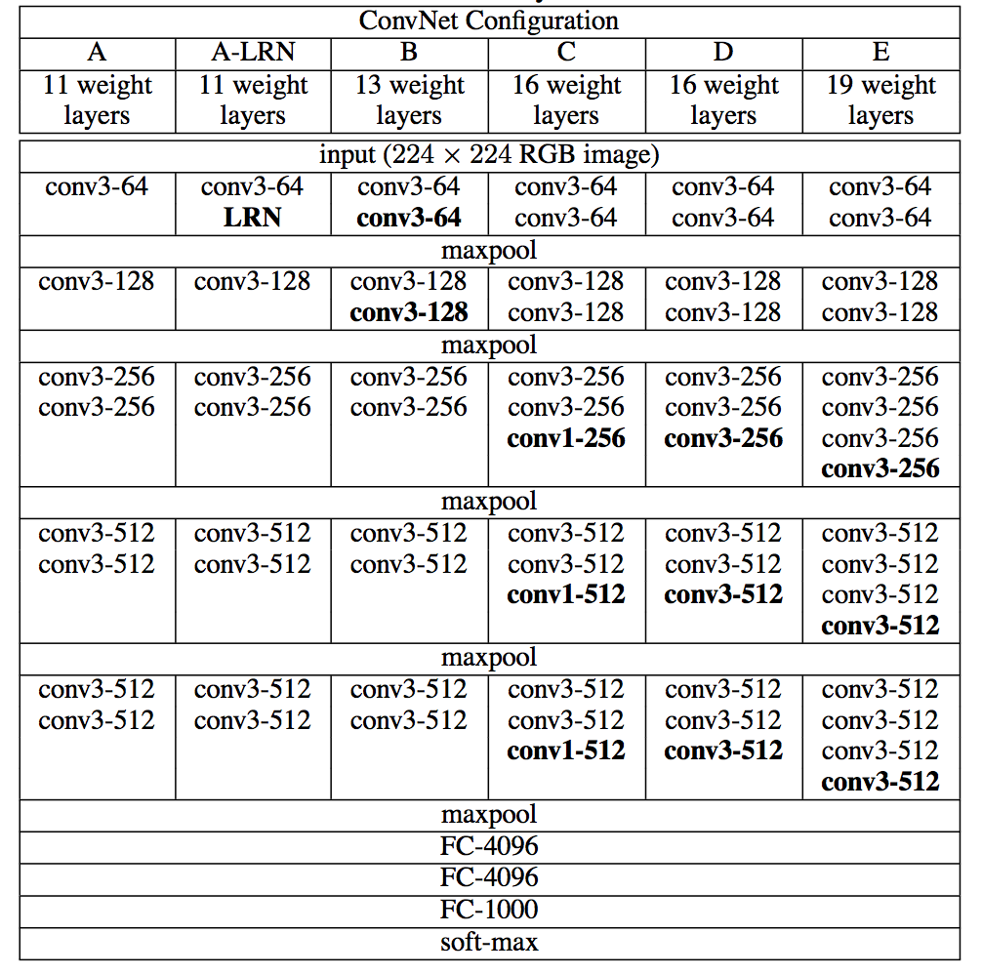
Configuration
Table1, ConvNet configurations
Input layer: Input image fixed size 224×224 RGB image with preprocessing.
Convolutional layers: Pass through a stack of conv.layers with a very small receptive field 3×3. Also used 1×1 convolutional filters as a linear transformation. All padding is 1 pixel for convolutional layers.
Max-pooling layers: Max-pooling is performed over a 2×2 pixel window, with stride 2.
Hidden layers: All hidden layers are equipped with the rectification (Relu) non-linearity. For one Local Response Normalisation (LRN) normalisation is used.
Fully-Connected (FC) layers: first two have 4096 channels each, the third performs 1000.
The final layer: the soft-max layer.
ConvNet configurations: VGG nets different by their names (A-E) from 11 weight layers in the network A (8 conv. and 3 FC layers) to 19 weight layers in the network E (16 conv. and 3 FC layers). Showed in the left Table 1.

Slide 5
Classification Framework
Training general methods: The training is carried out by optimising the multinomial logistic regression objective using mini-batch gradient descent (based on back-propagation) with momentum.
Parameters settings: Batch size = 256, momentum = 0.9, weight decay = 5×10⁻⁴ (the L2 penalty multiplier set it),
Dropout ratio for the first two fully-connected layers set to 0.5.
Learning rate was initially set to 10⁻², and decreased 3 times, stopped after 370K iterations (74 epochs).
Setting the training scale S: (1) Fix S corresponding to single-scale training.
(2) Multi-scale training, rescaled by randomly sampling S from a certain range [S_{min}, S_{max}] (S_{min} = 256 and S_{max} = 512).
Testing:
(1) Isotropically rescaled to a pre-defined smallest image side, denoted as Q.
(2) Applied densely over the rescaled test image.
(3) The resulting fully-convolutional net is then applied to the whole (uncropped) image.
(4) The class score map is spatially averaged (sum-pooled) and also concern about corp.
Implementation:
(1) Launch on publicly available C++ Caffe toolbox.
(2) Training and evaluation on multiple GPUs installed in a single system.
(3) Training and evaluation on full-size (uncropped) images at multiple scales.
(4) Use 4 NVIDIA Titan Black GPUs to achieve data parallelism.
Figure1. NVIDIA Titan GPU

Slide 6
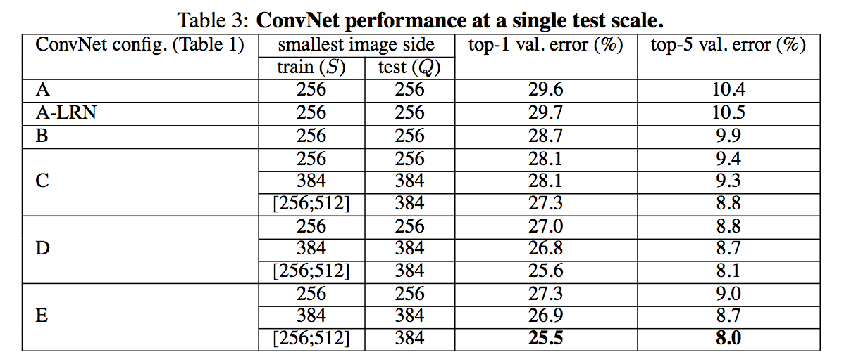
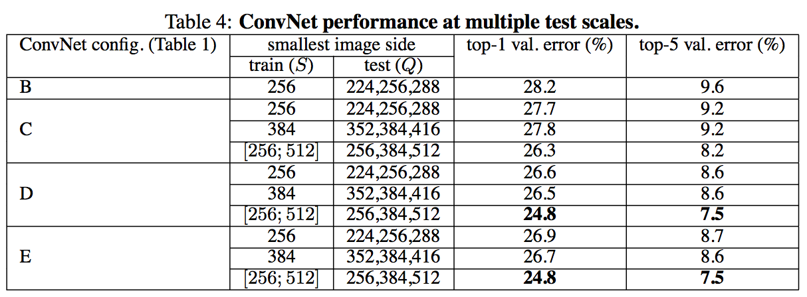
Experiment Evaluation
Dataset:
Use ILSVRC-2012 dataset, including 1000 classes, split into 3 subsets: training (1.3M images), validation (50K images) and testing (100K images with held-out labels)
Measures:
top-1 error, which is multi-class classification error.
top-5 error, which is computed as the proportion of images such that the ground-truth category is outside the top-5 predicted categories.
Single Scale Evaluation:
Multiple Scales Evaluation:
From single/multiple scales evaluation:
Deepest configurations (D and E) perform the best. The additional non-linearity does help (C is better than B).
Scale jittering is better than training with a fixed smallest side S.

Slide 7
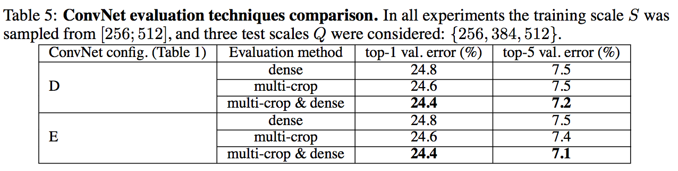
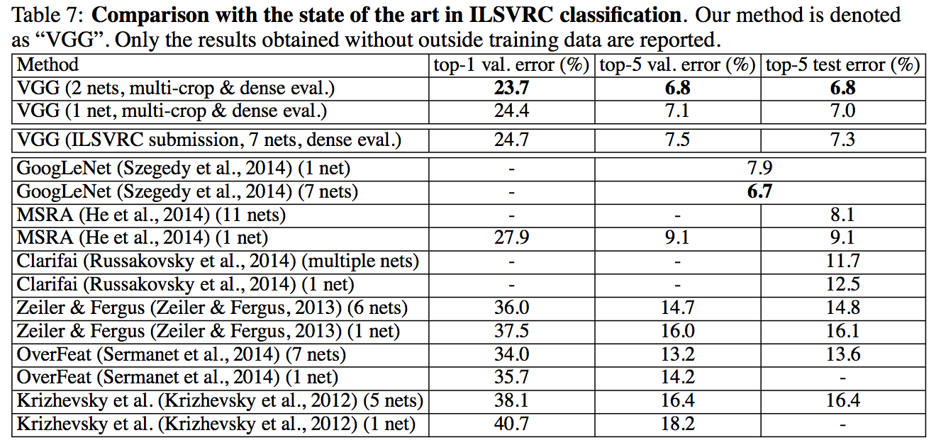
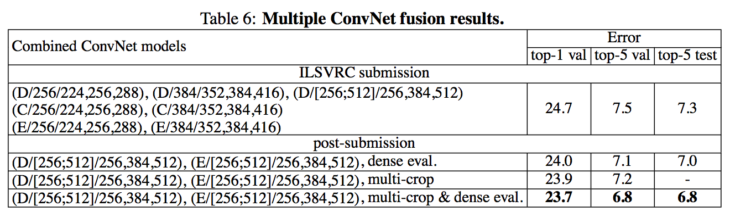
Experiment Evaluation
Multi-crop Evaluation:
Comparison with state of the art:
Using multiple crops performs slightly better than dense evaluation.
ConvNet Fusion:
As can be seen from Table 7, our very deep ConvNets significantly outperform the previous generation of models, which achieved the best results in the ILSVRC-2012 and ILSVRC-2013 competitions.
Ensemble reduced the test error to 7.0% using dense evaluation and 6.8% using combined dense and multi-crop evaluation. Comparatively, the best-performing single model achieves 7.1% error (model E, Table 5).

Slide 8
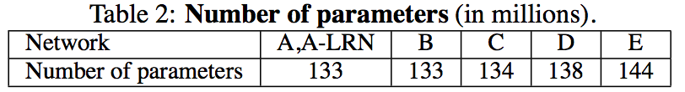
Novelty Summary
1. Using very small 3×3 receptive window size in all layers and deeper structure. Major Novelty
Compared with the former researches (like 7×7), the advantages:
Incorporate three non-linear rectification layers instead of a single one, which makes the decision function more discriminative.
Hugely decrease the number of parameters keep the same receptive field. E.g. three-layer 3×3 convolution stack has C channels, the stack is parametrised by 3(3²C²)= 27C² weights; at the same time, a single 7×7 conv. layer would require 72C² = 49C² parameters, 81% more.
More activation functions, rich feature capture make net enable to have more capacity and require less epochs to save computation resource and training time.
2. Make the VGG configurations into 6 kinds, from 11 weight layers to 19 layers.
3. Using 1×1 conv. layers to increase the nonlinearity of the decision function without affecting the receptive fields of the conv. layers.
4. In the train and test procedure, apply two novel scale methods to train the model, single scale training and multi-scale training. In evaluations, make ensemble incorporation to enhance the models performance.
5. For the implements, use 4 GPUs to exploit the data parallelism, processed in parallel on each GPU, and synchronized the gradients results across 4 GPUs.

Slide 9
Use Case Limitations
VGG as a deeper Conv. Net, which has the state-of-the-art accuracy in the large-scale image recognition tasks. VGG model also own its configurations by their names from A to E, corresponding to 11 weight layers to 19 weight layers.
Thus, VGG net would be flexibly capable of using in the large scale dataset recognition and classification like ILSVRC, and also can be applied in smaller datasets like VOC-2007, VOC-2012, Caltech-101 and Caltech-256, which are evaluated by the authors in the appendix. (mainly focus on Net-D and Net-E). The VGG16 and VGG19 parameters would be available in Keras.
VGG models have a relatively severe requirements on the computational ability such as parallel computing, GPU resource management and data synchronization. It will be a challenge for the normally simple recognition task to train over 140M parameters. Namely its computation consumption is relative huge especially on the first two Full Connection layers, and training time cost is also huge.
And compared to the prevailing Deep Convolutional Network like ResNet, NASNet, GoogLeNet and CapsNet, VGG’s too deep structure with million parameters tends to work over-fittingly.

