Slide 1
Git and Bitbucket

Slide 2
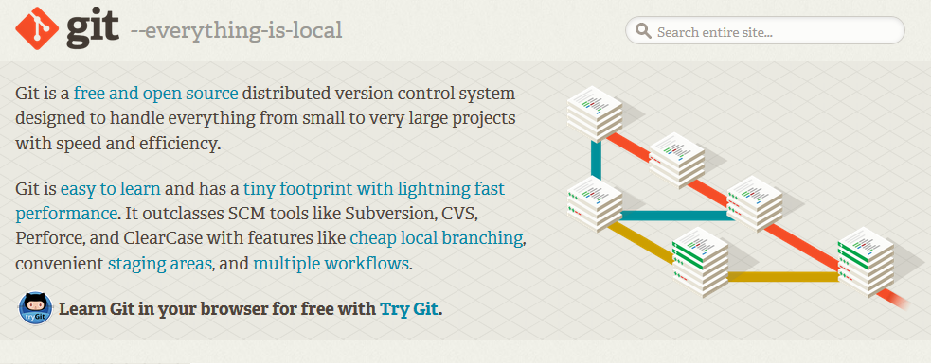
Git
Git is a free and open source distributed version control system.

Slide 3
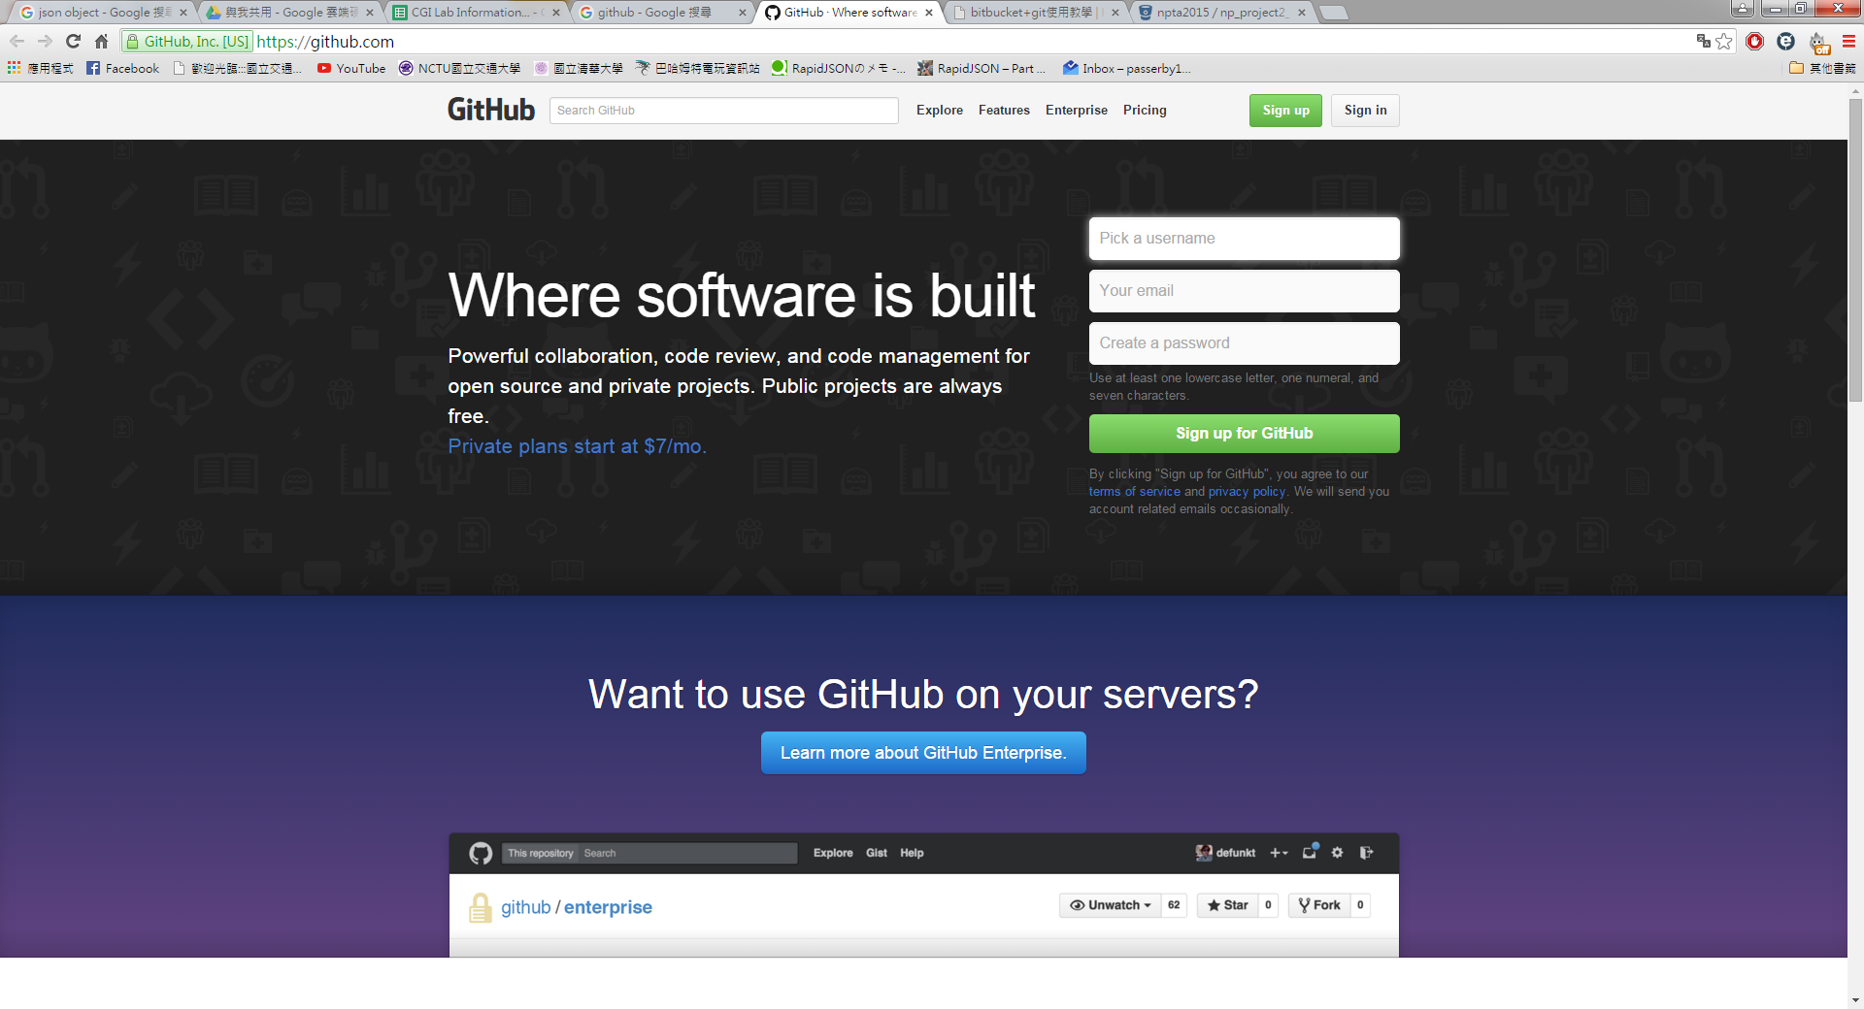
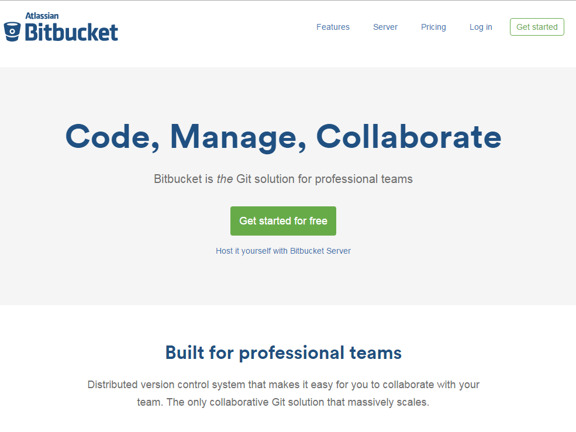
Git + Bit bucket
Git + Git hub -> not free for private repository.
Git + Bit bucket -> free

Slide 4
Bitbucket
Go to https://bitbucket.org/

Slide 5
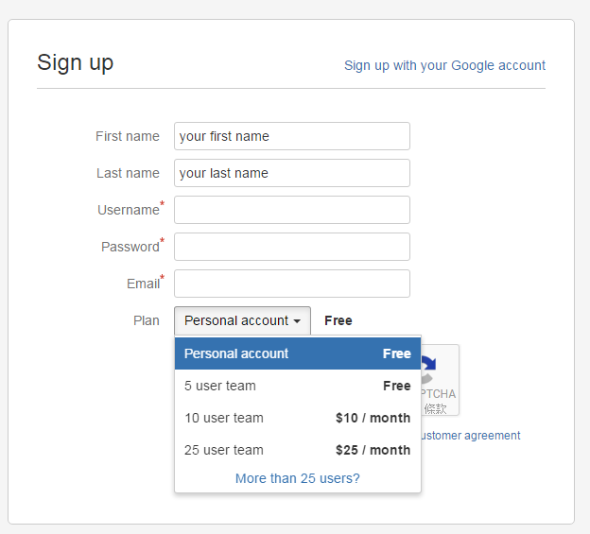
Sign up
Choose personal account

Slide 6
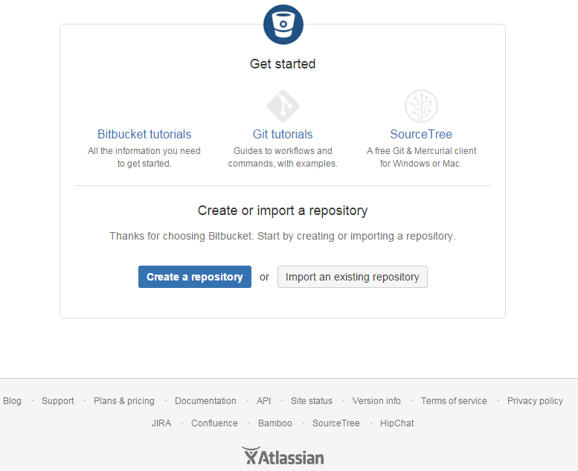
Repository setting
Create a repository

Slide 7
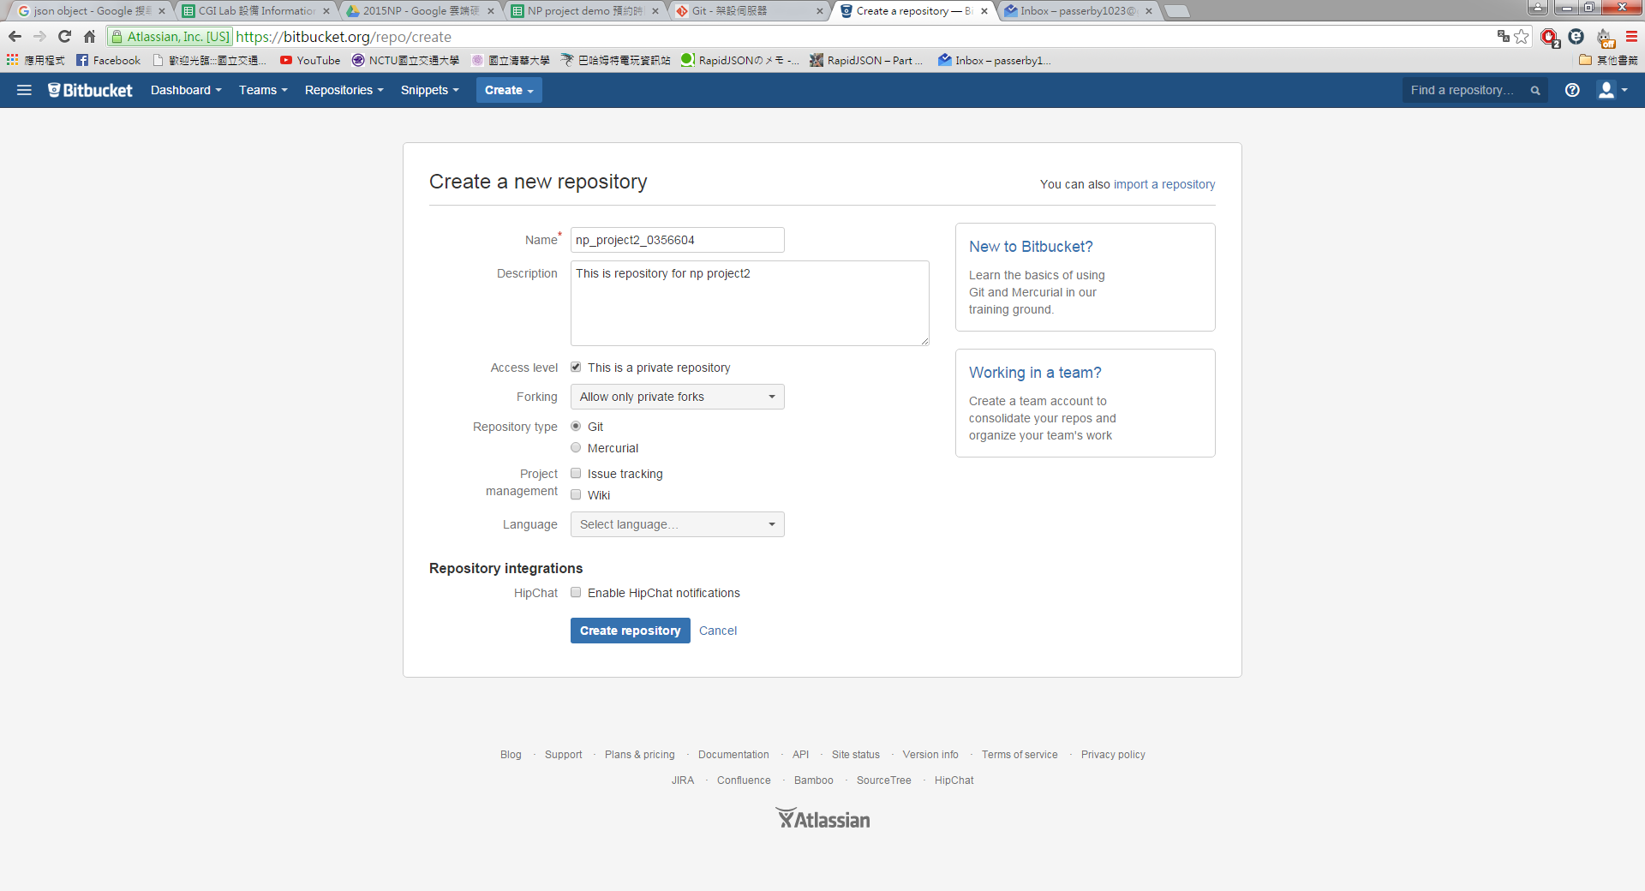
Repository setting
Name : np_project2_[your student number]
Access level must set to private!

Slide 8
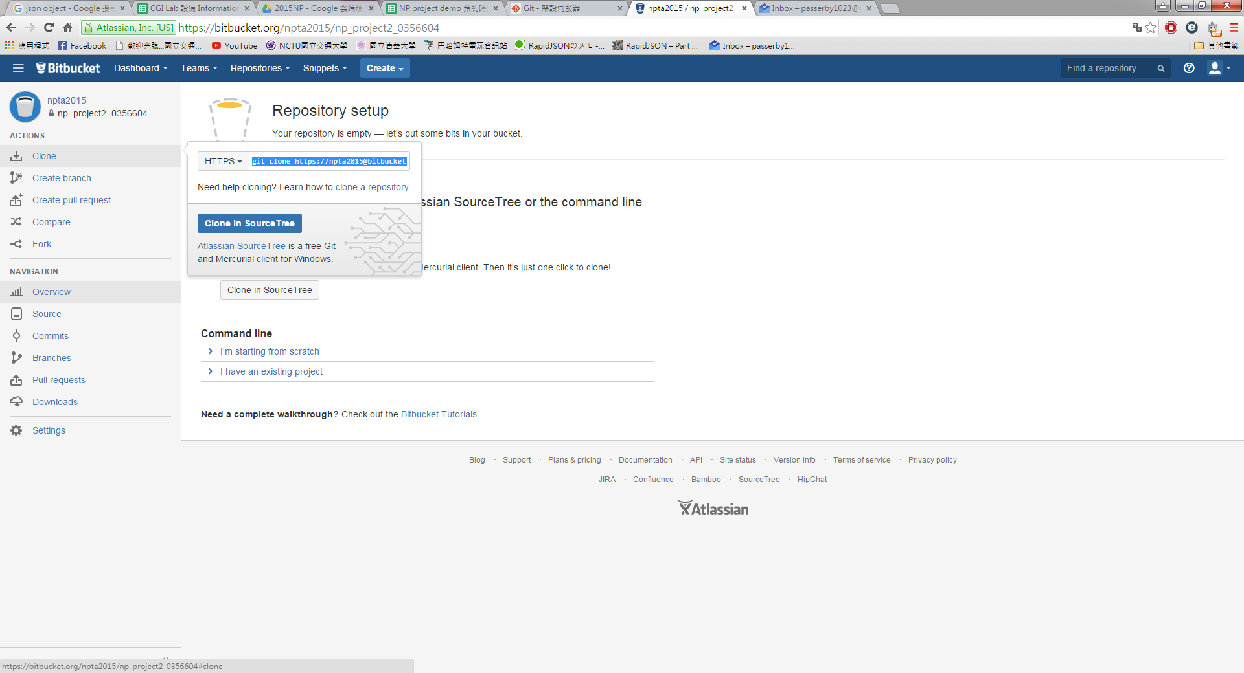
Clone
Click clone and you will get following command, copy it.

Slide 9
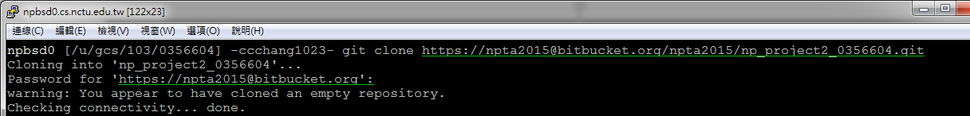
Clone
Paste and run the previous command in your home directory.
The repository will be clone to your home dir.
In project 2, all the related files should be placed under np_project2_[student number] directory.

Slide 10
Three basic git commands
1 - git add [file name] // add file to repository
( git add . // Can add all files in current dir)
Every time you create or move new file in to np_project2_[student number] dir, you should use this command.
2 - git commit -a -m “some description” //commit
-a : same as ‘git add .’.
-m “xxx” : write description of this commit.
3 - git push //push to git server (Bitbucket)

Slide 11
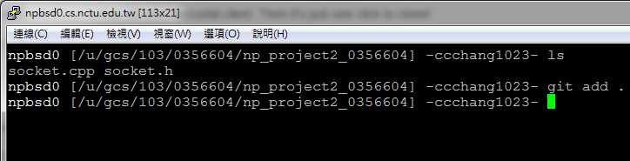
Example
In 0356604/np_project2_0356604, I create two files, socket.cpp and socket.h, I should use git add command before start writing the code:

Slide 12
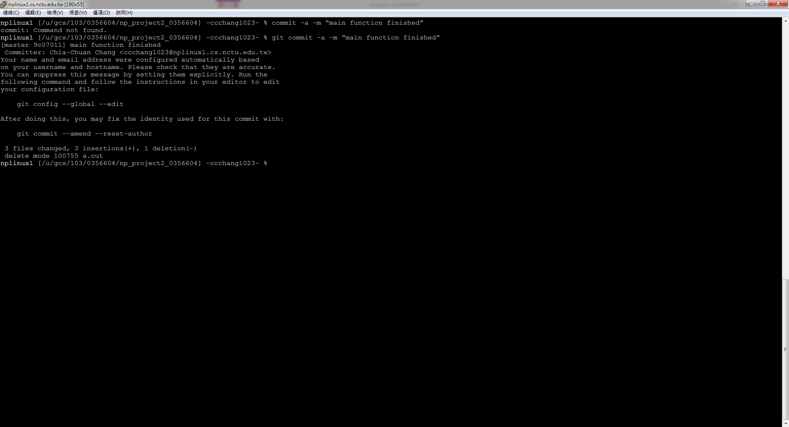
Example
After I write something in sockest.cpp, I should use git commit command:

Slide 13
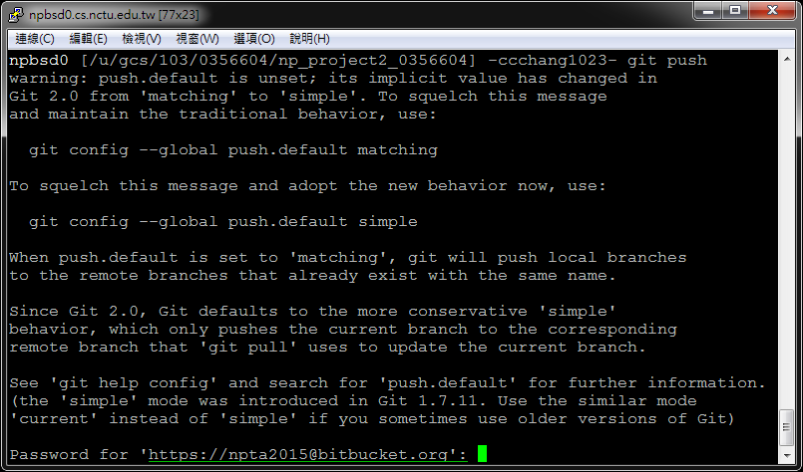
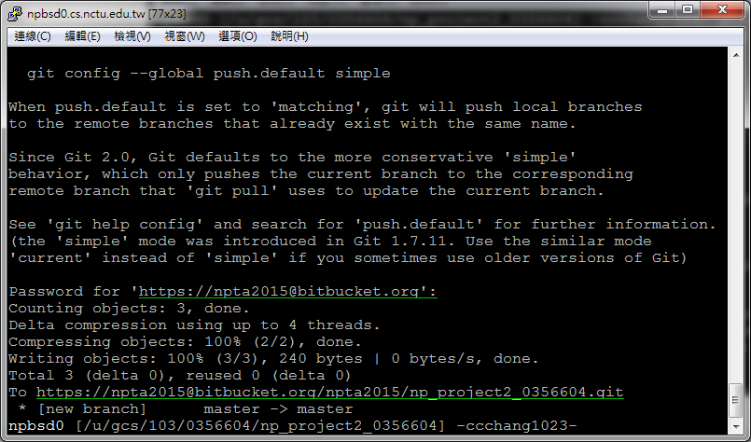
Example
Finally, use git push command, (your Bitbucket passwd is required)
1
2
Push success!

Slide 14
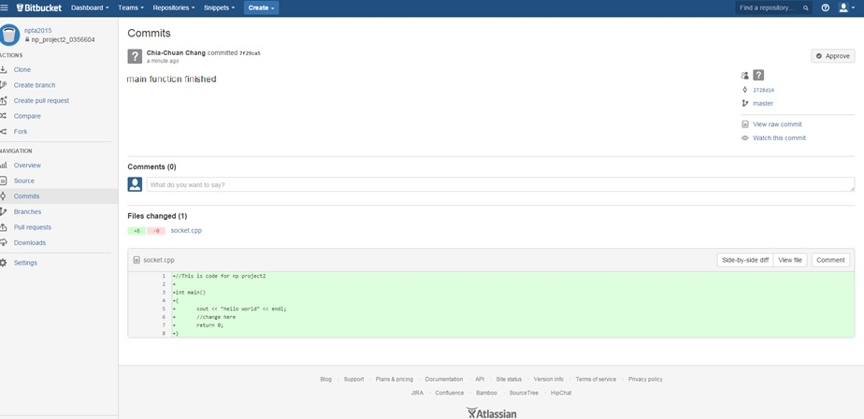
Example
And I can check all commit history on Bitbucket.

Slide 15
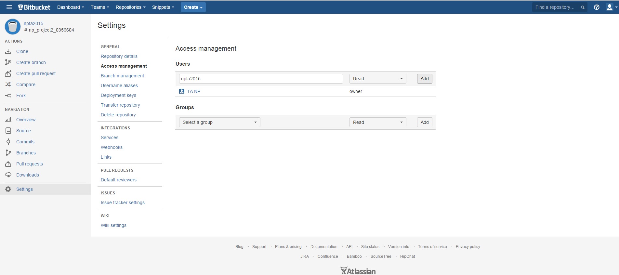
Set access management
In access management, add npta2015 to your user list, so that we can read your repository.

