Slide 1
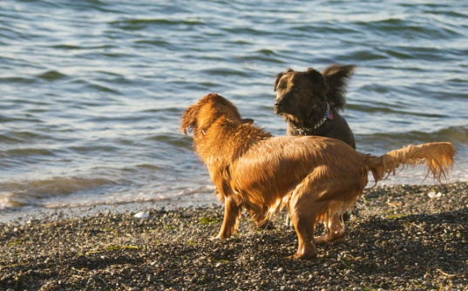
GoogLeNet: Chesapeake Bay retriever, Irish Terrier, Irish Setter
DeepSentiBank: wet dog, running dog, wild goose
Places205: coast, ocean, sandbar
NeuralTalk2: a couple of dogs standing on top of a sandy beach
Automatic text extraction
Flickr photo title: The Big Stare Down
Flickr photo description: Ok you dog lovers could you please tag this photo with the breed of the black dog, thanks.
Flickr tags given by the user: dogs playing, pets, boy and his dog, Washington State, Seattle, stick, beach, water, Golden Retriever, dogs, puget sound, Fetch, my new world view, red ball, sunset, Animals, play ball, blue water, fun, surf, playful, bitch, Nikon, D200
Textual information provided by the user
Source: https://www.flickr.com/photos/bewareofdog/2591207084/in/photolist-4WYBAd

