Slide 1


Slide 2
Ever had a
GREAT
application idea?
Notes:
Storyline:
Good ideas are awesome and need to be monetized on
Bad ideas are also awesome!
For both ideas we have came up with sparked

Slide 3
But …
no {
time,
money,
expertise
} ?

Slide 4
But also bad ideas can get somewhere
IMAGINE
Somebody sends you this…

Slide 5
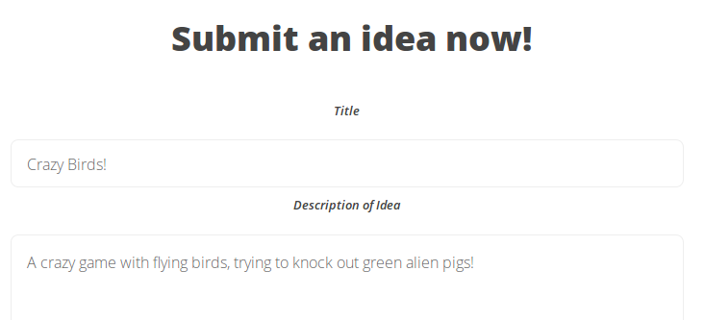
A crazy game with flying birds, trying to knock out green alien pigs!
Notes:
- Use the example of Angry Birds.. A great Idea can be a complete failure, and a seemingly bad or simple idea can make it too the top charts.. -- Flying birds knocking out green alien pigs??

Slide 6
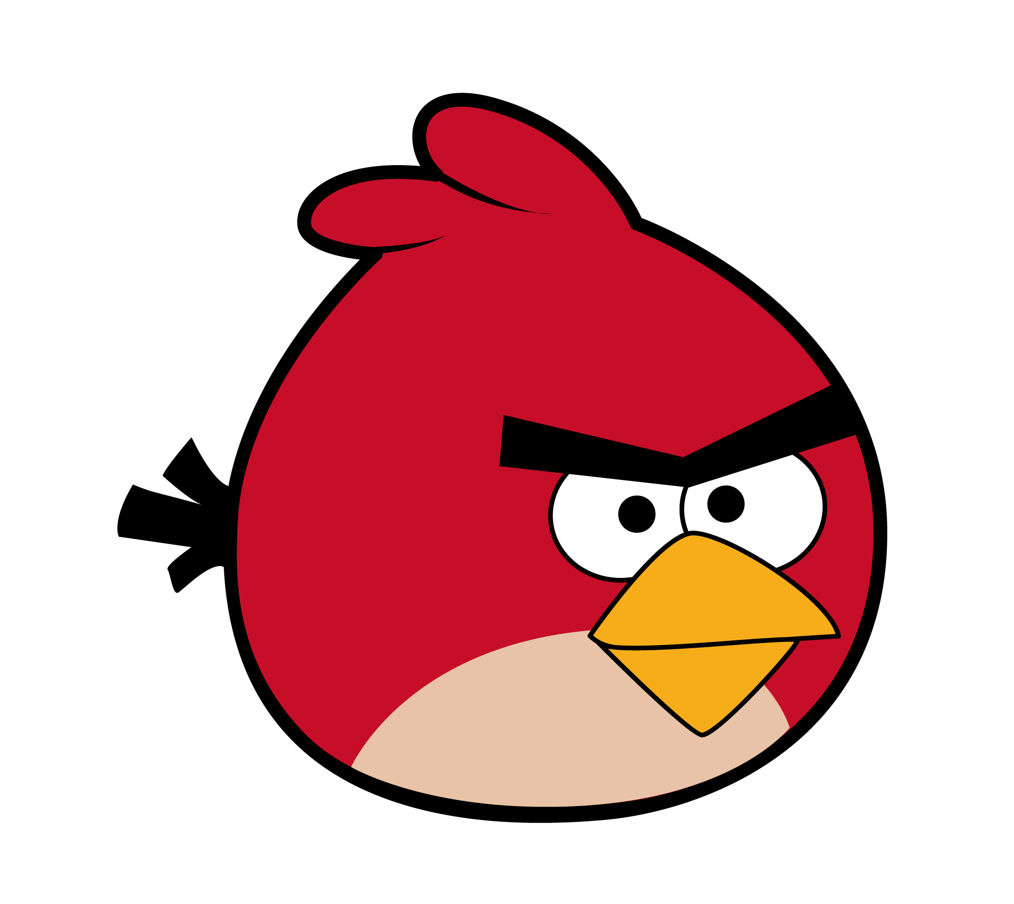
Notes:
- So only getting the idea funded is weird, you need a piece of execution to this! Therefore it makes sense..
This is exactly why it can be hard to find outside funding for app development. Without a rock solid business plan and/or prior development experience to reference, finding people to fund an idea alone isn't going to be easy.

Slide 7


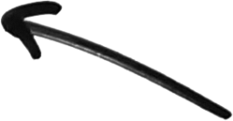

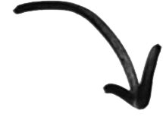


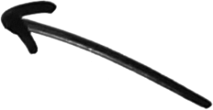


0
HC
HC
HC
SPARK’D
Sanitation/
Similarity Check
+
Prototypes
Enable Voting
Top of the Month
Find Investors/Kickstarter
Develop in-house
Find Delevopers
Notes:
For both good and bad ideas, we came up with the following application.
Ideas alone will not make a successful app. App success is all about execution. A great idea can be a complete failure, and a seemingly bad or simple idea can make it too the top charts.

Slide 8

TODAY
The Market
Implementation
Crowdsourcing
Human Computation
Information Retrieval
Our stack
DEMO
Conclusions/Final Remarks

Slide 9
The Market
Notes:
It is important to understand the context in which we are trying to operate and in which way we have to adjust ourselves.

Slide 10
The Market
“The App economy is Now ‘Bigger than Hollywood’” –
the Atlantic
Notes:
Kickstarter & Indiegogo; AppBackr and AppStori.
Stated is: The iOS App Store distributed $10 billion to developers in 2014, which is just about as much as Hollywood earned off U.S. box revenues the same year.
Although the totals for U.S. Box Office are not the complete Hollywood revenues picture, Apple's App Store billings is not the complete App revenue picture either. The Apps economy includes Android and ads and services businesses and custom development. Including all revenues, apps are still likely to be bigger than Hollywood.

Slide 11
The Market
Is finding investments that easy?
Notes:
Kind off to answer these questions a bit during the presentation right?

Slide 12
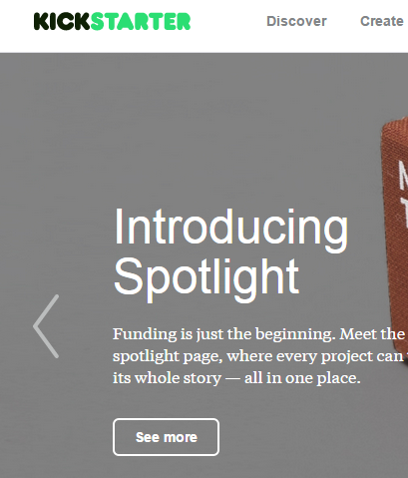
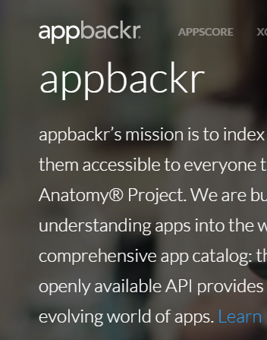
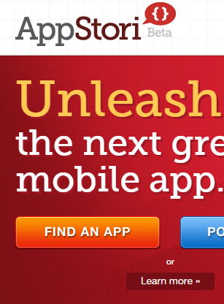

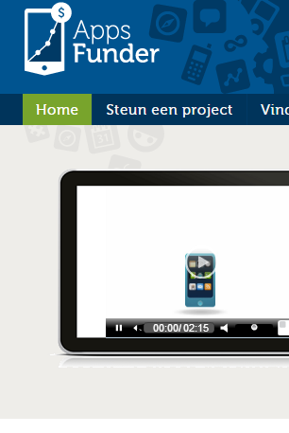
The Market
No, but:
Notes:
Kickstarter, Indiegogo, AppBackr, AppsFunder and AppStori
You have the all-purpose Kickstarter and IndiGogo but you even have the application specific:
Appbackr, appsfunder and appstori.
AppBackr:
When posting an app for appbackr, you enter your app details including title, marketplace, description what the money will be used for, and why they should back your app. You set a reserve goal, which is the number of copies that must be sold before backr purchases are completed and before you receive money. To define it, you need to know what is the minimum dollar amount you need to raise (which corresponds to the “what is the money for” section). If you don't reach this reserve goal, no money exchange hands.
You're probably wondering how much it is going to cost you.. That depends on two things: the price of your app and its stage (if it is already live or not on a mobile app store). Backing an app that is still in development has a potential profit of 54% and a finished app has a potential profit of 26% for backs.
Appstori seems to be more of a kickstarter for apps.
You define your funding goal and ask people to contribute in exchange for benefits (like the rewards on Kickstarter). Once again, it's all-or-nothing funding: if the project doesn't reach its goal, it will not be funded and funding can't exceed the goal.
http://appstori.com/projects Use this in the final presentation
Conclusion: anyone could do this but again, if you do not have anything to show for, this is really going nowhere on these websites. Therefore you need a certain group of developers to generate all the mockups and minimum viable products to show for but also people who can drive these funding ideas as well on these platforms. In this way, an idea like Angry birds can become something really interesting.

Slide 13
Implementation

Slide 14
Implementation: Crowdsourcing
Crowdsourcing

Slide 15
Implementation: Crowdsourcing
It makes sense to crowdsource ideas!
Crowdsourcing process generated ideas that score significantly higher in terms of novelty and customer benefit and slightly lower in feasibility (Poetz and Schreier, 2012).
Across industries, 25% of innovation comes from interactions between customers and professional designers (Terwiesch and Ulrigh, 2009).
Note: these typical crowdsourcing research does not go further than new product development.
Notes:
Poetz and Schreier:
The authors join the debate [of professional design teams (marketers, engineers, and/or designers vs. users] by presenting a real-world comparison of ideas actually generated by a firm's professionals with those generated by users in the course of an idea generation contest.
The study reveals that the crowdsourcing process generated user ideas that score significantly higher in terms of novelty and customer benefit, and somewhat lower in terms of feasibility [isn't this a very logical result????] . But they conclude that the average values for feasibility – in sharp contrast to novelty and customer benefit – tended to be relatively high overall, meaning that feasibility – in sharp contrast to novelty and customer benefit – tended to be relatively high overall, meaning that feasibility did not constitute a narrow bottleneck in this study.
Interesting insight: Regarding the idea generation process, they find that “professional developers elaborated with informational elements that were not as cognitively remote,” whereas users seemed to have “access to informational elements that were further apart”. As presented by those authors, the reason for this might again be the fact that prior knowledge and experience concerning what has technically worked (or not)( in the past blocked the divergent thinking skills necessary for developing truly novel solutions. AS users were not hampered by concerns regarding how current technologies operate, they were able to come up with mobile phone services that were more original. In contrast, professional developers seems to focus more on how a potential idea could be translated into an actual mobile phone service for the market (thus stressing the feasibility of the ideas). Kristensson et al. (2004) thus argue that professionals are more driven by a convergent thinking style that results in less novel ideas.
The Value of Crowdsourcing: Can Users Really Compete with Professionals in Generating New Product Ideas?
By Marion K. Poetz and Martin Schreier
http://onlinelibrary.wiley.com/doi/10.1111/j.1540-5885.2011.00893.x/epdf
In J PROD INNOV MANAG 2012;29(2): 245-256
2012 Product Development & Management Association

Slide 16
Implementation: Crowdsourcing
It makes sense to crowdsource ideas!
Their explenation:
Converging towards feasibility
Professional
Notes:
Poetz and Schreier:
The authors join the debate [of professional design teams (marketers, engineers, and/or designers vs. users] by presenting a real-world comparison of ideas actually generated by a firm's professionals with those generated by users in the course of an idea generation contest.
The study reveals that the crowdsourcing process generated user ideas that score significantly higher in terms of novelty and customer benefit, and somewhat lower in terms of feasibility [isn't this a very logical result????] . But they conclude that the average values for feasibility – in sharp contrast to novelty and customer benefit – tended to be relatively high overall, meaning that feasibility – in sharp contrast to novelty and customer benefit – tended to be relatively high overall, meaning that feasibility did not constitute a narrow bottleneck in this study.
Interesting insight: Regarding the idea generation process, they find that “professional developers elaborated with informational elements that were not as cognitively remote,” whereas users seemed to have “access to informational elements that were further apart”. As presented by those authors, the reason for this might again be the fact that prior knowledge and experience concerning what has technically worked (or not)( in the past blocked the divergent thinking skills necessary for developing truly novel solutions. AS users were not hampered by concerns regarding how current technologies operate, they were able to come up with mobile phone services that were more original. In contrast, professional developers seems to focus more on how a potential idea could be translated into an actual mobile phone service for the market (thus stressing the feasibility of the ideas). Kristensson et al. (2004) thus argue that professionals are more driven by a convergent thinking style that results in less novel ideas.
The Value of Crowdsourcing: Can Users Really Compete with Professionals in Generating New Product Ideas?
By Marion K. Poetz and Martin Schreier
http://onlinelibrary.wiley.com/doi/10.1111/j.1540-5885.2011.00893.x/epdf
In J PROD INNOV MANAG 2012;29(2): 245-256
2012 Product Development & Management Association

Slide 17
Implementation: Human computation
Human Computation
Notes:
Crowdsourcing
Human Computation
Information Retrieval
Our stack

Slide 18
Implementation: Information Retrieval
Information Retrieval
Notes:
Crowdsourcing
Human Computation
Information Retrieval
Our stack

Slide 19
Implementation: Our Stack
Our Stack
Notes:
Crowdsourcing
Human Computation
Information Retrieval
Our stack

Slide 20
DEMO
Notes:
- So only getting the idea funded is weird, you need a piece of execution to this! Therefore it makes sense..
This is exactly why it can be hard to find outside funding for app development. Without a rock solid business plan and/or prior development experience to reference, finding people to fund an idea alone isn't going to be easy.

Slide 21
Conclusions /
Final Remarks

Slide 22
Conclusions / Final Remarks
lalalala

