Slide 1
Enhanced Edge Detection Method - for Instant Image Cloning Zeev Farbman, Gil Hoffer, Yaron Lipman, Daniel Cohen-Or, and Dani Lischinski SIGGRAPH 2009
Team 40
R10525073 工科碩一 徐聖淮
https://github.com/alex9810171/ImageCloning-VFX-FinalProject

Slide 2
Outline
Motivation
Problem Definition
Algorithm
Experimental Results
Conclusion

Slide 3
1. Motivation

Slide 4
2. Problem Definition
Test object要是主體

Slide 5
3. Algorithm

Slide 6

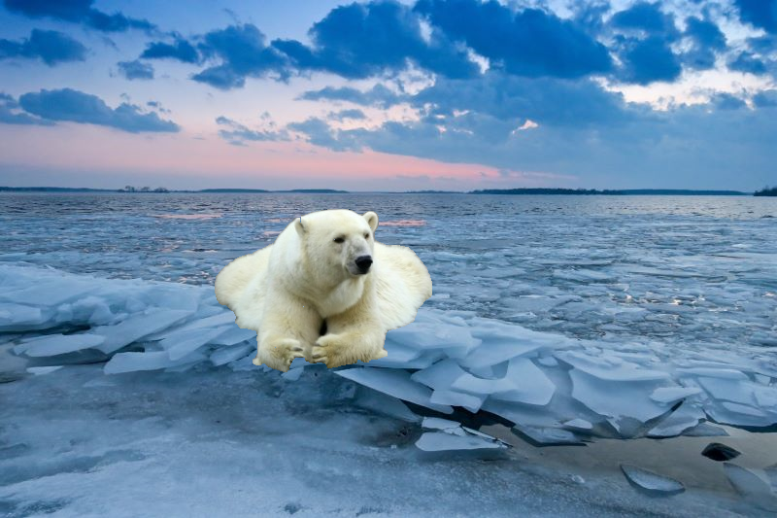
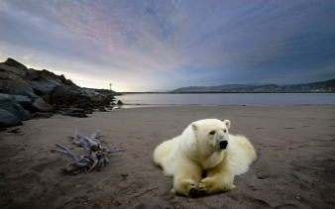
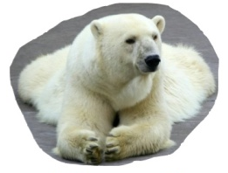
4. Experimental Results
Input
Result
Original Method

Slide 7
5. Conclusion

Slide 8
The End
Thank you for listening!

