Slide 1
Enhanced Edge Detection Method - for Instant Image Cloning Zeev Farbman, Gil Hoffer, Yaron Lipman, Daniel Cohen-Or, and Dani Lischinski SIGGRAPH 2009
Team 40
R10525073 工科碩一 徐聖淮
https://github.com/alex9810171/ImageCloning-VFX-FinalProject
https://imagecloning-vfx-finalproject.herokuapp.com

Slide 2
Outline
Motivation
Problem Definition and Constraints
Algorithm
Experimental Results
Conclusion and Future Work

Slide 3
1. Motivation
Today there are many beautiful but inaccessible landscapes that are difficult to photograph on site.
Image Cloning provides an immersive shooting simulation.
However, finding character boundaries and accurately placing characters in landscape images is difficult.

Slide 4
2. Problem Definition and Constraints
This study is an extension of SIGGRAPH 2009's "Coordinates for Instant Image Cloning" focus on the following problems:
Extract objects from photos and place them in background photos.
The object in the photo must take up the majority of the photo.

Slide 5
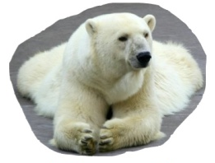
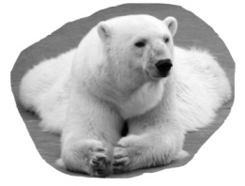

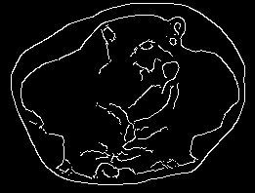
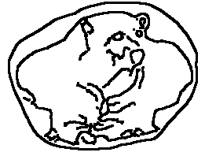
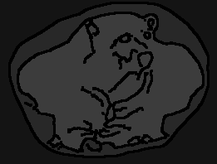
3. Algorithm
Convert object picture to grayscale.
Apply 13x13 Gaussian Filter to denoise the object image.
Using edge detection method to get object contour.
Dilate and inverse image.
use 4-connected components method to get labels map and take small components as big component.

Slide 6
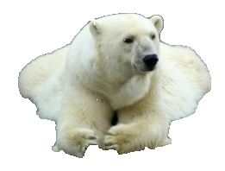
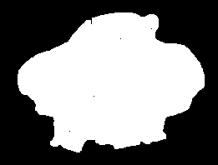
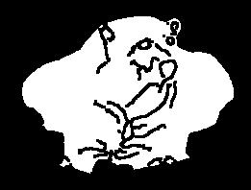
3. Algorithm (cont.)
Set 0 for not main object part, set 255 for others.
Dilate object again to cover edge, now we get object map.
Use object map to extract object from test image.
Finally, paste object to background image.

Slide 7
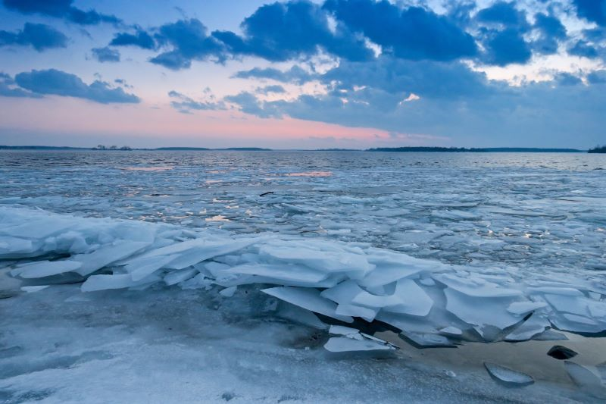
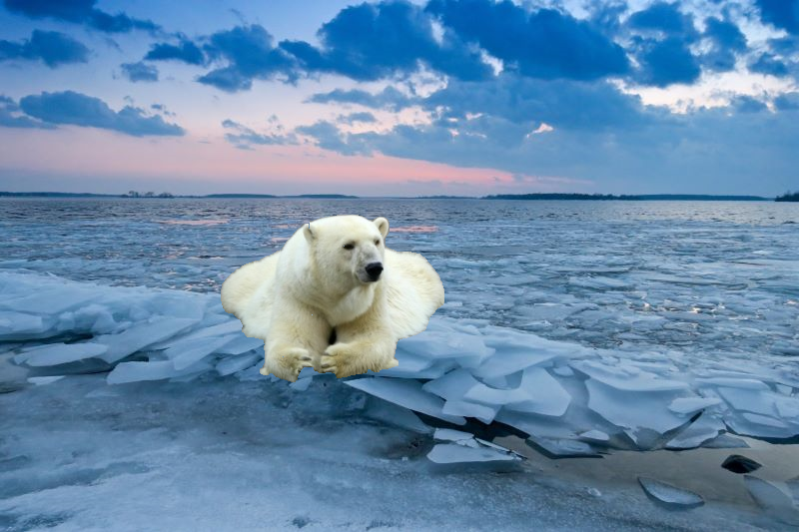
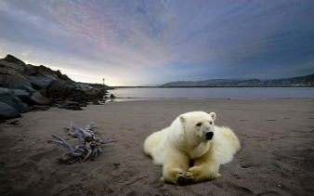
4. Experimental Results
Input
Result
Original Method

Slide 8
5. Conclusion and Future Work
In this work, we implement the edge detection, and morphological algorithms to get a cloning image.
We also have the experiment discussion on each implemented algorithms.
In the future, we hope to build a user-friendly system and add more options to make it more usable.

Slide 9
The End
Thank you for listening!

