Slide 1
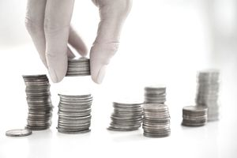
Lecture 7: Budget Your Project
Dr. Tsung-Wei Huang
Department of Electrical and Computer Engineering
University of Utah, Salt Lake City, UT
Notes:
Hello everyone, today we are going to help you go through the team forming process.

Slide 2
Group Meeting
Every one is assigned to a breakout room
Zoom: https://utah.zoom.us/j/2468214418
Each breakout room has 5 people
Check out your assignment below
https://docs.google.com/spreadsheets/d/1JfWZkEyoXdVLtHkiwOqk24G7WVhLWMCP113cSe9fgsQ/edit#gid=265465703
Each group is given 40 minutes to discuss:
Project name and objective
Try to use others’ ideas, avoiding reusing the same one
Identify monetary components and summarize your budget
e.g., thermistor at Amazon takes $20
Select one person to present
Fill in your discussion in the excel sheet

Slide 3
Few Store Options
Digikey
Radio Shack
Sparkfun
Adafruit
Servo City
Hobby Partz
Jameco
Mouser

Slide 4

Financial Management is Critical

Slide 5
Tips for Financial Management
Identify the monetary items
Keep in mind, budget can affect your project goal
Know where your money is going
You need a solid budget plan for each item
Spend your money wisely
Sales want to sell you the most expensive price

Slide 6

Financial Management Empowers Your Project
Why do you spend more money on pizzas if you can buy it cheaper? Saved money can go for ice cream!

Slide 7
Following the Three Steps
Step 1: Start with a gentle introduction
Step 2: Everyone talks about his/her idea
If your idea was used last week, avoid using it again; instead, listen to other members’ voice
Step 3: Identify monetary items
What is the cost of each item?
Where can you buy it?
Is this price the cheapest you can find? (same brand)

Slide 8

Just My 2 Cents …
This project experience is once-in-lifetime
Highly recommend working with others in a project
Thesis track is not for avoiding collaboration
Never think “you can’t collaborate” b4 you do it

