Slide 1
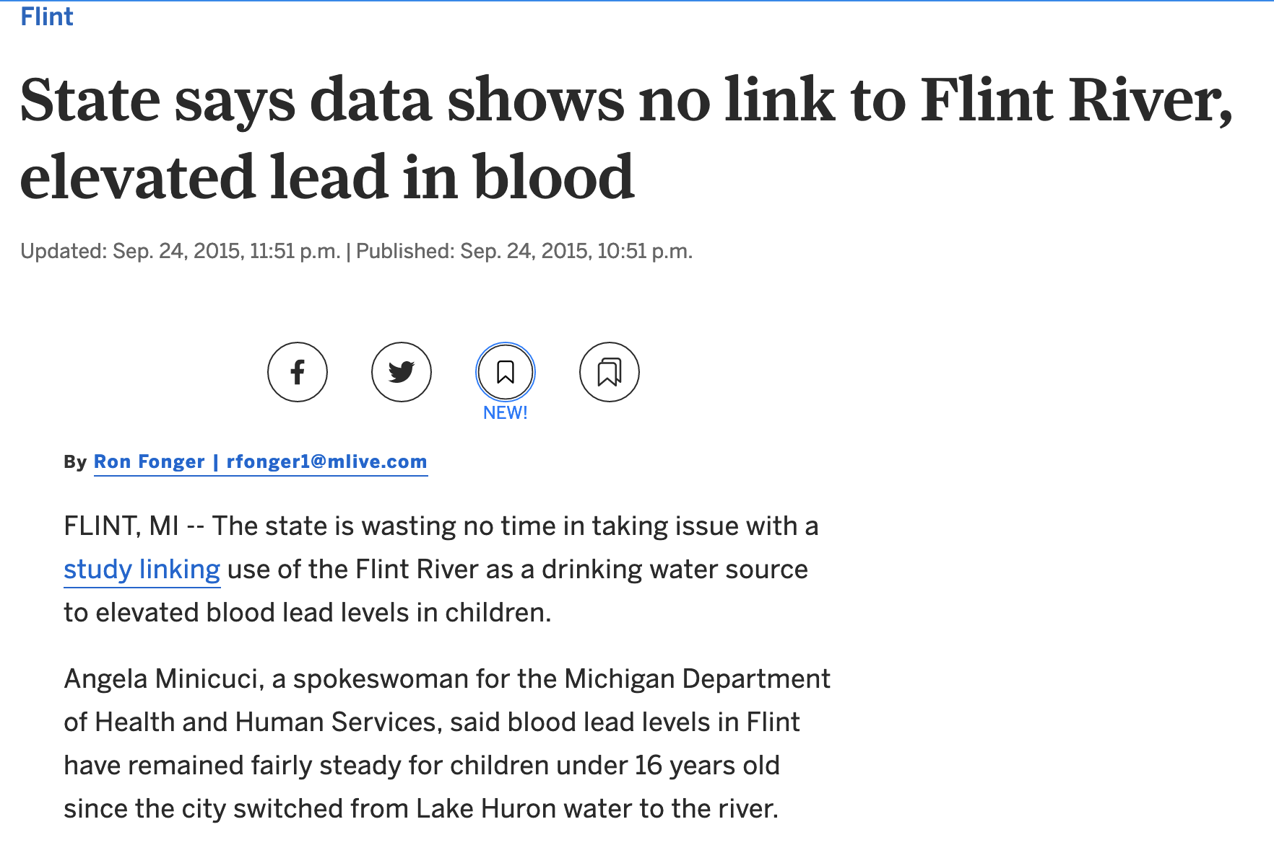
A Municipal Water Problem in Michigan
“Minicuci said the state's data on lead in blood is more comprehensive and "much more accurate" and said seasonal changes have tended to cause lead levels to fluctuate in Flint -- both before and after the change in water source.”
https://www.mlive.com/news/flint/2015/09/state_says_its_data_shows_no_c.html

Slide 2
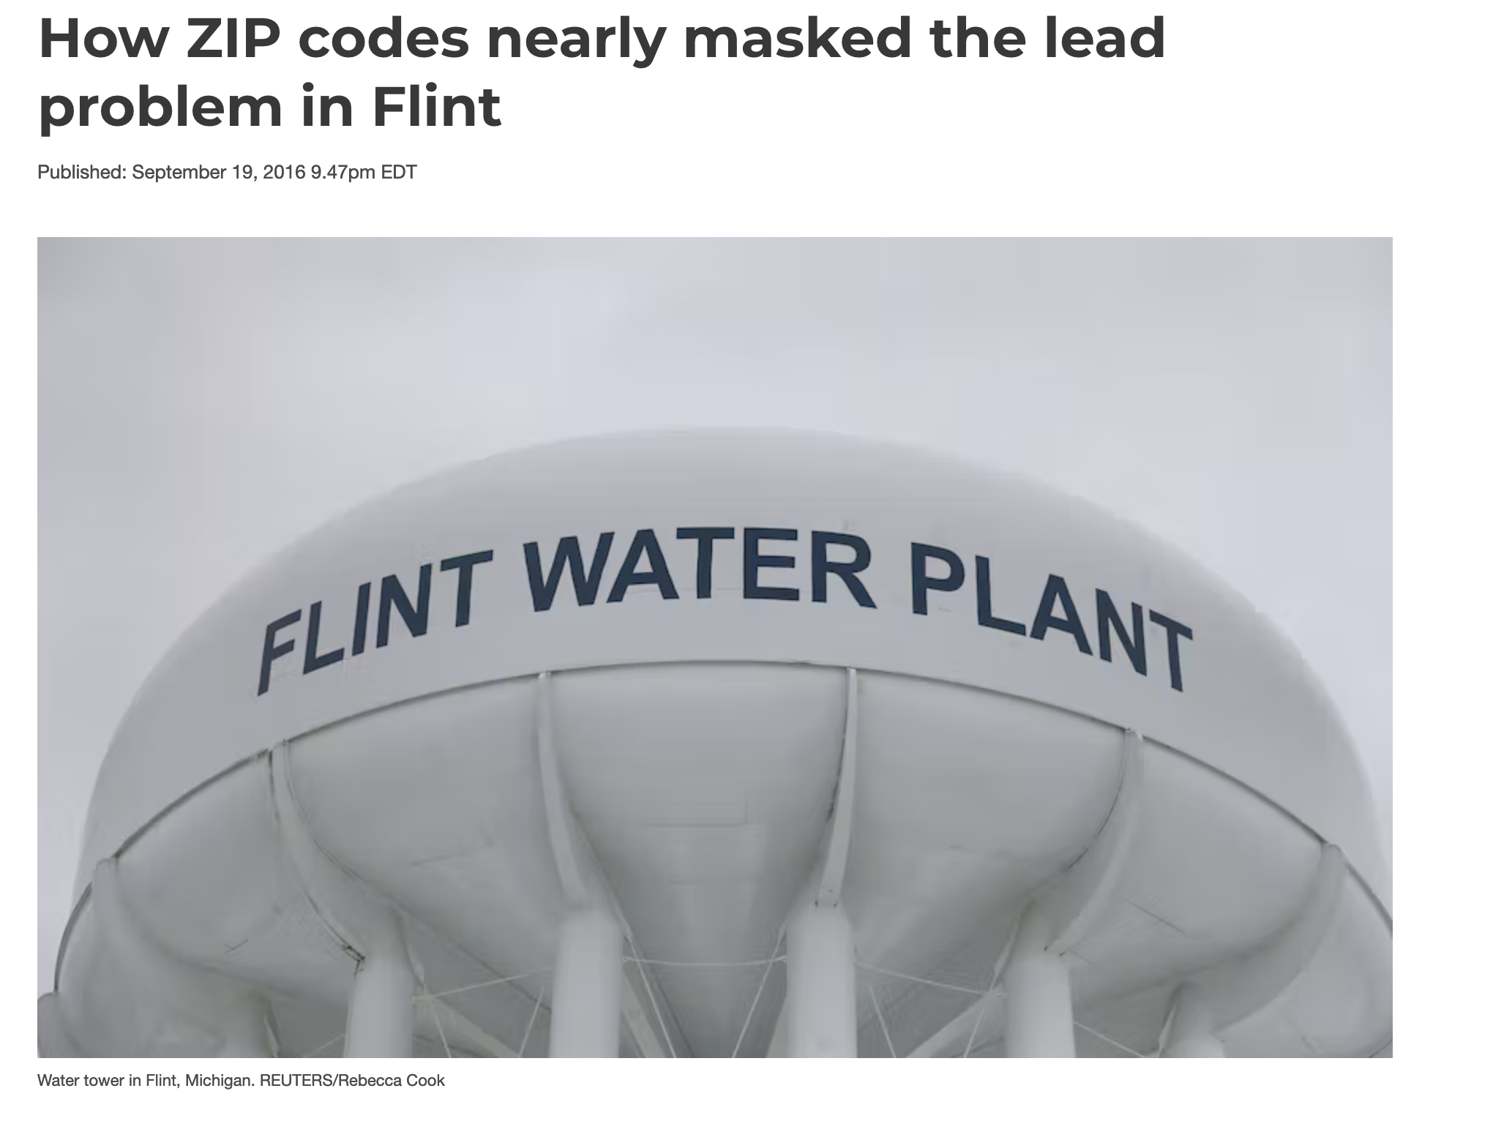
https://theconversation.com/how-zip-codes-nearly-masked-the-lead-problem-in-flint-65626
Richard Casey Sadler, Michigan State University

Slide 3
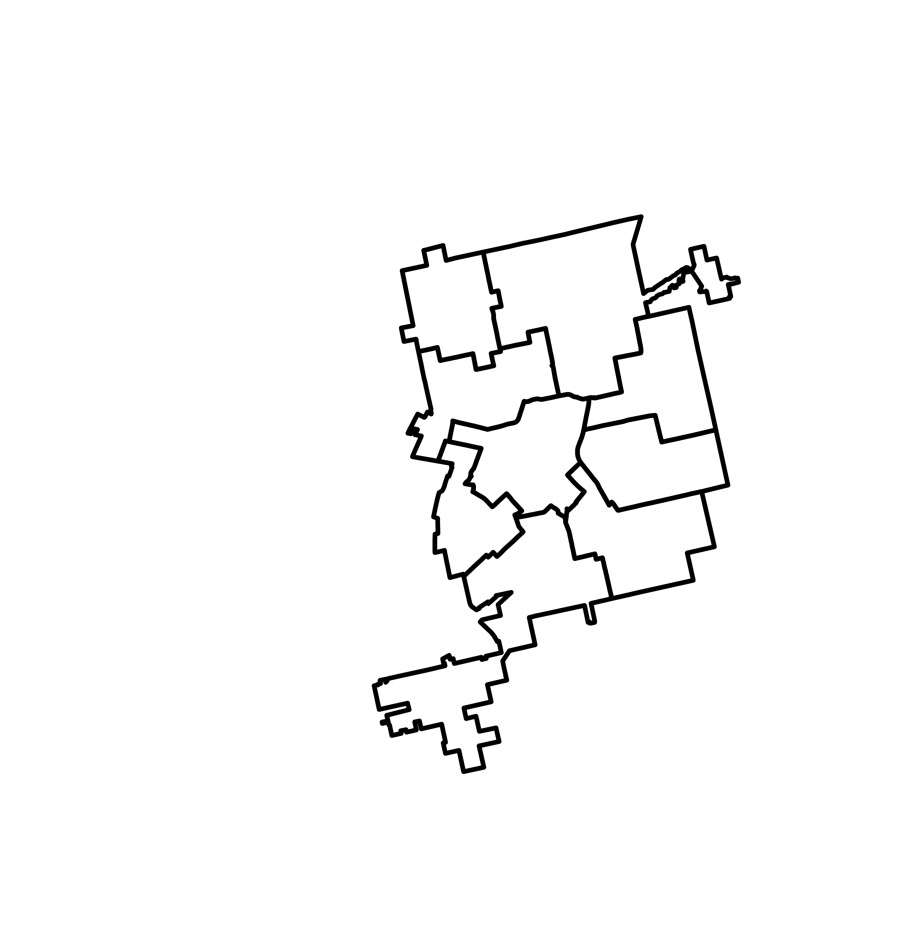
Flint

Slide 4
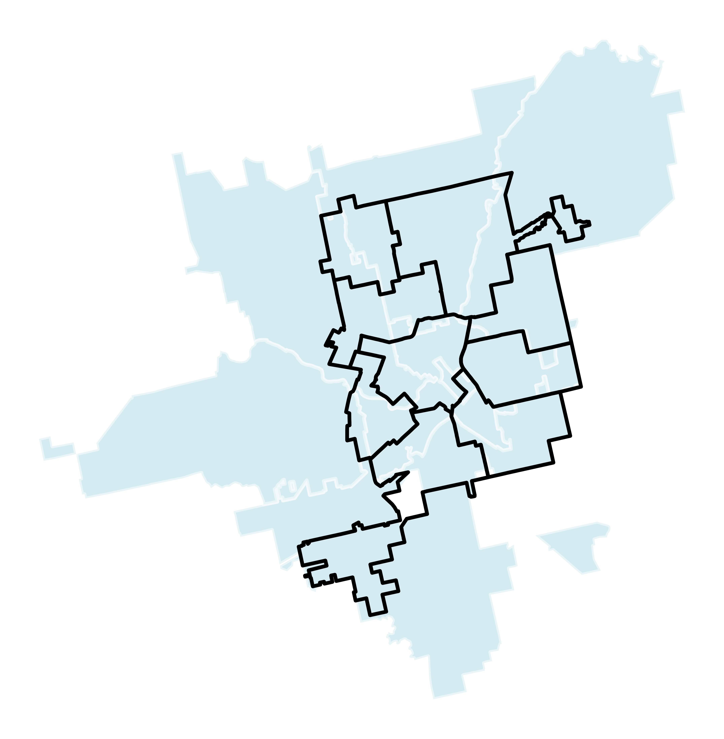
Flint
ZIP Codes of Flint

Slide 5
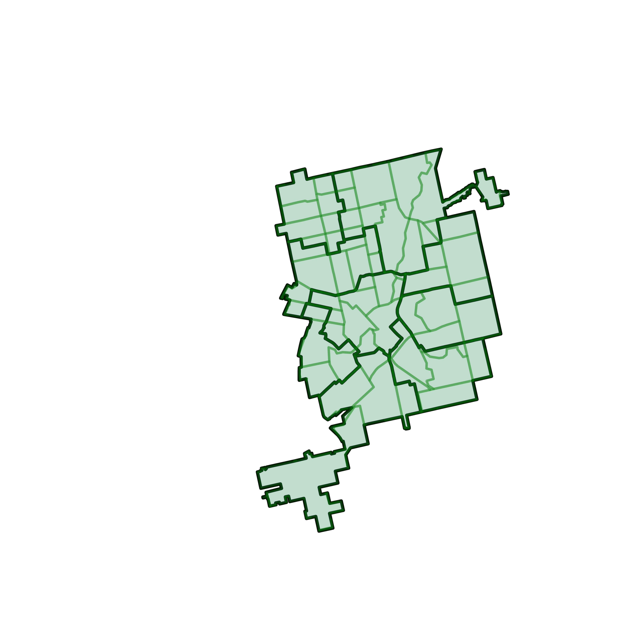
Flint
ZIP Codes of Flint
Census Tracts of Flint

Slide 6
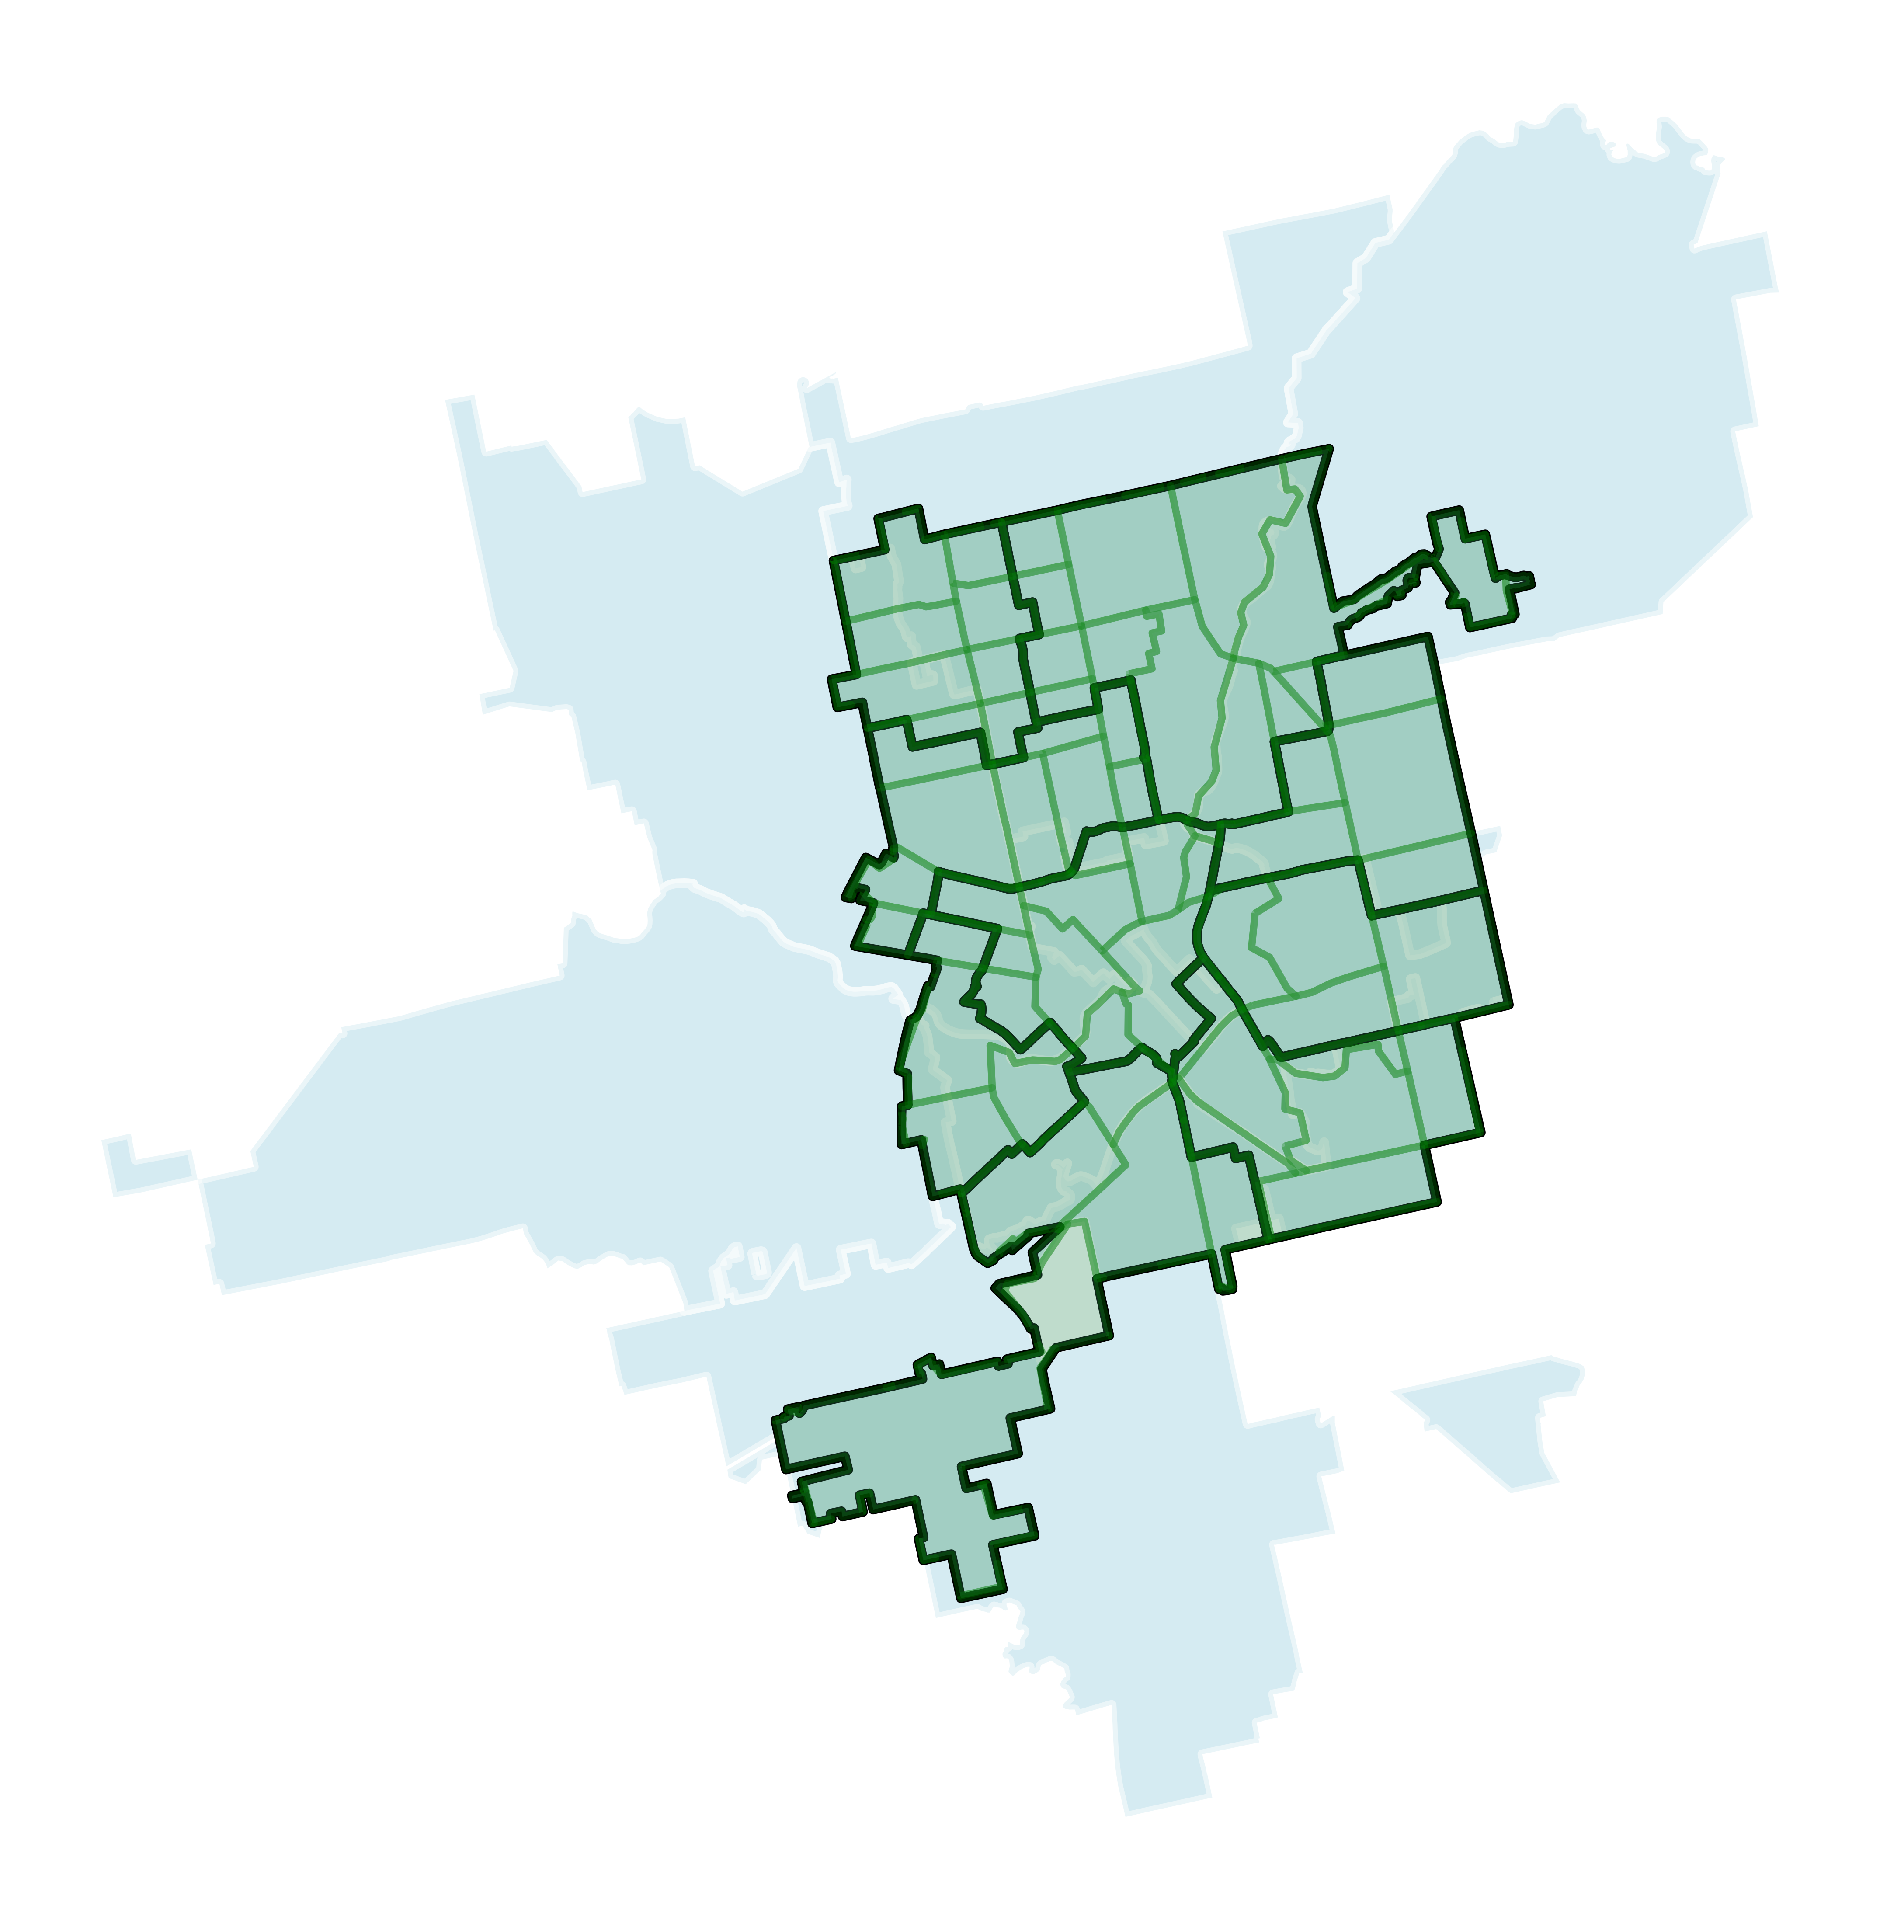
Remarkably Different Data Pictures

Slide 7
https://ajph.aphapublications.org/doi/10.2105/AJPH.2015.303003

