Slide 1
DroneOps Intelligence
Review 2 project capstone
Mentor
Team
Phạm Minh Trí
Đặng Ngọc Minh Đức
Lê Quốc Thống · Giang Nguyễn Gia Khánh
Hà Quang Nghĩa · Đặng Đào Anh Đức
DroneOps Intelligence · FA26SE238 | Review 2 · 19 Oct 2026
01
Notes:
DroneOps Intelligence supports mission planning, pre-flight validation, live monitoring, incident handling, post-flight reports and advisory AI. This review presents the system and database design, package responsibilities, state transitions and the main workflow demonstrations.

Slide 2
PROJECT CONTEXT · REVIEW 2
DroneOps brings UAV missions into one reviewable flow
Problem
Target users
Current UAV operations often rely on fragmented processes for mission planning, approval, and monitoring.
DroneOps targets UAV pilots and operation managers involved in planning, reviewing, and managing drone missions.
Changes since Review 1
Change marketing drone to lab drone
DroneOps Intelligence · FA26SE238 | Review 2 · 19 Oct 2026
02
Notes:
Post-flight reports use persisted telemetry and incidents, with coverage and missing metrics shown explicitly. AI assessments retain their mission context, provider and time. AI advice cannot approve a mission. The registered similarity-retrieval scope remains a review question recorded separately from the unchanged registration form.

Slide 3
PROJECT CONTEXT · REVIEW 2
Key Features
FE-01
UAV & Operator Management
FE-02
Mission Planning
FE-03
Mission Approval
FE-04
Geofence Validation
FE-05
MAVLink Telemetry
FE-06
Live Monitoring
FE-07
Alerts & Incidents
FE-08
Post-Flight Analysis
FE-09
AI Decision Support
FE-10
Operational Dashboard
DroneOps Intelligence · FA26SE238 | Review 2 · 19 Oct 2026
03
Notes:
Post-flight reports use persisted telemetry and incidents, with coverage and missing metrics shown explicitly. AI assessments retain their mission context, provider and time. AI advice cannot approve a mission. The registered similarity-retrieval scope remains a review question recorded separately from the unchanged registration form.

Slide 4
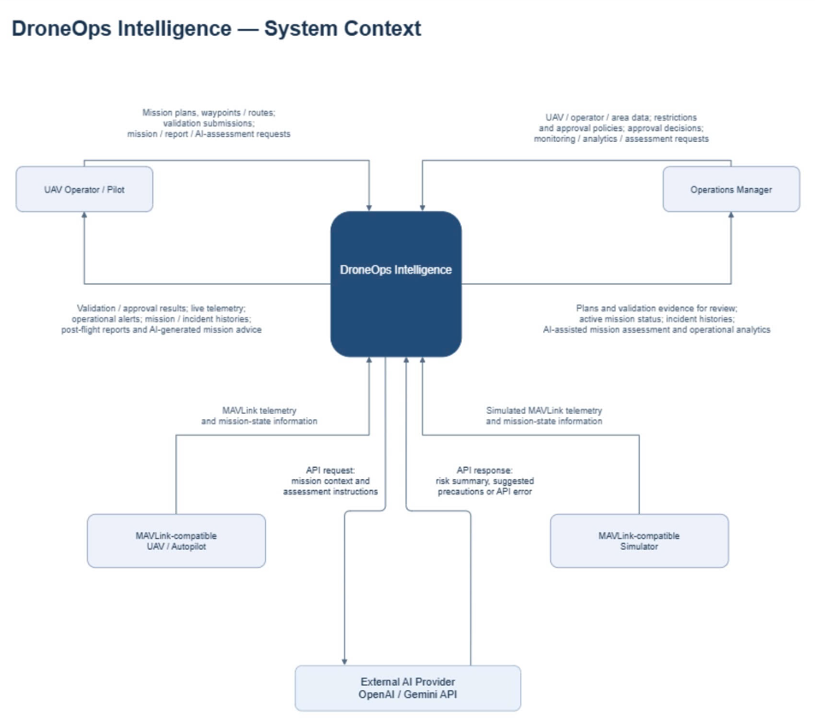
PROJECT CONTEXT · REVIEW 2
Context Diagram
04
DroneOps Intelligence · FA26SE238 | Review 2 · 19 Oct 2026
02
Notes:
Post-flight reports use persisted telemetry and incidents, with coverage and missing metrics shown explicitly. AI assessments retain their mission context, provider and time. AI advice cannot approve a mission. The registered similarity-retrieval scope remains a review question recorded separately from the unchanged registration form.

Slide 5
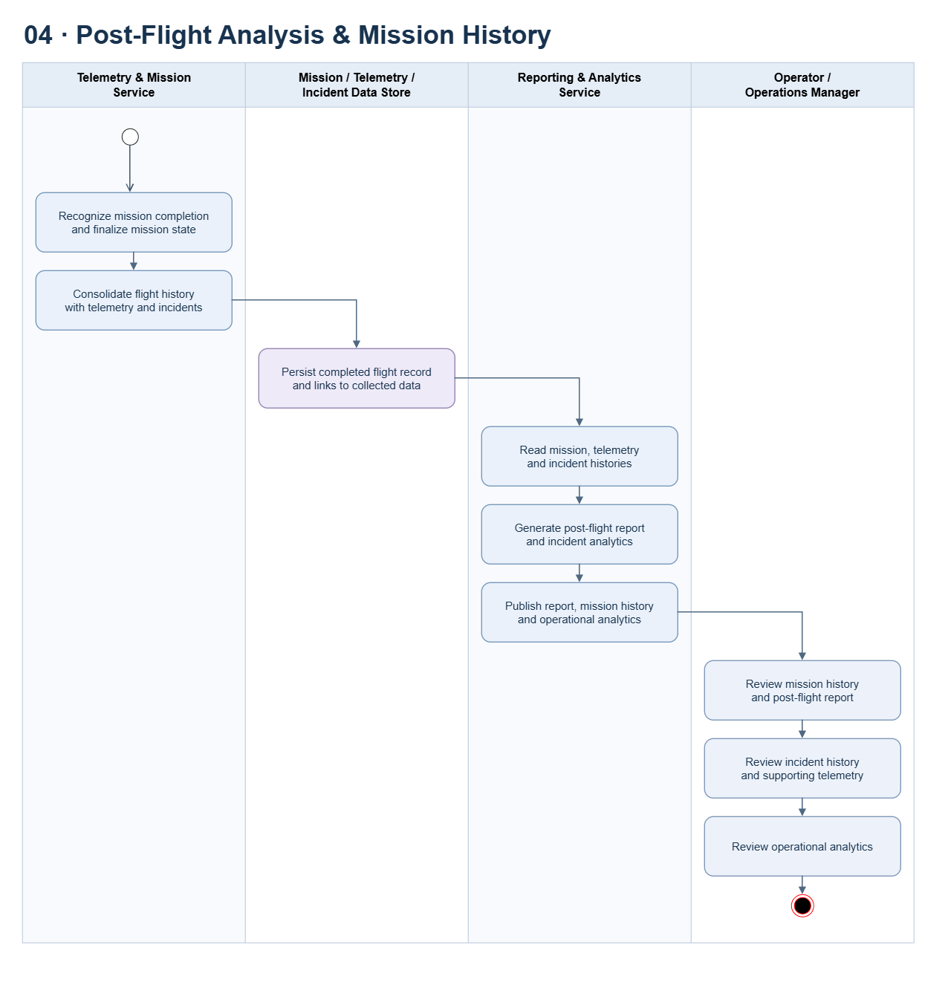
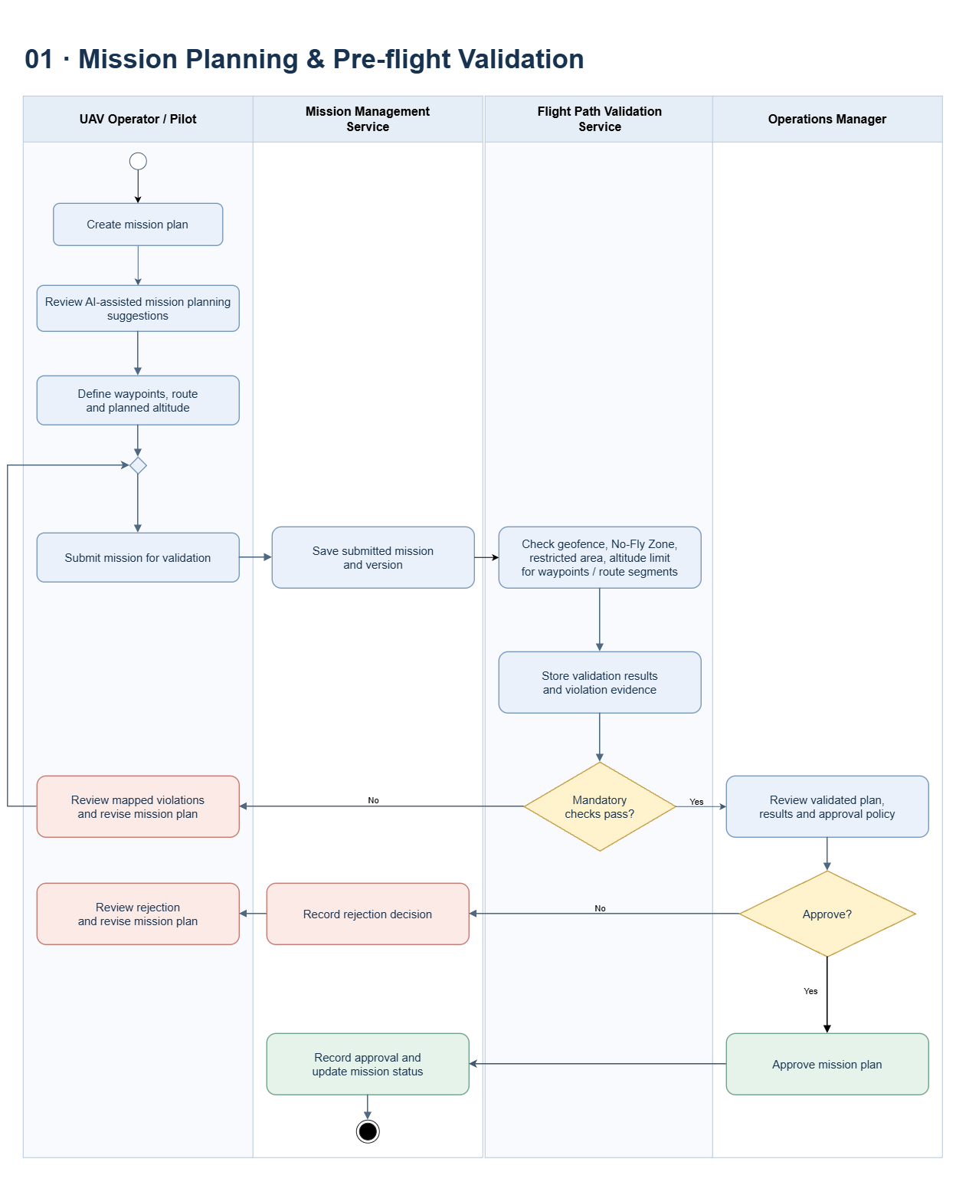
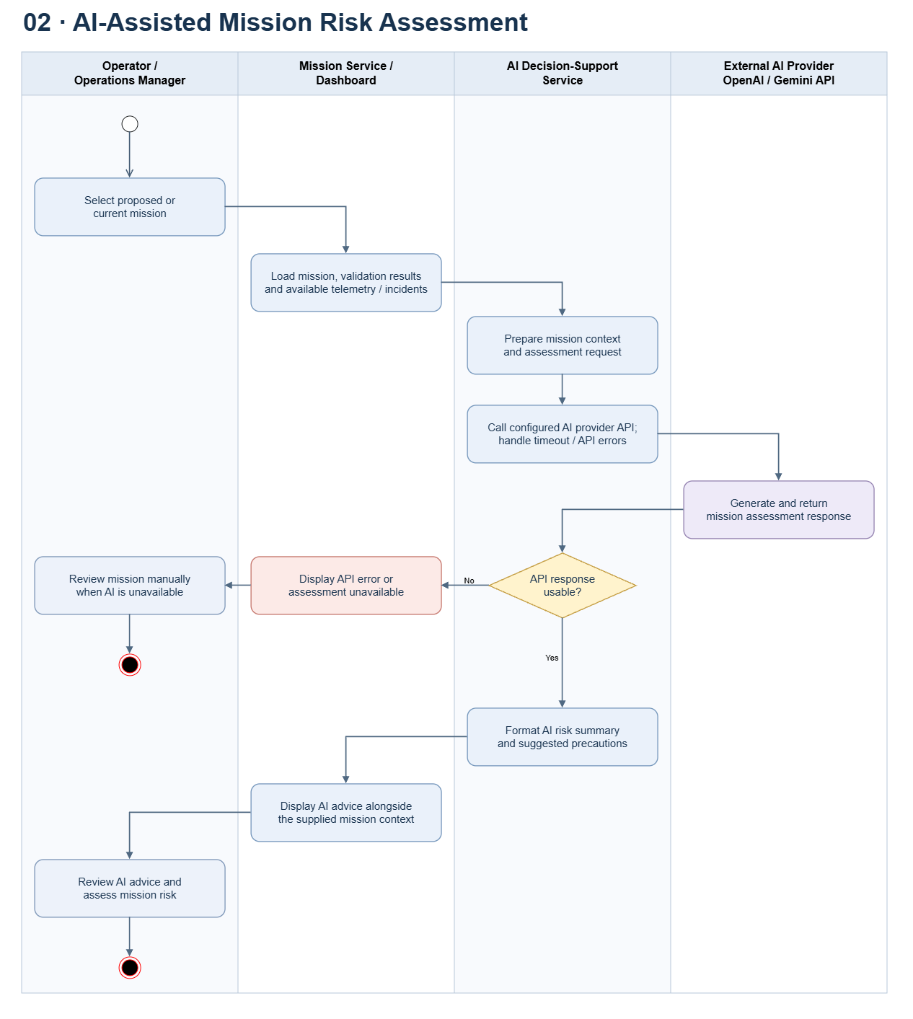
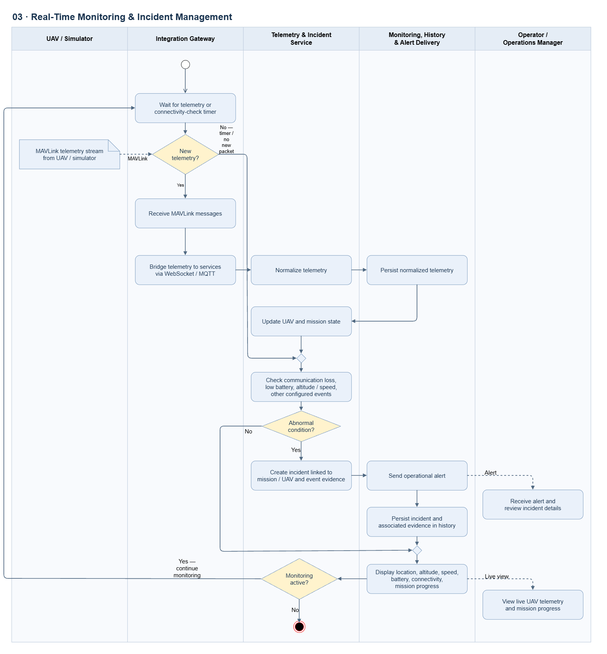
PROJECT CONTEXT · REVIEW 2
Activities diagram
05
DroneOps Intelligence · FA26SE238 | Review 2 · 19 Oct 2026
02
Notes:
Post-flight reports use persisted telemetry and incidents, with coverage and missing metrics shown explicitly. AI assessments retain their mission context, provider and time. AI advice cannot approve a mission. The registered similarity-retrieval scope remains a review question recorded separately from the unchanged registration form.

Slide 6
PROJECT CONTEXT · REVIEW 2
Activities diagram
DroneOps Intelligence · FA26SE238 | Review 2 · 19 Oct 2026
02
Notes:
Post-flight reports use persisted telemetry and incidents, with coverage and missing metrics shown explicitly. AI assessments retain their mission context, provider and time. AI advice cannot approve a mission. The registered similarity-retrieval scope remains a review question recorded separately from the unchanged registration form.

Slide 7
PROJECT CONTEXT · REVIEW 2
Activities diagram
DroneOps Intelligence · FA26SE238 | Review 2 · 19 Oct 2026
02
Notes:
Post-flight reports use persisted telemetry and incidents, with coverage and missing metrics shown explicitly. AI assessments retain their mission context, provider and time. AI advice cannot approve a mission. The registered similarity-retrieval scope remains a review question recorded separately from the unchanged registration form.

Slide 8
PROJECT CONTEXT · REVIEW 2
Activities diagram
DroneOps Intelligence · FA26SE238 | Review 2 · 19 Oct 2026
02
Notes:
Post-flight reports use persisted telemetry and incidents, with coverage and missing metrics shown explicitly. AI assessments retain their mission context, provider and time. AI advice cannot approve a mission. The registered similarity-retrieval scope remains a review question recorded separately from the unchanged registration form.

Slide 9
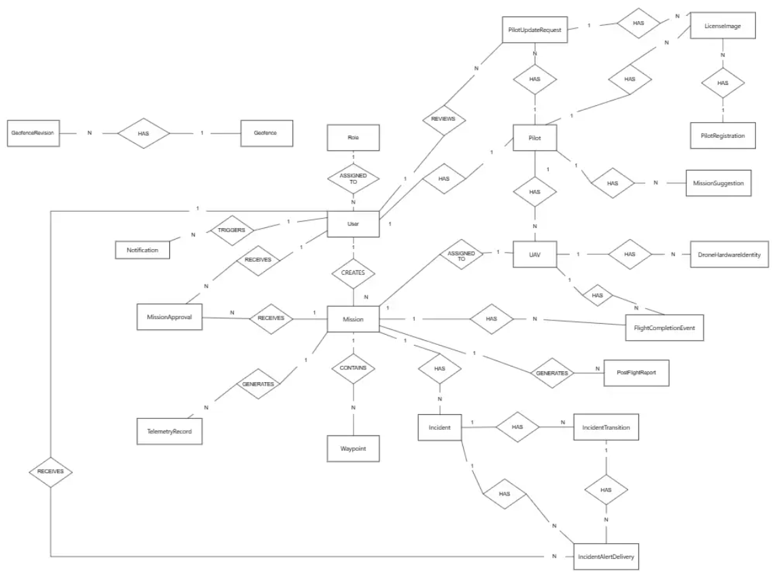
PROJECT CONTEXT · REVIEW 2
Entity diagram
DroneOps Intelligence · FA26SE238 | Review 2 · 19 Oct 2026
02
Notes:
Post-flight reports use persisted telemetry and incidents, with coverage and missing metrics shown explicitly. AI assessments retain their mission context, provider and time. AI advice cannot approve a mission. The registered similarity-retrieval scope remains a review question recorded separately from the unchanged registration form.

Slide 10
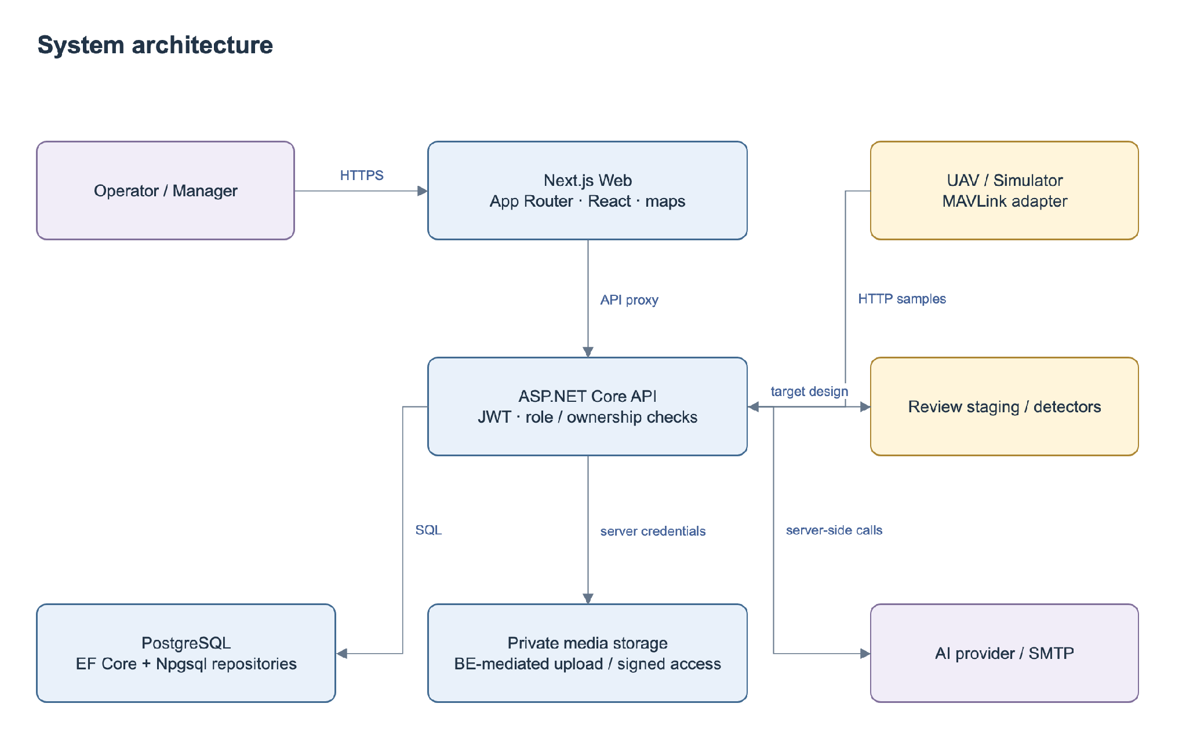
ARCHITECTURE
System design and integration boundaries
DroneOps Intelligence · FA26SE238 | Review 2 · 19 Oct 2026
02
Notes:
The browser communicates with the Next.js server and ASP.NET Core API. Application services enforce authorization and business rules, PostgreSQL stores operational records, and backend adapters handle private media, email and AI. The telemetry gateway supplies normalized MAVLink-derived samples; SSE provides authorized live updates.

Slide 11
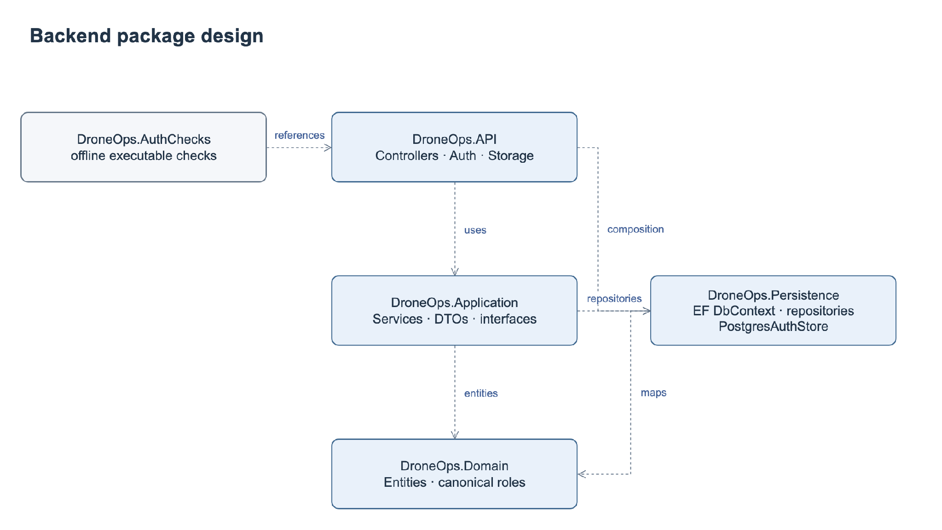
PACKAGES
Package design follows the actual repository
Web packages
Portal pages
↓
Shared clients
↓
API proxy
DroneOps Intelligence · FA26SE238 | Review 2 · 19 Oct 2026
03
Notes:
The API layer exposes controllers and configures dependencies. Application contains business services and DTOs. Persistence provides repositories, EF Core and Npgsql access. Domain defines operational entities. Frontend route components use shared clients and the API proxy.

Slide 12
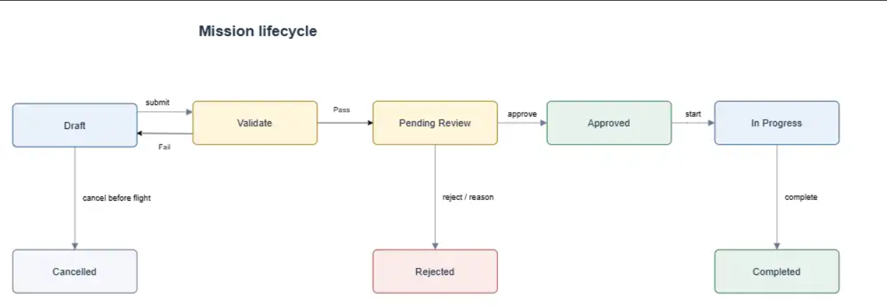
STATE DESIGN
Current mission and update request have separate states
Approved + rejected update → original content and approval remain
DroneOps Intelligence · FA26SE238 | Review 2 · 19 Oct 2026
05
Notes:
The current mission and pending update have separate states. An Approved mission remains Approved while an update is pending. If the update is rejected, its existing content and approval remain effective. If accepted, the same mission receives the approved changes.

Slide 13
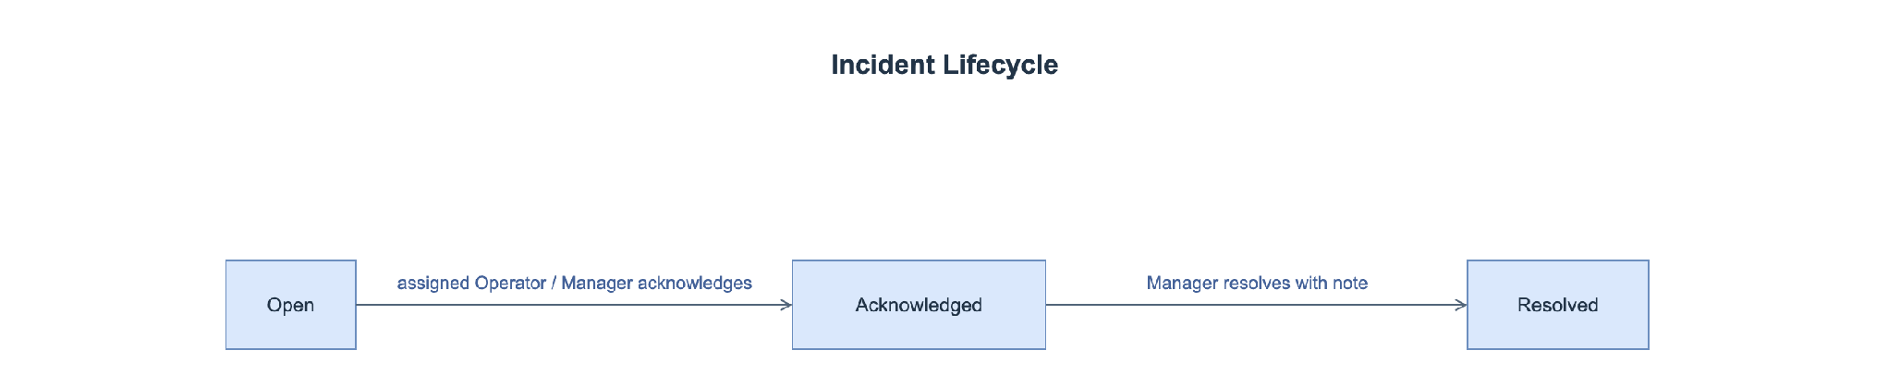
STATE DESIGN
Incident states preserve source evidence
Frozen evidence + actor/time/reason + durable alerts
Target actions still require API and FE integration.
DroneOps Intelligence · FA26SE238 | Review 2 · 19 Oct 2026
06
Notes:
An incident moves from Open to Acknowledged and then Resolved. Acknowledgement records the responsible user and time. Manager resolution requires a reason. State changes do not modify the frozen telemetry evidence.

Slide 14
WORKFLOW DEMO · MF1
Workflow A–C: review every mission update
1 · Save update
2 · Review
Store proposed content; send Manager review.
Compare old/new content and current validation.
3 · Reject
4 · Approve
Keep old content and prior Approved status.
Apply all accepted changes to the same mission.
DroneOps Intelligence · FA26SE238 | Review 2 · 19 Oct 2026
07
Notes:
First, the Operator saves the proposed changes. The Manager compares them with the current mission and validation findings. Rejecting the request keeps the existing content. Approving a request with current passing evidence applies its changes and records the decision.

Slide 15
WORKFLOW DEMO · MF2
Workflow D: telemetry → monitoring → incidents
Receive and persist
Monitor and reconnect
Authenticated normalized samples; source/receive times; deduplicate.
Latest snapshot + SSE; freshness, unavailable and offline states.
Detect and record
Handle and notify
Unit-aware rules; independent loss timer; frozen evidence.
Acknowledge → Manager resolve; durable alert and timeline.
DroneOps Intelligence · FA26SE238 | Review 2 · 19 Oct 2026
08
Notes:
The gateway supplies timestamped telemetry. The platform persists samples and publishes current state. Rules and an independent timer detect abnormal episodes and communication loss. Incidents retain frozen evidence, while acknowledgement, resolution and alerts provide a traceable handling process.

Slide 16
MF3 / MF4 DESIGN
History and AI retain a traceable evidence chain
Post-flight history
Advisory AI
Known telemetry fixture → report metrics, incidents and coverage.
Authorized context → provider result or explicit unavailable state.
Open scope item: registered Top-k similarity evidence versus current provider-only integration.
DroneOps Intelligence · FA26SE238 | Review 2 · 19 Oct 2026
09
Notes:
Post-flight reports use persisted telemetry and incidents, with coverage and missing metrics shown explicitly. AI assessments retain their mission context, provider and time. AI advice cannot approve a mission. The registered similarity-retrieval scope remains a review question recorded separately from the unchanged registration form.

Slide 17
TEST EXECUTION
Test design targets the critical invariants
Mission invariants
Realtime reliability
Reject preserves current data; approve applies atomically; stale evidence blocks.
Out-of-order/replay, null metrics, no-packet timeout and reconnect.
40 integration/system cases + 10 unit designs; selected regression run
Executed subset: 5 integration cases passed; raw logs attached.
CI: .NET build / analyzers / offline checks; FE lint / types / tests / build.
DroneOps Intelligence · FA26SE238 | Review 2 · 19 Oct 2026
10
Notes:
The test design includes 40 integration/system cases and 10 unit designs. The priorities are rejection preservation, atomic approval and rollback, scope enforcement, route validation, telemetry ordering and communication-loss timing. These planned cases require execution records before results can be reported.

Slide 18
DEMO PREPARATION
Workflow demonstration sequence
1. Create a mission and submit it for pre-flight validation.
2. Reject an update and verify the approved content is preserved.
3. Approve an update and verify the current mission changes.
4. Monitor telemetry and inspect incident evidence.
5. Review the post-flight report and AI assessment.
DroneOps Intelligence · FA26SE238 | Review 2 · 19 Oct 2026
18
Notes:
The workflow demonstration follows five steps: create and submit a mission, reject an update while preserving approved content, approve an update to the same mission, inspect monitoring and incident evidence, and review the post-flight report and AI assessment.

Slide 19
REVIEW CLOSURE
Decisions and next actions for Review 2
Agree the mission update and review rules.
Validate geometry, altitude references and boundary handling.
Complete gateway, monitoring and incident integration.
Execute test cases and record measurable results.
Review database migrations and deployment configuration.
DroneOps Intelligence · FA26SE238 | Review 2 · 19 Oct 2026
19
Notes:
The next steps are to agree the review rules and spatial constraints, complete the integration boundaries, execute the test plan, and review database migrations and deployment settings.

Slide 20
REVIEW CLOSURE
THANKS FOR LISTENING
DroneOps Intelligence · FA26SE238 | Review 2 · 19 Oct 2026
20
Notes:
The next steps are to agree the review rules and spatial constraints, complete the integration boundaries, execute the test plan, and review database migrations and deployment settings.

