Slide 1
Combined Universal Kriging and Kalman Filter Techniques to Improve Wind Speed Prediction for Northeastern U.S.
Alex Samalot
UConn Environmental Engineering M.S. Candidate
4/24/16

Slide 2
Outline
Introduction/Background
Objectives
Data
Methodology
Results and Discussion
Conclusions and Future Work
References

Slide 3
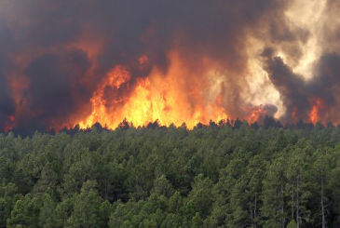

Introduction/Background
Numerical Weather Prediction model
High resolution wind speed forecasts in fields such as power production, air quality, and fire prediction (Cheng and Steenburgh 2005; Roux et al., 2010; Wyszogrodzki et al., 2013; Jiménez and Dudhia 2012).
Bias from
Imperfect initial conditions
Boundary conditions
Oversimplified terrain
Numerical approximations
Simplifications of other and physical processes (Wyszogrodzki et al., 2013; Galanis et al., 2006; Delle Monache 2011; Louka et al., 2008; McCollor 2007; Jimenez and Dudhia 2012).

Slide 4
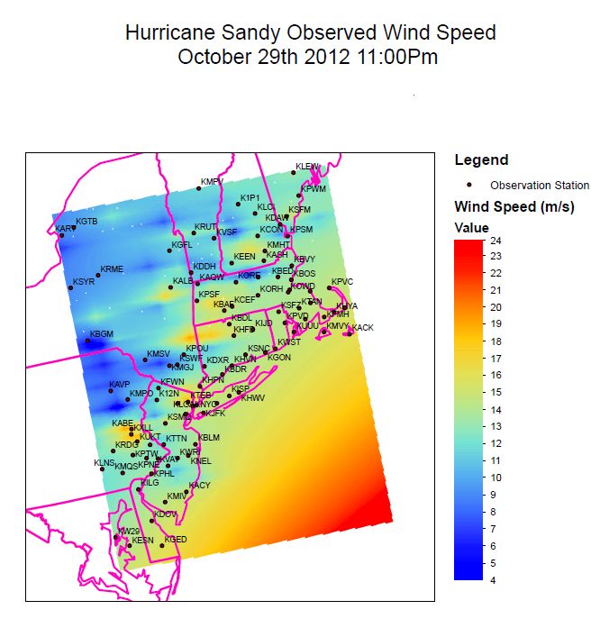
Introduction/Background
Wind speed spatial interpolation
Wind power (Sliz-Szkliniarz and Vogt 2011; Cellura et al., 2008)
Wind speed as input to other models such as pathogens, insurance/reinsurance (Joyner et al., 2015; Zlatev et al., 2010; Luo et al., 2008).
The Kalman Filter predictor corrector
Particulate matter (Djalalova 2015)
Ozone (Delle Monache 2006)
Acid Gas Removal (Prokash 2013)

Slide 5
Objectives
Reduce surface wind speed prediction error of storms that impacted Northeastern U.S. during 2003-2014
Assessment of spatial and temporal characteristics
Development a combined methodology for both spatial and temporal error reduction

Slide 6
Data
Forecasts
Observations

Slide 7
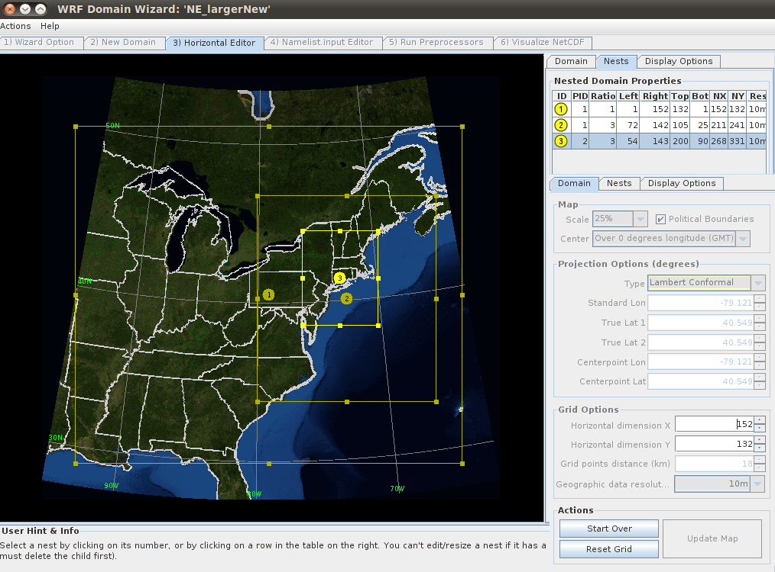
Data: Forecasts
The WRF model (Skamarock et al., 2008)
Northeastern U.S.
Simulate past extreme weather events
High wind speeds, intense precipitation and/or snowfall as well as tropical storm systems that affected the area
Surface wind speed results for the inner domain (2 x 2 km grid spacing)
Dr. Maria Frediani
Advisor: Prof. E.N. Anagnostou

Slide 8
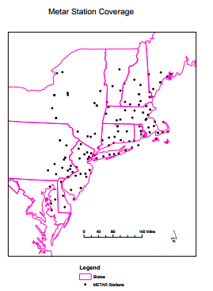
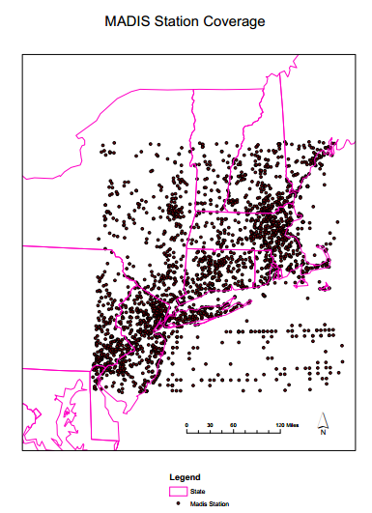
Data: Observations
Meteorological Terminal Aviation Routine Weather Report (METAR)
Meteorological Assimilation Data Ingest System (MADIS)

Slide 9
Methodology
Kriging
Universal Kriging
Kalman Filter
Observation Kriging (M1)
Expected Residual Kriging (M2)
Accuracy Metrics

Slide 10
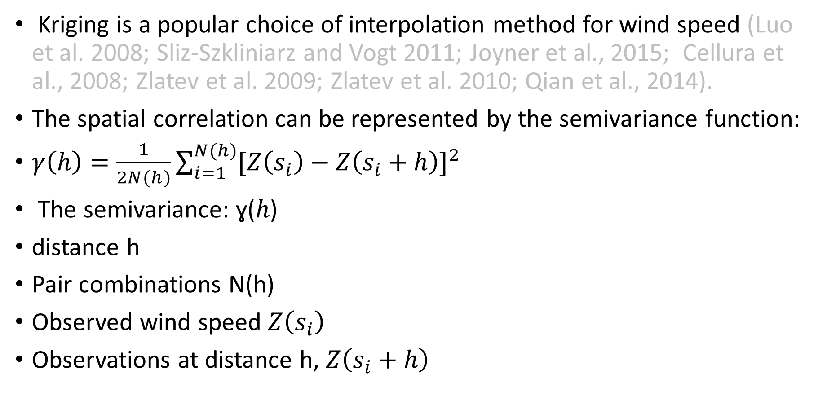
Methodology
Kriging is a popular choice of interpolation method for wind speed (Luo et al. 2008; Sliz-Szkliniarz and Vogt 2011; Joyner et al., 2015; Cellura et al., 2008; Zlatev et al. 2009; Zlatev et al. 2010; Qian et al., 2014).
The spatial correlation can be represented by the semivariance function:
$γ\left(h\right)=\frac{1}{2N(h)}\sum_{i=1}^{N(h)}{{[Z\left(s_{i}\right)−Z\left(s_{i}+h\right)]}^{2}}$
The semivariance: ɣ(ℎ)
distance h
Pair combinations N(h)
Observed wind speed $Z\left(s_{i}\right)$
Observations at distance h, $Z\left(s_{i}+h\right)$

Slide 11
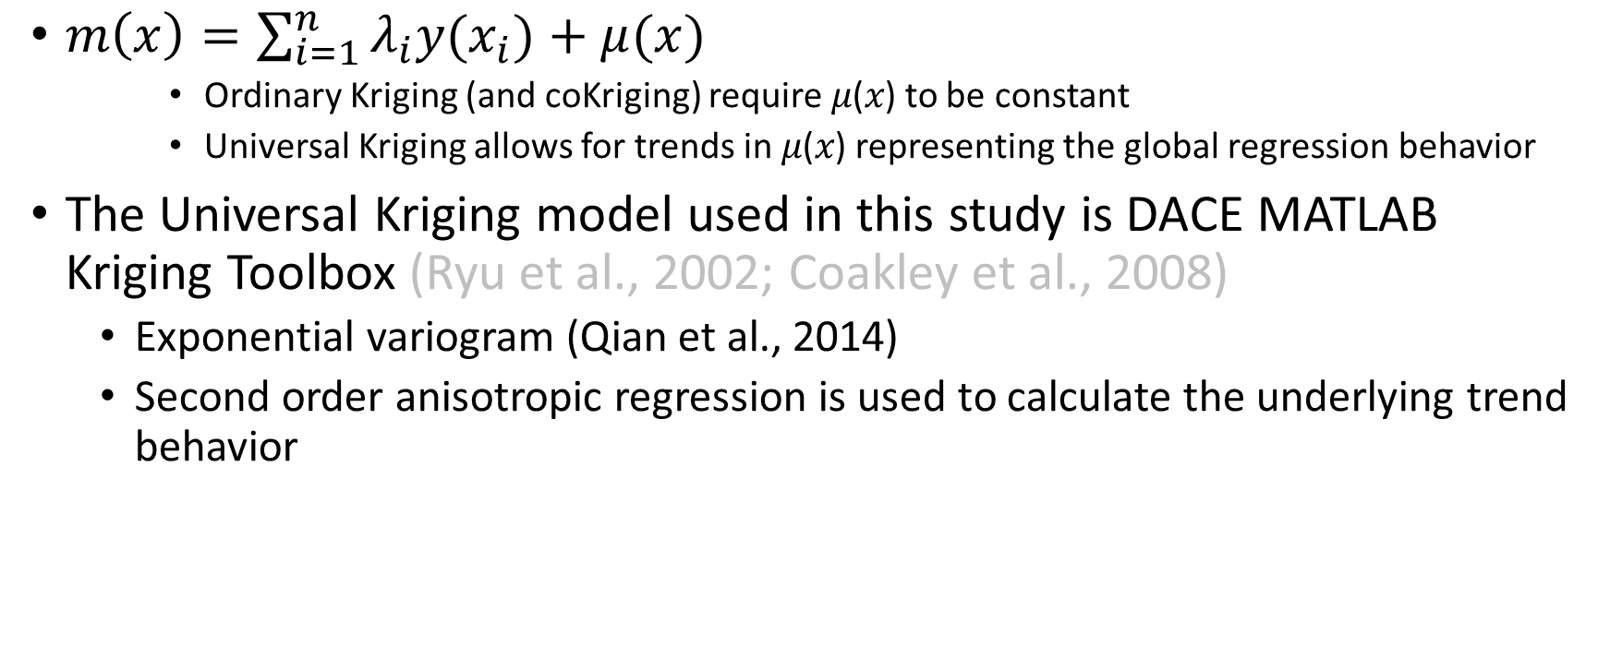
Methodology: Universal Kriging
$m\left(x\right)=\sum_{i=1}^{n}{{\text{λ}}_{i}y(x_{i}})+μ(x)$
Ordinary Kriging (and coKriging) require 𝜇(𝑥) to be constant
Universal Kriging allows for trends in 𝜇(𝑥) representing the global regression behavior
The Universal Kriging model used in this study is DACE MATLAB Kriging Toolbox (Ryu et al., 2002; Coakley et al., 2008)
Exponential variogram (Qian et al., 2014)
Second order anisotropic regression is used to calculate the underlying trend behavior

Slide 12
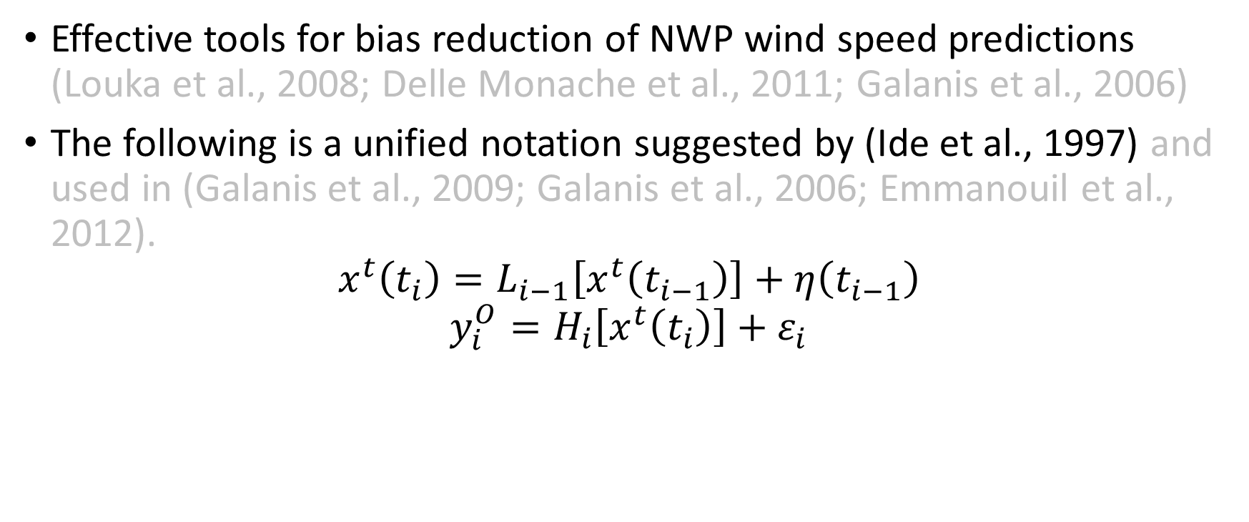
Methodology: Kalman Filter
Effective tools for bias reduction of NWP wind speed predictions (Louka et al., 2008; Delle Monache et al., 2011; Galanis et al., 2006)
The following is a unified notation suggested by (Ide et al., 1997) and used in (Galanis et al., 2009; Galanis et al., 2006; Emmanouil et al., 2012).
$$x^{t}\left(t_{i}\right)=L_{i−1}\left[x^{t}\left(t_{i−1}\right)\right]+η\left(t_{i−1}\right)$$
$$y_{i}^{O}=H_{i}\left[x^{t}\left(t_{i}\right)\right]+ε_{i}$$

Slide 13
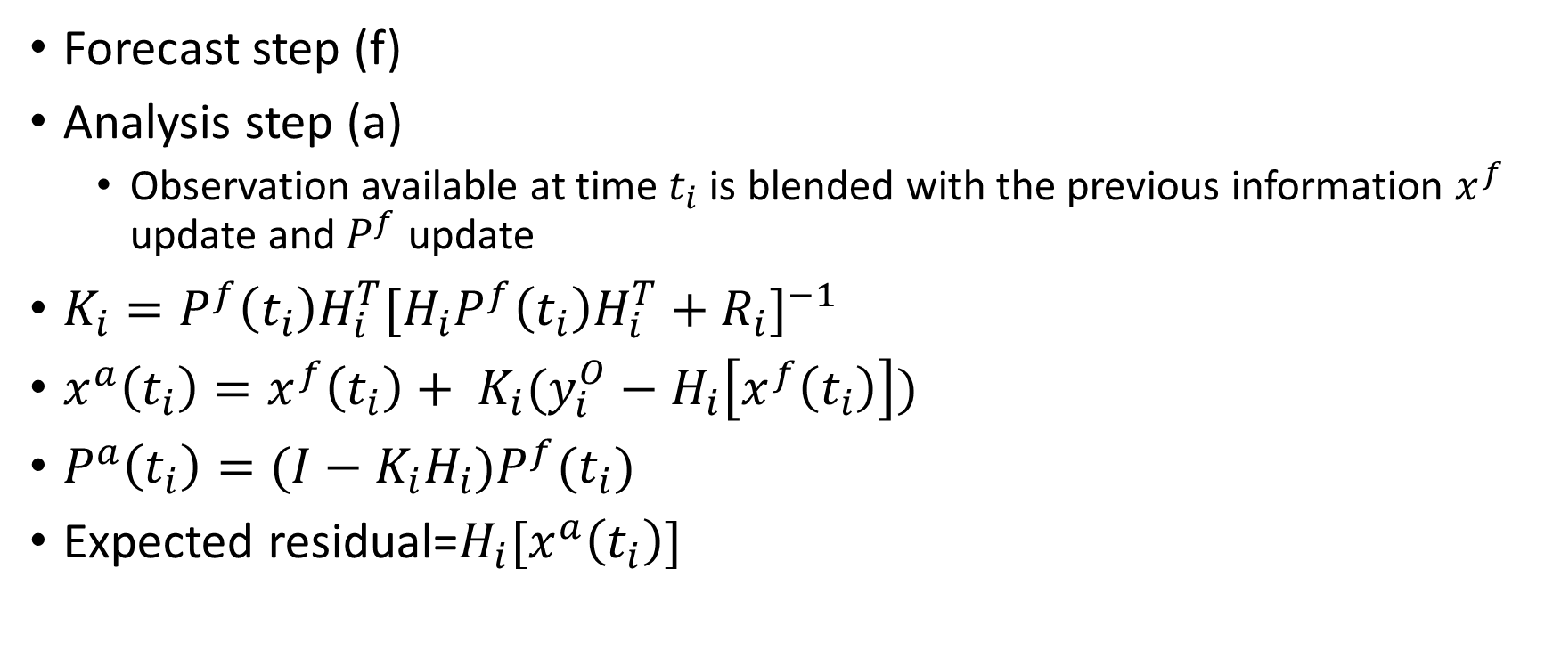
Methodology: Kalman Filter
Forecast step (f)
Analysis step (a)
Observation available at time $t_{i}$ is blended with the previous information $x^{f}$ update and $P^{f}$ update
$K_{i}=P^{f}\left(t_{i}\right)H_{i}^{T}{[H_{i}P^{f}\left(t_{i}\right)H_{i}^{T}+R_{i}]}^{−1}$
$x^{a}\left(t_{i}\right)=x^{f}\left(t_{i}\right)+ K_{i}(y_{i}^{O}−H_{i}\left[x^{f}\left(t_{i}\right)\right])$
$P^{a}\left(t_{i}\right)=(I−K_{i}H_{i})P^{f}(t_{i})$
Expected residual=$H_{i}[x^{a}\left(t_{i}\right)]$

Slide 14
Methodology: Observation Kriging (M1)
WRF
OBS
KGOBS
W | W | W | W
W | W | W | W
W | W | W | W
W | W | W | W
 |  |  | O
 | O
 |  | O
O
m | m | m | m
m | m | m | m
m | m | m | m
m | m | m | m
Kriging hourly observations
T1=1-24
KFWRF
K | K | K | K
K | K | K | K
K | K | K | K
K | K | K | K
 | O
 |  | O | O
O
Kriging hourly observations
m | m | m | m
m | m | m | m
m | m | m | m
m | m | m | m
T2=25-48
K | K | K | K
K | K | K | K
K | K | K | K
K | K | K | K
T3=49-72

Slide 15


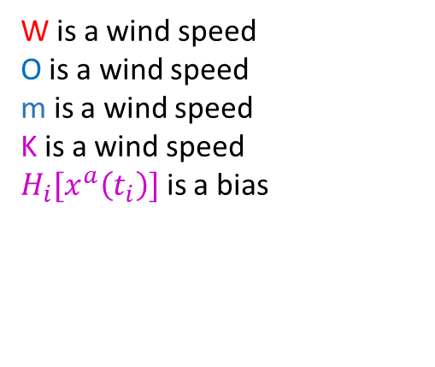


Methodology: Observation Kriging (M1)
WRF
OBS
KGOBS
W | W | W | W
W | W | W | W
W | W | W | W
W | W | W | W
 |  |  | O
 | O
 |  | O
O
m | m | m | m
m | m | m | m
m | m | m | m
m | m | m | m
Kriging hourly observations
$\text{W}\text{(}\text{T}\text{1)}$-m(T1)
T1=1-24
Kalman Filter
interpolated
wind speeds
KFWRF
K | K | K | K
K | K | K | K
K | K | K | K
K | K | K | K
 | O
 |  | O | O
O
Kriging hourly observations
m | m | m | m
m | m | m | m
m | m | m | m
m | m | m | m
${K\left(T2\right)=H}_{i}\left[x^{a}\left(T1\right)\right]$ + W(T2)
$\text{W}\text{(}\text{T}\text{2)}$-m(T1)
T2=25-48
Updating future time
step with previous
information
K | K | K | K
K | K | K | K
K | K | K | K
K | K | K | K
${K\left(T3\right)=H}_{i}\left[x^{a}\left(T2\right)\right]$ + W(T3)
W is a wind speed
O is a wind speed
m is a wind speed
K is a wind speed
$H_{i}[x^{a}\left(t_{i}\right)]$ is a bias
T3=49-72

Slide 16


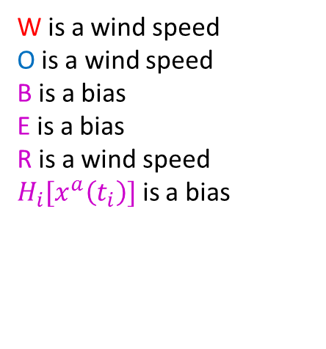
Methodology: Expected Residual Kriging (M2)
OBS
WRF
W | W | W | W
W | W | W | W
W | W | W | W
W | W | W | W
 |  |  | O
 | O
 |  | O
O
$\text{W}\text{(}\text{T}\text{1)}$-O(T1)
T1=1-24
Kalman Filter
observed
wind speeds
Expected Residuals
KFWRF
E | E | E | E
E | E | E | E
E | E | E | E
E | E | E | E
 |  |  | B
 | B
 |  | B
B
Kriging Kalman Filter
Expected Residuals
$${B\left(T2\right)=H}_{i}\left[x^{a}\left(T1\right)\right]$$
T2=25-48
WRF(T2)
Expected Residuals
Residual Kriged Wind
W is a wind speed
O is a wind speed
B is a bias
E is a bias
R is a wind speed
$H_{i}[x^{a}\left(t_{i}\right)]$ is a bias
W | W | W | W
W | W | W | W
W | W | W | W
W | W | W | W
E | E | E | E
E | E | E | E
E | E | E | E
E | E | E | E
R | R | R | R
R | R | R | R
R | R | R | R
R | R | R | R

Slide 17
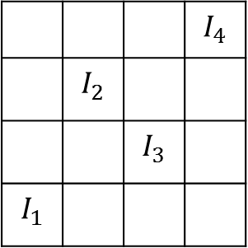
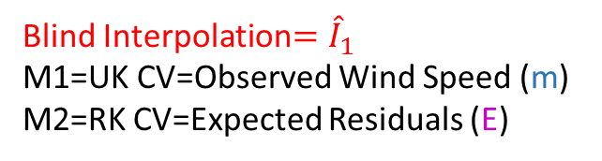
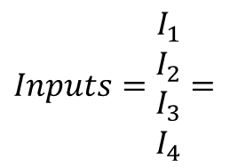
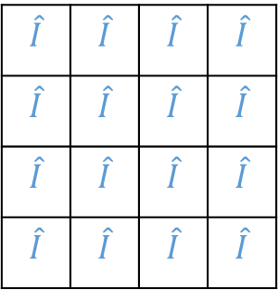
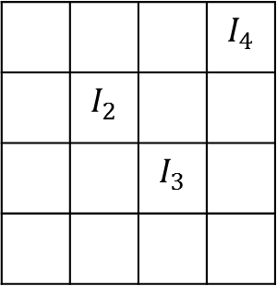
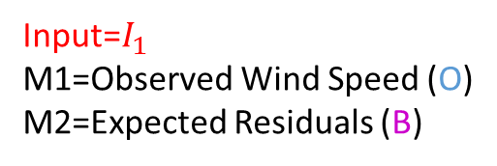
Methodology: Accuracy Metrics
Leave One Out Cross Validation (CV) performed on 10% storm sample 11/107
1) The original Kriging Input Dataset is shown below as
2) A station is removed from the dataset and the Kriging operation is performed without knowledge of the wind at that location
 |  |  | $$I_{4}$$
 | $$I_{2}$$
 |  | $$I_{3}$$
$$I_{1}$$
 |  |  | $$I_{4}$$
 | $$I_{2}$$
 |  | $$I_{3}$$
$$\hat{I}$$ | $$\hat{I}$$ | $$\hat{I}$$ | $$\hat{I}$$
$$\hat{I}$$ | $$\hat{I}$$ | $$\hat{I}$$ | $$\hat{I}$$
$$\hat{I}$$ | $$\hat{I}$$ | $$\hat{I}$$ | $$\hat{I}$$
$$\hat{I}$$ | $$\hat{I}$$ | $$\hat{I}$$ | $$\hat{I}$$
$Inputs=\begin{matrix}I_{1} \\ I_{2} \\ I_{3} \\ I_{4}\end{matrix}$ $=$
Input=$I_{1}$
M1=Observed Wind Speed (O)
M2=Expected Residuals (B)
Blind Interpolation${=\hat{I}}_{1}$
M1=UK CV=Observed Wind Speed (m)
M2=RK CV=Expected Residuals (E)

Slide 18
Discussion of the Results
10% Storm CV Observation Kriging (M1)
10% Storm CV Expected Residual Kriging (M2)
Kalman Filter Observed Wind Speed (M2)
Kalman Filter Kriged Wind Speed (M1)
Overall Model performance
Seasonality

Slide 19
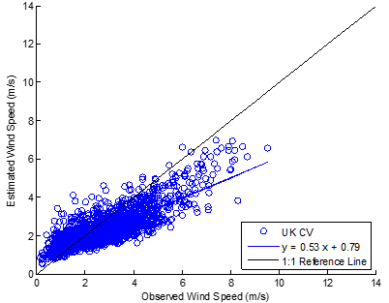
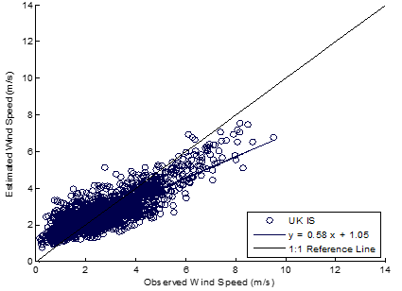
Results: 10% Storm CV Observation Kriging (M1)
UK CV Wind vs. Observed Wind
In-Sample Kriging vs. Observed Wind
 | UK CV | UK IS
RMSE | 1.34 | 1.16
Mean Bias | -0.66 | -0.16
Corr. Coeff. R | 0.83 | 0.85
Slope of linear regression | 0.53 | 0.58

Slide 20
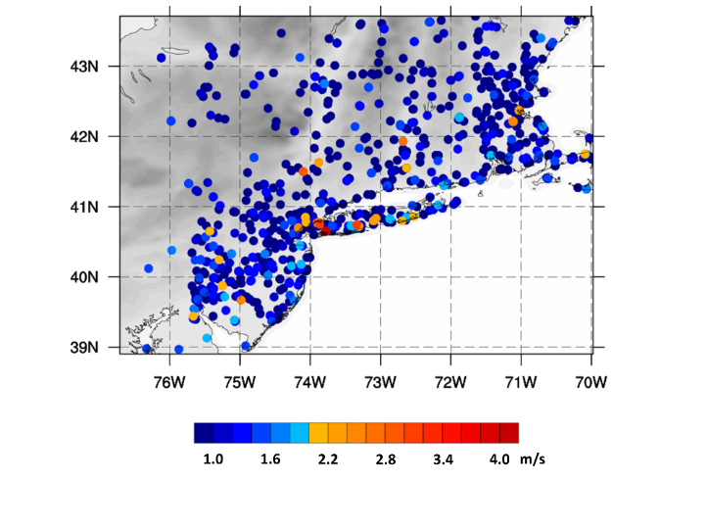
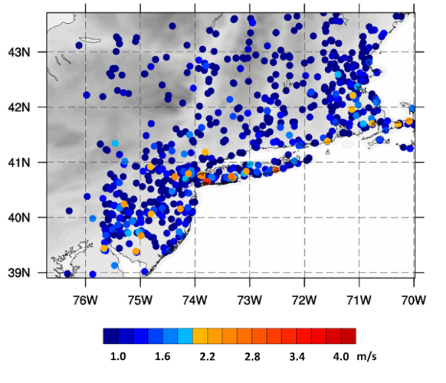
Results: 10% Storm CV Observation Kriging (M1)
Geographic distribution UK CV of RMSE
Geographic distribution of IS UK RMSE

Slide 21
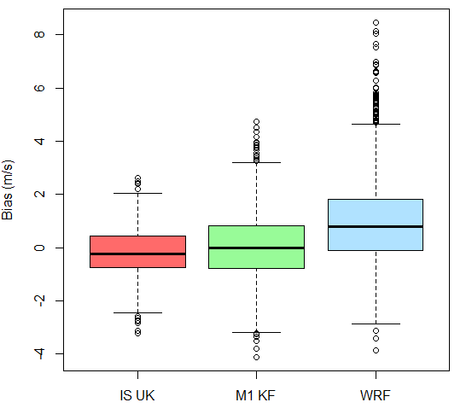
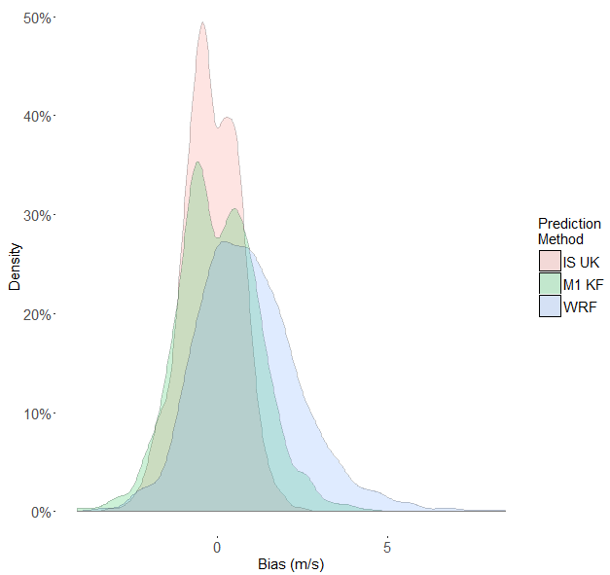
Results: 10% Storm CV Observation Kriging (M1)
Probability Density Function of the
IS UK, M1 KF and associated WRF Bias
Boxplot of the IS UK, M1 KF and associated WRF Bias

Slide 22
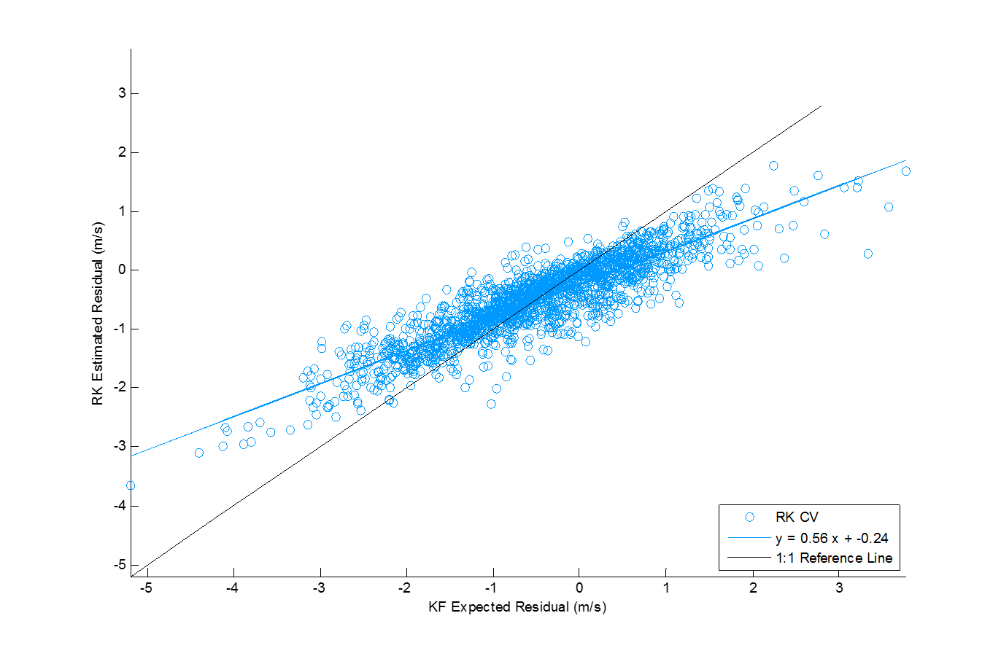
Results: 10% Storm CV Expected Residual Kriging (M2)
RK CV vs. KF Expected Residuals
Residual comparison:
Kalman Filtered expected residual and blind interpolated representation
 | RK CV
RMSE | 1.01
Mean Bias | -0.11
Corr. Coeff. R | 0.90
Slope of linear regression | 0.56

Slide 23

Results: 10% Storm CV Expected Residual Kriging (M2)
OBS
WRF
W | W | W | W
W | W | W | W
W | W | W | W
W | W | W | W
 |  |  | O
 | O
 |  | O
O
T1=1-24
Expected Residuals
KFWRF
E | E | E | E
E | E | E | E
E | E | E | E
E | E | E | E
 |  |  | B
 | B
 |  | B
B
Kriging Kalman Filter
Expected Residuals
T2=25-48
$$M2 KF(T2)=B(T2)+\text{W}\text{(}\text{T}\text{2)}$$
WRF(T2)
Expected Residuals
Residual Kriged Wind
W | W | W | W
W | W | W | W
W | W | W | W
W | W | W | W
E | E | E | E
E | E | E | E
E | E | E | E
E | E | E | E
R | R | R | R
R | R | R | R
R | R | R | R
R | R | R | R
Wind Speed representation of Expected residuals (by adding the WRF forecast)

Slide 24
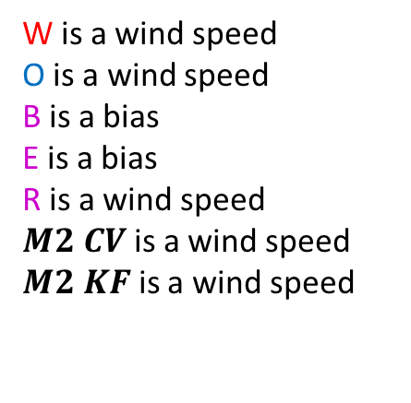

Results: 10% Storm CV Expected Residual Kriging (M2)
OBS
WRF
W | W | W | W
W | W | W | W
W | W | W | W
W | W | W | W
 |  |  | O
 | O
 |  | O
O
T1=1-24
Expected Residuals
KFWRF
$$M2 CV=RK CV+\text{W}\text{(}\text{T}\text{2)}$$
E | E | E | E
E | E | E | E
E | E | E | E
E | E | E | E
 |  |  | B
 | B
 |  | B
B
Wind speed representation of blind interpolations of expected residuals
T2=25-48
W is a wind speed
O is a wind speed
B is a bias
E is a bias
R is a wind speed
$M2 CV$is a wind speed
$M2 KF$ is a wind speed
WRF(T2)
Expected Residuals
Residual Kriged Wind
W | W | W | W
W | W | W | W
W | W | W | W
W | W | W | W
E | E | E | E
E | E | E | E
E | E | E | E
E | E | E | E
R | R | R | R
R | R | R | R
R | R | R | R
R | R | R | R

Slide 25
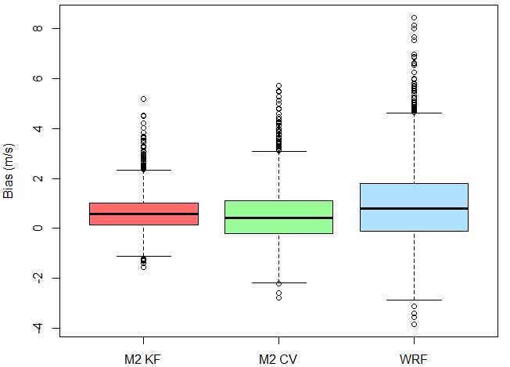
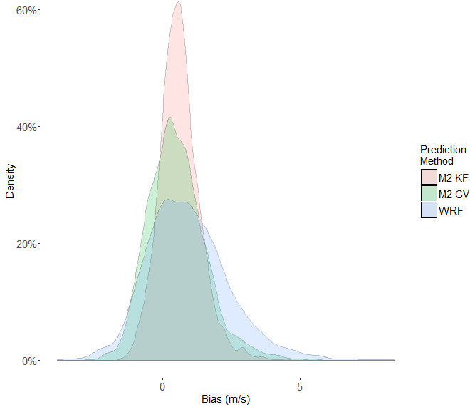
Results: 10% Storm CV Expected Residual Kriging (M2)
Boxplot of the M2 CV, M2 KF and associated WRF Bias
Probability Density Function of the
M2 CV, M2 KF and associated WRF Bias

Slide 26
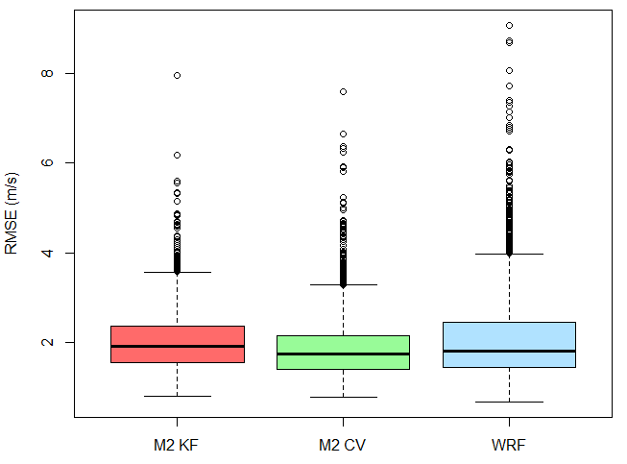
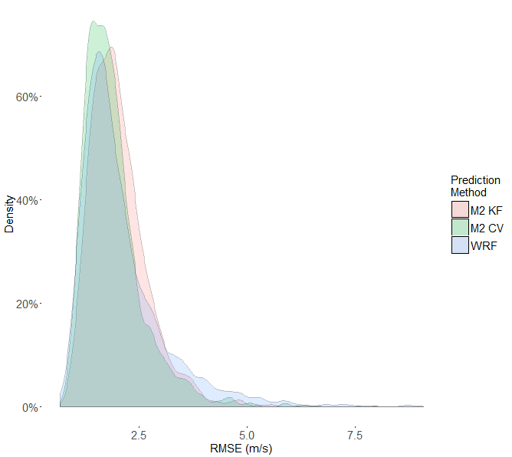
Results: 10% Storm CV Expected Residual Kriging (M2)
Boxplot of the M2 KF, M2 CV and associated WRF RMSE
Probability Density Function of the
M2 KF, M2 CV and associated WRF RMSE

Slide 27
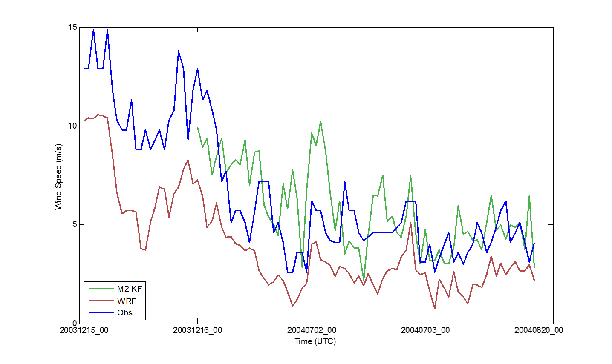
Results: Kalman Filter Observed Wind Speed (M2)
KBOS:
Kalman Filter (green line) is trained with observed wind speed (blue line) and forecasted wind speed (red line)
Updated over several time steps and bias correction improved

Slide 28
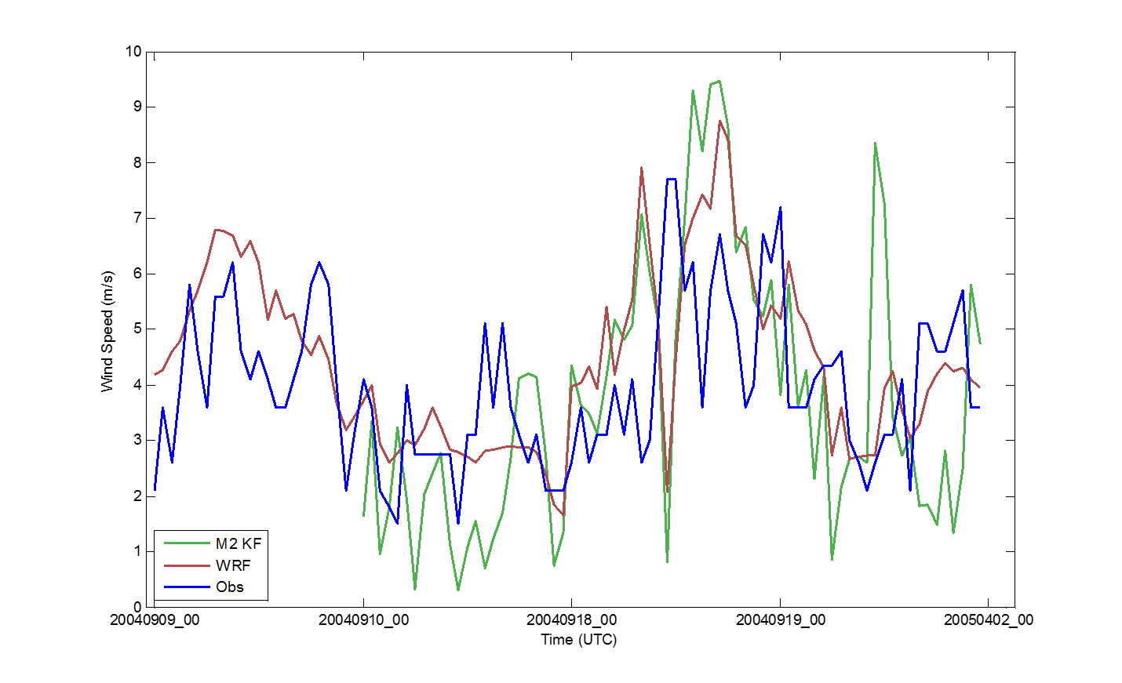
Results: Kalman Filter Observed Wind Speed (M2)
KUKT:
Kalman Filter is trained with peak storm behavior
Updates from 24 hour time steps do not capture bias behavior

Slide 29
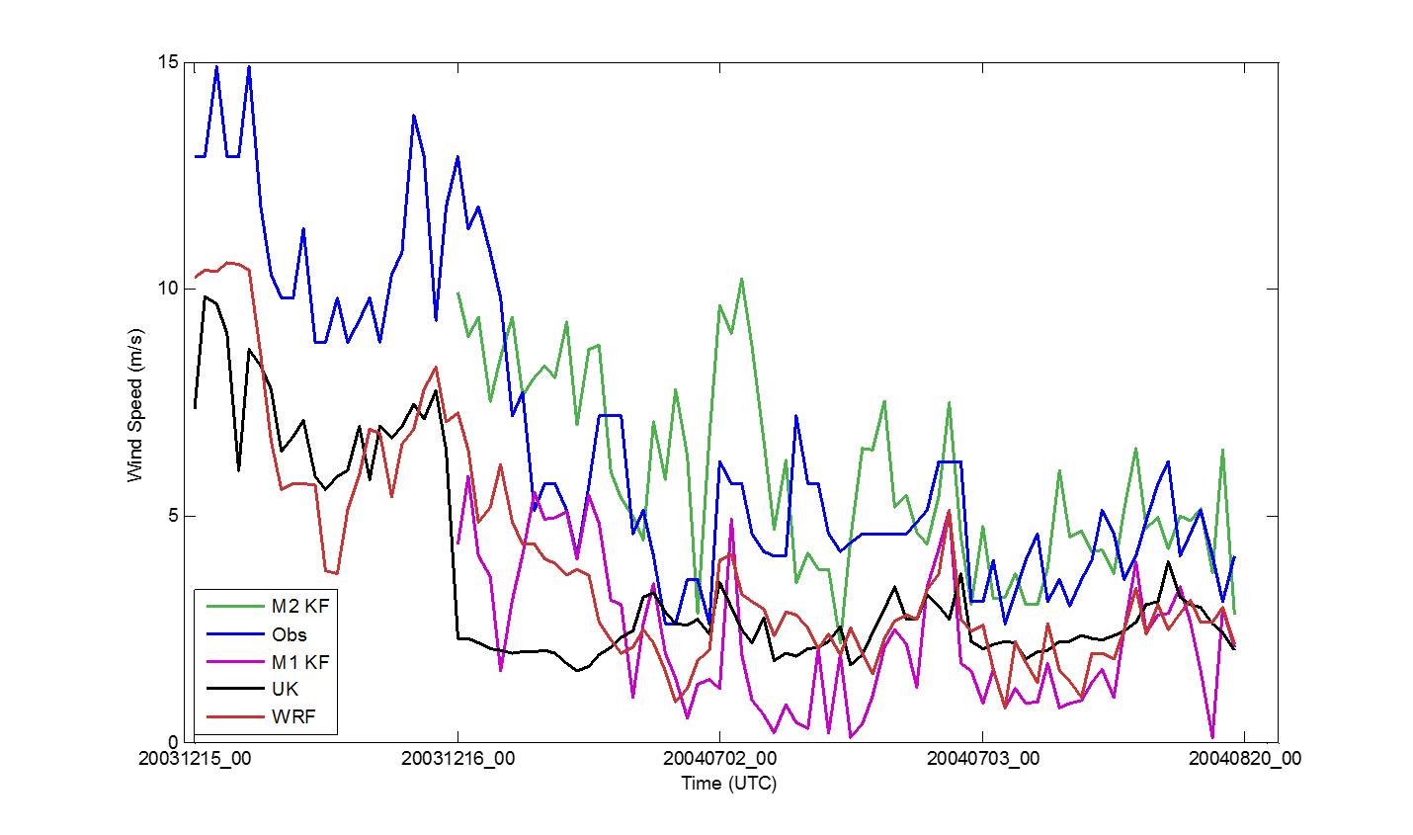
Results: Kalman Filter Kriged Wind Speed (M1)
KBOS:
Affect of training with an over simplified wind speed interpolation (black line)
M1 KF (purple line) not trained with appropriate bias information

Slide 30
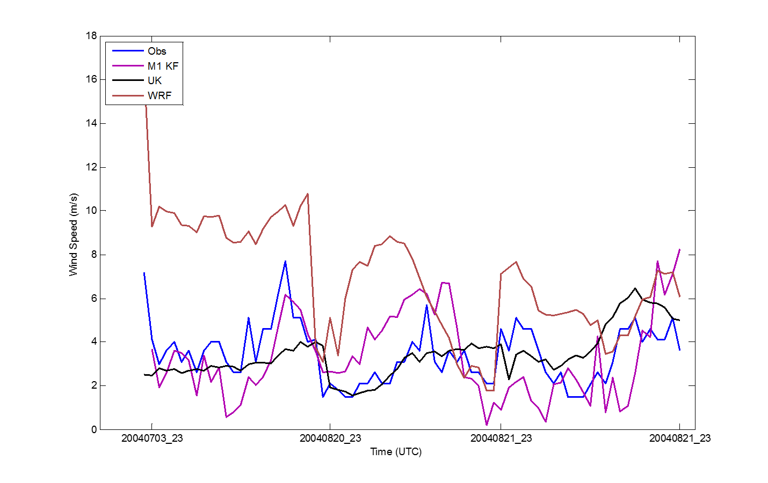
Results: Kalman Filter Kriged Wind Speed (M1)
K3B2
M1 KF bias reduction
Good representation of bias using an interpolated wind speed

Slide 31
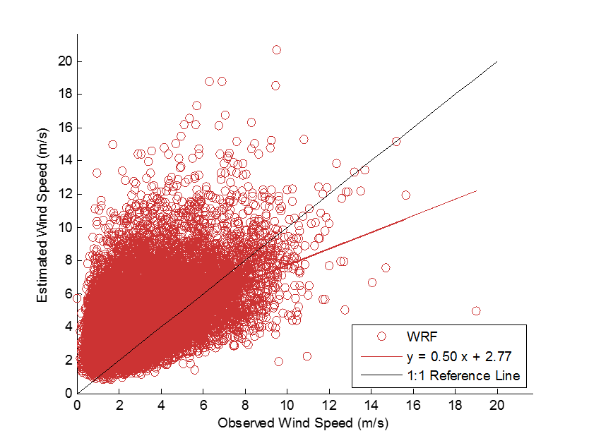
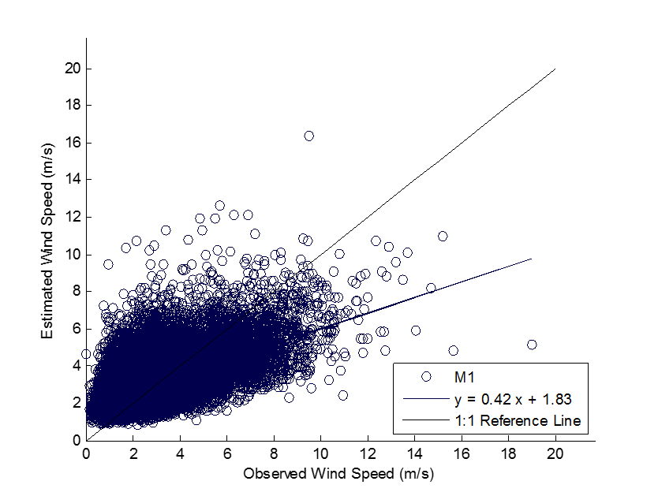
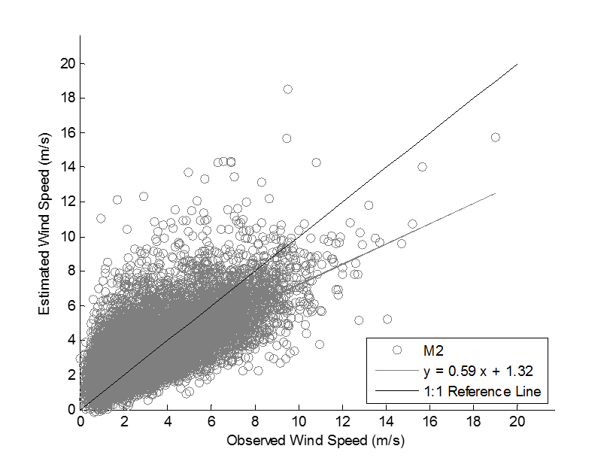
Results: Overall Model performance
WRF Wind Speed Prediction
Methodology 1 Final output (M1)
Methodology 2 Final output (M2)
 | WRF | M1 | M2
RMSE | 2.70 | 2.47 | 2.47
Mean Bias | 0.98 | -0.16 | -0.11
Corr. Coeff. R | 0.49 | 0.61 | 0.73
Slope of the linear regression | 0.50 | 0.42 | 0.59

Slide 32
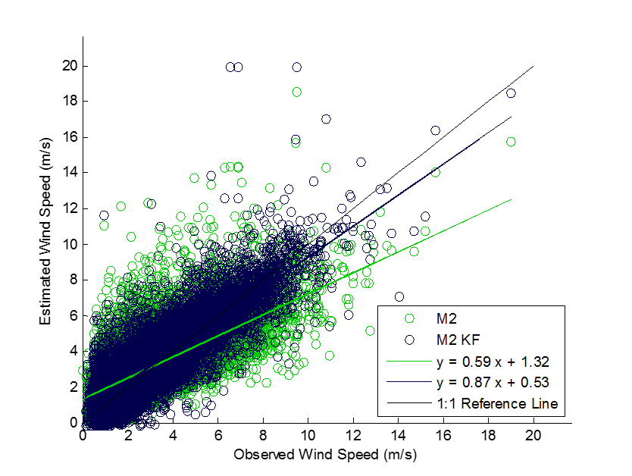
Results: Overall Model performance
M2 and M2 KF Wind Speed vs. Observed Wind
 | WRF | M2 | M2 KF
RMSE | 2.70 | 2.47 | 2.62
Mean Bias | 0.98 | -0.11 | 0.06
Corr. Coeff. R | 0.49 | 0.73 | 0.87
Slope of the linear regression | 0.50 | 0.59 | 0.87

Slide 33
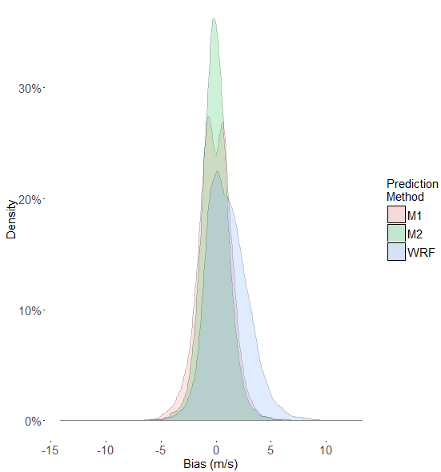
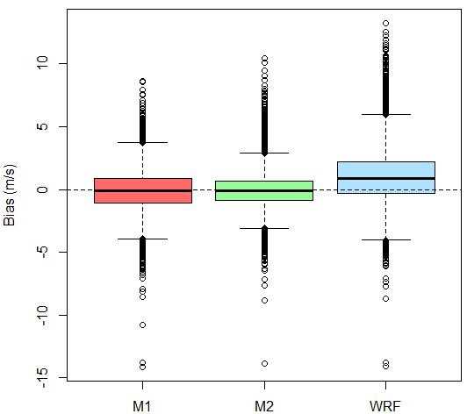
Results: Overall Model performance
Probability Density Function of the
M1, M2 and associated WRF Bias
Boxplot of M1, M2 and associated WRF Bias
 | WRF | M1 | M2
RMSE | 2.70 | 2.47 | 2.47
Mean Bias | 0.98 | -0.16 | -0.11
Corr. Coeff. R | 0.49 | 0.61 | 0.73
Slope of the linear regression | 0.50 | 0.42 | 0.59

Slide 34
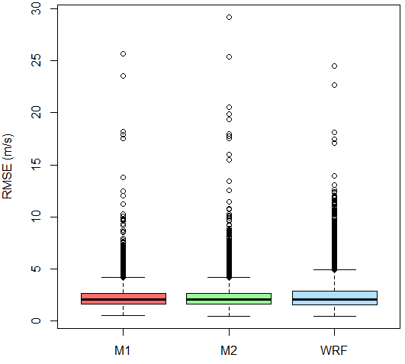
Results: Overall Model performance
Boxplot of M1, M2 and associated WRF Bias
Boxplot of M1, M2 and associated WRF RMSE
 | WRF | M1 | M2
RMSE | 2.70 | 2.47 | 2.47
Mean Bias | 0.98 | -0.16 | -0.11
Corr. Coeff. R | 0.49 | 0.61 | 0.73
Slope of the linear regression | 0.50 | 0.42 | 0.59

Slide 35
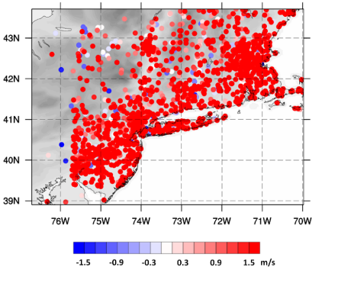
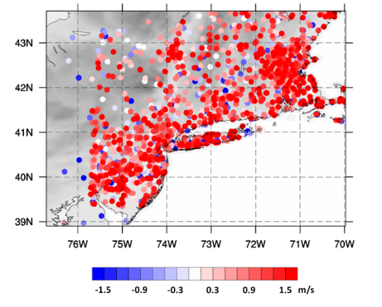
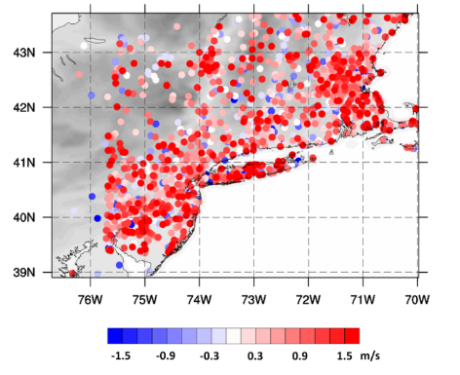
Results: Overall Model performance
Geographic distribution
of WRF Bias Average
Geographic distribution of
M1 Bias Average
Geographic distribution of
M2 Bias Average

Slide 36
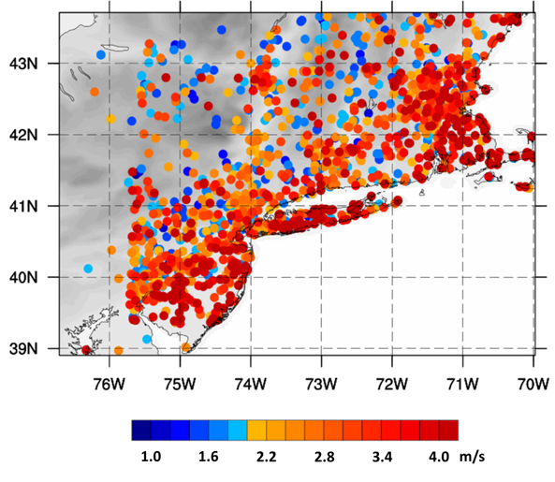
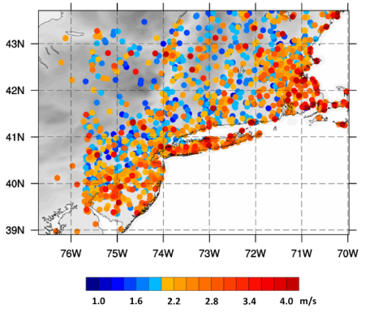
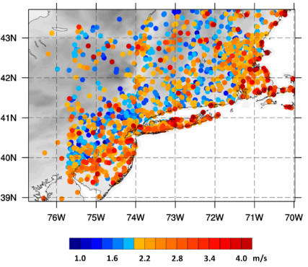
Results: Overall Model performance
Geographic distribution of WRF RMSE
Geographic distribution of M1 RMSE
Geographic distribution of M2 RMSE

Slide 37
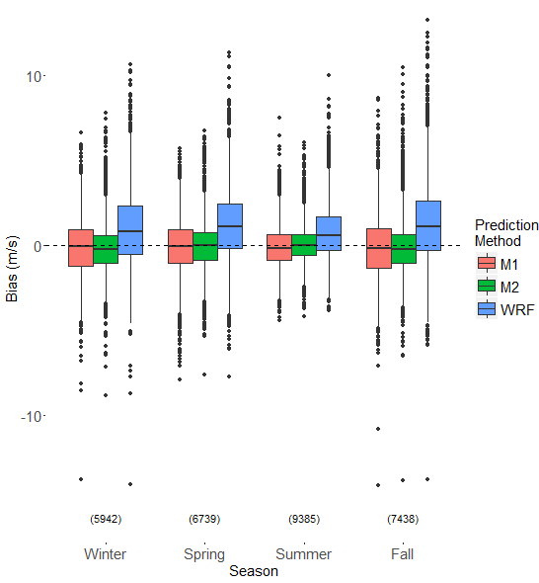
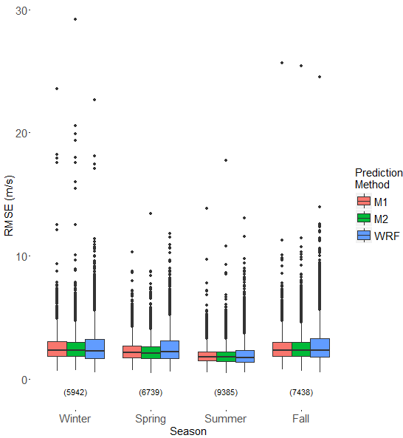
Results: Seasonality
Boxplot of M1, M2 and associated WRF Bias by Season
Boxplot of M1, M2 and associated WRF RMSE by Season

Slide 38
Conclusions
Bias reduction of the WRF forecast with second methodology
Use of UK as a residual interpolator was preferable to a wind speed interpolator
Cross-validation
Impact on final model outputs.
Benefits were not significant enough to suggest implementation on a larger scale
General ability of Universal Kriging to interpolate KF expected residuals
Rudimentary combination of temporal and spatial information
Lowered bias, and improved the slope and fit of the best fit line when compared to statistics from WRF raw forecast outputs

Slide 39
Citations
Akkala, A., V. Devabhaktuni, and A. Kumar. 2010. Interpolation techniques and associated software for environmental data. Environmental Progress & Sustainable Energy 29:134-141.
Al-Awadhi, Fahimah A., & Alhajraf, Ali. (2012). Prediction of non-methane hydrocarbons in Kuwait using regression and Bayesian kriged Kalman model.(Report). Environmental and Ecological Statistics, 19(3), 393.
Anagnostou, Emmanouil N. “Lecture Notes for Probabilistic Methods for Engineering Systems.” 2015 Probabilistic Methods for Engineering Systems. University of Connecticut. Lecture.
Cellura, M., G. Cirrincione, A. Marvuglia, and A. Miraoui. 2008. Wind speed spatial estimation for energy planning in Sicily: A neural kriging application. Renewable Energy 33:1251-1266. CGIAR-CSI.
Cheng WYY and Steenburgh WJ (2005) Evaluation of surface sensible weather forecasts by the WRF and the eta models over the Western United States. Weather Forecast 20:812–821
Coakley, Henry, Joshua Williams, and Doran Baker (2008). "Universal Kriging Interpolator for Satellite-derived Global Data."
Cortes, J. (2009). Distributed Kriged Kalman Filter for Spatial Estimation. Automatic Control, IEEE Transactions on, 54(12), 2816-2827.
Delle Monache, L., Nipen, T., Deng, X., Zhou, Y., & Stull, R. (2006). Ozone ensemble forecasts: 2. A Kalman filter predictor bias correction. Journal of Geophysical Research: Atmospheres, 111(D5), N/a.
Delle Monache, L., Liu, Y., Roux, G., Nipen, T., & Stull, R. (2011). Kalman filter and analog schemes to postprocess numerical weather predictions. Monthly Weather Review, 139(11), 3554-3570.
Djalalova, Delle Monache, & Wilczak. (2015). PM2.5 analog forecast and Kalman filter post-processing for the Community Multiscale Air Quality (CMAQ) model. Atmospheric Environment, 108, 76-87.
Emmanouil, G., Galanis, G., & Kallos, G. (2012). Combination of statistical Kalman filters and data assimilation for improving ocean waves analysis and forecasting.(Report). Ocean Modelling, 59 60, 11.
Galanis, G. and Anadranistakis, M. (2002), A one-dimensional Kalman filter for the correction of near surface temperature forecasts. Met. Apps, 9: 437–441. doi: 10.1017/S1350482702004061
Galanis, G., P. Louka, P. Katsafados, I. Pytharoulis, and G. Kallos (2006). "Applications of Kalman filters based on non-linear functions to numerical weather predictions." In Annales geophysicae, vol. 24, no. 10, pp. 2451-2460. Copernicus GmbH.
Galanis, Emmanouil, Chu, & Kallos. (2009). A new methodology for the extension of the impact of data assimilation on ocean wave prediction. Ocean Dynamics, 59(3), 523-535.
Grell, G.A. and D. Devenyi, 2002: A generalized approach to parameterizing convection combining ensemble and data assimilation techniques, Geoph. Res. Let., 29, NO 14., 10.1029/2002GL015311, 2002.
Hamill, T. M., 1999: Hypothesis tests for evaluating numerical precipitation forecasts. Wea. Forecasting, 14, 155–167.
Heath, Nicholas K., et al. "A simple lightning assimilation technique for improving retrospective WRF simulations." Journal of Advances in Modeling Earth Systems.
S.L.Mullen,C.Snyder,Z.Toth,andD.P.Baumhefner,2000: Ensemble forecasting in the short to medium range: Report from a workshop. Bull. Amer. Meteor. Soc., 81, 2653–2664.
Hong, S. Y., Y. Noh, and J. Dudhia (2006), A new vertical diffusion package with an explicit treatment of entrainment processes, Mon. Weather Rev., 134(9), 2318–2341, doi:10.1175/Mwr3199.1.
Jimenez PA, Dudhia J (2012) Improving the representation of resolved and unresolved topographic effects on surface wind in the WRF model. J Appl Meteor Climatol 51:300–316

Slide 40
Citations
Joyner, T., 2013. Optimizing peak gust and maximum sustained wind speed estimates from mid-latitude wave cyclones. Geography&Anthropology.LouisianaStateUniversity,LSUETD,p.169.
Joyner, Friedland, Rohli, Treviño, Massarra, & Paulus. (2015). Cross-correlation modeling of European windstorms: A cokriging approach for optimizing surface wind estimates. Spatial Statistics, 13, 62-75.
Klawa, M., and U. Ulbrich (2003), A model for the estimation of storm losses and the identification of severe winter storms in Germany, Nat. Hazards Earth Syst. Sci., 3, 725 – 732.
Lorenzana, Jesús, et al. "Sensitivity of WRF precipitation field to assimilation sources in northeastern Spain." EGU General Assembly Conference Abstracts. Vol. 17. 2015.
Louka, G. Galanis, N. Siebert, G. Kariniotakis, P. Katsafados, I. Pytharoulis, G. Kallos, 2008: Improvements in wind speed forecasts for wind power prediction purposes using Kalman filtering, Journal of Wind Engineering and Industrial Aerodynamics, Volume 96, Issue 12, December 2008, Pages 2348-2362, ISSN 0167-6105, http://dx.doi.org/10.1016/j.jweia.2008.03.013.
MacEachren AM, Davidson JV. 1987. Sampling and isometric mapping of continuous geographic surfaces. The American Cartographer 14: 299–320.
Mardia, K., Goodall, V., Redfern, C., & Alonso, E. (1998). The Kriged Kalman filter. Test, 7(2), 217-282.
Mass CF, Ovens D (2011) Fixing WRF’s high speed wind bias: a new subgrid scale drag parameterization and the role of detailed verification. In: 24th Conference on Weather and Forecasting and 20th Conference on Numerical Weather Prediction, Preprints, 91st American Meteorological Society Annual Meeting, 23–27 Jan, Seattle, WA. Paper 9B.6. http://ams.confex.com/ams/ 91Annual/webprogram/Paper180011.html
McCollor, D., R. Stull, 2008: Hydrometeorological accuracy enhancement via postprocessing of numerical weather forecasts in complex terrain. Wea. Forecasting, 23, 131–144.
doi: http://dx.doi.org/10.1175/2007WAF2006107.1
Michalakes, J., et al. (2005) The Weather Research and Forecast Model: Software Architecture and Performance. Proceedings of the Eleventh ECMWF Workshop on the Use of High Performance Computing in Meteorology. Eds. W. Zwieflhofer and G.Mozdzynski. World Scientific, 2005, pp 156 – 168.
Molders N (2008) Suitability of the weather research and forecasting (WRF) model to predict the June 2005 fire weather for Interior Alaska. Weather Forecast 23:953–973
Molders N (2008) Suitability of the weather research and forecasting (WRF) model to predict the June 2005 fire weather for Interior Alaska. Weather Forecast 23:953–973
Paul, P., Bhattacharyya, D., Turton, R., & Zitney, S. (2013). Adaptive Kalman filter for estimation of environmental performance variables in an acid gas removal process. American Control Conference (ACC), 2013, 2717-2721.
Qian, Hongkun, Tao, (2014) Wind Speed Spatio-temporal Forecasting of Wind Farms Based on Universal Kriging and Bayesian Dynamic Model. POWERCON 2014
Roux G, Liu Y, Delle Monache L, Sheu R-S, Warner TT (2009) Verification of high resolution WRF RTFDDA surface forecasts over mountains and plains. In: 10th WRF users’ workshop, 20–23 June, 2009, Boulder
Ryu, JS., Kim, MS., Cha, KJ. et al. Kriging Interpolation Methods in Geostatistics and DACE Model. KSME International Journal (2002) 16: 619. doi:10.1007/BF03184811[R1]
Skamarock, William C., et al. “A Description of the Advanced Research WRF Version 3. (2008).
Sliz-Szkliniarz, B., Vogt, J., 2011. GIS-based approach for the evaluation of wind energy potential: A case study for the Kujawsko–PomorskieVoivodeship.RenewableSustainableEnergyRev.15,1696–1707.
Tewari, F. Chen, W. Wang, J. Dudhia, M.A. LeMone, K. Mitchell, M. Ek, G. Gayno, J. Wegiel, R.H. Cuenca 2004. Implementation and verification of the unified NOAH land surface model in the WRF model. 20th Conference on Weather Analysis and Forecasting/16th Conference on Numerical Weather Prediction, pp. 11–15
Tieleman, H.W., 1995: "Simulation of Surface Wmds for Assessment of Extreme Wind Loads on Roofs," Proceedings of the 9th Intemational Conference On Wind Engineering, ppl 162-1169, New Delhi, India.
Welch, Greg, and Gary Bishop. "An Introduction to the Kalman Filter,." Department of Computer Science University of North Carolina at Chapel Hill (2006).[R2]
Wyszogrodzki, A., Y. Liu, N. Jacobs (more[R3] ) ,et al. 2013: Analysis of the surface temperature and wind forecast errors of the NCAR-AirDat operational CONUS 4-km WRF forecasting system. Meteorology and Atmospheric Physics, 122, 125-143, DOI: 10.1007/s00703-013-0281-5.
Zlatev, Z., S. E. Middleton, and G. Veres. 2009. Ordinary kriging for on-demand average wind interpolation of in-situ wind sensor data.in EWEC 2009, Marseilles.
Zlatev, Z., S. E. Middleton, and G. Veres. 2010. Benchmarking knowledge-assisted kriging for automated spatial interpolation of wind measurements. Pages 1-8 in 2010 13th Conference on Information Fusion (FUSION).

